Slide 1

Medicare Analysis

Slide 2

Statement
Using big data technology to analyze the Medicare data and to give business solutions.

Slide 3

Medicare
Health insurance covers medical expenses for illnesses, injuries and conditions.
Because accidents or health problems can happen at any time
Medical expenses can be high—they’re the number one cause of bankruptcy
To pay and keep track of medical payments quickly and easily
To safeguard your way of life and your family’s physical and financial wellbeing

Slide 4

Purpose
To answer business questions of company, clients or by our senior manager of the given data set of Medicare Analysis.
Which countries have taken the Medicare subscription?
Analysis of male and female participation?
Analysis of the amount payed by the user?

Slide 5
Technique
Data (uncleaned)
Microsoft Azure (upload and store data)
Data Bricks (code)
Clean Data
Power BI (Connect)
Visual Analysis
Business Solutions

Slide 6
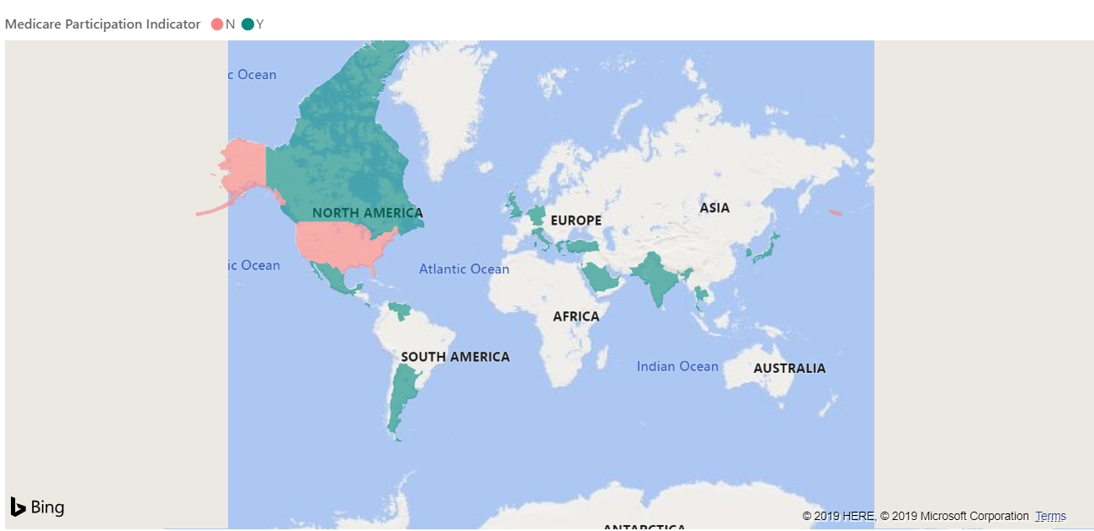
Analysis
Shows the country of the provider and participation of clients

Slide 7
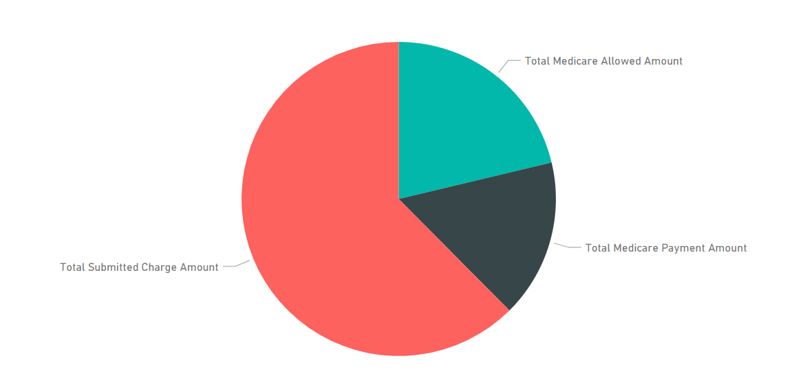
Analysis
Gives the Analysis of payment of Medicare insurance

Slide 8
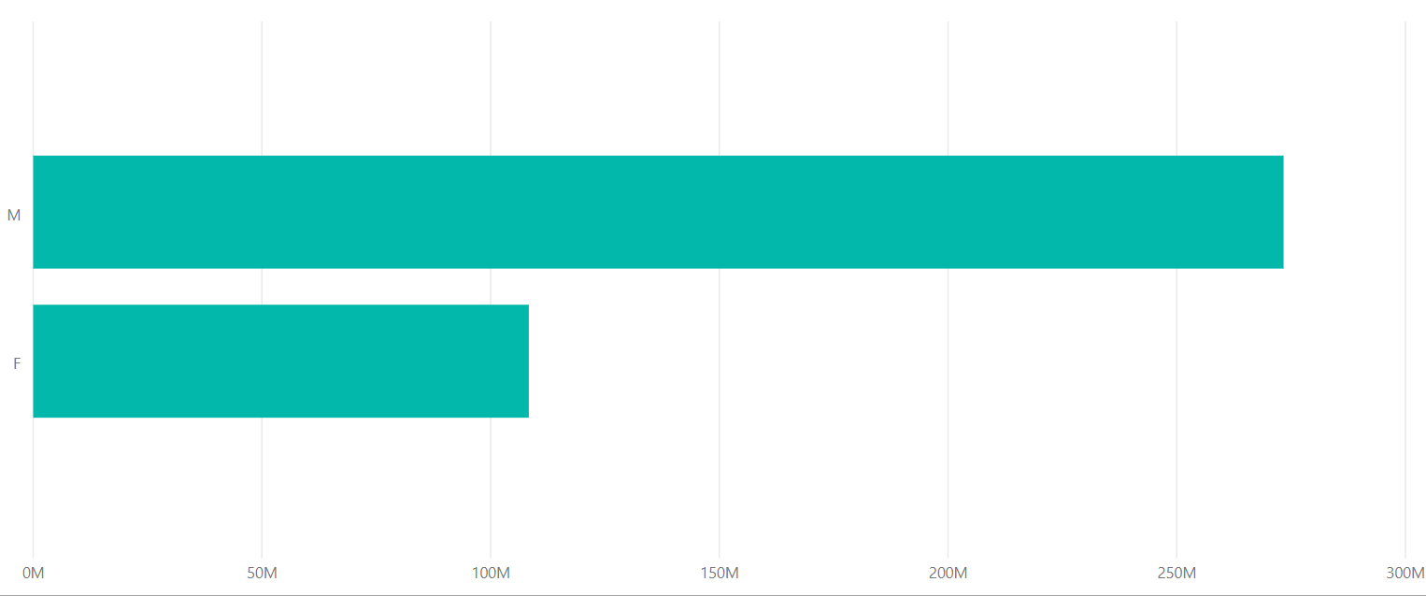
Analysis
Number of Beneficiaries with respect to gender

Slide 9

Outcome
The analysis of the data gives the following outcome:
People in North America have not participated in Medicare health insurance.
The submitted charges or claimed charges are more than the limit or the amount paid to the hospital.
The females have less beneficiaries as compared to male.

Slide 10

Conclusion
Analysis of huge data using Microsoft Azure made the process fast and easy.
Power BI Connection gave numerous visualizations of data and helped in providing business solutions.
The Medicare analysis gave the picture that not many people are using the insurance.
The payments of the insurance should be done right to gain more benefits.
Health should be our priority and we should plan to take insurance.

Slide 11

Health is Wealth
Thank you

