Slide 1
SAS Project
KARISHMA DAXESH PAREKH

Slide 2
DATASET
A study was conducted to determine whether a “DRUG A” helps to reduce fasting sugar level. There are 3400 patients were enrolled for this study. They were randomly assigned to one of three treatment groups: Low-Drug A, High-Drug A and Placebo. After 10 weeks their reading were taken. Patients were placed into three different sites – 1, 2 and 3.
Variables: Patient-ID, Age, State, Site, Length of Stay, Total Charges, Fasting_BS

Slide 3
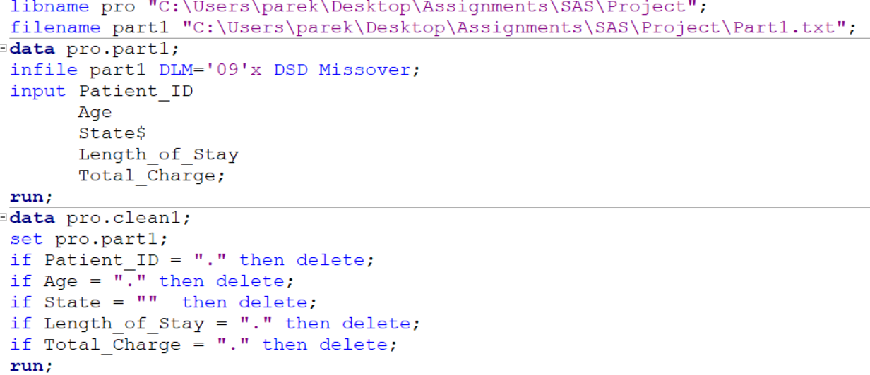
Manipulating the data
Two CSV excel sheets were saved as tab delimited file format.
Test_Scores variable was named as Fasting_BS
Missing values were deleted.

Slide 4
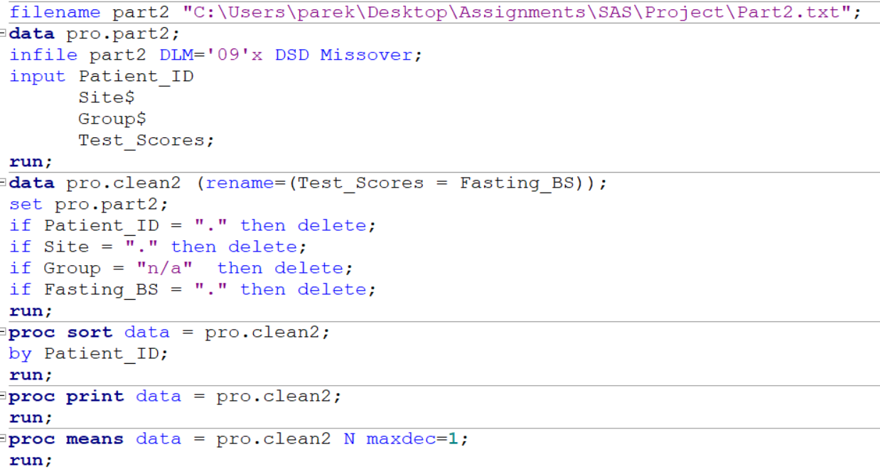

Slide 5
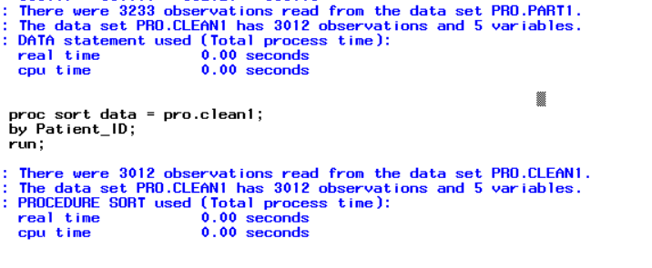
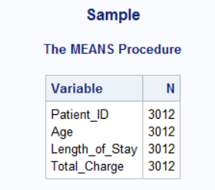
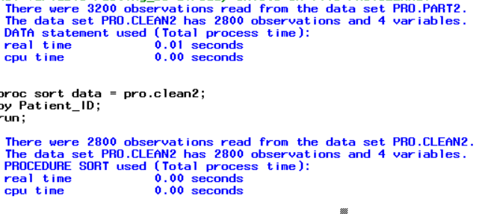
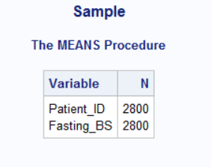

Slide 6
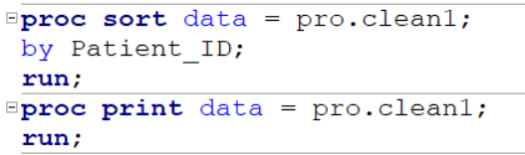
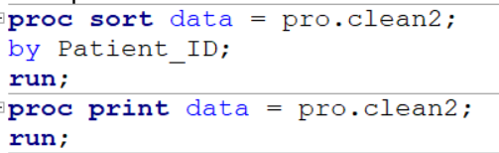
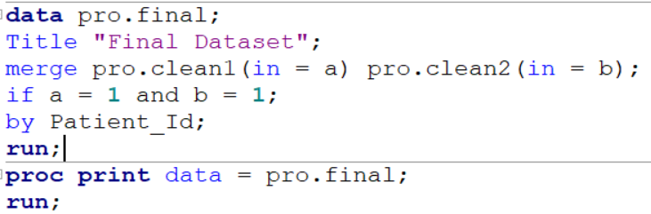
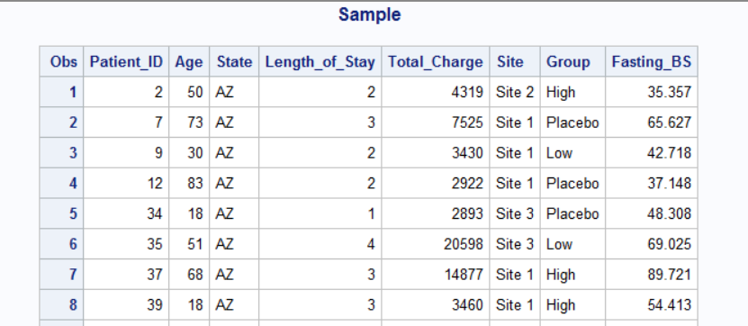

Merging the data
Sorting both the datasets with PROC SORT by the variable Patient-ID.
Using Horizontal Merge to merge the datasets with unique identifier – Patient ID.

Slide 7
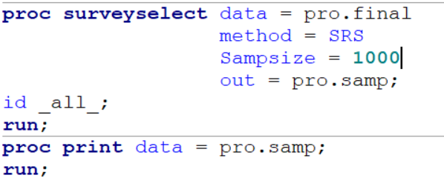
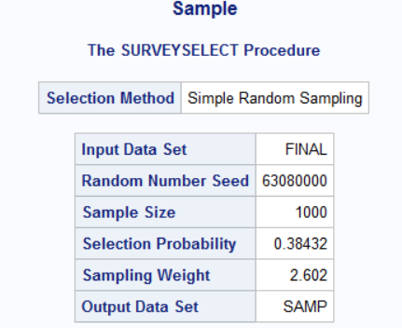
Sampling - SRS

Slide 8
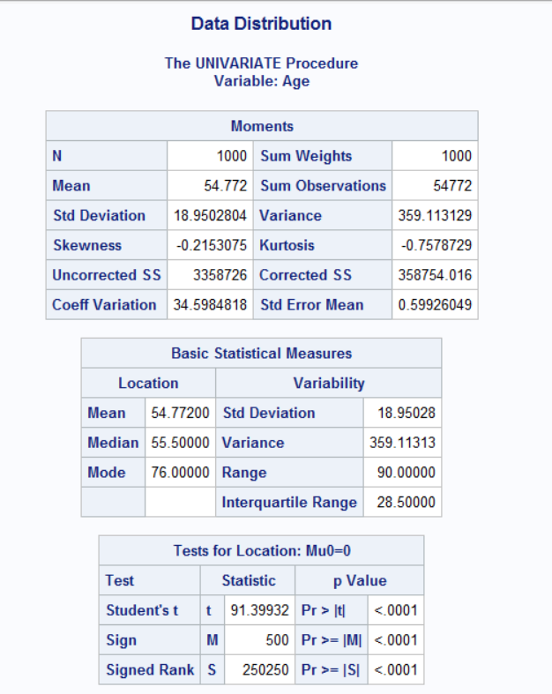
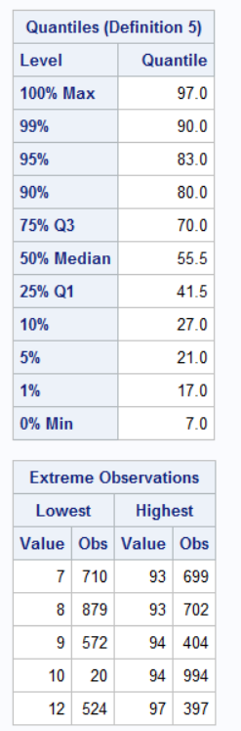
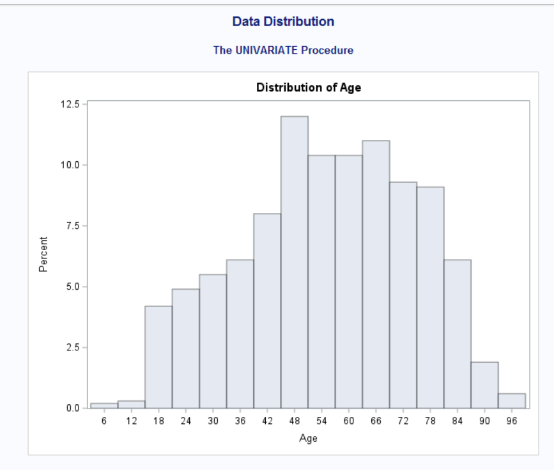
Distribution of data

Slide 9
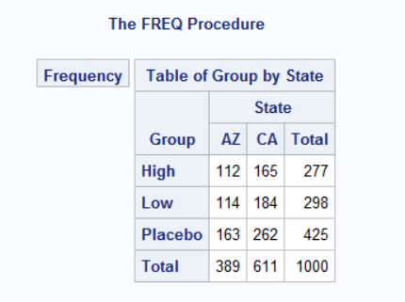
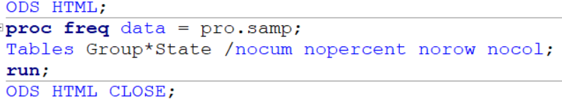
Number of patients enrolled in each state under the three categories

Slide 10
Research Questions
MAIN OBJECTIVE:
To know if there is a difference in fasting blood sugar levels between the groups – High, Low and Placebo.
FRAMING THE HYPOTHESIS:
Null Hypothesis: There is no difference in Fasting BS levels between the High, Low and Placebo groups.
Alternative Hypothesis: There is a difference in Fasting_BS between High, Low and Placebo groups.
TEST USED: ONE-WAY ANOVA
One independent variable [Groups] with more than two categories [High, Low, Placebo]
Assumption made: The data is normally distributed. To check for data distribution, using the PROC UNIVARIATE PROCEDURE.

Slide 11
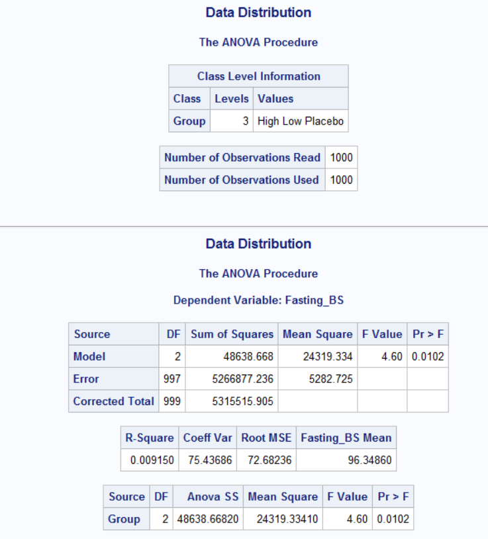
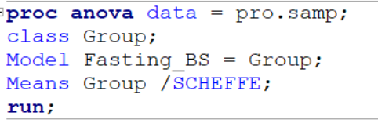
Interpreting the result for ONE-WAY ANOVA
Notes:
The p-value is 0.01, comparing it with 0.05, 0.01 < 0.05, we accept the alternative hypothesis – there is a difference in FBS levels among the groups.

Slide 12
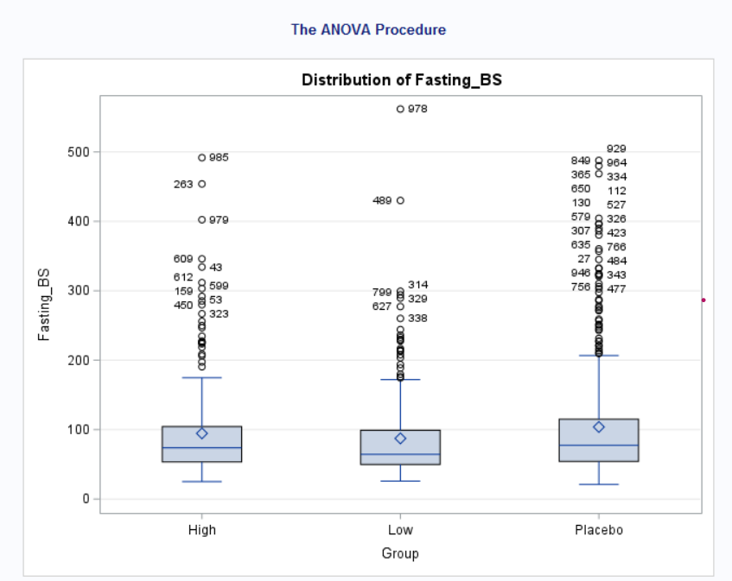

Slide 13
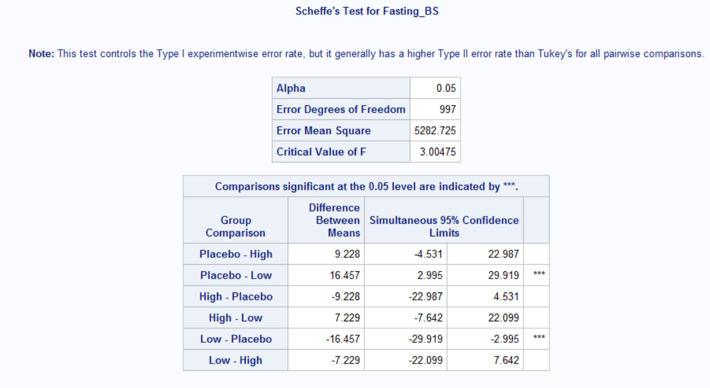

Slide 14
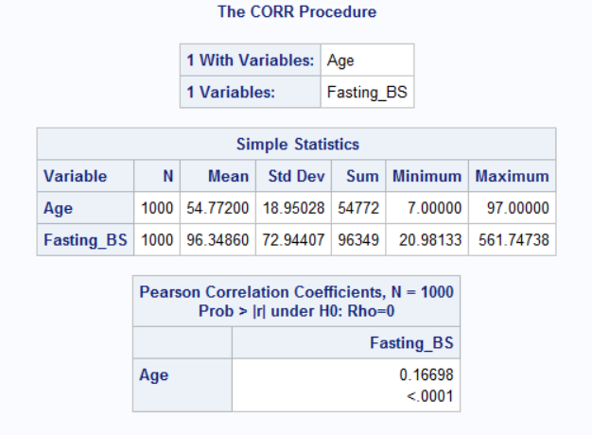
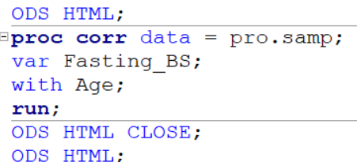
Understanding the relation between Age & Fasting Blood Sugar levels
Null hypothesis: There is no co-relation between Age and Fasting Blood Sugar levels
Alternative hypothesis: There is a co-relation between Age and Fasting Blood Sugar levels

Slide 15
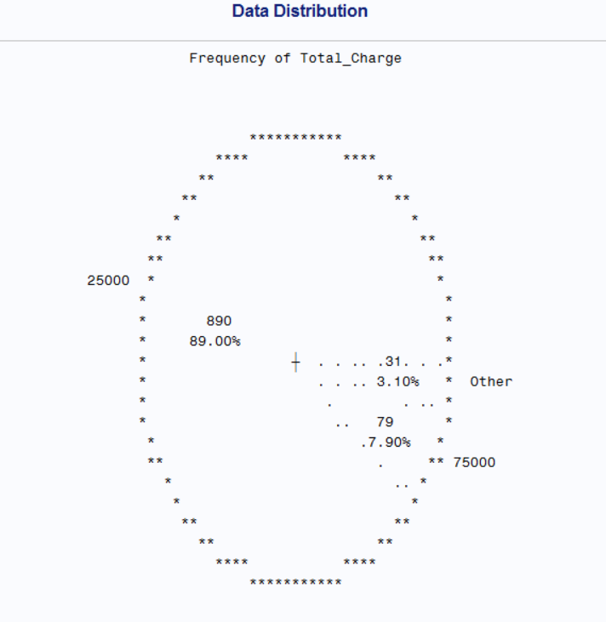
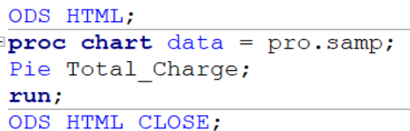
Frequency of Total_Charges in the sample

Slide 16
Conclusion
There is a mean difference in blood sugar fasting levels between the groups – High, Low and Placebo.
The group comparison (by SCHEFFE’s) shows that Low dose – Placebo group has a significant mean difference.
We understand that there is a weak positive co-relation between Age and Fasting Blood Sugar levels, but p-value <.0001 indicating that we accept the alternative hypothesis – there is a co-relation between the two variables.

Slide 17
Thank you

