Slide 1
Python Data Analysis Project: TB-DOTS Program
Project Using Pandas, NumPy, Matplotlib, Scipy
Karishma Daxesh Parekh| April 2025

Slide 2
Step1: Introduction
Topic: Tuberculosis (TB) Treatment Monitoring via DOTS
Source: Extended from SQL-based project dataset
Generated Dummy Dataset
Goal: Perform Descriptive and Inferential statistical and visual analysis using Python – NumPy, Pandas, Matplot & SciPy

Slide 3
Step 1: contd. Dataset Overview
Tables Used:
Patient
Observations: About 25 per table
Each table has about 5 columns
Diagnosis
Treatment
Outcome

Slide 4
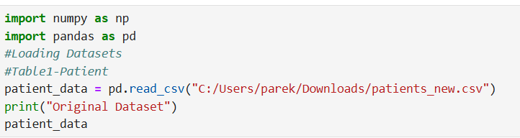
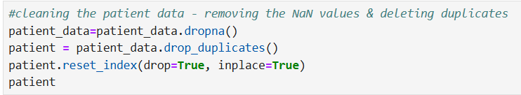
Step 2: Read and Clean Data
TABLE 1: PATIENT
Imported the modified dataset using pandas from CSV
Checked for missing values and duplicates
Resetting the Index

Slide 5
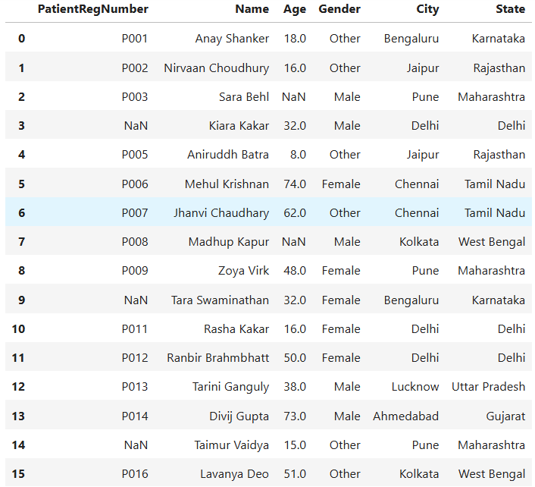
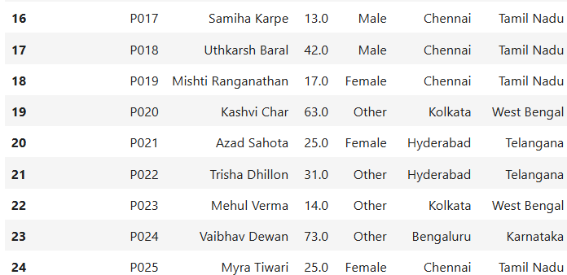
Table 1: Patient – Raw Data

Slide 6
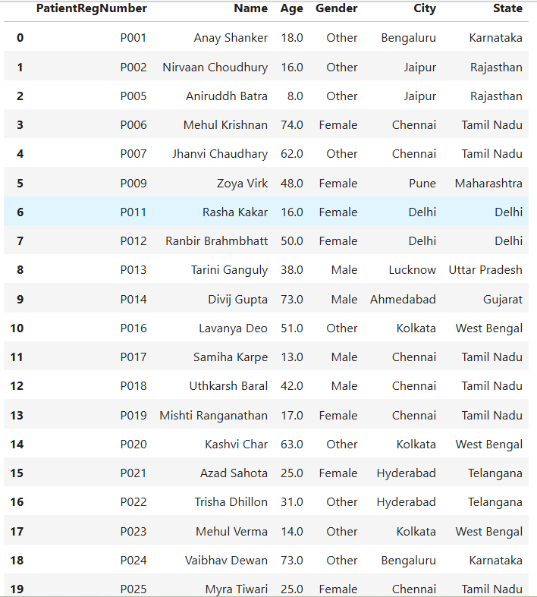
Table 1: Patient - Cleaned

Slide 7

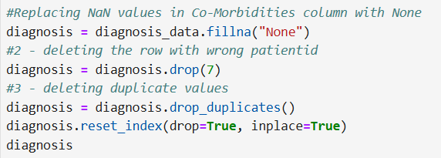
Step 2: Read and Clean Data
Imported the modified dataset using pandas from CSV
Dropped duplicates
& Replaced NaN in Co-morbidities with “None’
& Dropped a specific row with wrong Patient ID
Resetting the Index
TABLE 2: DIAGNOSIS

Slide 8
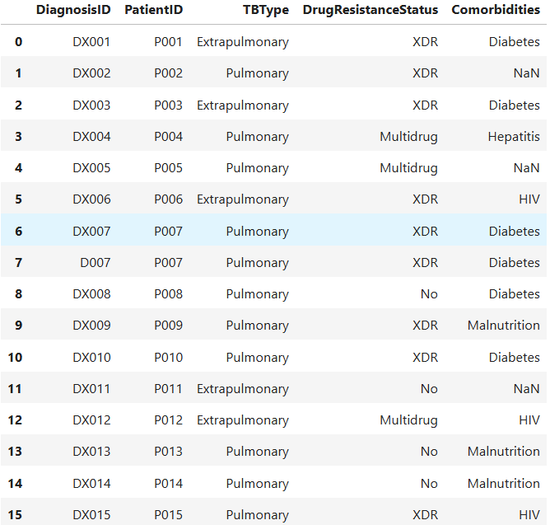
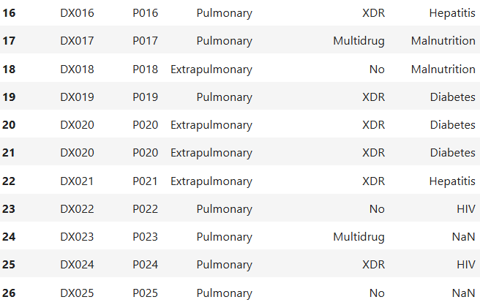
Table 2: Diagnosis -Raw Data

Slide 9
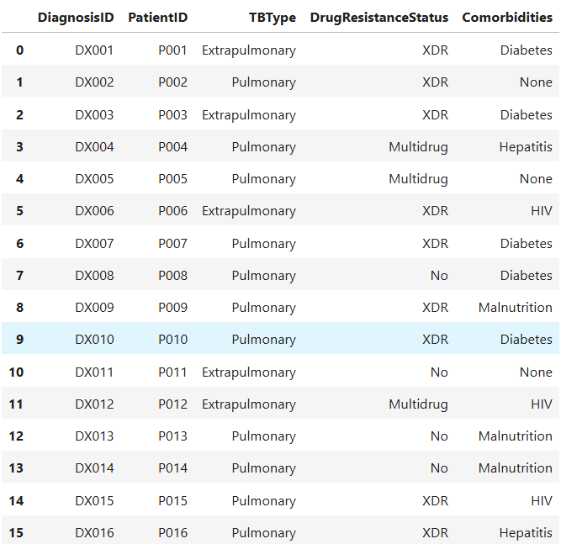
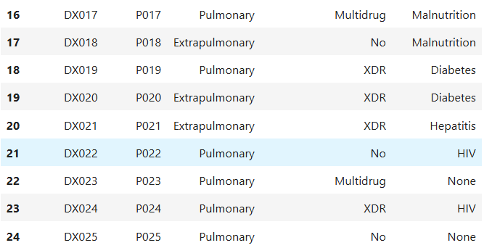
Table 2: Diagnosis -Cleaned

Slide 10
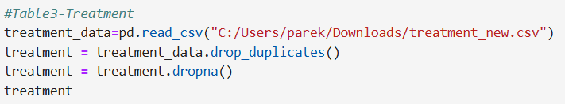
Step 2: Read and Clean Data
TABLE 3: TREATMENT
Imported the modified dataset using pandas from CSV
Checked & dropped duplicates and missing values, if any
Resetting the Index

Slide 11
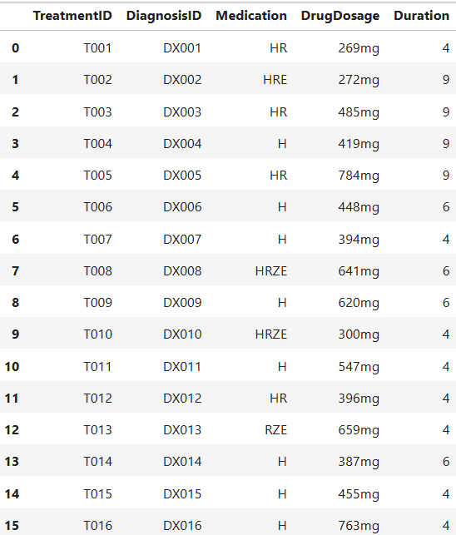
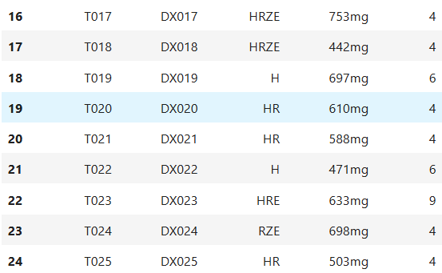
Table 3: Treatment -Raw Data It has no duplicates and missing values

Slide 12
Table 3: Treatment -Cleaned

Slide 13
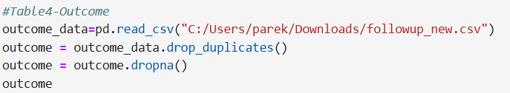
Step 2: Read and Clean Data
TABLE 4: OUTCOME
Imported the modified dataset using pandas from CSV
Checked & dropped duplicates and missing values, if any
Resetting the Index

Slide 14
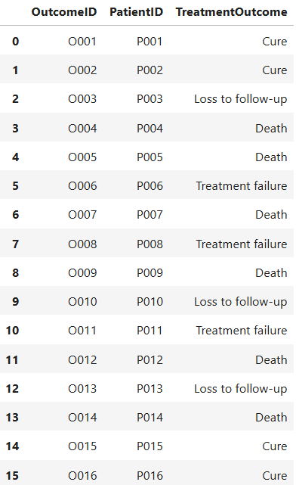
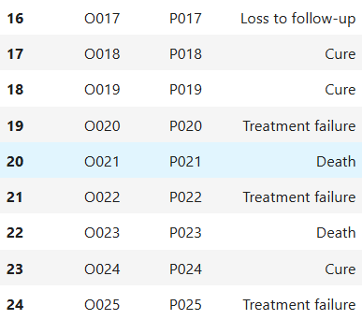
Table 4: Outcome -Raw Data It has no duplicates and missing values

Slide 15
Table 4: Outcome -Cleaned

Slide 16
Step 3: Data Manipulation
1. Merged Patient table with the Diagnosis table
2. Updating the Gender Column using IF-ELSE condition
3. Generated new column – Risk-Classification based on Drug Resistance Status & Comorbidity
4. Merged Diagnosis and Treatment Table using Right Join
5. Appended new patient rows to the patient table

Slide 17
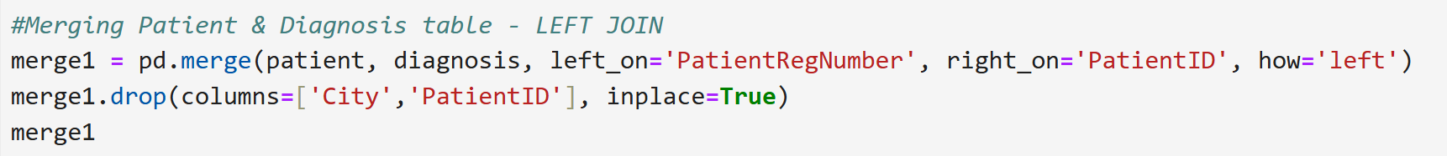
Step 3:
1. Merging Patient table with the Diagnosis table - using Left Join & PatientID as the Unique Identifier

Slide 18
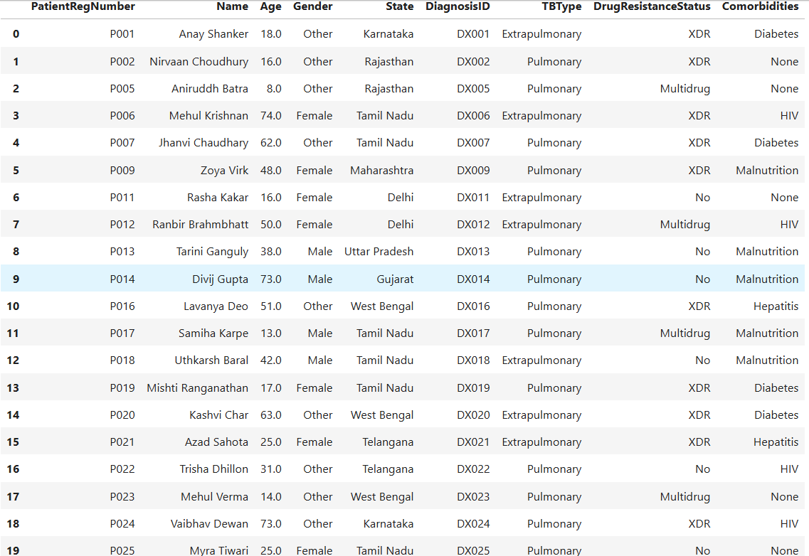

Slide 19
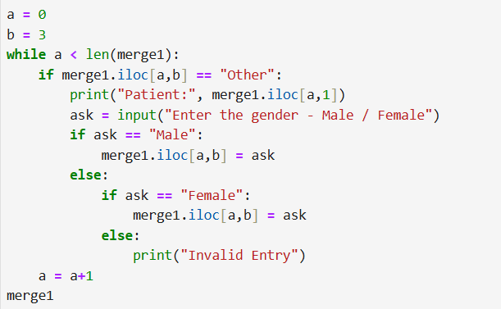
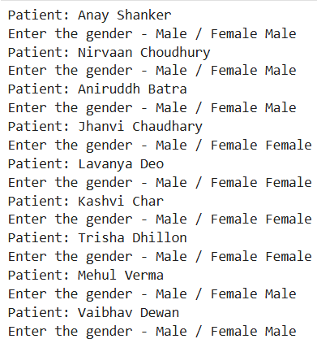
Step 3:
2. Updating Gender Column using IF-ELSE
CODE:
USER ENTRY:

Slide 20
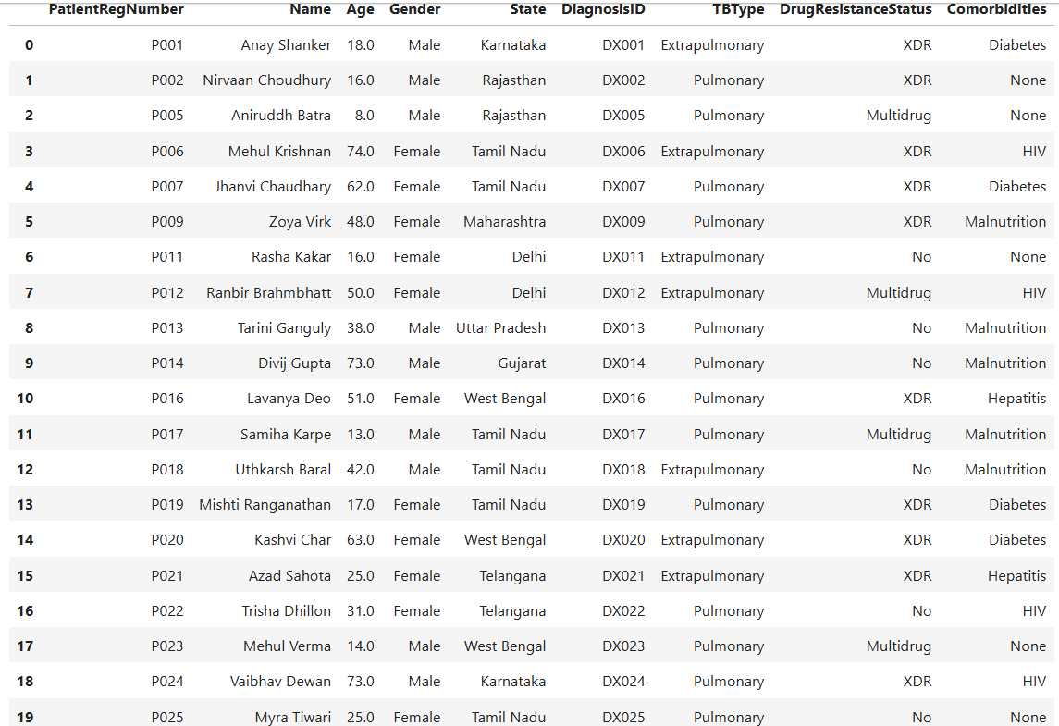
2. Updating Gender Column using IF-ELSE
OUTPUT:

Slide 21
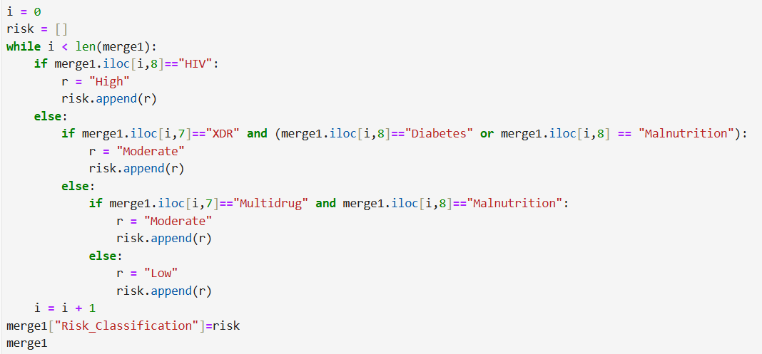
Step 3:
3. Generated new Risk-Level column based on Drug-Resistance & Co-morbidities
CODE:

Slide 22
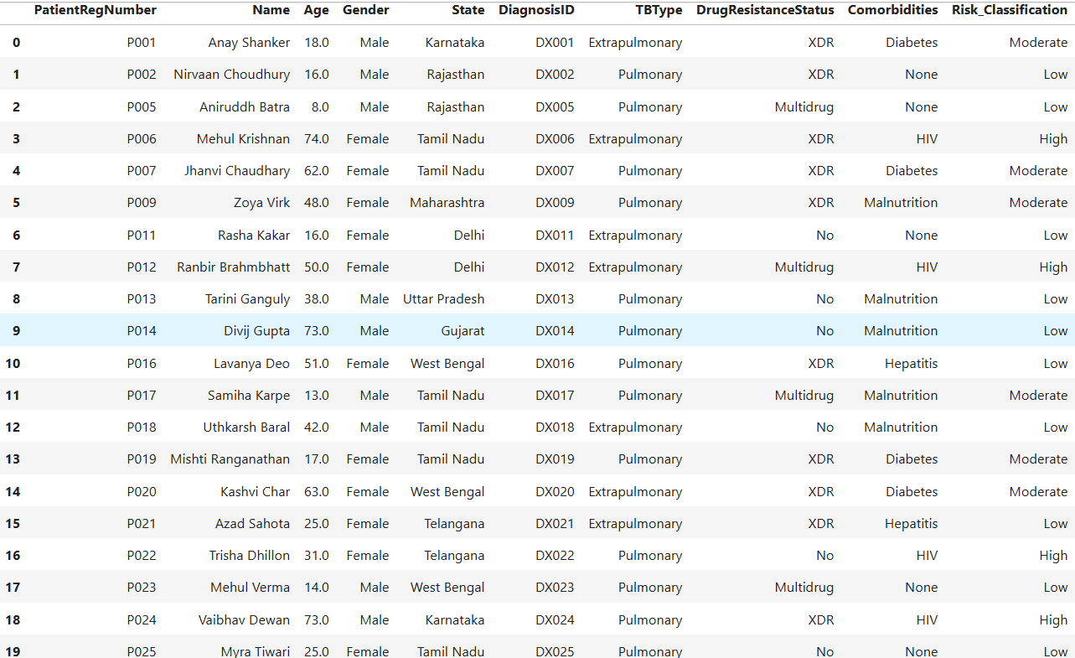
Step 3:
3. Generated new Risk-Level column based on Drug-Resistance & Co-morbidities
OUTPUT:

Slide 23
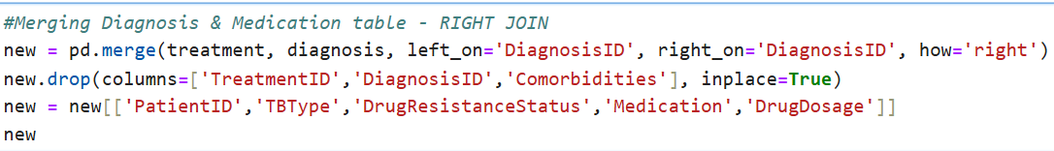
Step 3:
4. Merging Diagnosis & Treatment tables using Right Join
CODE:

Slide 24
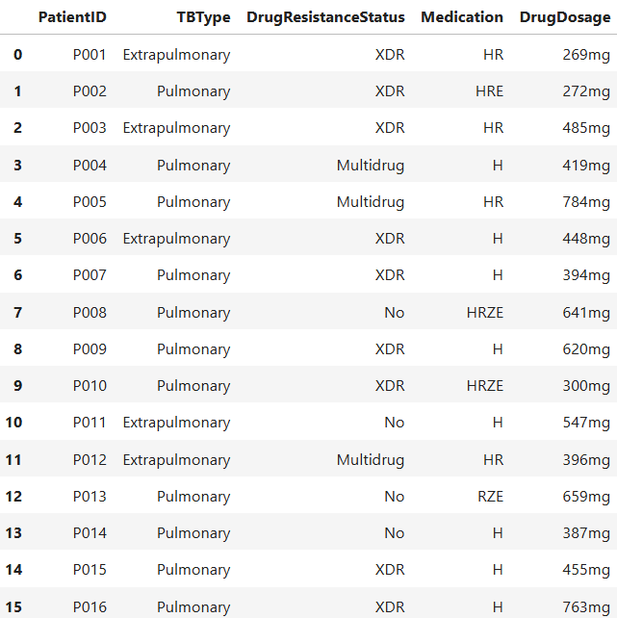
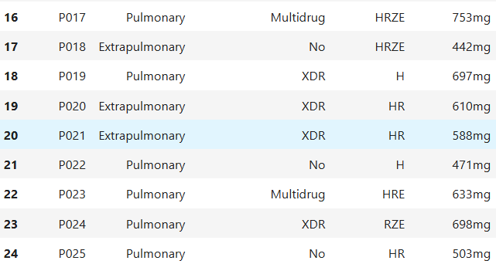
Step 3:
4. Merging Diagnosis & Treatment tables using Right Join
OUTPUT:

Slide 25
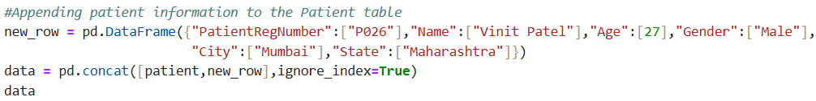
Step 3:
5. Appending new patient information to the Patient table
CODE:

Slide 26
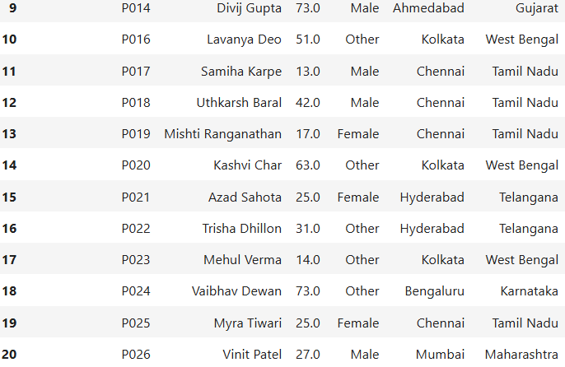
Step 3:
5. Appending new patient information to the Patient table
OUTPUT:

Slide 27

Step 4: OBJECTIVES Statistical Reports Generated for-
Percentage of Pulmonary v/s Extra-Pulmonary TB
Average drug dose for each drug resistance category
State-wise analysis of treatment outcomes
Minimum drug dosage for HRZE
Maximum drug dose for HRZE
Performed T-test, Correlation test and Linear Regression (further slides)

Slide 28
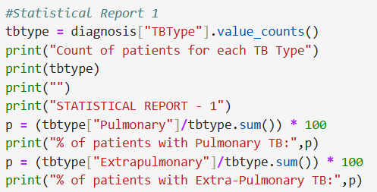
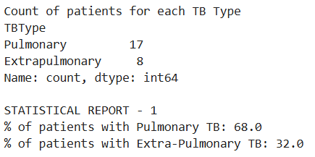
Step 4: 1. Percentage of Pulmonary vs Extra-Pulmonary TB
CODE:
RESULT:

Slide 29
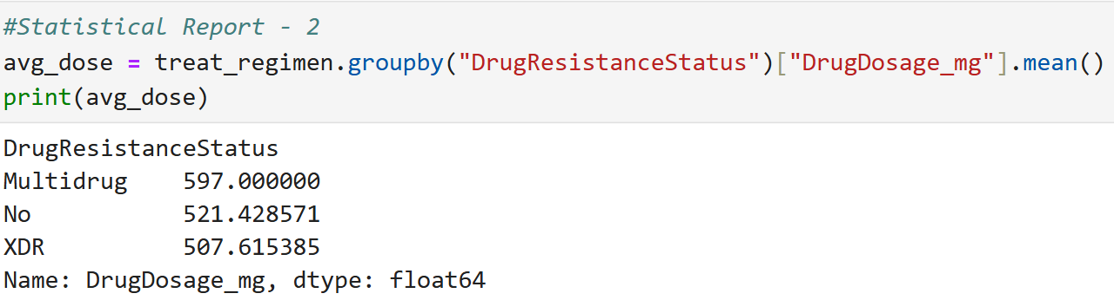
Step 4: 2. Mean Drug Dosage for each Drug Resistance Category
CODE:

Slide 30
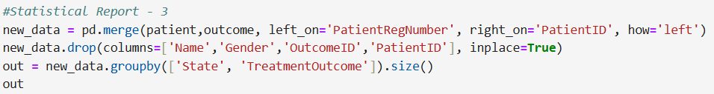
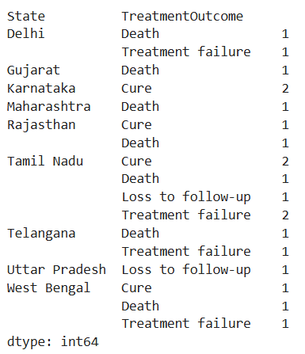
Step 4: 3. Understanding State-wise treatment outcomes
CODE:
RESULT:

Slide 31
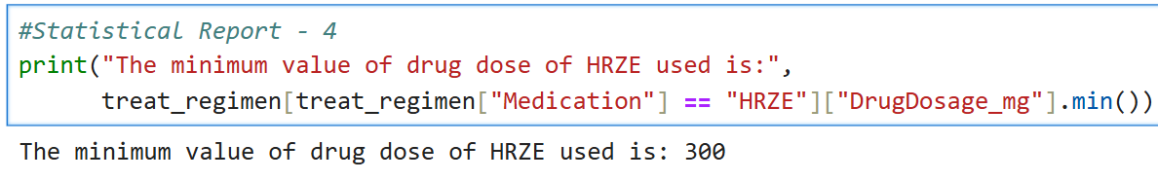
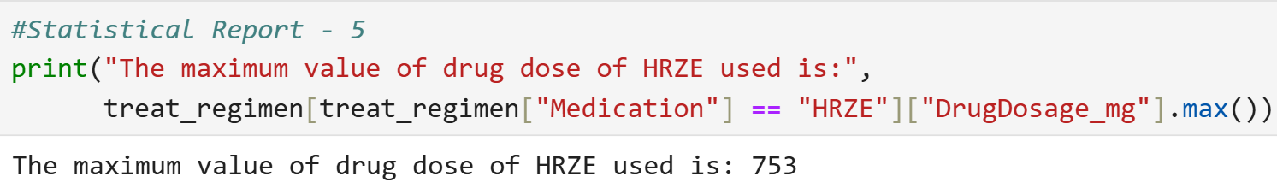
Step 4: 5. Maximum Drug Dose for medication - HRZE
Step 4: 4. Minimum Drug Dose for medication - HRZE
CODE:
CODE:

Slide 32

Step 5: Inferential Statistics
T-Test: Compare average age of Pulmonary vs Extra-Pulmonary TB
Correlation: Between Age and Treatment Duration
Linear Regression: Predict Treatment Duration based on Age, Comorbidities, etc.

Slide 33
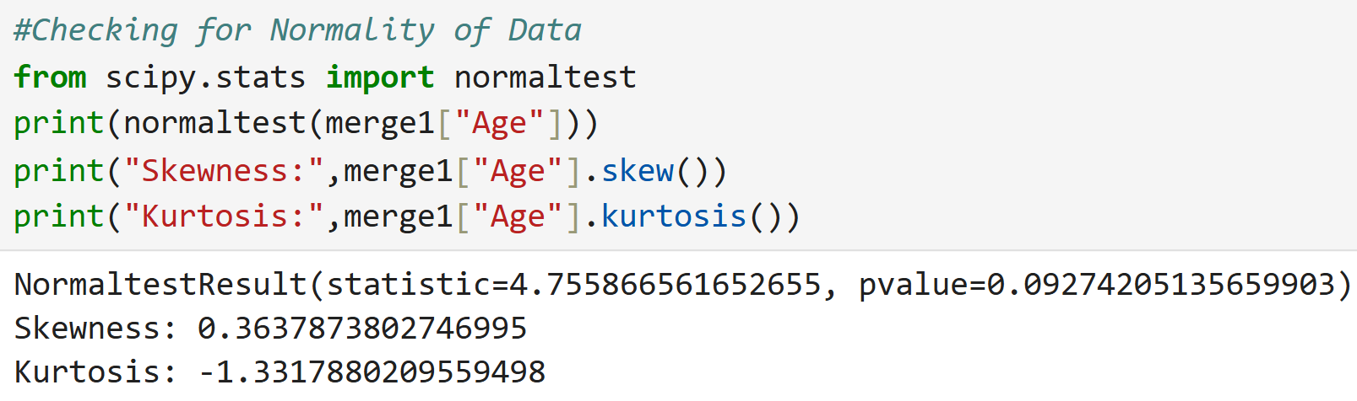
Step 5: Inferential Statistics
Checking whether the data is normally distributed or not
The normality test was conducted on the Age variable.
Test Statistic: 4.76
p-value: 0.093
Since the p-value is greater than 0.05, we fail to reject the null hypothesis, indicating that the age data is approximately normally distributed.
Additional metrics:
Skewness: 0.36 → Slight positive skew, but close to 0 (nearly symmetric)
Kurtosis: -1.33 → Indicates a platykurtic distribution (flatter peak and lighter tails than normal)
Conclusion: The distribution of patient age shows near-normal behavior with minor asymmetry and light tails.

Slide 34
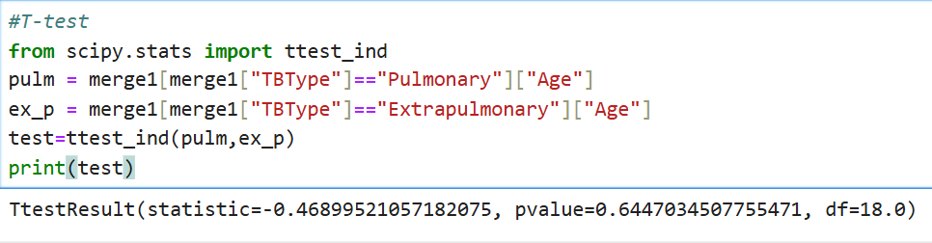
Step 5: Inferential Statistics – T-TEST
After checking that the data is normally distributed,
performing the test
Null Hypothesis (H₀): The mean age of patients with Pulmonary TB is equal to the mean age of patients with Extrapulmonary TB.
Alternative Hypothesis (H₁): The mean age of patients with Pulmonary TB is not equal to the mean age of patients with Extrapulmonary TB.

Slide 35
Step 5: Inferential Statistics – T-TEST
Interpretation of the T-test:
An independent samples t-test was performed to compare the average age of patients with Pulmonary and Extrapulmonary TB.
Test Statistic: -0.47
p-value: 0.645
Degrees of Freedom (df): 18.0
Since the p-value is greater than 0.05, we fail to reject the null hypothesis. This indicates that there is no statistically significant difference in the average age between the two TB types.
Conclusion: Age does not appear to influence whether a patient has Pulmonary or Extrapulmonary TB in this dataset.

Slide 36
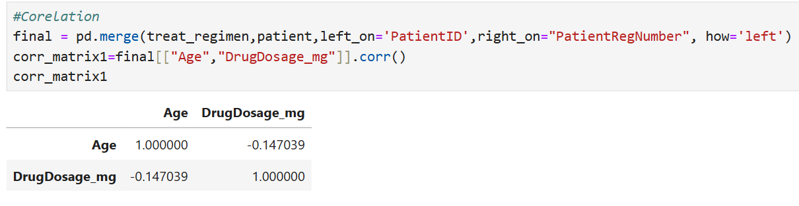
Step 5: Inferential Statistics – Correlation
After checking that the data is normally distributed,
performing the test
Null Hypothesis (H₀): There is no linear correlation between a patient’s age and drug dosage.
Alternative Hypothesis (H₁): There is a linear correlation between a patient’s age and drug dosage.

Slide 37
Step 5: Inferential Statistics – Correlation
Correlation Analysis between Age and Drug Dosage
To understand the relationship between patient age and the prescribed drug dosage, a Pearson correlation analysis was conducted after merging patient data with treatment records.
Correlation Coefficient (r = -0.147):
This indicates a weak negative correlation between age and drug dosage.
As patient age increases, the drug dosage tends to slightly decrease, though the relationship is not strong.
Implication:
The weak negative trend may suggest cautious dosing in older patients, possibly due to age-related physiological factors or comorbidities.
However, the low strength of correlation implies other factors likely influence dosage more significantly than age alone.

Slide 38
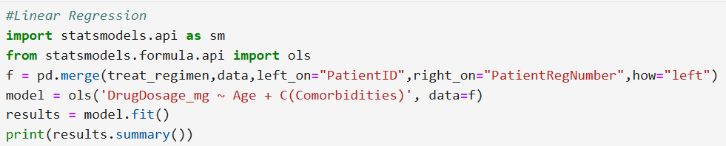
Step 5: Inferential Statistics – Linear Regression
Null Hypothesis (H₀): None of the predictors (Age or Comorbidities) have a statistically significant relationship with Drug Dosage
Alternative Hypothesis (H₁): At least one predictor has a significant effect on Drug Dosage. (At least one regression coefficient ≠ 0)

Slide 39
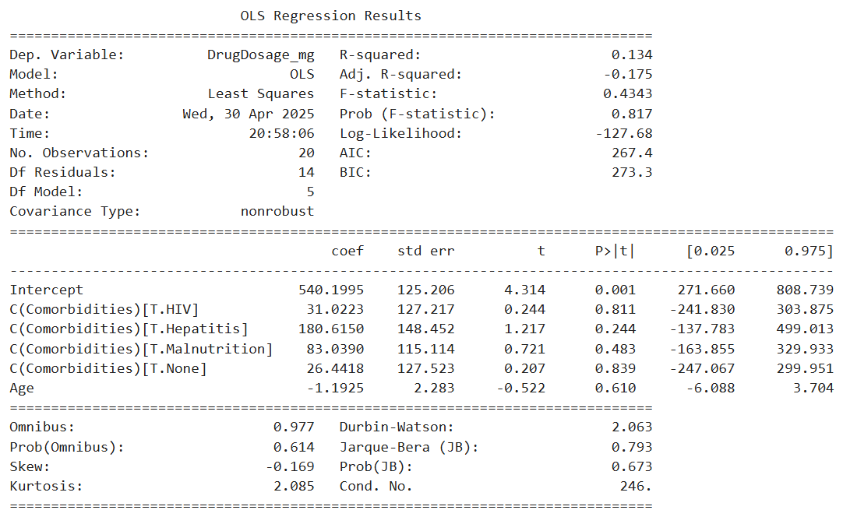
Step 5: Inferential Statistics – Linear Regression
RESULT:

Slide 40
Step 5: Inferential Statistics – Linear Regression
Result:
F-statistic = 0.4343, p = 0.817 → Fail to reject H₀ ⇒ The model is not statistically significant overall.
Individual Predictor Hypotheses (t-tests):
For each variable (e.g., Age, HIV, Hepatitis), we test:
H₀: Coefficient = 0 → The predictor does not significantly affect drug dosage.
H₁: Coefficient ≠ 0 → The predictor does significantly affect drug dosage.
Results:
All p-values > 0.05 (e.g., Age = 0.610, HIV = 0.811, etc.)
⇒ None of the individual predictors are statistically significant.

Slide 41

Step 6: Visualizations
Pie Chart: Treatment Outcome
Scatter Plot: Age vs Drug Dose
Box Plot: Minimum & Maximum doses of HRZE
Bar Chart: Treatment duration based on Co-morbidity

Slide 42
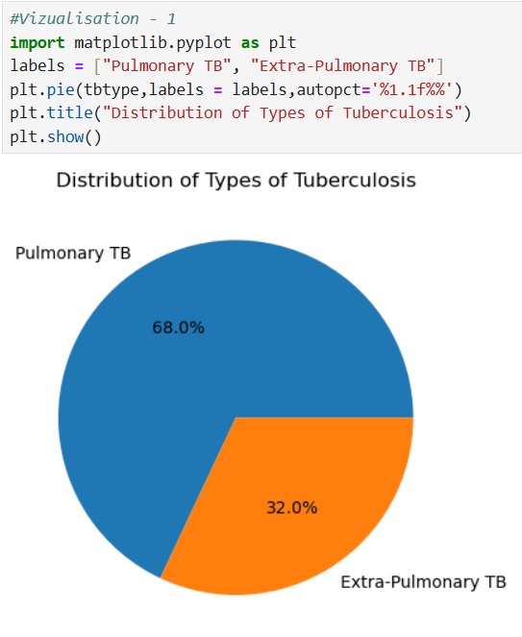
Step 5: Visualization- 1 Percentage of Pulmonary vs Extra-Pulmonary TB
CODE:

Slide 43
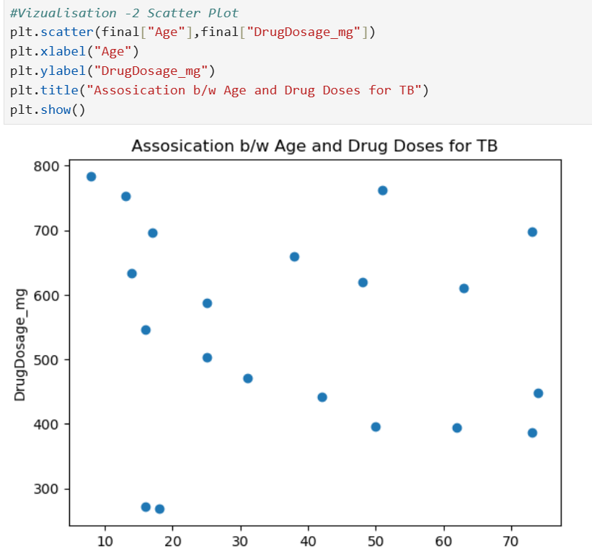
Step 5: Visualization- 2 Association between Age and Drug Doses for TB

Slide 44
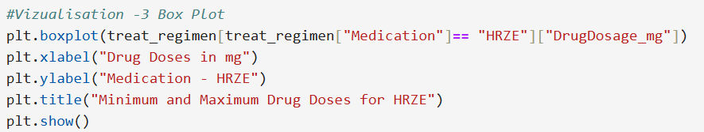
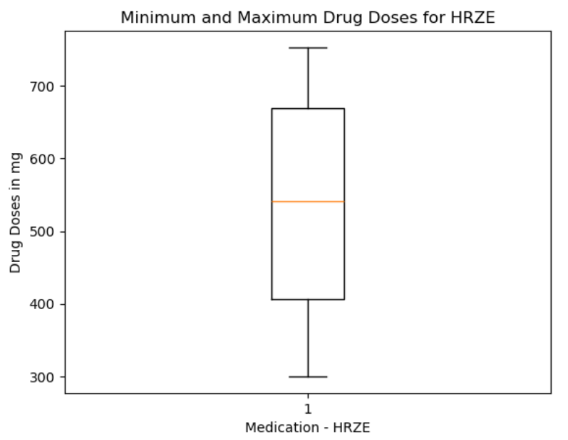
Step 5: Visualization- 3 Minimum & Maximum Doses of HRZE

Slide 45
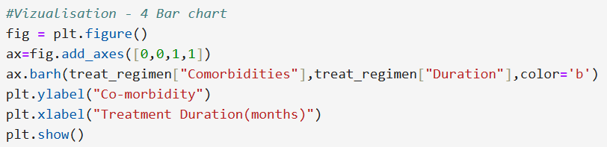
Step 5: Visualization- 4 Treatment Duration based on Comorbidity

Slide 46
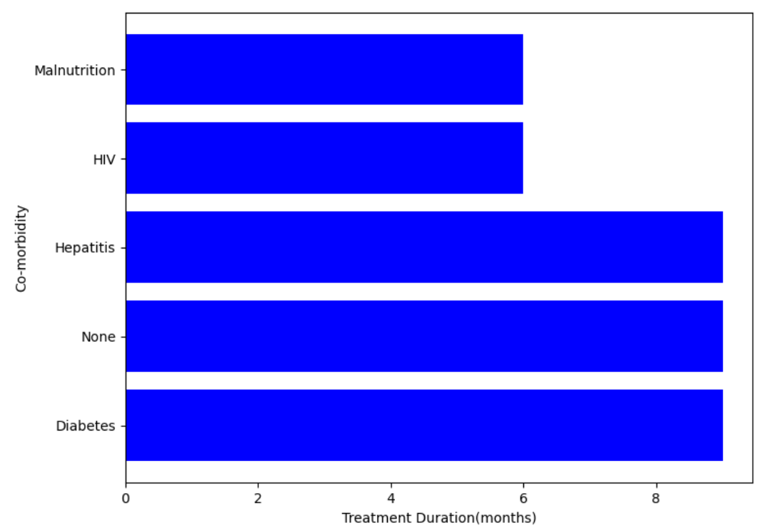
Step 5: Visualization- 4 Treatment Duration based on Comorbidity

Slide 47
Conclusion
Used Python to enhance SQL-based healthcare dataset
Extracted actionable insights via visual, statistical- descriptive and inferential analysis

