Slide 1
Predicting H1N1 Vaccine Uptake: Insights from H1N1 and Seasonal Flu Data
A Data-Driven Approach to Enhance Public Health Strategies\
Brian Kariuki
01-09-2024

Slide 2
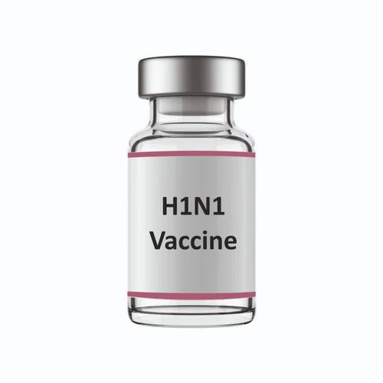
Introduction
Project Overview:
The constant struggle against the infectious diseases such as H1N1 influenza pandemic in 2009 has also contributed to the understanding of the role of the vaccination in the public health measures. Understanding how individuals respond to vaccines can help shape future health initiatives and improve vaccination rates.
Objective: Predict and understand factors influencing H1N1 and seasonal flu vaccine uptake.
Importance: Addressing vaccine hesitancy to improve public health outcomes.

Slide 3
Project Goals
Identify key factors that influence individuals' decisions to receive the H1N1 vaccine.
Build a predictive model to forecast public response to newly introduced vaccines based on demographic and behavioral data.
Provide actionable insights to public health organizations for developing targeted vaccination campaigns and strategies.
Enhance preparedness for future pandemics by understanding vaccine acceptance and hesitancy patterns.

Slide 4

Stakeholder Needs
Stakeholders:
Public Health Organizations
Healthcare Providers
Policy Makers
Needs:
Increased vaccination rates.
Understanding of factors affecting vaccine uptake.
Effective communication and intervention strategies.

Slide 5
Data Overview
Dataset Description:
Utilized a combined dataset from multiple sources, including national surveys and health records.
The dataset encompasses information on individuals’ demographics, vaccination history, and personal opinions on vaccines.
Data Sources:
Surveys: Gathered from public health surveys focusing on H1N1 and seasonal flu vaccination rates.
Health Records: Provided background health information to assess risk factors and vaccine eligibility.
Key Variables Analyzed:
Demographics: Age, gender, education level, and socioeconomic status.
Health Behaviors: History of flu vaccinations, frequency of medical visits, and general health practices.
Opinions and Concerns: Levels of concern about H1N1 and flu, trust in health authorities, and perceived vaccine effectivenes

Slide 6
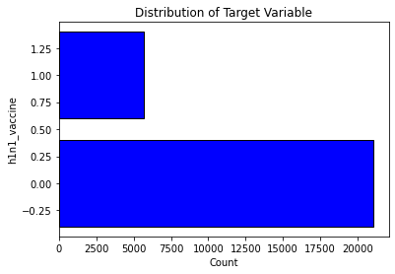
Data Exploration
Initial Findings from EDA:
Only 20% of the surveyed population received the H1N1 vaccine, indicating low uptake.
Strong correlation observed between levels of concern about H1N1 and the likelihood of getting vaccinated.
Key Patterns Identified:
Higher vaccine uptake among individuals with greater awareness and understanding of vaccine benefits.
Differences in vaccine uptake by demographic segments, such as age and education.
Behavioral Insights:
Knowledge and awareness significantly increase the likelihood of vaccination.
Individuals with regular healthcare engagement (e.g., frequent doctor visits) showed higher vaccination rates.

Slide 7
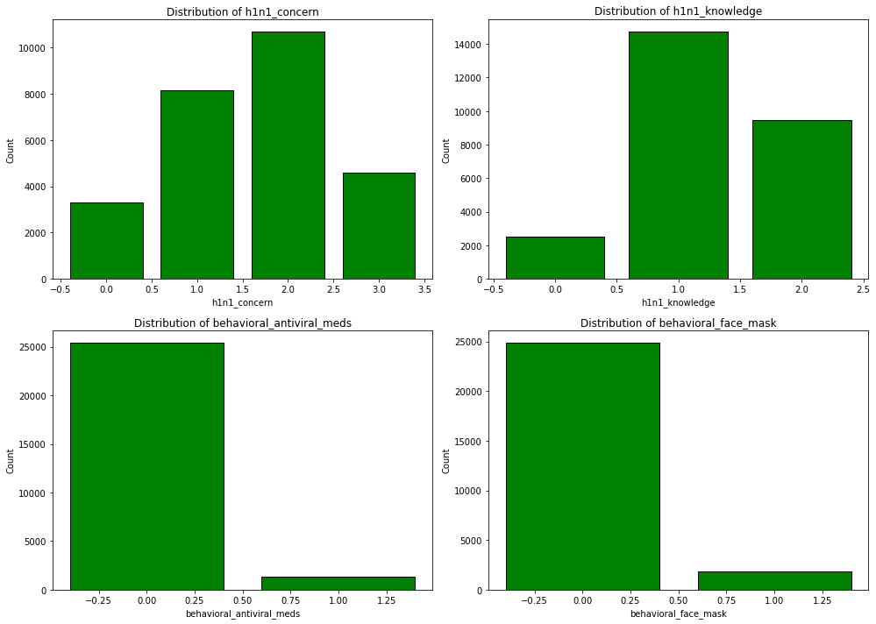
Univariate Analysis of Features:

Slide 8
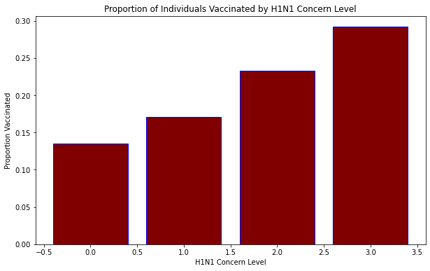
Bivariate Analysis
The bar plot shows that individuals with higher levels of concern about H1N1 are more likely to have received the vaccine. This suggests that the level of concern might be a strong predictor of vaccine uptake.

Slide 9
Methodology
Employed Exploratory Data Analysis (EDA) to identify underlying patterns and correlations within the dataset.
Used Predictive Modeling techniques, specifically logistic regression, to predict the likelihood of vaccine uptake.
Logistic Regression: Chosen for its effectiveness in binary classification problems (vaccinated vs. not vaccinated).
Feature selection to determine the most influential factors affecting vaccination decisions.
Evaluated model performance using metrics like accuracy, precision, recall, and F1-score to ensure robust predictions.

Slide 10
Key Findings
Significant Predictors Identified:
Higher levels of health concern and knowledge were associated with increased vaccination rates.
Demographic factors such as age, education level, and health history were significant predictors of vaccine uptake.
Impact of Awareness and Education:
Clear trend showing increased vaccine uptake among individuals better informed about the risks of H1N1 and flu.
Behavioral Patterns:
People with a history of regular vaccinations (e.g., yearly flu shots) were more likely to receive the H1N1 vaccine.
Insights for Public Health Strategies:
Tailored education and outreach programs could address specific demographic groups with lower vaccine uptake.

Slide 11
Recommendations
1. Investigate Vaccine Hesitancy Factors: Conduct in-depth research to understand the reasons behind the low vaccine uptake (approximately 20%). Investigate whether lack of concern, insufficient knowledge, or other factors contribute to the reluctance to get vaccinated.
2. Enhance Public Awareness Campaigns: Upgrade and launch specific campaigns in the mass media to increase the population’s awareness and knowledge about the H1N1 vaccine. Therefore, the focus should be made on the further enhancement of the dissemination of relevant information and the elimination of misunderstandings regarding the vaccine.
3. Address Vaccine Concerns: Enumerate and discuss some of the issues that could be associated with the H1N1 vaccine. This could include debunking myths, presenting facts about the vaccine, and working with the local authorities to gain their support.
4. Leverage High-Concern Groups: Focus on delivering messages and interventions for the high-concern groups. As people with higher concern levels are also more likely to get vaccinated, use this fact to devise strategies that will target people who are already concerned and aware of the H1N1 danger.
5. Evaluate and Adjust Strategies Regularly: It is also important to track progress in terms of vaccine coverage and the impact of the measures that have been taken. Feedback and data should be used to modify the public health interventions and enhance the outreach with the aim of enhancing the rates of vaccination in future.
6. LAstly, Address Model Limitations: While the decision tree model performs well, it is crucial to continuously evaluate and refine it. Consider integrating additional features or employing advanced models such as ensemble methods to enhance predictive performance further.

Slide 12
Value to Stakeholders
Provides actionable insights that can be directly applied to public health policies and intervention strategies.
Enables targeted outreach efforts based on empirical evidence, maximizing the effectiveness of public health campaigns.
Anticipated increase in vaccination rates through more informed and tailored public health approaches.
Lowered incidence of flu-related illnesses through higher vaccination coverage, reducing strain on healthcare resources.

Slide 13
Conclusion
Successfully identified key factors influencing vaccine uptake and provided a predictive model for future campaigns.
Recommendations provide a clear roadmap for enhancing public health interventions and increasing vaccine uptake.
Implement the suggested strategies and continue data collection for ongoing analysis and adjustment.
Encourage stakeholders to adopt a data-driven approach and integrate findings into public health planning.

Slide 14
Thank You

