Slide 1
Exploratory Data Analysis
Yashish Karkera

Slide 2
01
Context
This dataset was collected by me from car sale advertisements for study/practice purposes in 2016. Though there is couple well known car features datasets they seems quite simple and outdated. Car topic is really interesting.
02
This dataset contains data for more than 9.5K cars sale in Ukraine.
03
Most of them are used cars so it opens the possibility to analyze features related to car operation.
04
At the end of the day I look at this data as a subset from all Ukrainian car fleet.

Slide 3
Attributes Of The Data
The data consists of 9576 rows and 10 columns
Column | Description
Car | manufacturer brand
Price | Seller’s adv Price (USD)
Body | Car Body Type
Mileage | As mentioned in adv (000 Km)
EngV | rounded engine volume
EngType | Type of fuel
Registration | Car registered in Ukraine
Year | Year of production
Model | Specific model name
Drive | Drive type
Inspiration
Data will be handy to study and practice different models and approaches.
As a further step you can compare patters in Ukrainian market to your own domestic car market characteristics.

Slide 4
EXPLORING THE DATASET
1
Data Acquisition
The procedure starts with loading the required libraries which we will be using for exploring our data. We have used following libraries.
library(dplyr)
library(vtree)
library(ggplot2)
library(psych)
library(plotly)
library(scales)
3
Data Cleaning
2
We replaced NA values for engV with mean of that column.
We replaced NA with mode for the drive variable.
We had 267 rows for price variable with zero values hence we removed it.
We had 4 rows with scientific notation which again was removed.
Insights From Data
We should clearly understand the data before starting with analysis. Data has a variety of types. It is always important to check the data types.
There were 6 factors and 4 integers.
Mean price of the car was 15k, it was positively skewed.
Car data is ranging from 1953 to 2016.
There were null values in engV & drive variable.
Price variable had zero values & scientific notation populating.

Slide 5


Exploratory Data Analysis
Top Selling Cars
Car Sales Over The Year
We used %>% function and grouped the data by cars and used summarize function to get the count of all the cars. We then considered only top 10 cars. Using ggplot we created a geom_bar chart.
Volkswagen sold more car followed by Mercedes-Benz and BMW.
Car data was ranging from 1953 - 2016.
After the dissolution of the Soviet Union in 1991, there has been a clear spike in car sales.
After 2008 there has been a sharp decline in car sales due to the automotive industry crisis from the year 2008 to 2010.
Univariate Analysis
Preferred Body Type
Preferred Engine Type
Sedan type of body was preferred type because Sedans are reasonably priced, and get decent gas mileage (cost is important for people on a fixed income).
Petrol was preferred choice.
Diesel engines are more expensive to build and maintain, hence small cars where buyers are most price sensitive, tend to be buying Petrol cars.

Slide 6
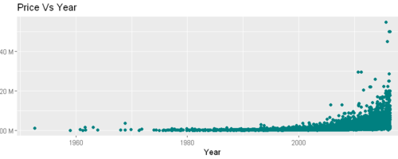
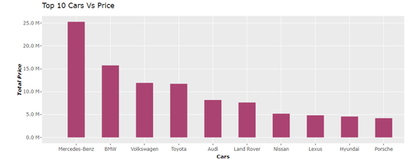
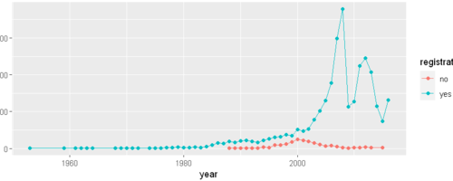
How Car Price has varied over the years
With the Scatter Plot, we visualize the correlations between values.
We see the collation between year and price. We cannot comment on the price increasing as the years increase, but in general, an increase in the price has been observed in recent years.
Highest priced cars sold over the years
Bivariate Analysis
Seems like Ukraine people prefer German made cars.
Mercedes-Benz, BMW & Volkswagen all are german made cars.
VAZ & ZAZ are Russian made cars which was famous in Ukraine but people's choices had changed over the period.
Registration of the cars over the years
There was highest registration done in the year 2008, We have seen in our earlier graph as well.
But suprising is we have many cars without registrations, what does this mean? Could be these are foriegn license plate numbers and not registered in Ukraine.

Slide 7
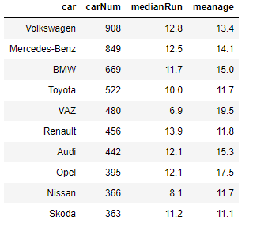

Feature Engineering
1st
We have very high varying values in price hence, we will divide the price value with 1000.
We will create a new variable from the year called Age.
We will also create a net annual mileage from the age of the car.
It seems that VAZ (Soviet/Russian car manufacturer) has much lower annual mileage than other popular producers. On the other hand it has the biggest age in average. It is obvious that annual mileage falls while car is getting older. But let’s check further.

Slide 8
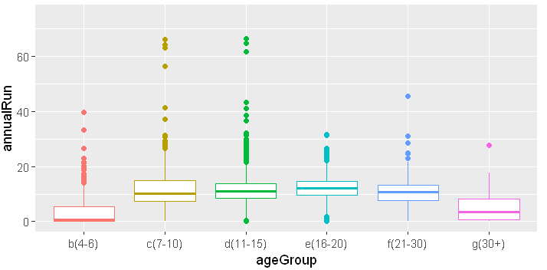
Feature Engineering
2nd
We created a age group bucket, so we can compare mileage variance for different age groups. We did not consider the age which is zero. Hence we did not have groups <=3 years of age.
As we see average values of mileage for VAZ are lower than 2nd quartile for all cars of this age. I know that in this cars it is easy to “adjust” speedometer readings. And I assumed that we got evidence of such massive manipulations.
Age Group
4-6
7-10
11-15
16-20
21-30
30+
Count
962
2449
3361
1267
951
315

Slide 9
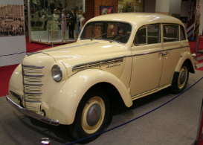
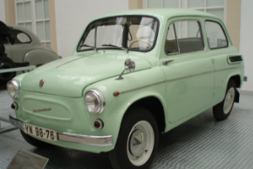
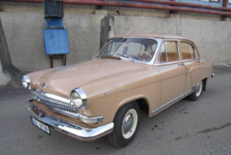
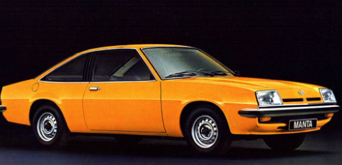
Oldest Cars used by Ukraine
Moskvich-AZLK
ZAZ
GAZ
Opel Manta

Slide 10
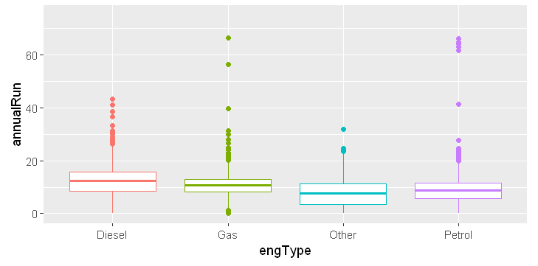
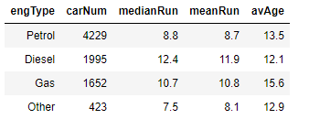
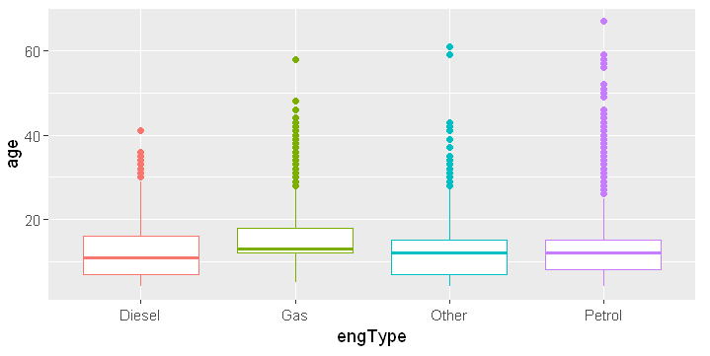
What about Petrol and body type? Do they influence drivers mileage?
Body Type
Petrol cars
We have excluded vans because they are mainly diesels and are often used as commercial transport. Anyway we see Diesel engines have consistently bigger annual mileage. Though they are some younger than other types.

Slide 11
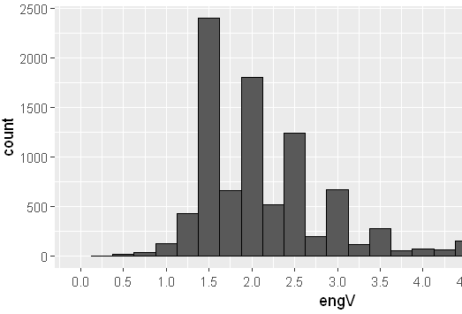
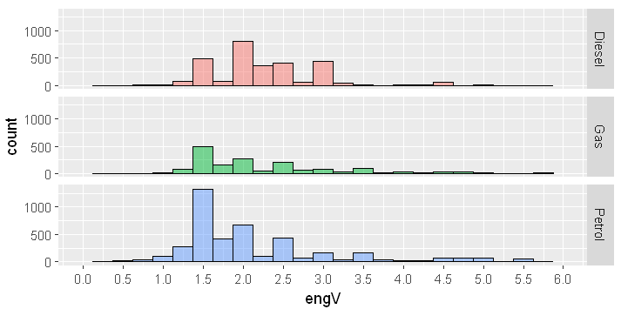
Engine Volume
Indeed main part of diesel engines has 2l volume, while petrol as usual is just 1.5l. Gas engines have the same pattern as petrol because again they are just reworked petrol ones.
Content Here
Get a modern PowerPoint Presentation that is beautifully designed.

Slide 12
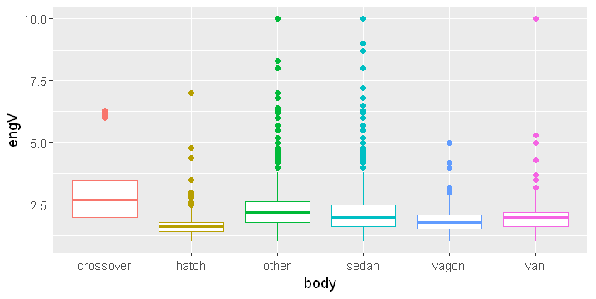
Body Type
This shows people prefer Sedan type of body mostly may be because Sedans are reasonably priced, and get decent gas mileage (cost is important for people on a fixed income).
Sedan
43%
24%
Crossover
Hatchbacks almost don’t have variance - their engines gathered in 1.4-1.6 liters zone. Almost the same with wagons which often have 2l volume. While crossover engine volume can vary significantly.
14%
19%
Other
Hatch

Slide 13
Conclusion
I've tried to cover basic initial steps of exploratory data analysis Identification of variables and data types
Missing value treatment
Outlier treatment
Non-Graphical Univariate Analysis
Graphical Univariate Analysis
Bivariate Analysis
Variable transformations
Also I've made use of libraries like dplyr, ggplot2 and plotly to develop better insights about the data.
We have seen impact of columns like mileage, year, body type and engType on the Price increase/decrease rate.
It is clear from the analysis that Ukraine people prefer German made cars.
This analysis indicates that there is wide opportunities for other country car manufacturers to make their mark here like Hyundai.

Slide 14
THANK YOU

