Slide 1

Project III STOCK MANAGEMENT SYSTEM
BY: MILAN KARKI
Tu Register No: 6-2-712-52-2019
Roll No: 4

Slide 2
Project analysis slide 2
Introduction
Stock Management is the practice of ordering, storing, and controlling Stock applies to every item a business uses to produce its products or services from raw materials to finished goods.
A lot of orders are being placed every day and Managing the Orders consumes lot of time the system will record and will provide alerts when the level of inventory is very low and focuses on the three aspects of inventory management.
Stock Management System helps in the efficient monitoring of constant flow of units into and out of an existing inventory.
In other words, stock management covers every aspect of a business’s inventory.

Slide 3
Project analysis slide 2
Problem Statement
Many businesses still manage their stock by hand, which can lead to mistakes like forgetting to update inventory or missing important information
Relying on physical books to track stock is also inconvenient because they need to be with staff all the time, and if they’re not available, updates can't be made.
Additionally, the manual system makes it hard to track when stock is running low. Without reminders, staff may forget to reorder items in time, leading to stockouts and disruptions in operations.
The current system is slow, prone to errors, and not efficient for managing inventory or reordering stock.

Slide 4
Project analysis slide 2
Objective
To design and develop a user-friendly system that effectively handles and manages information about items or products, while also providing calculations for the information system.
To develop a system that deals with the day-to-day needs of organization like managing purchase, sales, return, and available stocks.
Keep each and every calculation and help to generate reports of transactions in Excel, PDF format with addition of Email and Printing Features as well.
Additionally, the System will Show Visual representation like Charts and Heat Map with addition of Advance Algorithms like Rule Based, ABC Inventory and Safety Stock Check Algorithms.

Slide 5
Project analysis slide 2
Scope and Limitation
SCOPE
LIMITATION
All authorized users with proper access credentials can use this system to manage Stock.
The system allows users to easily input, track, and update stock levels.
The system offers comprehensive reports and analytics, enabling users to make well-informed decisions regarding purchasing and Stock management.
The system accurately calculates and maintains records of transactions, facilitating the generation of reports in Excel and PDF formats.
The accuracy of inventory levels depends on the accuracy of data input by users.
The system may not be able to integrate with all other business software, depending on compatibility.
The system's functionality may vary depending on the specific industry or type of business..
The system has limited amount of category.

Slide 6
Project analysis slide 2
Report Organization
Chapter 1 Deals with the introduction of the system with its objectives and limitations along with the reason why the system is made.
Chapter 2 Summarizes the work that has been carried out in the field of Stock management and also describes the features about some existing applications related to the Stock Management Systems.
Chapter 3 Focuses on the different requirement of the system, which describes about the functional, non-functional, Object Modelling ,Process Modelling: Activity Diagram ,Component Diagram, and Deployment Diagram and the implementations of Algorithm.
Chapter 4 Emphasizes tools used in system development, implementing details and result of test performed.
Chapter 5 Highlights brief summary of lesson learnt, outcome and conclusion of the whole project and explain what have been done and what further improvements could be done.

Slide 7
Project analysis slide 2
Background Study
Dashboard
User Interface
Stock Tracking
Purchase Order Management
Sales Order Management
Reporting
The system should have a user-friendly interface that allows users to easily navigate through the system.
The system should have a dashboard that provides a quick overview of stock levels, sales trends, and other important metrics.
The system should be able to track stock levels for each item, including current stock levels, incoming stock, and outgoing stock
The system should allow users to create and manage purchase orders for stock items, including tracking the status of each order.
The system should allow users to create and manage sales orders for stock items, including tracking the status of each order.
The system should provide a range of reports, including stock levels, sales trends, and inventory turnover, to help users make informed decisions.

Slide 8
Project analysis slide 2
LITERATURE REVIEW
SAP ERP Inventory Management
Trade Gecko
Fishbowl Inventory
Zoho Inventory
QuickBooks Online Inventory Management

Slide 9
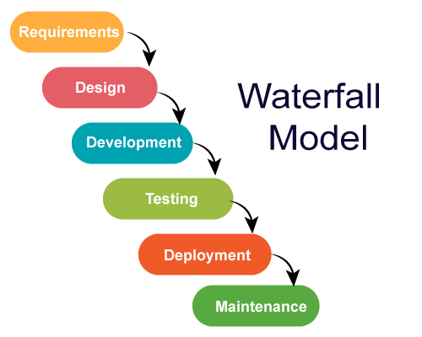
Project analysis slide 2
System Analysis
I've chosen water fall model as I'm developing software for predefined problems only.
The project can easily de broken down into different parts based on this model.
However, feedback loops will be allowed during the whole software development process. I find this model suitable for me to follow.
Fig 1: Waterfall Model

Slide 10
Project analysis slide 2
Requirements
Functional requirement
User Module:
User shall login the system.
User shall Manage Purchase, Sales, Back Order and Return Orders.
User shall Print Purchase, Sales, Return Orders and Exporting data into excel or PDF.
User shall View Analytics.
User shall view available Stocks.
Admin Module:
Admin shall login the system.
Admin shall Manage Purchase, Sales, Back Order and Return Orders.
Admin shall see the registered users and create the user also delete the users.
Admin shall view available Stocks.
Admin shall Print Purchase, Sales, Return Orders and Exporting data into excel or PDF
Admin shall manage supplier and Items.
Admin shall View Analytics

Slide 11
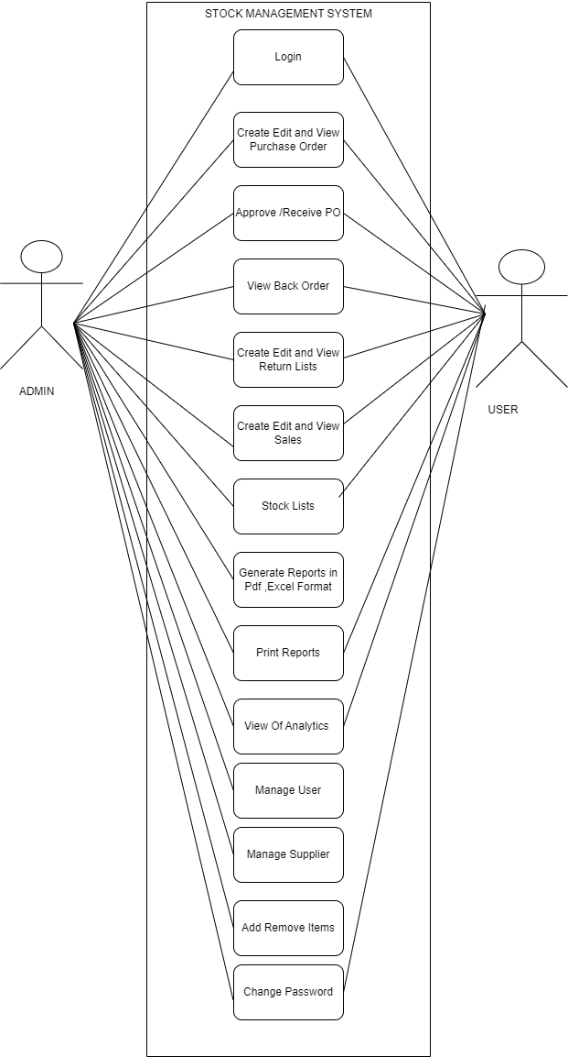
Project analysis slide 4
Use Case Diagram
Fig 2: Use Case Diagram

Slide 12
Project analysis slide 2
Requirements
Non-Functional Requirement
Reliability
Performance
Scalability
Usability
Security

Slide 13
Project analysis slide 2
Requirements
Feasibility study
Technical feasibility: In order to design this system, it uses existing technologies, software and hardware so there is no technological hurdle to build this system.
Economic feasibility: The system development does not have any requirement of expensive hardware and software, and used software are mostly open source so development is economically feasible.
Operational feasibility: The proposed system is operationally feasible as it is reliable for all type of user i.e., whether or not the user has the knowledge of computer or not. It is simple and easy to use due to simple user interface and its operational feasible.
Schedule Feasibility: The system that we developed is scheduling feasible as it does not require more time for the development phase.

Slide 14
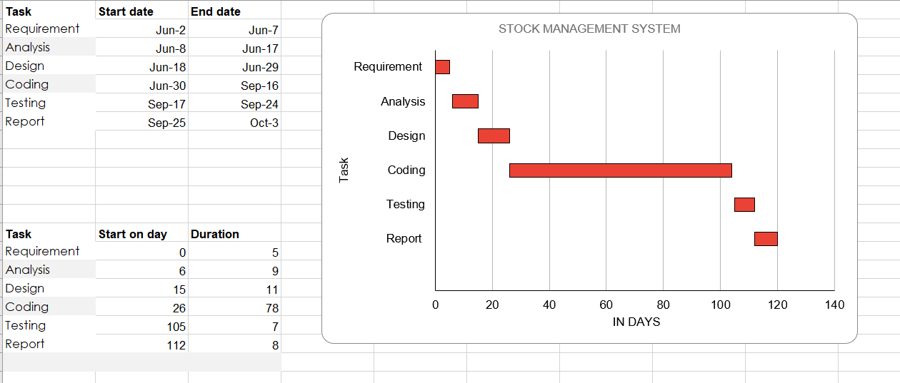
Project analysis slide 2
Requirements
Gantt chart is used for planning projects of all sizes, and it is a useful way of showing what work is scheduled to be done on a specific day.
It can also help you view the start and end dates of a project in one simple chart.
.
Fig 3: Gantt Chart

Slide 15
Project analysis slide 2
TECHNOLOGY
Database: MySQL
IDE: VS Code
Languages: PHP, JavaScript, HTML, CSS
Hosting: Apache (XAMPP)
Libraries: PHP Mailer, Highcharts, Charts.js
Visual Studio Code is the primary development environment. It offers code highlighting, debugging, and extensions, making coding more efficient.
MySQL is used as the database for storing information like stock levels, orders, and user data. It’s a reliable and widely used solution for managing large amounts of data.
PHP handles the server-side logic of the system, processing data and connecting to the database. JavaScript adds interactivity to the user interface. HTML is used to structure the web pages, while CSS styles them to look modern and user-friendly.
XAMPP provides a local server environment using Apache, allowing the web application to be hosted and tested during development.
PHP Mailer is used for sending emails from the system, while Highcharts and Charts.js generate interactive reports and charts to help users understand sales, stock levels, and other data.
Frameworks: Bootstrap
Bootstrap is used to create a responsive and mobile-friendly design. It simplifies the styling process and ensures that the application looks good on any device.
Version Controlling: GIT, GitHub
Git and GitHub are essential for version control, allowing the development team to track changes in the code and collaborate efficiently. is used to create a responsive and mobile-friendly design. It simplifies the styling process and ensures that the application looks good on any device.
Browsers: Chrome, Edge
The system is tested on Google Chrome and Microsoft Edge to ensure it works well across different web browsers.
Documentation: Draw.io, MS Word
Draw.io is used for creating system flowcharts and diagrams, while MS Word is used for writing documentation and reports.

Slide 16
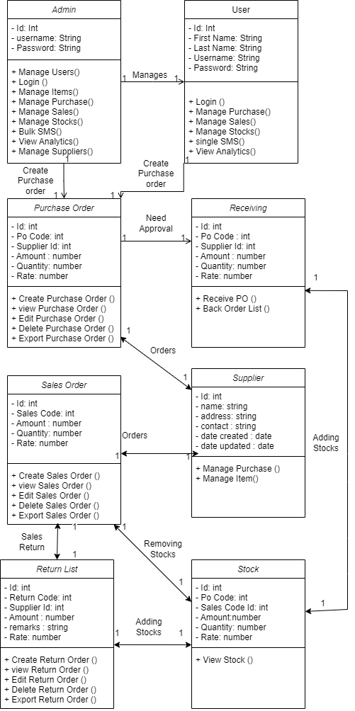
Project analysis slide 4
Object Modelling using Class Diagram and Object Diagram
Fig 4: Class Diagram

Slide 17
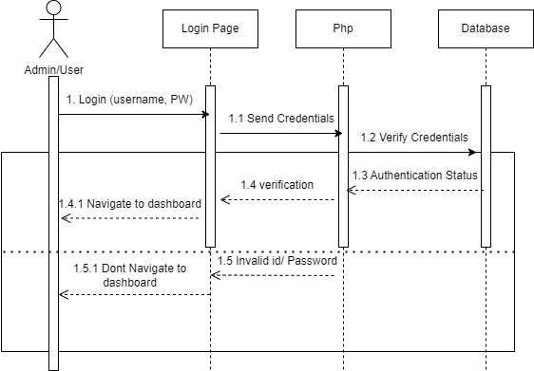
Project analysis slide 4
Dynamic Modelling using State and Sequence Diagrams
Fig 5.1: Sequence Diagram for Login

Slide 18
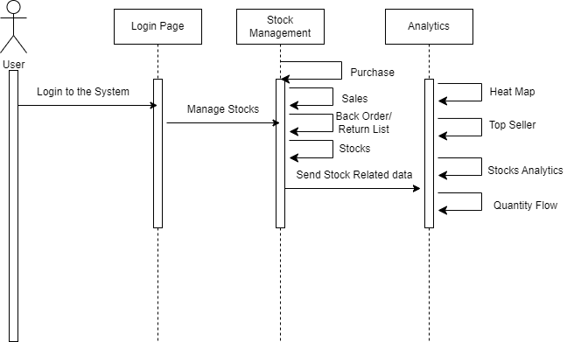
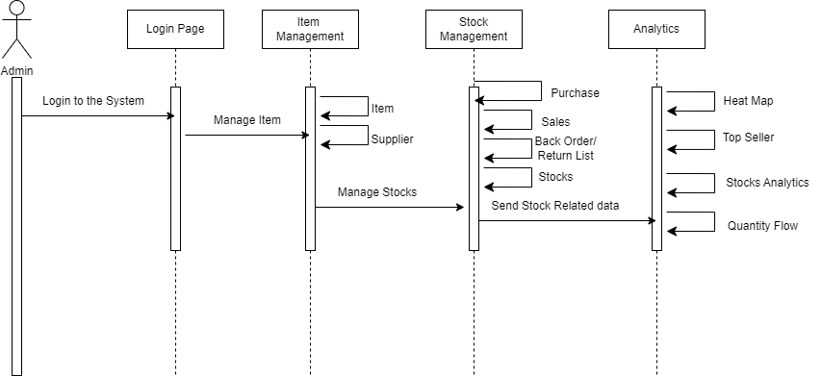
Project analysis slide 4
Dynamic Modelling using State and Sequence Diagrams
Fig 5.1: Sequence Diagram for Users
Fig 5.2: Sequence Diagram for Admin

Slide 19
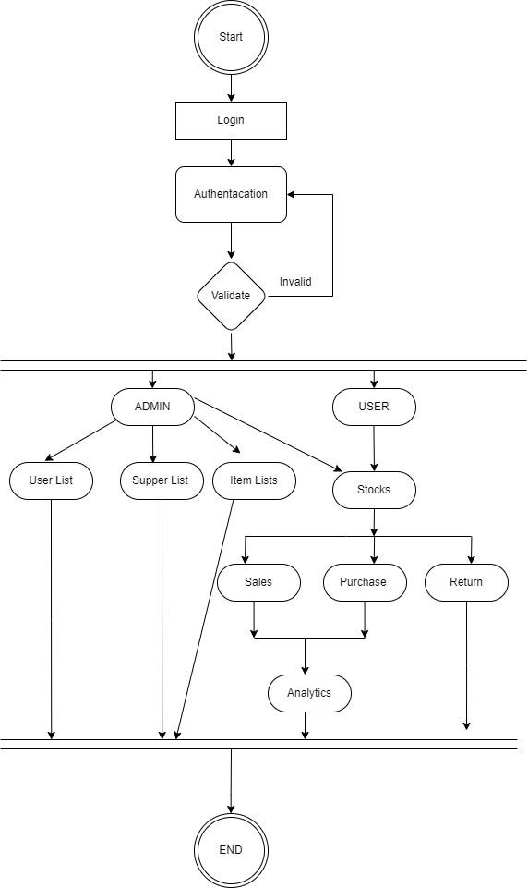
Project analysis slide 4
Process Modelling using Activity Diagram
Fig 6: Activity Diagram

Slide 20
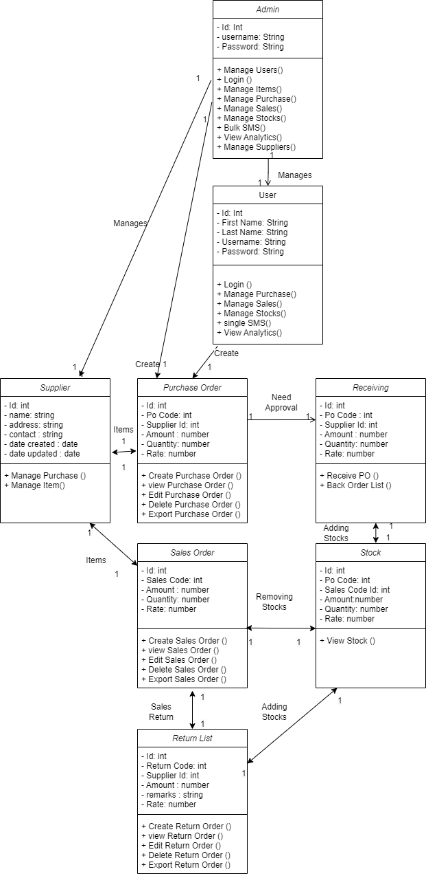
Project analysis slide 4
Refinement of classes and object
Fig 7: Refinement of Classes and Object Diagram

Slide 21
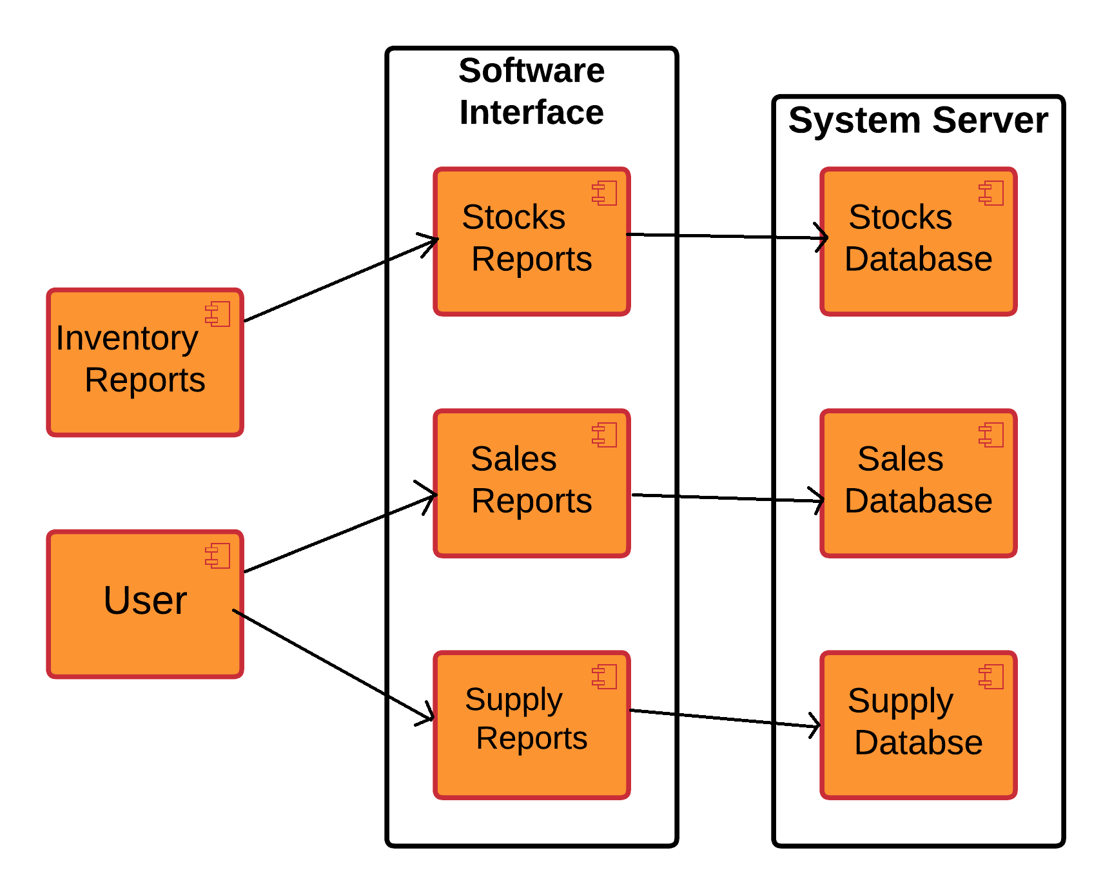
Project analysis slide 4
Component Diagram
Fig 8: Component Diagram

Slide 22
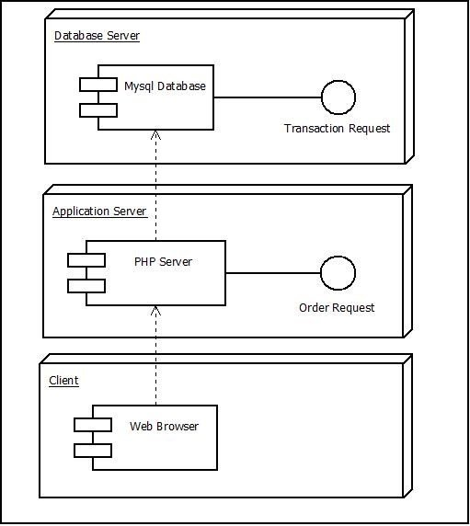
Project analysis slide 4
Deployment Diagram
Fig 9: Deployment Diagram

Slide 23
Project analysis slide 2
Algorithms
Rule Based Algorithm for Top Seller Page
The algorithm is designed to compare sales performance for clients in the current year with their historical all-time performance and generate specific recommendations.
Rule 1: It calculates the difference between the highest and lowest sales for this year. The rule suggests that the client with the lowest sales can improve by a certain amount to catch up to the client with the highest sales this year.
Rule 2: This rule is similar to Rule 1 but focuses on all-time sales. It compares the client with the lowest total sales to the one with the highest total sales and recommends how much the lower-performing client needs to increase their sales to catch up.
Rule 3: The algorithm also identifies the client with the highest growth potential based on the percentage growth of sales from the all-time total to the current year's sales. This rule highlights which client has shown the most promising increase in sales performance this year.

Slide 24
Project analysis slide 2
Algorithms
ABC Algorithm for Stock Analytics Page
This method divides inventory into three categories: A, B, and C, according to their value and how frequently they are sold or used.
First, the code collects and merges stock data based on the date, summing up the quantity and calculating the total value (quantity multiplied by price) for each date. Once the stock data is merged, the total value of all stock items is calculated.
Each stock item is then assigned to Category A, B, or C based on its contribution to the total value:
Items contributing more than 70% are placed in Category A.
Items contributing between 20% and 70% are placed in Category B.
Items contributing less than 20% are placed in Category C.

Slide 25
Project analysis slide 2
Algorithms
Safety Stock Check Algorithm for Quantity Flow Page
The stock safety check algorithm works by analyzing historical stock and purchase data to determine the optimal level of safety stock, which helps ensure that a business maintains sufficient inventory to meet demand despite fluctuations.
First, stock and purchase quantities are retrieved from the database. Then, the average demand is calculated by taking the total stock quantities over time and dividing by the number of data points. To account for demand variability, the algorithm computes the standard deviation, which measures how much stock levels fluctuate from the average.
Using a desired service level (in this case, 95%, which corresponds to a Z-score of 1.64), the safety stock is determined by multiplying the standard deviation by the Z-score. This provides an extra buffer of stock to cover unpredictable demand surges.

Slide 26
Project analysis slide 4
Implementation Details of Modules
• Header: It displays the header with the logo of the Stock management system website, or the login. It is used in the navbar of the homepage. It is used in order to provide links to different pages of the website.
• Login Form: It is used in order to provide the user the gateway to the website. It uses the data like username and password from register form to authenticate the user and give further access.
• Home Page: This would serve as the main page of the application. It would display an overview of the system, including key performance indicators, such as inventory levels, sales, and purchases.
• Purchase Order Page: This page would allow users to create purchase orders for products. It would include a form for entering details about the purchase, such as the supplier, the products being ordered, and the quantity.
• Back Order Page: This page would allow users to create back orders for products that are out of stock. It would include a form for entering details about the back order, such as the supplier, the products being ordered, and the quantity.
• Return Order Page: This page would allow users to initiate return orders for products that are defective or not as described. It would include a form for entering details about the return, such as the product being returned and the reason for the return.
• Receive Order Page: This page would allow users to receive and record deliveries of products from suppliers. It would include a form for entering details about the delivery, such as the supplier, the products received, and the quantity.

Slide 27
Project analysis slide 4
Implementation Details of Modules
• Sales Order Page: This page would allow users to create sales orders for products. It would include a form for entering details about the sale, such as the customer, the products being sold, and the quantity.
• Supplier Page: This page would allow users to manage supplier information, such as adding new suppliers, updating supplier details, and deleting suppliers.
• Analytics Page: This page would allow users to view analytics and reports about the system, such as sales trends, inventory levels, and supplier performance

Slide 28
Project analysis slide 4
Testing
Testing is done to check the behaviour of a complete and fully integrated software product based on the software requirement specification document. For the application or website to be deployed it has to be tested.
1. Login Page:
• Verify that valid credentials allow the user to log in.
• Verify that invalid credentials result in an error message.
2. Home Page:
• Verify that all the links and buttons on the home page work as expected.
• Verify that the navigation menu is correctly displayed and functional.
3. Purchase Order Page:
• Verify that the page allows the user to create a new purchase order.
• Verify that the user can add products to the purchase order.
• Verify that the purchase order is saved correctly in the database.
• Verify that the user can edit and delete the purchase order.
4. Back Order Page:
• Verify that the page allows the user to create a new back order.
• Verify that the user can add products to the back order.
• Verify that the back order is saved correctly in the database.
• Verify that the user can edit and delete the back order.

Slide 29
Project analysis slide 4
Testing
5. Return Order Page:
• Verify that the page allows the user to create a new return order.
• Verify that the user can add products to the return order.
• Verify that the return order is saved correctly in the database.
• Verify that the user can edit and delete the return order.
6. Receive Order Page:
• Verify that the page allows the user to receive products from a purchase order.
• Verify that the user can update the inventory levels.
• Verify that the received products are saved correctly in the database.
7. Sales Order Page:
• Verify that the page allows the user to create a new sales order.
• Verify that the user can add products to the sales order.
• Verify that the sales order is saved correctly in the database.
• Verify that the user can edit and delete the sales order.
8. Supplier Page:
• Verify that the page displays a list of all the suppliers.
• Verify that the user can add, edit, and delete suppliers.
• Verify that the supplier details are saved correctly in the database.

Slide 30
Project analysis slide 4
Testing
9. Analytics Page:
• Verify that the page displays the relevant data in a meaningful way.
• Verify that the graphs and charts are accurate and up-to-date.
• Verify that the user can filter and sort the data as needed.

Slide 31
Project analysis slide 4
Unit Testing
S.No | Test Case Description | Test Data | Expected Result | Actual Result | Pass/Fail
1 | Verify that the login page loads correctly | N/A | Login page is displayed | Login page is displayed | Pass
2 | Verify that valid credentials allow the user to log in | Username:admin, Password: admin123 | User is logged in | User is logged in | Pass
3 | Verify that invalid credentials result in an error message | Username: invaliduser, Password: invalidpassword | Error message is displayed | Error message is displayed | Pass
4 | Verify that the purchase order page loads correctly | N/A | Purchase order page is displayed | Purchase order page is displayed | Pass
5 | Verify that the user can add products to the purchase order | Product: Widget, Quantity: 10 | Product is added to the purchase order | Product is added to the purchase order | Pass
6 | Verify that the purchase order is saved correctly in the database | Purchase order details | Purchase order is saved in the database | Purchase order is saved in the database | Pass
Register page test case
Fig: Register page test case

Slide 32
Project analysis slide 4
Unit Testing
S.No | Test Case Description | Test Data | Expected Result | Actual Result | Pass/Fail
7 | Verify that the user can edit and delete the purchase order | Purchase order ID: 123, New quantity: 20 | Purchase order is updated in the database | Purchase order is updated in the database | Pass
8 | Verify that the supplier page loads correctly | N/A | Supplier page is displayed | Supplier page is displayed | Pass
9 | Verify that the user can add suppliers | Supplier details | Supplier is added to the database | Supplier is added to the database | Pass
10 | Verify that the user can edit and delete suppliers | Supplier ID: 456, New address: Kathmandu` | Supplier details are updated in the database | Supplier details are updated in the database | Pass
Register page test case
Fig: Register page test case

Slide 33
Project analysis slide 4
System Testing
S.No | Test Case Description | Test Data | Expected Result | Actual Result | Pass/Fail
1 | Verify that valid credentials allow the user to log in | Username: testuser, Password: testpassword | User is logged in | User is logged in | Pass
2 | Verify that invalid credentials result in an error message | Username: invaliduser, Password: invalidpassword | Error message is displayed | Error message is displayed | Pass
3 | Verify that all the links and buttons on the home page work as expected | N/A | Links and buttons work as expected | Links and buttons work as expected | Pass
4 | Verify that the navigation menu is correctly displayed and functional | N/A | Navigation menu is displayed and functional | Navigation menu is displayed and functional | Pass
5 | Verify that the purchase order page allows the user to create a new purchase order | Supplier: ABC Company, Product: Item2, Quantity: 10 | Purchase order is created | Purchase order is created | Pass
6 | Verify that the back order page allows the user to create a new back order | Supplier: XYZ Company, Product:Itme1, Quantity: 5 | Back order is created | Back order is created | Pass
7 | Verify that the return order page allows the user to create a new return order | Customer: Milan Karki, Product: Defective Widget, Quantity: 1 | Return order is created | Return order is created | Pass
Register page test case
Fig: Register page test case

Slide 34
Project analysis slide 4
Conclusion
After the successful completion of Stock Management System that incorporates all the necessary functionalities for efficient stock management.
The current application has fulfilled all the objectives.
We followed the specifications strictly but enhanced some of the features when there was need it to be done.
There have been challenges especially when it came to backend and making sure that the application responses in a predictable manner.
Choosing PHP for this project is because it is very simple and easy to use, it could handle a lot of data and easily manipulation compared to another scripting language, this is widely used all over the world. it is Open source; we can freely download and use. And it is platform independent as well.

Slide 35
Project analysis slide 4
Outcome
When this project is completed, we developed Stock Management System with Proper Functionality, Validation and verification.
In this System the Admin and Users will be able to login in the system, Create Purchase Order, Approve Orders, If the Orders are Partially approved then the not Approved order will be Displayed in Backorder, and will also be able to Create Return List then list will be added to the remaining stocks, and the Admin and Users will also be able to create Sales list and will be able to See the Remaining Stocks.
The System will also generate the bill in printable format, PDF format and Excel format. Admin will only have the privileges to create and add Suppliers and Items in the system.
The User and Admin will Both Be able to see the Analytics Part in the system.
The analytics part will cover the Sales analytics, Purchase analytics, Top seller, Stocks Quantity analytics, and Quantity Flow in the system..

Slide 36
Project analysis slide 4
Future Recommendation
Here is what can be added in the future on this website to increase its usability, user experience and portability of the website. There is a lot to be done hence this application can be considered as a starting point for something big to come
• Integration with barcode scanners.
• Integration with automated re-ordering systems.
• Advanced analytics and reporting.
• Integration with others platforms.
• Mobile app

Slide 37
Project analysis slide 4
Reference
[1]techtarget.com,“techtarget.com,”.[Online].Available:https://www.techtarget.com/searchcio/definition/stock. [Accessed 1 5 2024].
[2]investopedia.com, "Stock Management System," [Online]. Available: https://www.investopedia.com/terms/s/stock-management-system.asp. [Accessed 5 5 2024].
[3] netsuite.com, "Inventory Management," [Online]. Available: https://www.netsuite.com/portal/resource/articles/inventory-management.shtml. [Accessed 5 5 2024].
[4] zoho.com, "Inventory Management System," [Online]. Available: https://www.zoho.com/inventory/. [Accessed 5 5 2024].
[5] oracle.com, "Inventory Management Solutions," [Online]. Available: https://www.oracle.com/applications/inventory-management.html. [Accessed 5 5 2024].
[6]researchgate.net.”researchgate.net”,[Online].Available:https://www.researchgate.net/publication.[Accessed 3 5 2024].
[7] Ramesh singh saudh , System Analysis and Design, Ktm: KEC Publication, 2020(Revised).
[8] Ramesh singh saudh , Software Engineering, Ktm: KEC Publication, 2020(Revised).
[9] Alexandre de Castro Moura and Alessandra Angelucci, "A System for Stock Management of Clothing Retail Companies," Procedia Manufacturing, vol. 39, pp. 545-554, 2019.
[10] G. H. Hashmi, M. H. Jamil, and A. I. Sheikh, "Development of an Automated Inventory Management System using RFID," International Journal of Advanced Computer Science and Applications, vol. 8, no. 5, pp. 322-327, 2017.
.

Slide 38
Project analysis slide 4
Reference
[11] Imran Khan, "Development of an Inventory Management System for Small Business," International Journal of Computer Applications, vol. 180, no. 36, pp. 34-40, 2018.
[12] Alexandre de Castro Moura and Alessandra Angelucci, "An Analysis of the Use of Barcodes and RFID in Stock Management of a Clothing Retail Company," Journal of the Brazilian Society of Mechanical Sciences and Engineering, vol. 41, no. 11, pp. 1-12, 2019.
[13] J. A. N. Martins and J. M. F. Calado, "A Framework for Stock Management in Small and Medium-sized Enterprises," International Journal of Production Economics, vol. 132, no. 2, pp. 294-305, 2011.
[14] S. Chopra and P. Meindl, "Supply Chain Management: Strategy, Planning, and Operation," Pearson, 2019.
[15] R. G. Frazelle, "Supply Chain Strategy: The Logistics of Supply Chain Management," McGraw-Hill, 2002.
[16] K. Lysons and M. Farrington, "Procurement and Supply Chain Management," 9th ed., Pearson, 2016.
[17] L. A. Zadeh, "Fuzzy Sets and Stock Management," Journal of Operations Research, vol. 53, no. 3, pp. 456-472, 2010.
[18] G. Cachon and C. Terwiesch, "Matching Supply with Demand: An Introduction to Operations Management," McGraw-Hill, 2008.
.

Slide 39
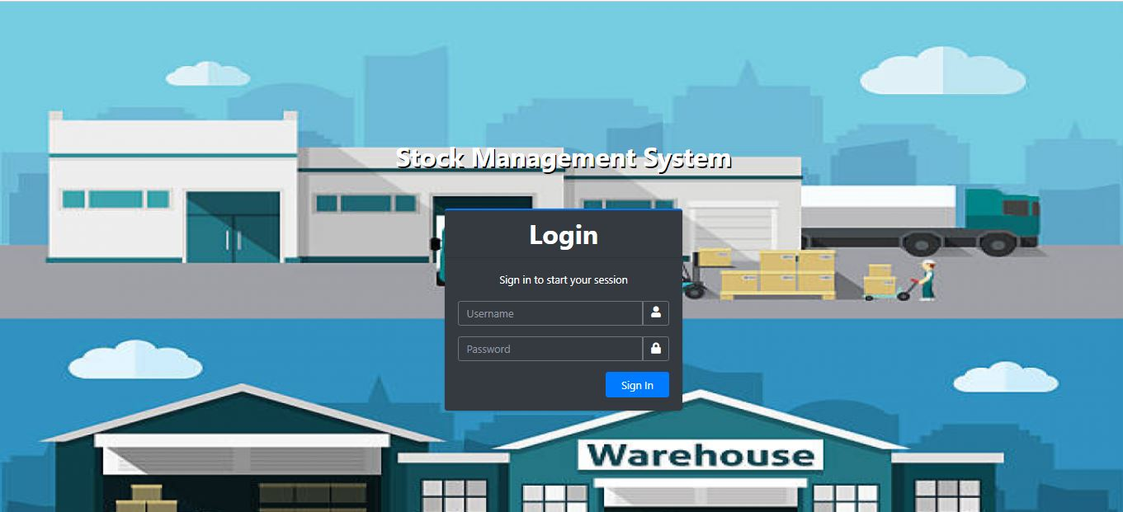
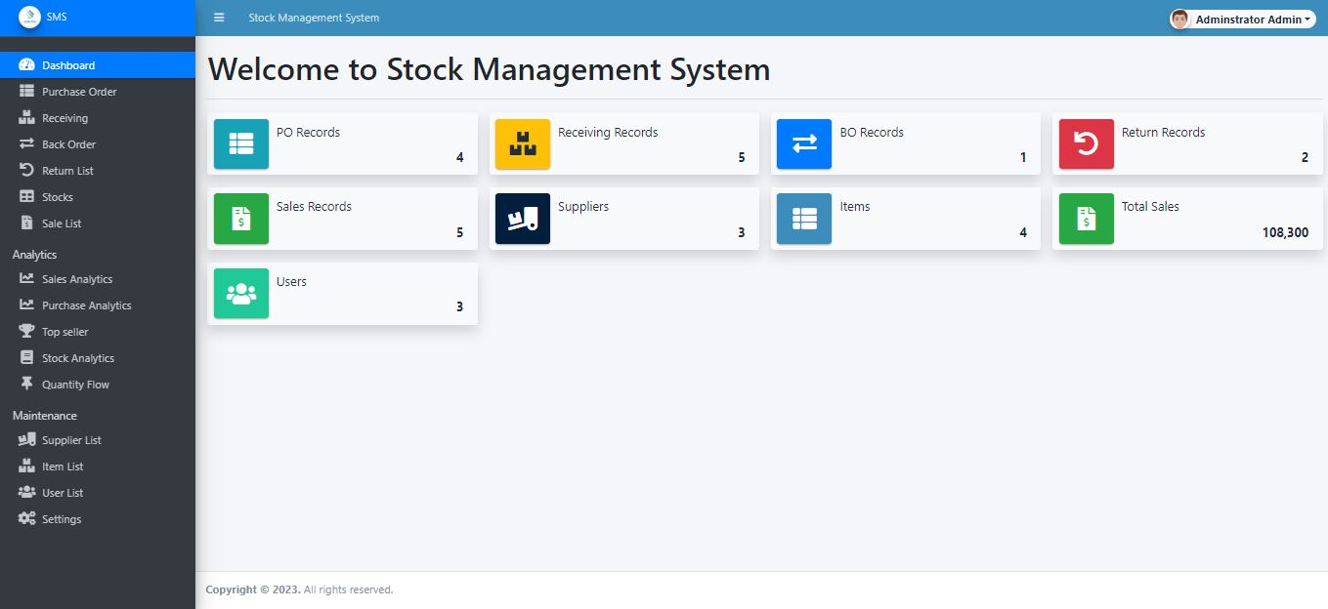
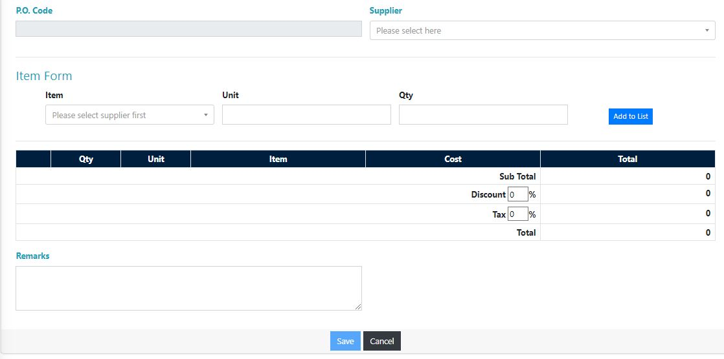
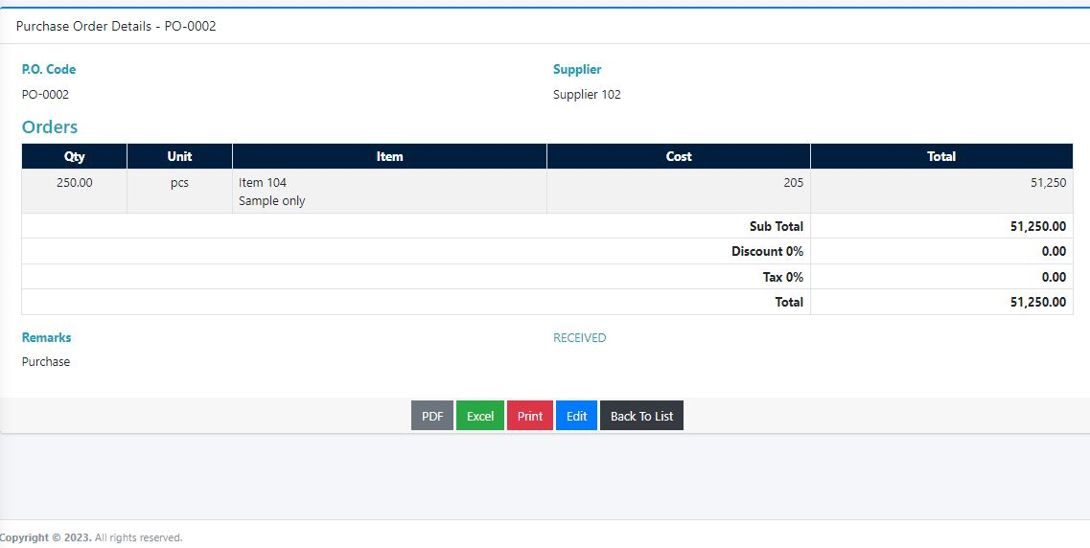
Project analysis slide 4
APPENDICES

Slide 40
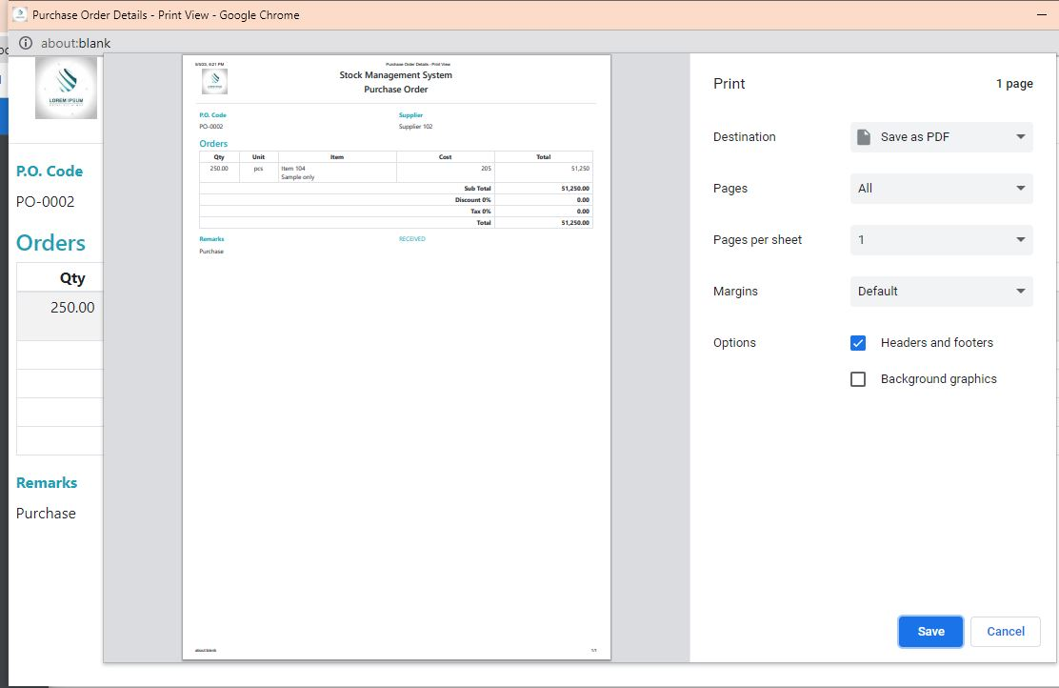
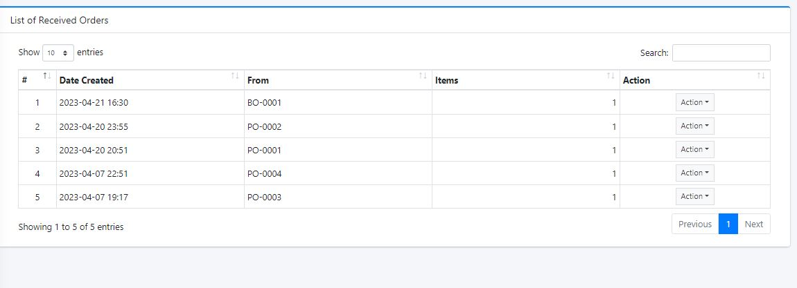
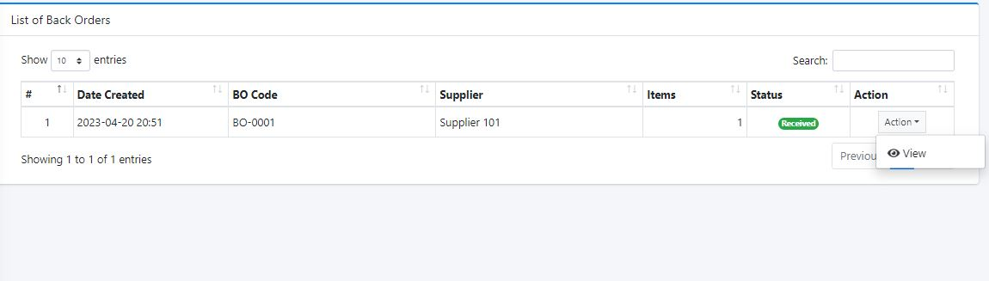
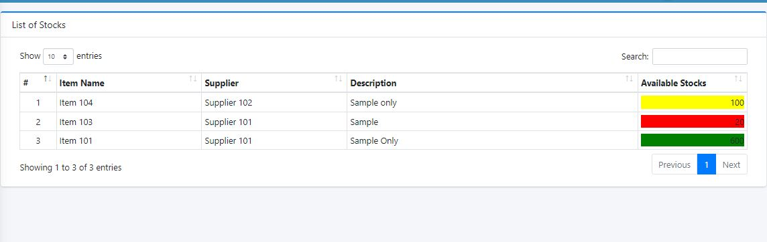
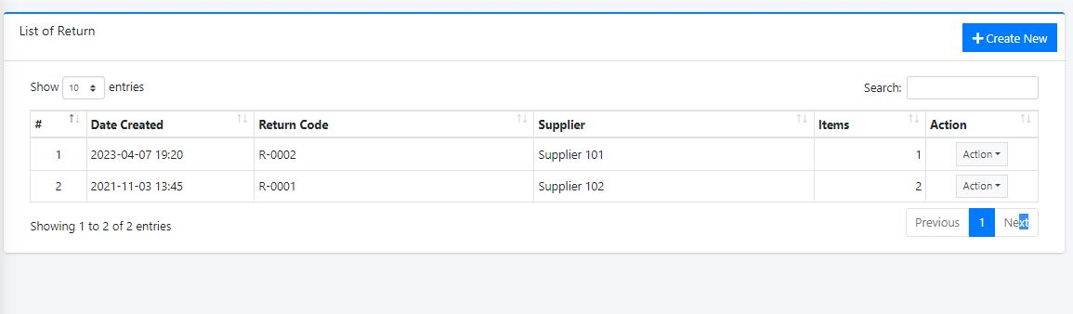
Project analysis slide 4
APPENDICES

Slide 41
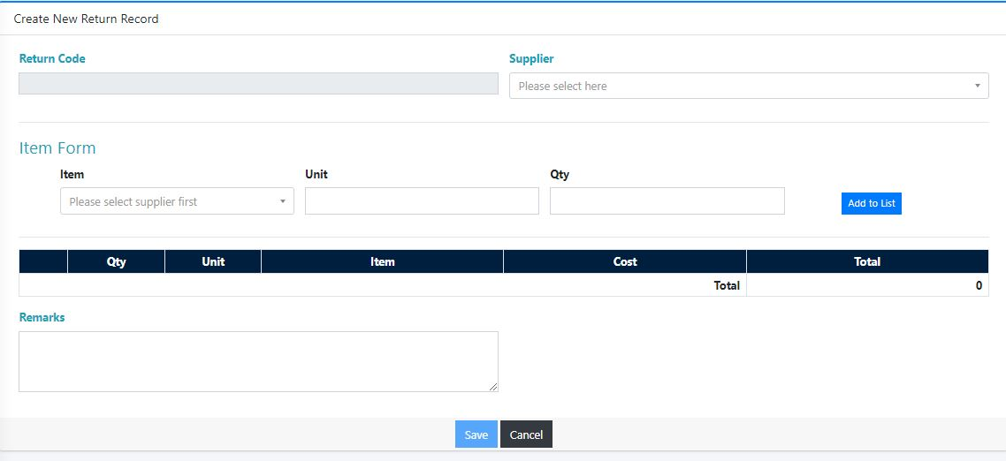
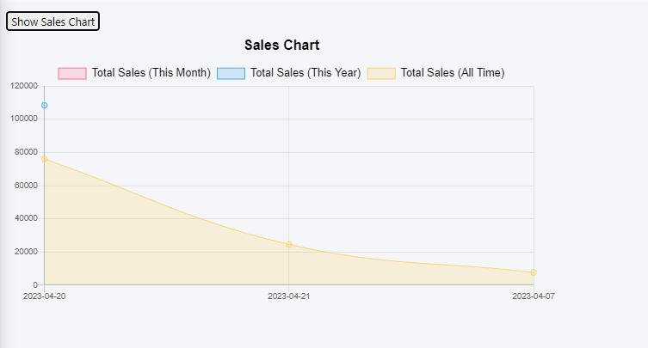
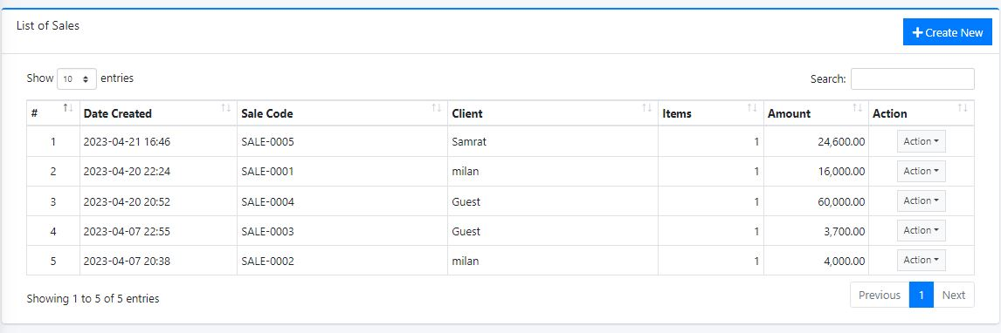
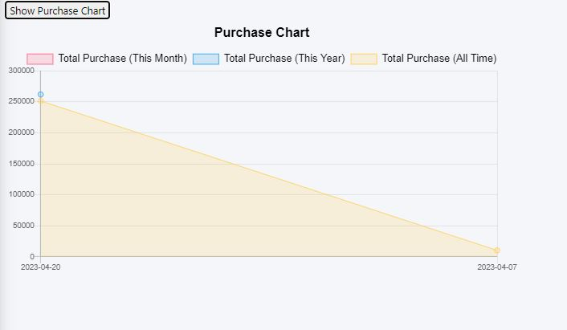
Project analysis slide 4
APPENDICES

Slide 42
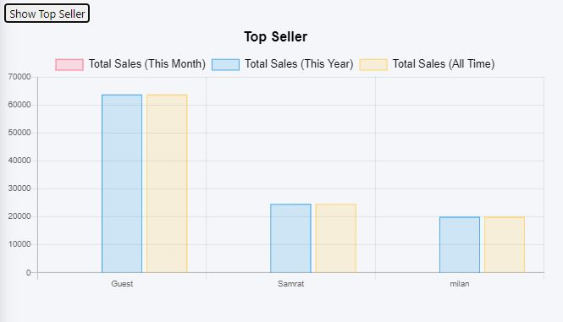
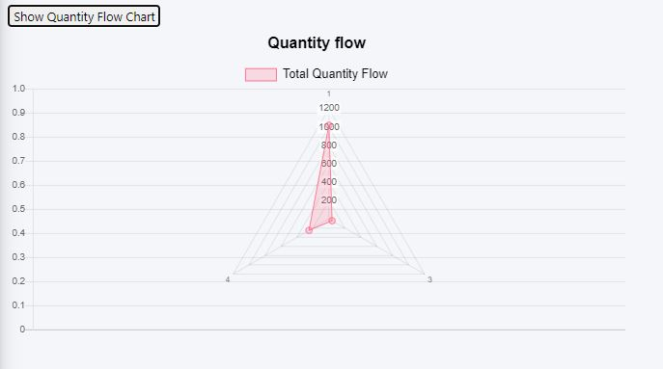
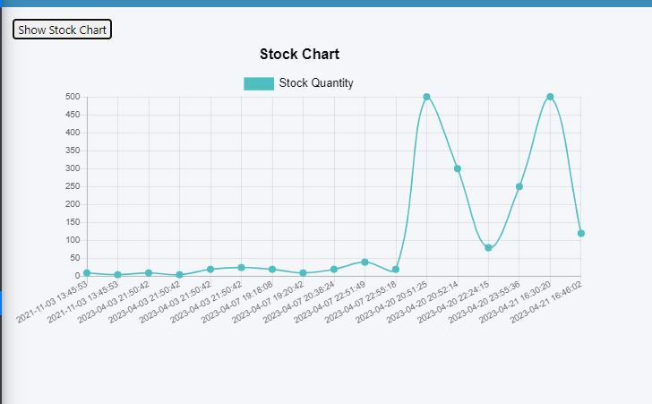
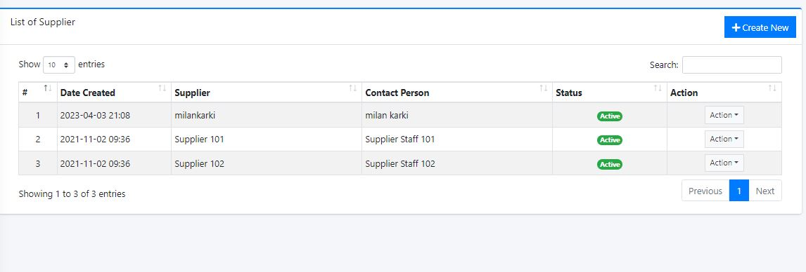
Project analysis slide 4
APPENDICES

Slide 43
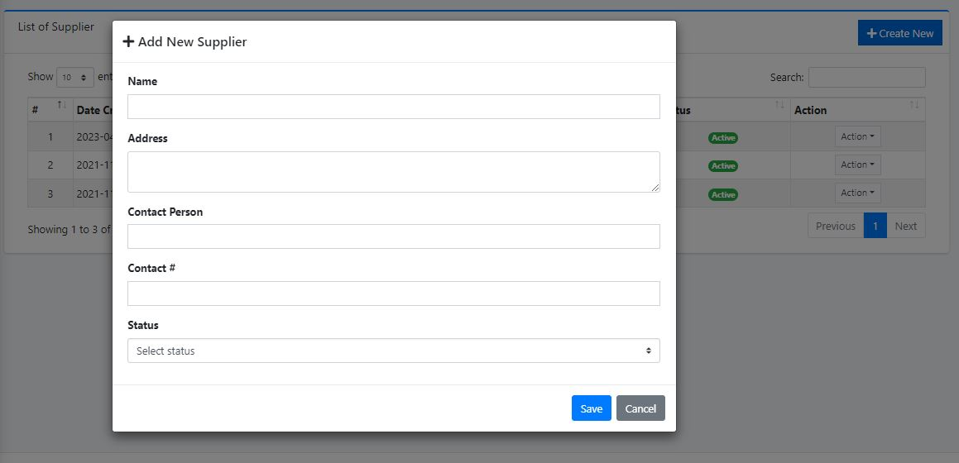
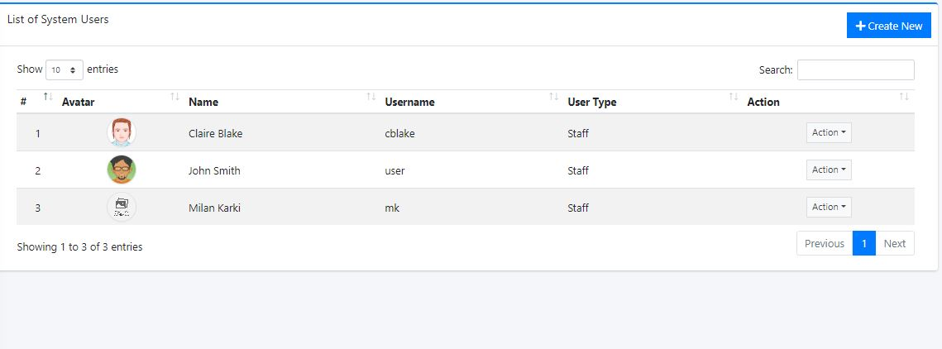
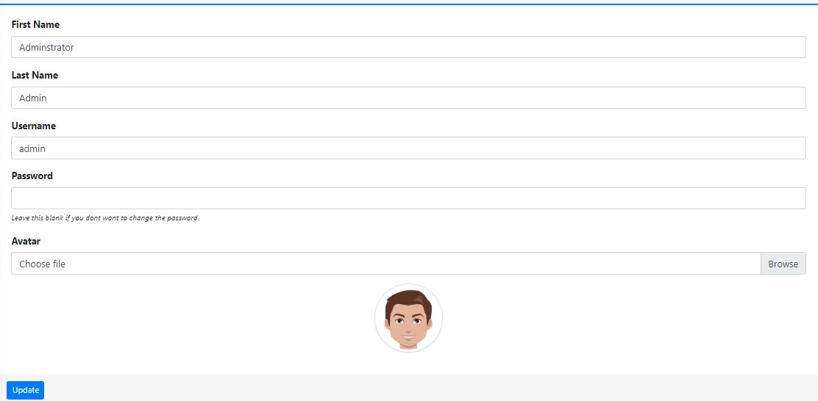
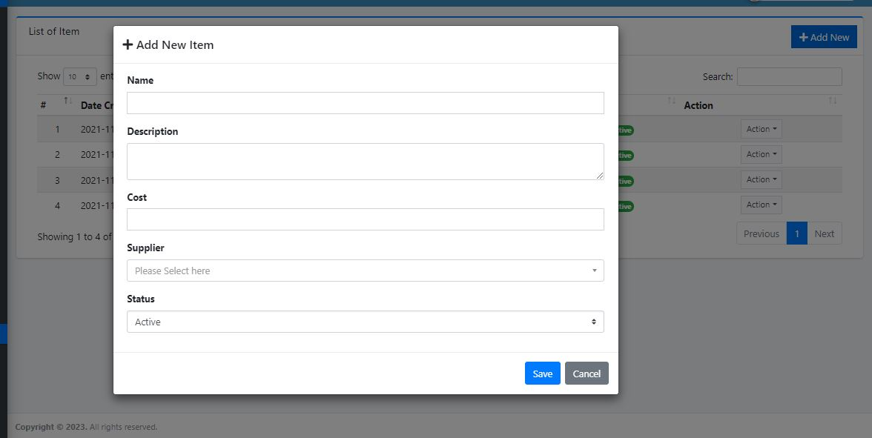
Project analysis slide 4
APPENDICES

Slide 44

Project analysis slide 4
Any Question?

Slide 45
Thank You

