Slide 1
Unit 1: Introduction of C# and the .NET Framework
Sudan Pudasaini

Slide 2
Introduction
C# is a general-purpose, type-safe, object-oriented programming language.
The goal of the language is programmer productivity.
The chief architect of the language since its first version is Anders Hejlsberg (creator of Turbo Pascal and architect of Delphi).
The C# language is platform-neutral and works with a range of platform-specific compilers and frameworks, most notably the Microsoft .NET Framework for Windows
To this end, C# balances simplicity, expressiveness, and performance.

Slide 3
Object Orientation
C# is a rich implementation of the object-orientation paradigm
Encapsulation, inheritance, and polymorphism
Encapsulation means creating a boundary around an object, to separate its external (public) behavior from its internal (private) implementation details.
The distinctive features of C# from an object-oriented perspective are:
Unified type system
Classes and interfaces
Properties, methods, and events

Slide 4
Unified type system
The fundamental building block in C# is an encapsulated unit of data and functions called a type.
C# has a unified type system, where all types ultimately share a common base type.
This means that all types, whether they represent business objects or are primitive types such as numbers, share the same basic functionality.
For example, an instance of any type can be converted to a string by calling its ToString method.

Slide 5
Classes and interfaces
In a traditional object-oriented paradigm, the only kind of type is a class.
In C#, there are several other kinds of types, one of which is an interface.
An interface is like a class, except that it only describes members. The implementation for those members comes from types that implement the interface.
Interfaces are particularly useful in scenarios where multiple inheritance is required (unlike languages such as C++ and Eiffel, C# does not support multiple inheritance of classes).

Slide 6
Properties, methods, and events
In the pure object-oriented paradigm, all functions are methods (this is the case in Smalltalk).
In C#, methods are only one kind of function member, which also includes properties and events (there are others, too).
Properties are function members that encapsulate a piece of an object’s state, such as a button’s color or a label’s text.
Events are function members that simplify acting on object state changes.

Slide 7
While C# is primarily an object-oriented language, it also borrows from the functional programming paradigm. Specifically:
Functions can be treated as values
Through the use of delegates, C# allows functions to be passed as values to and from other functions.
C# supports patterns for purity
Core to functional programming is avoiding the use of variables whose values change, in favor of declarative patterns. C# has key features to help with those patterns, including the ability to write unnamed functions on the fly that “capture” variables (lambda expressions), and the ability to perform list or reactive programming via query expressions. C# also makes it easy to define read-only fields and properties for writing immutable (read-only) types.

Slide 8
Type Safety
C# is primarily a type-safe language, meaning that instances of types can interact only through protocols they define, thereby ensuring each type’s internal consistency. For instance, C# prevents you from interacting with a string type as though it were an integer type.
More specifically, C# supports static typing, meaning that the language enforces type safety at compile time. This is in addition to type safety being enforced at runtime.
Static typing eliminates a large class of errors before a program is even run. It shifts the burden away from runtime unit tests onto the compiler to verify that all the types in a program fit together correctly. This makes large programs much easier to manage, more predictable, and more robust. Furthermore, static typing allows tools such as IntelliSense in Visual Studio to help you write a program, since it knows for a given variable what type it is, and hence what methods you can call on that variable.

Slide 9
NOTE
C# also allows parts of your code to be dynamically typed via the dynamic keyword. However, C# remains a predominantly statically typed language.
C# is also called a strongly typed language because its type rules (whether enforced statically or at runtime) are very strict. For instance, you cannot call a function that’s designed to accept an integer with a floating-point number, unless you first explicitly convert the floating-point number to an integer. This helps prevent mistakes.
Strong typing also plays a role in enabling C# code to run in a sandbox—an environment where every aspect of security is controlled by the host. In a sandbox, it is important that you cannot arbitrarily corrupt the state of an object by bypassing its type rules.

Slide 10
Memory Management
C# relies on the runtime to perform automatic memory management. The Common Language Runtime has a garbage collector that executes as part of your program, reclaiming memory for objects that are no longer referenced. This frees programmers from explicitly deallocating the memory for an object, eliminating the problem of incorrect pointers encountered in languages such as C++.
C# does not eliminate pointers: it merely makes them unnecessary for most programming tasks. For performance-critical hotspots and interoperability, pointers and explicit memory allocation is permitted in blocks that are marked unsafe.

Slide 11
Platform Support
C# has runtimes that support the following platforms:
Windows Desktop 7-11 (for rich-client, web, server, and command-line applications)
macOS (for rich-client, web, and command-line applications)
Linux and macOS (for web and command-line applications)
Android and iOS (for mobile applications)
Windows 10 devices (Xbox, Surface Hub, and HoloLens)
There is also a technology called Blazor that can compile C# to web assembly that runs in a browser.

Slide 12
CLRs, BCLs, and Runtimes
Runtime support for C# programs consists of a Common Language Runtime and a Base Class Library.
A runtime can also include a higher-level application layer that contains libraries for developing rich-client, mobile, or web applications (see Figure 1-1).
Different runtimes exist to allow for different kinds of applications, as well as different platforms.

Slide 13
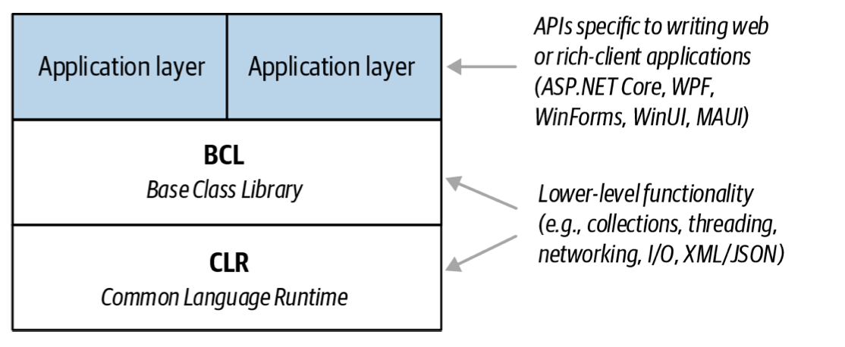
CLRs, BCLs, and Runtimes

Slide 14
the CLR
A Common Language Runtime (CLR) provides essential runtime services such as automatic memory management and exception handling. (The word “common” refers to the fact that the same runtime can be shared by other managed program‐ ming languages, such as F#, Visual Basic, and Managed C++.)
C# is called a managed language because it compiles source code into managed code, which is represented in Intermediate Language (IL). The CLR converts the IL into the native code of the machine, such as X64 or X86, usually just prior to execution. This is referred to as Just-in-Time (JIT) compilation. Ahead-of-time compilation is also available to improve startup time with large assemblies or resource-constrained devices (and to satisfy iOS app store rules when developing mobile apps).
The container for managed code is called an assembly. An assembly contains not only IL but also type information (metadata). The presence of metadata allows assemblies to reference types in other assemblies without needing additional files.

Slide 15
the CLR
The container for managed code is called an assembly. An assembly contains not only IL but also type information (metadata). The presence of metadata allows assemblies to reference types in other assemblies without needing additional files.
You can examine and disassemble the contents of an assembly with Microsoft’s ildasm tool. And with tools such as ILSpy or JetBrain’s dotPeek, you can go further and decompile the IL to C#. Because IL is higher level than native machine code, the decompiler can do quite a good job of reconstructing the original C#.
A program can query its own metadata (reflection) and even generate new IL at runtime (reflection.emit).

Slide 16
Base Class Library
A CLR always ships with a set of assemblies called a Base Class Library (BCL). A BCL provides core functionality to programmers, such as collections, input/out‐ put, text processing, XML/JSON handling, networking, encryption, interop, con‐ currency, and parallel programming.
A BCL also implements types that the C# language itself requires (for features such as enumeration, querying, and asynchrony) and lets you explicitly access features of the CLR, such as reflection and memory management.

Slide 17
Runtimes
A runtime (also called a framework) is a deployable unit that you download and install. A runtime consists of a CLR (with its BCL), plus an optional application layer specific to the kind of application that you’re writing—web, mobile, rich client, etc. (If you’re writing a command-line console application or a non-UI library, you don’t need an application layer.)
When writing an application, you target a particular runtime, which means that your application uses and depends on the functionality that the runtime provides.
Your choice of runtime also determines which platforms your application will support.

Slide 18
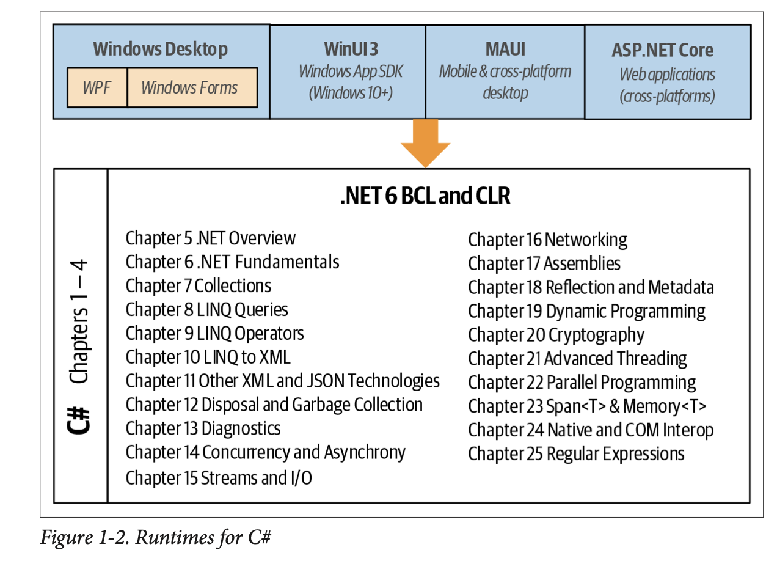

Slide 19
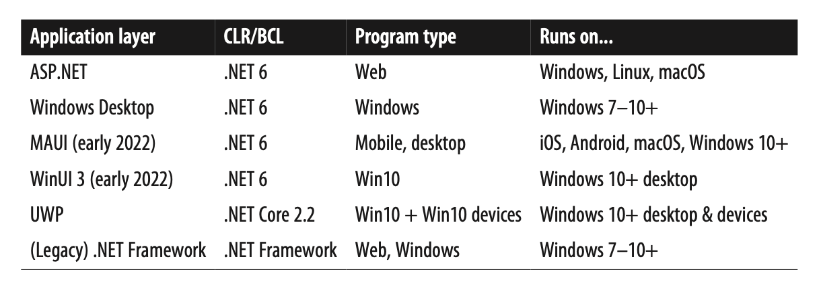
Other Frameworks

Slide 20
Niche Runtimes
There are also the following niche runtimes:
The .NET Micro Framework is for running .NET code on highly resource- constrained embedded devices (under one megabyte).
Unity is a game development platform that allows game logic to be scripted with C#.
It’s also possible to run managed code within SQL Server. With SQL Server CLR integration, you can write custom functions, stored procedures, and aggregations in C# and then call them from SQL. This works in conjunction with .NET Framework and a special “hosted” CLR that enforces a sandbox to protect the integrity of the SQL Server process.

Slide 21
A Brief History of C#
C#10
C#9
…….
C#2
The big new features in C# 2 were generics (Chapter 3), nullable value types (Chap‐ ter 4), iterators (Chapter 4), and anonymous methods (the predecessor to lambda expressions). These features paved the way for the introduction of LINQ in C# 3.
C# 2 also added support for partial classes and static classes, and a host of minor and miscellaneous features such as the namespace alias qualifier, friend assemblies, and fixed-size buffers.
The introduction of generics required a new CLR (CLR 2.0), because generics maintain full type fidelity at runtime.

Slide 22
THANK YOU

