Slide 1

IoT Software Foundation for Hackwil
The Mean Squares – PolyHACK 2020
ASUS Robotics & AI Center Challenge

Slide 2
Our mission
We, The Mean Squares, are representatives of the company Polycraft.
Our goal is to provide the software to automate IoT devices throughout Hackwil.
To proof our technical competence we have build an MVP with various types of sensors and actuators communicating via a server that act in a simulated environment.

Slide 3




System Overview Fat server with thin clients implemented using Flask
Environment
Send status update
Read data
IoT Sensors
(client)
Send measured data
API Web Service
(server)
IoT Actuators
(client)
Send status, receive jobs
Check sensor status,
Send actuator jobs
Rule Engine

Slide 4

API Web Service & Rule engine Fat server containing most of the application‘s logic
Server
Implemented with Flask
Communicates with sensors and actuators
Stores the sensor data and actuator status
Rule engine
Rules can be initialised from a .json file or on the webinterface
The engine knows the existing types of rules
It checks the sensor data and actuator data associated with each rule and decides if a job needs to be done
Sensor data, actuator status
Open jobs

Slide 5

Client-Server Communication Protocols
Client side communication
All clients communication must contain the following fields:
'id': a unique identifier for the device
'ancestors': a list of inheritance of the device in question, in order from youngest to oldest (e.g. ['TemperatureSensor', 'Sensor', 'IOT_Device’])
Clients are Sensor or Actuator.:
A Sensor has a data entry, which contains a dictionary of measured values
An actuator instance has a status entry, containing a dictionary describing the state of the device.
Server side communication
The server receives messages from the client, and stores the received data locally.
Sensor:
The sensor only sends data
Actuator:
If an actuator needs actuating, the server will wait until the next time the actuator contacts the server, and will return the job to do be executed by the actuator.
The response from the server is a list of jobs from the rules engine as a dictonary .
If there is nothing to do, the dictonary is empty. If there is something to do, the dictionary will list what values to change. E.g. if a door should be unlocked, the response will be: {'DoorLocked': False}.

Slide 6
IoT Sensors Sensors are Thin clients that read from the environment and send their data to the server
Implemented sensor types:
Temperature sensor
Humidity sensor
Brightness sensor
Proximity sensor
Noise sensor
Motion sensor
Distance sensor
Airquality sensor
Initialisation:
Each sensor has an ID, a type and a position
The number and type of sensors in Hackwil can by configured in a .json file

Slide 7

IoT Actuators Actuators are thin clients that sent their status to the server and receive jobs to execute
Implemented actuator types:
Smart lamp
Smart door lock
Motor position
Smart heating
Smart sprinkler
Initialisation:
Each actuator has an ID, a type, a position and a status
The number and type of sensors in Hackwil can by configured in a .json file

Slide 8

Simulated Environment
The environment is a class simulating the input data for each sensor
Each sensor can read a feed of random variables that are scaled according to its type
The actuators can influence the environment (e.g. a heater inreases the temperature in its surrounding)
Due to the modular implementation, the environment can easily be replaced by real input data

Slide 9
Try our MVP
Our sourcecode: https://github.com/Karko93/Polyhack2020-Project.git
Run the code according to the readme.md
Go to the webpage http://127.0.0.1:5000/ to see the simulations of Hackwil

Slide 10

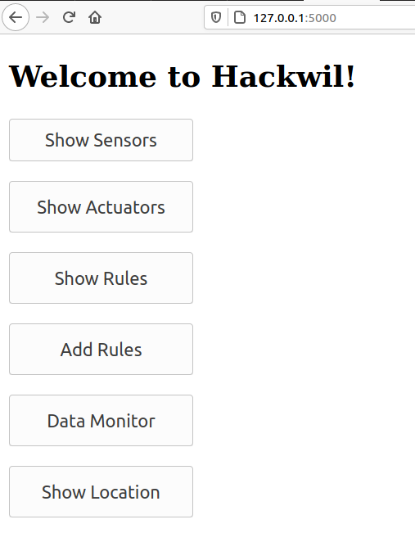
The Webinterface
With our interactive webinterface the state of our IoT system can be monitored.
See all active Sensors, Actuators and Rules
Add new rules on the fly
Plot the data of selected sensors simultaneously
Show the location all IoT devices

Slide 11
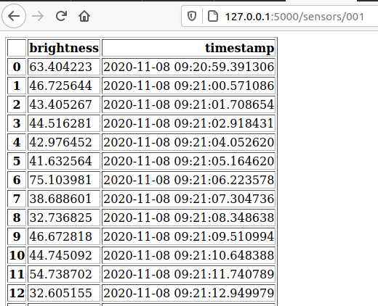
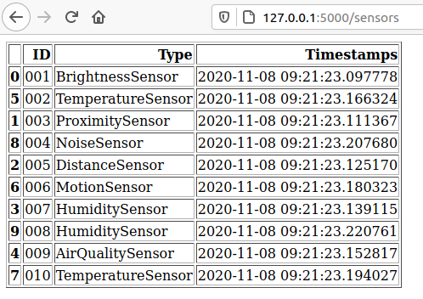
The Sensor
Overview over all connected sensor with last interaction
The measurement data for each sensor given an ID

Slide 12
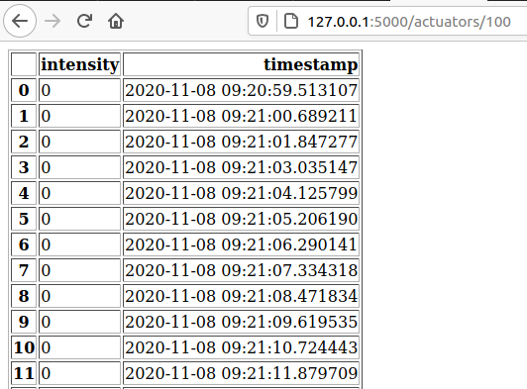
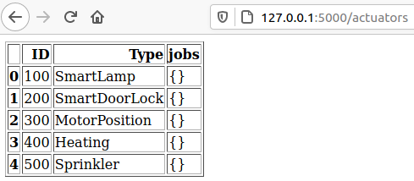
The Actuator
Overview over all connected actuators with assigned jobs
The record of the latest state of each actuator by ID

Slide 13
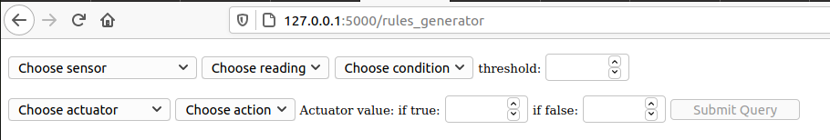
The Rules
Overview over all assigned rules with the relevant actuator and sensor IDs. Furthermore the type of sensor and rule is shown.
Interface to live add rules to the system. All available sensors and actuators can be selected and a variety of conditions can be applied.

Slide 14
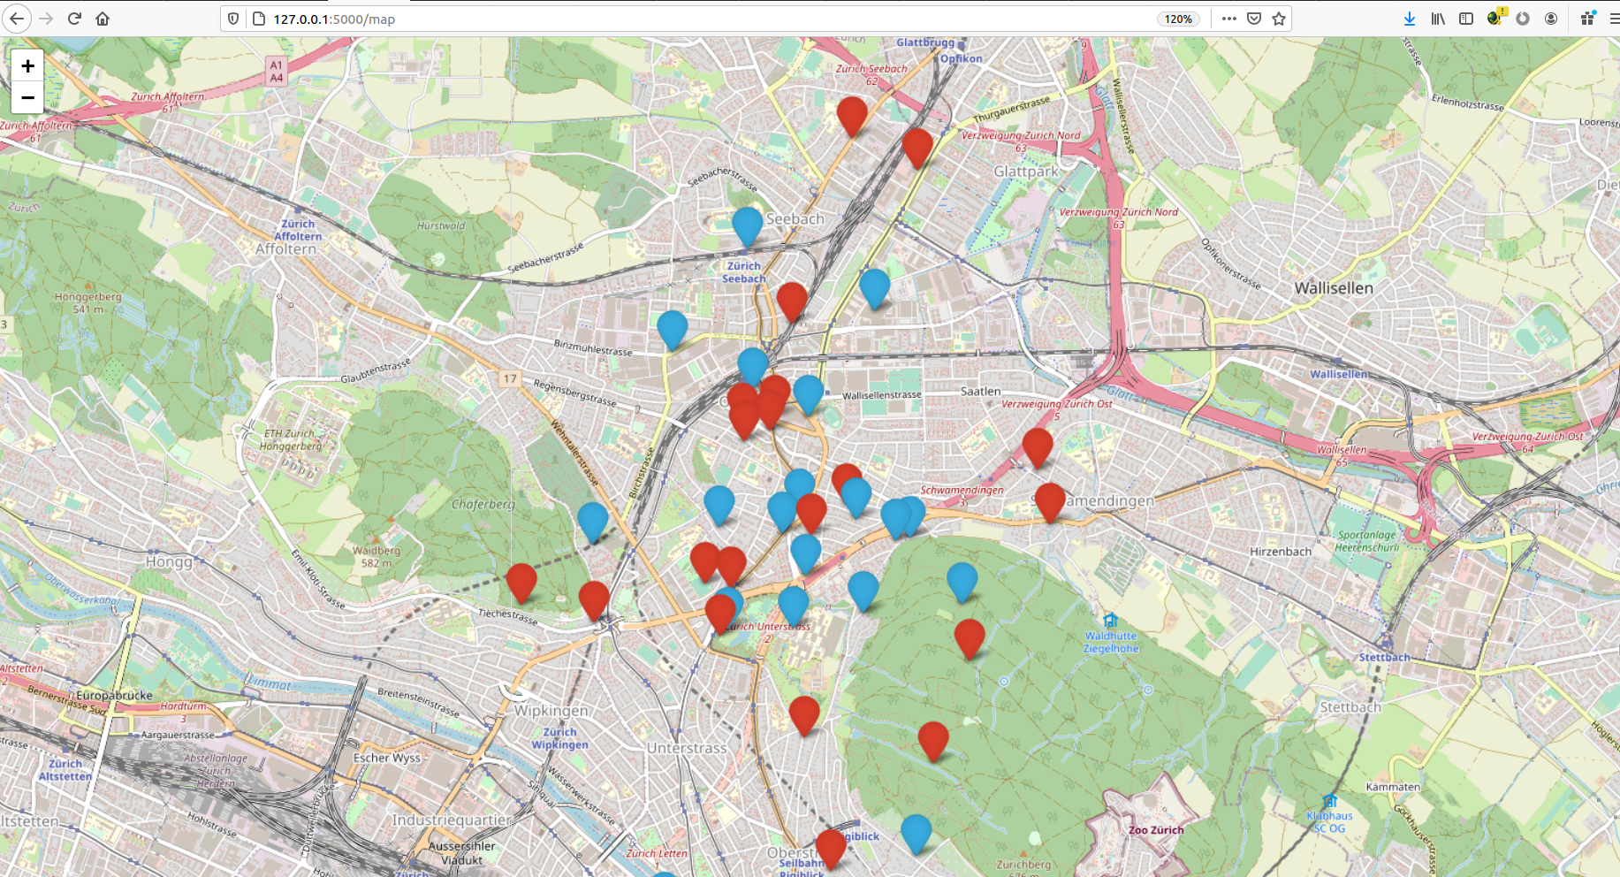
The Location Map

Slide 15
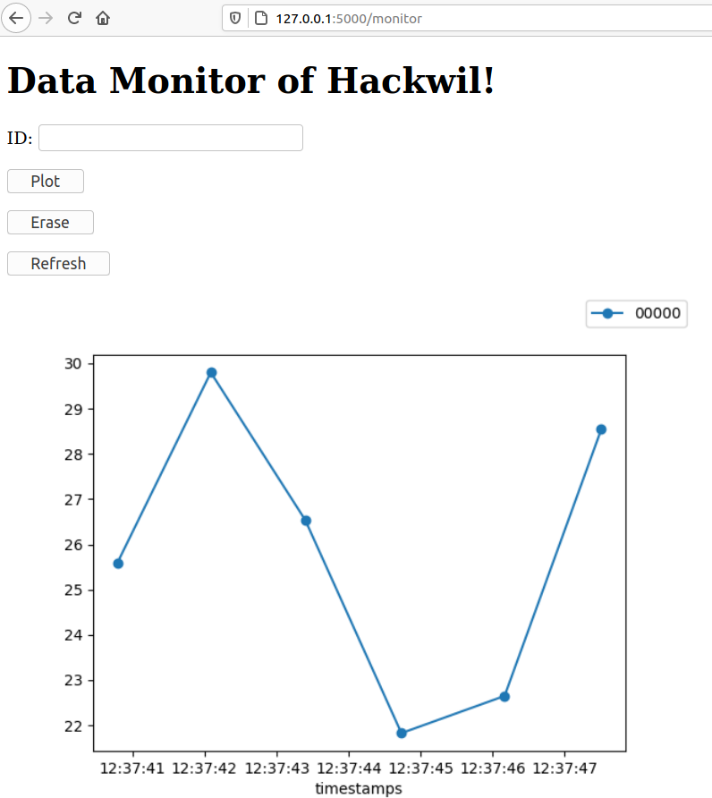
The Data Monitor
Any Sensor can be added to the plot by entering the ID into the prompt.

Slide 16
The Mean Squares
Dominik Windey
Eric Bonvin
Marco Ketzel
Andrei Militaru
Rebecca Westphal
Remark: The software is most intensively tested on Ubuntu.

