Slide 1

5/3/25, 7:42 PM
Social_Media_Sentiment_Analysis
Goal of the Project: Social Media Trend and Sentiment Analysis
The goal is to analyze social media posts to understand trending topics and user sentiments across platforms like Twitter, Instagram, and LinkedIn. Using the
sentimentsdataset.csv file, we will:
Identify popular hashtags to find trending topics.
Perform sentiment analysis on the text to classify emotions. Study trends over time using timestamps.
Analyze user engagement through likes and retweets. Explore how trends vary by platform and country.
This analysis helps businesses gain insights into public interest, market trends, and user behavior.
Importing Libraries
In [279…
# For data manipulation and numerical operation
import pandas as pd import numpy as np import warnings
warnings.filterwarnings("ignore")
# For Data Visulization
import matplotlib.pyplot as plt
import seaborn as sns
#For Text Visualization
from wordcloud import WordCloud
import wordcloud

Slide 2
5/3/25, 7:42 PM
Social_Media_Sentiment_Analysis
# For text processing
import re
import string
from collections import Counter
#Natural language processing
import nltk
from nltk.corpus import stopwords
from nltk.tokenize import word_tokenize
from nltk.stem import WordNetLemmatizer
from nltk.sentiment.vader import SentimentIntensityAnalyzer
#Sentiment Analysis
from textblob import TextBlob
#Date and Time handling
from datetime import datetime
In [280…
nltk.download('punkt')
nltk.download('stopwords') nltk.download('wordnet')
nltk.download('vader_lexicon')
[nltk_data] Downloading package punkt to
[nltk_data] C:\Users\dell\AppData\Roaming\nltk_data... [nltk_data] Package punkt is already up-to-date!
[nltk_data] Downloading package stopwords to
[nltk_data] C:\Users\dell\AppData\Roaming\nltk_data... [nltk_data] Package stopwords is already up-to-date!
[nltk_data] Downloading package wordnet to
[nltk_data] C:\Users\dell\AppData\Roaming\nltk_data... [nltk_data] Package wordnet is already up-to-date!
[nltk_data] Downloading package vader_lexicon to
[nltk_data] C:\Users\dell\AppData\Roaming\nltk_data... [nltk_data] Package vader_lexicon is already up-to-date!
Out[280…
True
Load the Dataset
In [319…
# Load the dataset
df = pd.read_csv('sentimentdataset.csv')
In [320…
# Displaying the first few rows to get an initial look at the data
df.head(200)

Slide 3
5/3/25, 7:42 PM
Social_Media_Sentiment_Analysis
Out[320…
Unnamed: 0.1 | Unnamed: 0 | Text | Sentiment | Timestamp | User | Pl
 |  |  | Enjoying a
0 | 0 | 0 | beautiful day at the | Positive
2023-01-15
12:30:00
User123
park! ...
1
1
Traffic was
1 terrible this morning. ...
Negative
2023-01-15
08:45:00
CommuterX
Just finished an amazing
workout!
💪 ...
2
2
2
Positive
2023-01-15
15:45:00
FitnessFan Ins
Excited about the
3 upcoming weekend
getaway! ...
3
3
Positive
2023-01-15
18:20:00
AdventureX Fa
Trying out a new recipe for dinner tonight. ...
2023-01-15
19:55:00
4
4
4
Neutral
ChefCook Ins
...
...
...
...
...
...
...
Boredom lingers, a stagnant pool of
indiffere...
195
196
198
Boredom
2021-10-02
19:00:00
StagnantHeart Fa
Embarking
on a
199 journey of discovery, fueled b...
196
197
Curiosity
2023-04-15
10:15:00
InquisitiveMind
Lost in the vast sea of
information, an indif...
2022-11-28
17:30:00
197
198
200
Indifference
ApatheticObserver Ins
The complex puzzle of life leaves me in a
sta...
198
199
201
Confusion
2020-04-02
09:45:00
SeekingClarity Fa
A
numbness
202 settles over
me, a shield against ...
199
200
Numbness
2021-08-10
14:00:00
EmotionallyDistant
200 rows × 15 columns

Slide 4
5/3/25, 7:42 PM
Social_Media_Sentiment_Analysis
Checking Dataset Structure
In [321…
# Checking the structure of the dataset
df.info()
<class 'pandas.core.frame.DataFrame'> RangeIndex: 732 entries, 0 to 731
Data columns (total 15 columns):
# Column Non-Null Count Dtype
0 |  | Unnamed: | 0.1 | 732 | non-null |  | int64
1 |  | Unnamed: | 0 | 732 | non-null |  | int64
2 |  | Text |  | 732 | non-null |  | object
3 |  | Sentiment |  | 732 | non-null |  | object
4 |  | Timestamp |  | 732 | non-null |  | object
5 |  | User |  | 732 | non-null |  | object
6 |  | Platform |  | 732 | non-null |  | object
7 |  | Hashtags |  | 732 | non-null |  | object
8 |  | Retweets |  | 732 | non-null |  | float64
9 |  | Likes |  | 732 | non-null |  | float64
10 |  | Country |  | 732 | non-null |  | object
11 |  | Year |  | 732 | non-null |  | int64
12 |  | Month |  | 732 | non-null |  | int64
13 |  | Day |  | 732 | non-null |  | int64
14 |  | Hour |  | 732 | non-null |  | int64
dtypes: float64(2), int64(6), object(7) memory usage: 85.9+ KB
We check the structure of the dataset using
.info()
.
It shows the column names, data types, and whether any values are missing. All 732 rows are complete, and there are 15 columns in total.
In [322…
# printing the shape to see how many rows and columns I'm working with
print("Shape of the dataset:", df.shape)
Shape of the dataset: (732, 15)
 |  | Removing Unwanted Columns
In | [323… | # Dropping redundant index columns df.drop(['Unnamed: 0', 'Unnamed: 0.1'], axis=1, inplace=True)
 |  | # Confirming changes print("Remaining columns:", df.columns.tolist())
Remaining columns: ['Text', 'Sentiment', 'Timestamp', 'User', 'Platform', 'Hashta gs', 'Retweets', 'Likes', 'Country', 'Year', 'Month', 'Day', 'Hour']
We remove the two extra index columns that are not useful for analysis. This keeps the dataset clean and easier to work with.
Now we have only the important columns left.

Slide 5
5/3/25, 7:42 PM
Social_Media_Sentiment_Analysis
In [324…
# Checking for duplicate rows
duplicate_count = df.duplicated().sum()
print("Number of duplicate rows:", duplicate_count)
Number of duplicate rows: 20
In [325…
# Removing duplicate rows
df.drop_duplicates(inplace=True)
Descriptive Summary
In [346…
df.describe(include=[np.number])
Out[346…
Retweets | Likes | Year | Month | Day | Hour | Week
count
712.000000 712.000000 712.000000 712.000000 712.000000 712.000000 712.00
mean
21.542135 42.966292 2020.476124 6.108146 15.514045 15.592697 3.11
std 7.124840 14.215995
2.828326 3.406099 8.444895 4.062778 2.03
min 5.000000 10.000000 2010.000000 1.000000 1.000000 0.000000 0.00
25% 17.750000 34.750000 2019.000000 3.000000 10.000000 13.000000 1.00
50% 22.000000 43.000000 2021.000000 6.000000 15.000000 16.000000 3.00
75% 25.000000 50.000000 2023.000000 9.000000 22.000000 19.000000 5.00
max 40.000000 80.000000 2023.000000 12.000000 31.000000 23.000000 6.00
This shows basic statistics (like average, min, max) for numeric columns.
Most posts are from recent years with a good number of likes and retweets. The average post gets about 21 retweets and 43 likes.
VADER Sentiment Classification
In [326…
# Initializing the VADER SentimentIntensityAnalyzer
sia = SentimentIntensityAnalyzer()
# Function to classify sentiment based on VADER scores
def get_vader_sentiment(text):
# Getting the sentiment score from VADER
score = sia.polarity_scores(text)
# Classifying sentiment based on the compound score
if score['compound'] > 0.05:
return 'Positive'
elif score['compound'] < -0.05: return 'Negative'
else:
return 'Neutral'

Slide 6
5/3/25, 7:42 PM
Social_Media_Sentiment_Analysis
# Applying sentiment analysis to the 'Text' column
df['VADER_Sentiment'] = df['Text'].apply(get_vader_sentiment)
# Displaying the first few rows with classified sentiment
print(df[['Text', 'VADER_Sentiment']].head(25))
# Counting and displaying the distribution of sentiments
vader_sentiment_counts = df['VADER_Sentiment'].value_counts() print("\nVADER Sentiment distribution:")
print(vader_sentiment_counts)
Text VADER_Sentiment
0
1
2
3
4
5
6
7
8
9
Just published a new blog post. Check it out!...
Feeling a bit under the weather today.
Exploring the city's hidden gems.
New year, new fitness goals! 💪
Technology is changing the way we live.
Reflecting on the past and looking ahead.
Just adopted a cute furry friend! 🐾
Late-night gaming session with friends.
Attending a virtual conference on AI.
Winter blues got me feeling low.
Sipping coffee and enjoying a good book.
Exploring the world of virtual reality.
Productive day ticking off my to-do list.
Just finished a challenging workout routine. ...
Celebrating a milestone at work! 🎉
Enjoying a beautiful day at the park! Traffic was terrible this morning.
Just finished an amazing workout! 💪
Excited about the upcoming weekend getaway! Trying out a new recipe for dinner tonight.
...
...
...
...
...
Positive Negative
Positive Positive Neutral
Positive Negative Neutral Neutral Negative Neutral Positive Neutral
Positive Neutral Neutral Positive
Positive Neutral Negative Positive Neutral Neutral Positive
Positive
Feeling grateful for the little things in lif... Rainy days call for cozy blankets and hot coc...
The new movie release is a must-watch! ... Political discussions heating up on the timel...
Missing summer vibes and beach days. ...
...
...
...
...
...
...
...
...
...
...
...
...
...
VADER Sentiment distribution: VADER_Sentiment
Positive Negative Neutral
444
186
82
Name: count, dtype: int64
We used VADER sentiment analyzer to simplify the many different emotions (like joy, anger, etc.) into 3 main groups: Positive, Negative, and Neutral.
This helps us clearly understand general public mood in a simple way. Most posts are Positive, followed by Negative and Neutral.
In [327…
# Visualizing VADER sentiment distribution
plt.figure(figsize=(8,6))
sns.countplot(x='VADER_Sentiment', = , plt.title('VADER Sentiment Distribution')
plt.xlabel('Sentiment') plt.ylabel('Count')
plt.show()
='icefire')

Slide 7
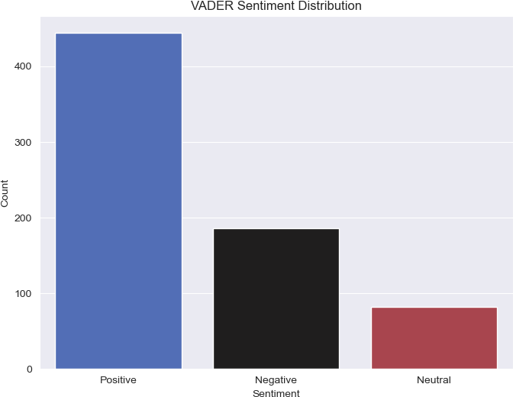
5/3/25, 7:42 PM
Social_Media_Sentiment_Analysis
Number of Posts per Platform
In [328…
# Checking the number of posts per platform
print("\nPosts per platform:")
print(df['Platform'].value_counts())
Posts per platform: Platform
Instagram | 252
Facebook | 224
Twitter | 122
Twitter | 114
Name: count, | dtype: int64
We count how many posts came from each social media platform.
After combining the duplicate Twitter entries, Instagram has the most posts (252), Twitter comes second (236), and Facebook is third (224).
We may need to clean inconsistent entries for accurate analysis.
Cleaning Sentiment and Platform Columns
In [329…
#Cleaning the 'Sentiment' and 'Platform' columns by removing extra spaces and st
df['Sentiment'] = df['Sentiment'].str.strip() df = df[df['Sentiment'] != '']

Slide 8
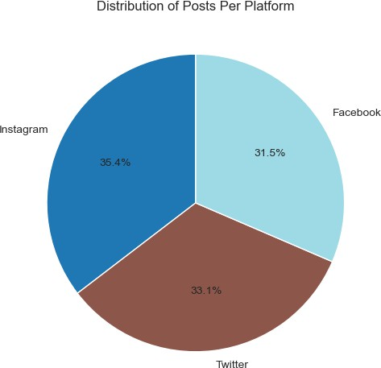
5/3/25, 7:42 PM
Social_Media_Sentiment_Analysis
In [330…
df['Platform'] = df['Platform'].str.strip().str.title()
# Confirming cleanup
print("Unique platforms after cleaning:", df['Platform'].unique())
Unique platforms after cleaning: ['Twitter' 'Instagram' 'Facebook']
We removed extra spaces and made all platform names consistent (e.g., 'twitter' → 'Twitter').
Now, only valid and clean sentiment and platform values remain for analysis. This ensures accurate grouping and comparison across platforms.
Pie Chart – Distribution of Posts Per Platform
In [331…
# Creating a pie chart for the number of posts per platform
plt.figure(figsize=(6, 6))
platform_counts = df['Platform'].value_counts()
# Plotting the pie chart
platform_counts.plot(kind='pie', autopct='%1.1f%%', startangle=90, cmap='tab20') plt.title("Distribution of Posts Per Platform")
plt.ylabel('') plt.show()

Slide 9
5/3/25, 7:42 PM
Social_Media_Sentiment_Analysis
Analysis & Insight:
This pie chart visualizes how posts are distributed among different platforms:
Instagram remains the top platform in terms of volume.
Twitter, after combining duplicates, comes second.
Facebook has the fewest posts among the three, though still close to Twitter.
The chart helps us understand where users are most active in terms of posting content, which is valuable for targeting
platform-specific campaigns or analyses.
Sentiment Distribution Across Platforms
In [349…
# Counting sentiment distribution by platform
sentiment_by_platform = df.groupby(['Platform', 'VADER_Sentiment']).size().unsta print(sentiment_by_platform)
VADER_Sentiment Platform | Negative | Neutral | Positive
Facebook | 57 | 22 | 145
Instagram | 62 | 31 | 159
Twitter | 67 | 29 | 140
We grouped the data by Platform and VADER_Sentiment to count the sentiment distribution for each platform. The sentiment counts are displayed for Facebook,
Instagram, and Twitter, showing the breakdown of Negative, Neutral, and Positive
sentiments. This helps us understand the sentiment trends across different social media platforms.
Visualizing Sentiment Distribution by Platform
In [356…
# Plotting the bar chart
sentiment_by_platform.plot(kind='bar', figsize=(10, 6))
plt.title('Sentiment Distribution by Platform') plt.xlabel('Platform')
plt.ylabel('Number of Posts') plt.legend(title='Sentiment') plt.xticks(rotation=0)
plt.tight_layout() plt.show()

Slide 10
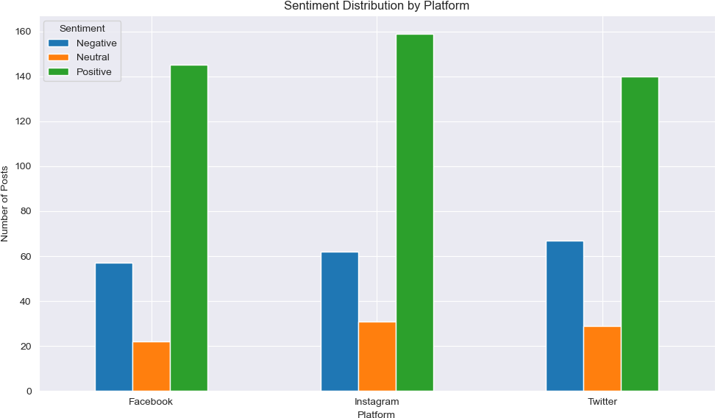
5/3/25, 7:42 PM
Social_Media_Sentiment_Analysis
We created a bar chart to visualize the sentiment distribution by platform. The chart
displays the number of posts with different sentiments (Negative, Neutral, Positive) for each platform. This provides a clear visual comparison of sentiment trends across
Facebook, Instagram, and Twitter.
Extracting the Top 10 Most Common Hashtags
In [332…
# Extracting the top 10 most common hashtags from the dataset
hashtags = df['Hashtags'].apply(lambda x: re.findall(r'\#\w+', x)).explode() hashtag_counts = Counter(hashtags)
top_10_hashtags = hashtag_counts.most_common(10)
top_10_hashtags_df = pd.DataFrame(top_10_hashtags, columns=['Hashtag', 'Count']) top_10_hashtags_df

Slide 11
5/3/25, 7:42 PM Out[332… |  |  |  | Social_Media_Sentiment_Analysis
 | 0 | #Serenity | 15
 | 1 | #Excitement | 13
 | 2 | #Gratitude | 12
 | 3 | #Despair | 11
 | 4 | #Nostalgia | 11
 | 5 | #Curiosity | 10
 | 6 | #Awe | 9
 | 7 | #Contentment | 9
 | 8 | #Grief | 9
 | 9 | #Enthusiasm | 8
Hashtag | Count
We extracted hashtags from the 'Hashtags' column using regular expressions. The top 10 most common hashtags were identified by counting their occurrences. This allows us to see which hashtags are most frequently used in the dataset.
Visualizing the top hastags
In [333…
# Plotting the top 10 hashtags
plt.figure(figsize=(10,6))
plt.bar(top_10_hashtags_df['Hashtag'], top_10_hashtags_df['Count']) plt.xlabel('Hashtags')
plt.ylabel('Count')
plt.title('Top 10 Most Used Hashtags') plt.xticks(rotation=45)
plt.show()

Slide 12
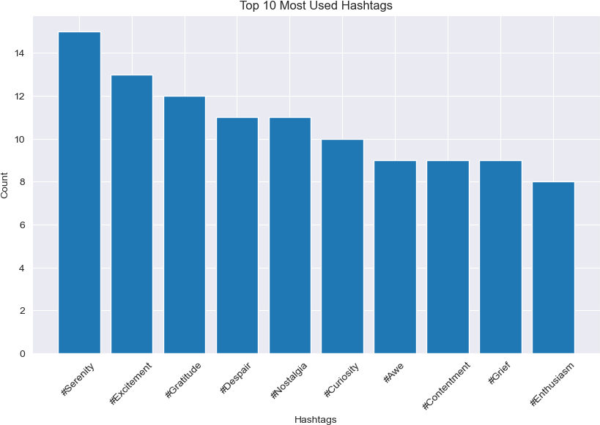
5/3/25, 7:42 PM
Social_Media_Sentiment_Analysis
We created a bar chart to visualize the top 10 most used hashtags in the dataset. The chart shows the frequency of each hashtag, helping to identify the most popular ones. This provides a clear visual comparison of hashtag usage across the dataset.
Converting Timestamp and Extracting Time Related Features
In [334…
#Converting the 'Timestamp' column to datetime format
df['Timestamp'] = pd.to_datetime(df['Timestamp'], errors='coerce')
#Extracting time-related features (e.g., year, month, day, hour)
df['Year'] = df['Timestamp'].dt.year
df['Month'] = df['Timestamp'].dt.month df['Day'] = df['Timestamp'].dt.day
df['Hour'] = df['Timestamp'].dt.hour
df['Weekday'] = df['Timestamp'].dt.weekday
We converted the 'Timestamp' column to datetime format for better manipulation. Then, we extracted year, month, day, hour, and weekday as separate time-related features.
These new features allow us to perform time-based analysis on the dataset.
Visualizing the Number of Posts Per Month
In [335…
# Plotting the number of posts per month
plt.figure(figsize=(10,6))

Slide 13
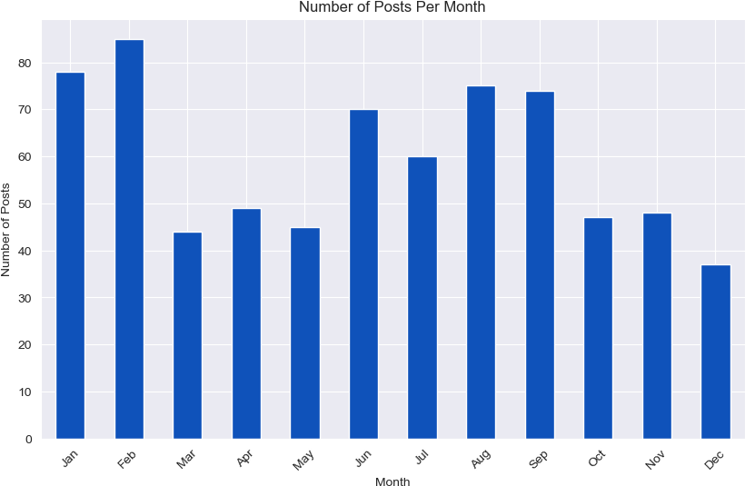
5/3/25, 7:42 PM
Social_Media_Sentiment_Analysis
df.groupby('Month').size().sort_index().plot(kind='bar', color='#0F52BA') plt.title("Number of Posts Per Month")
plt.xlabel("Month")
plt.ylabel("Number of Posts")
plt.xticks(ticks=range(12), labels=['Jan', 'Feb', 'Mar', 'Apr', 'May', 'Jun', 'J plt.show()
We plotted a bar chart showing the number of posts per month based on the extracted Month feature. The chart provides a clear view of how posts are distributed across the months .
Visualizing for Posts by Year Grouped by Platform
In [336…
#creating a count plot for posts by year grouped by platform
plt.figure(figsize=(10, 6))
ax = sns.countplot(x='Year', hue='Platform', data=df,palette = 'Blues')
for container in ax.containers: ax.bar_label(container)
plt.title('Posts per Year by Platform') plt.xlabel('Year')
plt.ylabel('Posts')
plt.xticks(rotation=45) plt.show()

Slide 14
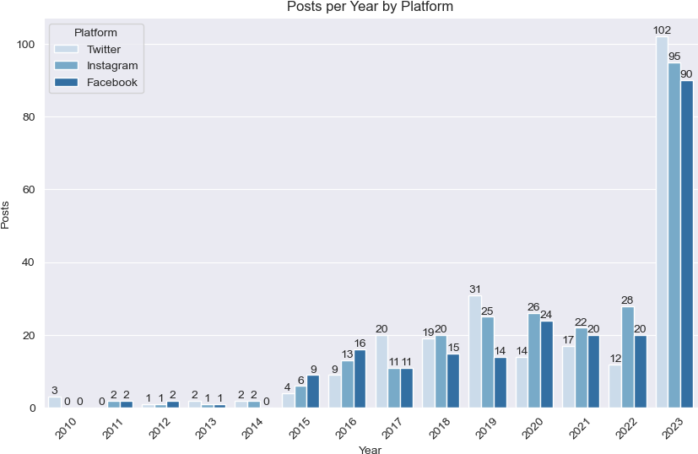
5/3/25, 7:42 PM
Social_Media_Sentiment_Analysis
Visualizing posts vs year
In [337…
#creating a countplot for the totalpost by year
plt.figure(figsize=(8, 5))
ax = sns.countplot(x='Year', data=df,palette ='crest') ax.bar_label(ax.containers[0])
plt.title('Total Posts per Year') plt.xlabel('Year')
plt.ylabel('Posts')
plt.xticks(rotation=45) plt.show()

Slide 15
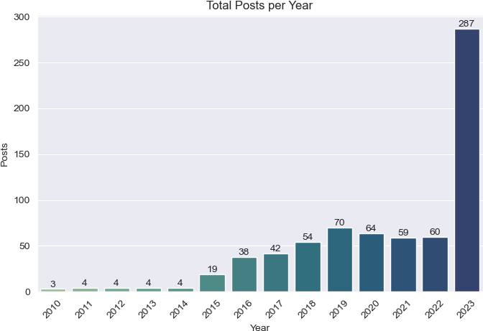
5/3/25, 7:42 PM
Social_Media_Sentiment_Analysis
We created a count plot to visualize the total number of posts per year. The chart
displays the overall trend of posts over the years, with the bar labels showing the exact number of posts for each year. This helps to understand how the total post count
changes annually.
Extracting the Top 10 Most Liked Posts
In [338…
# Top 10 most liked posts
top_liked = df.sort_values(by='Likes', ascending=False).head(10) top_liked[['Text', 'Likes', 'User', 'Platform']]

Slide 16
5/3/25, 7:42 PM
Social_Media_Sentiment_Analysis
Out[338…
Text | Likes | User | Platform
570
Underneath the city lights, the dancer express...
80.0 DanceEnthusiastCityNightPerformance
Twitter
Awe-inspired by the
402 vastness of the cosmos on
...
80.0
CosmosExplorer Instagram
550
After a series of defeats, the
soccer team fac...
80.0
SoccerFanTeamDefeats
Twitter
540
Celebrating a historic victory in the World Cu...
80.0
FootballFanWorldCupCelebration Instagram
560
In the serene beauty of a sunset, nature unfol...
80.0
NatureEnthusiastSunsetWonder
Instagram
Anticipation for an
355 upcoming adventure in an
e...
80.0
Wanderlust
Twitter
530
Captivated by the spellbinding plot twists, th...
80.0
MovieEnthusiastPremiereAttendee
Twitter
470
Dancing on sunshine, each step a celebration o...
80.0
SunshineDancer Instagram
432
Heartache deepens, a solitary journey through ...
80.0
SolitaryDescent
Instagram
345
Motivated to achieve fitness goals after an in...
80.0
FitnessJunkie Facebook
Extracting the Top 10 Most Reweeted Posts
In [339…
# Top 10 most retweeted posts
top_retweeted = df.sort_values(by='Retweets', ascending=False).head(10) top_retweeted[['Text', 'Retweets', 'User', 'Platform']]

Slide 17
5/3/25, 7:42 PM
Social_Media_Sentiment_Analysis
Out[339… |  | Text | Retweets | User | Platform
 |  | Captivated by the
 | 530 | spellbinding plot | 40.0 | MovieEnthusiastPremiereAttendee | Twitter
 |  | twists, th...
 |  | Elation over
 | 368 | discovering a rare book | 40.0 | Bookworm | Instagram
 |  | in a quai...
 |  | After a series of
 | 550 | defeats, the soccer | 40.0 | SoccerFanTeamDefeats | Twitter
 |  | team fac...
 |  | Motivated to achieve
 | 345 | fitness goals after an | 40.0 | FitnessJunkie | Facebook
 |  | in...
 |  | At a Justin Bieber
 | 520 | concert, the infectious | 40.0 | BieberDanceEnthusiast | Instagram
 |  | bea...
 | 560 | In the serene beauty of a sunset, nature unfol... | 40.0 | NatureEnthusiastSunsetWonder | Instagram
 |  | Underneath the city
 | 570 | lights, the dancer | 40.0 | DanceEnthusiastCityNightPerformance | Twitter
 |  | express...
 |  | At the front row of
 | 510 | Adele's concert, each | 40.0 | AdeleConcertGoer | Instagram
 |  | note...
 |  | Awe-inspired by the
 | 402 | vastness of the cosmos | 40.0 | CosmosExplorer | Instagram
 |  | on ...
 |  | Celebrating a historic
 | 540 | victory in the World | 40.0 | FootballFanWorldCupCelebration | Instagram
 |  | Cu...
Grouping Data by Platform and Summing Likes
In [340…
#Grouping the data by platform, adding up the likes, and sorting to see which pl
df['Likes'] = df['Likes'].astype(int)
df_aggregated = df.groupby('Platform')['Likes'].mean().reset_index() df_likes = df.groupby('Platform')['Likes'].sum().reset_index()
Visual Representation of likes by Platform
In [341…
# Grouping and summing likes by platform
likes_by_platform = df.groupby("Platform")["Likes"].sum().sort_values(ascending=

Slide 18
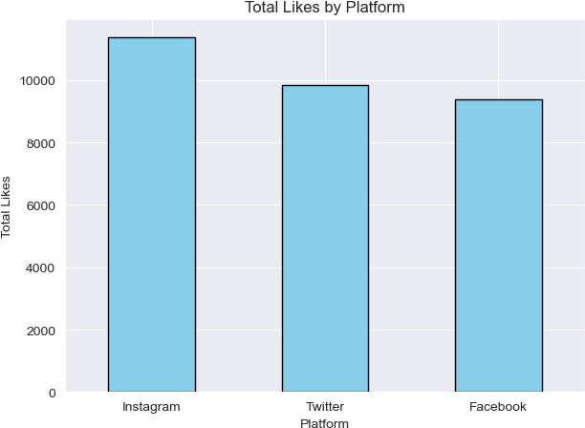
5/3/25, 7:42 PM
Social_Media_Sentiment_Analysis
# Plotting
likes_by_platform.plot(kind='bar', color='skyblue', edgecolor='black') plt.title("Total Likes by Platform")
plt.xlabel("Platform")
plt.ylabel("Total Likes") plt.xticks(rotation=0)
plt.tight_layout() plt.show()
Visualizing Engagement of top 10 countries in Social Media
In [342…
# Cleaning the 'Country' column to remove inconsistencies
df['Country'] = df['Country'].str.strip().str.title()
# Analyzing the top 10 most active countries
country_counts = df['Country'].value_counts().head(10)
plt.figure(figsize=(10, 6))
sns.barplot(x=country_counts.values, y=country_counts.index) plt.title('Top 10 Countries by Number of Posts')
plt.xlabel('Number of Posts') plt.ylabel('Country')
plt.tight_layout() plt.show()

Slide 19
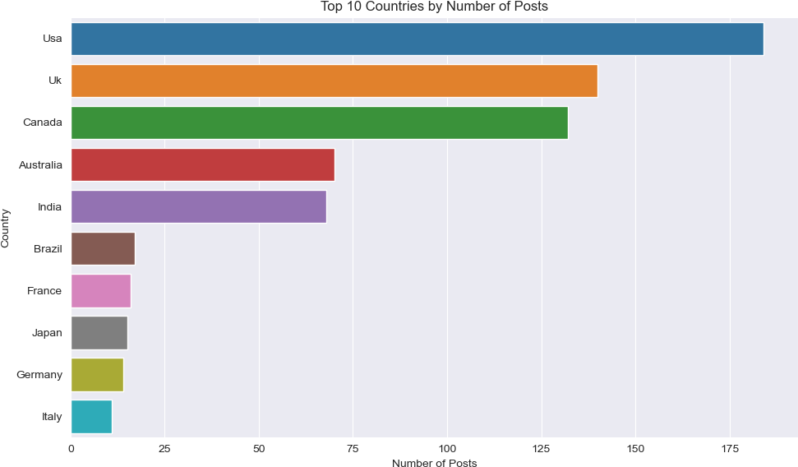
5/3/25, 7:42 PM
Social_Media_Sentiment_Analysis
Grouping Sentiment by Country
In [357…
# Grouping sentiment by country
sentiment_by_country = df.groupby(['Country', 'VADER_Sentiment']).size().unstack
# Displaying sentiment distribution by country
print(sentiment_by_country)

Slide 20
5/3/25, 7:42 PM
Social_Media_Sentiment_Analysis
VADER_Sentiment Country | Negative | Neutral | Positive
Australia | 24 | 4 | 42
Austria | 0 | 0 | 1
Belgium | 0 | 1 | 1
Brazil | 6 | 1 | 10
Cambodia | 1 | 0 | 0
Canada | 38 | 17 | 77
China | 0 | 0 | 1
Colombia | 0 | 0 | 1
Czech Republic | 0 | 0 | 2
Denmark | 0 | 0 | 2
France | 4 | 4 | 8
Germany | 6 | 1 | 7
Greece | 3 | 1 | 1
India | 24 | 5 | 39
Ireland | 1 | 0 | 0
Italy | 1 | 0 | 10
Jamaica | 0 | 1 | 0
Japan | 1 | 1 | 13
Jordan | 0 | 0 | 1
Kenya | 0 | 0 | 1
Maldives | 0 | 0 | 1
Netherlands | 0 | 0 | 4
Norway | 0 | 0 | 1
Peru | 0 | 0 | 1
Portugal | 0 | 0 | 2
Scotland | 0 | 0 | 1
South Africa | 1 | 2 | 3
Spain | 2 | 2 | 1
Sweden | 0 | 0 | 2
Switzerland | 0 | 1 | 1
Thailand | 0 | 0 | 1
Uk | 38 | 16 | 86
Usa | 36 | 25 | 123
We counted how many positive, neutral, and negative posts came from each country. This shows which countries had more positive or negative feelings in their posts.
Countries like the USA, UK, and Canada had the most posts, and most of them were positive
Visual Representation of Sentiment by Country
In [359…
# Plotting the bar chart
sentiment_by_country.plot(kind='bar', figsize=(12, 8))
# Adding chart title and labels
plt.title('Sentiment Distribution by Country') plt.xlabel('Country')
plt.ylabel('Number of Posts') plt.legend(title='Sentiment') plt.xticks(rotation=45)
plt.tight_layout() plt.show()

Slide 21
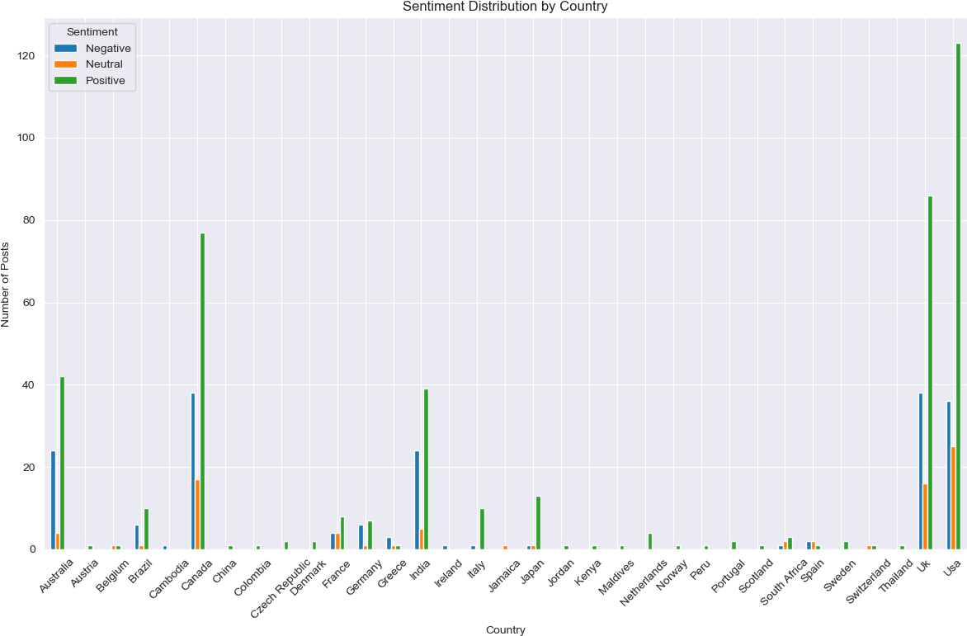
5/3/25, 7:42 PM
Social_Media_Sentiment_Analysis
Correlation Between Numeric Columns
In [347…
# Selecting numeric columns only
numeric_df = df.select_dtypes(include='number')
# Computing correlation matrix corr_matrix = numeric_df.corr() print(corr_matrix)
 | Retweets | Likes | Year | Month | Day | Hour | Weekday
Retweets | 1.000000 | 0.998475 | -0.035511 | 0.081559 | 0.010345 | 0.196162 | 0.053444
Likes | 0.998475 | 1.000000 | -0.038813 | 0.074696 | 0.012598 | 0.194503 | 0.053641
Year | -0.035511 | -0.038813 | 1.000000 | -0.318224 | 0.031665 | -0.088485 | -0.049901
Month | 0.081559 | 0.074696 | -0.318224 | 1.000000 | -0.153564 | 0.137145 | -0.029166
Day | 0.010345 | 0.012598 | 0.031665 | -0.153564 | 1.000000 | 0.040422 | -0.063474
Hour | 0.196162 | 0.194503 | -0.088485 | 0.137145 | 0.040422 | 1.000000 | -0.002284
Weekday | 0.053444 | 0.053641 | -0.049901 | -0.029166 | -0.063474 | -0.002284 | 1.000000
We selected only the numeric columns and calculated how they are related to each
other. We found that Likes and Retweets have a very strong positive relationship, when
one increases, the other usually does too. Other columns like Hour, Month, or Day do not show strong connections with Likes or Retweets.
In [348…
# Plotting the heatmap
plt.figure(figsize=(10, 6))
sns.heatmap(corr_matrix, annot=True, cmap='coolwarm', fmt=".2f", linewidths=0.5) plt.title('Correlation Matrix Heatmap')
plt.show()

Slide 22
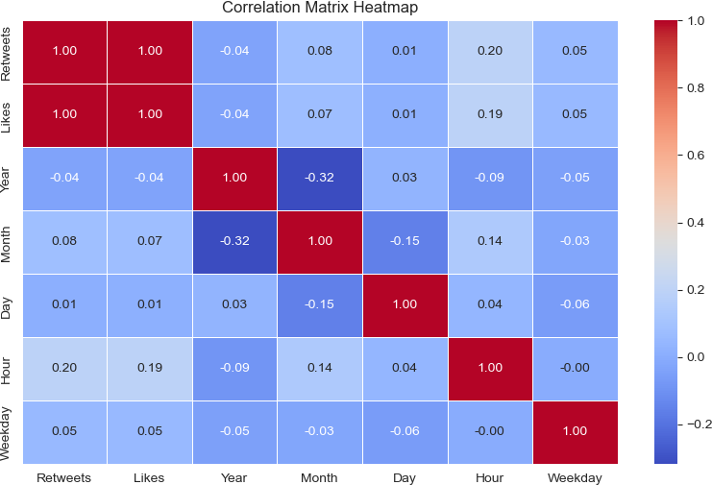
5/3/25, 7:42 PM
Social_Media_Sentiment_Analysis
Top 10 Most Engaged Users
In [366…
user_stats = df.groupby('User').agg({ 'Text': 'count',
'Likes': 'sum',
'Retweets': 'sum'
}).reset_index().rename(columns={'Text': 'Post_Count'})
# Sorting by Likes Desc
user_stats_sorted = user_stats.sort_values(by='Likes', ascending=False)
# Displaying top 10 engaged users
print(user_stats_sorted.head(10))
 | User | Post_Count | Likes | Retweets
124 | CosmosExplorer | 2 | 160 | 80.0
134 | CulinaryExplorer | 2 | 140 | 70.0
395 | MusicHarmonist | 2 | 140 | 70.0
180 | EchoedLaughter | 2 | 130 | 65.0
268 | GrowthSeeker | 2 | 120 | 60.0
670 | WinterWarmth | 2 | 110 | 55.0
234 | ForestDreamer | 2 | 110 | 56.0
144 | DanceEnthusiast | 2 | 110 | 56.0
648 | VacationDreamer | 2 | 105 | 52.0
574 | SpringEnthusiast | 2 | 100 | 50.0
We grouped the data by User and calculated the total number of posts, likes, and
retweets each user received. Then, we sorted users by total likes to identify the top 10 most engaged users. These users consistently received high engagement across their posts, these users got most attention.

Slide 23
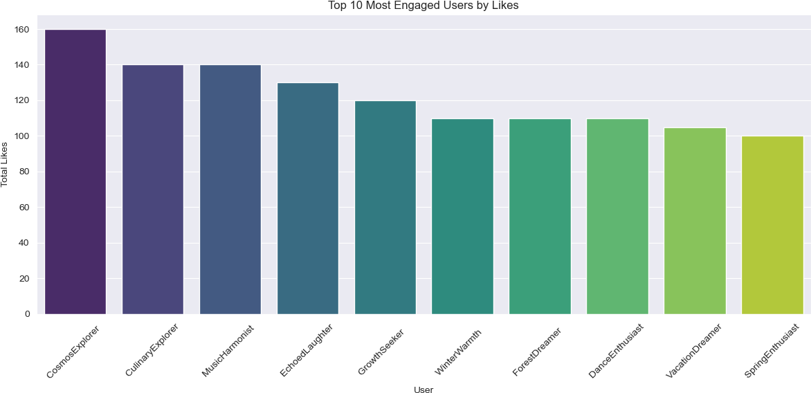
5/3/25, 7:42 PM
Social_Media_Sentiment_Analysis
Visual Representation of top 10 users according to their engagement on Social Media
In [367…
# Selecting top 10 users by Likes
top_users = user_stats_sorted.head(10)
# Plot
plt.figure(figsize=(12, 6))
sns.barplot(data=top_users, x='User', y='Likes', palette='viridis')
plt.title('Top 10 Most Engaged Users by Likes') plt.xlabel('User')
plt.ylabel('Total Likes') plt.xticks(rotation=45) plt.tight_layout()
plt.show()
Yearly Sentiment Trends of each Platform
In [372…
twitter = df[df['Platform'] == 'Twitter']
tw = twitter.groupby(['Year', 'VADER_Sentiment']).size().unstack().fillna(0) tw.plot(marker='o', figsize=(8,5), title='Twitter: Yearly Sentiment Trend') plt.ylabel('Post Count')
plt.grid(True)
plt.tight_layout() plt.show()

Slide 24
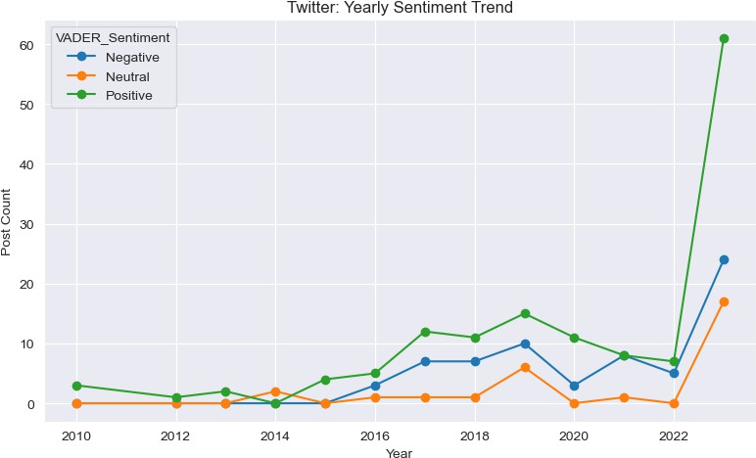
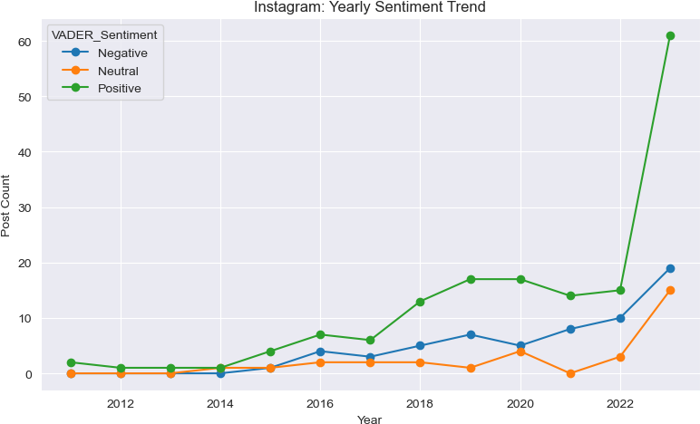
5/3/25, 7:42 PM
Social_Media_Sentiment_Analysis
In [373…
instagram = df[df['Platform'] == 'Instagram']
ig = instagram.groupby(['Year', 'VADER_Sentiment']).size().unstack().fillna(0) ig.plot(marker='o', figsize=(8,5), title='Instagram: Yearly Sentiment Trend') plt.ylabel('Post Count')
plt.grid(True)
plt.tight_layout() plt.show()
In [374…
facebook = df[df['Platform'] == 'Facebook']
fb = facebook.groupby(['Year', 'VADER_Sentiment']).size().unstack().fillna(0) fb.plot(marker='o', figsize=(8,5), title='Facebook: Yearly Sentiment Trend') plt.ylabel('Post Count')
plt.grid(True)
plt.tight_layout() plt.show()

Slide 25
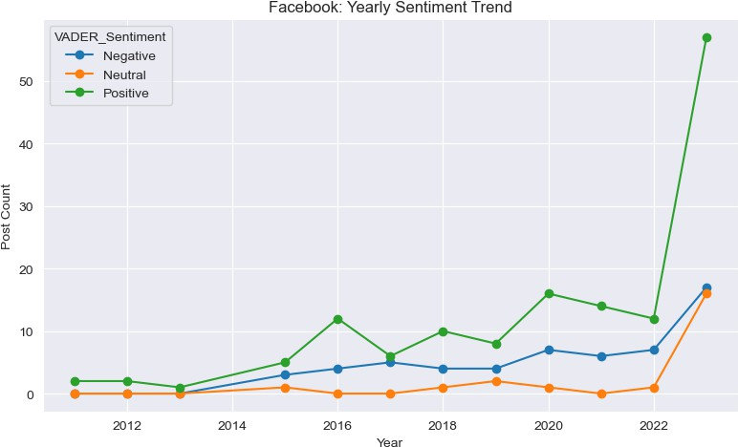
5/3/25, 7:42 PM
Social_Media_Sentiment_Analysis
WordCloud of Most Used Words
In [375…
# Combining all text and cleaned it
all_text = ' '.join(df['Text']).lower()
clean_text = re.sub(r'[^a-zA-Z\s]', '', all_text)
# Generating word list using TextBlob
words = TextBlob(clean_text).words
filtered_words = ' '.join([word for word in words if len(word) > 3])
# Generating and plotting word cloud
wordcloud = WordCloud(width=800, height=400, background_color='white').generate(
plt.figure(figsize=(10, 5))
plt.imshow(wordcloud, interpolation='bilinear') plt.axis('off')
plt.title('Most Used Words WordCloud') plt.show()

Slide 26
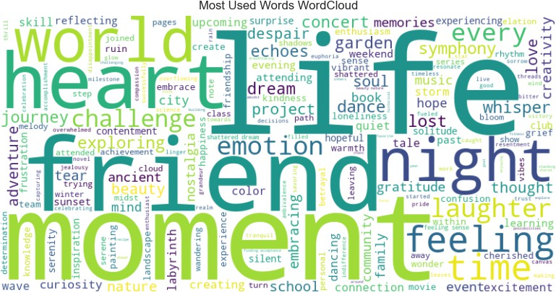

5/3/25, 7:42 PM
Social_Media_Sentiment_Analysis
We combined all the post text, cleaned it by removing special characters, and filtered out short words. Then, using the cleaned text, we created a WordCloud to visually show the most frequently used words in the posts. The bigger the word, the more often it
appeared.
In [ ]:

