Slide 1
DATA BASED OUTLOOK TO REDUCE FLOOD DAMAGE TO PROPERTY
PROPONENTS:
AGUBA, KIETH STEPHEN
ASI, JOHN AZER
CALIMUTAN, KARL ANDREI
DELA CRUZ, KURT DAVID
TOLENTINO AIYANA MIKHAYLA

Slide 2
TOPICS
01
02
03
04
Sustainable Development Goals
Introduction
Statement of The Problem
Objectives of the Study
05
Sources of Datasets

Slide 3


Sustainable Development Goals
Goal 11: Sustainable Cities and Communities
Goal 13: Climate Action
This SDG aims to make cities and human settlements inclusive, safe, resilient and sustainable.
This goal strives to take urgent action to combat climate change and its impacts.

Slide 4
$ 3,566,003

Slide 5
Introduction
Southeast Asia is highly susceptible to frequent and severe environmental disasters. The recent floods in Southeast Asia have been caused by a variety of events, including typhoons, severe rainfall, and tropical storms .

Slide 6
Statement of the Problem
The main issue that this study pertains is the flood damage to property and how it differs in countries of the SEA and how will they be able to reduce flood damage.

Slide 7
Objectives of the Study
Determine which flood subtype is the primary cause of overall damage in the top five countries.

Slide 8
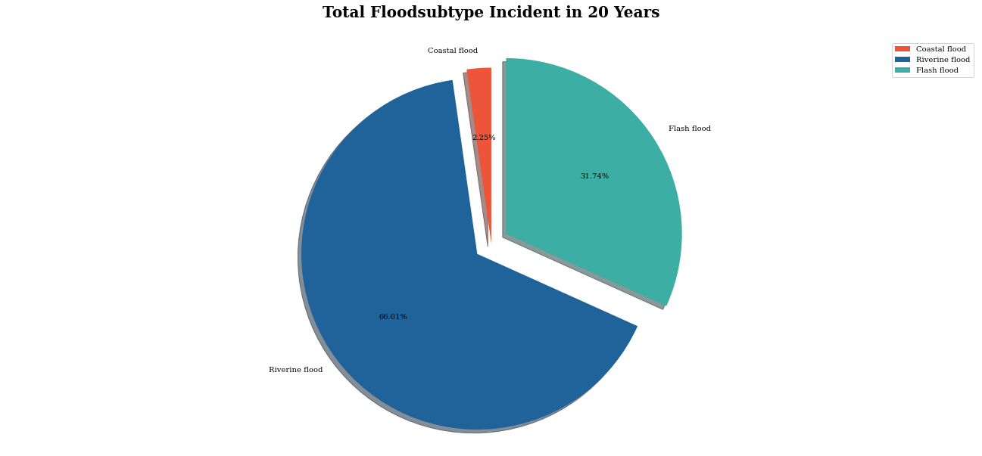
t
Source: Public Em-Dat South East Asia Flood 2001-2020

Slide 9
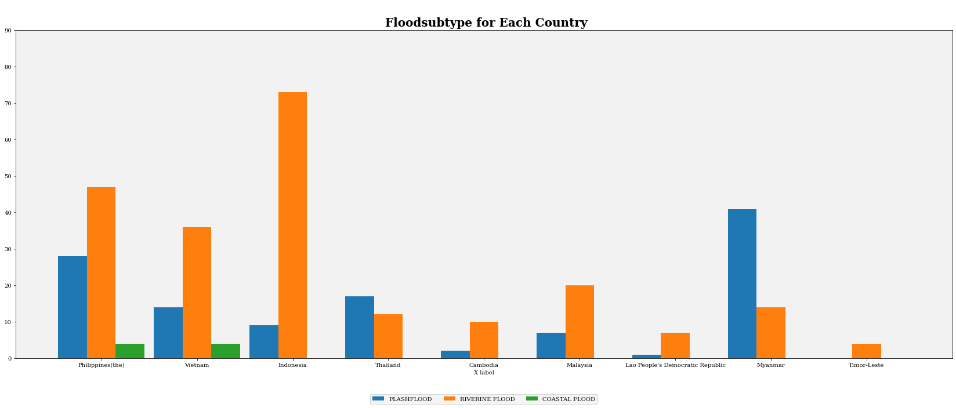
Source: Public Em-Dat South East Asia Flood 2001-2020

Slide 10
Objectives of the Study
From 2001 to 2020, determine the top 5 countries in Southeast Asia in terms of the most damaged country based on overall damage down to the least damaged country.

Slide 11
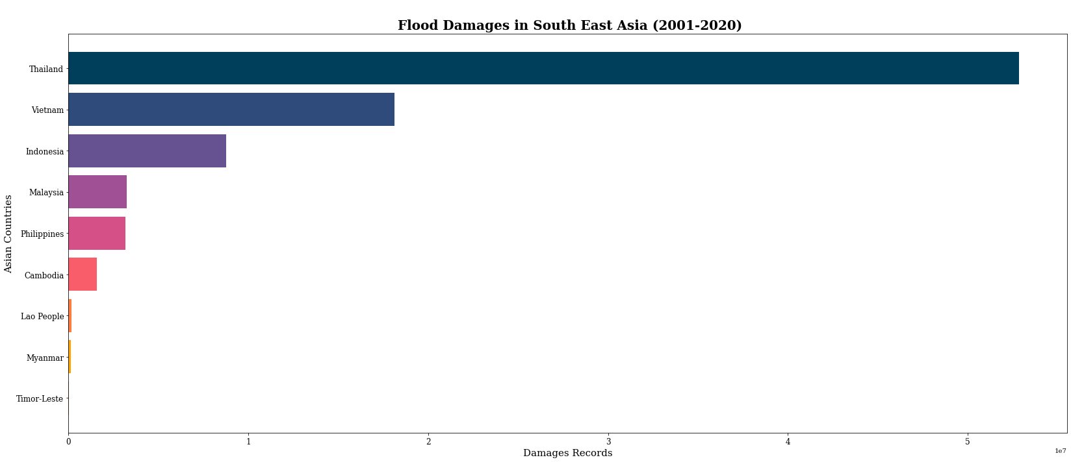
Source: Public Em-Dat South East Asia Flood 2001-2020

Slide 12
Objectives of the Study
Determine which of the top five countries have the most total deaths between 2001 and 2020.

Slide 13
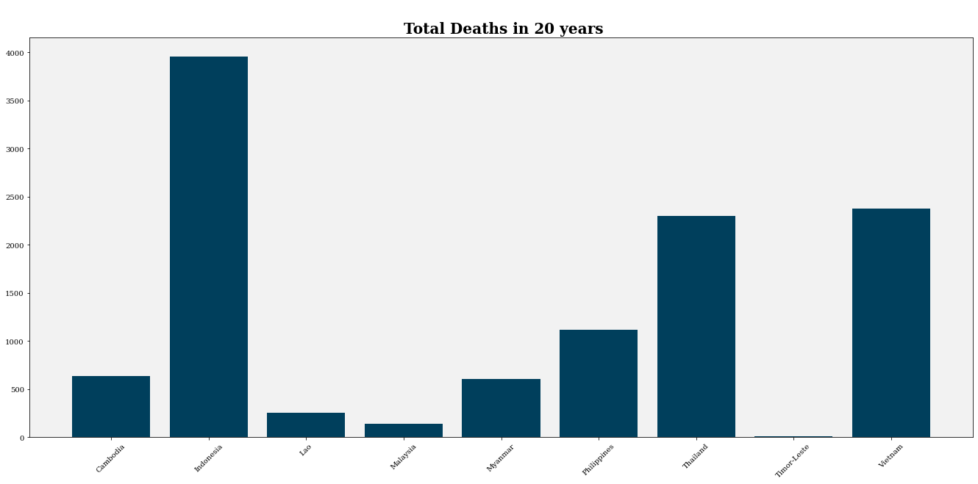

Slide 14
Objectives of the Study
Obtain information with relation to the data about the countries of Southeast Asia, which will be ranked from lowest to highest in terms of overall property damage.

Slide 15
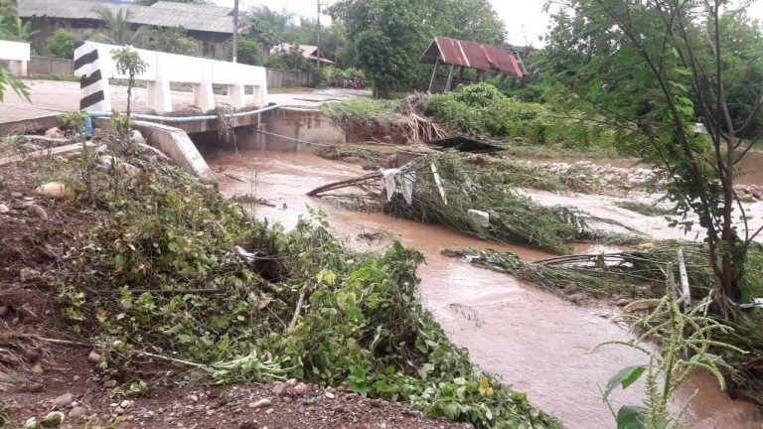
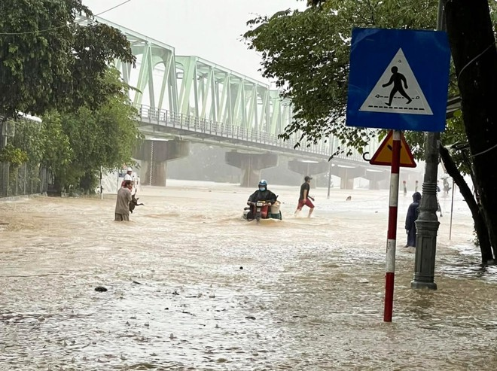
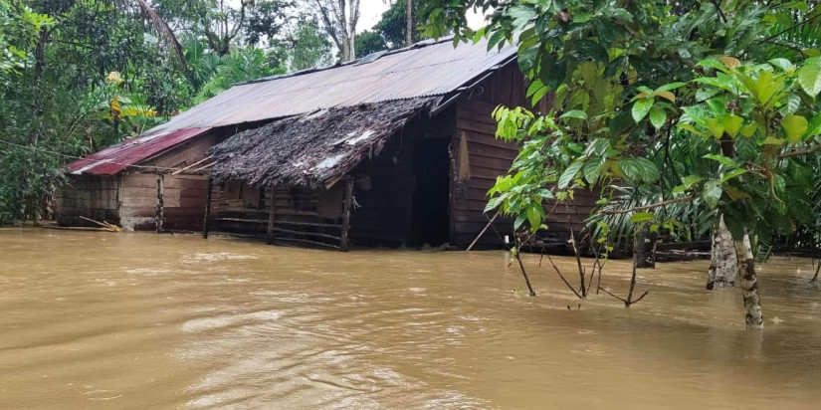
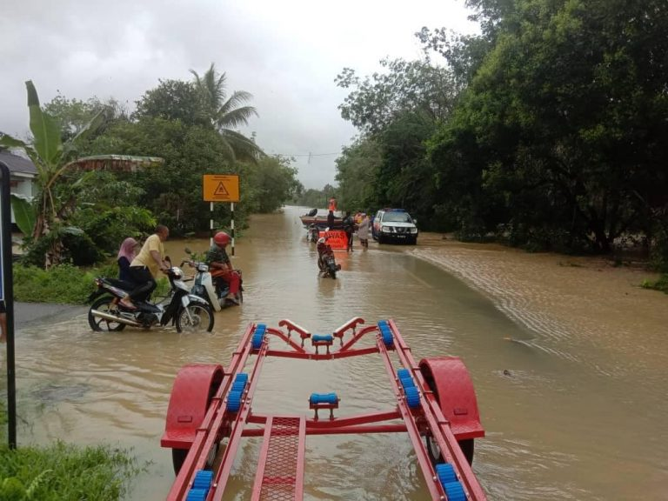
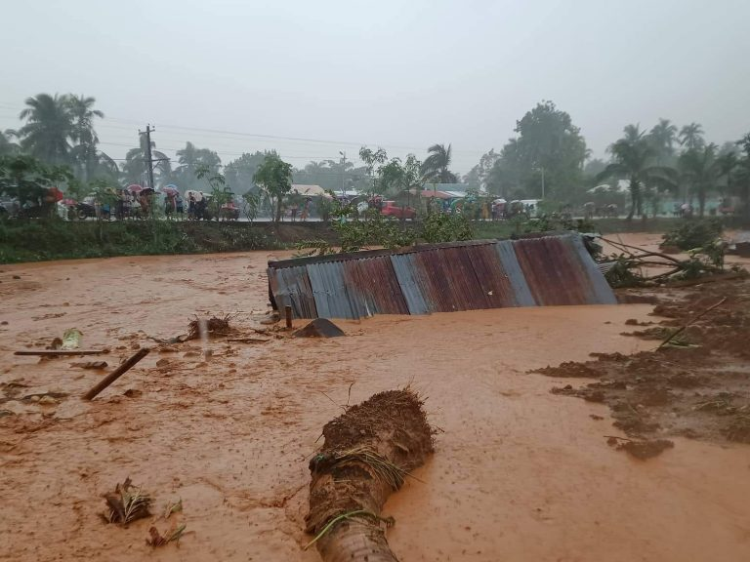
Thailand
Vietnam
Indonesia
Malaysia
Philippines

Slide 16
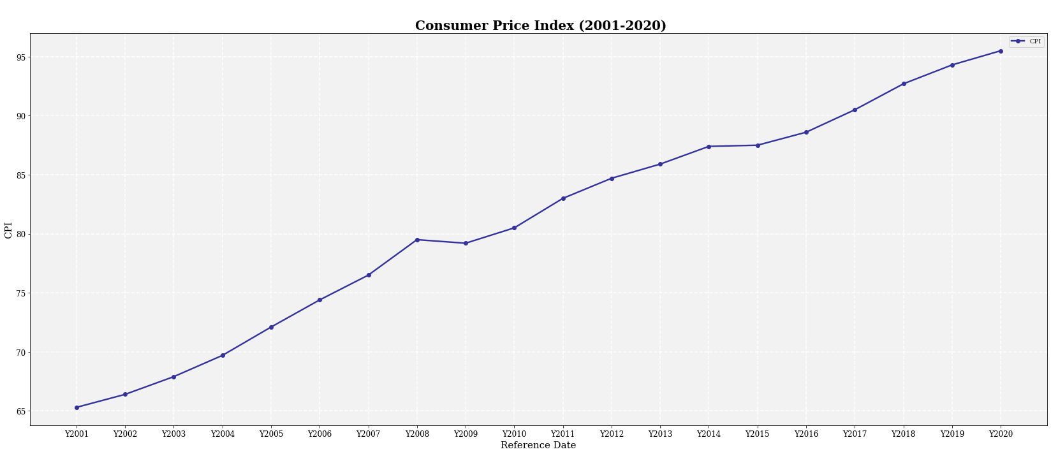
Source: Public Em-Dat South East Asia Flood 2001-2020

Slide 17
CORRELATION ANALYSIS

Slide 18
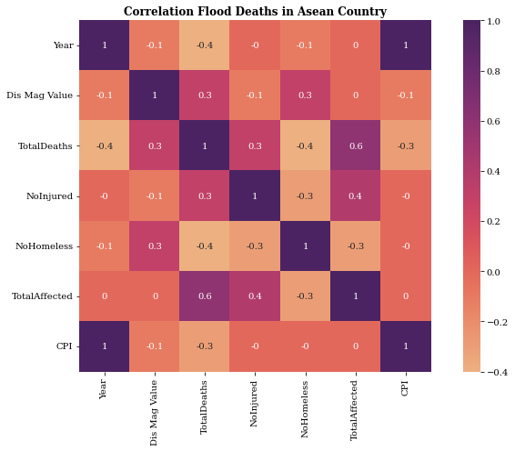
Source: Public Em-Dat South East Asia Flood 2001-2020

Slide 19
LINE REGRESSION ANALYSIS

Slide 20
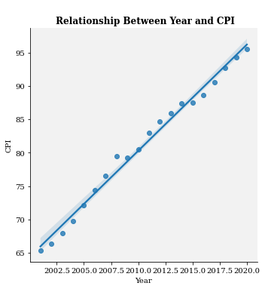
Source: Public Em-Dat South East Asia Flood 2001-2020

Slide 21
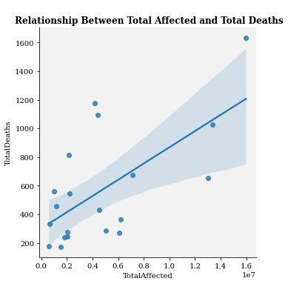
Source: Public Em-Dat South East Asia Flood 2001-2020

Slide 22

Source of Datasets
The Centre promotes research, training and technical expertise on humanitarian emergencies, particularly in public health and epidemiology.
CRED

