Slide 1

A Big Data Fusion to Profile CPS Security Threats Against Operational Technology WoWMoM 2020
Karl Biron‡
‡University of Dubai, College of Engineering and IT, Dubai, UAE.
kvbiron@ud.ac.ae
Notes:
Authors
DESC logo allowed?
Cybersec-esc background
Date of presentation
Name of conference
Logos for all slides
Footer: speaker name(me), conference name, year MM-YYYY,

Slide 2

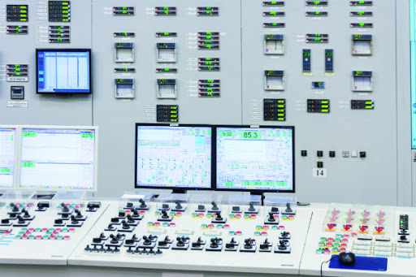
Cyber Physical Systems
Notes:
While CPS is included in several critical sectors, such as power, nuclear plants, and urban infrastructures, these systems are often subtle to various cyber security threats due to several reasons.
First, these systems were not designed to be part of a public network, i,e, the Internet, they were in fact built and operated in a segregated and contained environment, this has changed over the past two decades due to the need for remote operations as well as providing live and continuous support from various vendors.
In addition, these CPS are often equipped with IoT devices, many of these are low cost and low-performance devices that are designed with built-in security features.
As a result, several security concerns emerged about these critical systems

Slide 3
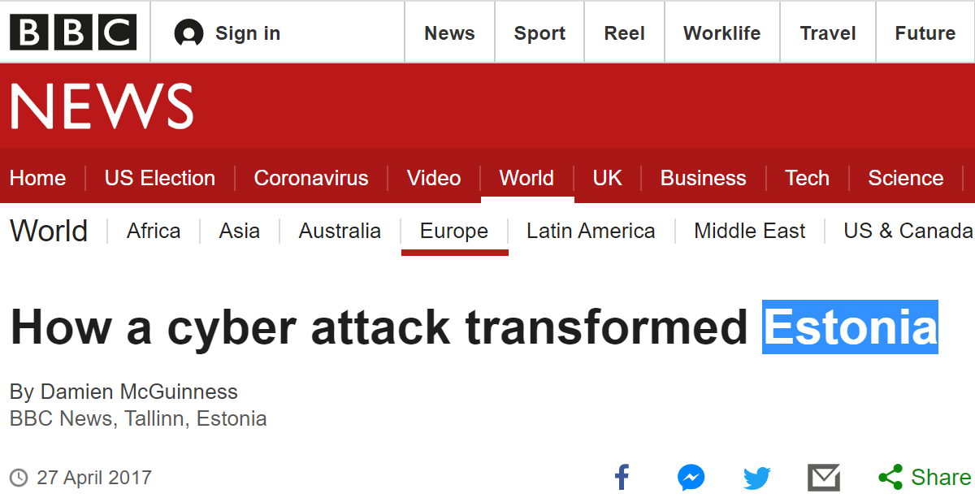
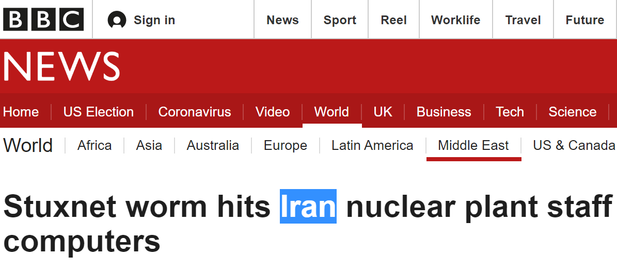
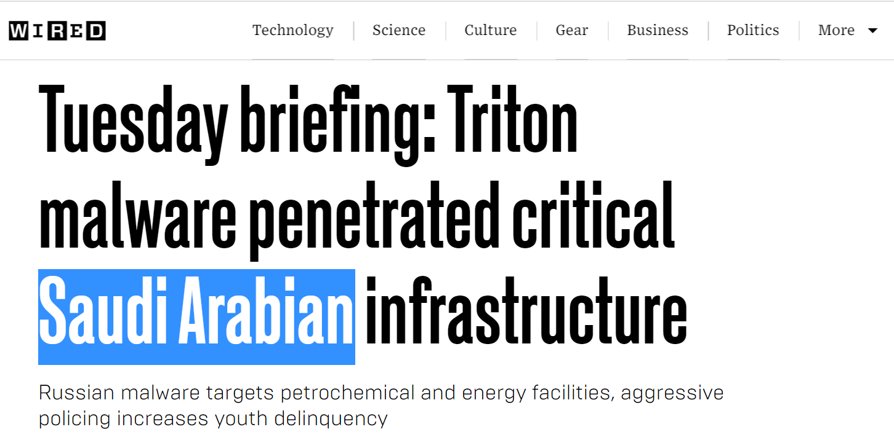
CPS Security Attacks
Estonia Cyber Blackout
Iran Stuxnet Attack
KSA Triton Malware Attack
Notes:
Cyber security threats and attacks have been on the rise during the past decade.
The advancement of technology in cyber-physical systems (CPS) has led to many advantages but also created several new advanced threats.
A real example would be the event known as the Estonia Blackout, which involved a series of cyber-attacks directed towards government entities such as ministries, financial institutions, Internet Service Providers (ISPs), and telecommunication land line systems. These attacks that targeted critical infrastructures caused a so-called “cyber blackout”, which effectively took down various online services including critical ones such as banking.
In 2017, Triton Malware was used to attack the petrochemical plant in the Kingdom of Saudi Arabia (KSA) and caused it to shutdown to prevent an explosion.
In 2010, the Stuxnet Worm attack an Iranian nuclear facility. The Stuxnet worm is capable of seizing control of industrial plants. Some Western experts say its complexity suggests it could only have been created by a "nation state".

Slide 4
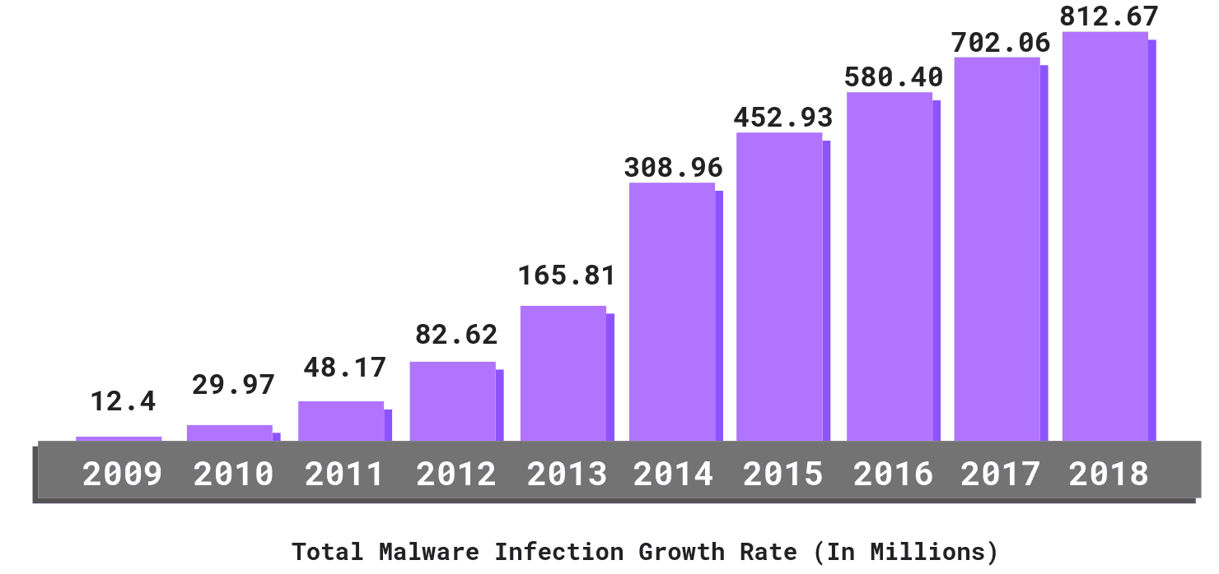
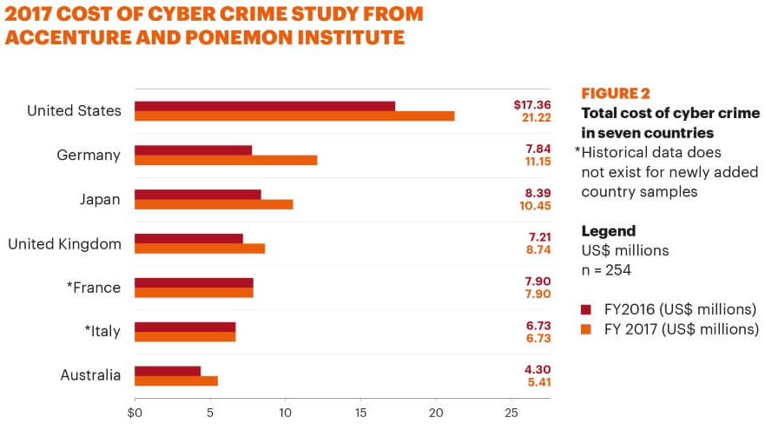
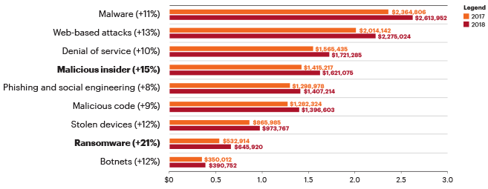
Problem Statement
References:
https://purplesec.us/resources/cyber-security-statistics/
https://www.accenture.com/ca-en/insights/security/cost-cybercrime-study
Notes:
The diagram with the purple diagram shows the gradual but steady increase of the total malware infection growth rate over that decade. This alone should be a cause to be alarmed.
The diagram below that shows the classification of cyber attacks and the correlated estimate loss in US dollars due to the damage it has done to the organization.
The diagram on the left shows the top 7 countries that have spent the most on cyber security.
As shown, cyber attacks and cost need to mitigate them are also on the rise.
Therefore, our research has been geared towards creating smart and comprehensive solutions that is focused on monitoring and being specific on CPS which has one of the most impact in terms of magnitude and also vector

Slide 5
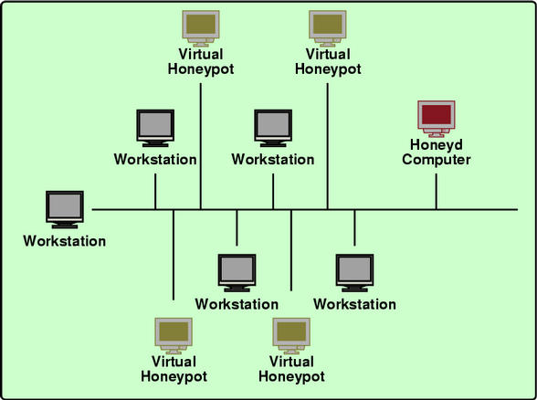
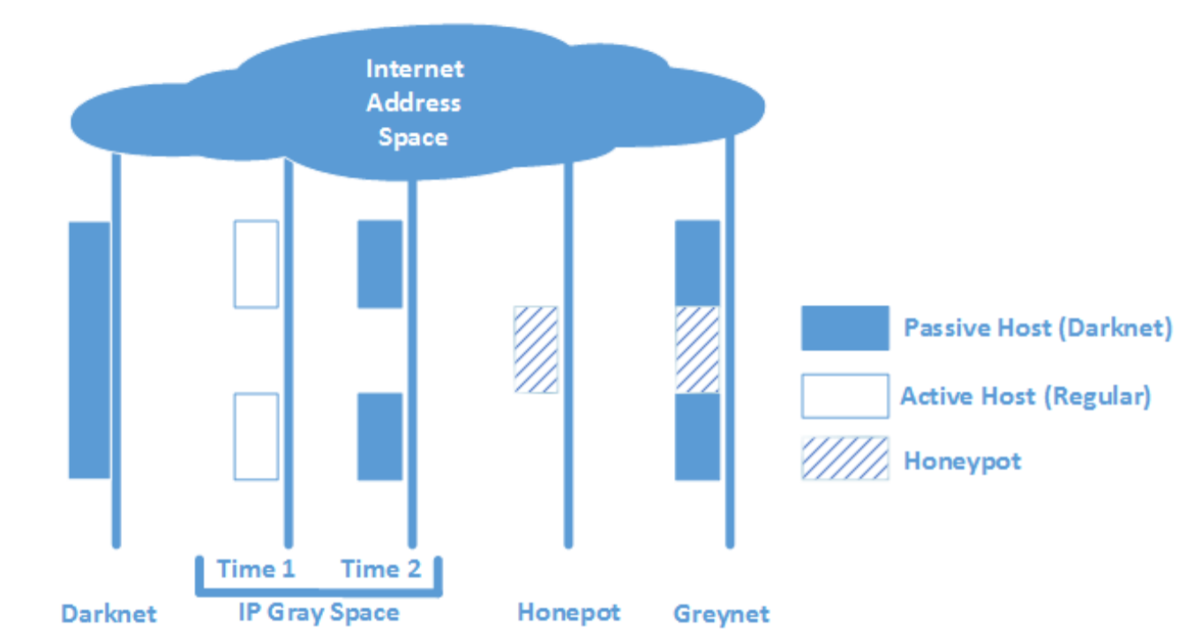
Fusion Approach Honeypot and Darknet
Honeypot
Darknet
Honeypot
Darknet
Honeypot
[Fachkha et al.]
Notes:
The Darknet is commonly misinterpreted as the Dark Web which is an entirely different affair in the broad field of information technology and information systems. A better and more accurate term for Darknet would be a network telescope [3]. A Darknet is a segment of an ssigned IP Address block that has no active services running. The traffic that arrives in this IP space is typically unwanted and thus should arise suspicion of malicious intent or activity.
A Honeypot however is an information security terminology that pertains to a mechanism that is intended to counteract, deflect and detect directed efforts of unauthorized usage of systems. In a general sense, a honeypot contains data or a set of data that may seem to appear as a legitimate component of a network or system but in reality is actually a standalone system that is monitored. It lures potential attackers as these honeypots may seem to contain resources or information that could be of value to attackers. A comparative study and more about a trap-based monitoring system can be found in [3]

Slide 6
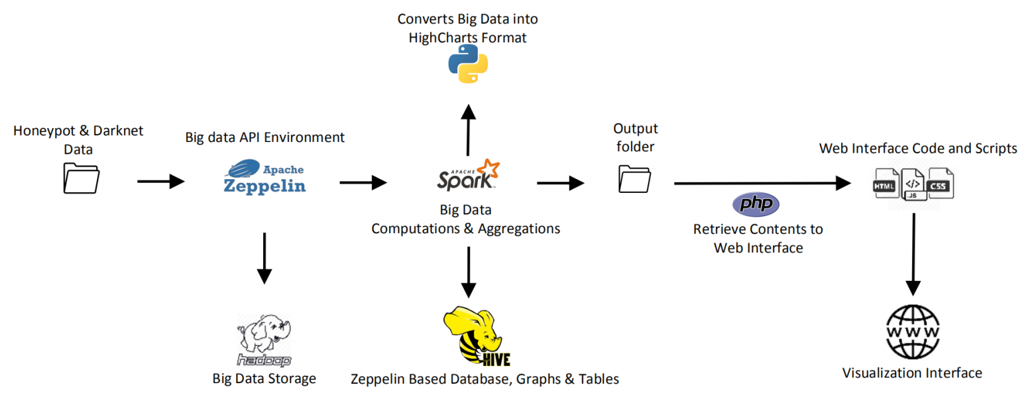
Proposed Big Data Fusion Approach
Notes:
Figure 1 depicts an overview of our system, which consists of several tools including Apache Zeppelin, Hadoop, Hive, Python, Spark, PHP, HTML, CSS, and JavaScript, which are used to process, analyze, and visualize the data generated from around all our trap-based monitoring systems.
First, datasets are aggregated from both Darknet and Honeypot networks for processing.
Apache Zeppelin provides the back-end environment for the big data programming languages to interact while the data files are also concurrently being stored as Hadoop DFS for backup purposes.
Consequently, Spark is used to compute the values using aggregation and other big data techniques while Python scripts are utilized to parse data into a format acceptable by HighCharts JavaScript.
During this process, HiveQL queries generate tables, CSV files and Zeppelin based graphs.
The results are gathered in processed files in specific directories. The files are retrieved by PHP codes and then submitted to the web development folder. HTML, CSS and JavaScript files are used together to create the visualization dashboard.

Slide 7
General Project Information
Analyzed Data: 18 months
Number of Monitors: 92 (46 Honeypot sensors, and 46 Darknet sensors)
Data Volume: 100 GB
Activities originated from 150 countries.

Slide 8
Preliminary Results (Targeted Services)
Top Honeypot CPS Ports | Top Darknet CPS Ports | Top Darknet Conventional Port
IPMI, 632 (51.38 %) | IPMI, 632 (56.29 %) | Others (64.13 %)
S7Comm, 10201 (24.46 %) | BACnet, 47808 (26.34 %) | Telnet, 23 (7.01 %)
Modbus, 502 (13.21 %) | Guardian, 10001 (9.64 %) | Microsoft-DS, 445 (5.45 %)
BACnet, 47808 (5.33 %) | Kamstrup_mngt, 50100 (6.18 %) | HTTP, 8080 (5.29 %)
IEC104, 2404 (4.07 %) | IEC104, 2404 (0.4 %) | IPMI, 632 (4.83 %)
Kamstrup_ch_a, 1025 (0.59 %) | Kamstrup_ch_a, 1025 (0.34 %) | Huawei, 37215 (4.71 %)
Guardian, 10001 (0.50 %) | S7Comm, 10201 (0.33 %) | SMTP, 25 (3.15 %)
Kamstrup_ch_b, 1025 (0.28 %) | Kamstrup_ch_b, 1025 (0.29 %) | SSH, 22 (2.76 %)
Kamstrup_mngt, 50100 (0.18 %) | Modbus, 502 (0.18 %) | HTTP, 80 (0.96%)
Notes:
Table as raw data, Description the columns, Describe Findings (IPMI), What is IPMI, Describe, Modbus as de facto for SCADA?
IPMI: provides management and monitoring capabilities.
Modbus is a data communications protocol originally published by Modicon (now Schneider Electric) in 1979 for use with its programmable logic controllers (PLCs). Modbus has become a de facto standard communication protocol and is now a commonly available means of connecting industrial electronic devices.

Slide 9
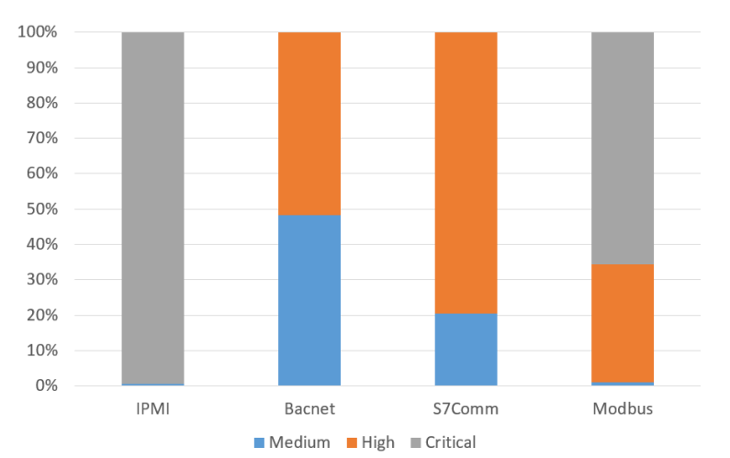
Preliminary Results (Focused on Honeypot Dataset)
IPMI has been found critical in the majority of its communication
BACnet is distributed almost equally between medium and high severity.
The majority of S7Comm communication has been found high in terms of severity.
Modbus traffic are distributed between high and critical, with majority to the latter.
The lack of critical severity label within BACnet and S7Comm is because these services run on top of UDP. As such, no connection setup and data exchange.
Modbus has been found to be the only CPS service that has all variants of attack severity (maybe because running on top of TCP )
Notes:
This diagram is focused on the Honeypot data set:
> Three types of severity.
> Top four ports emulated by our Honeypot
IPMI has been found critical in the majority of its communication
BACnet is distributed almost equally between medium and high severity.
The majority of S7Comm communication has been found high in terms of severity.
Modbus traffic are distributed between high and critical, with majority to the latter.
Furthermore, the lack of critical severity label within BACnet and S7Comm is because these services run on top of UDP. As such, no connection setup and data exchange.
Modbus has been found to be the only CPS service that has all variants of attack severity (maybe because running on top of TCP )

Slide 10
Discussions and Limitations
Dataset used is limited to the scope we cover and the duration (period) of our analysis.
Almost impossible to assess the real attack impact (damage) on physical infrastructure without having one.
Identifying and filtering between benign and malicious data in systematic and automated manners are done manually.
Notes:
(limit to 6 points, remove long texts, use key words, use image if possible)Collaboration between different entities
Access the critical infrastructure
Getting approval/authorizations
Dataset used is limited to the scope we cover and the duration (period) of our analysis.
Almost impossible to assess the real attack impact (damage) on physical infrastructure without having one.
Identifying and filtering between benign and malicious data in systematic and automated manners are done manually.

Slide 11
Conclusion
Big Data fusion model that leverages a correlation engine.
Utilized two types of trap-based network monitoring systems, namely, Honeypot and Darknet.
The Honeypot data are found to be more stable than darknet.
The Darknet, though are more attractive monitors to hackers and easier to secure and hide.
The IPMI is the number one targeted CPS service (among the top conventional darknet abused services)
Notes:
Big Data fusion model that leverages a correlation engine.
Utilized two types of trap-based network monitoring systems, namely, Honeypot and Darknet.
The Honeypot data are found to be more stable than darknet.
The Darknet, though are more attractive monitors to hackers and easier to secure and hide.
The IPMI is the number one targeted CPS service (among the top conventional darknet abused services)

Slide 12
Future Work
Automating Internet scanners’ IP addresses filtering
Investigating larger and more recent dataset
Integrating our solution with physical testbed
Leveraging machine learning techniques to predict future attacks
Notes:
Use key words and images, remove long text

Slide 13
Thank You Q & A Session

