Slide 1
Global ecological problems of the Earth

Slide 2
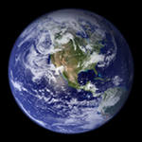
The earth

Slide 3
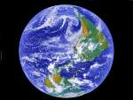
The main problems are:
Water pollution
Air pollution
Land pollution
Destroying of ozone layer
Global warming

Slide 4
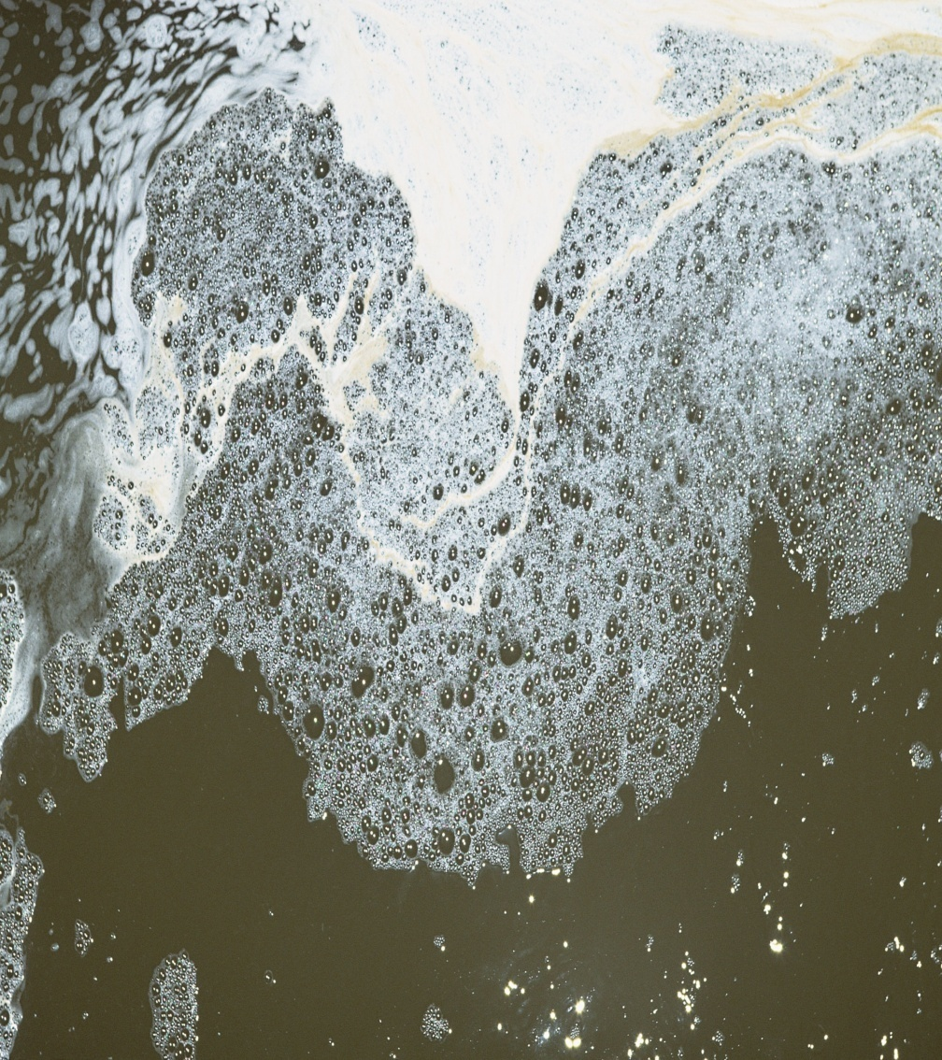
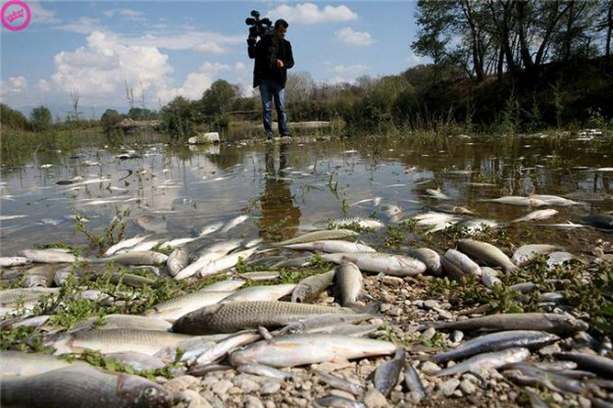
Water is necessary for our life. all organisms contain it, some drink it and some live in it.

Slide 5
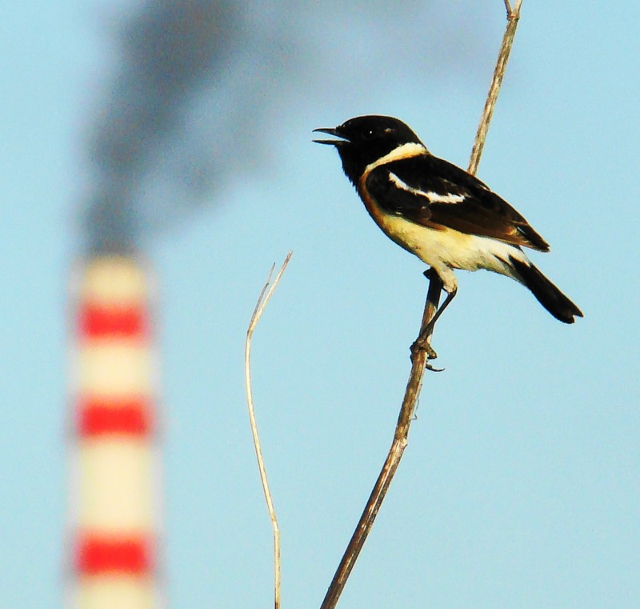
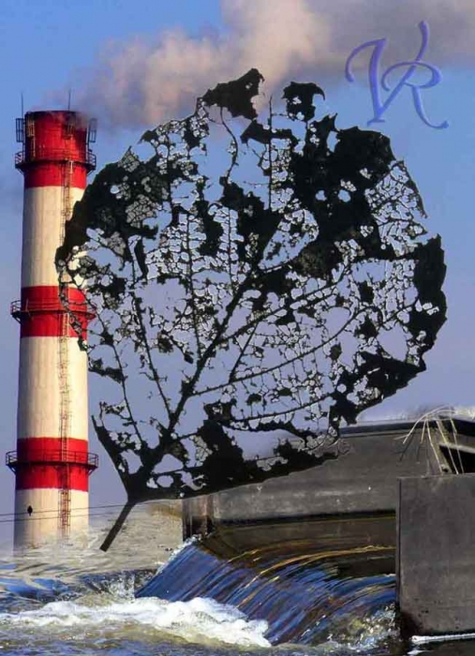
Air is the most essential element for all living. but people play a big role on it`s polluting. Asthma, cancer, acid rains are only a few causes of air pollution.

Slide 6
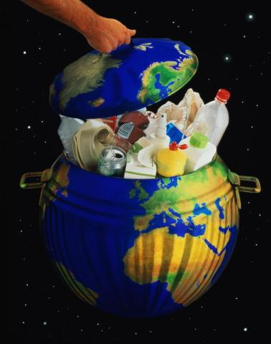
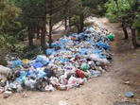
Land is our home. but our home is in a big trouble and needs “first aid”. The land is very dirty. it is full of litter.

Slide 7
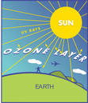
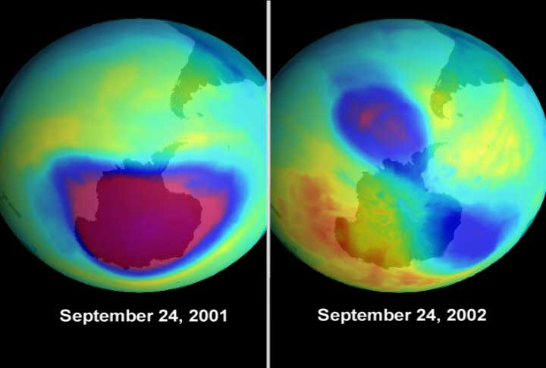
Ozone layer is a protecting layer of our planet. It protects us from UV and other high radiation. But the Ozone layer has holes.

Slide 8
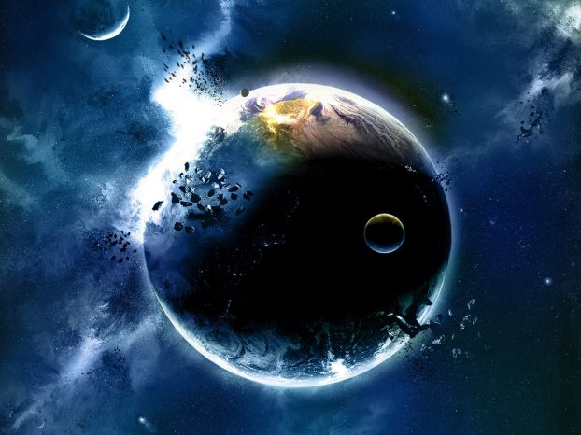
the planet without ozone layer

Slide 9
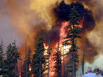
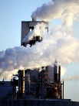
Global warming is sometimes referred as the greenhouse effect. It means that atmosphere becomes warmer.

Slide 10

There are many different groups which try to find solutions to the problems of pollution at the national and international level.

Slide 11
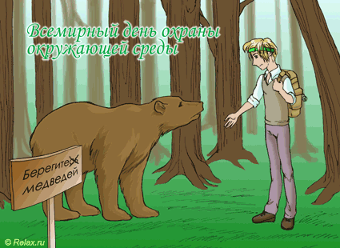
National parks play a big role in protecting the nature

Slide 12
Protect and save the nature!!!
Remember the three R`s: reduce, reuse, recycle!!!!
Put your litter in the bin!!!
Never cut down baby trees!!!
Don`t hurt animals!!!
Protect wildlife, plants and trees!!!
Feed birds in winter!!!
Plant trees and flowers!!!

Slide 13
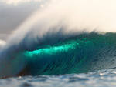
World Water Day | World Water Day 2022
The world day of water

Slide 14

All-World Health Day -
The world day of health

Slide 15
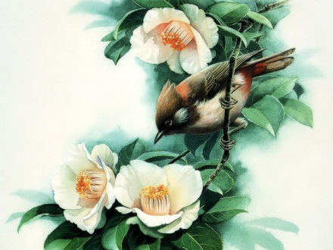
International day of birds -
The international day of birds

Slide 16
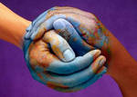
All-World Earth Day –
The world day of the Earth

Slide 17
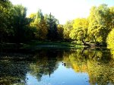
All-peaceful day to protect the surrounding environment -
The world day of environment protection

Slide 18
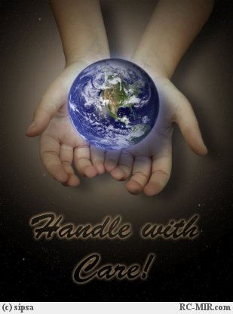
Be a friend to the nature!!!

Slide 19
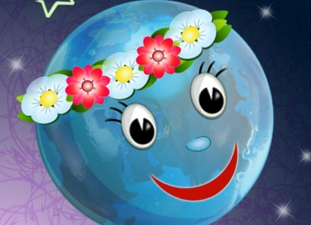
The End

