Slide 1
Hamburg builds Green Roof Cover over Sections of the A7 Motorway
https://inhabitat.com/hamburg-is-building-a-giant-green-roof-cover-over-sections-of-the-a7-motorway/

Slide 2
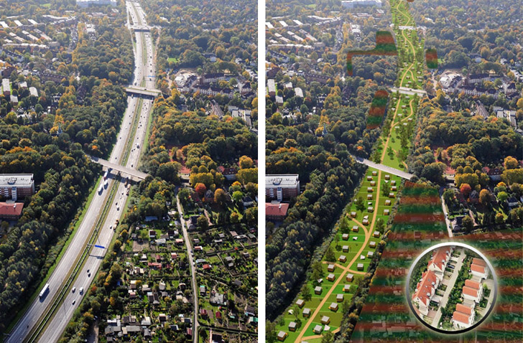
For decades, the A7 motorway, a major north-south highway that connects Germany with Scandinavia, has been a headache for Hamburg residents. The expressway is loud, it creates a physical barrier between neighborhoods, and because it contains heavy truck

Slide 3
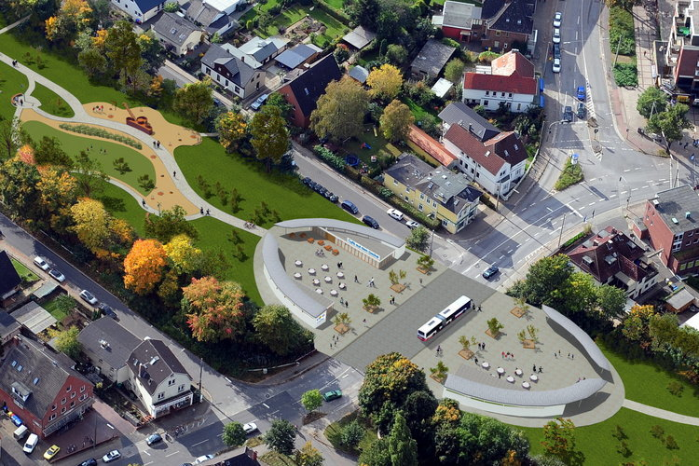
Covering the A7 will reconnect neighborhoods that have been disconnected for the 30 years since the motorway was built.

Slide 4
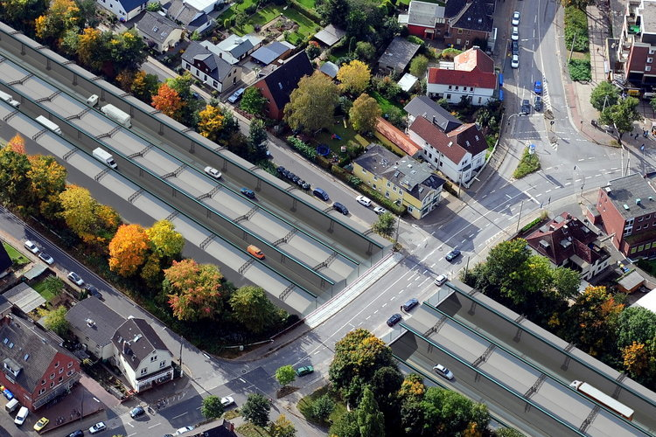
Covering the A7 will reconnect neighborhoods that have been disconnected for the 30 years since the motorway was built.

Slide 5
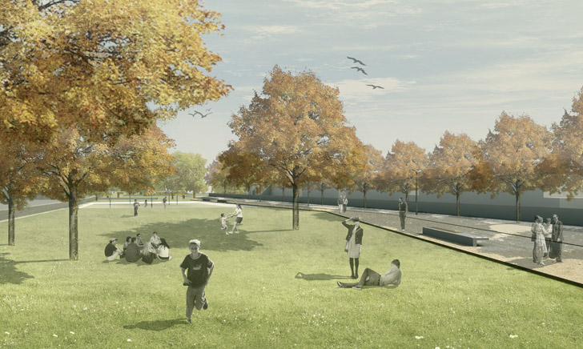
Much of the A7 cover will be designated parkland, adding green space to surrounding neighborhoods and helping to keep storm water from entering the city's sewer system.

Slide 6
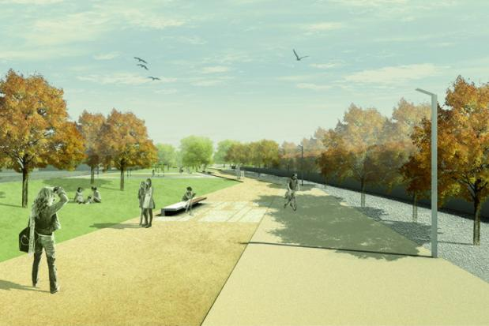
The canopy will be 34 meters wide and 2 to 3 meters thick in places -- thick enough to support mature trees.

Slide 7
Hamburg Autobahn Park

Slide 8
