Slide 1
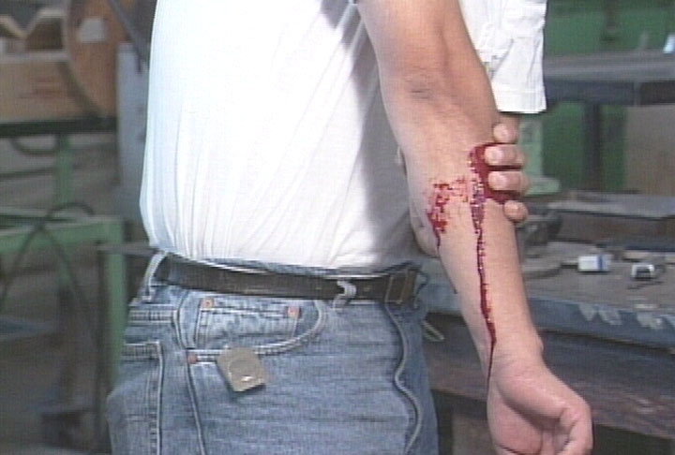
Accident Causes, Prevention and Control
Notes:
Today’s topic is Accident Causes, Prevention and Control. This training is a part of OSHA’s Accident Reduction Standards, 29 CFR 1926.20(b).
You will learn about:
What is an accident?
Causes of accidents.
How accidents can be prevented.
Ultimately, why you’re the most important element in working more safely.
Suggestions for the Speaker
An effective ice breaker is to ask the trainees the following questions:
In your own words, what is an accident?
What’s the difference between an accident at work and one that happens elsewhere?
Has anyone been involved in an accident at work? What happened, and what happened afterward?

Slide 2
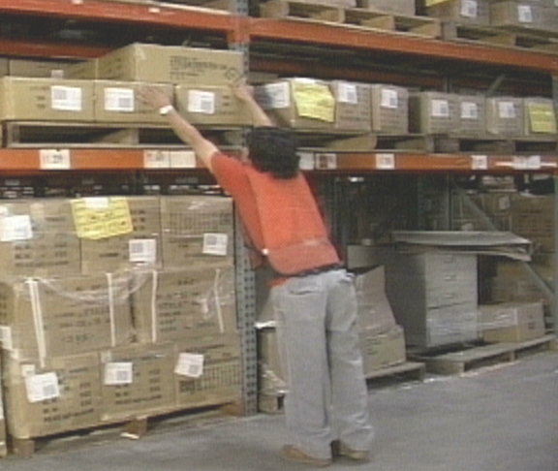
Accidents Always Have Causes
Accidents don’t “just happen”
Accidents always have causes
Accidents always can be prevented
For every accident reported, there are 600 near-misses
Notes:
Some people believe accidents “just happen” because they are inevitable. It’s either bad luck, bad karma or simply being in the wrong place at the wrong time.
Excuses such as these disguise the truth: Accidents almost always have causes, which means accidents always can be prevented.
5,524 workers died in workplace accidents in 2002. There were thousands more injuries that were caused by accidents.
For every serious or disabling injury reported, researchers estimate there were:
10 minor injuries
30 property damage incidents, and
600 near-misses.
Suggestions for the Speaker
Now might be a good time to share a story about someone getting injured in a workplace accident. If you do not have one, you can use the following true story:
A worker was loading a truck. While tightening a chain to secure the load, the chain broke. It didn’t hit him, but the sudden jolt injured his head and neck. He underwent neck surgery and still must take several medications daily to cope with the pain. He’s barely able to work, but fears losing his benefits and retirement if he quits.

Slide 3
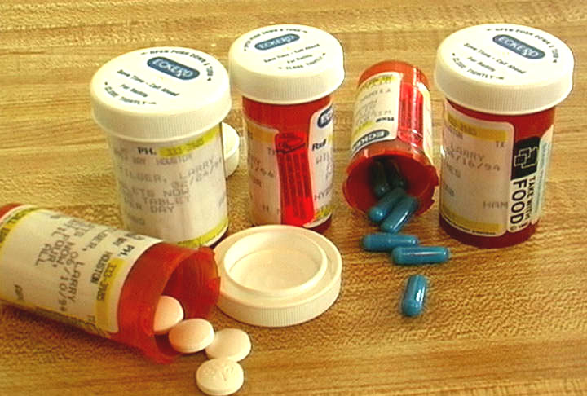
Two Primary Causes of Accidents
There are two primary causes of accidents: unsafe conditions and unsafe acts
Unsafe conditions include defective tools or equipment, lack of machine guards, and poor lighting
Unsafe acts include disabling safety devices and being under the influence on the job
Notes:
An accident is an unplanned and unwanted event which may or may not cause injury and/or property damage. It also interferes with the ability to get the job done.
A “near-miss” is a type of accident that doesn’t cause injury or damage, but was a close call nonetheless. It’s often valuable to study “near-misses” to make sure the circumstances that led to them aren’t repeated.
There are two primary causes of accidents:
Unsafe conditions, which are hazardous conditions or circumstances that could lead directly to an accident, and
Unsafe acts, which occur when a worker either ignores or is unaware of safe practices or standard operating procedures.

Slide 4
Causes of Accidents
88% of all accidents are caused by unsafe acts
Unsafe conditions cause only about 10% of workplace accidents
Engineering can eliminate most unsafe conditions
2% are due to acts of God
Notes:
Accident causes can be grouped into these categories:
88% caused by the unsafe acts of people
10% caused by unsafe conditions, and
2% caused by acts of God, such as hurricanes or floods.
Unsafe conditions in the workplace account for only about one of every 10 injuries.
Through the use of engineering principles, many of the unsafe conditions that can cause accidents can be eliminated. When a machine is working soundly and safely, it’s much less likely that someone could do something unsafe.
Examples of safety engineering in the workplace include: machine guards, automatic shut-off switches, and even handrails on the stairs.
Suggestions for the Speaker
It might be an opportune time to ask trainees what they would do if confronted with an unsafe condition in the workplace. Would they wait for the next person to come along to report it? Why is this a bad idea? Who would they report it to?

Slide 5
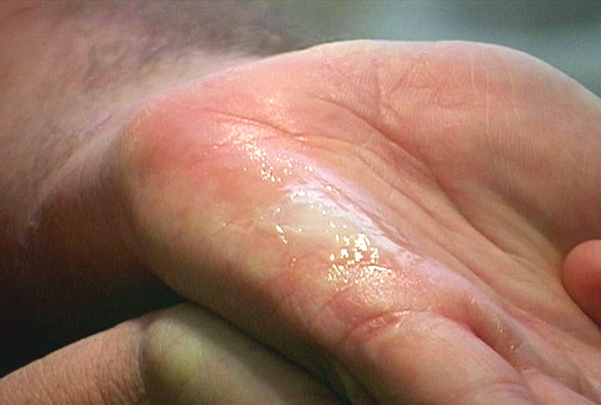
Unsafe Conditions and Unsafe Acts
Examples of unsafe conditions include:
Defective tools or equipment
Lack of guards
Examples of unsafe acts include:
Using the wrong tool
Disabling safety devices
Notes:
What are some examples of unsafe conditions and unsafe acts?
Examples of unsafe conditions include:
Defective tools or equipment
Lack of proper machine guards
Poor lighting
Sloppy housekeeping, and
Excessive noise.
Examples of unsafe acts include:
Using the wrong tool for the job
Disabling safety devices
Employing improper lifting techniques, and
Being under the influence of drugs or alcohol while on the job.

Slide 6
Personal Factors and Job Factors
Unsafe conditions and unsafe acts usually result from two factors
Personal Factors, such as lack of knowledge or skills, can lead to unsafe acts
Job Factors, such as substandard equipment, contribute to unsafe conditions
Notes:
All unsafe conditions and unsafe acts can be attributed to two factors: Personal Factors and Job Factors.
Personal Factors include:
Improper motivation
Distractions that interfere with the worker’s ability to concentrate
A worker’s physical limitations, and
Lack of knowledge or skills due to inadequate training.
Job Factors include:
Poor equipment maintenance
Substandard equipment design
Substandard tools, equipment and materials
Poorly focused work standards, and
Sudden or unusual increases in equipment usage.
The Personal Factors usually lead to unsafe acts.
The Job Factors can contribute greatly to unsafe conditions.
Suggestions for the Speaker
You might want to initiate a discussion among trainees about the difference between Personal Factors and Job Factors. Ask them to share any experiences they might have when Personal Factors or Job Factors contributed to unsafe acts or unsafe conditions.

Slide 7
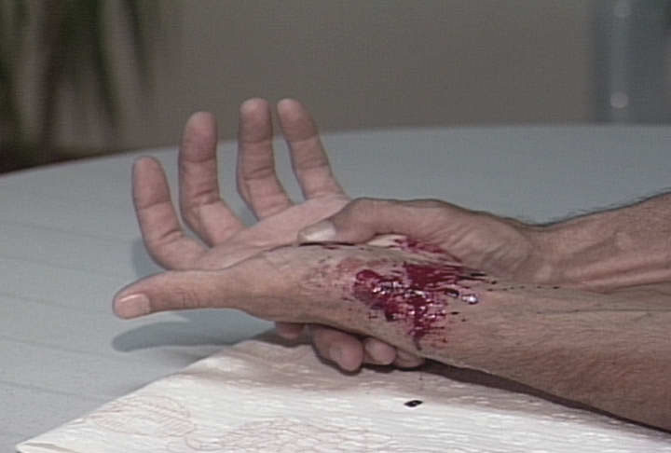
Eliminating Unsafe Acts
Employees are the most important factor in eliminating unsafe acts in the workplace
Some of the most common unsafe acts include:
Horseplay
Not using Personal Protective Equipment
Disabling or bypassing safety procedures
Notes:
Since safety engineering can eliminate most unsafe conditions, it obviously makes sense to focus our accident-prevention efforts on eliminating unsafe acts.
Examples of unsafe acts include:
Unauthorized operation of equipment
Horseplay
Not following procedures
Not using protective equipment, and
Disabling or bypassing safety procedures.
Suggestions for the Speaker
This might be an opportune time to ask trainees what they would do if they saw a co-worker – or even a supervisor – engaging in unsafe acts. How would they handle it? Would they ignore it? Who might they report it to?

Slide 8
Education and Enforcement
There are two ways to help keep people from committing unsafe acts: Through safety education and training, and enforcement
With proper instruction, training and education, we can reduce accidents
When workers fail to follow the rules, enforcement of the rules becomes necessary
Notes:
There are two ways to attack and control unsafe acts by people: through education and training, and through enforcement. By effectively combining these elements, it’s possible to reduce accidents in the workplace.
Safety education and training is the most effective way to prevent unsafe acts.
When people don’t comply with safety standards and rules, corrective action is necessary. Many accidents result from violating safety principles. Enforcement is necessary to make sure rules and principles are followed.
Suggestions for the Speaker
Now might be a good time to share this real story about someone getting injured:
A worker climbed on top of a truck to dislodge something that was stuck, without shutting down the truck first. While on top of the truck, she was crushed by the truck’s mechanical arm.
Ask trainees to discuss what might have been done differently in terms of engineering or education that could have prevented this.

Slide 9
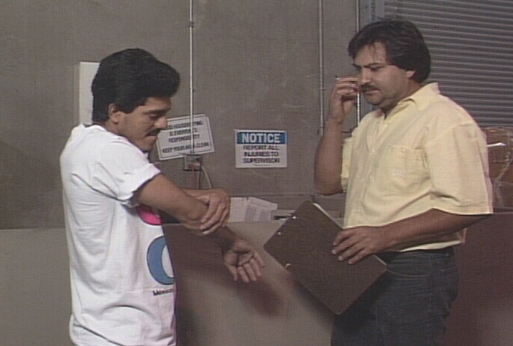
Accident Reaction – and Prevention
It’s important that Accident Prevention is part of reacting to an accident
To prevent future occurrences, accidents are usually handled in three stages:
Accident Response
Accident Investigation
Corrective Actions
Notes:
Some workplaces only practice accident reaction, instead of accident reaction and accident prevention.
Accident reaction is investigating an accident after it happens to determine the cause or causes, then implementing corrective measures to prevent the accident from happening again.
Accident prevention is identifying and eliminating potential causes before an accident occurs.
That’s why accidents are generally handled in three stages:
Accident Response
Accident Investigation, and
Corrective Actions.
Suggestions for the Speaker
You might want to describe this accident to trainees, then ask why accident prevention would be an important part of the follow-up:
At one manufacturing plant, a safety device on an entry door to a large machine had been disabled. A worker was inside the machine doing routine maintenance when another worker restarted the machine without checking inside it. The employee who was inside the machine became trapped and was killed.

Slide 10
Responding to an Accident
The first priority when responding to an accident is to make sure other workers are safe from harm and tending to anyone who might have been injured
It’s important to secure the scene after an accident, to make sure no one else gets hurt
It’s also important not to disturb anything that could help in the Accident Investigation
Notes:
There are several steps to take in response to an accident. The first priority, of course, is to make sure other workers are in a safe area and to tend to the injured employee. If outside emergency services are necessary, make sure they’ve been contacted.
Secure the scene where the accident took place, to make sure no one else could wander into the area and possibly be injured.
Another reason it’s important to secure the scene is because of evidence that could be valuable in the accident investigation. Such evidence could be critical to determining the cause of the accident.
Don’t try to collect any evidence yourself or disturb the scene in any way, unless a supervisor has asked for your assistance.
Suggestions for the Speaker
It’s probably a good time to ask trainees if anyone has ever witnessed a workplace accident. Why might witnesses to an accident be an important part of the investigation?

Slide 11
Investigating an Accident
An Accident Investigation is a standard part of following up such workplace incidents
If you were involved in the accident, you’ll be part of the Accident Investigation
Even if you weren’t involved, you might be part of the Accident Investigation
Honesty is essential – lives could depend on it
Notes:
For any accident that occurs in the workplace, supervisors must fill out and submit a series of forms and other paper work. But there’s more to it than paper work. That’s why an Accident Investigation is conducted.
If you’re involved in the accident, you will be involved in the Accident Investigation. Do your best to remember exactly what happened.
Even if you weren’t involved in the accident, you could find yourself involved in the Accident Investigation. That’s because investigating an accident is more than just filling out some forms.
If you were a witness to an accident, you can expect to be interviewed one-on-one. This is a standard part of many Accident Investigations. It’s important that you’re honest – your co-workers’ lives could depend on it.

Slide 12
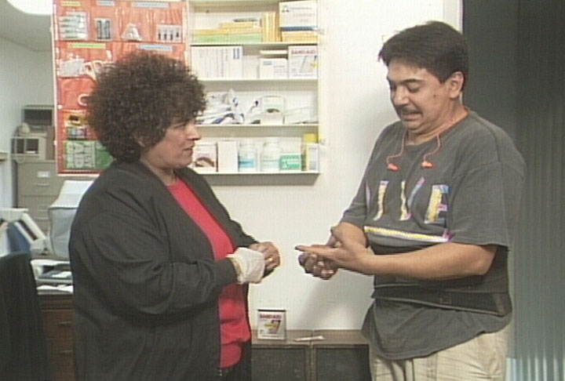
Taking Corrective Actions
The final step would be to follow an Accident Investigation with suggestions for Corrective Actions
Your feedback and participation are important
If you ever have any questions, please ask
Notes:
The third and final step in making sure an accident won’t happen again is to follow up the Accident Investigation with Corrective Action.
Corrective Actions are identified after the cause of the accident has been determined. Corrective Actions usually are a part of the Accident Report.
Your feedback and participation are an important part of this process, too.
Through your feedback, supervisors can gain insights to proper Corrective Actions.
Your participation in the Corrective Action phase is critical. If Corrective Actions are implemented in the area where you work, it’s vital that you understand and observe them. It’s essential that if you have any questions at all, you ask those questions and obtain the information or training you need to work safely.
Suggestions for the Speaker
To get a discussion going among trainees, you might to ask them: “Why do you think some people are afraid to ask questions about a part of their job or a process they don’t understand?”

Slide 13
Analyzing Job Safety
You are observed informally every day
A Job Safety Analysis is a formal observation
There are three elements to a Job Safety Analysis:
Sequence of job steps
Potential hazards
Actions to prevent hazards
Notes:
Supervisors, managers and your co-workers are always watching out for you. Supervisors observe you informally on the job every day.
One method that’s often used to identify potentially hazardous jobs is conducting a Job Safety Analysis.
A Job Safety Analysis generally has three elements:
Sequence of basic job steps
Potential hazards at each step, and
Recommended actions or procedures to prevent potential hazards.
As part of your specialized training for an individual process or piece of equipment, you should be able to identify these elements.

Slide 14
Your Role in Safety
It’s essential that each employee take an active role in staying safe on the job
This means always being aware of the consequences of choosing to take unsafe actions
No matter how many times you’ve done something, it’s critical to observe each and every safety step
You are the most important element in working safely
Notes:
When it comes to going home safely every day, there’s only so much your supervisors can do. We can make sure the place where you work is safe. We can make sure you have the training and the proper tools to do the job. We can provide you with the proper Personal Protective Equipment you need to be safe on the job.
But we can’t stand watch over you every moment of the workday. That’s why it’s important that each employee take an active role in maintaining his or her own safety on the job.
This means you must always keep in mind the consequences of what can occur when you choose to take unsafe actions in the workplace. We can teach good habits, but only you can exercise those good habits.
No matter how skilled you are at what you do or how long you’ve been doing it, it’s absolutely critical that every safety step be observed each and every time you engage in a potentially dangerous action or process.
Part of our goal as supervisors is to send you home safely at the end of each and every day. But we need your help and cooperation to do that.

Slide 15
Summary
Accidents are caused by unsafe conditions and by people committing unsafe acts
Knowledge and training help keep people from committing unsafe acts
When an accident occurs, there will be:
Accident Response
Accident Investigation, and
Corrective Actions
You are the key to accident prevention
Notes:
Accidents don’t “just happen.” They are usually caused by unsafe conditions or by people committing unsafe acts.
Your managers and supervisors, and you and your co-workers, all work together to prevent unsafe conditions. The best way to prevent people from committing unsafe acts is to make sure they’re knowledgeable about the process and the risks, and they are well-trained.
Any time an accident does occur in the workplace, three things will follow:
Accident Response
Accident Investigation, and
Corrective Actions.
Even if you weren’t involved in the accident, you could be impacted by the Corrective Actions.
The bottom line: You are the best form of accident prevention.

