Slide 1
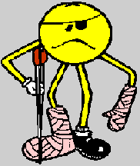
Young Workers in WA between the ages of 15 and 24 are at
High Risk of Major Work-Related Injuries
Don’t let your first day at work be your worst day!
(Worksafe Australia)

Slide 2
Occupational Safety and Health Laws in WA aim to make Workplaces
Safer and to Reduce the Incidence of
Injury and Disease caused by work.
LO1 - OHT 1

Slide 3
The Objectives of the OSH Act are:
To promote and secure the safety and health of people at work.
To protect people at work against hazards.
To assist in securing safe and hygienic work environments.
To reduce, eliminate and control the hazards.
To foster co-operation and consultation between employers and employees.
To promote education and community awareness.
LO1 - OHT 2

Slide 4
Some of the Workplaces covered by the OSH laws include:
offices
hospitals
factories
construction sites
boats
aircraft
vehicles
forest areas
A workplace is any place where employees work or are likely to be in the course of their work.
LO1 - OHT 3

Slide 5
Workplace Safety and Health Laws apply to you if you are:
an employer
an employee
self-employed
working in a family business
in control of a workplace
a person who designs, manufactures, imports or supplies any plant or substance for use at a workplace.
LO1 - OHT 4

Slide 6
DUTIES OF EMPLOYERS
Employers must, so far as is practicable,
provide and maintain
a working environment
where employees are not exposed to hazards.
General Duties Include:
safe systems of work;
information, instruction, training and
supervision;
consultation and co-operation;
personal protection;
safe plant and substances; and
reporting of accidents.
LO1 - OHT 5

Slide 7
DUTIES OF EMPLOYEES
Employees must take reasonable care for their
own safety and health at work
and for the
safety and health of other people.
General Duties Include:
following safety and health instructions;
using personal protective clothing and equipment;
taking care of equipment;
reporting hazards;
reporting work-related injuries or harm to health;
and
co-operating with employers.
LO1 - OHT 6

Slide 8
CONSULTATION
The OSH Act requires consultation
between employers and employees in the
workplace.
Consultation promotes:
open communication;
co-operation;
access to the wide range of knowledge and experience held by employees and employers;
speedy resolution of issues and disputes;
active and informed participation by employees in the management of workplace safety and health;
shared ownership of safety and health goals.
LO2 - OHT 1

Slide 9
FUNCTIONS OF
SAFETY & HEALTH REPRESENTATIVES
Inspect the workplace.
Investigate accidents & dangerous occurrences.
Investigate risk of serious injury to, or harm to the health of, any person.
Keep informed on safety and health information.
Report hazards to the employer.
Refer matters to safety and health committee (if present).
Consult and co-operate with the employer.
Liaise with employees.

Slide 10
SAFETY & HEALTH COMMITTEES
Are made up of:
the safety and health representatives, if any;
the person(s) elected by the employees for this committee;
the person(s) nominated by the employer for this committee.
OSH Committee Functions include:
facilitating consultation and co-operation between employer and employees;
keeping informed on Standards;
making recommendations to employer and employees about occupational safety and health issues;
keeping information accessible;
considering proposed changes to the workplace; and
considering matters referred by representatives.

Slide 11
A WORKPLACE HAZARD IS
. . . anything in the workplace which could
cause an injury or illness to people at work.
A WORKPLACE RISK
IS
. . . the likelihood that a particular hazard will cause injury or disease in the way that it is used or occurs in the workplace.

Slide 12
RISK ASSESSMENT
Risk assessment is
the process used to decide
in what order to
manage workplace hazards
eg: work out what are the most serious risks and deal with these first.
The sort of information used to assess the risk includes:
check injury and incident records;
ask the employees about near misses and unreported minor injuries and harm to health;
check how the hazard affects people in the area;
take note of the number of people who are placed at risk during a given time - say a day or a week;
talk to employees who have had past experience with the identified hazard;
use a 1-10 probability scale of injury or disease symptoms occurring within a set time, say six months, a year or five years.
LO3 - OHT 2

Slide 13
IDENTIFYING HAZARDS
Identifying hazards means recognising anything
in the workplace that may cause injury or harm
to the health of a person.
IDENTIFY HAZARDS BY LOOKING AT:
records of injuries or disease (including “near misses” or incidents) occurring in the workplace;
what is happening in other similar workplaces;
appropriate publications such as Codes of Practice, Guidance Notes and material safety data sheets;
walk through inspections of the workplace (checklists may be useful);
consultation with employees and their representatives to find out what problems they may have in performing their jobs;
by anyone in the workplace at any time, through a clear workplace hazard reporting procedure; and
consultation with OSH specialists, other employers in the industry, government regulatory bodies.
LO3 - OHT 3

Slide 14
MULTIPLE CAUSES OF ACCIDENTS
OUTCOME OF AN INCIDENT eg: injury, harm to health, property damage, production loss.
INCIDENT OCCURS
IMMEDIATE CAUSES (the tangible events immediately before the incident occurred) eg:
UNSAFE ACTS (removing safety devices; failing to use personal protective equipment properly etc.)
UNSAFE CONDITIONS (inadequate guards or barriers; poor housekeeping - untidy workplace etc.)
BASIC CAUSES (the reasons why the immediate causes occurred) eg:
stress, tiredness, lack of knowledge or skill;
inadequate guards or barriers, maintenance, engineering & design, training & supervision.
MANAGEMENT / SYSTEMS FACTORS eg:
inadequate leadership and commitment by employer
inadequate planning and programs for managing safety and health
inadequate process for identifying hazards
inadequate instruction, training and supervision

Slide 15
REMEMBER!
Injuries and disease are seldom, if ever, caused by one thing. They are almost always the result of multiple causes.
This is why everyone
in the workplace must be regularly
checking for hazards.
LO3 - OHT 5

Slide 16
HIERARCHY OF
RISK CONTROL
CONTROL THE RISK BY:
1. ELIMINATING THE HAZARD ALTOGETHER
2. SUBSTITUTION eg: using a non-flammable solvent in place of a flammable one.
3. ENGINEERING CONTROLS eg: modification of machinery, tools and equipment.
4. ADMINISTRATIVE CONTROLS eg. changing work practices such as reducing period of exposure to the hazard by shorter shifts.
5. PROTECTIVE CLOTHING AND EQUIPMENT

Slide 17
TYPES OF HAZARDS
The following are examples of the types of hazards likely to be found in the workplace, and specific examples:
Gravity eg: falling objects, falls of people
Kinetic energy eg: projectiles, penetrating objects
Mechanical energy eg: skin contact, inhalation
Hazardous substances eg: skin contact, inhalation
Thermal energy eg: spills and splashes of hot matter
Extremes of temperature eg: effects of heat and cold
Radiation eg: ultraviolet, arc flashes, microwaves, lasers
Sound eg: hearing damage
Electrical eg: shock, burns
Vibration eg: to hands
Biological eg: micro -organisms
Stress eg: unrealistic workload and expectations

Slide 18
INJURIES TO BE REPORTED TO WORKSAFE
WESTERN AUSTRALIA
Injury that results in the death of the employee
Fracture of the skull, spine or pelvis
Fracture of any bone in
- the arm (not wrist or hand)
- leg (not ankle or foot)
Loss of sight of an eye
Injury resulting in likely absence from work of 10 or more working days

Slide 19
PHONE IN INJURY INFORMATION TO WORKSAFE
WESTERN AUSTRALIA ON:
Employer’s name and business address
Address of workplace where injury occurred
Type of workplace where injury occurred (eg: office, construction site, foundry, factory, bar)
Name of injured person
- Occupation
- Age
- Sex
Nature of injury
Brief description of how injury occurred (giving an as objective and specific account as possible)
Place injured person was removed to
Name of person reporting injury
- position
- contact phone number
Name and contact phone number of a liaison person

Slide 20
THE PURPOSE OF REPORTING AND INVESTIGATING INCIDENTS, INJURY & DISEASE
To look at what incidents are occurring in a particular workplace, and take steps to prevent these incidents from re-occuring
Employers can compare their experience with aggregate data for industry as a whole (either through employer’s industry association or with State/Territory and national workers’ compensation-based statistics)
Aggregate picture obtained eg: of industries, occupations, age groups, experience/inexperience and literacy levels at the industry, state and national level

Slide 21
NEAR-MISSES
A near-miss incident is an undesired event in the workplace that, under slightly different circumstances, could have resulted in injury or disease.
Near-misses are sometimes referred to as “free lessons in safety”.
Near-misses provide a warning of uncontrolled hazards in the workplace!

Slide 22
REASONS FOR A VISIT BY A WORKSAFE WESTERN AUSTRALIA INSPECTOR
An inspector may visit a workplace when:
1. the employer, the safety and health representative or an employee (if there is no safety and health representative) has notified an inspector after unsuccessfully attempting to resolve a safety and health issue according to the Act, and where there is risk of imminent and serious injury or harm to health;
2. to investigate incidents involving death, injuries or dangerous situations involving possible breach of the Act or Regulations or non-compliance with an improvement notice, prosecution action or verbal direction; or
3. as part of other prevention and workplace assessment programs.

Slide 23
SPECIFIC HAZARDS
NOTE: The following overheads are intended to provide useful discussion points to start an awareness raising training session on specific hazards.
They do not “cover” the subject of each specific hazard.
MANUAL HANDLING
ELECTRICITY
FALLS
HAZARDOUS SUBSTANCES
POWERED MOBILE PLANT

Slide 24
MANUAL HANDLING.
Any activity requiring the use of force
exerted by a person to:
Lift,
Lower
Push,
Pull,
Carry or otherwise
Move,
Hold or
Restrain
a person, animal or thing.

Slide 25
PRIORITY OF CONTROLS FOR RISKS TO MANUAL HANDLING
Priority 1
JOB RE-DESIGN
Priority 2
MECHANICAL HANDLING EQUIPMENT
Priority 3
TRAINING

Slide 26
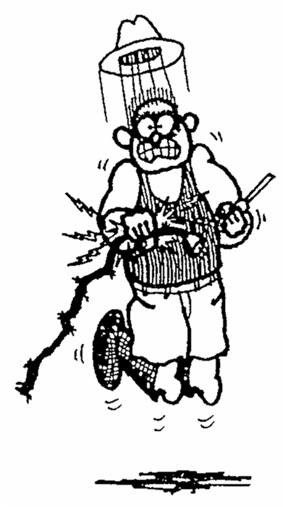
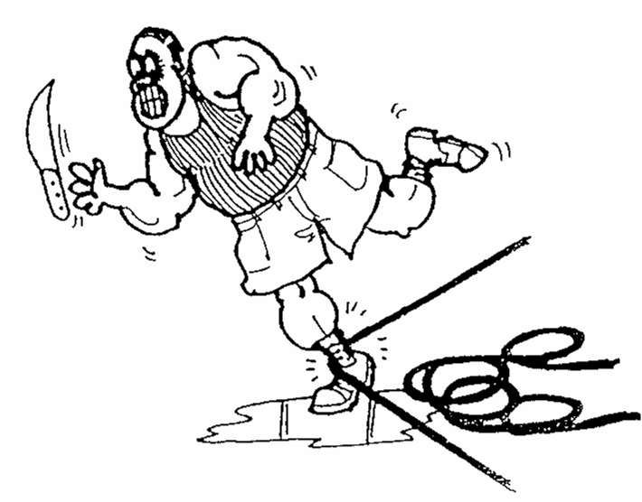

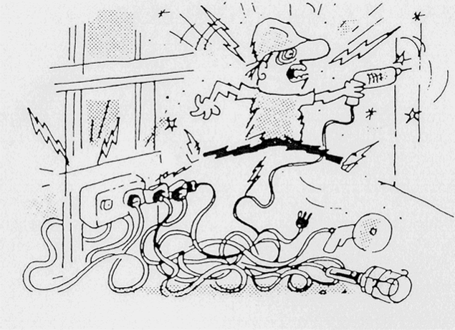
ELECTRICITY
KILLS INSTANTLY
ELECTRICITY
USE A LICENCED ELECTRICAL CONTRACTOR
THE OFFICE OF ENERGY

Slide 27
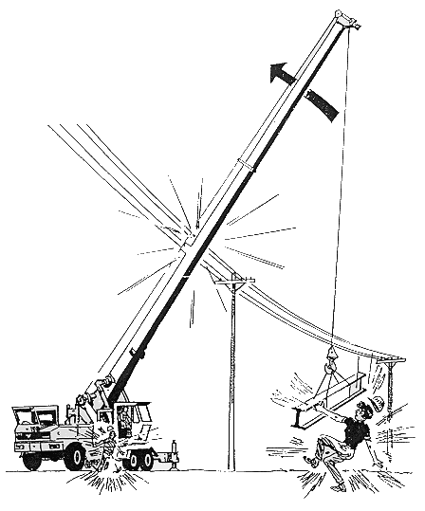

Slide 28
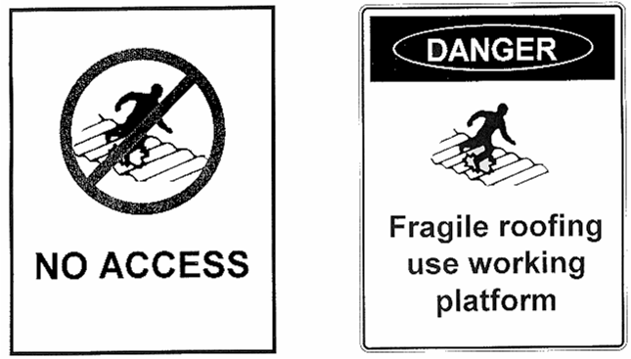
FALLS

Slide 29
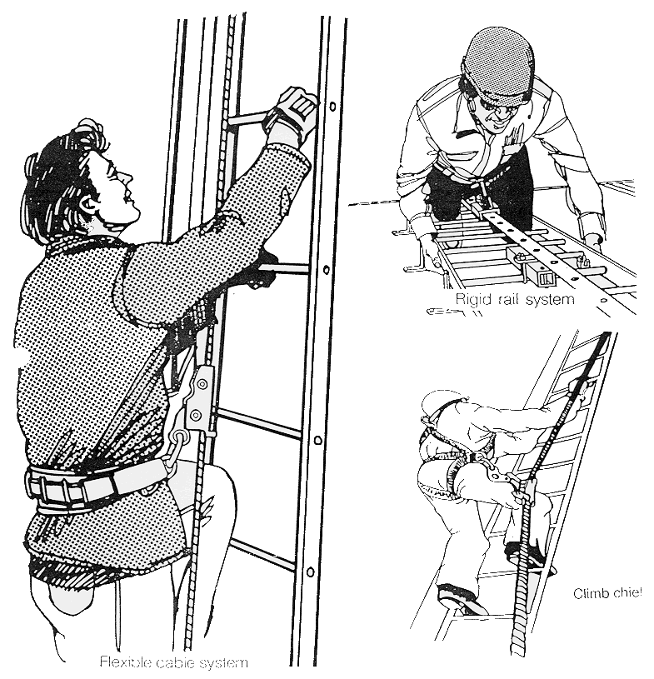
LADDER SAFETY SYSTEMS

Slide 30
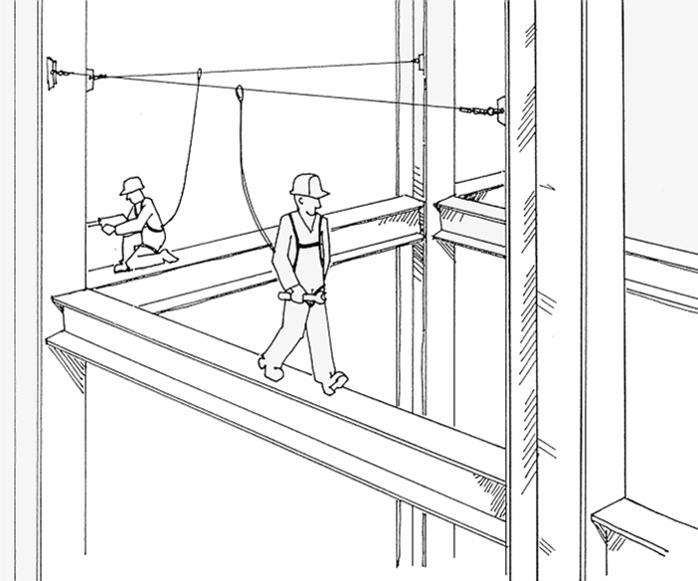

Slide 31
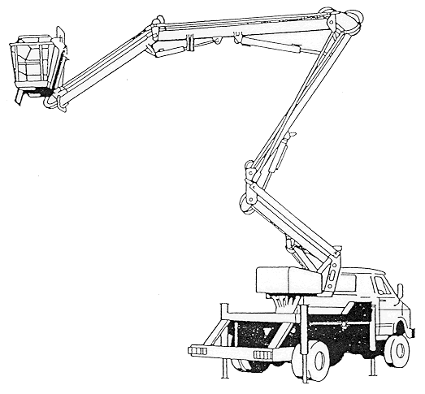
SAFETY CHECKLIST mobile elevating work platforms
Daily inspection completed
Safety harnesses and helmets worn
Wind speed not excessive
Signs-barriers erected
Authorised operative - fully fit
SWL not exceeded
All clear overhead
Ground conditions satisfactory
Outriggers and stabilisers
Machine level
No cellars or - drains beneath
Tools-materials secure
Platform not slippery or obstructed
Work within specified reach of unit
If movement planned, route clear and safe
No restricted or confined space hazards

Slide 32
WHAT IS A HAZARDOUS SUBSTANCE?
HAZARDOUS SUBSTANCES
ANY TYPE OF CHEMICAL THAT CAN HARM HUMAN HEALTH
(INCLUDING THE UNBORN CHILD)
THE CHEMICAL COULD BE A:
LIQUID
SOLID
GAS
VAPOUR
MIST
DUST
Eg: industrial chemicals, cleaning products, pool chemicals, solvents, pesticides, glues, hair products.

Slide 33
MATERIAL SAFETY DATA SHEET (MSDS)
AN MSDS PROVIDES DETAILED INFORMATION ABOUT A HAZARDOUS SUBSTANCE
MSDS ARE AVAILABLE THROUGH THE
MANUFACTURER OR SUPPLIER
OF A HAZARDOUS SUBSTANCE TO BE USED IN THE WORKPLACE.
AN MSDS TELLS YOU:
THE INGREDIENTS OF THE PRODUCT
THE HEALTH EFFECTS OF THE
PRODUCT AND FIRST AID
INSTRUCTIONS
PRECAUTIONS TO FOLLOW WHEN YOU USE THE
PRODUCT
SAFE HANDLING AND STORAGE INFORMATION
ASK FOR AN MSDS IF ONE IS NOT SUPPLIED.
READ THE MSDS CAREFULLY.

Slide 34
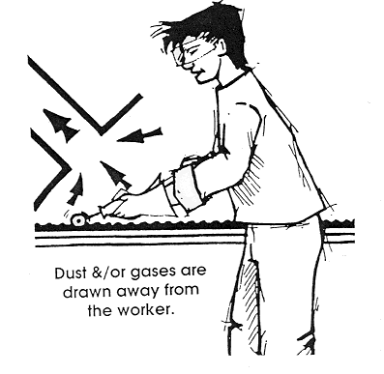
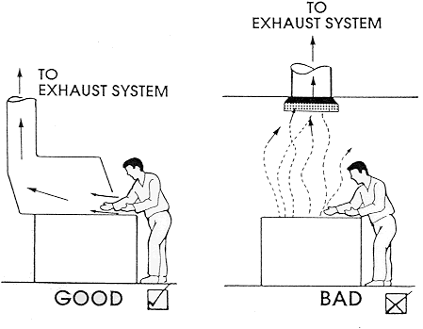
HAZARDOUS SUBSTANCES
LOCAL EXHAUST VENTILATION CAPTURES AIR CONTAMINANTS
(EG: SOLVENT VAPOURS, HYDROGEN SULPHIDE)
Local Exhaust Ventilation is the most effective way to clear the air if the workplace is dusty or there are gases or vapours in the air.

Slide 35
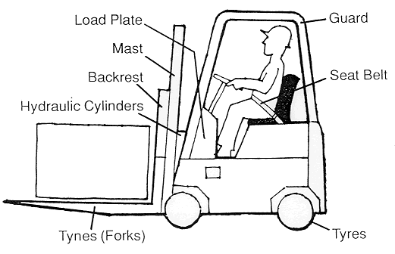
POWERED MOBILE PLANT
Any plant driven other than by human or animal power. It is
designed to move during use, from one location of operation
to another eg:
Earthmoving machinery
Industrial lift trucks
Mobile cranes
Tractors and forklifts are powered mobile plant.
FORKLIFT

Slide 36
POWERED MOBILE PLANT
ALL POWERED MOBILE PLANT IS POTENTIALLY HAZARDOUS IF I IS NOT USED PROPERLY.
IT CAN CAUSE SERIOUS OR FATAL ACCIDENTS.
EMPLOYERS MUST PROVIDE SAFE SYSTEMS OF WORK FOR
THE USE OF POWERED MOBILE PLANT IN THE WORKPLACE.
EMPLOYERS MUST ALSO ENSURE, THROUGH TRAINING
AND SUPERVISION, THAT OPERATORS OF POWERED
MOBILE PLANT:
do not start powered mobile plant unless seated
at the operating controls
do not attempt to get on or off moving powered
mobile plant
do not get off or work on powered mobile plant
while the engine is running, unless the parking
brake is on and the transmission is in neutral or part
do not use platforms to transport workers
use operator restraint devices at all times
observe speed limits and other traffic signs

Slide 37
POWERS OF WORKSAFE WESTERN AUSTRALIA INSPECTORS
Inspectors have powers to:
enter and inspect any workplace:
take samples, photographs and copies of any document; and
interview any employee in private and require than to answer questions.

