Slide 1
And here are the winners of the competition:
SAFETY AT WORK

Slide 2
10th place

Slide 3
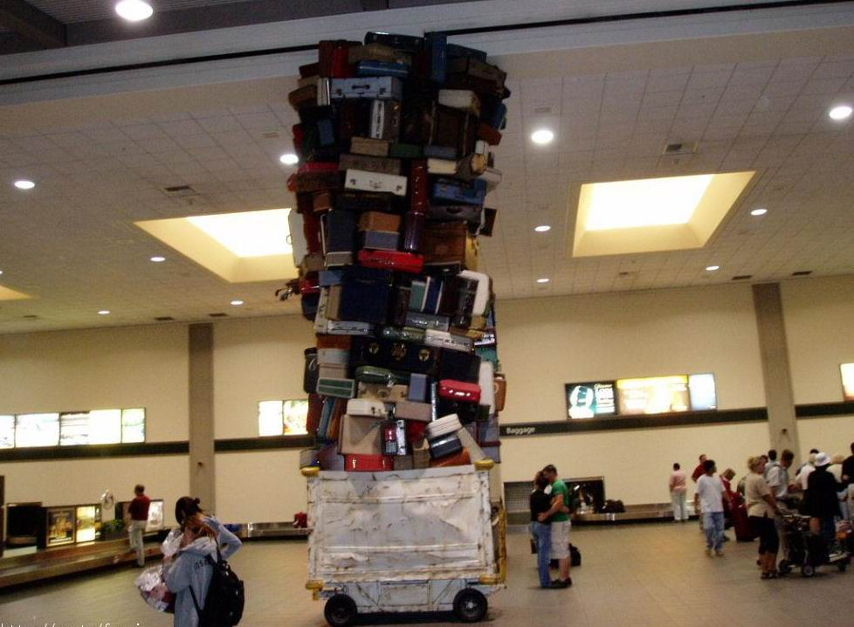

Slide 4
9th place

Slide 5
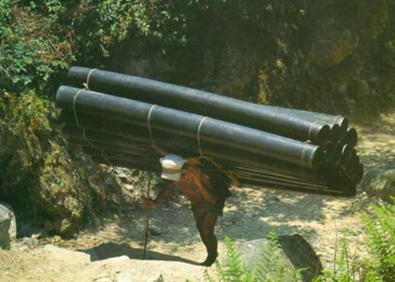

Slide 6
8th place

Slide 7
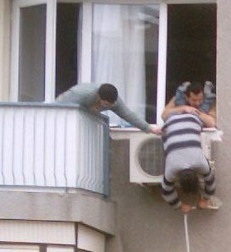

Slide 8
7th place

Slide 9
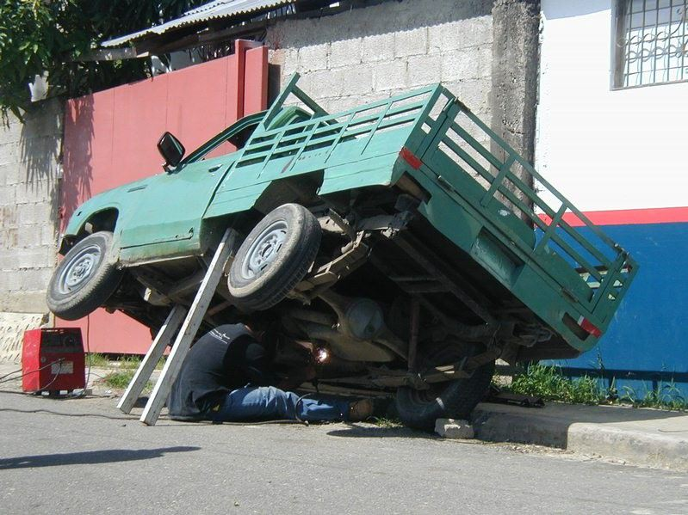

Slide 10
6th place

Slide 11
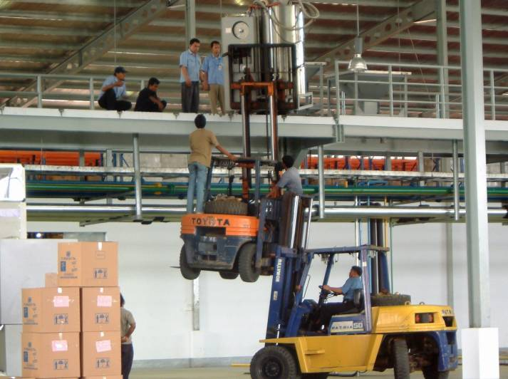

Slide 12
5th place

Slide 13
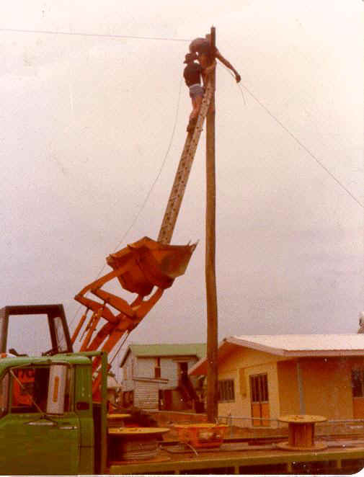

Slide 14
4th place

Slide 15
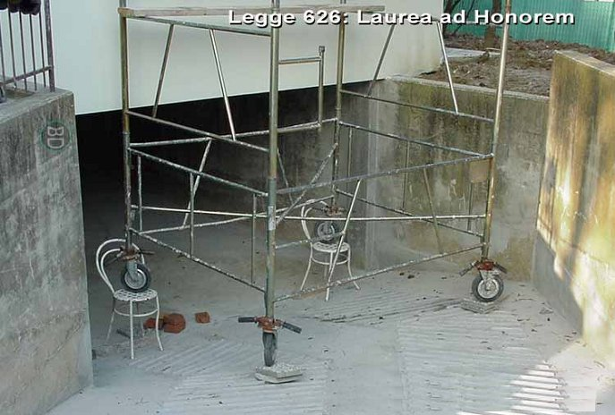

Slide 16
3rd place

Slide 17
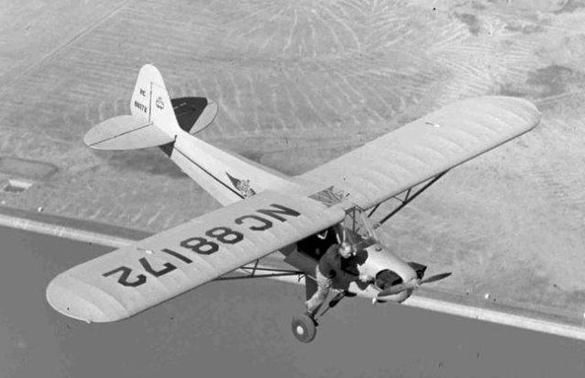

Slide 18
2nd place

Slide 19
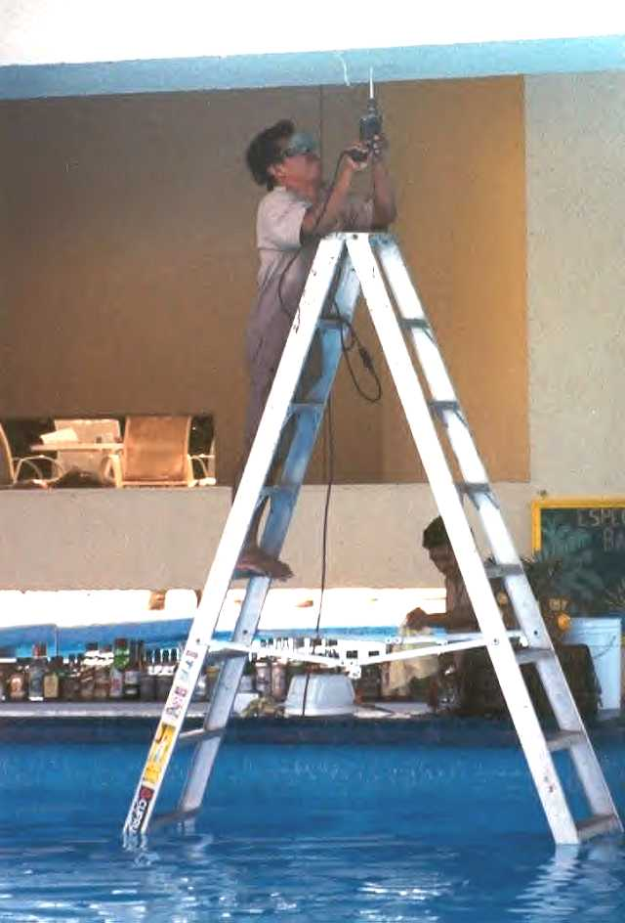

Slide 20
And the WINNER is…..

Slide 21
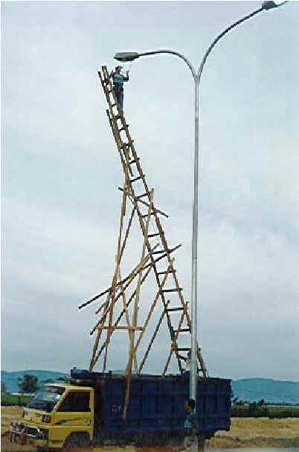

Slide 22
Outside competition :
„nec plus ultra“

Slide 23
