Slide 1
TILT-UP CONSTRUCTION
Topics to be covered:
BCA Requirements
AS 3850 - 2003
Construction methods
Safety issues
Code of practice
22-Dec-12
Karl Boeing

Slide 2
Section C Fire Resistance
SPECIFICATION C1.11 PERFORMANCE OF EXTERNAL WALLS IN FIRE
Deemed-to-Satisfy Provisions
3 General requirements for external wall panels
Intent
To provide general requirements for external wall panels which will minimise the risk of them collapsing in a fire and causing death and/or injury.
22-Dec-12
Karl Boeing

Slide 3
BCA Requirements
BCA Volume One
Section C Fire Resistance
FIRE RESISTANCE
PART C1 FIRE RESISTANCE AND STABILITY (Deemed-to- Satisfy Provisions)
C1.11 Performance of external walls in fire
  Concrete external walls that could collapse as complete panels (eg. tilt-up and precast concrete), in a building having a rise in storeys of not more than 2, must comply with Specification C1.11.
22-Dec-12
Karl Boeing

Slide 4
SPECIFICATION C1.11
PERFORMANCE OF EXTERNAL WALLS IN FIRE
(Deemed-to-Satisfy Provisions)
Scope
  1 This Specification contains measures to minimise, in the event of fire, the likelihood of external walls covered by Clause 2 collapsing outwards as complete panels and the likelihood of panels separating from supporting members.
2 Application
This Specification applies to buildings having a rise in storeys of not more than 2 with concrete external walls that could collapse as complete panels (eg. tilt-up and precast concrete) which-
  (a) consist of either single or multiple panels attached by steel connections to lateral supporting members; and
  (b) depend on those connections to resist outward movement of the panels relative to the supporting members; and
  (c) have height to thickness ratio not greater than 50.
22-Dec-12
Karl Boeing

Slide 5
'Tilt-up construction‘
  CP5 is intended to overcome a problem observed when a fire has occurred in a building of 'tilt-up construction', and the panels have collapsed outwards, either during the fire or shortly after with little or no warning, endangering public safety, health, amenity and fire fighting operations.
  A wide variety of structural systems and materials are possible to achieve this.
  CP5 is only applicable to walls that could collapse as complete panels and, therefore, is not applicable to concrete and clay masonry walls, and the like, because such walls tend to fail in portions, rather than as complete panels.
  The height limitation of 2 storeys is based upon the observation that the problem only seems to occur in low-rise buildings. This is due to taller buildings usually having fire rated floors and other building elements to restrain wall panels during a fire.
22-Dec-12
Karl Boeing

Slide 6
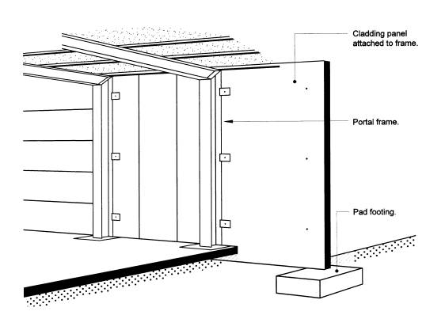
Figure Spec C1.11(1)
TYPICAL NON-LOADBEARING PANELS REQUIRED TO COMPLY WITH SPECIFICATION C1.11 (PANELS MAY BE FULL BAY, MULTIPLE VERTICALLY OR HORIZONTALLY SPANNING)
22-Dec-12
Karl Boeing

Slide 7
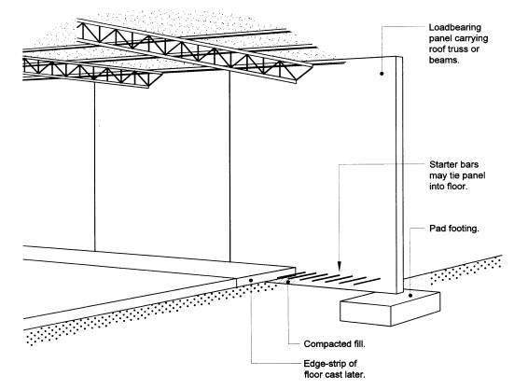
Figure Spec C1.11(2)
TYPCIAL LOADBEARING PANELS REQUIRED TO COMPLY WITH SPECIFICATION C1.11
22-Dec-12
Karl Boeing

Slide 8
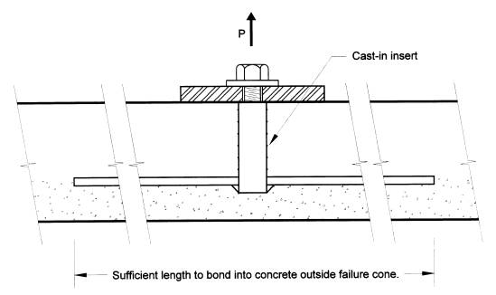
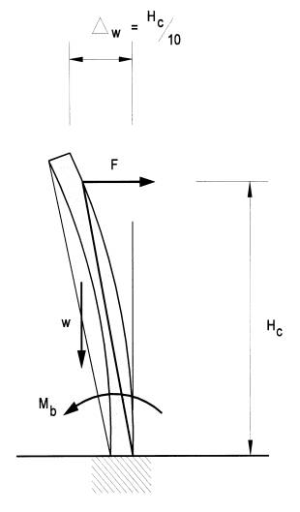
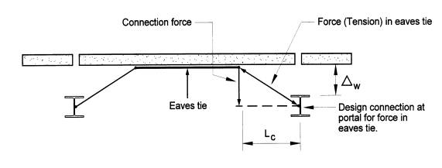
Figure Spec C1.11(3)
TYPICAL ANCHOR BARS FOR INSERTS
Figure C1.11(4)
FORCES TO PULL PANEL INWARDS
Figure Spec C1.11(5)
FORCES IN EAVES TIE
22-Dec-12
Karl Boeing

Slide 9
QUESTIONS ON BRACING TILT-UP PANELS
What wind velocity should panels be braced for?
Due to the variation in moisture content and gusts, wind bracing is normally designed for a particular force. Most panels are designed for a 15 pounds per square foot wind force with a safety factor of 1-1/2. This amounts to approximately a 65-mile-per-hour wind with gusts.
What safety factor is necessary for brace design?
Most designers use a minimum safety factor of 1-1/2.
How many braces are needed per panel?
A minimum of two are needed for aligning the panel, but large panels require more. Check with the design charts provided with the erection design for type and quantity of braces.
When should the braces be attached to the panel?
When they are still on the casting bed if at all possible. It speeds and simplifies the erection when the braces are raised with the panels.
What do I brace to if the floor isn't available?
Have a deadman designed for job site conditions, including the soil type and grade elevations.
22-Dec-12
Karl Boeing

Slide 10
QUESTIONS ON BRACING TILT-UP PANELS (continued)
Are there any precautions necessary when bracing to the floor?
Be certain that the floor is of adequate thickness and strength. The inserts should not be near edges or joints, and must be placed in large enough slab sections to withstand uplift forces.
When and how should braces be removed from panels?
The panel should be removed after the roof connections and/or diaphragm are completed. Braces should be disconnected from the floor first, and then carefully disconnected at the top and lowered to the ground. If they are dropped or allowed to slide down the wall, they may be damaged.
Can drill-in expansion type anchors be used?
I don't recommend them. The majority requires some skill and certainty of setting that is not always obtained. Even when properly set, the working load with a 4-to-1 safety factor on 3/4" expansion anchors is much lower than the design load of most tilt-up braces.
How do I brace and shore lintel panels?
The panel bracing and shoring should be designed by a professional engineer, and the shores should be braced against lateral movement separately from the panel. All members
22-Dec-12
Karl Boeing

Slide 11
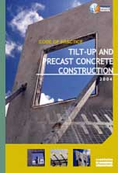
WorkSafe WA
Code of Practice
for Tilt-up and Precast Concrete Construction applies to all workplaces in Western Australia covered by the Occupational Safety and Health Act 1984 where concrete wall panels, whether precast on or off-site, or other precast concrete elements are used in the building and construction industry.
It covers the areas of tilt-up and precast concrete construction where safety is a concern.
You can download a copy of the Code of Practice in Adobe Portable Document Format
http://www.safetyline.wa.gov.au/pagebin/pg003147.htm
22-Dec-12
Karl Boeing

Slide 12
WorkSafe WA
Accident Reports, or Significant Incident Summaries (SIS)
Fake Bolts in Tilt-Up Construction: SIS 13/20008
Tilt-up Panel Falls Over: SIS 4/19996
Tilt-Up Panel Collapses : SIS 51/19995
Code of Practice: Tilt-up and Precast Concrete Construction4
Wrong Bracing Inserts Cause Tilt-Up Panel Collapse: SIS 33/20004
10 Accredited Training Courses: Course in 'Contribute to Safe Tilt-up3
17Collapse of a Tilt-up Concrete Structure : SIS 7/20022
18Precast Concrete Panel Falls Over: SIS 13/20012
22-Dec-12
Karl Boeing

Slide 13
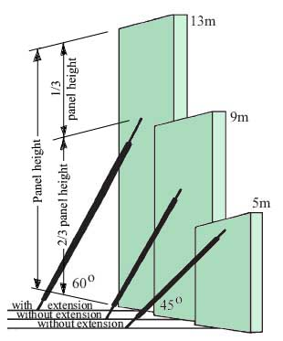
Bracing Information
Bracing should be installed in accordance with AS 3850 and the approved shop drawings
Braces are usually installed at an angle of 45° to 60° and square to the line of the panel
Generally two (2) braces are used to support each panel
Where a single brace is used (eg on narrow panels) to brace a panel particular care is required.
Buried concrete blocks ‘deadmen’ are commonly used to anchor braces and prevent panels falling over due to wind loads or other factors.
A deadman relies both on its mass and cohesion with the ground to resist wind loads tending to pull the deadman out of the ground (i.e. wind
blowing on to the back face of the panel).
22-Dec-12
Karl Boeing

Slide 14
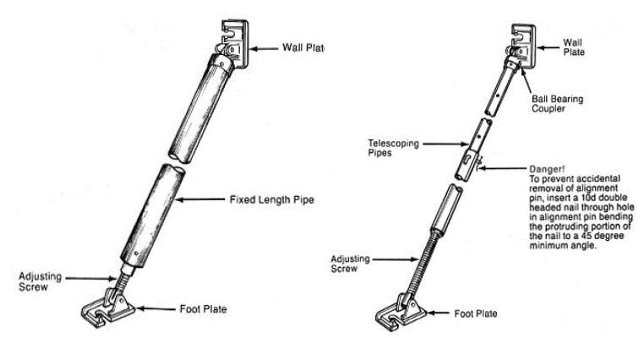
Brace Types
The fixing of the brace to the floor slab should be in accordance with the bolt manufacturers requirements and a complete record of all installation torques be kept including regular in-place checks after installation.
To fix the brace to the footing or panel bolts or nuts with washers of the correct grade and size must be used.
22-Dec-12
Karl Boeing

Slide 15
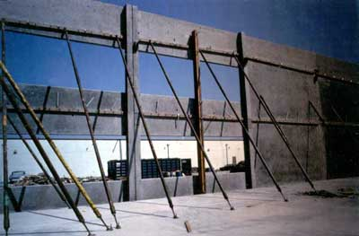
Two storey bracing
22-Dec-12
Karl Boeing

Slide 16
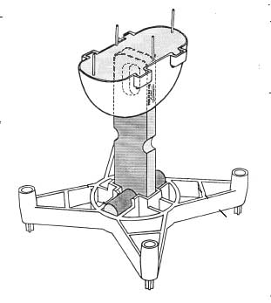
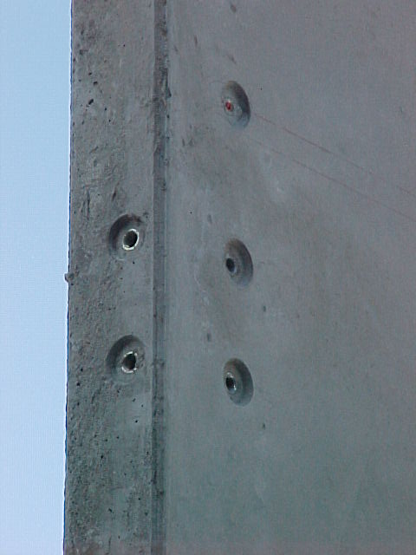
INSERTS
22-Dec-12
Karl Boeing

Slide 17
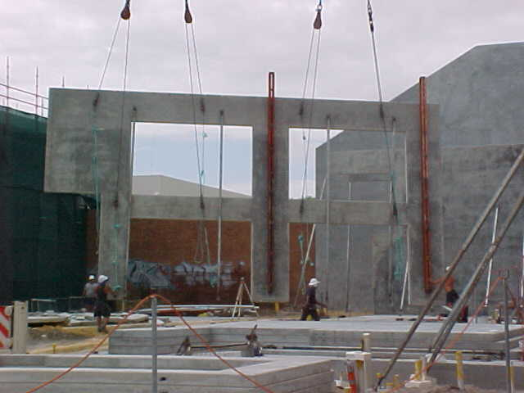
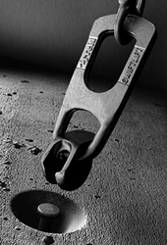
Face and Edge lifting
The rigging configuration, spreader bar length and sling lengths are specified in AS 3850. The crane size and boom lengths are determined by the crane company.
Before the panels are cast, have the crane company representative assist in the layout to ensure that the panels can be lifted in the sequence cast.
22-Dec-12
Karl Boeing

Slide 18
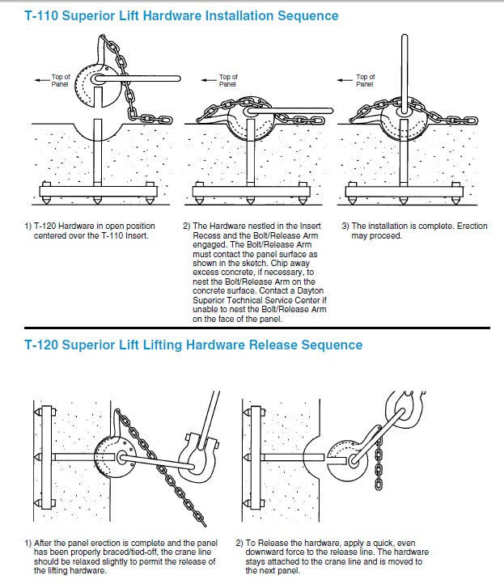
22-Dec-12
Karl Boeing

Slide 19
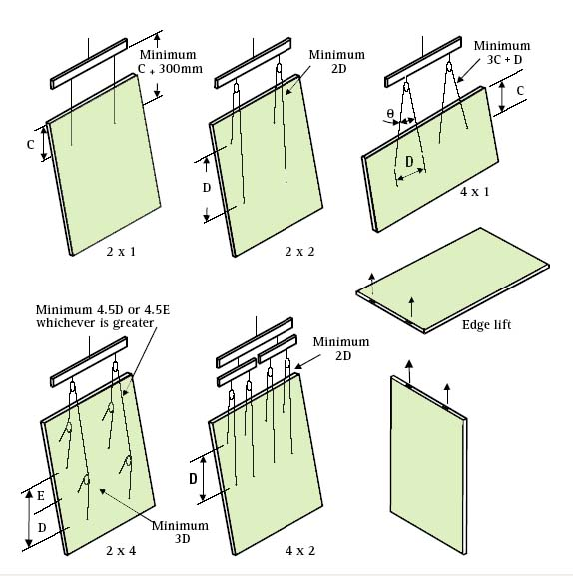
22-Dec-12
Karl Boeing

Slide 20
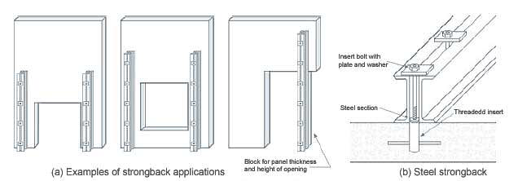
Strongbacks
22-Dec-12
Karl Boeing

Slide 21
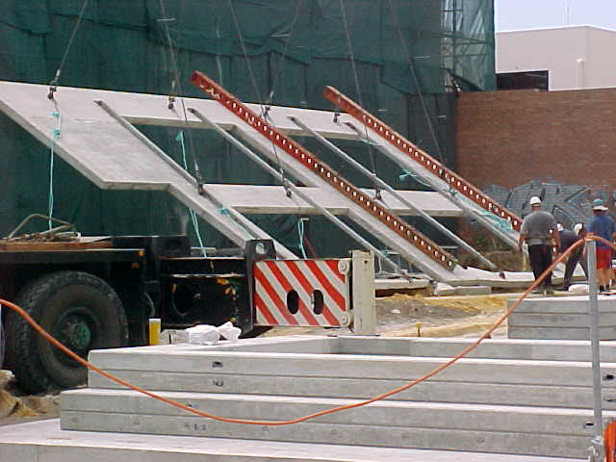
22-Dec-12
Karl Boeing

Slide 22
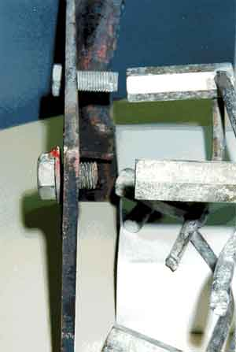
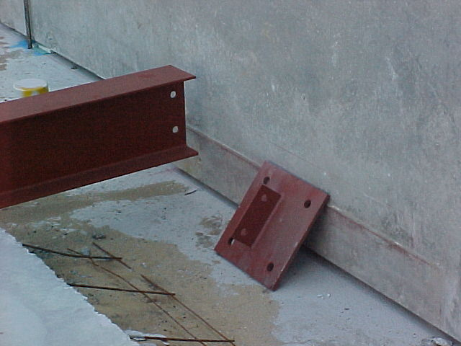
22-Dec-12
Karl Boeing

