Slide 1
II.
Physical Properties

Slide 2
Outline
Soil Texture
Grain Size and Grain Size Distribution
Particle Shape
Atterberg Limits
Some Thoughts about the Sieve Analysis
Some Thoughts about the Hydrometer Analysis
Suggested Homework

Slide 3
1. Soil Texture

Slide 4
1.1 Soil Texture
The texture of a soil is its appearance or “feel” and it depends on the relative sizes and shapes of the particles as well as the range or distribution of those sizes.
Coarse-grained soils:
Gravel Sand
Fine-grained soils:
Silt Clay
0.075 mm (USCS)
0.06 mm (BS) (Hong Kong)
Sieve analysis
Hydrometer analysis
Notes:
Talk about the difference between the clay-size particle or clay minerals.

Slide 5
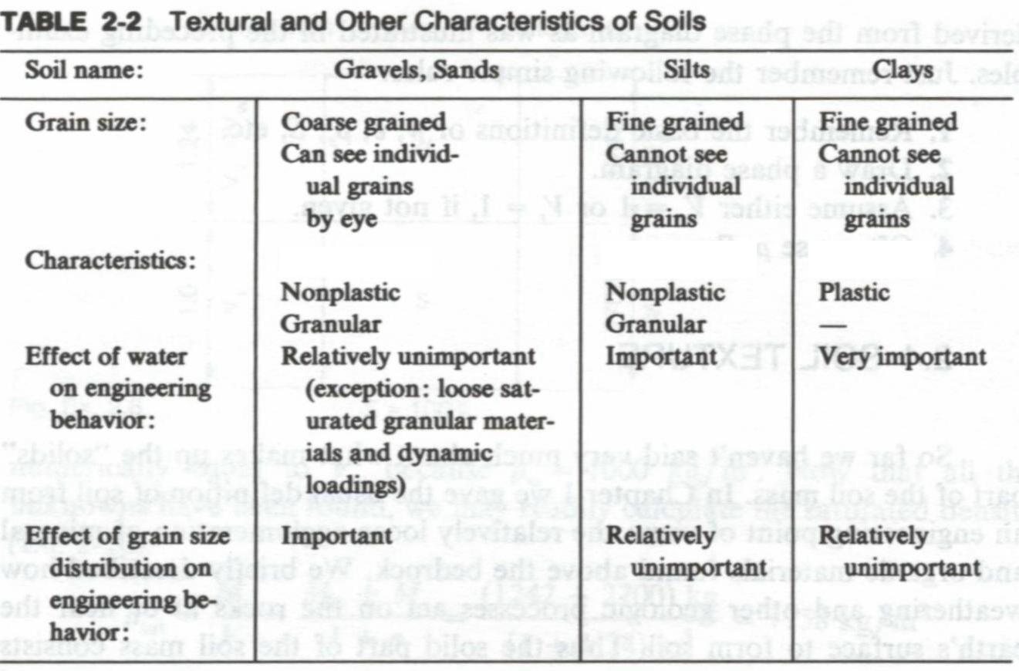
1.2 Characteristics
(Holtz and Kovacs, 1981)
Notes:
Please remind students about the oxymoron of the cohesion and cohesionless.
Change this table

Slide 6
2. Grain Size and Grain Size Distribution

Slide 7
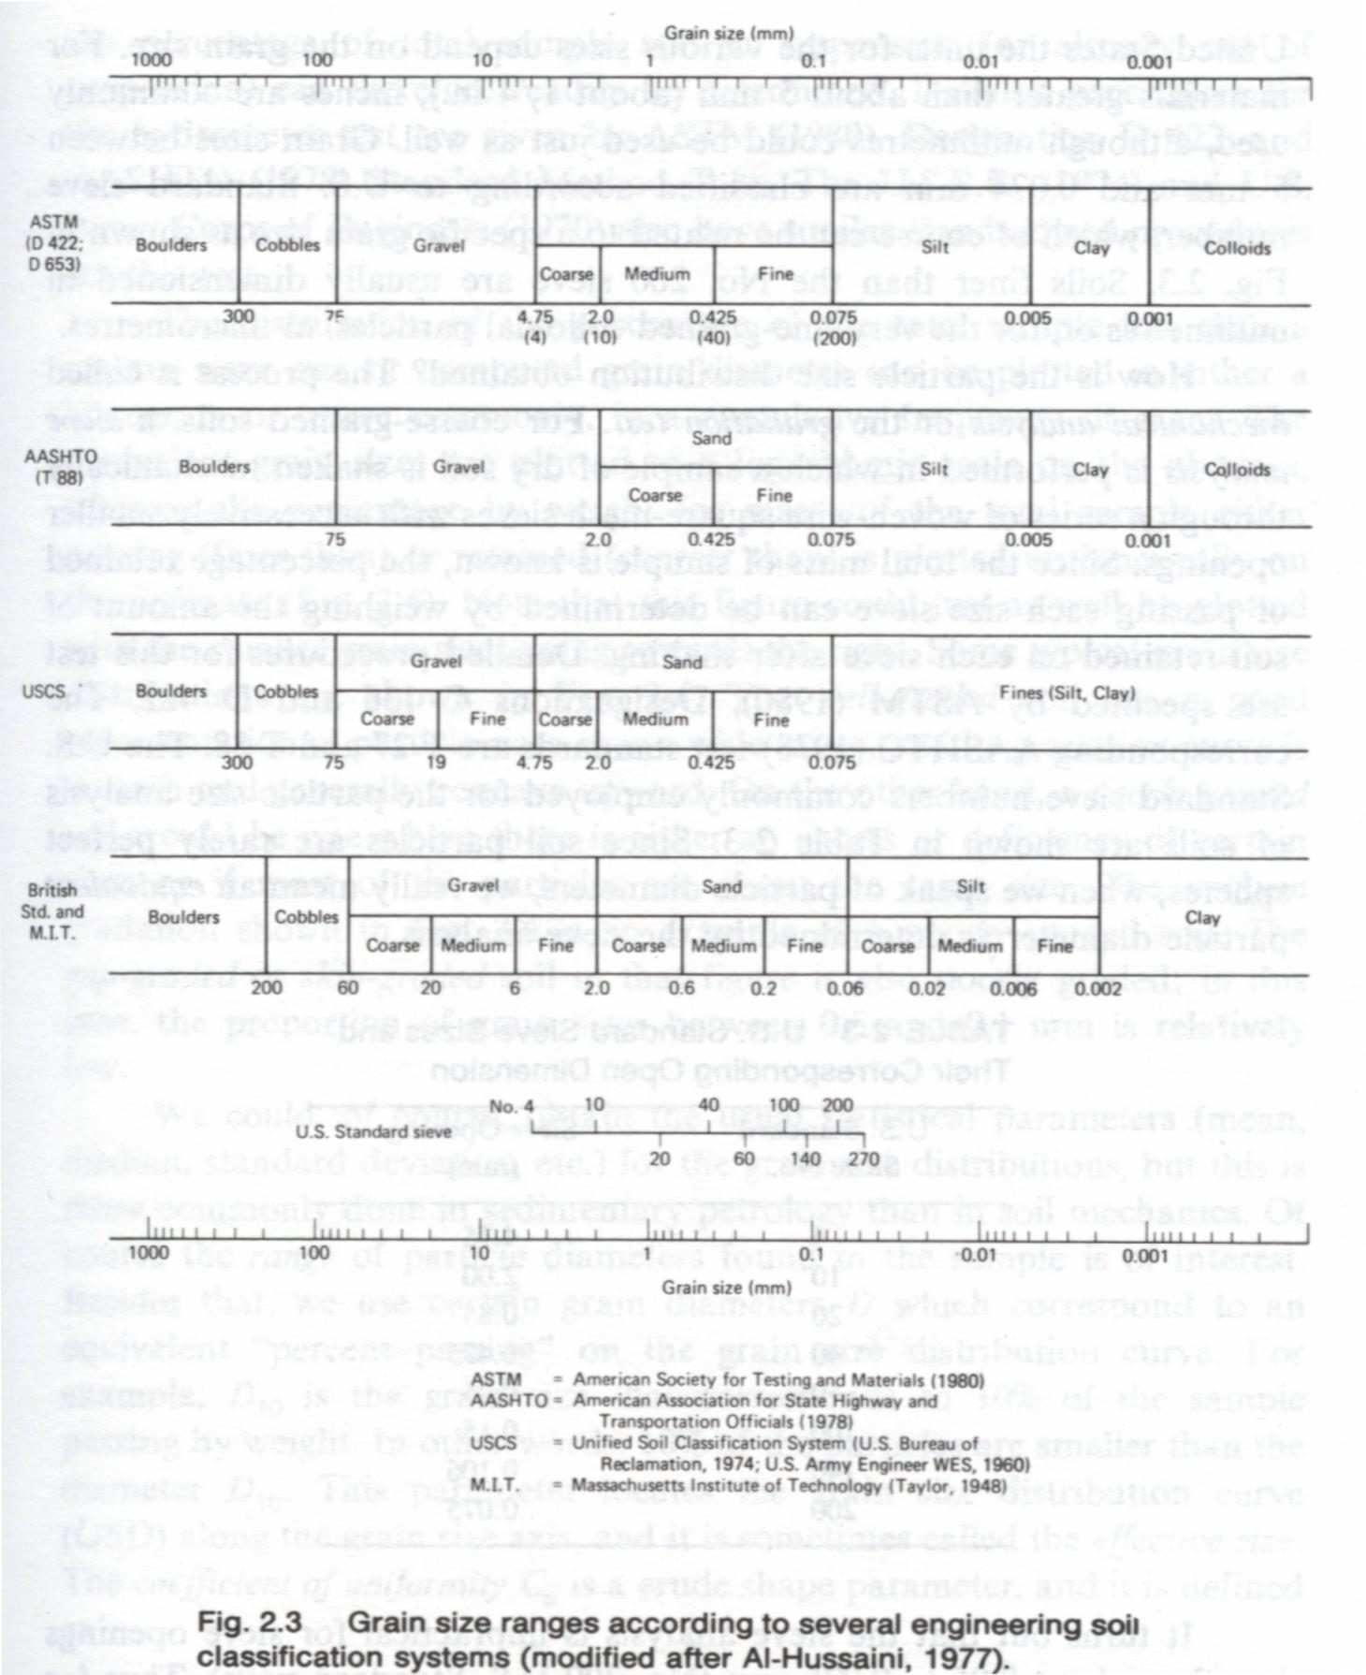
2.1 Grain Size
Gravel
Sand
Silt
Clay
USCS
4.75
0.075
BS
2.0
0.06
0.002
USCS: Unified Soil Classification
BS: British Standard
Unit: mm
(Holtz and Kovacs, 1981)
Notes:
Mention sieve analysis and hydrometer analysis for different size of soils
There is not distinguish for silt and clay in the USCS system.

Slide 8
Note:
Clay-size particles
For example:
A small quartz particle may have the similar size of clay minerals.
Clay minerals
For example:
Kaolinite, Illite, etc.

Slide 9
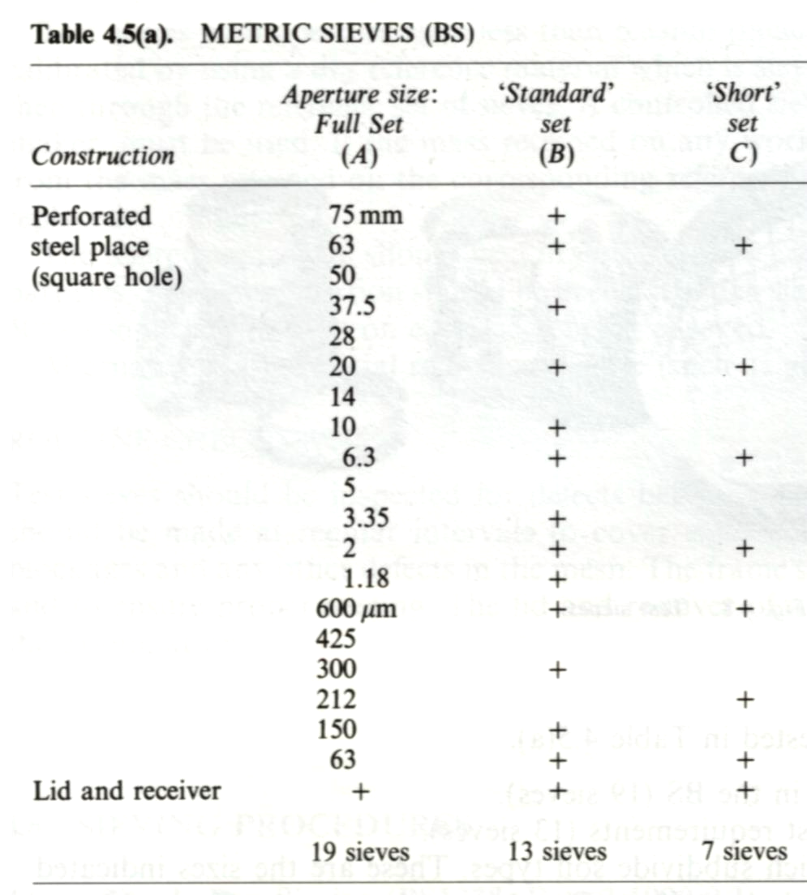
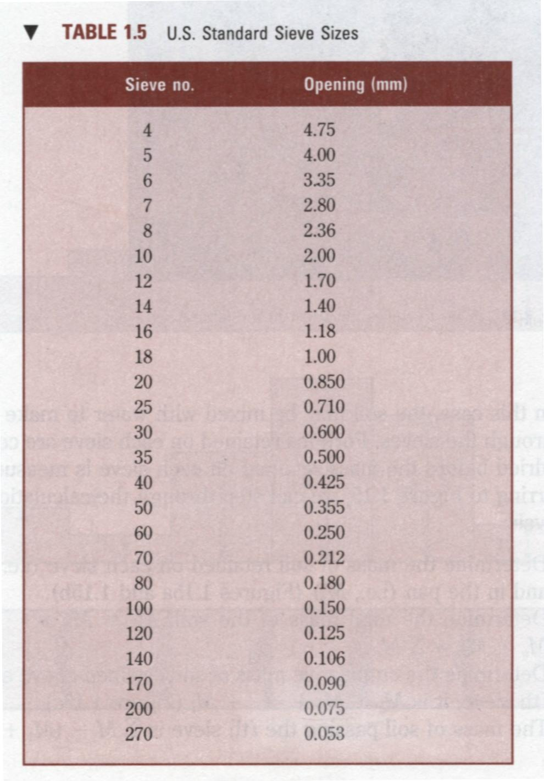
2.2 Grain Size Distribution
Sieve size
(Das, 1998)
(Head, 1992)
Notes:
It is not necessary to use the full set of sieves, but the particle size should be distinguished.

Slide 10
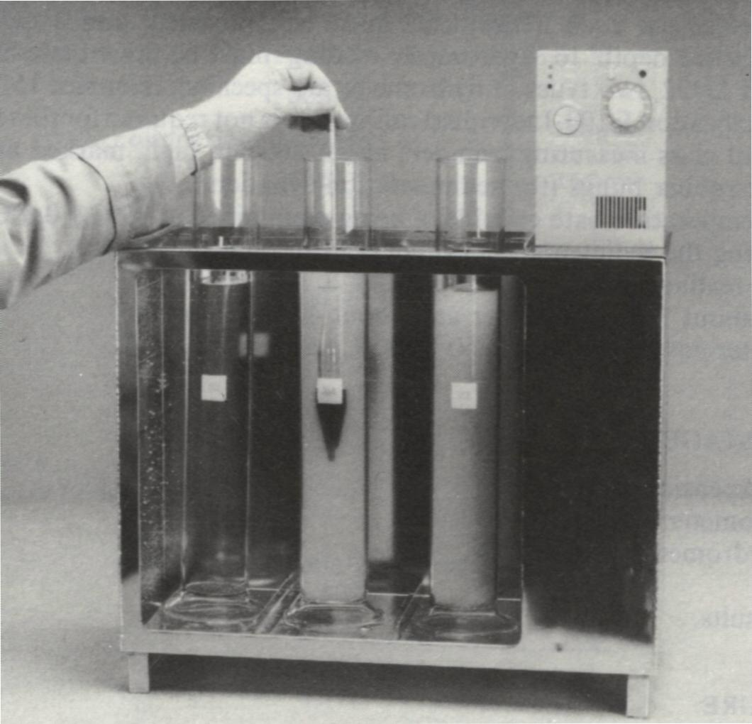
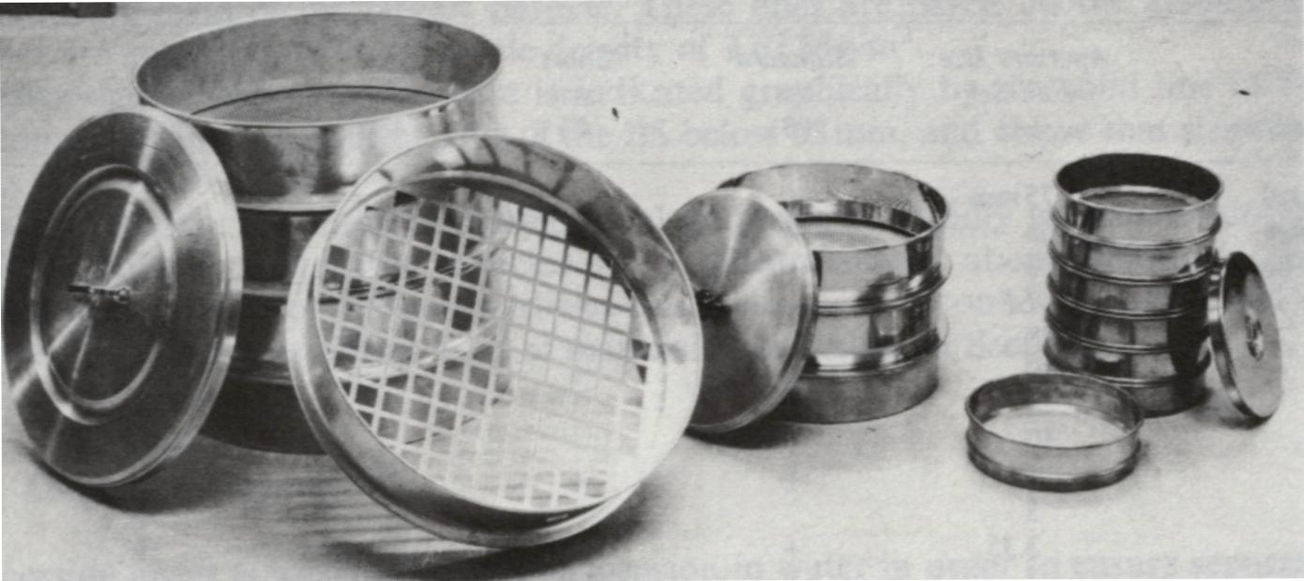
2.2 Grain Size Distribution (Cont.)
Experiment
Coarse-grained soils:
Gravel Sand
Fine-grained soils:
Silt Clay
0.075 mm (USCS)
0.06 mm (BS) (Hong Kong)
(Head, 1992)
Sieve analysis
Hydrometer analysis
Notes:
Wet sieving:
According to the British standard, dry sieving may be carried out only on materials for which this procedure gives the same results as the wet-sieving procedure. This means that it is applicable only to clean granular materials, which usually implies clean sandy or gravelly soils-that is, soils containing negligible amounts of particles of silt or clay size. Normally the wet-sieving procedure (section 4.6.4) should be followed for all soils (Head, 1992).

Slide 11
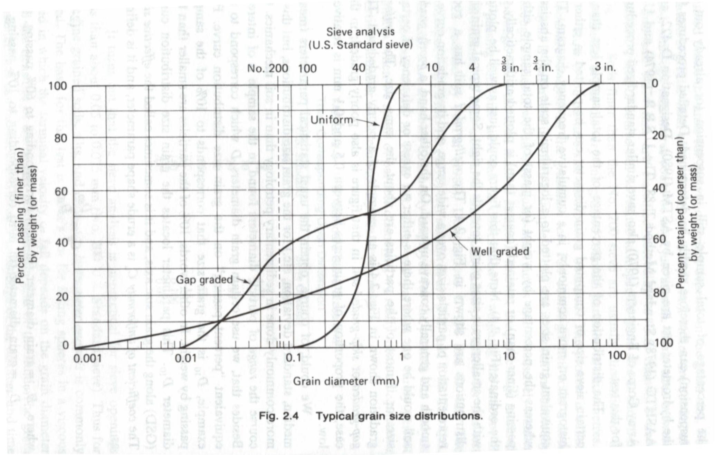
2.2 Grain Size Distribution (Cont.)
Finer
Log scale
Effective size D₁₀: 0.02 mm
D₃₀: D₆₀:
(Holtz and Kovacs, 1981)
Notes:
Effective size (D10): This parameter is the diameter in the particle-size distribution curve corresponding to 10% finer. The effective size of a granular soil is a good measure to estimate the hydraulic conductivity an ddrainage through soils.

Slide 12
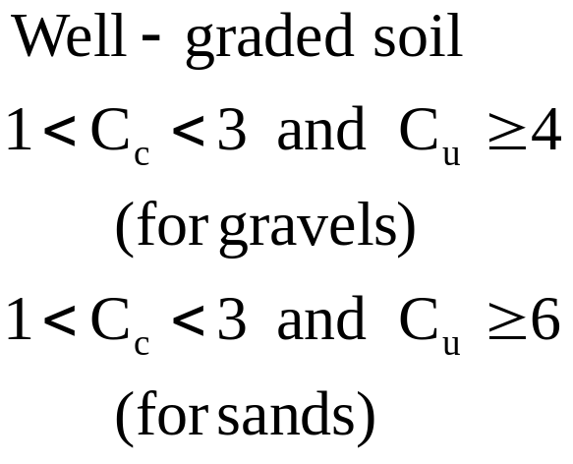
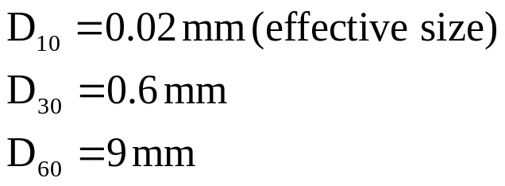
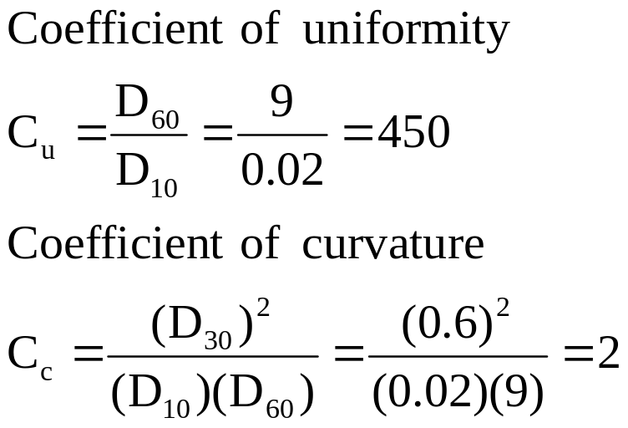
2.2 Grain Size Distribution (Cont.)
Describe the shape
Example: well graded
Criteria
Question
What is the C_{u} for a soil with only one grain size?

Slide 13
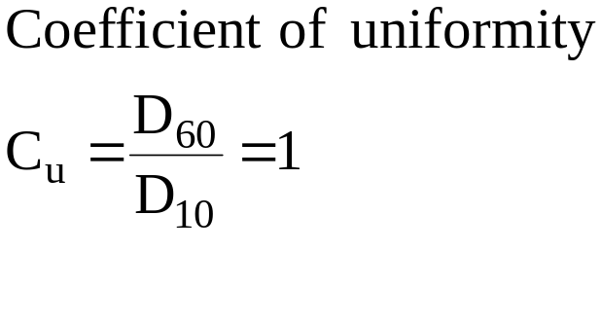
Answer
Question
What is the C_{u} for a soil with only one grain size?
Finer
D
Grain size distribution

Slide 14
2.2 Grain Size Distribution (Cont.)
Engineering applications
  It will help us “feel” the soil texture (what the soil is) and it will also be used for the soil classification (next topic).
  It can be used to define the grading specification of a drainage filter (clogging).
  It can be a criterion for selecting fill materials of embankments and earth dams, road sub-base materials, and concrete aggregates.
  It can be used to estimate the results of grouting and chemical injection, and dynamic compaction.
  Effective Size, D₁₀, can be correlated with the hydraulic conductivity (describing the permeability of soils). (Hazen’s Equation).(Note: controlled by small particles)
The grain size distribution is more important to coarse-grained soils.

Slide 15
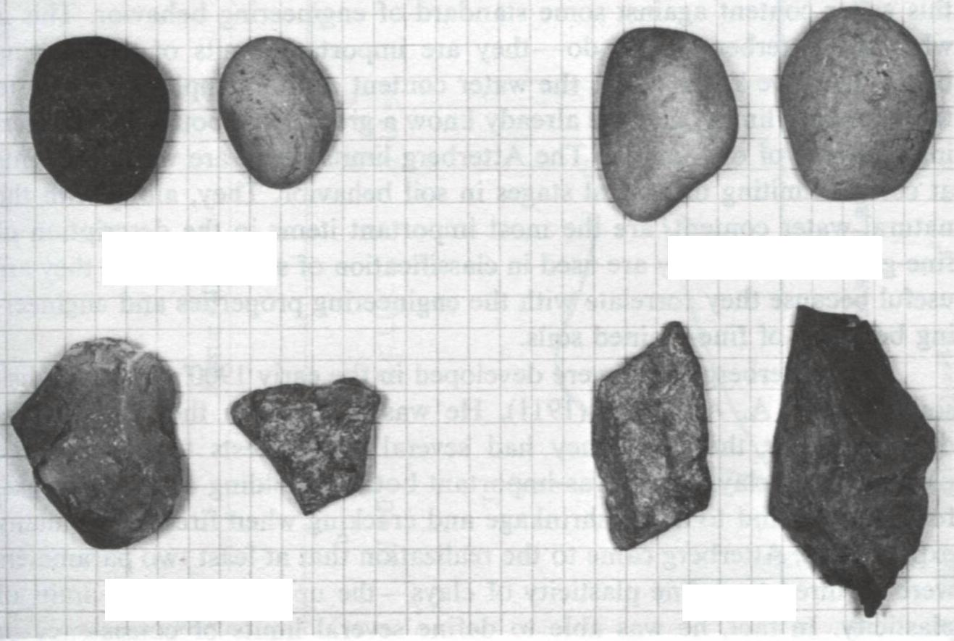
3. Particle Shape
Important for granular soils
Angular soil particle → higher friction
Round soil particle → lower friction
Note that clay particles are sheet-like.
Coarse-grained soils
Rounded
Subrounded
Subangular
Angular
(Holtz and Kovacs, 1981)

Slide 16
4. Atterberg Limits and
Consistency Indices

Slide 17
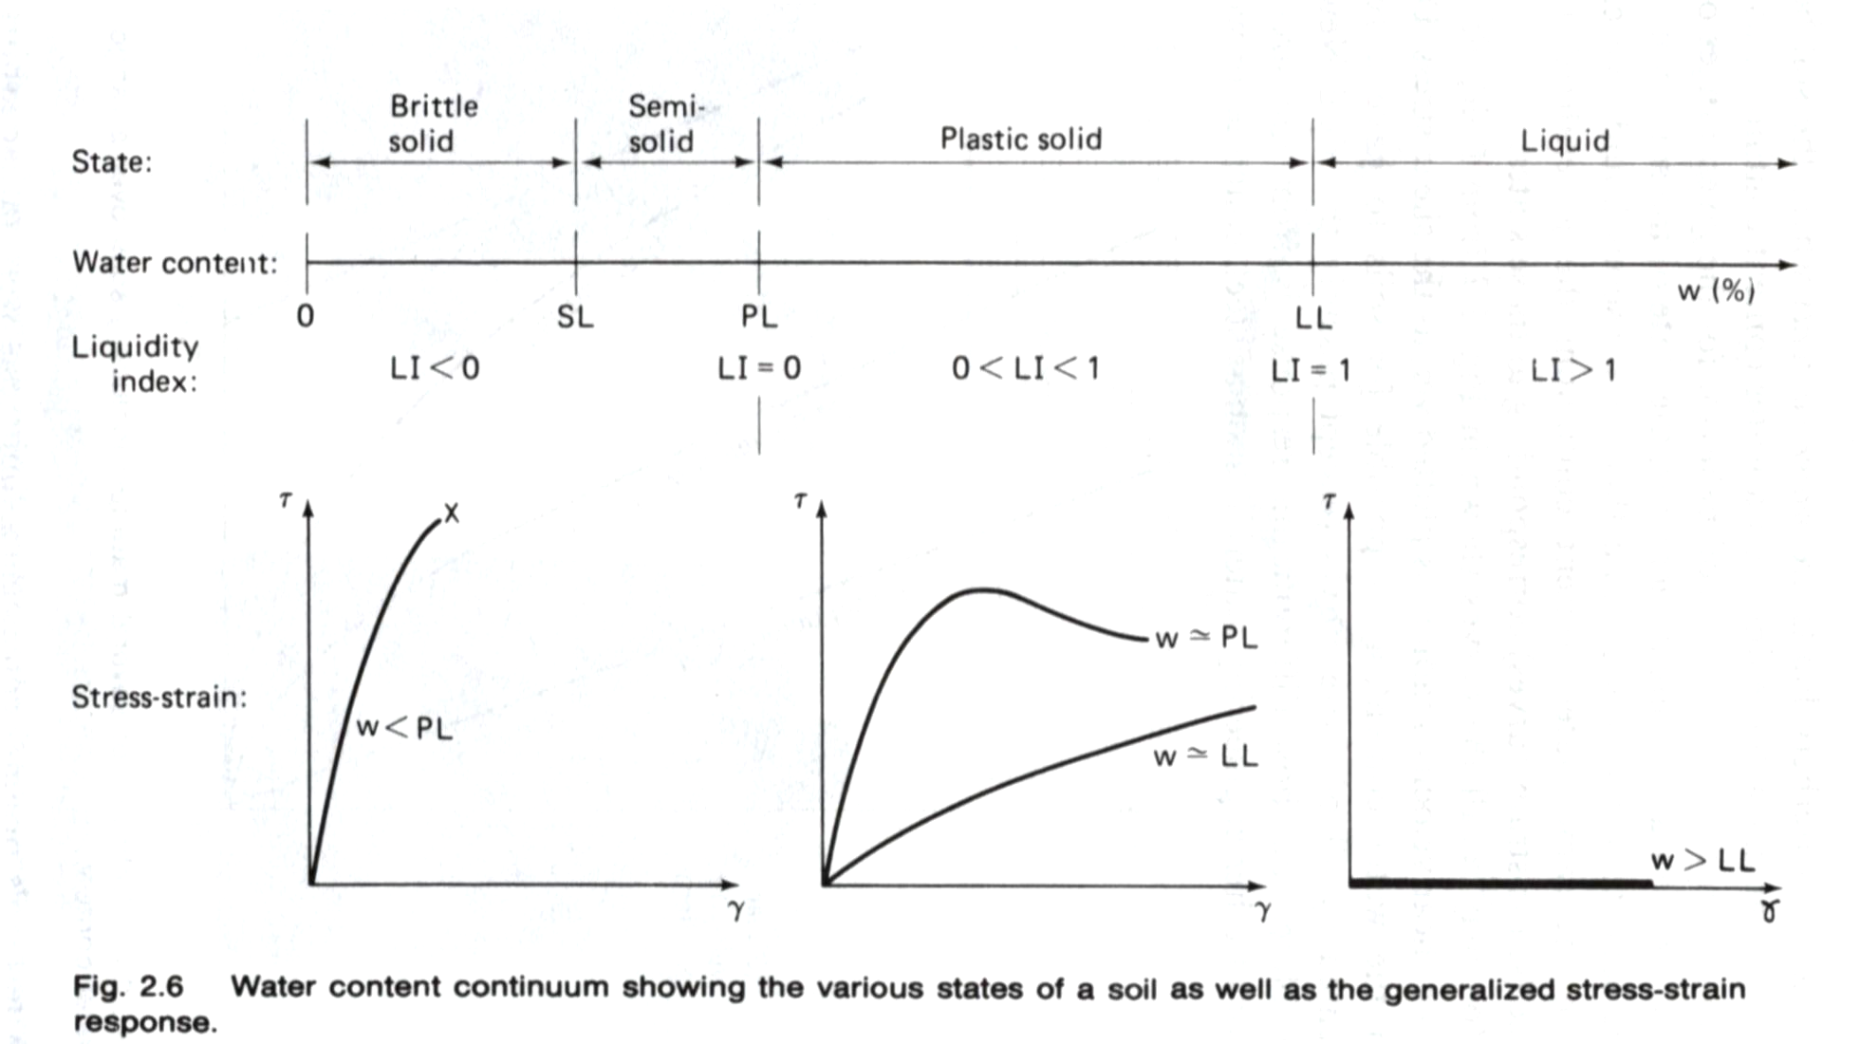
4.1 Atterberg Limits
The presence of water in fine-grained soils can significantly affect associated engineering behavior, so we need a reference index to clarify the effects. (The reason will be discussed later in the topic of clay minerals)
In percentage
(Holtz and Kovacs, 1981)

Slide 18
4.1 Atterberg Limits (Cont.)
Fluid soil-water mixture
Liquid State
Liquid Limit, LL
Plastic State
Plastic Limit, PL
Increasing water content
Semisolid State
Shrinkage Limit, SL
Solid State
Dry Soil

Slide 19
4.2 Liquid Limit-LL
Casagrande Method
(ASTM D4318-95a)
Professor Casagrande standardized the test and developed the liquid limit device.
Multipoint test
One-point test
Cone Penetrometer Method
(BS 1377: Part 2: 1990:4.3)
This method is developed by the Transport and Road Research Laboratory, UK.
Multipoint test
One-point test
Notes:
The comparison between the fall cone test and the Casagrande test, Page. 79 (Head’s book)
The definition of the liquid limit is dependent on he point at which the soil begins to acquire a recognizable shear strength (about 1.7 kN/m2) (Head, 1992).
The one-point methods are useful as “rapid” test procedures, or when only a very small amount of soil is available and when a result of lesser accuracy is acceptable (Head, 1992).
Drying, even air drying at laboratory temperature, can cause irresible changes in the physical behavior of some soils, especially tropical residuals, which can result in dramatic changes in their plasticity properties (Head, 1992).
ASTM D4318-95a. The sample is processed to remove any material retained on a 0.425 mm. (No.40) sieve .
Both the type and amount of clay in a soil influence the properties, and the Atterberg limits reflect both of these factors.

Slide 20
4.2 Liquid Limit-LL (Cont.)
Dynamic shear test
Shear strength is about 1.7 ~2.0 kPa.
Pore water suction is about 6.0 kPa.
(review by Head, 1992; Mitchell, 1993).
Particle sizes and water
Passing No.40 Sieve (0.425 mm).
Using deionized water.
  The type and amount of cations can significantly affect the measured results.

Slide 21
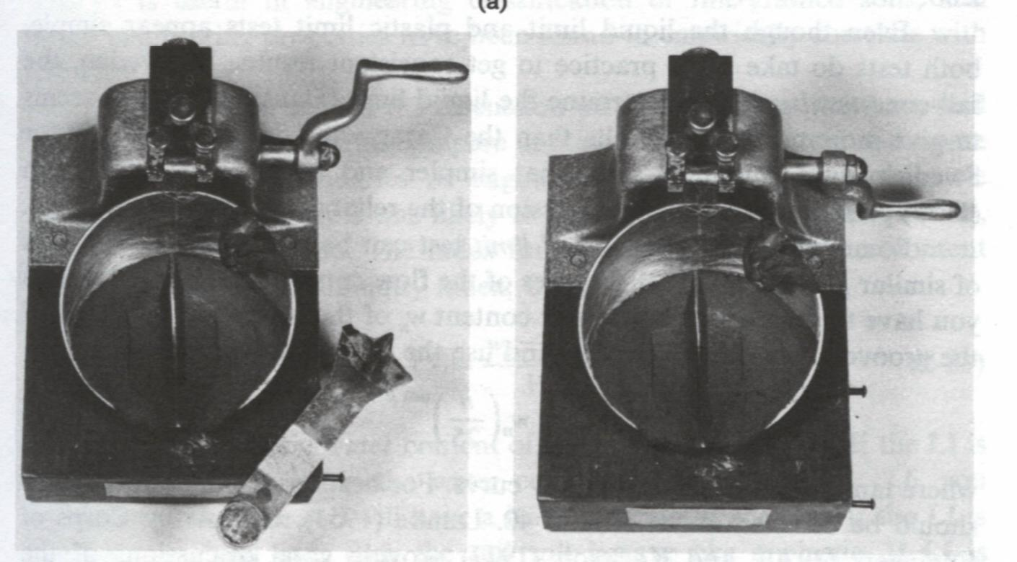
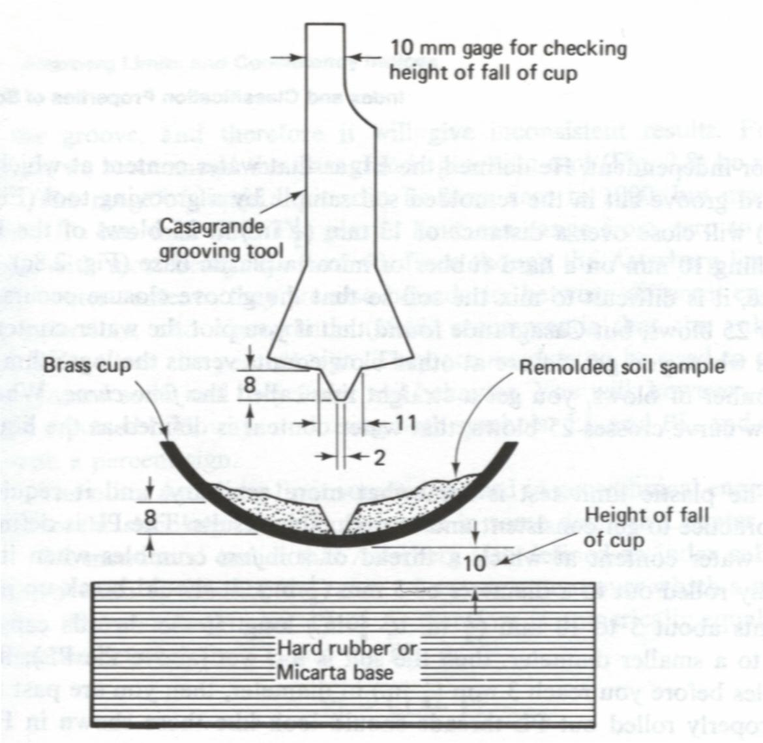
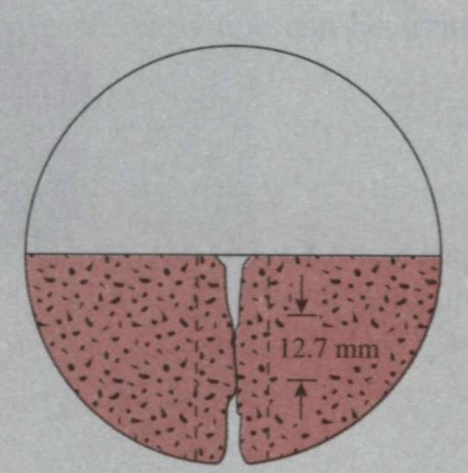
4.2.1 Casagrande Method
Device
N=25 blows
Closing distance = 12.7mm (0.5 in)
The water content, in percentage, required to close a distance of 0.5 in (12.7mm) along the bottom of the groove after 25 blows is defined as the liquid limit
(Holtz and Kovacs, 1981)

Slide 22
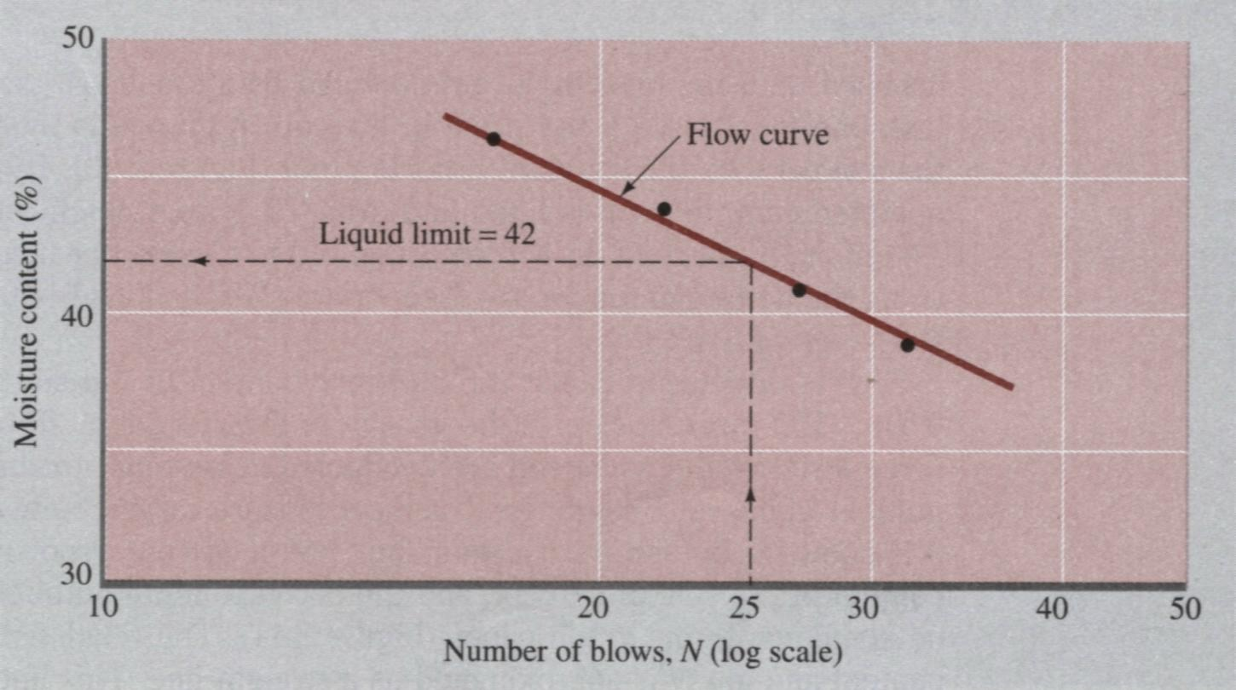
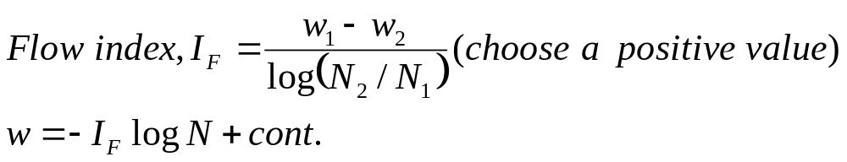
4.2.1 Casagrande Method (Cont.)
Multipoint Method
w
N
Das, 1998

Slide 23
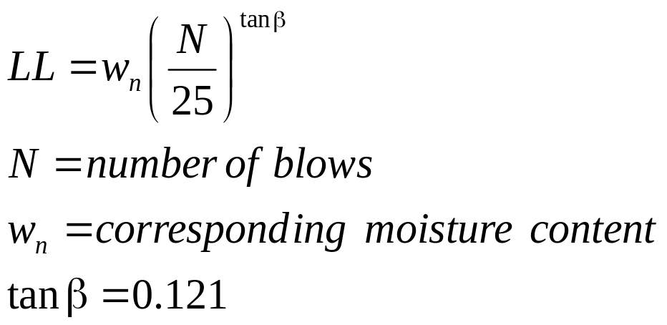
4.2.1 Casagrande Method (Cont.)
One-point Method
Assume a constant slope of the flow curve.
The slope is a statistical result of 767 liquid limit tests.
Limitations:
The β is an empirical coefficient, so it is not always 0.121.
Good results can be obtained only for the blow number around 20 to 30.
Notes:
One-point method

Slide 24
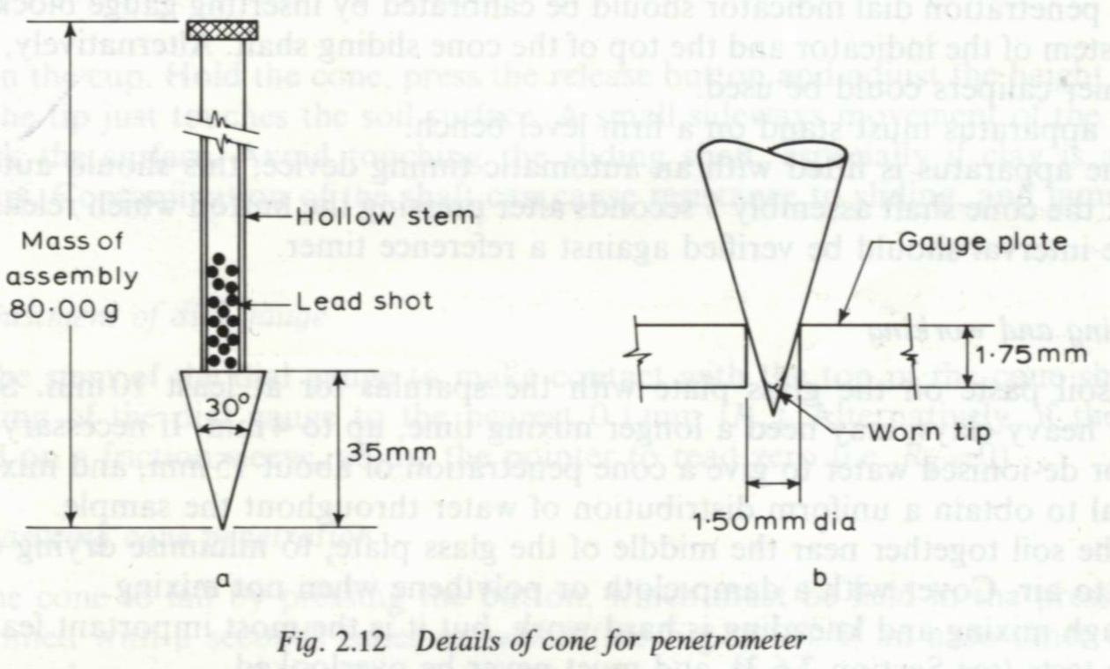
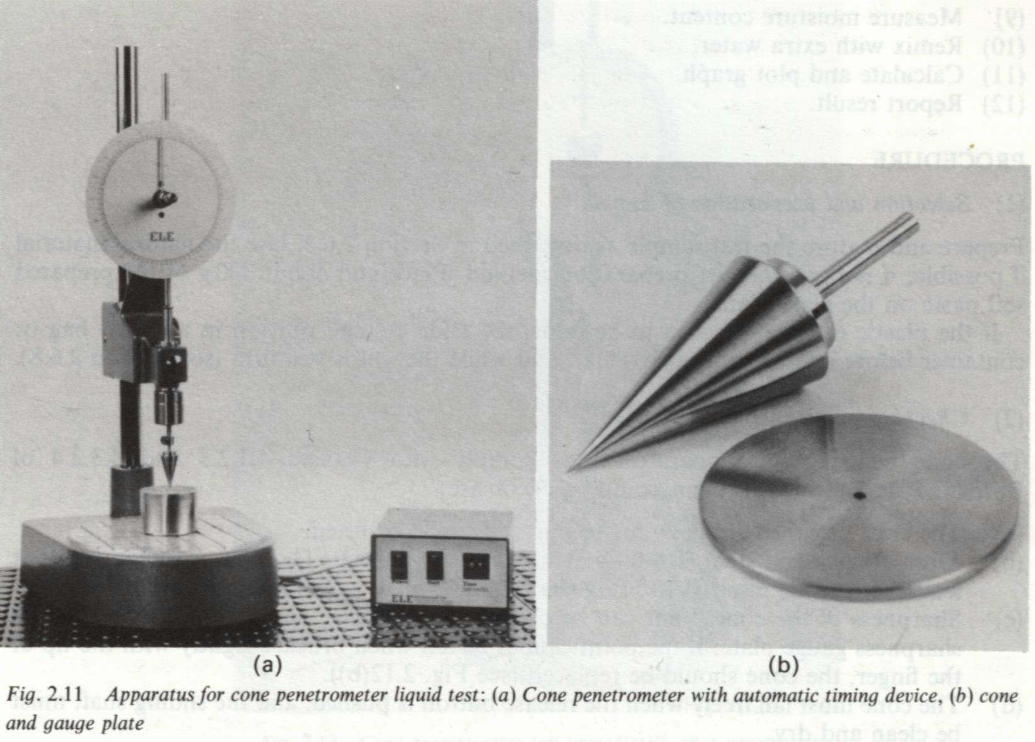
4.2.2 Cone Penetrometer Method
Device
This method is developed by the Transport and Road Research Laboratory.
(Head, 1992)

Slide 25
4.2.2 Cone Penetrometer Method (Cont.)
Multipoint Method
20 mm
Penetration of cone (mm)
LL
Water content w%

Slide 26
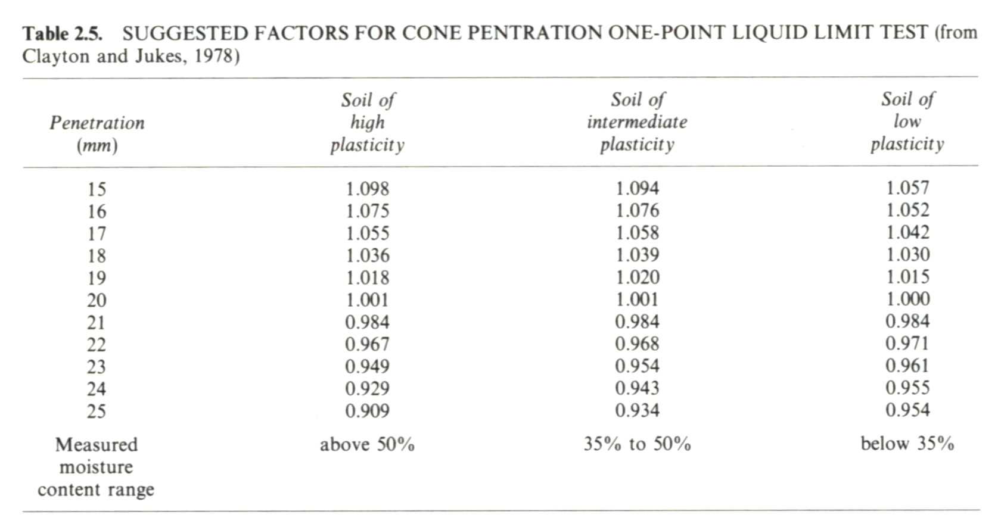
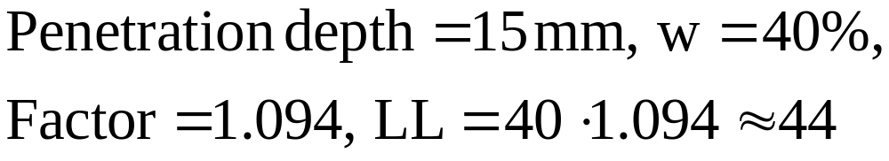
4.2.2 Cone Penetrometer Method (Cont.)
One-point Method (an empirical relation)
(Review by Head, 1992)
Example:

Slide 27
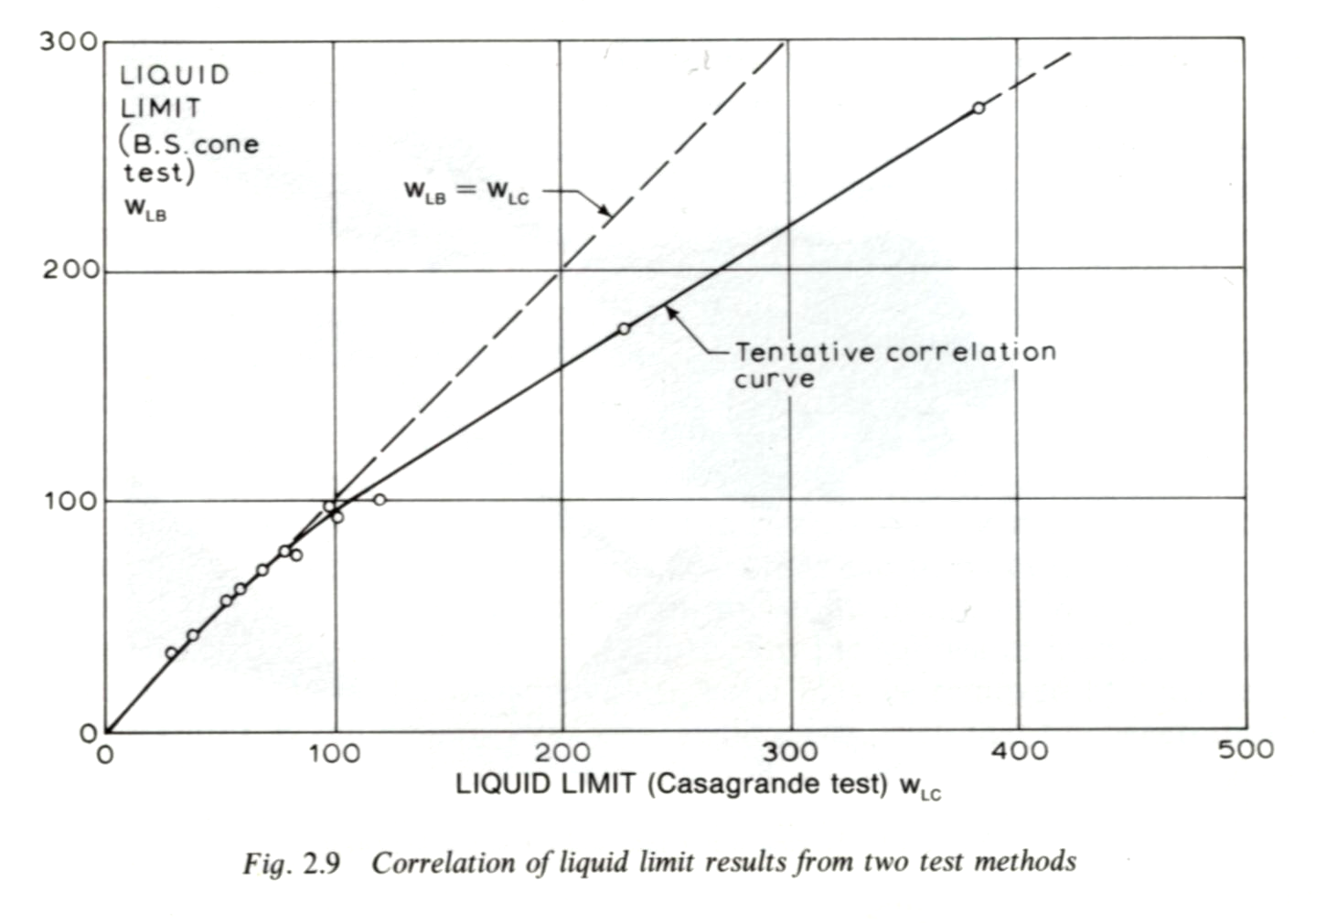
4.2.3 Comparison
A good correlation between the two methods can be observed as the LL is less than 100.
Littleton and Farmilo, 1977 (from Head, 1992)

Slide 28
Question:
Which method will render more consistent results?

Slide 29
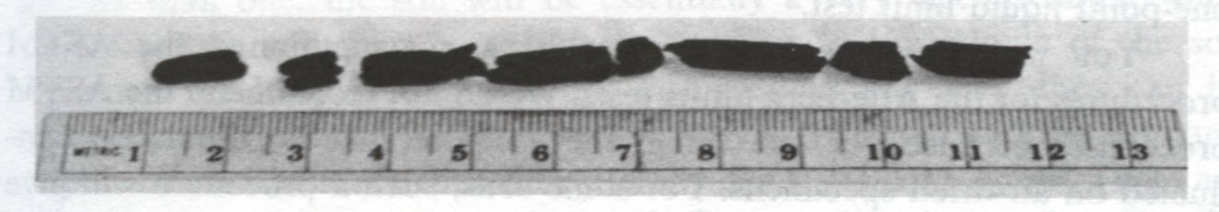
4.3 Plastic Limit-PL
(Holtz and Kovacs, 1981)
The plastic limit PL is defined as the water content at which a soil thread with 3.2 mm diameter just crumbles.
ASTM D4318-95a, BS1377: Part 2:1990:5.3
Notes:
From Mitchell
The plastic limit has been interpreted as the water content below which the physical properties of the water no longer correspond to those of free water (Terzaghi, 1925) and as the lowest water content at which the cohesion between particles or groups of particles is sufficiently low to allow movement, but sufficiently high to allow particles to maintain the molded position (Yong and Warkentin, 1966).

Slide 30
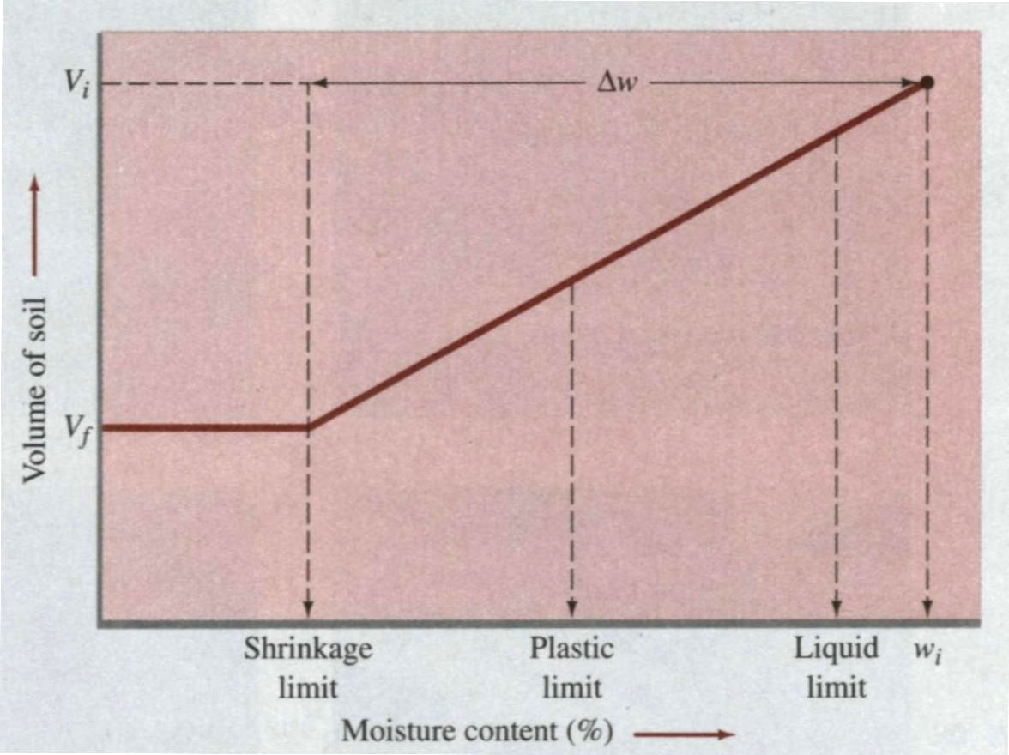
4.4 Shrinkage Limit-SL
Definition of shrinkage limit:
The water content at which the soil volume ceases to change is defined as the shrinkage limit.
SL
(Das, 1998)

Slide 31
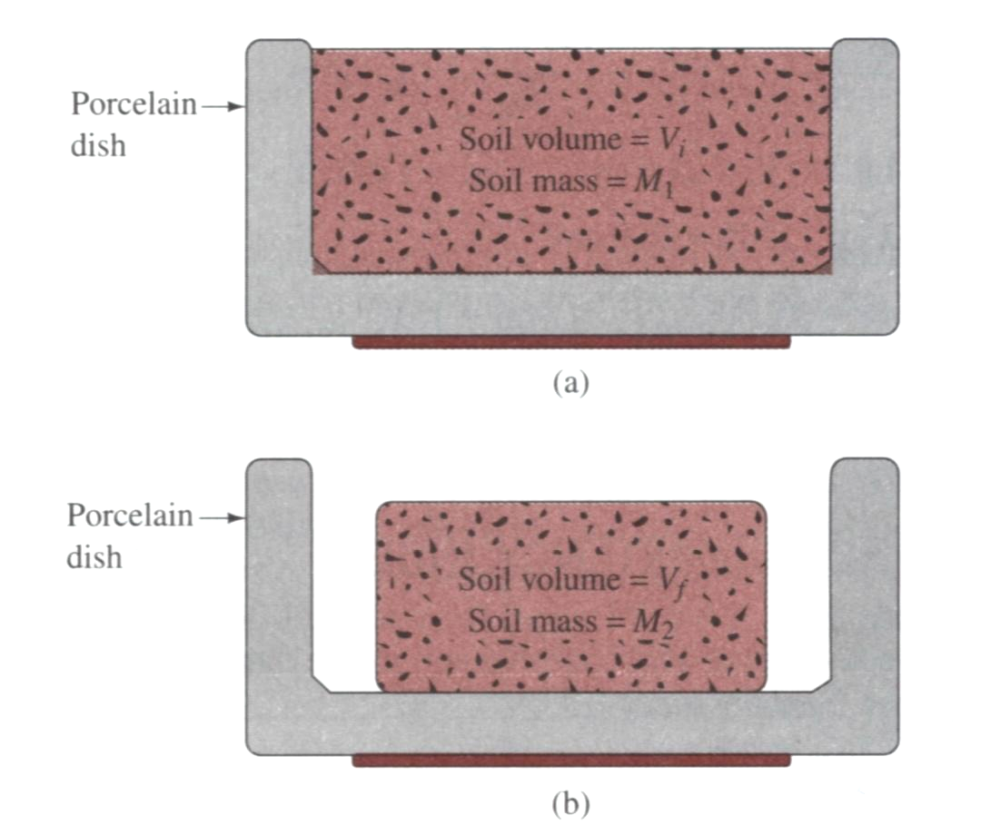
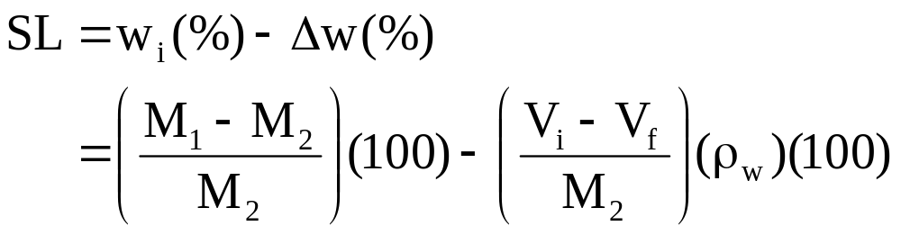
4.4 Shrinkage Limit-SL (Cont.)
Soil volume: V_{i}
Soil mass: M₁
Soil volume: V_{f}
Soil mass: M₂
(Das, 1998)

Slide 32
4.4 Shrinkage Limit-SL (Cont.)
“Although the shrinkage limit was a popular classification test during the 1920s, it is subject to considerable uncertainty and thus is no longer commonly conducted.”
“One of the biggest problems with the shrinkage limit test is that the amount of shrinkage depends not only on the grain size but also on the initial fabric of the soil. The standard procedure is to start with the water content near the liquid limit. However, especially with sandy and silty clays, this often results in a shrinkage limit greater than the plastic limit, which is meaningless. Casagrande suggests that the initial water content be slightly greater than the PL, if possible, but admittedly it is difficult to avoid entrapping air bubbles.” (from Holtz and Kovacs, 1981)

Slide 33
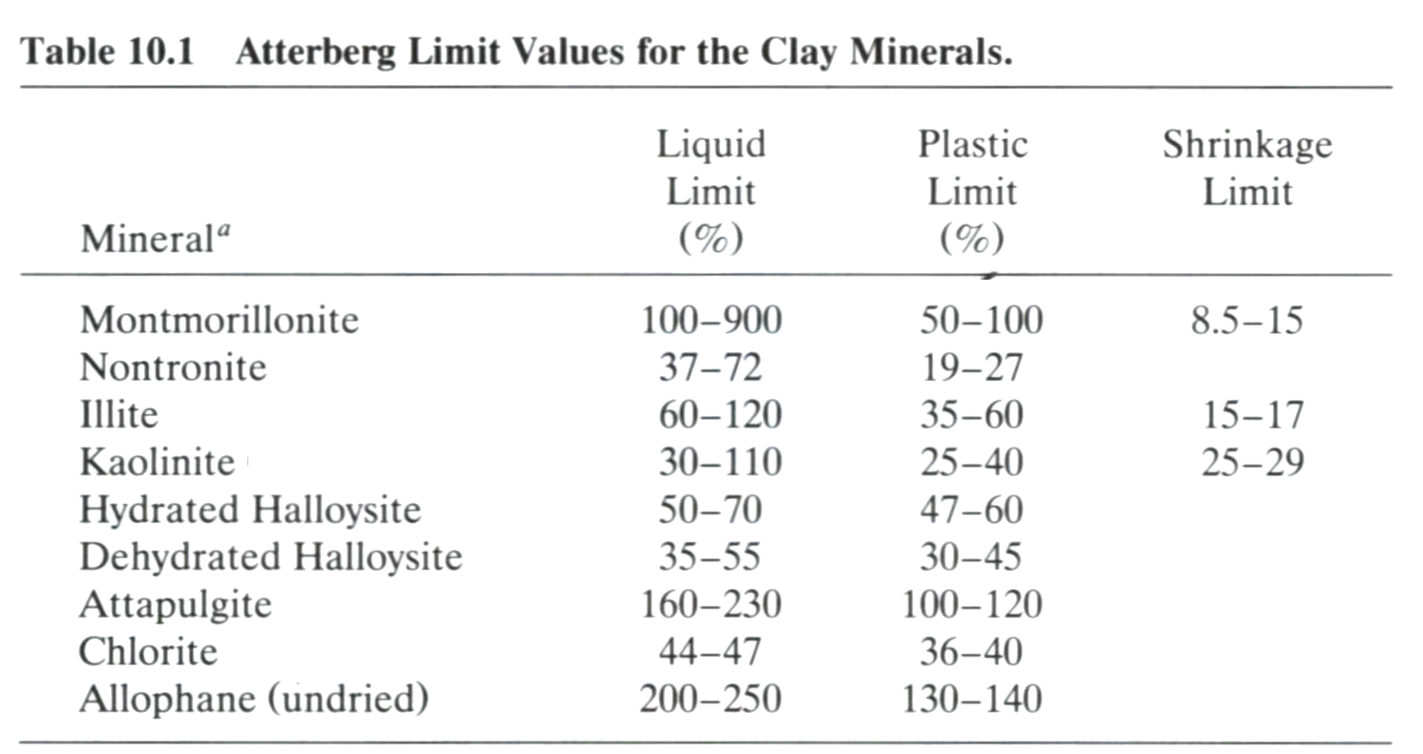
4.5 Typical Values of Atterberg Limits
(Mitchell, 1993)
Notes:
If you have different clay minerals, you will have different Atterberg limit.

Slide 34
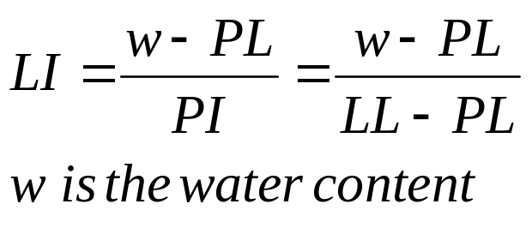
4.6 Indices
Plasticity index PI
For describing the range of water content over which a soil was plastic
PI = LL – PL
Liquidity index LI
For scaling the natural water content of a soil sample to the Limits.
Liquid State
C
Liquid Limit, LL
PI
Plastic State
B
Plastic Limit, PL
LI <0 (A), brittle fracture if sheared
0<LI<1 (B), plastic solid if sheared
LI >1 (C), viscous liquid if sheared
Semisolid State
A
Shrinkage Limit, SL
Solid State
Notes:
The PI is useful in engineering classification of fine-grained soils, and many engineering properties have been found to empirically correlates with the PI.

Slide 35
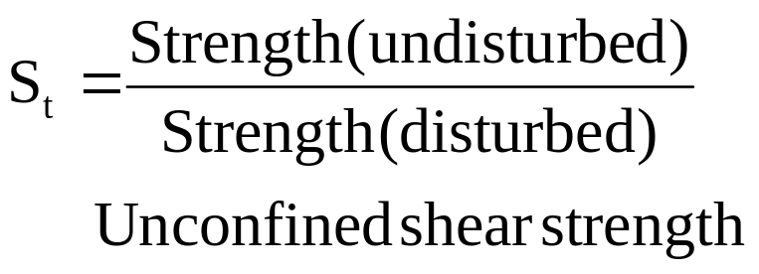
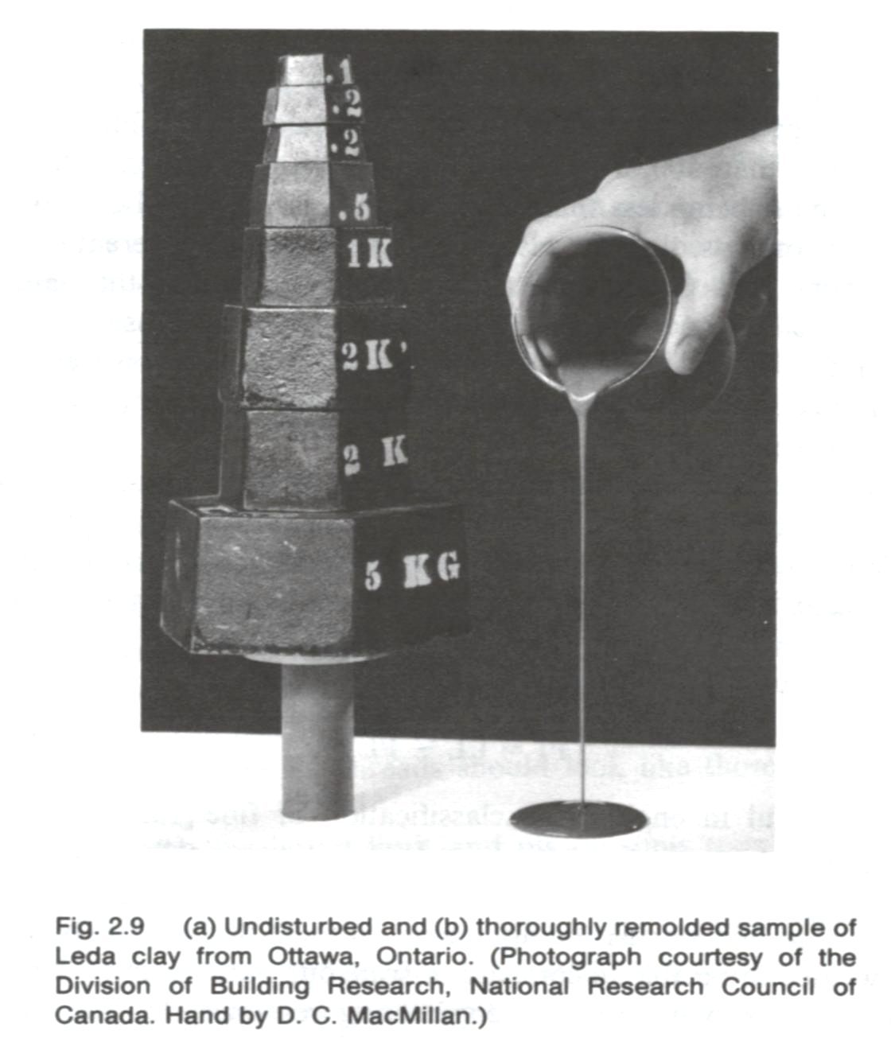
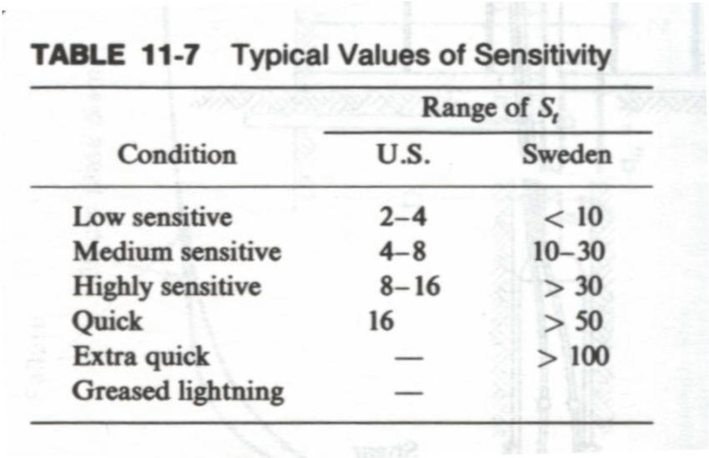
4.6 Indices (Cont.)
Clay particle
Sensitivity S_{t} (for clays)
w > LL
Water
(Holtz and Kavocs, 1981)

Slide 36
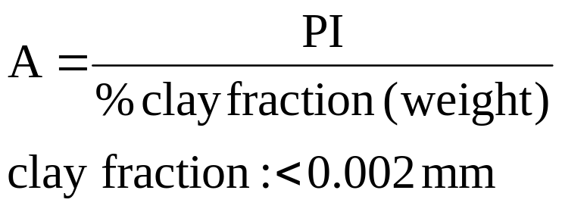
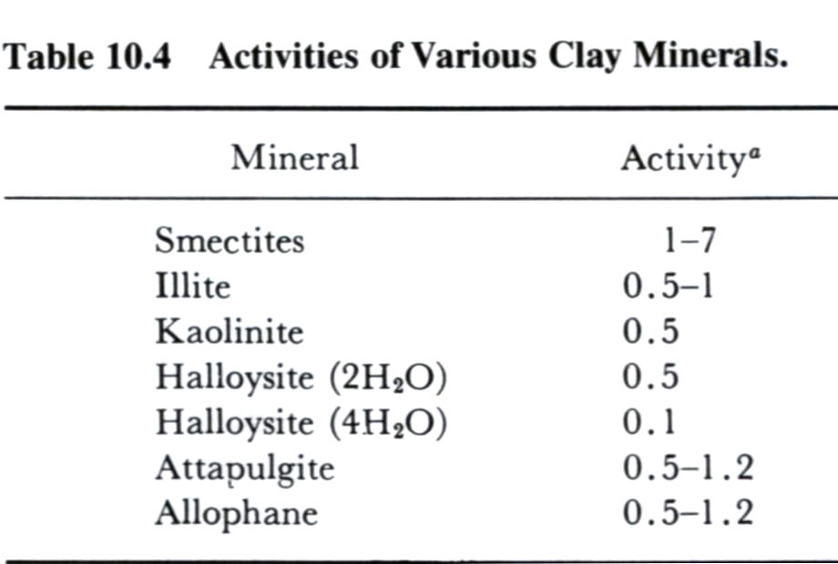
4.6 Indices (Cont.)
Activity A
(Skempton, 1953)
Normal clays: 0.75<A<1.25
Inactive clays: A<0.75
Active clays: A> 1.25
High activity:
large volume change when wetted
Large shrinkage when dried
Very reactive (chemically)
Mitchell, 1993
Purpose
Both the type and amount of clay in soils will affect the Atterberg limits. This index is aimed to separate them.
Notes:
There is fair/good correlation of the activity and the type of clay mineral (chapter 4)
However, the Atterberg limits alone are usually sufficient for these purposes, and the activity provides no really new information.

Slide 37
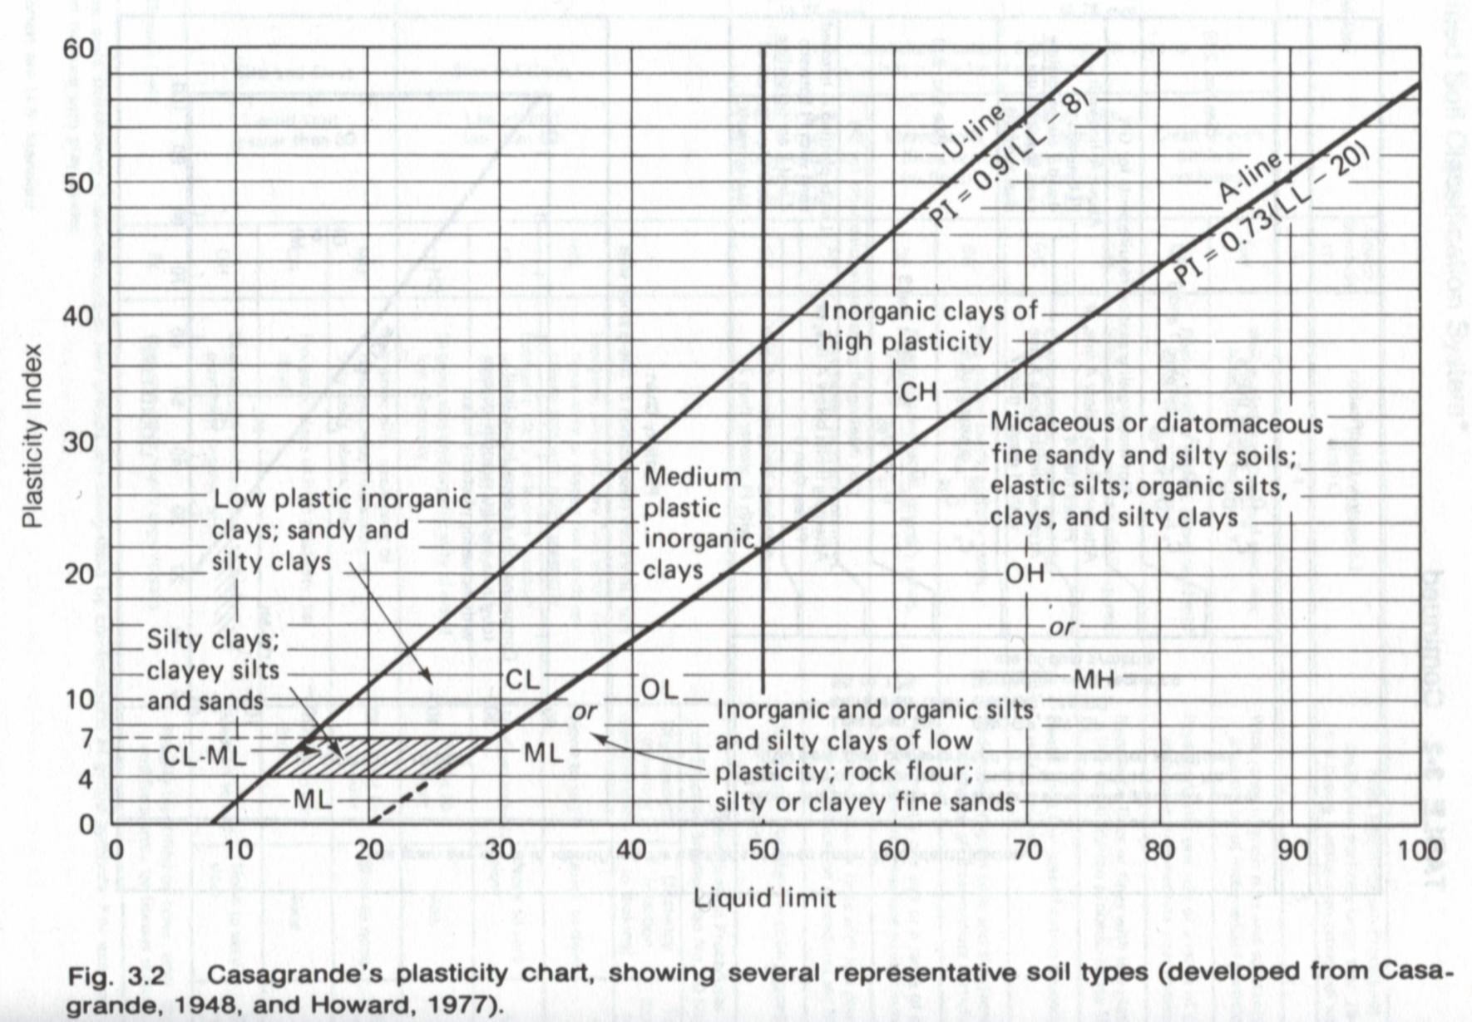
4.7 Engineering Applications
Soil classification
  (the next topic)
The Atterberg limits are usually correlated with some engineering properties such as the permeability, compressibility, shear strength, and others.
  In general, clays with high plasticity have lower permeability, and they are difficult to be compacted.
  The values of SL can be used as a criterion to assess and prevent the excessive cracking of clay liners in the reservoir embankment or canal.
  The Atterberg limit enable clay soils to be classified.
Notes:
In general, clays of high plasticity are likely to have a lower permeability, to be more compressible and to consolidate over a longer period of time under load than clays of low plasticity. High-plasticity clays are more difficult to compact when used as fill materials.
Relate to the permeability.
The values of SL are particular useful to in connection with the placing of puddle clay in reservoir embankments or canal linings. To prevent excessive cracking is some drying out of the clay is likely to occur, the shrinkage range can be limited.

Slide 38
5. Some Thoughts about the Sieve Analysis
The representative particle size of residual soils
  The particles of residual soils are susceptible to severe breakdown during sieve analysis, so the measured grain size distribution is sensitive to the test procedures (Irfan, 1996).
Wet analysis
  For “clean” sands and gravels dry sieve analysis can be used.
  If soils contain silts and clays, the wet sieving is usually used to preserve the fine content.

Slide 39
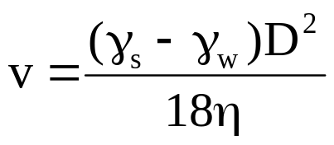
6. Some Thoughts about the Hydrometer Analysis
Assumption
Reality
Stokes’ law
Sphere particle
Platy particle (clay particle) as D ≤ 0.005mm
Single particle
(No interference between particles)
Many particles in the suspension
Known specific gravity of particles
Average results of all the minerals in the particles, including the adsorbed water films.
Note: the adsorbed water films also can increase the resistance during particle settling.
Terminal velocity
Brownian motion as D ≤ 0.0002 mm
(Compiled from Lambe, 1991)
Notes:
Clay minerals and clay-size particles

Slide 40
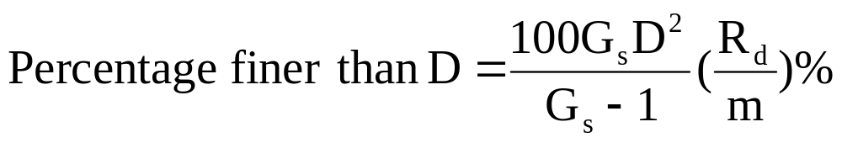

7. Suggested Homework
Please derive the equation for calculating the percentage finer than D (hint: please see the note).
Please understand the calibration of hydrometer.
Please go over examples 1-1 to 1-3 in your notes
Please understand how to get this equation.

Slide 41
8. References
Main References:
Das, B.M. (1998). Principles of Geotechnical Engineering, 4th edition, PWS Publishing Company. (Chapter 2)
Holtz, R.D. and Kovacs, W.D. (1981). An Introduction to Geotechnical Engineering, Prentice Hall. (Chapter 1 and 2)
Others:
Head, K. H. (1992). Manual of Soil Laboratory Testing, Volume 1: Soil Classification and Compaction Test, 2nd edition, John Wiley and Sons.
Ifran, T. Y. (1996). Mineralogy, Fabric Properties and Classification of Weathered Granites in Hong Kong, Quarterly Journal of Engineering Geology, vol. 29, pp. 5-35.
Lambe, T.W. (1991). Soil Testing for Engineers, BiTech Publishers Ltd.
Mitchell, J.K. (1993). Fundamentals of Soil Behavior, 2nd edition, John Wiley & Sons.

