Slide 1
Soil Classification

Slide 2
Outline
Purpose
Classification Systems
The Unified Soil Classification System (USCS)
American Association of State Highway and Transportation Officials System (AASHTO)
Suggested Homework

Slide 3
1. Purpose
Classifying soils into groups with similar behavior, in terms of simple indices, can provide geotechnical engineers a general guidance about engineering properties of the soils through the accumulated experience.
Communicate between engineers
Classification system (Language)
Estimate engineering properties
Achieve engineering purposes
Simple indices
GSD, LL, PI
Use the accumulated experience
Notes:
Most soil classifications employ very simple index-type tests to obtain the characteristics of the soil needed to place it in a given group. Clearly a soil classification loses its value if the index tests become more complicated than the test to measure directly the fundamental property needed. The most commonly used characteristics are particle size and plasticity.
Empirical correlations between index properties and fundamental soil behavior have many large deviations.
The particle size distribution and the Atterberg limits are useful index tests inherently involves disturbance of the soil, they may not give a good indication of the behavior of the in situ, undisturbed soil.

Slide 4
2. Classification Systems
Two commonly used systems:
Unified Soil Classification System (USCS).
American Association of State Highway and Transportation Officials (AASHTO) System
Notes:
Grain size distribution characteristics are most relevant for the classification of coarse-grained soils. On the other hand, Atterberg limits are central to the classification (Santamarina et al., 2001).
Specific surface, porosity, and degree of saturation are three salient properties in particulate materials (Santamarina et al., 2001)

Slide 5
3. Unified Soil Classification System
(USCS)
Origin of USCS:
This system was first developed by Professor A. Casagrande (1948) for the purpose of airfield construction during World War II. Afterwards, it was modified by Professor Casagrande, the U.S. Bureau of Reclamation, and the U.S. Army Corps of Engineers to enable the system to be applicable to dams, foundations, and other construction (Holtz and Kovacs, 1981).
Four major divisions:
Coarse-grained
Fine-grained
Organic soils
Peat

Slide 6
3.1 Definition of Grain Size
No specific grain size-use Atterberg limits
Gravel
Sand
Silt and
Clay
Boulders
Cobbles
Coarse
Fine
Coarse
Medium
Fine
300 mm
75 mm
No.4
4.75 mm
No.200
0.075 mm
19 mm
No.10
2.0 mm
No.40
0.425 mm

Slide 7
3.2 General Guidance
50 %
Coarse-grained soils:
Gravel Sand
Fine-grained soils:
Silt Clay
50%
NO. 4
4.75 mm
NO.200
0.075 mm
Grain size distribution
C_{u}
C_{c}
PL, LL
Plasticity chart
LL>50 LL <50
Required tests: Sieve analysis
Atterberg limit

Slide 8
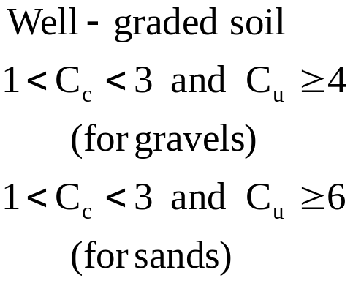
3.3 Symbols
Soil symbols:
G: Gravel
S: Sand
M: Silt
C: Clay
O: Organic
Pt: Peat
Liquid limit symbols:
H: High LL (LL>50)
L: Low LL (LL<50)
Gradation symbols:
W: Well-graded
P: Poorly-graded
Example: SW, Well-graded sand
SC, Clayey sand
SM, Silty sand,
MH, Elastic silt
Notes:
See Table 3.1
Silty sand. Elastic silt
Adjective, noun

Slide 9
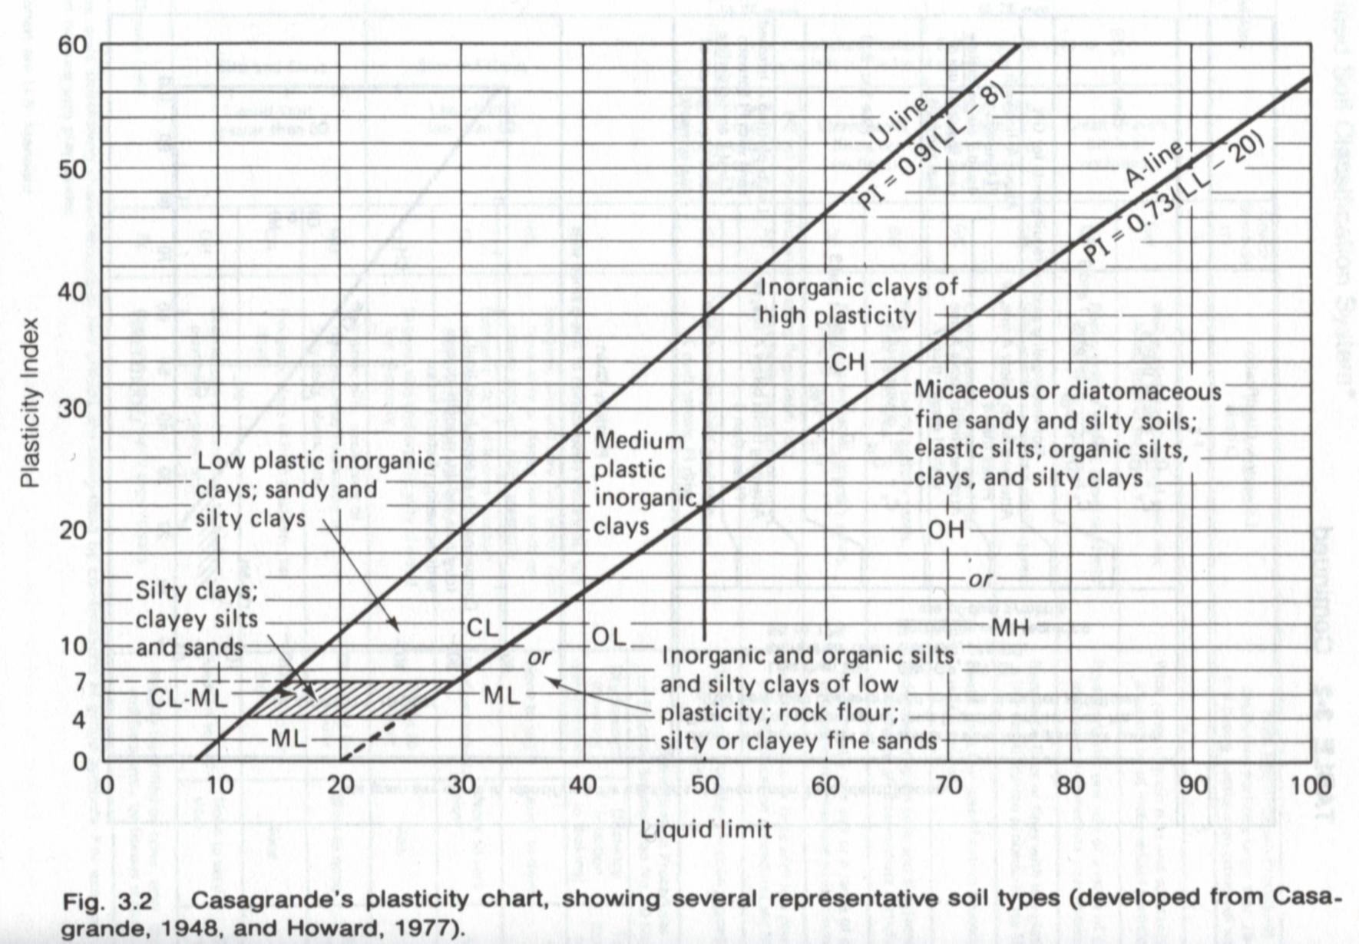
3.4 Plasticity Chart
L
H
The A-line generally separates the more claylike materials from silty materials, and the organics from the inorganics.
The U-line indicates the upper bound for general soils.
Note: If the measured limits of soils are on the left of U-line, they should be rechecked.
PI
LL
(Holtz and Kovacs, 1981)
Notes:
The A-line generally separates the more claylike materials from those that are silty and also the organics from the inorganics.
The U-line indicates the upper range for natural soils

Slide 10
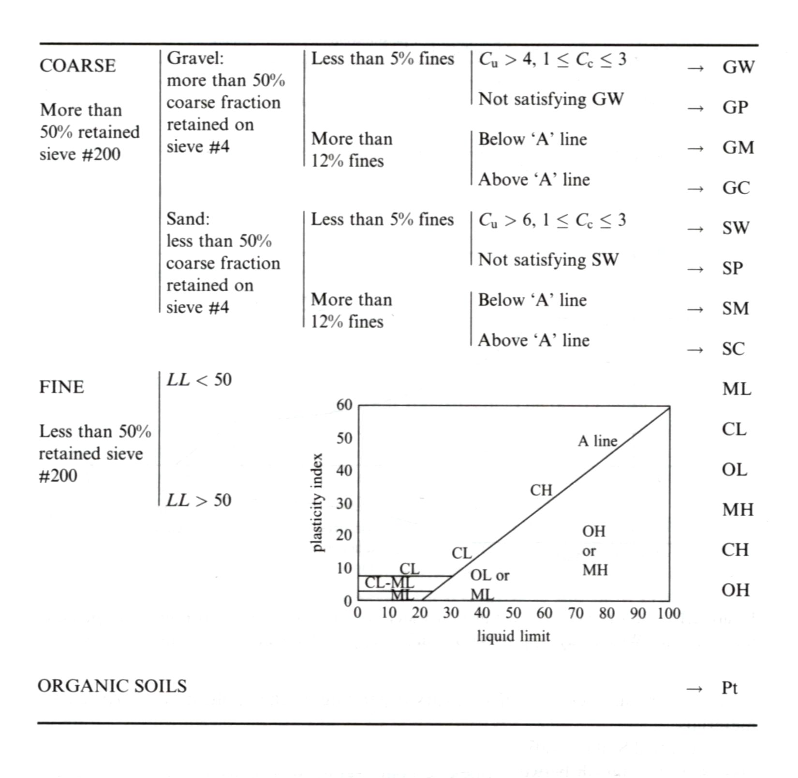
3.5 Procedures for Classification
Coarse-grained material
Grain size distribution
Fine-grained material
LL, PI
Highly
(Santamarina et al., 2001)
Notes:
Peat: a soil composed of vegetable tissue in various stages of decomposition usually with an organic odor, a dark-brown to black color, a spongy consistency, and a texture ranging from fibrous to amorphous.
Organic clay: a clay with sufficient organic content to influence the soil properties. For classification, an organic clay is a soil that would be classified as a clay except that its liquid limit value after oven drying is less than 75% of its liquid limit value before oven drying.

Slide 11
3.6 Example
Passing No.200 sieve 30 %
LL= 33
Passing No.4 sieve 70 %
PI= 12
Passing No.200 sieve 30 %
Passing No.4 sieve 70 %
LL= 33
PI= 12
PI= 0.73(LL-20), A-line
PI=0.73(33-20)=9.49
SC
(≥15% gravel)
Clayey sand with gravel
Highly
(Santamarina et al., 2001)

Slide 12
3.7 Organic Soils
Highly organic soils- Peat (Group symbol PT)
  A sample composed primarily of vegetable tissue in various stages of decomposition and has a fibrous to amorphous texture, a dark-brown to black color, and an organic odor should be designated as a highly organic soil and shall be classified as peat, PT.
Organic clay or silt( group symbol OL or OH):
  “The soil’s liquid limit (LL) after oven drying is less than 75 % of its liquid limit before oven drying.” If the above statement is true, then the first symbol is O.
  The second symbol is obtained by locating the values of PI and LL (not oven dried) in the plasticity chart.

Slide 13
3.8 Borderline Cases (Dual Symbols)
For the following three conditions, a dual symbol should be used.
  Coarse-grained soils with 5% - 12% fines.
    About 7 % fines can change the hydraulic conductivity of the coarse-grained media by orders of magnitude.
    The first symbol indicates whether the coarse fraction is well or poorly graded. The second symbol describe the contained fines. For example: SP-SM, poorly graded sand with silt.
  Fine-grained soils with limits within the shaded zone. (PI between 4 and 7 and LL between about 12 and 25).
    It is hard to distinguish between the silty and more claylike materials.
    CL-ML: Silty clay, SC-SM: Silty, clayed sand.
  Soil contain similar fines and coarse-grained fractions.
    possible dual symbols GM-ML
Notes:
The fines content in coarse soils is carefully considered because the presence of more than ≈ 7 percent fines is sufficient to change the hydraulic conductivity to the medium by orders of magnitude; in turn, the hydraulic conductivity defines whether drained or undrained load deformation takes place (Carlos’ book).
ASTM does not mention this part 50% case.

Slide 14
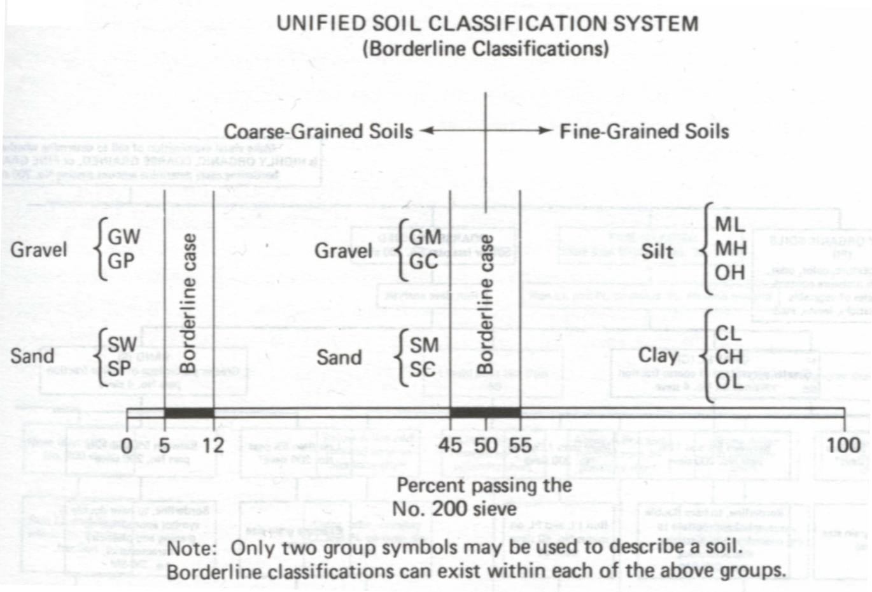
3.8 Borderline Cases (Summary)
(Holtz and Kovacs, 1981)

Slide 15
4. American Association of State Highway and Transportation Officials system (AASHTO)
Origin of AASHTO: (For road construction)
This system was originally developed by Hogentogler and Terzaghi in 1929 as the Public Roads Classification System. Afterwards, there are several revisions. The present AASHTO (1978) system is primarily based on the version in 1945. (Holtz and Kovacs, 1981)
Notes:
In the late 1920’s the U.S. Bureau of Public Roads (now the Federal Highway Administration) conducted extensive research on the use of soils especially in local or secondary road construction, the so-called “farm-to-market” roads. From that research the Public Roads Classification System was developed by Hogentogler and Terzaghi (1929). The original system was based on the stability characteristics of soils when used as a road surface or with a thin asphalt pavement. There are several revisions since 1929, and the latest in 1945 is essentially the present AASHTO (1978)
system.

Slide 16
4.1 Definition of Grain Size
No specific grain size-use Atterberg limits
Boulders
Gravel
Sand
Silt-Clay
Coarse
Fine
75 mm
No.4
4.75 mm
No.200
0.075 mm
No.40
0.425 mm

Slide 17
4.2 General Guidance
  8 major groups: A1~ A7 (with several subgroups) and organic soils A8
  The required tests are sieve analysis and Atterberg limits.
  The group index, an empirical formula, is used to further evaluate soils within a group (subgroups).
  The original purpose of this classification system is used for road construction (subgrade rating).
A1 ~ A3
A4 ~ A7
Granular Materials
≤ 35% pass No. 200 sieve
Silt-clay Materials
≥ 36% pass No. 200 sieve
Using LL and PI separates silty materials from clayey materials (only for A2 group)
Using LL and PI separates silty materials from clayey materials
Notes:
Highly organic soils including peats and mucks may be placed in group A-8. As with the USCS, classification
Find what the subgrade rating is in the pavement book.

Slide 18
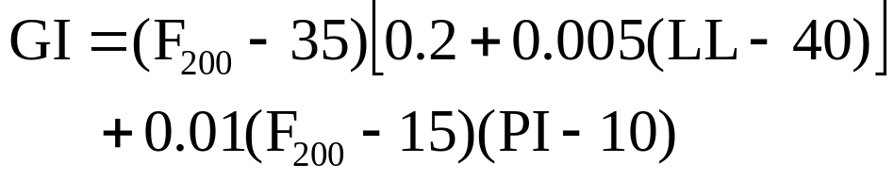

4.3 Group Index
The first term is determined by the LL
The second term is determined by the PI
For Group A-2-6 and A-2-7
use the second term only
F200: percentage passing through the No.200 sieve
In general, the rating for a pavement subgrade is inversely proportional to the group index, GI.

Slide 19
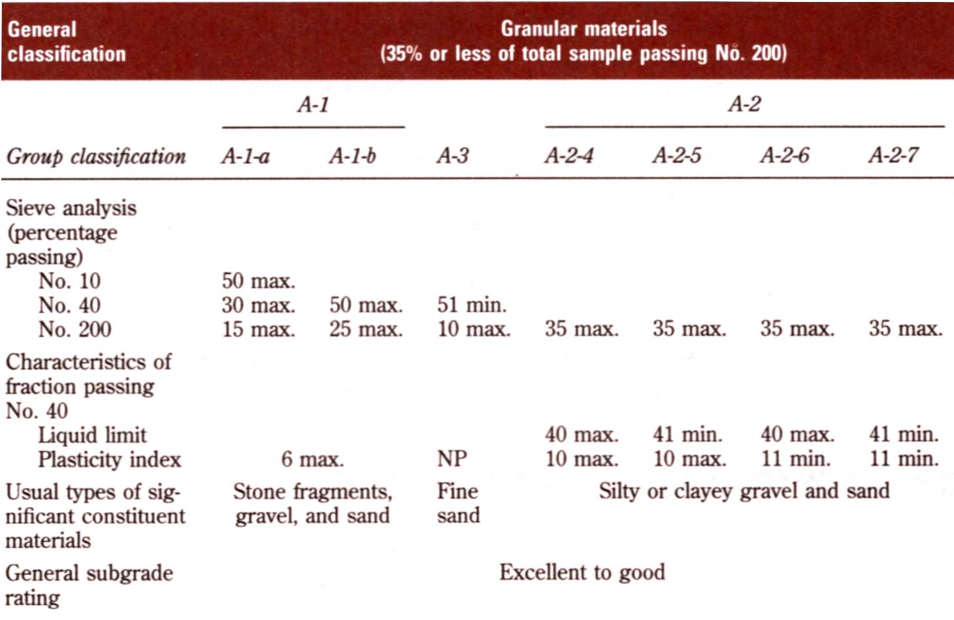
4.4 Classification
Das, 1998
Notes:
A-1 materials are well graded, whereas A-3 soils are clean, poorly graded sands. A-2 materials are also granular (less than 35% passing the No.200 sieve), but they contain a significant amount of silts and clays. A-4 to A-7 are fine-grained soils, the silt-clay materials. They are differentiated on the basis of their Atterberg Limits.

Slide 20
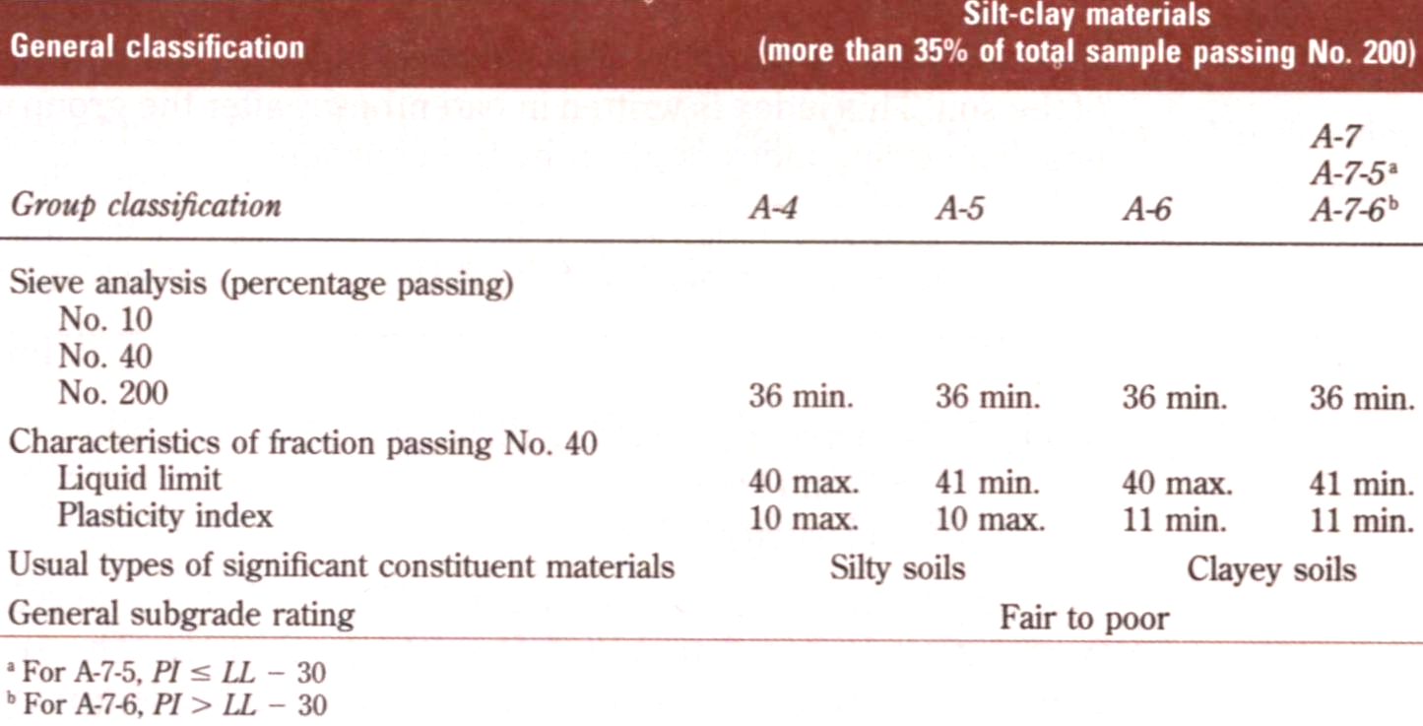
4.4 Classification (Cont.)
Note:
The first group from the left to fit the test data is the correct AASHTO classification.
Das, 1998
Notes:
Tell them the figure in the handout.

Slide 21
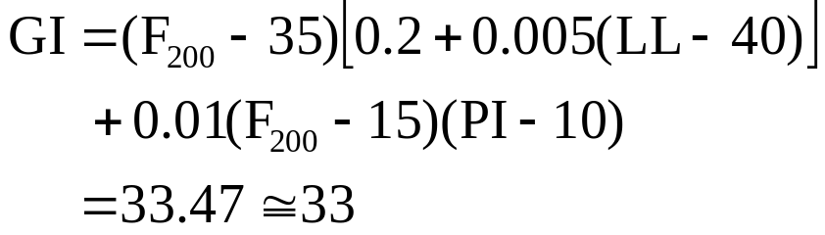
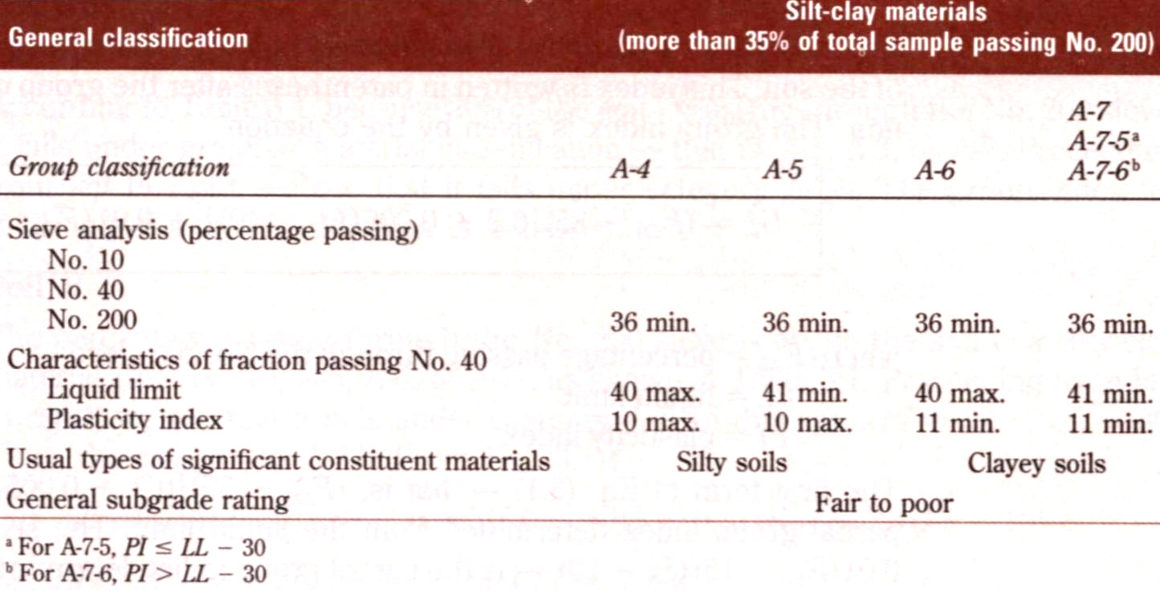
4.4 Example
Passing No.200 86%
LL=70, PI=32
LL-30=40 > PI=32
Passing No.200 86%
LL=70, PI=32
LL-30=40 > PI=32
A-7-5(33)
Round off
Notes:
The group index is round off to the nearest whole number.

Slide 22
5. Suggested Homework
Please read Chapter 3 (Holtz’s Book).
Read ASTM D2487 and D 2488.
Please go over Example 3.1 and 3.2.

Slide 23
6. References
Main References:
Das, B.M. (1998). Principles of Geotechnical Engineering, 4th edition, PWS Publishing Company. (Chapter 3)
Holtz, R.D. and Kovacs, W.D. (1981). An Introduction to Geotechnical Engineering, Prentice Hall. (Chapter 3)
Others:
Santamarina, J.C., Klein, K.A., and Fam, M.A. (2001). Soils and Waves, John Wiley & Sons, LTD.

