Slide 1
Footings & Geomechanics (SIN No. 27440)
Module ABC309
Learning outcome 1
  Outline the geological formation of rocks and their subsequent weathering to form various soil types.
Learning outcome 2
  Determine the difference between topographical and geological maps and to be able to read and comprehend both maps.
Learning outcome 3
  Distinguish between soil types and their behaviour.
Learning outcome 4
  Outline the factors that will determine the suitability of foundation soils to support various types of structures.
Learning outcome 5
  Identify the various methods of soil testing, the most appropriate application for each, and the relevant Australian standard used for soil testing.
Learning outcome 6
  Classify a site from the nature of soil found and to suggest a footing system that would be suitable for the site conditions and building type.
Learning outcome 7
  Suggest site maintenance requirements that will be necessary to minimise long term damage to the structure.

Slide 2
Rock Formation
IGNEOUS ROCKS
Examples
Granite | basalt | obsidian | pumice
    Igneous rocks are formed from molten magma or lava. The word, igneous means "fire". All igneous rock starts deep in the earth as hot, molten magma. If the magma cools and hardens inside the earth it is called "intrusive" rock. These rocks cool slowly and have large crystals. When the magma comes out of the earth's crust through a volcano, it is called "extrusive". It cools off quickly, and the crystals that form are very small. Molten, or hot, liquid rock is called MAGMA when it is still inside the earth, but once it comes out through a volcano it is called LAVA.

Slide 3
SEDIMENTARY ROCKS
Examples
  Limestone | Jasper | Gypsum | Conglomerate | Sandstone |
Every minute of every day, rocks are being worn down by wind and rain. Tiny grains of dirt, sand, mud and clay are worn off and washed into streams, rivers, lakes and oceans. When these tiny bits of sand and dirt settle to the bottom of the water, they are called sediment. Minerals in the water and microscopic, or very tiny sea animals also get mixed in with the dirt and sand to form the sediment. Every day more sediment piles on top of what is already there. After.thousands and millions of years we end up with a really deep pile of sediment. The weight and pressure from all the stuff on top turns the sediment on the bottom into sedimentary rock!

Slide 4
METAMORPHIC ROCKS
Examples
Quartz | Amethyst | Marble | Slate | Gneiss | Graphite | Coal |
Metamorphic rocks are formed when other kinds of rocks are changed by great heat and pressure inside the earth. The word "metamorphic" means changed. Think of metamorphic rocks as recycled rocks. When igneous, sedimentary or even metamorphic rocks get buried deep beneath the surface of the earth, over millions of years the heat and pressure inside the earth change them into something else. Limestone can be changed to marble, sandstone can be changed into quartzite, and shale can be changed to slate. It's just another example of how the earth is constantly changing!

Slide 5
Transportation, deposition and formation of sands, gravels and clays
As rocks are broken down by chemical and physical forces, particles become increasingly smaller. The particles are transported through rivers and by wind. The three main sizes of soil include sand, silt, and clay.
Soil formation occurs due to the change in particle size, organic matter, and the movement of elements and minerals. The four major influences on soil are weathering, climate, land surface, and living organisms.

Slide 6
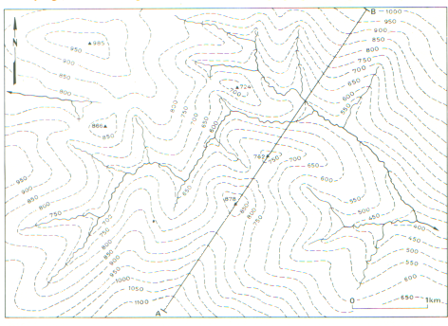
Topographic Maps
Particular features can be recognised from the contour pattern, thus allowing a mental picture of the topography to be constructed. Studying the natural features such as rivers, lakes, marshes, cliffs and coasts, which are shown in topographic maps, helps to identify the hills and valleys which together form the topography of an area.

Slide 7
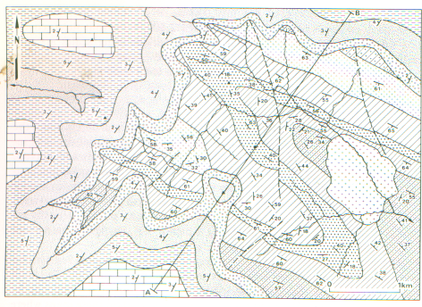
Geological Maps
Geological maps show the distribution of the superficial deposits (glacial sands and gravel, boulder clay, alluvial sands and gravel etc) and the underlying solid rocks at the earth’s surface. The distribution of the solid rocks in a particular region is shown by means of geological boundaries, drawn as lines in the geological map.

Slide 8
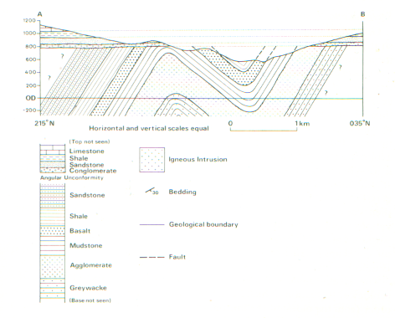
Cross-section A-B
Stratigraphic column showing in chronological order the sequence of geological formation shown in Figure 2
Geological maps are generally accompanied by vertical cross-sections, a stratigraphic column, a legend or key showing the structural symbols, ornament and colours used on the map, and a brief description of the geology.
Vertical cross-sections are drawn across the map to illustrate the geological structure of the rocks, as shown in the above cross-section.

