Slide 1
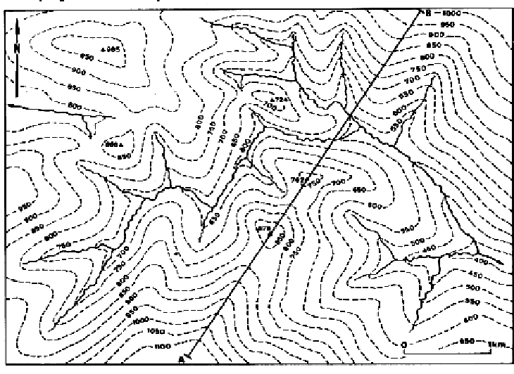
Topographical maps
Particular features can be recognised from the contour pattern, thus allowing a mental picture of the topography to be constructed. Studying the natural features such as rivers, lakes, marshes, cliffs and coasts, which are shown in topographic maps, helps to identify the hills and valleys which together form the topography of an area.

Slide 2
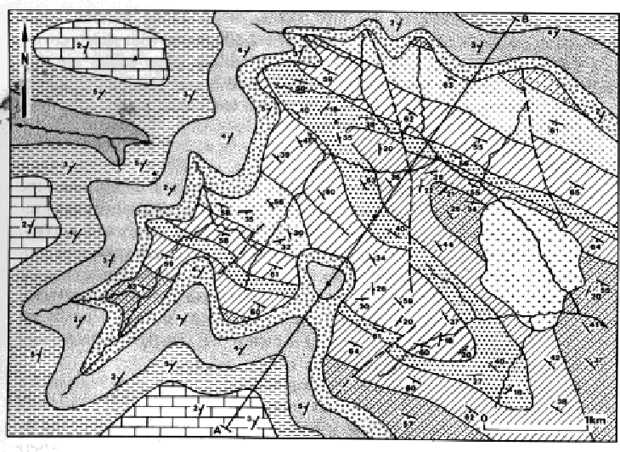
Geological maps
Geological maps show the distribution of the superficial deposits (glacial sands and gravel, boulder clay, alluvial sands and gravel etc) and the underlying solid rocks at the earth’s surface. The distribution of the solid rocks in a particular region is shown by means of geological boundaries, drawn as lines in the geological map.

Slide 3
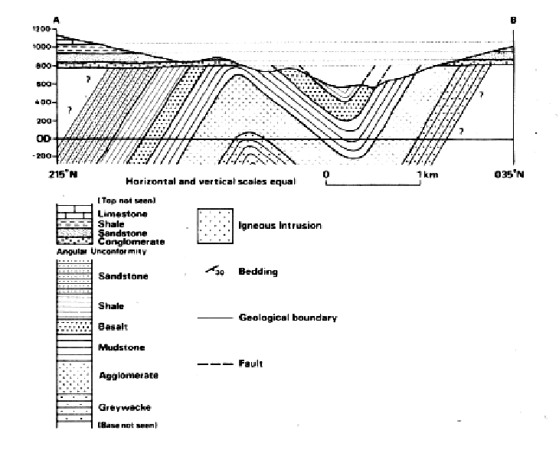
Cross-section A-B
Stratigraphic column showing in chronological order the sequence of geological formation shown in Figure 2
Geological maps are generally accompanied by vertical cross-sections, a stratigraphic column, a legend or key showing the structural symbols, ornament and colours used on the map, and a brief description of the geology.
Vertical cross-sections are drawn across the map to illustrate the geological structure of the rocks, as shown in the above cross-section.

