Slide 1
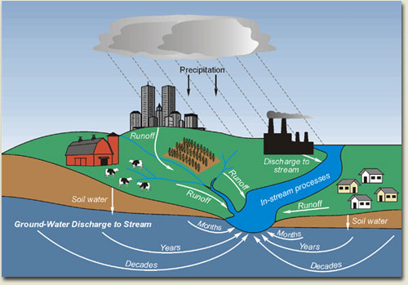
Contaminant Hydrogeology
Hydrogeology
study of ground water
anything in water that renders
it unsuitable for a particular use
Contaminant
Basic understanding of physical and chemical processes

Slide 2
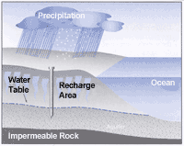
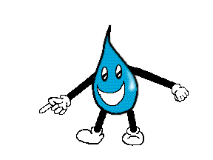
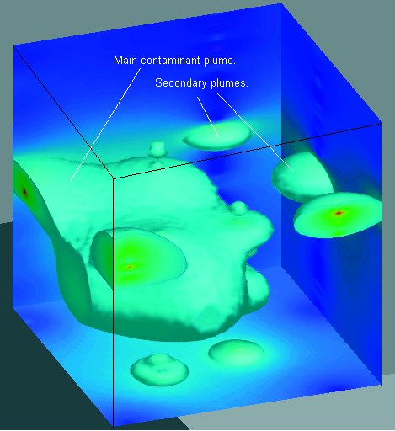
Water Supply Geology
Volumetric flux rate (Q,q)
Hydrostratigraphy (aquifers)
Fluid / soil mechanics (physics)
Gw flow equation; well hydraulics
Contaminant Hydrogeology
advective velocity (v)
variability of K (microstratigraphy)
Hydrogeochemistry
solute transport equation

Slide 3
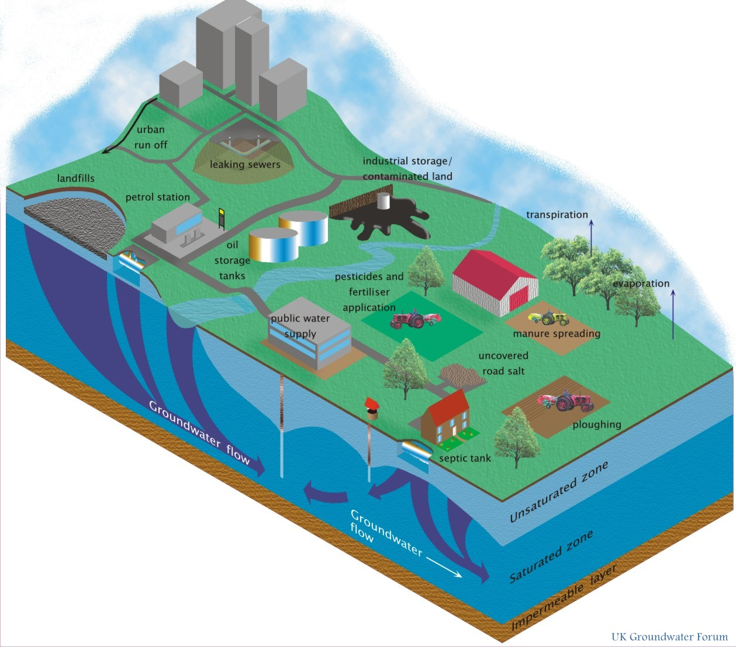
Many Sources and Types of Contaminants

Slide 4
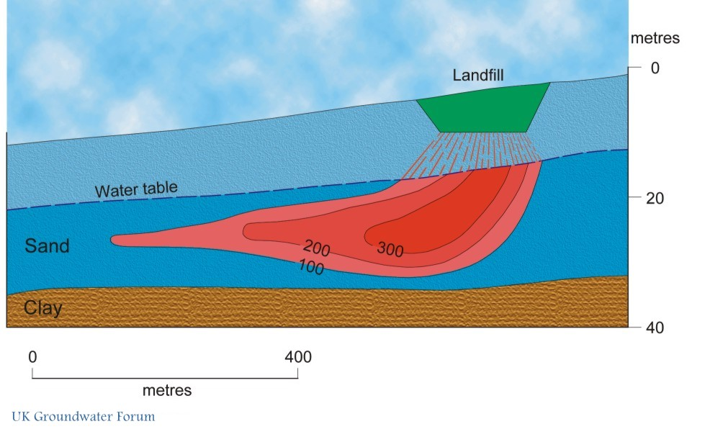
Contaminant Transport

Slide 5
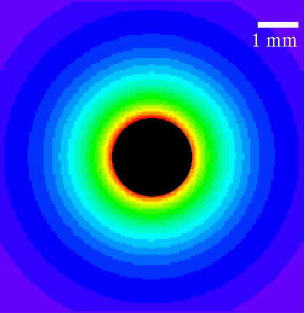
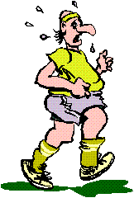
Contaminant / Solute Transport
Process of solute movement complex
Diffusion
moving from higher
to lower concentrations
Advection
solute moves
with groundwater
Dispersion
acts to dilute the solute; spreading

Slide 6
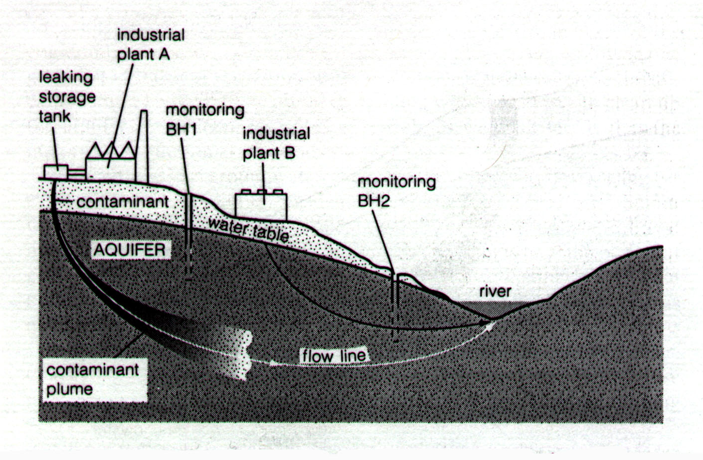
Advection
Simple velocity transport
Particle tracking
Contaminants traveling at same velocity as the groundwater
Dissolved in the ground water
K
n_{e}
dh
dl
v_{x} = average linear velocity
K = hydraulic conductivity
n_{e} = effective porosity
dh / dl = hydraulic gradient
v_{x} = -

Slide 7
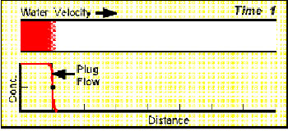
Advective Transport
Plug flow

Slide 8
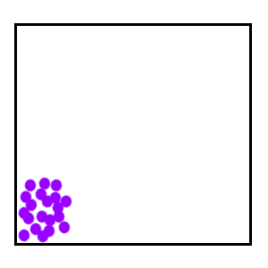
A solute in water will move from
an area of greater concentration
toward an area where it is less
Diffusion
Fick’s Law
diffusion of solute
through water
F = - D_{d} dC/dx
F = mass flux of solute per unit area per unit time
D_{d} = diffusion coefficient
C = concentration
dC/dx = concentration gradient
Negative sign - movement from higher to lower concentration

Slide 9
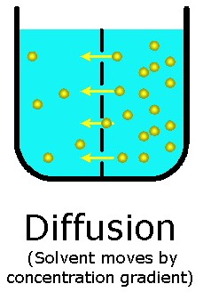
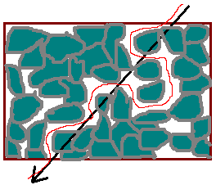
In porous medium,
diffusion not as effective as in open water
Tortuosity
actual length of flow path (Le)
divided by straight line distance (L)
Solute only moves through pores
D* = effective diffusion coefficient
D* = ωD_{d}
ω = empirical coefficient
Function of the tortuosity, always < 1
For non sorbed species, ω = 0.01 – 0.5

Slide 10
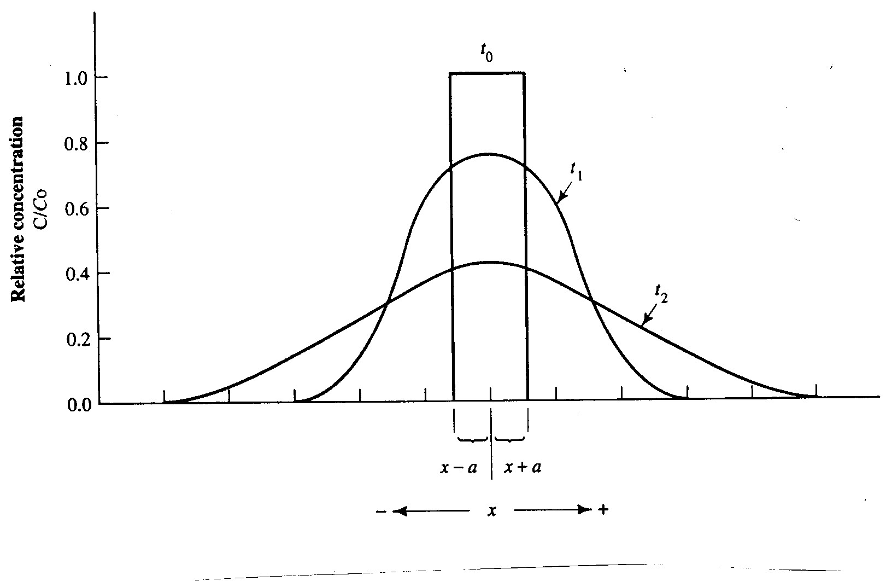
Diffusion through time
With time, peak concentration lowers,
but area contaminated increases
Solute concentration follows a normal distribution

Slide 11
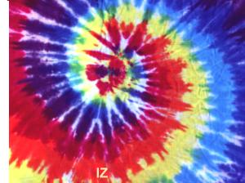
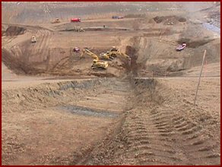
Possible for solutes to move
without groundwater movement
Diffusion important in
low permeability materials

Slide 12
Dispersion
Mechanical dispersion - caused by motion of the fluid
Flow
Direction
→
Longitudinal dispersion – along the streamline
Transverse dispersion – perpendicular to flow path

Slide 13
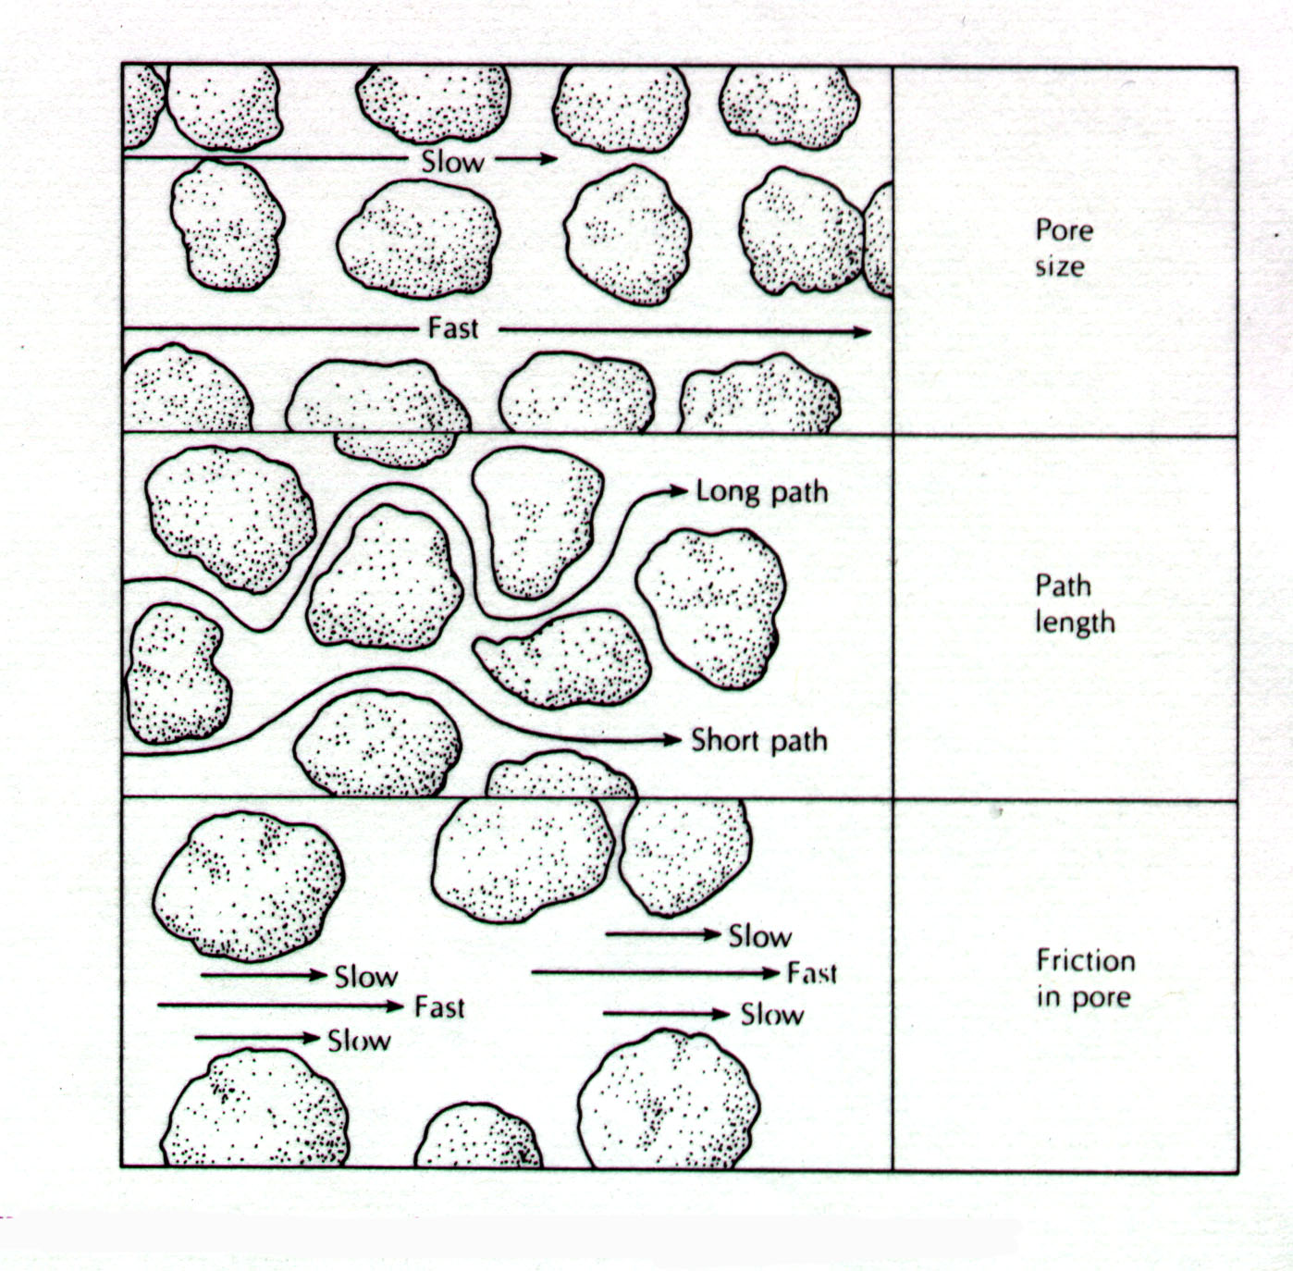
Dispersion
Pore Size
Tortuosity
Length of flow path
Friction
Faster through
the center

Slide 14
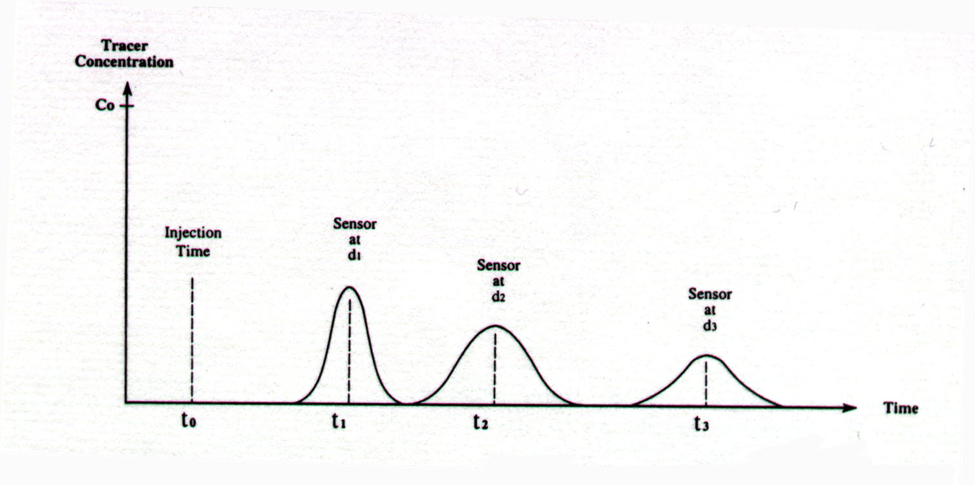
Coeff. Of Longitudinal Mechanical Dispersion = α_{L}v_{x}
α_{L} = longitudinal dispersivity
Coeff. Of Transverse Mechanical Dispersion = α_{T}v_{x}
α_{T} = transverse dispersivity
Hydrodynamic Dispersion
Processes of diffusion and dispersion can’t be separated out
D_{L} = coeff. of longitudinal hydrodynamic dispersion
D_{L} = α_{L}v_{x} + D*
D_{T} = coeff. of transverse hydrodynamic dispersion
D_{T} = α_{T}v_{x} + D*

Slide 15
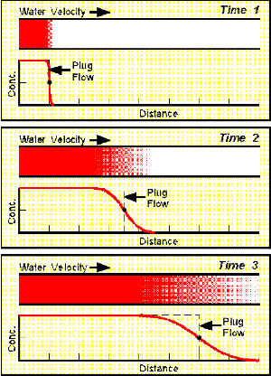
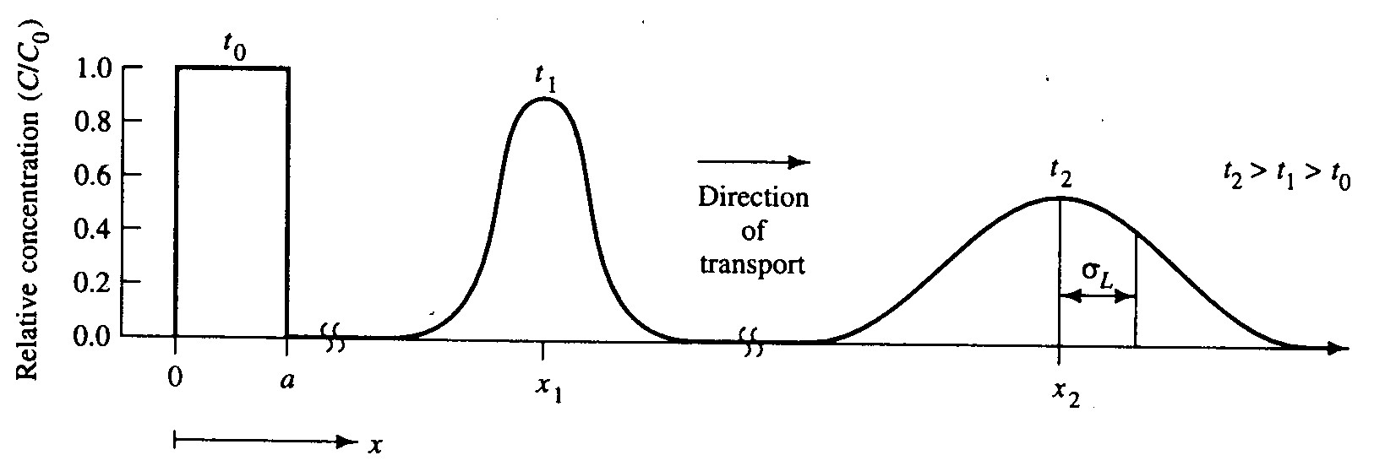
Plume migration
Center of mass is moving at the
same rate as the average linear
velocity of groundwater
Normal distribution
Gaussian distribution

Slide 16
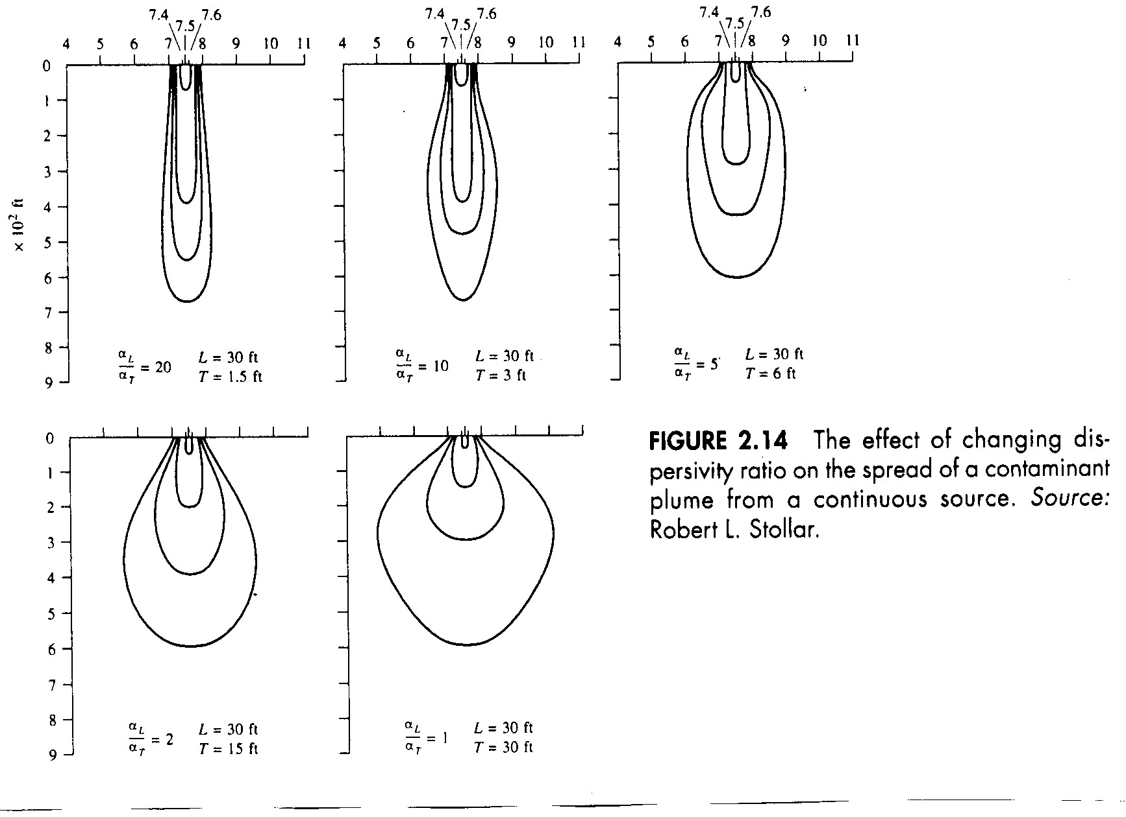
D_{L} = α_{L}v_{x} + D*
Transverse Dispersion
D_{T} = α_{T}v_{x} + D*
Ratio of longitudinal (α_{L}) to transverse (α_{T}) dispersivity
controls the
shape of plume
Lower the ratio
broader the shape

Slide 17

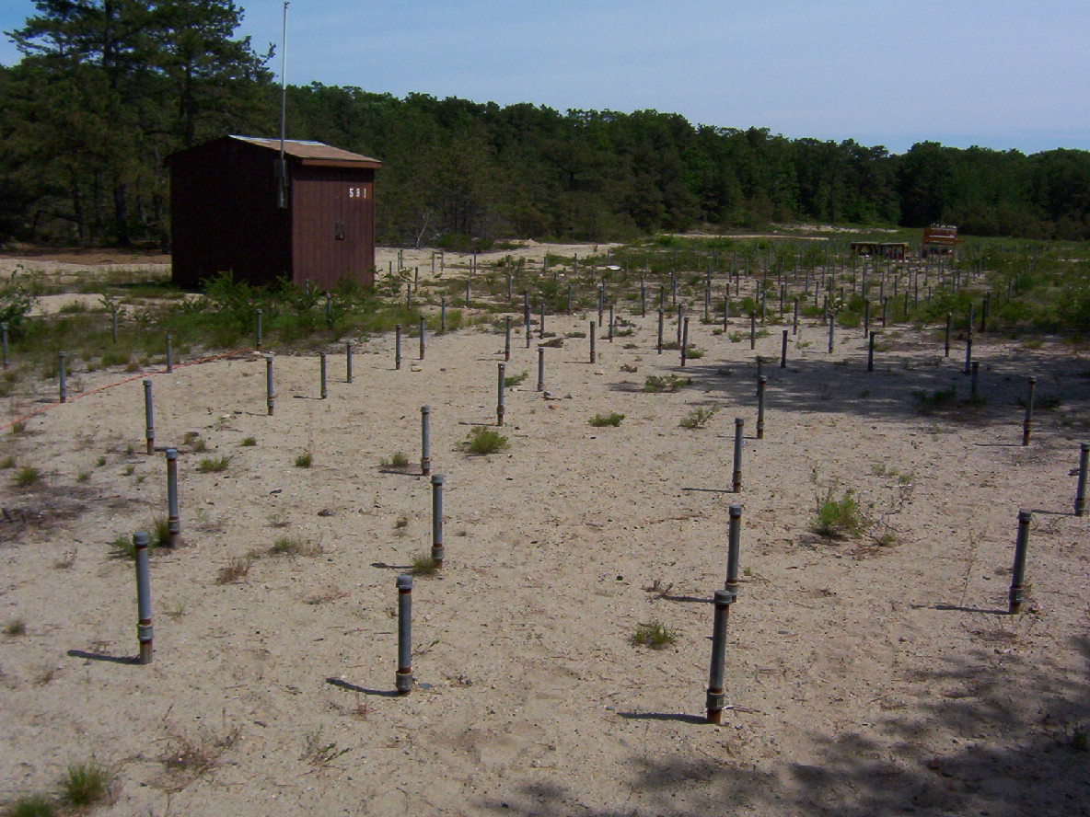
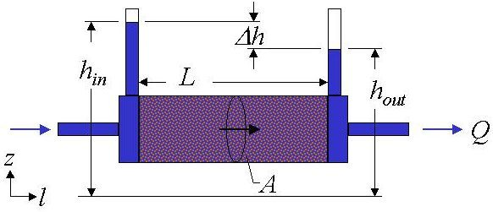
Because of its influence on the shape of the plume
it is important that we know the ratio
Trouble is there is little data available on dispersivity
α_{L}
α_{T}
Ranges from 6 to 20
So how do we determine dispersivity?
1. Laboratory Tests
2. Field Tests

Slide 18
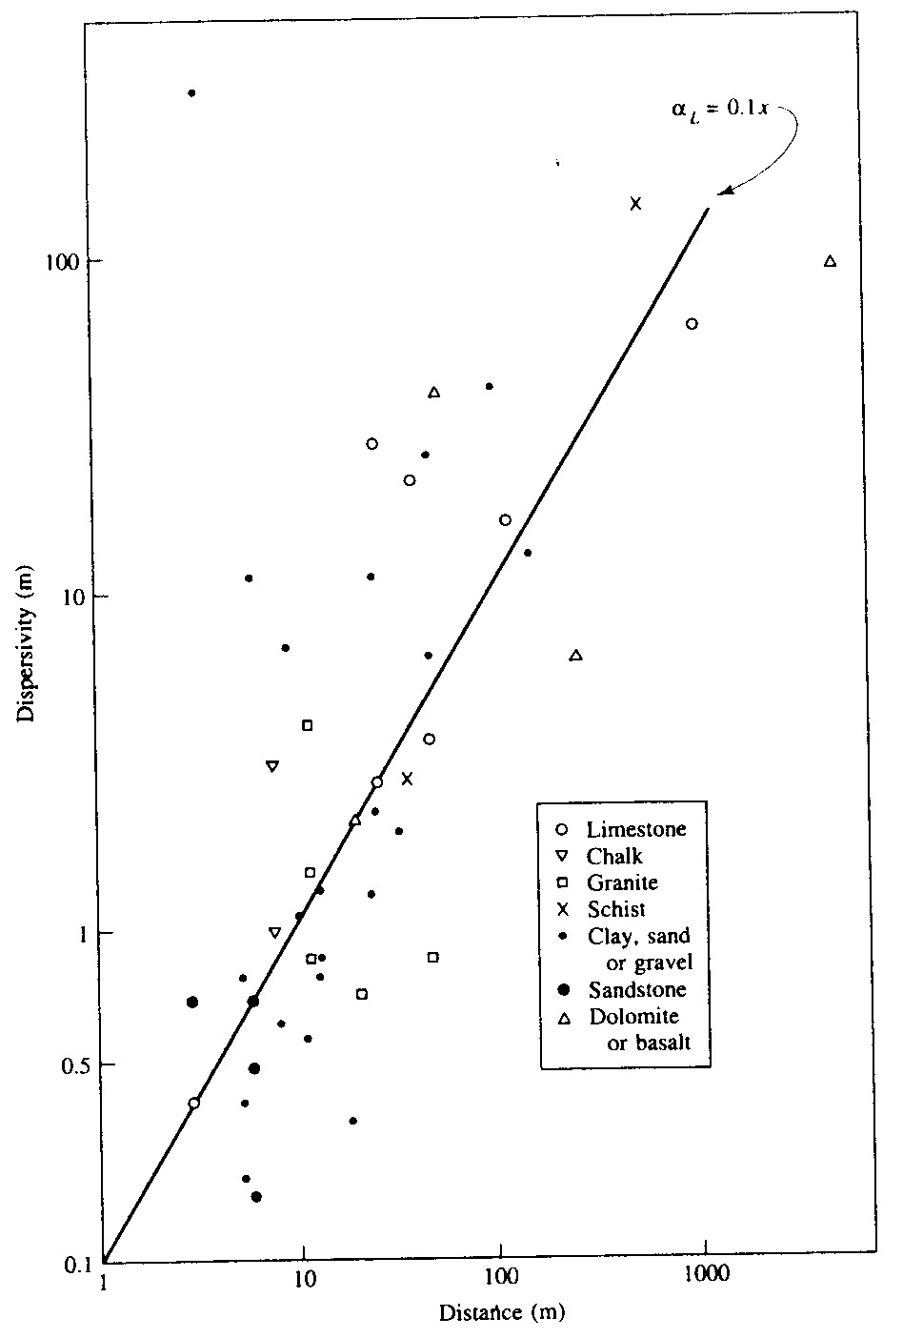
Scale Effect on Dispersivity
At lab scale α was 0.035 cm
when flow length was 30 cm
α_{L} = 0.1 x
In field test α was 3 cm when
flow length was 3.1 m
In another field test α was 5 cm
when flow length was 5 meters
Greater the distance over
which dispersivity measured,
greater the dispersivity
Macrodispersion (field scale)
vs
lab measured values

Slide 19
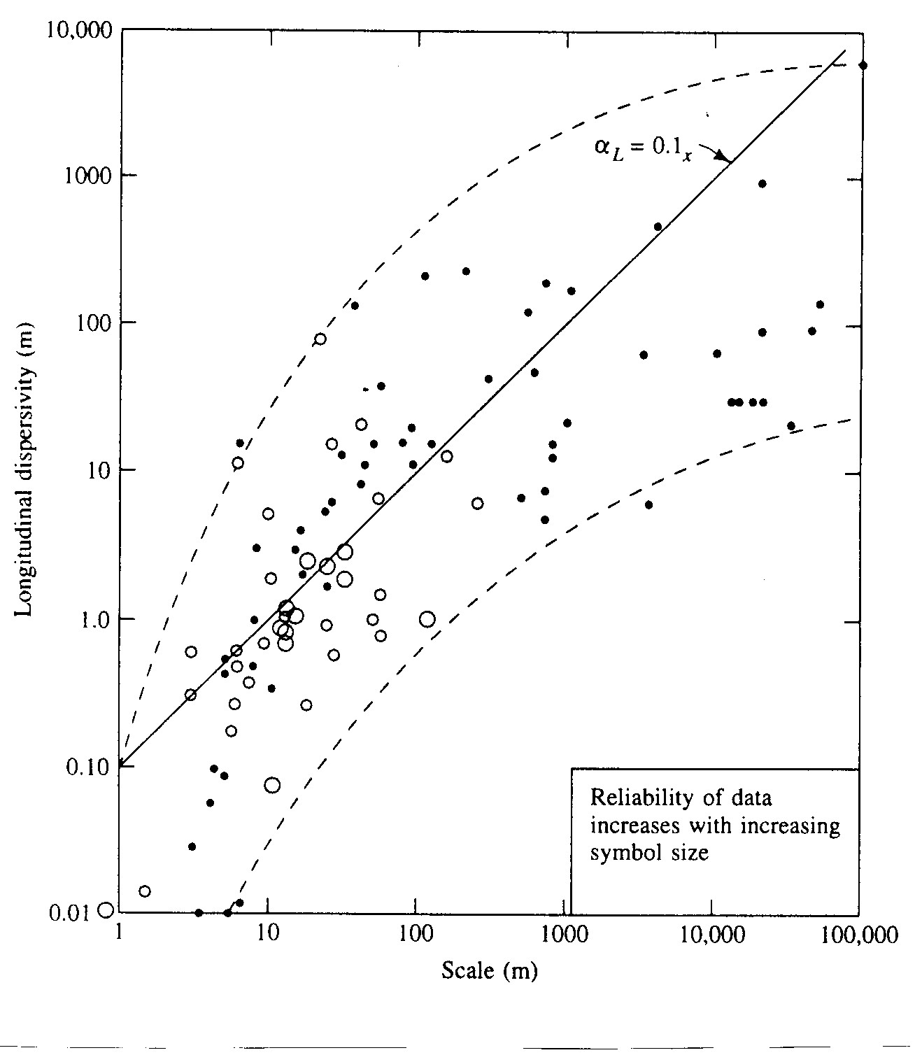
How can we explain the scale effect of dispersion?
At small scale (lab scale)
Dispersion due to diffusion,
pore size distribution and
pore size geometry
Tortuosity and microscopic
variations in velocity within
a pore and between pores
At field scale dispersion due
to variations in stratigraphy
and permeability
heterogeneity in K and n

Slide 20

Solute Transport
Conservative and Reactive Solutes
Conservative
do not react with soil / groundwater
Reactive
Sorbed onto mineral grains
as well as organic matter

Slide 21
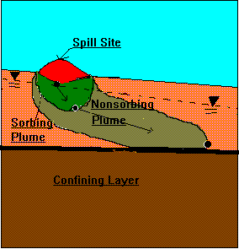
Retardation
As a result of sorption processes some solutes will move
more slowly through the aquifer than the ground water
that is transporting them

Slide 22
If solute is reactive, it will travel slower than
groundwater rate due to adsorption
v_{c} = v_{x} / [1 + (B_{d} / θ) (K_{d})] = v_{x} / r_{f}

Slide 23
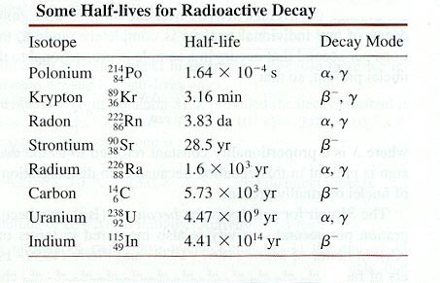
Contaminant Decay
Half Life λ
A period of time in which half the nuclei of a
species of radioactive substance would decay
C = C₀e^{–(ln2/λ)t}
C₀ = initial conc. and t = time

Slide 24
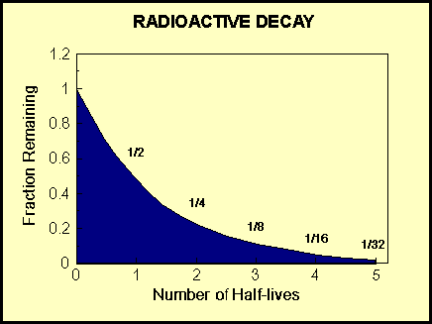
If radionuclides enter the groundwater system, they can
undergo radioactive decay which reduces their concentration
Radioactive decay is an exponential decay law

Slide 25
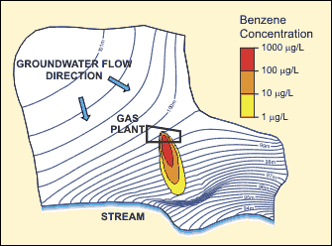
Use MODFLOW to solve flow equation …
Generates heads and velocities
Use output from MODFLOW to input into transport models
concentration in space and time

Slide 26
One dimension advection - dispersion
with sorption and reaction
∂C
∂ t
∂²C
∂x²
∂C
∂ x
B_{d}
θ
∂C*
∂ t
( )
∂C
∂ t
=
D_{L}
-
v_{x}
-
+
rxn
dispersion
advection
sorption
reaction
D_{L} = coefficient of longitudinal hydrodynamic dispersion
C = solute concentration in liquid phase
v_{x} = average linear groundwater velocity
t = time
B_{d} = bulk density of aquifer
= porosity (saturated aquifer)
C* = amount of solute sorbed per unit weight of solid
rxn = indicates biological or chemical reaction of the solute

