Slide 1
Compartmentation

Slide 2
Definition of Fire Compartmentation
A fire compartment is defined as an area of the building which is totally separated from the remainder of the building by continuous construction.
This area could be:
► a single room,
► a series of rooms,
► even an entire floor area.
► a vertical service space or
► a horizontal service space.
Notes:
If we were to so separate every room or space in a building, we might achieve a very high level of fire safety. However, this would be an expensive solution, which might not be practical or cost effective, at least from a strictly life safety point of view. A more rational approach is to consider the location of each fire compartment as a strategic decision which must be fully compatible with the life safety or property protection goals.

Slide 3
Compartmentation (a)
Is the idea of enclosing spaces with continuous barriers a practical one?
Openings are needed to allow:
• access and egress from the area and
• to provide electrical, mechanical and plumbing services.
In order to ensure the integrity of the fire compartment, it is critical that every opening or penetration adequately protected to resist the passage of fire.
Notes:
through its walls, floor and ceiling, from large openings such as doorways to the smaller service penetrations (wiring, piping, and ducts), be

Slide 4
Compartmentation (b)
The potential impact of inadequate barrier penetrations needs to be assessed.
Fire rarely spreads from one area of a building to another by destroying or burning through a wall or a floor.
It usually bypasses these physical barriers, via common concealed spaces in walls or ceilings
These openings must be protected to ensure that the fire will be contained to the desired area.
Notes:
large holes that have been punched through masonry walls to let electrical or communications cables through; doors 'wedged' open.

Slide 5
Standard fire resistance test
The standard fire resistance test is often criticized as not representing real-world fires.
Fires can be more or less severe depending on:
• the amount, type and geometry of combustible load (things which can burn) present in the compartment,
• the availability of fresh air (door and window openings), and
• the thermal properties of the interior finish materials (Figure 1).
Notes:
Testing each assembly for the various possible fires is not, however, an economically appealing solution. This problem was raised when the standard heat exposure was introduced and, in 1928, some efforts were made by S.H. Ingberg, a U.S.National Bureau of Standards testing engineer, to develop a relationship between the 'standard' fire and real fires.

Slide 6
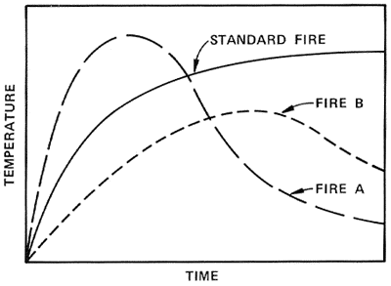
Compartmentation (fig.1)
Figure 1 Comparison of typical compartment fires (A and B) and standard fire exposure

Slide 7
Compartment testing
Testing each assembly for the various possible fires is not an economically appealing solution.
A series of full-scale room burns with the combustible content representative of typical office have been conducted.
On the basis of these tests, in which room temperatures were recorded as a function of time, using the equal area hypothesis to compare the severity of a real fire to that of a standard fire of specified duration (“Fire Severity” Concept)
The hypothesis, illustrated in Figure 2 to 4, essentially states that the severities of the actual and the test fires can be considered similar if the areas under their respective temperature-time curves above a base level are equal.

Slide 8
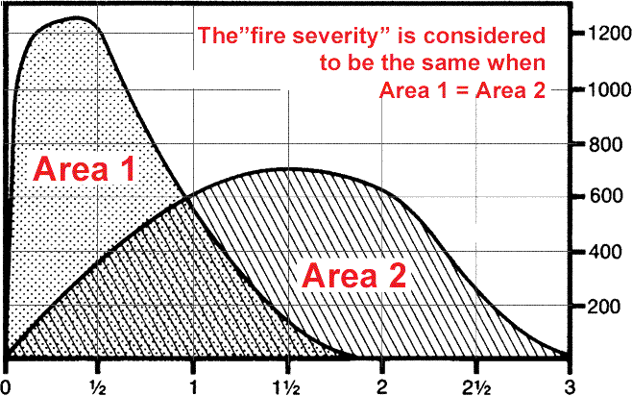
The “Fire Severity” Concept
Temperature in °C
Figure 2

Slide 9
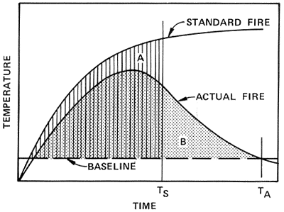
Relationship between the 'standard' fire and the 'real office' fire.
Figure 3

Slide 10
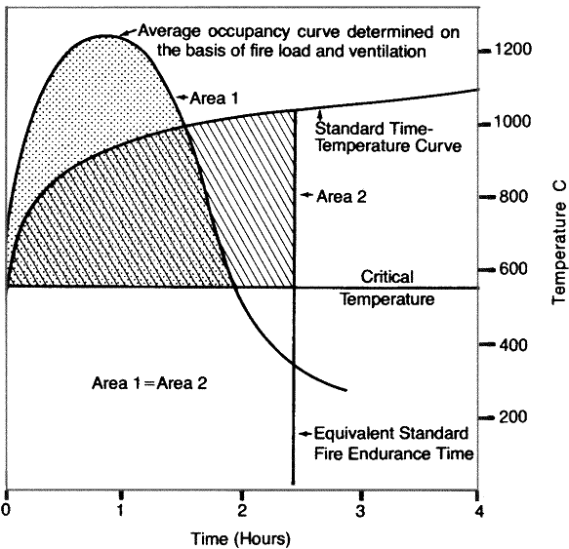
Determination of Equivalent Fire Endurance Time
Figure 4

Slide 11
Reason for Compartmentation
A fire separation is defined as a continuous barrier in which every opening or gap is effectively protected.
To protect the openings in the fire separation must possess some level of fire resistance, i.e. they must be able to withstand the effects of fire and contain it for a specified period of time.
To evaluate the ability of a specific building element or assembly to perform in this respect, small- and full-scale fire resistance tests have been developed.
Notes:
with a 'closure' (a special device or mechanism which blocks an opening, such as a door, wired glass or a rolling shutter) or fire stopped with fire-resistant materials.

Slide 12
Compartmentation performance
The level or duration of performance against the effects of fire which is necessary will vary for different buildings.
In a low building, such separation need only retard the vertical progression of fire long enough to allow full evacuation of the upper storeys.
According to building codes, 45 minutes to one hour is sufficient for this purpose.
In higher buildings, the floor separations must be effective for the entire duration of a fire emergency, that is, the time it takes for all the combustible fuel on a floor (furniture and furnishings) to burn out completely or for fire fighters to suppress the fire, since the time needed to fully evacuate the building could exceed the duration of the emergency.

Slide 13
Evacuation (a)
Table 1 Time required for total evacuation of building population
Building Height | Evacuation Time (min)
(storeys) | Office | Residential
5 | 6-12 | 3-6
15 | 18-36 | 9-18
20 | 24-48 | 12-24
30 | 36-72 | 18-36
40 | 48-96 | 24-48
50 | 60-120 | 30-60

Slide 14
Evacuation (b)
If stairways are designed to accommodate the evacuation of occupants from one floor at a time, occupants of floor areas above the fire floor will require protection against fire spread for a longer period of time than that afforded by unprotected conventional construction (about ten to twenty minutes). Storey-to-storey compartmentation is normally the best way of providing such protection; all floor/ceiling assemblies are built as fire separations, as illustrated in Figure 6.

Slide 15
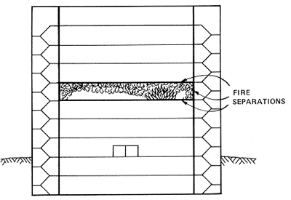
Higher buildings compartmentation
Figure 6 Floor-to-floor and exit compartmentation

Slide 16
Compartmentation
the building designer therefore should contact fire experts to elucidate the following actions:
· to describe the fire problem specific to the building
· to describe different alternatives to obtain the required fire safety level
· to analyse system choice regarding technical solutions and economy
· to create presumptions for technical optimized system choices

Slide 17
Compartmentation
The fire resistance required by a compartment depends upon its intended purpose and on the expected fire.

Slide 18
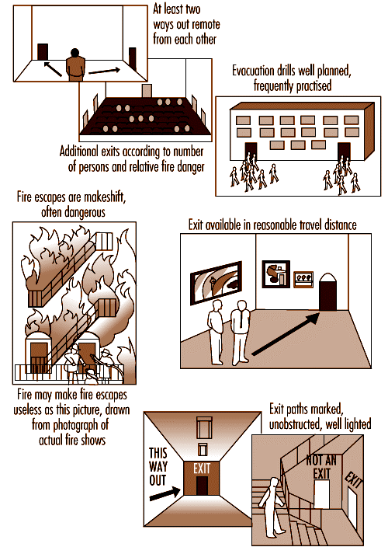
Principles of exit safety

Slide 19
People evacuating from a burning building are influenced by a number of impressions during their escape. The occupants have to make several decisions during the escape in order to make the right choices in each situation. These reactions can differ widely, depending upon the physical and mental capabilities and conditions of building occupants.
The building will also influence the decisions made by the occupants by its escape routes, guidance signs and other installed safety systems. The spread of fire and smoke will have the strongest impact on how the occupants make their decisions. The smoke will limit the visibility in the building and create a non-tenable environment to the evacuating persons. Radiation from fire and flames creates large spaces that cannot be used for evacuation, which increases the risk.
In designing means of egress one first needs a familiarity with the reaction of people in fire emergencies. Patterns of movement of people must be understood.
The three stages of evacuation time are notification time, reaction time and time to evacuate. The notification time is related to whether there is a fire alarm system in the building or if the occupant is able to understand the situation or how the building is divided into compartments. The reaction time depends on the occupant's ability to make decisions, the properties of the fire (such as the amount of heat and smoke) and how the building's egress system is planned. Finally, the time to evacuate depends on where in the building crowds are formed and how people move in various situations.
In specific buildings with mobile occupants, for example, studies have shown certain reproducible flow characteristics from persons exiting the buildings. These predictable flow characteristics have fostered computer simulations and modelling to aid the egress design process.
The evacuation travel distances are related to the fire hazard of the contents. The higher the hazard, the shorter the travel distance to an exit.
A safe exit from a building requires a safe path of escape from the fire environment. Hence, there must be a number of properly designed means of egress of adequate capacity. There should be at least one alternative means of egress considering that fire, smoke and the characteristics of occupants and so on may prevent use of one means of egress. The means of egress must be protected against fire, heat and smoke during the egress time. Thus, it is necessary to have building codes that consider the passive protection, according to evacuation and of course to fire protection. A building must manage the critical situations, which are given in the codes concerning evacuation. For example, in the Swedish Building Codes, the smoke layer must not reach below 1.6 + 0.1H (H is the total compartment height), maximum radiation of short duration, and the temperature in the breathing air must not exceed .
An effective evacuation can take place if a fire is discovered early and the occupants are alerted promptly with a detection and alarm system. A proper mark of the means of egress surely facilitates the evacuation. There is also a need for organization and drill of evacuation procedures.

Slide 20
Human behaviour during fires
How one reacts during a fire is related to the role assumed, previous experience, education and personality; the perceived threat of the fire situation; the physical characteristics and means of egress available within the structure; and the actions of others who are sharing the experience. Detailed interviews and studies over 30 years have established that instances of non-adaptive, or panic, behaviour are rare events that occur under specific conditions. Most behaviour in fires is determined by information analysis, resulting in cooperative and altruistic actions.
Human behaviour is found to pass through a number of identified stages, with the possibility of various routes from one stage to the next. In summary, the fire is seen as having three general stages:
1. The individual receives initial cues and investigates or misinterprets these initial cues.
2. Once the fire is apparent, the individual will try to obtain further information, contact others or leave.
3. The individual will thereafter deal with the fire, interact with others or escape.
Pre-fire activity is an important factor. If a person is engaged in a well-known activity, for example eating a meal in a restaurant, the implications for subsequent behaviour are considerable.
Cue reception may be a function of pre-fire activity. There is a tendency for gender differences, with females more likely to be recipients of noises and odours, though the effect is only slight. There are role differences in initial responses to the cue. In domestic fires, if the female receives the cue and investigates, the male, when told, is likely to “have a look” and delay further actions. In larger establishments, the cue may be an alarm warning. Information may come from others and has been found to be inadequate for effective behaviour.
Individuals may or may not have realized that there is a fire. An understanding of their behaviour must take account of whether they have defined their situation correctly.
When the fire has been defined, the “prepare” stage occurs. The particular type of occupancy is likely to have a great influence on exactly how this stage develops. The “prepare” stage includes in chronological order “instruct”, “explore” and “withdraw”.
The “act” stage, which is the final stage, depends upon role, occupancy, and earlier behaviour and experience. It may be possible for early evacuation or effective fire-fighting to occur.

Slide 21
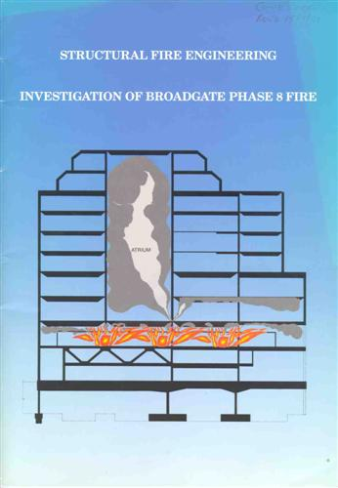
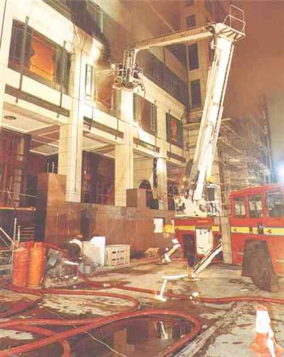
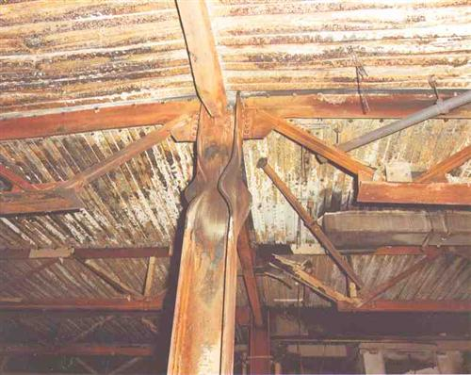

Slide 22
Building Code of Australia (BCA)
Objective CO1
Functional Statements CF1 - CF2
Performance Requirements CP1 - CP9
Verification Methods CV1 - CV2

Slide 23
PART C3 PROTECTION OF OPENINGS Deemed-to-Satisfy Provisions
C1.0 Deemed-to-Satisfy Provisions
C1.1 Type of construction required
C1.2 Calculation of rise in storeys
C1.3 Buildings of multiple classificationC1.4 Mixed types of construction
C1.5 Two storey Class 2, 3 or 9c buildings
C1.6 Class 4 parts of buildings
C1.7 Open spectator stands and indoor sports stadiums
C1.8 Lightweight construction
C1.9 * * * * *
C1.10 Fire hazard propertiesC1.11 Performance of external walls in fire
C1.12 Non-combustible materials

Slide 24
C2.0 Deemed-to-Satisfy Provisions
C2.1 Application of Part
C2.2 General floor area and volume limitations
C2.3 Large Isolated Buildings
C2.4 Requirements for open spaces and vehicular access
C2.5 Class 9a and 9c buildings
C2.6 Vertical separation of openings in external walls
C2.7 Separation by fire walls
C2.8 Separation of classifications in the same storey
C2.9 Separation of classifications in different storeys
C2.10 Separation of lift shafts
C2.11 Stairways and lifts in one shaft
C2.12 Separation of equipment
C2.13 Electricity supply system
C2.14 Public corridors in Class 2 and 3 buildings

Slide 25
PART C2 COMPARTMENTATION AND SEPARATION
C2.9 Separation of classifications in different storeys
If parts of different classification are situated one above the other in adjoining storey's they must be separated as follows:
(a) Type A construction — The floor between the adjoining parts must have an FRL of not less than that prescribed in Specification C1.1 for the classification of the lower storey.
(b) Type B or C construction — If one of the adjoining parts is of Class 2, 3 or 4, the floor separating the part from the storey below must—
(i) be a floor/ceiling system incorporating a ceiling which has a resistance to the incipient spread of fire to the space above itself of not less than 60 minutes; or
(ii) have an FRL of at least 30/30/30; or
(iii) have a fire-protective covering on the underside of the floor, including beams incorporated in it, if the floor is combustible or of metal.
Back to previous slide

Slide 26
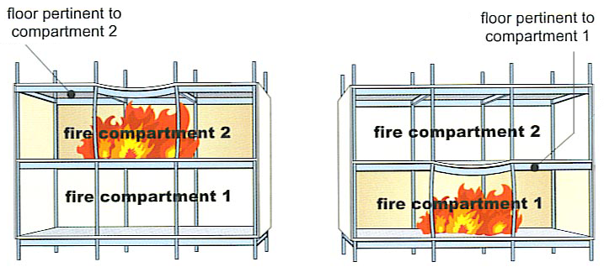
SPECIFICATION A2.3 FIRE-RESISTANCE OF BUILDING ELEMENTS
C2.9
Separation of classifications in different storeys
If parts of different classification are situated one above the other in adjoining storeys they must be separated as follows:
(a) | Type A construction — The floor between the adjoining parts must have an FRL of not less than that prescribed in Specification C1.1 for the classification of the lower storey.
(b) | Type B or C construction — If one of the adjoining parts is of Class 2, 3 or 4, the floor separating the part from the storey below must—
Thus in the diagram below, the floor should be considered as the floor above the compartment and should have the appropriate FRL for that compartment (see also BCA Clause C2.9).
Back to slide 36
(ii) | have an FRL of at least 30/30/30; or
(iii) | have a fire-protective covering on the underside of the floor, including beams incorporated in it, if the floor is combustible or of metal.

Slide 27
C3.0 Deemed-to-Satisfy Provisions
C3.1 Application of Part
C3.2 Protection of openings in external walls
C3.3 Separation of external walls and associated openings in different fire compartments
C3.4 Acceptable methods of protection
C3.5 Doorways in fire walls
C3.6 Sliding fire doors
C3.7 Protection of doorways in horizontal exits
C3.8 Openings in fire-isolated exits
C3.9 Service penetrations in fire-isolated exits
C3.10 Openings in fire-isolated lift shafts
C3.11 Bounding construction: Class 2, 3 and 4 buildings
C3.12 Openings in floors and ceilings for services
C3.13 Openings in shafts
C3.14 * * * * *
C3.15 Openings for service installations
C3.16 Construction joints
C3.17 Columns protected with lightweight construction to achieve an FRL

Slide 29
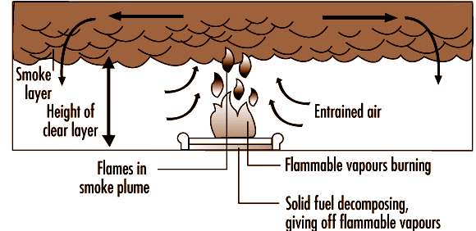
Compartmentation

