Slide 1

FirstRate House Energy Rating Training
BCGSV5013A
Apply principles of energy efficient design to buildings

Slide 2

BCGSV5013A Apply principles of energy efficient design to buildings
  House Energy Rating background
  General Concepts
  Reading Plans and entering data
  Guided data entry house 1
  Assessment - Students data entry for house 2

Slide 3
AccuRate replaces NatHERS
Nationwide House Energy Rating Scheme National Greenhouse Response Strategy
Jointly developed, state based implementation
Assigns an energy rating to a house on a scale from 0 to 5 stars in a consistent way through Australia
Notes:
The point of this is to communicate that there is a national frame work for rating houses which is agreed between states, however, each state manages their own scheme.

Slide 4
Limitations
FirstRate is accurate enough
Do not use FirstRate if
  Total glazing area > 50% of NCFA
  Glazing area in one direction is >25% NCFA
Combine glazing area of immediately adjacent orientations eg. Nth & NNE

Slide 5
What does the rating do?
Gives a score to each part of the building
Scores can be positive & negative
Total of all scores gives star rating
Shows energy efficiency relative to a base case
Notes:
The base case is a lightweight insulated house without windows and scores 0 points in each climate. That is why the point scores to get the various stars vary between climates as the base case house is better suited to some climates than others.

Slide 6
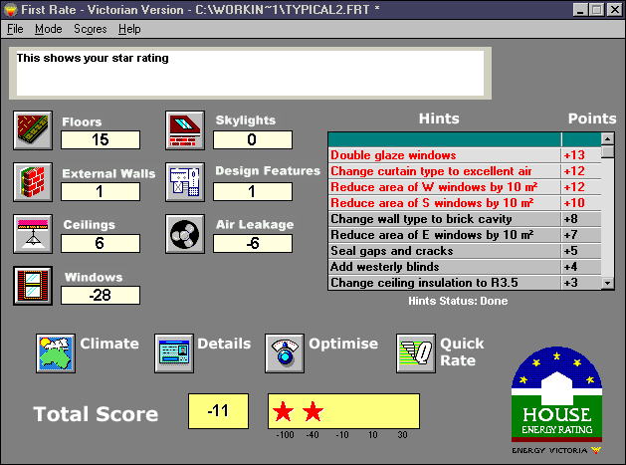
General Concepts: main screen
Menus
Info box
Hints
Icons
QuickRate
Element
scores
Optimise
Design
Stars
Climate
selection
Total Score
Notes:
Each box is animated and will fly in at a button press. Describe each feature in turn. Emphasise the following:
Info box: provides help in all screen relative to the position of the mouse pointer. It describes range of data inputs, how to use FirstRate features, and if you are such is the first thing to look at for help.
Icons: click to bring up data entry screen for each element.
Scores: shows how each element performs, the more positive the better. The more negative shows where the main weakness of the building is. Note in some climates it is virtually impossible to get a positive score for single glazed windows so the task is to make them less negative.
Note that changing the data in one element may change the score of another. The software is highly interactive.
Stars & points: Must draw attention to the numbers under the stars and that these represent the star thresholds. Star thresholds change for each climate.
Note that for some designs the colour of the total score may change from black. If this happens it means that the total scores for heating or cooling (or both) have reached their maximum.
Optimise, Hints: ways in which FirstRate helps you to find out how to improve your house.
QuickRate: Shortcut to obtaining a rating. Software makes a number of assumptions about a design. Useful where a fast and indicative rating is required.

Slide 7
Overview of rating session
Select climate (postcode or town)
Click on the icons to enter data
Save the file (save often!!!!)
Enter identification details (for reports)
Use Optimise & Hints to fine tune
Print a report
Notes:
If you don’t pick the right climate first the feedback the software gives on the strengths and weaknesses of the house via point scores, the hints etc. will potentially be misleading, so this is very important to get right. Note that a default start up climate can be set in the climate screen and once set will stay at that climate until you change it. If you are doing lots of ratings in the one climate this is very useful.
Our convention with saving is do everything except windows then save, then save again after windows, the with final optimise, and rating details etc.

Slide 8
Reading plans
Dimensions shown on lines outside plan. Use dimensions to outside of wall
Elevations: for window sizes (sometimes shown on plan) and distance from head of window to eaves.
Sections: Ceiling height, bulkheads
Notes:
Dimensions to outside of wall is very important. Getting floor area right is fundamental as the basis of the rating is energy per square metre. Get the square metres too small and the rating will be worse, too large and it will be better.
Why to outside of walls? Its generally easier, also Gross Floor Areas are the way in which the building industry traditionally reports house sizes.
Note that for walls we take floor to ceiling height and don’t include the structure. Also wall size includes windows, software takes out the window area for the purposes of its calculations.
Bulkheads are vertical elements facing an attic. They usually occur in the transition between flat and sloping ceilings. These are actually classified as ceilings. Upper floor external walls which face the attic of a room on the ground floor are also classified as ceilings. These are classified as ceilings even though they are not flat or sloping because they face an attic space and heat must flow not just through the element but through the attic space as well which changes the nature of the heat flow compared to a wall. If it is a vertical element at ceiling level but does not face an attic then it is a wall eg. row of clerestory windows.

Slide 9
Interpreting plans: Utility areas
When taking area measurements from plans, it is very important that you:
  exclude floors, walls and ceilings facing utility rooms and exclude any air leakage sites in utility rooms
  unless the utility room is
    centrally heated,
    the door to the utility room opens directly to a bedroom or
    the utility room is enclosed inside the dwelling
  utility windows and skylights are included
Notes:
The basis of the utility rules is that if a room is going to be heated or cooled it should be included in the rating. So generally non habitable rooms like bathrooms and laundries should be excluded. But use your common sense, there will be a few cases where there seems to be no black and white answer, and it is up to you to make a logical case for you decision.
You might like to draw some examples on a whiteboard or show some plans using an overhead projector. The help system has some good diagrammatic examples: Help, New Features, General Software Features, Utility zones, or just search on Utility Zone.
Include width of walls between utility and rest of house in floor and ceiling area of house. However, in the wall screen you don’t need to enter area of the walls between utility and rest of house. The software already knows there will be some small heat flows to utility areas and takes these into account.

Slide 10
Interpreting plans cont:
Note on upper floors & shared ceilings
  An upper floor is:
    a floor within the house but not exposed to outside eg. a mezzanine, first floor in two storey house
  A shared ceiling is:
    the ceiling of the house which is shared with another house directly above
Notes:
The floor of the upper storeys must be entered as the software needs to know what area of the house is heated/cooled to determine the rating (energy/area basis).
People sometimes get confused with ceilings and think they have to enter all ceilings within a house when in actual fact only those between the house and the outside or between the house and a separate house need to be entered.
General principle in FirstRate is that you don’t have to enter the same piece of the building twice*. So if you have entered the floor of the upper storey, you won’t need to add it again as a ceiling to the ground floor. In fact the ceiling/floor between ground and upper floors is really just an internal partition and these don’t need to be entered unless there is thermal mass as the software already allows for an effect of internal partitioning.
* Except timber doors with glass inserts where the inserts are counted as window and again as a door for air leakage. Note that this is because the glass inserts have much less area than the door itself, so that simply entering the area of the glass will not adequately allow for the air leakage of the door. With Aluminium sliding doors the frame is slender and the full glass area is entered into the software, so these do not need to be entered twice. Note that entry doors need to be entered twice in air leakage also, once in no. of doors, again if it opens directly into living areas.

Slide 11
Interpreting plans cont:
Assumptions for plans (if not on plan)
  Insulation at minimum regulations
    Ceiling R2.5
    Brick veneer / timber wall R1.0
  Materials
    If unknown, apply most common type of material (ie aluminium frame & single glazing)
    Fit out materials (ie. external blinds): assume none
Notes:
Often the most time consuming part of the rating is finding out the details that are not shown on the plan. To save time we use some defaults in Victoria (for example insulation levels required under the Building Code of Australia (Vic) but these may need to vary between jurisdictions.

Slide 12
Screen by screen
most screens present data in tables
rows and columns like a spreadsheet
command buttons: add, copy, delete, help
each box in the table is a field
Yes/No field
Option List field
Number field
Notes:
I usually open up the floors screen to show the features listed on the slide. Also show the area calculator.

Slide 13
Climate
3 ways to choose your climate
  pick a state and town
  select the climate directly
  enter your postcode
Postcode is the best and most reliable
  some postcodes have 2 climates
  generally a cooler climate at a higher elevation
Notes:
Some important things:
Postcode is always the best way to select your climate.
If there are 2 climates it is usually because part of that postcode is at a higher elevation. Look at the climates available and determine which one is the coldest one. This will be the one to use at higher elevations. Often the alternative climate will be 24 (Canberra) or 25 (Alpine). This should help pick the correct climate.
The default climate box check box.
The first time you start the software open the climate screen. Select the climate you will be using most frequently. Check the box, then click close. From then on unless you check the box on a different climate the software will start up in that climate zone.

Slide 14
Details
House, client and assessment details for printed report
Comments: will show when you open a file so you can keep track of your files
This version has file names limited to eight letters, a full stop, and a 1rt extension eg. sdetyuip.1rt
Custom data field
Appliance details
Notes:
Opening a file to demonstrate how the comments field shows up in the file open dialog.
Note that there is an extra screen for accredited raters.
Assessor name has set as default check box which once checked will fill in the current name whenever a new file is created until you change it.
Custom data field allows you to add an additional field to the front page of the printed report. In File|Options|Settings you can make this field appear each time on the rating report with the field name you have nominated. Very useful for our friends in the ACT who want to have the block & section number recorded on the report.
Appliance details
Open the appliance screen and demonstrate how to fill in the information. Point out the information is not used in the assessment it is for information purposes only and will be printed on the first page of the printed reports.

Slide 15
Floors
Id. Number
  whole numbers
  next number is highest number plus 1
  two rows can have the same number
Type
  suspended slab is a slab over an air space
Notes:
Suspended slab has a different meaning to engineers than we use here. For an engineer a suspended slab is one that can support its own weight across a span. It may well be still in contact with the ground. For FirstRate a suspended slab is one made of concrete which is not in direct contact with the ground but is instead above a sub floor space.

Slide 16
Floors
Sub floor ventilation: see the info. Box
Upper: a floor within your own house ie. the first floor in a two storey house
Shared: shared with someone else’s house ie. shared with a medium density unit below
Foil: one layer of reflective foil facing down, no need to add to Insulation R
Notes:
Sub floor ventilation points to emphasise:
What to do when the house is over a garage (Open ventilation if garage is closable, elevated if not closable - see help file).
Upper and shared have covered the confusion re is an upper floor an ceiling (ans: no) I previous slides but may be a good idea to emphasise again.
Foil: if anyone asks, the R value we assume for the foil surface is the R value NatHERS assumes. Yes, I know it is wimping out, but … Note also that selecting foil does not affect the total R value shown because there is no one answer to the question and it will vary with direction of heat flow, and temperature conditions. At Sustainable Energy Authority of Victoria we get manufacturers will seemingly identical foil products quoting different R values, so if the industry can’t get one answer neither can we.

Slide 17
Floors
Carpet: Yes/no see help for cork etc.
Ins R value: the thermal resistance of an insulation product installed in this element
Total R value: total thermal resistance of the element including construction materials
Area: measure to outside of walls
  note area calculator
Notes:
With cork set 1/2 the floor to carpet, 1/2 to no carpet (in help file)
Area calculator now has a cancel button so if you enter something in error you don’t muck up the entry.
In next version, area calculator entries will be remembered, but not yet as the 16 bit version just couldn’t have any more features added without becoming unstable due to the limitations of the old style 16 bit programming language.
Now they’ve seen all the fields lets fill in the data for the first building’s floors. I’ll show how I get the area from the plan on the white board (separate floor into carpeted and uncarpeted, ignore utility bits, measure to outside of walls). Then I’ll fill in the details and they copy.

Slide 18
Walls
Type
  Brick Cavity
  AAC Aerated Autoclaved Concrete eg. Hebel
  Concrete 100 mm Int: 100mm thick precast concrete insulation if present is on the inside
Length & height
  floor to ceiling height
  two storey: enter each floor separately
  FirstRate takes wall area out, so must know total wall length (Wall length calculator)
Notes:
What if your wall type isn’t there? See help file, I usually show them the entry from the help file to try and get them used to looking up things in the help file as many of user’s questions are answered there.
Height of walls is floor to ceiling, so in a two storey house it is floor to ceiling of EACH STOREY IE. DOESN’T INCLUDE FLOOR BETWEEN STOREYS.
FirstRate deducts a fixed width multiplied by the length of the wall to allow for the wall ‘footprint’. So you need to enter walls in each storey separately, not combine with one length and height of both floors combined.
Add R0.5 to walls adjoining garages fitted with a garage door.
Now go through the way you get the wall length and height from the plan. Point out that for this house the ceiling is flat, but if it had a cathedral ceiling the wall height adjacent to this would be different. Then all enter data.
On the whiteboard show how to use the ‘short cut’ to measure wall length
(A + B) x 2 (works unless there is a courtyard (then add twice the depth of the courtyard)
A
B

Slide 19
Ceilings
Type: refers to ventilation, external material is not important
  low ventilation: due to metal deck or sarking
  see help for other types
Foil one surface facing down, for multi foil batts use Ins. R value
  remember to deduct existing air space R value
Notes:
Roof material and colour is often suggested to be an important determinant of energy efficiency. However, where the ceiling is insulated the effect of roof material and colour is very small. As it is impossible to obtain a reasonable rating without insulation in the ceiling the effect of material and colour is ignored.
If insulation is provided under the roof, but the roof ventilation is parasol, heat flow through the ceiling dominates and the effect of insulation under the roof material can be ignored (except for reflective foil).
Expert opinion is far from united over the R value of reflective foil surfaces in a horizontal position. The R value changes with temperature, temperature difference, emissivity of the foil and direction of heat flow so care should be exercised in assigning an R value to multi foil batts. In general, take the R value for the dominant season: see help file. Also remember to deduct the R value of existing air spaces before adding the R of the various layers of foil. This is why the help file gives an R value for the first layer and a higher R value for subsequent layers.

Slide 20
Skylights
Orientation: select from 8
Slope: select from 6, if over 75º it’s a window!
Type: opal is translucent, double includes skylight with diffuser at ceiling
Summer shading: adjustable device drawn only when hot
Area: be careful over 10% of NCFA
Notes:
Not 16 orientations as the performance difference between orientations is smaller than for windows.
Summer shading: can’t cope with louvres built into the skylight. Is for an external blind type of shade (or if double glazed) a blind between the panes.
It is hoped that the Window Energy Rating Scheme will come up with similar detail for skylights.

Slide 21
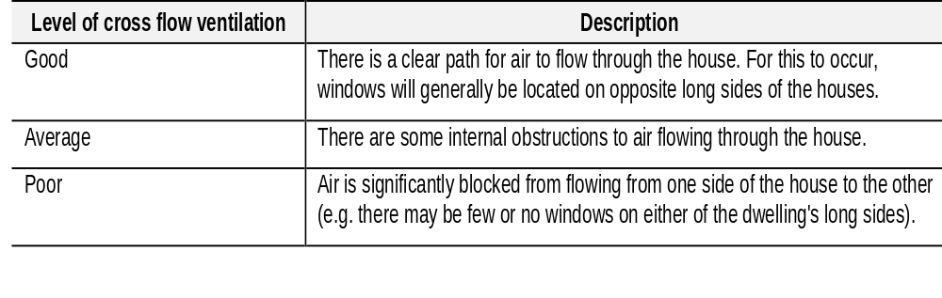
Design Features
Cross ventilation
Notes:
This is an area where there is a lot of grey.
Poor and Good are easy to define, there is a lot of average in between. In reality this is a very basic assessment and we are looking to further developments in NatHERS to allow a better assessment of this.

Slide 22
Design Features
Internal Mass
  Internal partitions only
  Mass in external walls is already accounted for
Light weight is for AAC block
Include brick, mud brick, pre cast concrete panel, straw bale (has 40mm render either side) as thickness of mass does not matter

Slide 23
Air Leakage
Air leakage sites: sealed & unsealed see info box
Some sealed sites don’t exist, just there for convenience eg. sealed vent
Doors to utility rooms: assumed to be closer to outdoor temperature
Notes:
In the columns count the number of air leakage sites
Skylights to habitable rooms - as ensuites are classed as habitable rooms include any vented skylights to these rooms
Vents, down lights and exhaust fans - do not include any vents exhaust fans to utility rooms, instead make sure that the door to the room is counted in the number of doors to utility rooms
Doors to utility rooms - do not count doors to ensuites only those doors to rooms designated as utility rooms for the purposes of the software
External doors - include all external doors, note that where there is more than one door in a doorway count each opening. Note that glass sliding doors only need to be entered once - as a window. Other glass doors should be entered twice, once the glass and frame area entered into the windows screen and once in the doors column.

Slide 24
Air Leakage
Location: exposure to wind, so 20th floor is coastal, not inner city
2 storey houses exposed to higher wind
Gap sizes shown in info box
Gaps and cracks: behind wind mould, around pipe penetrations
Notes:
Main entry door opens to living area: this can be an area where several points can be lost or gained so it is important to assess this carefully.
If there are no doors between the main door and any adjacent living areas answer Yes. If the nearest living room is at the end of a long hallway answer No. Also answer No in situations where the main entry door does not open from the outside environment (such as in apartment blocks with shared hallways)

Slide 25
Windows
Direction: 16
Height & width, measure to outside of frame
Glass & Frame: U values given in help
Blind: external like canvass awning
Summer & Winter eave
  the same unless an adjustable horizontal device is used
Notes:
Mention and show the orientation template.
Alternative ways of entering height and width:
w2127 gives a 2.1 high x 2.7 wide window
c24 gives a dimension of 24 brick courses in height or width cells.
Glass and frame U values shown in the help file are for some generic windows. These can be used as a guide to determining what windows you should select for your house if you know the U value but the window you are using is not available in the Custom Windows section. Note that the U values referred to here and in the Custom Windows section are measured under specific conditions, so not any calculation of U value can be used but ONLY THOSE PROVIDED BY WERS.
Curtains: the type of curtain to be used is often unknown at the time of rating. It is convention to assume Holland blinds as these have a small but significant effect where the actual type is not known.
The effect of external blinds is that for canvass awnings. This is a reasonable approximation for any type of eternal shading device including shutters, but will not properly model the effect of things like insulated shutters which reduce heat loss in winter as well as solar gain in summer. To simulate this select a curtain with an added R value similar to the R value of the shutter. Note that for substantially insulated shutters, even this is not enough.
Summer and winter eave: this over estimates the effect of this feature as it assumes that people will be adjusting frequently depending on whether you want to heat or cool. While the inaccuracy will generally not be too great it is good practice to not assume a winter eave of less than 0.3 m. where adjustable horizontal devices are provided.

Slide 26
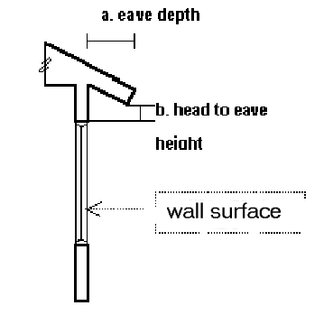
Windows
Head to eave:
Notes:
If the eave extends below the head height of the window a negative head to eave height is entered.
Pergolas with shading battens will almost always have a +ve head to eave as the battens are positioned on top of the pergola.
Distance should be measured from face of wall to edge of eave (not from face of window as this is already accounted for in software).

Slide 27
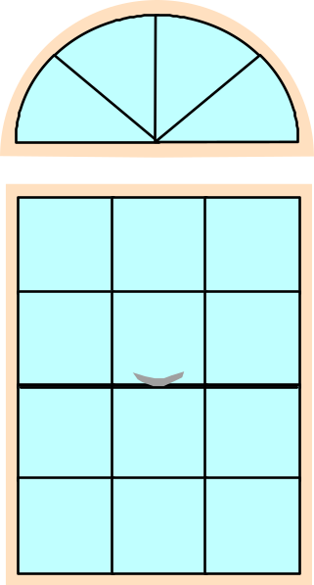
Windows and obstructions
When obstructions are not directly opposite
  see Windows section in manual
  Use Shadcalc
    Divides window into obstructed and unobstructed portions
    Reality is more complex than
    Shadcalc, but error is only large for small amounts of shading
Notes:
Obstructions generally refers to overshadowing buildings. The term can be applied to high fences and, under some circumstances, to trees. For a tree to be considered to be an obstruction the foliage must be very dense. Trees which let a fair amount of light through the foliage (such as eucalypts) should not be considered to be an obstruction. Point out that in the suburban environment trees are generally not as permanent as buildings so including a tree in a rating may result in a different rating should the tree be removed.
For houses to be built on lots where neighbouring houses are not yet constructed raters can assume that any obstructions will be located the minimum required distance from the boundary and be the predominant height of buildings in the estate (ie one or two storeys).
The proportion of a window overshadowed depends on distance and height in addition to the offset (which is all Shadcalc takes into account). The reality is more complex than represented by Shadcalc. However, the error is only large when the shading effect itself is small so there is no great benefit in the additional accuracy. You can always use NatHERS for greater accuracy anyway. In the next upgrade Shadcalc will be integrated into FirstRate and the division into shaded and unshaded components will be handled within the software. At this stage the algorithms will be upgraded to add accuracy.
Demonstrate the use of Shadcalc. In particular show the scale feature, noting that actual dimensions may need to be manually entered after scaling. Also that window width can be entered directly and doesn’t have to be limited to drop down box alternatives.

Slide 28
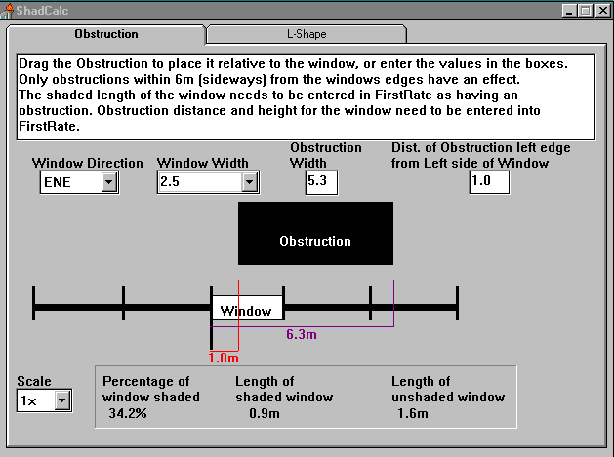
Shadcalc & obstructions
Select orientation
or enter width of obst. here
Enter width of window
Enter width of obst. (click, hold and drag)
and offset here
Shows length of window shaded

Slide 29
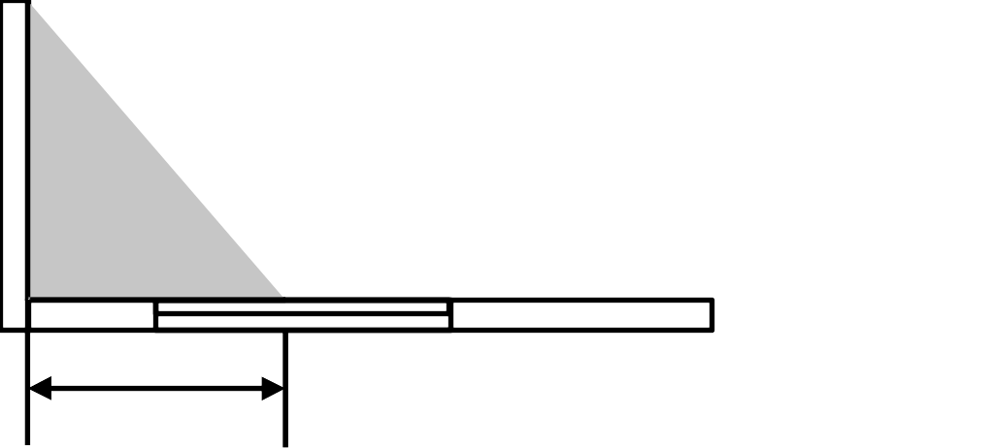
L shaped buildings
Overshadowing of building on itself:
  Use Shadcalc
  Divides window into unshaded and south facing portions
Notes:
Demonstrate use of Shadcalc. Note the use of the shift key will allow you to change the fin depth without affecting the offset. At large dimensions some anomalies will occur eg. shading reduces when it should increase. This is just a limitation of the algorithms and the errors are not large enough to worry about (that we know, someone out there may turn up a problem we haven’t found).
Now you have covered all the window fields, get trainees to enter the window information themselves. You will have to mention assumption re glass and frame type, extent of eaves etc. Allow 20 - 25 minutes max. for their data entry.
After data entry a good exercise is to write up the area of glass and window score for each student on a whiteboard and explore why the differences occurred for those which show a big departure. This is a key exercise as it shows how the rating can depend on data interpretation and the importance of raters having a common understanding of data to ensure that ratings are consistent.

Slide 30
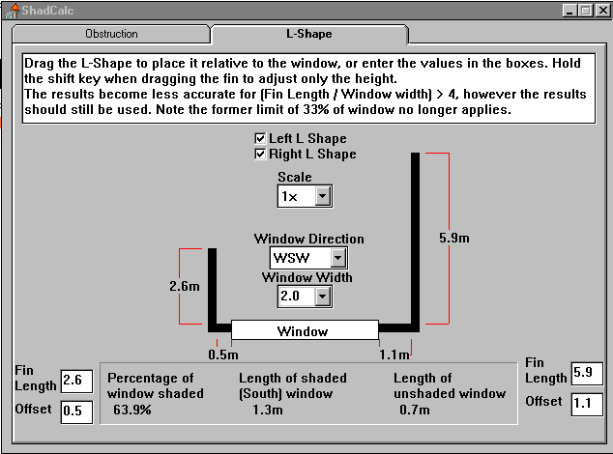
Shadcalc and L shapes
Select left &/or right
Or enter length and offset manually
Enter window orientation
Enter window width
Click, hold & drag length. Shift locks offset
Click, hold & drag offset

Slide 31
Diagnostic Screens
Optimise
  test drive design changes
Scores menu
  breaks down scores to components to better show strengths and weaknesses
  Rating at different orientations and energy use

Slide 32
Optimise: testing what if?
Tests the effect of design changes on the energy efficiency rating
Changes are made across all elements
  eg ‘reduce south windows by 20m²’ - reduces the width of each south window by till total area is reduced by 20 m² or until 0 area

Slide 33
Optimising
To make a change:
  find the item you want to change (use scroll bars to see more)
  click on the item to select it
  click on no to change it to yes
  if the third column has “...” double click on this to see the options available
  double click on the option you want

Slide 34
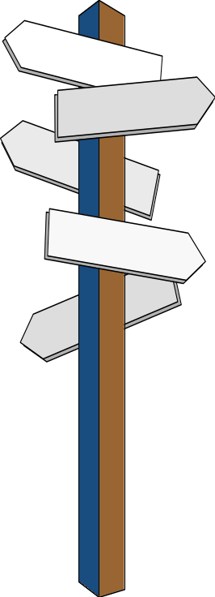
Notes on optimising: reorientation
Reorienting sets all obstructions to 0
After reorienting, any changes made to windows (ie adding shading or reducing window size) will need to be made as if the window still faced the ‘original’ direction
Can always go back and change in the windows screen
Notes:
After reorienting using Optimise, any optimised changes to window shading or to the size of windows (ie increasing or decreasing size) will need to be made as if the windows still faced the original direction. For example, if a building with large north windows was reoriented by 90o these windows would now face east. To add blinds to these reoriented windows select ‘Add northerly external blinds’ and not easterly. The alternative is to add blinds in the actual windows screen. Note in particular this will affect the proportion of window deemed south due to L shapes and deemed overshadowed due to obstructions, but the software is not smart enough to figure this out for itself. So take care reorienting heavily shaded houses!
Show and demonstrate the Clear All button, Save as New and Transfer to 1Rate button. Warn about saving files if the Transfer to 1Rate function is used.

Slide 35
View on screen reports
The on screen reports can be very useful when determining how to best optimise the rating
They provide a breakdown of the point scores for each element (including the scores for summer and winter)
Select the ‘Scores’ menu to view the on screen reports
Notes:
On screen reports show why elements get good or bad scores. This gives the user an idea of the key areas to improve the rating. These scores are the key way in which FirstRate helps the user through the rating process. It is a good idea to look at these scores after each data entry screen and explain the scores in these screens to introduce trainees to the diagnostic value of these reports. Eg. if the window score is negative, the report shows in what orientations and at what time of year. Sometimes this can show some non intuitive but very useful information, like fix the heat loss through north glass before heat gain through west if the north loss figure is a high negative. If left to depend on rules of thumb only you wouldn’t even look at north facing glass, thinking this was the best orientation.

Slide 36
On screen reports
Seasonal scores
Windows
Construction
Air leakage & design
Orientation
Energy use
Notes:
Seasonal scores:
Note that the maximum score for each season is shown to give a better idea of relative performance in each season. This represents the nominal 0 energy use score for each season. Now is a good time to point out the change to the colour of the score when heating/cooling/total energy is nominal 0 and that the element scores may improve beyond this point but not the total scores.
Windows:
Note “deemed south” can cause some confusion with window areas.
Construction:
Breaks down scores into mass, insulation and surface area. 2 storey house will have bad score for wall surface area, but good for floor and ceiling. R1.0 in walls gives a 0 score at reference wall area, and R 2.5 for ceilings. Mass in walls is sometimes negative for precast concrete even when insulated and also for weatherboard. This is because the reference wall is BV and these types do not perform as well even when insulated.
Energy Use:
Handle with care. This has been inserted for NatHERS compatibility, but bears almost no relationship to actual energy use as this depends on actual use of appliances, efficiency of appliances (note cooling will always be at least half of that shown due to the efficiency of air con being at least 200%), and the actual severity of the climate that year.

Slide 37
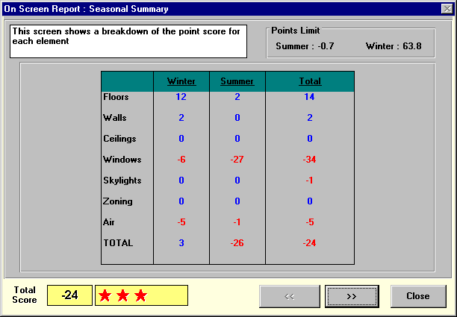
Seasonal Scores
Represents ‘0’ energy use
Summer score: cooling
Winter score: heating
See next screen

Slide 38
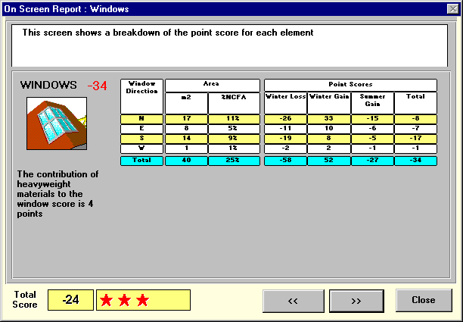
Windows
Orientation
Area: m2 and % of NCFA
Heat losses in winter: conduction
Heat gain in winter: radiation
Heat gain in summer: radiation and conduction

Slide 39
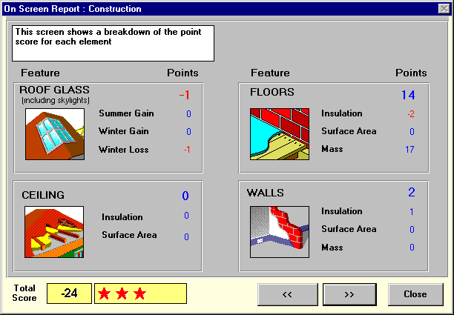
Construction
Roof glazing summer & winter
Opaque elements:
Insulation
Surface area
Mass

Slide 40
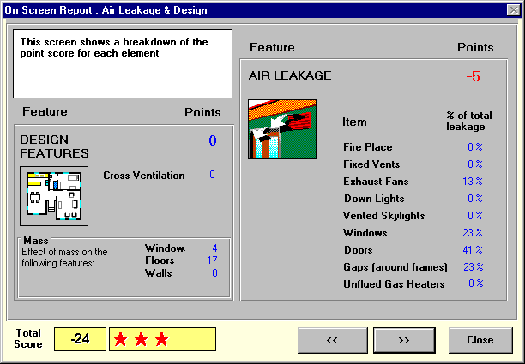
Air Leakage & design
Cross ventilation
Mass effect (included in other scores, compares rating if no mass
Proportion of air leakage via each path

Slide 41
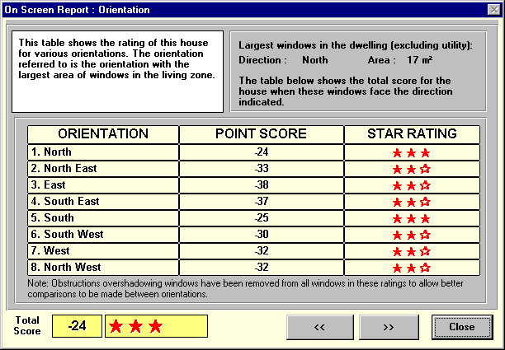
Orientation
Orientation of largest area of glass
Rating at 8 orientations (largest glass area faces this direction)
Beware: does not include overshadowing by surrounding buildings

Slide 42
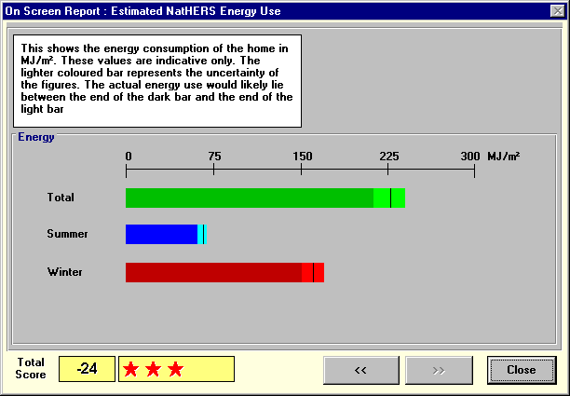
Energy Use
Energy use predicted by NatHERS for standard climate and use pattern, no appliance efficiency
Black line is prediction
Lighter bar is error band

Slide 43
Two new modes for rating
QuickRate
  Rate house in 2 screens
  No official ratings, good for sketch design
Batch mode
  Rate multiple houses in multiple climates and output results to a spreadsheet for analysis
  accredited raters use to send details of ratings to SEAV

Slide 44
QuickRate mode
Rate building in 2 data screens
Makes assumptions about data:
  all windows 2.1 m. high, 8 orientations, vertical blinds, no head to eave clearance
  all ground floors/walls/ceilings/windows are the same
  Air leakage: 2 external doors, an unsealed exhaust fan and 2 doors to high ventilation rooms, suburban location
Notes:
Point out that QuickRate is generally accurate to within around 4 points of FirstRate. Where QuickRate will differ greatly is where there are different types of external floors, walls etc.
As a demonstration of how QuickRate works you may like to enter the data collected for the previous FirstRate assessment into QuickRate. This data is shown on the last page of the solution sheet for plan 1. This will make an interesting comparison of not only data entry but the final score. Transfer QuickRate to FirstRate to demonstrate how the software transfers data and the assumptions which are made.

Slide 45
QuickRate
Good for sketch design analysis
Designed for use with data forms (on disk)
Can’t use for certification

Slide 46
QuickRate Tips
Light weight / heavy weight elements
Use area calculator for window areas
If windows are not 2.1 m. high
Proportion of window overshadowed
Changing assumptions
Notes:
If windows are markedly different to the set window height of 2.1 m (i.e. most of the design’s windows are only 1 m high). Then it may be more accurate to use FirstRate.
Point out that the built in assumptions can be changed only by transferring a QuickRate file to FirstRate. However, once a file is transferred to FirstRate it can’t be opened in QuickRate.

Slide 47
Batch mode
Rates all files in a folder
Output to spreadsheet compatible file
Output includes points & data summary
Used for accredited raters to send data to the Sustainable Energy Authority, research projects, multi unit developments for summary reports
Notes:
Note to find on line help you will need to use the search function and search for “batch”.
The output is quite extensive, it includes a full seasonal breakdown of point scores for major elements, and a summary of data like areas, R values, types of construction. It is good to show how to open a batch mode output file so that they can see how to do this and to show students what data is output.
The Full Glazing Results check box forces the reporting of winter gain and loss and summer gain points for each orientation.
The Do Orientations check box will rate the house at the 8 cardinal and cross cardinal orientations.
Util. Correction should only be used on old .her files as it takes out utility areas from these. It is not accurate on a house by house basis, but should be OK for examining a large number of files.
Output file: selecting use folder name puts the results in a file based on the first 6 letters of the folder where the rating files are located and the climate zone number. So if you are using multiple folders and multiple climates the batch mode will produce a separate output file for each folder/climate combination. Selecting Use defined name puts output into one file regardless of how many folders and climates are selected.

Slide 48
Getting Help
RTFM: read the free manual!
consult the on line help:
  extensively upgraded to include FAQ
  press the help button, or
  select help from the File menu
Look in the information box
e-mail: FirstRate@seav.vic.gov.au
Exit Windows, start again!

Slide 49
Tips for rating multi unit dwellings
Determine if there are any identical units
  you may only need to rate one unit
If there are only minor differences, there is no need to re-enter all data
  after one unit has been rated, save the file and make the necessary changes to the file
  select ‘save as’ and rename the file

Slide 50
Saving files
To save a data for later reference select File, then Save
Enter information about the file into the 3 line comment field in the Identification Screen:
  comments are shown before you open the file
  helps you keep track of files

Slide 51
Printed Reports
Print from QuickRate by selecting File, then Print
Can print a 1 to 5 page report:
  Pg 1: The current rating
  Pg 2: Potential rating and how to achieve it (taken from optimise screen)
  Pg 3: Rating at 8 orientations
  Pg 4: Detailed point scores
  Pg 5: Data listing
  Pg 6:Accredited rater information
Notes:
Ensure that each trainee has a sample report to look at as it may not be possible to print the report at the training facility. Note that pg. 6 is only available for accredited raters. Also note that pg. 5 is not available in QuickRate

Slide 52
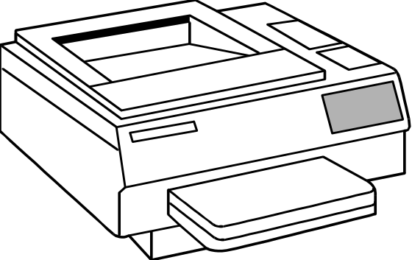
Reports
To print the report click the Report Icon
Ensure that the printer
  is plugged in & switched on
  is ‘on line’
  has enough paper
  is the currently selected printer in Windows, and
  Use Page Set-up to select ‘portrait’ orientation
Notes:
There is a known print problem where the selected printer’s driver is set up with a space in the name (usually in the path which refers to the folder in which the computer can find the printer driver). Windows will sometimes insert this space itself when the driver is installed. To fix this problem the printer driver should be reinstalled without any spaces in the name (hint: use underscores instead of spaces).

Slide 53

Demo-house
Examples
The file “demo.1rt” of the FirstRate software is used to compare the Energy used with the Star-rating and Point allocation for different climate zones in Australia
October 2003

Slide 54
FirstRate Analysis
October 2003
Demo house First Rate Energy used in MJ/m²
Location |  |  | Summar | Winter | Total | Star Rating | Points
Hobart 26 | 7000 | TAS | 6 | 218 | 224 | 4½ | 12
Alpine 25 | 2628 | VIC | 15 | 380 | 395 | 4 | 2
Esperance 18 | 6450 | WA | 54 | 94 | 148 | 4½ | -11
Melbourne 21 | 3000 | VIC | 55 | 130 | 185 | 4 | -8
Armidale 34 | 2350 | NSW | 55 | 243 | 298 | 3½ | -11
Canberra 24 | 2600 | ACT | 55 | 238 | 293 | 3½ | -10
Sydney 17 | 2000 | NSW | 75 | 56 | 131 | 4 | -31
Adelaide 16 | 5000 | SA | 86 | 110 | 196 | 5 | -20
Mildura 27 | 3500 | VIC | 102 | 105 | 207 | 4 | -14
Perth 13 | 6000 | WA | 136 | 23 | 159 | 3½ | -35
Alice Spring 6 | 870 | NT | 223 | 11 | 234 | 3½ | -46
Broken Hill 8 | 2880 | NSW | 230 | 29 | 259 | 4 | -42

Slide 55
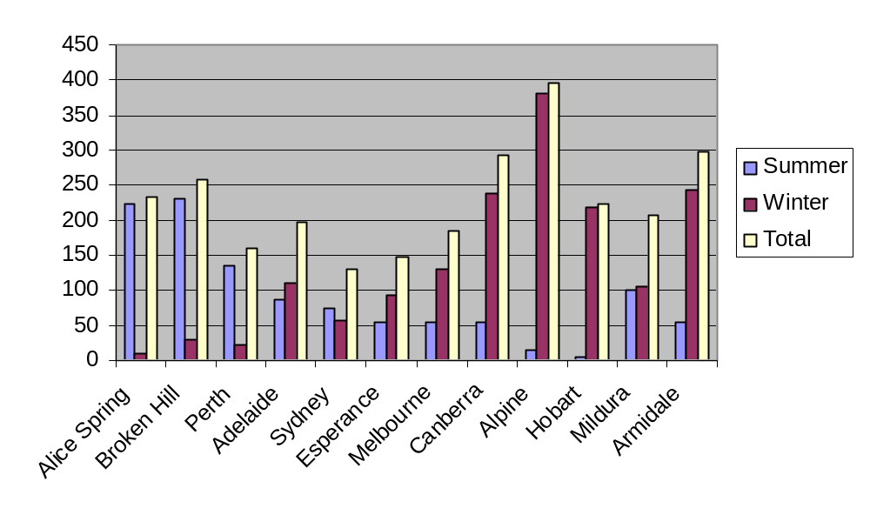
Energy consumption in MJ/m² for Demo house of the 1stRate software
October 2003
1 MJ = 0.2777 kWh
1 kWh = 3.6 MJ

