Slide 1


BCGSV5013A
Apply principles of energy efficient design to buildings
BASIX briefing
July 2005

Slide 2
Definition + Targets
BASIX:
A web-based planning tool
Targets:
Up to 40% reduction in water
25% reduction in greenhouse gas emissions
‘Pass’ in Thermal Comfort
Development must meet all 3 targets

Slide 3
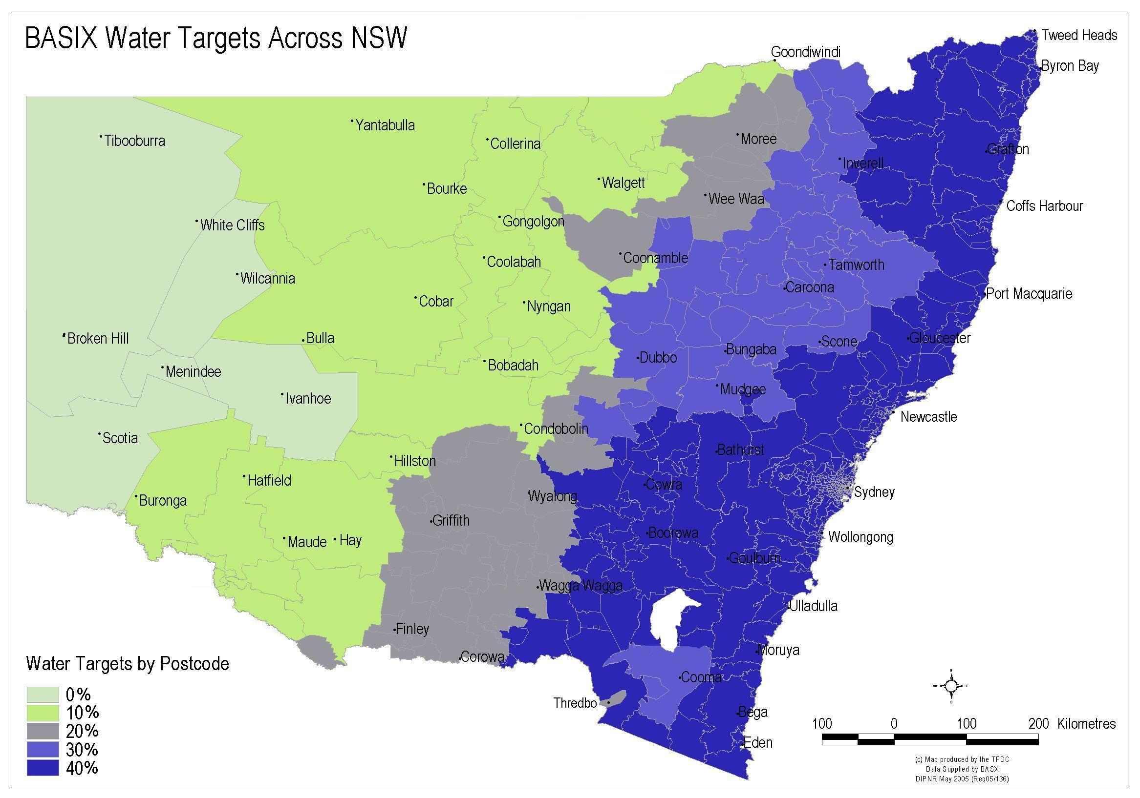
Regional Water Targets

Slide 4
Timeline
1 July 2005:
BASIX applies to all new residential single dwellings and dual occupancies in NSW
1 October 2005:
BASIX applies to all new residential dwellings in NSW:
  Single dwellings
  Dual occupancies
  Villas and townhouses
  Multi-units (low, mid and high-rise)
July 2006:
Energy target increases to 40%

Slide 5
Does BASIX apply to me?
Single dwellings in NSW
All DA’s lodged on/after July 1 – BASIX required
All DA’s lodged before July 1 – BASIX not required irrespective of DA status
  Undetermined
  Approved
  CC Pending

Slide 6
Does BASIX apply to me?
Multi-dwellings in NSW
All DA’s lodged before 1 October:
BASIX voluntary irrespective of DA status
  Undetermined
  Approved
  CC Pending
  Section 96 affected
All DA’s lodged on/after 1 October – BASIX mandatory

Slide 7
Web Based Assessment Tool
Timely update in response to regulation changes
No disks or software to install
Can perform very sophisticated calculations quickly
On line help, definitions, tutorials
E-Newsletter to ensure users aware of enhancements

Slide 8
Framework
The BASIX regulatory framework ensures:
BASIX requirements dovetail within existing development approval process
Overrides planning controls that relate to water and energy reduction for residential development
Development cannot be assessed / approved without BASIX certificate

Slide 9
Process
Use BASIX as both a design and assessment tool for Development Application (DA)
Every DA must be accompanied by a BASIX certificate
Approval of development is by consent authority
Update BASIX Certificate if required prior to construction certificate
BASIX Certificates need to be validated at DA, Construction Certificate (CC) and Occupation Certificate (OC)

Slide 10
Councils
What BASIX means for Councils
A single evaluation of building water use and greenhouse gas emissions
No further requirement to produce planning controls for energy and water reduction in residential development
Councils need to check that commitments on the BASIX certificate match DA plans
Don’t need to be experts in sustainability

Slide 11
Designers
What BASIX means for designers
A free design tool - does not need a third party to operate
No more arguing with clients about why they should be sustainable
Flexible - focused on outcome
Regionally sensitive
Defines + provides comprehensive documentation for DA
Normalises planning controls across the state

Slide 12
Consumers
What BASIX means for consumers
A water and energy efficient dwelling
A more comfortable home to live in
Savings on energy and water bills
Expect to pay slightly more for your new home
A BASIX Certificate is free, and only takes 1-2 hours

Slide 13

How BASIX works
Project details (eg. postcode) determine climate and rainfall data
Number of bedrooms and postcode determine energy and water budget of proposal
Large dwellings work harder than small homes
Percentage targets are a reduction compared to the state average:
  3,292 kg CO₂ per person, per year
  90,340 litres per person, per year
Notes:
Proposed floor area is compared to average dwelling of same type

Slide 14
How BASIX works
Interactive web tool:
  Landscape choice affects water savings
  Insulation, glazing and shading choices dictate the heating and cooling demands that need to be offset on the Energy page
  Changing your showerhead will affect both your energy and water score
  Replacing an air-conditioner with an evaporative cooler will improve your Energy score but reduce your Water score

Slide 15
Mixed-Use Buildings
Information for multi-dwellings
BASIX residential only
BASIX asks about non-residential areas
if non-residential components exist, BASIX apportions accordingly
e.g. shared lobby areas, car-park areas, waste storage areas ….
Takes into account function of different common areas
Areas nominated early in BASIX data entry and affect rest of assessment accordingly
Considered throughout BASIX especially in Energy

Slide 16
Centralised Systems
Opportunities to nominate many different systems (heating, cooling, rainwater, lifts, fire sprinkler system, pools, saunas …)
When systems are nominated, responses needed in subsequent sections of BASIX
May affect BASIX score positively / negatively

Slide 17

How to Pass (Multi-Unit): Water
Internal efficiencies (3A):
Showerheads
Toilets
Tap fittings
Water efficient appliances
Whitegoods only ‘allowable’ in vertical developments
Alternative water supply:
Rainwater or stormwater capture and use
Recycled wastewater

Slide 18
How to Pass (Multi-Unit): Thermal Comfort
Increased use of external shading to glazing
Cross ventilated apartments will score better but not essential
Performance glazing for highly glazed apartments
Increased use of wall insulation

Slide 19
How to Pass (Multi-Unit): Thermal Comfort
Simulation method from July 1 2005
Deemed to Comply under development
Simulation method undertaken by accredited assessor
Assessor typically able to group ‘same type’ apartments for modelling purposes
Floor area adjustment to heating/cooling maximum allowable loads applies
Each dwelling to meet a minimum Thermal Comfort performance target
Whole development must meet “Average of All Dwellings” performance target
“Average of All Dwellings” cap is more stringent than “Individual Dwelling” caps
This allows some dwellings to under-perform if compensated for by better performing dwellings

Slide 20
How to Pass (Multi-Unit): Energy
High efficiency hot water systems
Additional insulation of hot water piping
High efficiency for heating and cooling systems
Naturally ventilated apartments
Efficient and smart controlled lighting systems
Smart car-park and other common area ventilation
Building Mgt System
Power Factor Correction
Swimming pool, spa & sauna controls
Efficient appliances
  Whitegoods only ‘allowable’ in vertical developments

Slide 21
Information for single dwellings
Examples of selections that improve the Energy score:
Solar, heat pump or high efficiency gas hot water systems
Ceiling fans, evaporative coolers, fixed flue gas heating or very high efficiency air conditioning
Energy efficient lighting
Increased efficiencies for pool heating and pumps
Alternative energy - photovoltaics

Slide 22
How to Pass (Single dwelling): Water
Internal efficiencies (3A-5A)
  Showerheads
  Toilets
  Tap fittings
  Indigenous species may be required
Alternative water:
  Rainwater capture and use for garden irrigation and toilet flushing or clothes washing (where appropriate).
  BASIX regional recognises rainwater use for drinking or all household uses.
  Greywater is also an option where appropriate

Slide 23
How to Pass (Single dwelling): Thermal Comfort
Three options – Deemed to Comply (Rapid) and NatHERS (simulation method)
Need to consider:
  Good orientation
  External shading
  Performance glazing where large glazed area or poor orientation
  Cross ventilation (inland – focus more on bedroom night-time cooling)
  Insulation

Slide 24
Plan Marking
Plans must be clearly marked at each stage, according to the BASIX commitments:
Raintanks – location and capacity in litres
Rainwater / stormwater collection areas in m²
Hot water system type, location (including any solar panels), and gas rating (if applicable)
Fixed heating / cooling systems and energy efficiency rating
Landscape – lawns, low water demand planting areas marked and shown in m²

Slide 25
Savings
Over a 10 year period BASIX will save:
9.5 million tonnes of greenhouse gas emissions
287 billion litres of water
Each year, an average consumer will save approximately $300-$600 on their energy and water bills

Slide 26

Sustainability Unit
NSW Department of Infrastructure, Planning and Natural Resources
BASIX Helpline
1300 650 908
BASIX Email
basix@dipnr.nsw.gov.au
Website
www.basix.nsw.gov.au
End of Presentation

