Slide 1

The file “demo.1rt” of the FirstRate software is used to compare the Energy with the Star-rating and Point allocation

Slide 2
Demo house First Rate Energy used in MJ/m²
Location |  |  | Summar | Winter | Total | Star Rating | Points
Hobart 26 | 7000 | TAS | 6 | 218 | 224 | 4½ | 12
Alpine 25 | 2628 | VIC | 15 | 380 | 395 | 4 | 2
Esperance 18 | 6450 | WA | 54 | 94 | 148 | 4½ | -11
Melbourne 21 | 3000 | VIC | 55 | 130 | 185 | 4 | -8
Armidale 34 | 2350 | NSW | 55 | 243 | 298 | 3½ | -11
Canberra 24 | 2600 | ACT | 55 | 238 | 293 | 3½ | -10
Sydney 17 | 2000 | NSW | 75 | 56 | 131 | 4 | -31
Adelaide 16 | 5000 | SA | 86 | 110 | 196 | 5 | -20
Mildura 27 | 3500 | VIC | 102 | 105 | 207 | 4 | -14
Perth 13 | 6000 | WA | 136 | 23 | 159 | 3½ | -35
Alice Spring 6 | 870 | NT | 223 | 11 | 234 | 3½ | -46
Broken Hill 8 | 2880 | NSW | 230 | 29 | 259 | 4 | -42

Slide 3
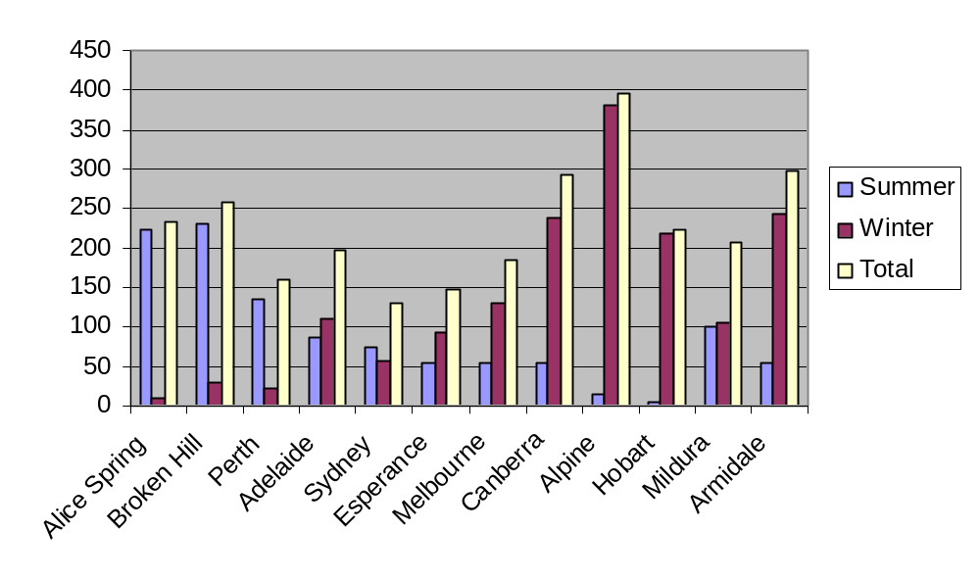
Energy consumption in MJ/m² for Demo house of the 1stRate software

