Slide 1
AutoSketch Overview
AutoSketch is an inexpensive drawing program, which is part of Autodesk’s Personal Solutions Group.
Current Version is AutoSketch 9.0
AutoSketch is an affordable tool for creating accurate technical drawings.
http://reviews.cnet.com/AutoSketch_9/4014-3627_7-31092911.html

Slide 2
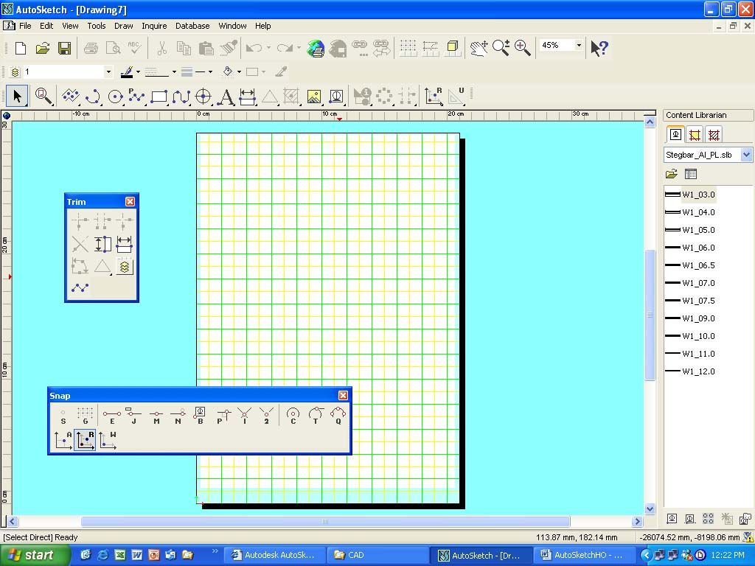
Menu Bar
Standard bar
Property bar
All-In-One bar
Drawing page
Drawing space
(outside the page)
File ⇒ Page Setup
(size, margin & printer page)
Customise tool bar
(floating)
Snap mode (floating)
Content Librarian

Slide 3
Settings/Customization
Changing the environment settings in AutoSketch is done from two main popup menus
Graphic Options, and
Drawing Options.
Both of these are accessible from the "tools" pulldown menu.

Slide 4
Editing/Modifying
Ability to edit existing drawings.
Moving and copying entities in AutoSketch is not difficult at all.
To copy, select the entity first, then select "copy" from the "edit" pulldown menu. Then, select "paste" from the same pulldown, and then select the location point for the "paste" in the drawing.
An quicker way to deal with copy / paste will be shown.

Slide 5
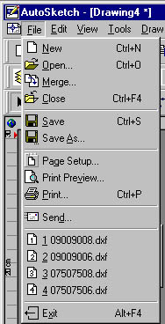
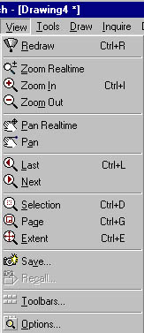
The commands in the Menu bar are similar arranged as in all other computer programs
File & View command
Look at all the commands you find in the File heading
To start a new drawing you should select a size for your drawing. In most cases we’ll use the Landscape format
You can show how many recently files should be shown (that’s done in Drawing Option)
The View command is usually used for zooming.
Ctrl+plus (+) = zooming in
Ctrl+minus = zooming out
Pan moves a drawing in a pane by selecting two points
To do dimensioning you often have to zoom in and to get back to your original drawing. If you zoom in, Ctrl+L will return to the previous view

Slide 6
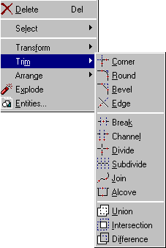
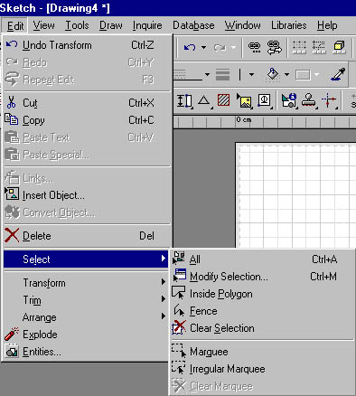
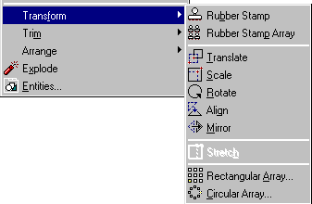
The Edit Command is the
command that you will be using most frequently
Edit command
Select is seldom used. If there is a dashed rectangle on your drawing Select  Marquee will delete it
Get familiar with Transform and Trim Command because these are the most
frequent use commands

Slide 7
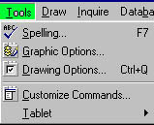
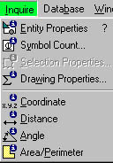
Tools & Inquiry command
If you want to know information about an entity you need, either, to select the entity first and
then access the
Inquire command or click on
Inquire command and then select the entity.
Tools command is always used to set up:
1st Drawing options
(Units and Scale and other settings)
2nd Graphic Options (Layers)

Slide 8
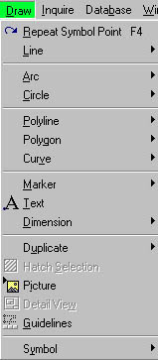
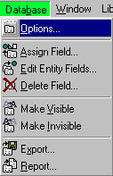
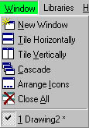
Draw command
Database & Window command
Draw commands are the commands that need to be known by heart.
Refer also to snap points. When all else fails hit the
S-key to change to Snap Off.
We are not using Database
And Window is similar to all other programs

Slide 9
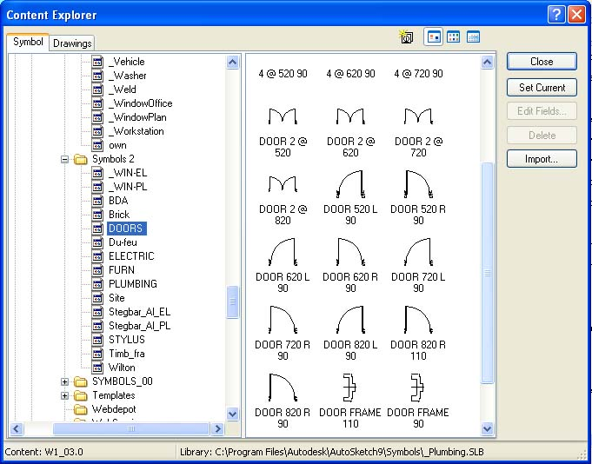
Symbol library (Version 9)
The library is used to insert symbols like windows, doors, furniture etc.
You can access the library from Draw
 Symbol
 Explore

Slide 10
Starting a Drawing
If you are familiar with technical drawing it’ll be fairly easy to produce simple CAD-drawings.
There are a few basic settings to be made before you start your drawing.
First you need to select an appropriate Paper size
(eg. A4, A3 etc.)
and the drawing Orientation
(Landscape or Portrait)
The next step is to click on
Tools ➔Drawing Options (Ctrl Q) and do the following settings:

Slide 11
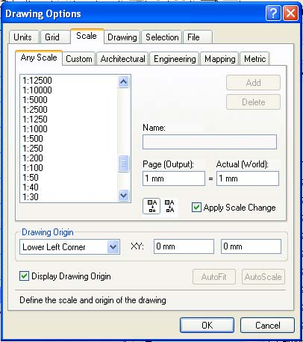
Starting a Drawing (continue)
Units
Length  Millimeters
Decimal Precision  change to 1.
Grid  not yet required
Scale  select the Metric tab 1:10, 1:20. 1:00 etc.
Drawings settings not yet required
(Entity rotation is by default 45°. You can rotate an entity by selecting the entity and use the
+ or – key.)
You can set the Draw Parameters - Plus/Minus Rotation to a different degree
There are no further settings at this stage required.

Slide 12
Entering points
A line must have a start and an end point.
For other entities you may have to select more points to complete the entity. (an arc requires 3 points or 2 points and a center point etc.).
To move an entity, you must enter a “from” point and a “to” point.

Slide 13
Entering points (continue)
⧫ Snap modes can be accessed from the toolbar or by typing the appropriate letter using the keyboard.
If the snap mode is not S or G you cannot draw a line.
Hit the S-key (Snap mode off) or G-key
(G snaps on grid point) and then you can select a start-point for an entity (line, arc, circle, polygon etc.).

Slide 14


Snap Modes
There are a number of input modes (snap & lock) you can choose from
Locks
U = Unlock
X = Horizontal Lock (or H)
Y = Vertical Lock (or V)
O = Ortho Lock
L = Normal Lock
S = Snap mode off
G = Gridpoint input mode
E = Endpoint input mode
J = Jump input mode
M = Midpoint input mode
N = Nearest input mode
B = Basepoint input mode
P = Perpendicular input mode
2 = 2 Point Intersection
I = Intersection input mode
C = Centerpoint input mode
T = Tangent input mode
Q = Quadrant input mode
A = Absolute Input
R = Relative Input
W = Set Last (Working) Point

Slide 15
Lock modifiers
The Lock modifiers gives you control over
Horizontal-(x-directions),
Vertical-(y-directions)
Orthogonal-movements (both Horiz. & Vert-directions).
The L Normal Lock let you draw perpendicular lines to an angle of pre-determined degree. If you don’t want horizontal, vertical or perpendicular lines type U for Unlock. Unlock is the default setting and is regularly used.
The cursor will always show the Snap and Lock mode that you are presently using. (eg. Snap Off and Unlock or depending on your previous selection End Point and Y Coordinate (vertical)).

Slide 16

Lines
Line is a straight segment between to points.
It must have a start point & an end point
Line
Single
Line
Multiple
Line
Tangent
Line
Angle
Line
Segment
Line Double
Line
Perpendicular
Version 9

Slide 17





Drawing items (All In One Toolbar)
Arcs
Circles
Polylines
Fitted curve
Polygons

Slide 18

Dimensioning
Horizontal
Rotated
Angular
Diameter
Ordinate
Vertical
Aligned
Radius
Centerline
Leader

Slide 19
Trim commands (Version 9)
Corner
Bevel
Break
Divide
Join
Union
Difference
Round
Edge
Channel
Subdivide
Alcove
Intersection

Slide 21
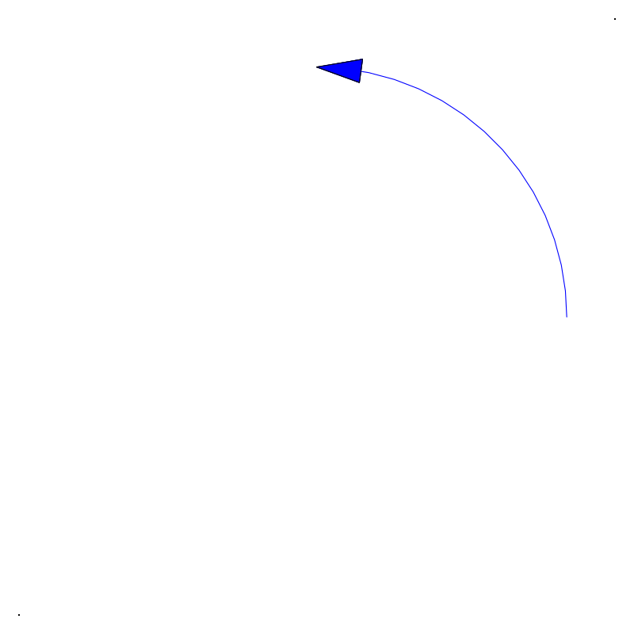
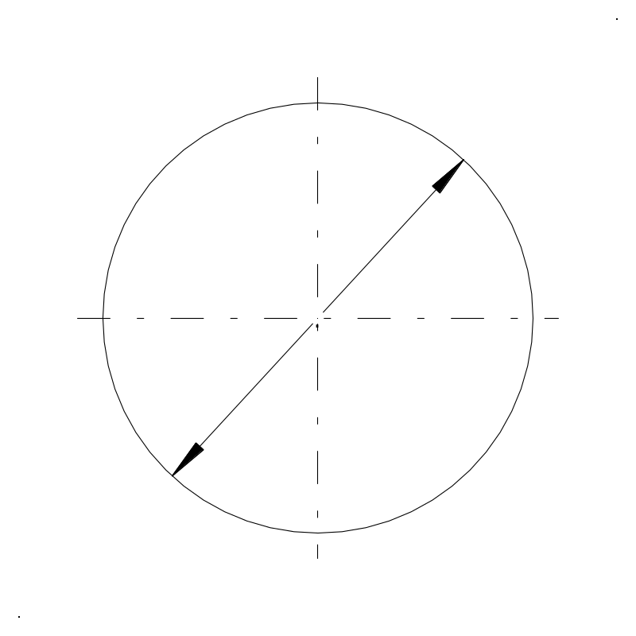
Angle Modes
Two angle modes
Standard
Compass
90°
Angle modes can be selected from the
Tools
Drawing ⇒ Option commands
45°
180°
0°
Standard
225°
The standard option is 0° to the right and goes anti-clockwise.
270°

Slide 22
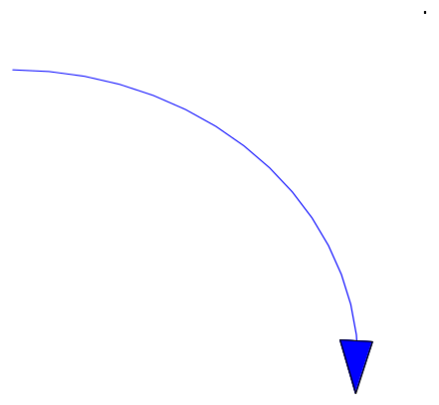
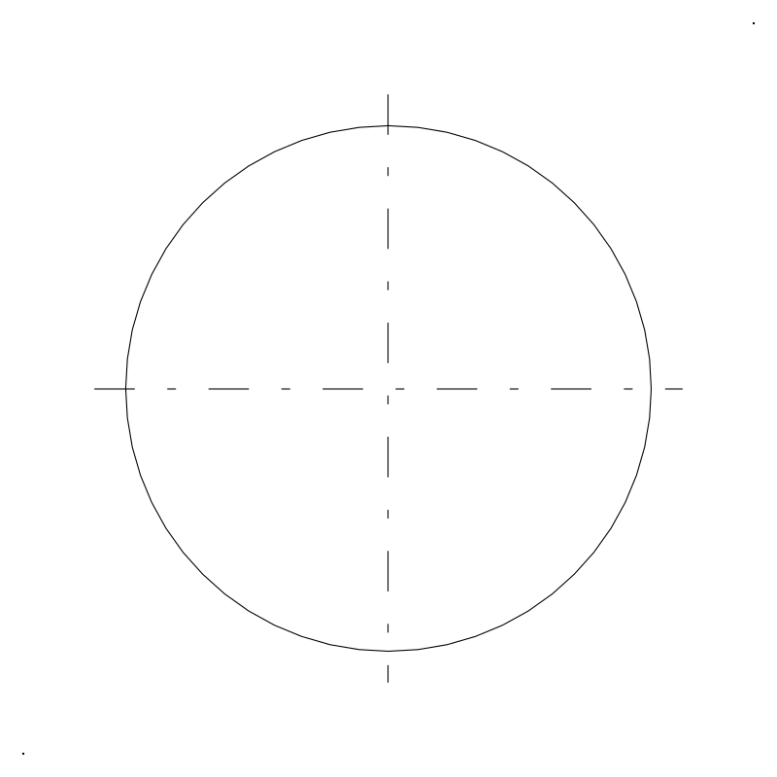
Angle Modes
Two angle modes
Standard
Compass
0°
(N)
Angle modes can be selected from the
Tools
Drawing ⇒ Option commands
(NW)
(NE)
270°
(W)
90°
(E)
Compass
The compass option is 0° to the vertical and goes clockwise.
(SW)
(SE)
180°
(S)

