Slide 1
5
Fire Behavior

Slide 2
Objectives (1 of 4)
Describe the chemistry of fire.
Define the three states of matter.
Describe how energy and work are interrelated.
Describe the conditions needed for a fire.
Explain the chemistry of combustion.
Describe the products of combustion.

Slide 3
Objectives (2 of 4)
Explain how fires can spread by conduction, convection, and radiation.
Describe the four methods of extinguishing fires.
Define Class A, B, C, D, and K fires.
Describe the characteristics of solid-fuel fires.

Slide 4
Objectives (3 of 4)
Describe the ignition phase, growth phase, fully developed phase, and decay phase of a fire.
Describe the characteristics of a room-and-contents fire.
Explain the causes and characteristics of flameover, flashover, thermal layering, and backdraft.

Slide 5
Objectives (4 of 4)
Describe the characteristics of liquid-fuel fires.
Define the characteristics of gas-fuel fires.
Describe the causes and effects of a boiling liquid expanding vapor explosion (BLEVE).
Describe the process of reading smoke.

Slide 6
Introduction
Understanding of fire behavior is the basis for all firefighting principles and actions.
Understanding fire behavior requires knowledge of physical and chemical processes of fire.

Slide 7
The Chemistry of Fire
Understanding how fire ignites and grows will assist in the fire fighter’s ability to extinguish fire situations.
Being well trained in fire behavior will allow the fire fighter to control a fire utilizing less water.

Slide 8
What Is Fire?
Rapid chemical process that produces heat and usually light
Fire is neither solid nor liquid.
Wood is a solid, gasoline is a liquid, and propane is a gas—but they all burn.

Slide 9
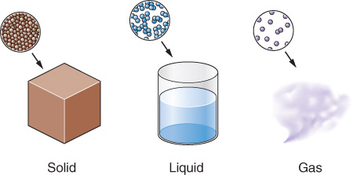
Fuel
What is actually being burned
Physical states
  Solid
  Liquid
  Gas
Combustion occurs when fuel is in a gaseous state.

Slide 10
Solids
Most fuels are solids.
Pyrolysis releases molecules into atmosphere.
  Converts solid to a gas
Solids with high surface-to-mass ratio combust more easily and rapidly.

Slide 11
Liquids
Assume the shape of their containers
Vaporization is the release of a liquid’s molecules into the atmosphere.
Liquids with a high surface-to-volume ratio vaporize and combust more easily and rapidly.

Slide 12
Gases
Have neither shape nor volume
Expand indefinitely
Fuel-to-air ratio must be within a certain range to combust.

Slide 13
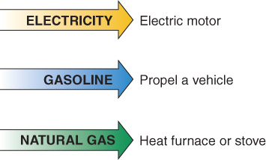
Types of Energy
Chemical
Mechanical
Electrical
  Light
  Nuclear

Slide 14
Chemical Energy
Energy created by a chemical reaction.
Some of these reactions produce heat and are referred to as exothermic reactions.
Some of these reactions absorb heat and are referred to as endothermic reactions.

Slide 15
Mechanical Energy
Converted to heat when two materials rub against each other and create friction
Heat is also produced when mechanical energy is used to compress air in a compressor.

Slide 16
Electrical Energy
Produces heat while flowing through a wire or another conductive material
Examples of electrical energy
  Heating elements
  Overloaded wires
  Electrical arcs
  Lightning

Slide 17
Light Energy
Caused by electromagnetic waves packaged in discrete bundles called photons
Examples of light energy
  Candles
  Light bulbs
  Lasers

Slide 18
Nuclear Energy
Created by nuclear fission or fusion
  Controlled (nuclear power plant)
  Uncontrolled (atomic bomb explosion)
  Release radioactive material

Slide 19
Conservation of Energy
Energy cannot be created or destroyed by ordinary means.
Energy can be converted from one form to another.
  Chemical energy in gasoline is converted to mechanical energy when a car moves along a road.

Slide 20
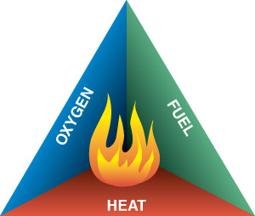
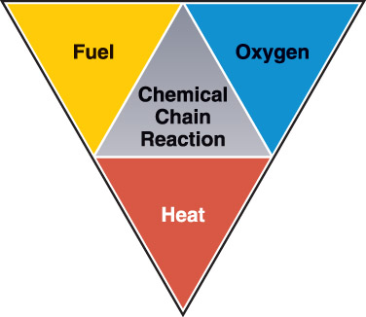
Conditions Needed for Fire
Three basic factors required for combustion:
  Fuel
  Oxygen
  Heat
Chemical chain reactions keep the fire burning.

Slide 21
Chemistry of Combustion (1 of 2)
Exothermic reactions
  Reactions that result in the release of heat energy
Endothermic reactions
  Reactions that absorb heat or require heat to be added

Slide 22
Chemistry of Combustion (2 of 2)
Oxidation
Combustion
Pyrolysis

Slide 23
Products of Combustion
Combustion produces smoke and other substances.
Specific products depend on:
  Fuel
  Temperature
  Amount of oxygen available
Few fires consume all available fuel.

Slide 24
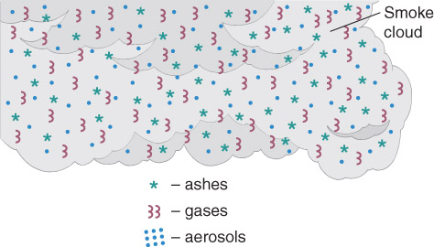
Smoke
Airborne products of combustion
Consists of:
  Ashes
  Gases
  Aerosols
Inhalation of smoke can cause severe injuries.

Slide 25
Smoke Contents (1 of 2)
Particles
  Solid matter consisting of unburned, partially, or completely burned substances
  Can be hot and/or toxic
Vapors
  Small droplets of liquids suspended in air
  Oils from the fuel or water from suppression efforts

Slide 26
Smoke Contents (2 of 2)
Gases
  Most gases produced by fire are toxic.
  Common gases include:
    Carbon monoxide
    Hydrogen cyanide
    Phosgene

Slide 27
Heat Transfer
Combustion gives off heat that can ignite other nearby fuels.
Heat energy always flows from hotter to colder.
Three methods of heat transfer:
  Conduction
  Convection
  Radiation

Slide 28
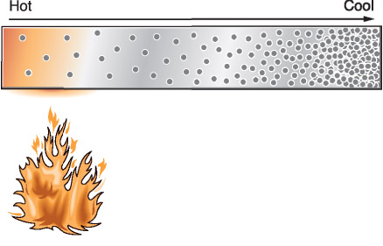
Conduction
Heat transferred from one molecule to another (direct contact)
Conductors transfer heat well.
Insulators do not transfer heat well.

Slide 29
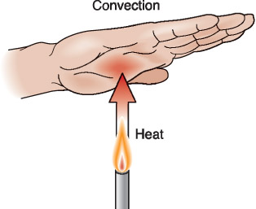
Convection
Movement of heat through a fluid medium such as air or a liquid
Creates convection currents

Slide 30
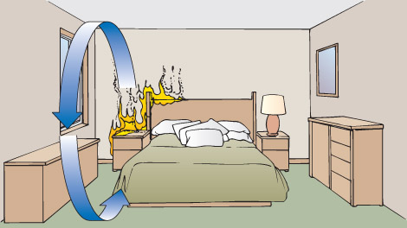
Convection Within a Room
Hot gases rise, then travel horizontally.
Gases then bank down a wall or move outside the room.
  Horizontally
  Vertically

Slide 31
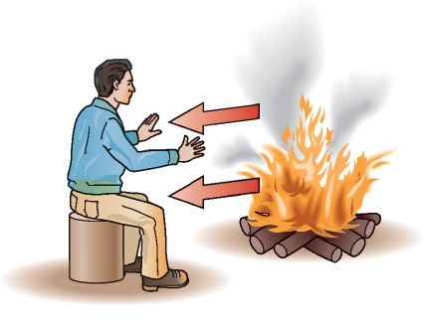
Radiation
Transfer of heat in the form of an invisible wave
Heat radiated to a nearby structure can ignite it.
Radiated heat passing through a window can ignite an object.

Slide 32
Methods of Extinguishment
Cool the burning material.
Exclude oxygen.
Remove fuel.
Break the chemical reaction.

Slide 33
Classes of Fire (1 of 2)
Fires are classified according to type of fuel.
Extinguishing agents are classified to match type(s) of fires they extinguish.
A fire can fit into more than one class.

Slide 34
Classes of Fire (2 of 2)
Five classes of fires:
  Class A
  Class B
  Class C
  Class D
  Class K

Slide 35
Class A
Fuel: Ordinary solid combustibles
  Wood
  Paper
  Cloth
Extinguishing agents:
  Water (cools the fuel)

Slide 36
Class B
Fuel: Flammable or combustible liquids
  Gasoline
  Kerosene
  Oils
Extinguishing agents:
  Foam or carbon dioxide
  Dry chemicals

Slide 37
Class C
Fuel: Energized electrical equipment
  Underlying fuel is often Class A or Class B
  Special classification required due to electrical hazards
Extinguishing agents:
  Carbon dioxide
  Use of water is not advised.
    Be sure to shut off power before using water.

Slide 38
Class D
Fuel: Burning metals
  Potassium
  Lithium
  Magnesium
Extinguishing agents:
  Special salt-based powders or dry sand
  Do not use water.

Slide 39
Class K
Fuel: Combustible cooking media
  Cooking oils
  Grease
Extinguishing agents:
  Designation is new and coincides with a new classification of Class K extinguishing agents.

Slide 40
Phases of Fire
Four distinct phases:
  Ignition
  Growth
  Fully developed
  Decay

Slide 41
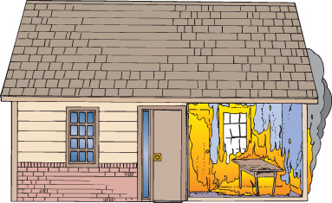
Ignition Phase
Fuel, heat, and oxygen are present.
Fuel is heated to its ignition temperature.

Slide 42
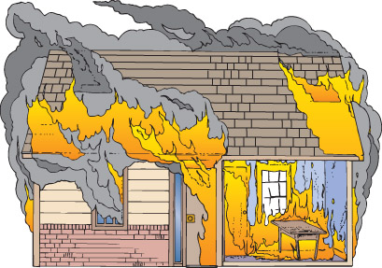
Growth Phase
Additional fuel is involved.
Fire grows larger.
Convection draws more air into fire.
Thermal layering
  Hot gases collect at ceiling and bank downward.

Slide 43
Flashover
Point between growth phase and fully developed phase
All combustible materials in a room ignite at once.
Temperatures can reach 1000 °F.
Flashovers are deadly!

Slide 44
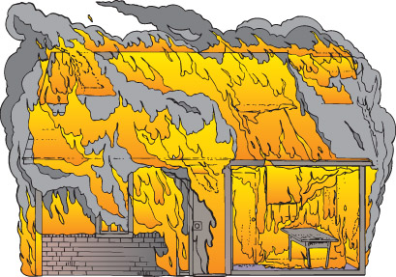
Fully Developed Phase
Heat produced at maximum rate
Oxygen consumed rapidly
Fire will burn as long as fuel and oxygen remain.

Slide 45

Decay Phase
Fuel is nearly exhausted.
Intensity reduces.
Eventually fire will go out.

Slide 46
Key Principles of Solid-Fuel Fire Development (1 of 2)
Hot gases and flame tend to rise.
Convection is the primary factor in spreading the fire upward.
Downward spread occurs primarily from radiation and falling chunks of flaming material.
If there is no remaining fuel, the fire will go out.

Slide 47
Key Principles of Solid-Fuel Fire Development (2 of 2)
Variations in the direction of fire spread occur if air currents deflect the flame.
The total material burned reflects the intensity of the heat and the duration of the exposure to the heat.
An adequate supply of oxygen must be available to fuel a free-burning fire.

Slide 48
Room Contents (1 of 2)
Many fires in buildings burn the contents of the structure, but do not involve the structure itself.
Most modern rooms are heavily loaded with materials made of plastics and synthetic materials.
  These produce dense smoke that can be highly toxic.

Slide 49
Room Contents (2 of 2)
Newer upholstered furniture is more resistant to ignition from glowing sources, but it has little resistance to ignition from flaming sources.
Finishes used on walls and ceilings can burn readily.
  This can increase the intensity and spread of the fire.

Slide 50
Special Considerations
Four conditions particular to interior fires that affect fire fighter (and civilian) safety:
  Flashover
  Flameover (or rollover)
  Backdraft
  Thermal layering and thermal balance

Slide 51
Flashover
Sudden ignition of all contents
Minimal chance of survival
Flashover often occurs just as fire fighters arrive on the scene.
Signs of flashover

Slide 52
Rollover (Flameover)
A warning sign of imminent flashover
Licks of flame ignite briefly in upper layers of smoke
Situation calls for aggressive cooling of atmosphere, immediate exit, or immediate ventilation.

Slide 53
Thermal Layering and Thermal Balance
Superheated gases collect near ceiling.
Temperatures are lowest near floor.
Fire streams create steam that expands and rises.
Prevention

Slide 54
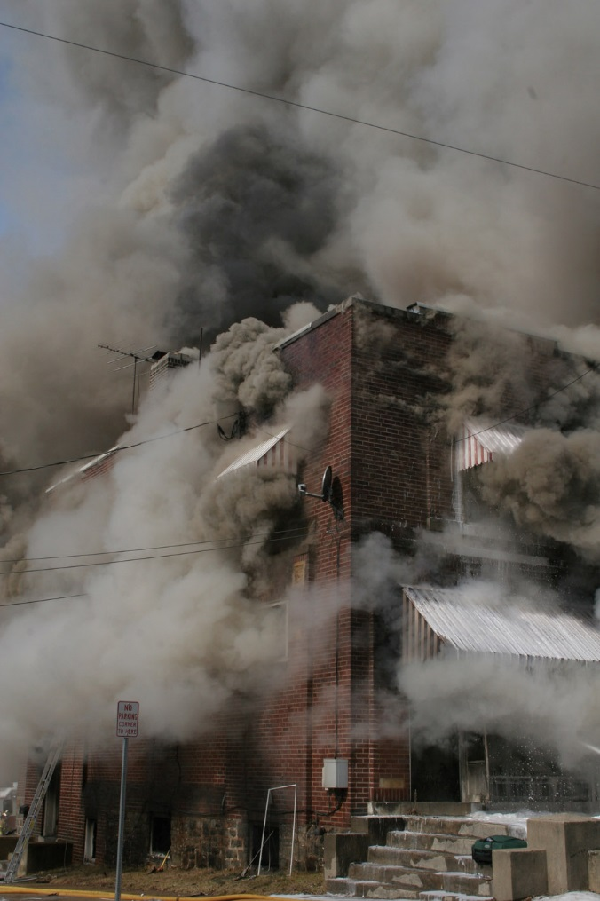
Backdraft (1 of 4)
Explosion that occurs when oxygen is suddenly admitted to a confined area that is very hot and filled with combustible vapors
Notes:
Image © Dennis Wetherhold, Jr.

Slide 55
Backdraft (2 of 4)
Usually occurs when a fire is smoldering
  Room is filled with carbon monoxide and other products of combustion.
  Sudden introduction of air will explosively feed the fire.

Slide 56
Backdraft (3 of 4)
Signs of an impending backdraft:
  Little or no flame visible
  Smoke emanating from cracks
  No large openings
  “Living fire” visible
  Unexplained change in color of smoke
  Glass smoke stained or blackened
  Signs of extreme heat

Slide 57
Backdraft (4 of 4)
Prevention of backdrafts:
  Ventilate at a high level to allow superheated gases to escape.
  Well-coordinated fire attack

Slide 58
Liquid-Fuel Fires (1 of 3)
A liquid must vaporize before it burns.
A minimum and maximum concentration of vapors must be present to ignite.
Most flammable liquids can ignite well below their boiling point.

Slide 59
Liquid-Fuel Fires (2 of 3)
Conditions required for ignition:
  Fuel–air mixture within flammable limits
  An ignition source with sufficient energy
  Sustained contact between ignition source and fuel–air mixture

Slide 60
Liquid-Fuel Fires (3 of 3)
Flash point
  Lowest temperature at which vapor is produced
Flame point (or fire point)
  Lowest temperature at which sufficient vapors are produced to support a small flame for a short time

Slide 61
Gas-Fuel Fires (1 of 2)
Vapor Density
  Weight of a gas fuel
  Gas with vapor density less than 1.0 will rise.
  Gas with vapor density greater than 1.0 will settle.
  Knowing vapor density helps predict where the danger of ignition will be.

Slide 62
Gas-Fuel Fires (2 of 2)
Fuel–air mixtures only burn when mixed in certain concentrations.
Flammability/explosive limits
  Below the lower flammability limit
    Too little fuel = too lean
  Above the upper flammability limit
    Too much fuel = too rich

Slide 63
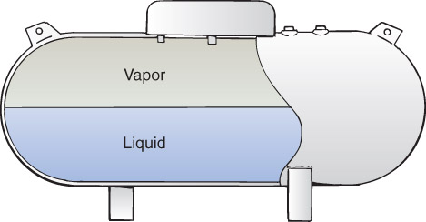
BLEVE (1 of 3)
Boiling liquid expanding vapor explosion
Occurs when a tank storing liquid fuel under pressure is heated excessively

Slide 64
BLEVE (2 of 3)
Sequence:
  Tank is heated.
  Internal pressure rises past ability to vent.
  Tank fails catastrophically.
  Liquid fuel above boiling point is released.
  Liquid immediately turns into a rapidly expanding cloud of vapor.
  Vapor ignites into a huge fireball.

Slide 65
BLEVE (3 of 3)
BLEVEs can injure and even kill fire fighters and civilians.
  Fireball created by the ignition of expanding vapors
  Large pieces of the tank propelled great distances

Slide 66
Smoke Reading (1 of 4)
Understanding how to read smoke will assist the fire fighter in knowing three distinct things:
  Where the fire is
  How big the fire is
  Where the fire is going

Slide 67
Smoke Reading (2 of 4)
Determining the key attributes of smoke
  Four key attributes:
    Smoke volume
    Smoke velocity
    Smoke density
    Smoke color

Slide 68
Smoke Reading (3 of 4)
Determine the influences on the key attributes
  Size of the structure
  Wind conditions
  Thermal balance
  Fire streams
  Ventilation openings
  Sprinkler systems

Slide 69
Smoke Reading (4 of 4)
Determine the rate of change
  Ask the following questions:
    How are the volume of smoke, the velocity of smoke, the density of smoke, and the color of smoke changing?
    In what ways are they changing?
    How rapidly are these changes occurring?
    What do these changes suggest about the progression of the fire?

Slide 70
Summary (1 of 3)
To be a successful fire fighter you must know fire behavior.
Characteristics of solids, liquids, and gases are different.
Fire triangle and fire tetrahedron represent conditions necessary for combustion.

Slide 71
Summary (2 of 3)
Five classes of fire require specific extinguishing methods.
Knowledge of heat transfer is required to understand how fires propagate.
Typical fires pass through four distinct phases.

Slide 72
Summary (3 of 3)
Liquid-fuel fires, gas- fuel fires, and interior fires have unique characteristics.
Flashover, rollover, backdraft, and thermal layering are conditions that threaten fire fighters and victims.

