Slide 1
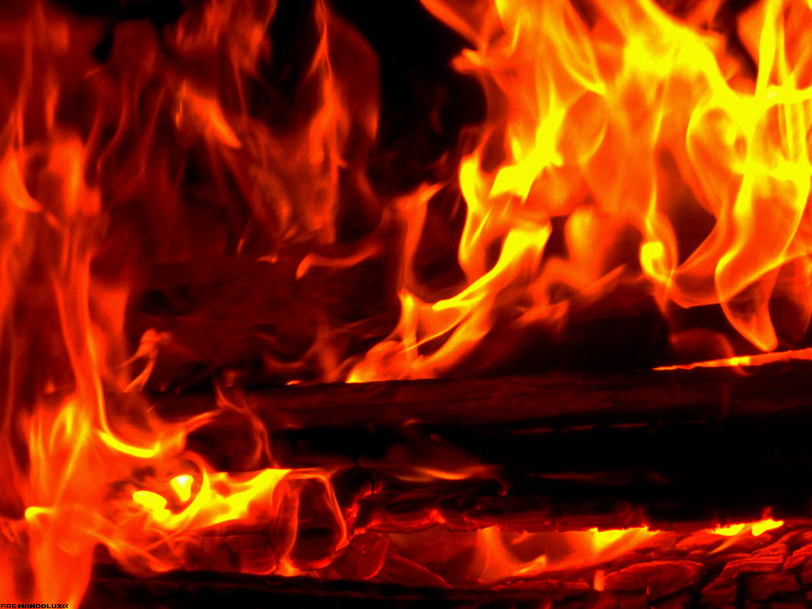
Fire Basics

Slide 2
Overview of Presentation
Fire triangle
Adiabatic flame temperature
Life cycle of a fire (4 stages)
The four stages of combustion
The chemistry of fire extinction
Prevention of fire and flammability
Storage guidelines
Classes of fire
Fire extinguisher
Fires in buildings (flame test & temperature)
Development of room fire
Photos

Slide 3
What is combustion ?
Combustion is the act or process of burning. For combustion to occur, fuel, oxygen (air), and heat must be present together.
The combustion process is started by heating the fuel above its ignition temperature in the presence of oxygen. Under the influence of heat, the chemical bonds of the fuel are split.
If complete combustion takes place, the elements carbon (C), hydrogen (H) and sulphur (S) react with the oxygen content of the air to form carbon dioxide CO₂, water vapour H₂O and sulphur dioxide SO₂ and, to a lesser degree, sulphur trioxide SO₃.

Slide 4
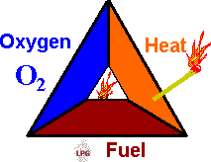
Fire Triangle
Fuel + Oxygen + Heat = Fire
The FIRE TRIANGLE represents the three elements
needed for fire to occur: heat, fuel, and oxygen.
The air we breathe is about 21% oxygen. Fire requires an atmosphere with at least 16% oxygen.
Heat is the energy necessary to increase the temperature of the fuel to a point where sufficient vapors are given off for ignition to occur.
Fuel can be any combustible material in any state of matter - solid, liquid, or gas. Most solids and liquids become a vapor or gas before they will burn.

Slide 5
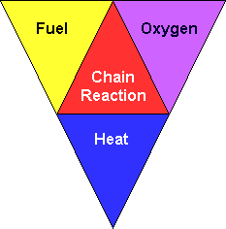
Fire Tetrahedron
1. There must be Fuel to burn.
Any combustible material - solid, liquid or gas. Most solids and liquids must vaporise before they will burn.
2. There must be Air to supply Oxygen.
Sufficient oxygen (at least 16%) must be present in the atmosphere surrounding the fuel for fire to burn. This is usually not a problem since the air we breathe is about 21% oxygen.
3. There must be Heat (ignition temperature) to start and continue the combustion process. Sufficient heat energy must be applied to raise the fuel to it's ignition temperature
However by adding in a fourth element, you have a fire "tetrahedron".
4. CHEMICAL CHAIN REACTION - This reaction can occur when all three of the above elements are present in the proper conditions and proportions. Fire (rapid oxidisation) is the result of this chemical reaction.

Slide 6
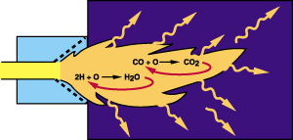
ADIABATIC FLAME TEMPERATURE
Adiabatic is a term used to describe a combustion reaction in which all heat generated is retained in the products of combustion.
Adiabatic flame temperature is the theoretical temperature that would be attained by the products of combustion provided the entire chemical energy of the fuel is transferred to the products of combustion.
This assumes that there is no heat loss to surroundings and no dissociation
Dissociation is a reaction involving the breakdown of chemical compounds. In the case of combustion, these are water vapour and carbon dioxide.

Slide 7
LIFE CYCLE OF A FIRE
4 STAGES
FLASHOVER
FULLY
DEVELOPED
GROWTH
DECAY
FIRE

Slide 8

Self sustaining reaction
      Burning vapor
      produces heat
Heat releases
and ignites
more vapor

Slide 9
1.) GROWTH STAGE
  Earliest stage of a fire beginning with actual ignition.
  Fire limited to origin of ignition material.
  Flame temperature may be well above 540°C.
  Some heat being generated. Amount of heat will increase with the progress of the fire.
  Sufficient oxygen and fuel are available for fire growth to a point where total involvement is possible.
  Heat carried to uppermost region of confined area.
  Heated gases spread laterally from the top and then down.
  Cooler air forced to lower levels.
  Upper region can exceed 700°C.

Slide 10
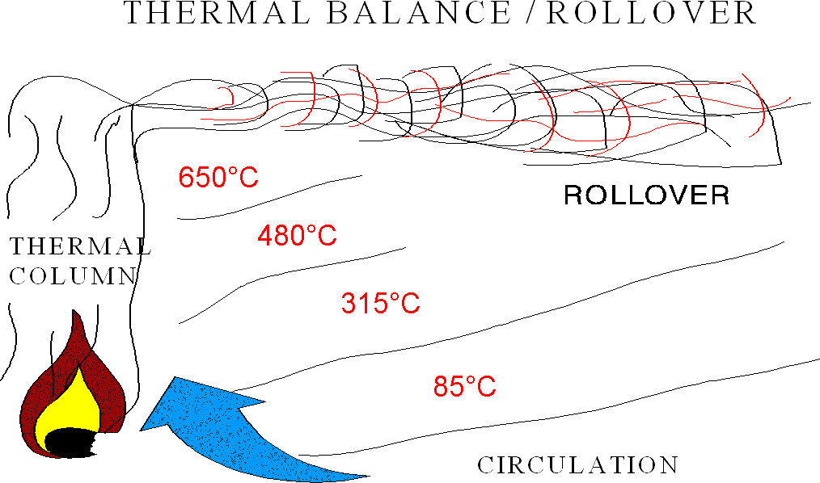

Slide 11
2.) FLASHOVER
  Simultaneous ignition of all contents of the compartment.
  Normally occurs when the upper gas layer reaches 600°C.
  Flashover can also occur in the space above the fire.
  Can usually be prevented by proper fog application or venting.

Slide 12
3.) FULLY DEVELOPED STAGE
  All combustibles in the space have reached their ignition temperature.
  Burning rate limited by the amount of oxygen available in the air for combustion.
  Unburned fuel in the smoke may burn as it meets fresh air in adjacent compartments.
  Structural damage to exposed steel normally occurs.
  Normally inaccessible by hose teams.
  Best fought using indirect attack.

Slide 13
4.) DECAY STAGE
  Available oxygen is consumed or reduced to a point where there is insufficient oxygen to react with fuel.
  Flame may cease to exist if the area is sufficiently airtight.
  Burning reduced to glowing embers
  If fire continues to smolder, compartment will fill with dense smoke and gases and temperatures could reach well over 1000⁰C.
  Intense heat and high concentration of fire gases could produce suitable conditions for a backdraft explosion.

Slide 14
THE FOUR STAGES OF COMBUSTION
Most fires have quite humble beginnings and grow through four stages:
Incipient Stage - At this stage, decomposition is occurring at the surface of the fuel due to the influence of some form of heat. Products of combustion given off at this stage are invisible to the eye.
Smoldering Stage - At this stage, up to 10% of the decomposing products released at the surface of the fuel are visible.

Slide 15
THE FOUR STAGES OF COMBUSTION
3. Flaming Stage - Vapors from the decomposing fuel have ignited and are at the stage where flames are self propagating.
4. Heat Stage - At this stage the burning has progressed to the point where the fire is still small but generating sufficient heat to warm the air immediately around the fire, sending warm products of combustion upwards by convection.

Slide 16
THE FOUR STAGES OF COMBUSTION (cont.)
The time required for a fire to develop through the first two stages is usually quite long when compared to the last two.
Depending on conditions, the time involved going through all stages may be anything from seconds to days.

Slide 17
THE CHEMISTRY OF FIRE EXTINCTION
The principles of fire extinction consist of the elimination or removal of one or more of the four elements. These principles are:
COOLING
The most commonly used fire fighting medium is water. Water absorbs heat from the fire and cools the fuel to a temperature where it no longer produces flammable vapors.
2. SMOTHERING
By excluding the oxygen in the surrounding atmosphere, the fire will be extinguished.

Slide 18
THE CHEMISTRY OF FIRE EXTINCTION
3. STARVATION
Starvation is achieved by removal of the fuel burning in the fire. Sometimes combustible material can be removed such as by shutting off gas valves or fuel flows.
4. STOP CHAIN REACTION
Stop or interrupt the chain reaction between the fuel, heat and oxygen the fire will be extinguished.
Specific methods of extinguishing fires often involve a combination of more than one of the four principles

Slide 19
The Strategy of Preventing a Fire
A fire must have three things to ignite and maintain combustion:
  Fuel
  Heat
  Oxygen
The basic strategy of fire prevention is to control or isolate sources of fuel and heat in order to prevent combustion.
If all three are not present in sufficient quantities a fire will not ignite or a fire will not be able to sustain combustion

Slide 20
Causes of Ignition
Flammable materials may ignite in many ways, some familiar, some less so.
The most common ignition source is flame.
Hot surfaces can also cause fire
Sparks generate very high temperatures in a very small space, but it is rare that a spark will cause ignition in the absence of other factors.

Slide 21
Flammable and combustible liquids
Flammable and combustible liquids are potential fuel sources for fires and are present in almost every workplace.
It is actually the vapor created by flammable and combustible liquids that ignites and burns.
It is important to understand what materials in your work area are flammable and combustible so that you may properly store and isolate them from ignition sources.

Slide 22
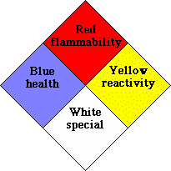
How do I tell what’s flammable?
NFPA classification system
  The NFPA diamond is an easy way to determine the safety risks associated with hazardous materials. To determine a materials flammability refer to the red section of the diamond. A number in this section will indicate the flammability rating of the material.
For example, An NFPA diamond on a can of gasoline would have a 3 in the red section indicating that gasoline could ignite at normal working temperatures.
The following numbering system is used to
indicate flammability
      0- will not burn
      1- must be preheated to burn
      2-ignites when moderately heated
      3-ignites at normal temperature
      4-extremely flammable
NFPA Diamond

Slide 23
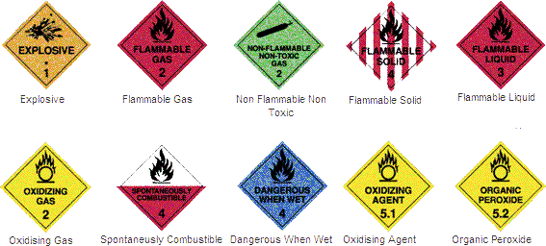
Here are some Australian signs

Slide 24
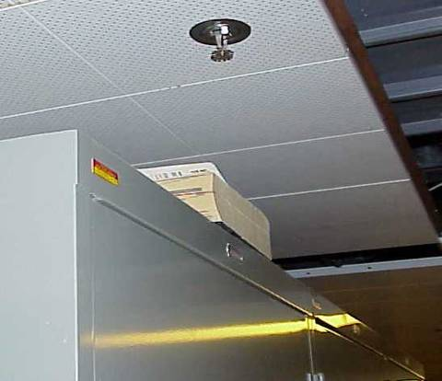
Storage Guidelines
No storage is allowed in corridors and stairwells. A cluttered hallway could slow down emergency evacuation.
Storage must not exceed a plane of 450 mm below sprinkler heads or smoke detectors. Storage that breaks this plane may prevent sprinkler heads from fully covering room during a fire.
NOTICE
Storage guidelines are applicable to all locations within buildings and are not limited to storage rooms. This includes stored materials in offices, labs, etc.
A simulated example of how storage can protrude into 450 mm plane below sprinkler heads.

Slide 25
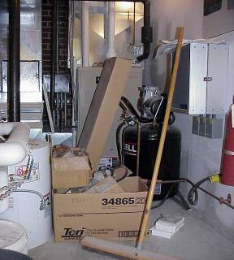
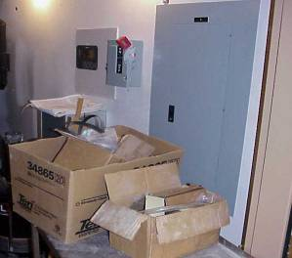
Storage Guidelines
Maintain at least a 1 m clearance from heating surfaces, air ducts, heaters, and lighting fixtures.
Storage of combustible materials in mechanical rooms is prohibited.
All storage must be at least 1 m from electrical panels. In some emergency situations it will be necessary to access these panels quickly.
Improper Mechanical Room Storage
Improper Storage in front of Electrical Panel

Slide 26
Classes of Fire
Not all fires are the same and not all extinguishing agents are compatible with all types of fuel.
Fires are normally classified according to the fuel involved.
Most fire extinguishers will have a pictograph label telling you which fuels the extinguisher is designed to fight. (Band on fire extinguisher)
Notes:
If you use the wrong type of fire extinguisher on the wrong class of fire, you can, in fact, make matters worse (eg water used on a flammable liquid fire is likely to increase the rate of burning dramatically and to disperse the fuel to cover a greater area. It is therefore very important to understand the six different classes of fires.
For example, a simple water extinguisher should have a label indicating that it should only be used on Class A fuels and never on Class B fuels (flammable liquids) and class (E), electrical fires.

Slide 27
Fire Classes in Australia Europe & UK
Class A Ordinary combustible or fibrous material such as wood, paper, fabric, coal, leather, sugar, rubber and some plastics.
Class B Flammable liquids such as petrol, kerosene, alcohol, oil and paint thinners.
Class C Flammable Gasses such as LPG, Butane, Acetylene, Hydrogen, natural gas and methane.
Class D Combustible Metals: potassium, sodium, lithium, aluminium, magnesium and metal swarf. Fires of this class may occur in laboratories or industries that use these materials. Metal swarf fires may occur in machine shops where metal turning or milling is carried out. These fires burn at high temperatures and give off sufficient oxygen to support combustion. They may also react violently with water or other chemicals.
Class E Electrical Hazards. Fires involving live electrical equipment (e.g. computers, switchboards and power tools). As long as it's "plugged in," it would be considered a class (E) fire. If the electricity supply to the equipment is disconnected (plug pulled out), then the fire is not class (E). It takes the class of the fuel that is burning.
Class F Cooking Oil or Fat.

Slide 28
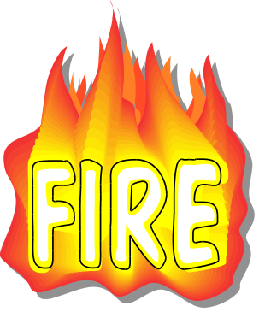
EXTINGUISHER
Understand the combustion process and different fire classes.
Understand fire extinguisher types, operating procedures, capabilities, and limitations.
Understand basic firefighting concepts:
► R.A.C.E.
    ► P.A.S.S.
Rescue Alarm Contain Extinguish
Pull the pin
Aim low at the base of flames
Squeeze the Handle
Sweep side to side
Notes:
BRIEFLY REVIEW OBJECTIVES.

Slide 29
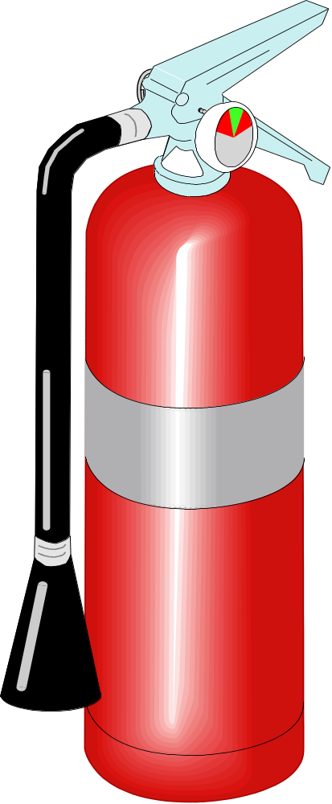
Fire Extinguisher Anatomy
DISCHARGE LEVER
PRESSURE GAUGE
(not found on CO₂
extinguishers)
DISCHARGE LOCKING PIN
AND SEAL
CARRYING
HANDLE
DISCHARGE HOSE
BAND INDICATES TYPE OF FIRE
DISCHARGE NOZZLE
BODY
DISCHARGE ORIFICE
Notes:
POINT OUT DIFFERENT COMPONENTS OF PORTABLE FIRE EXTINGUISHER.
POINT OUT THAT CO₂ EXTINGUISHER IS UNIQUE IN THAT IT DOES NOT HAVE PRESSURE GAUGE.

Slide 30
Australia
Type | Pre-1997 | Current | Class
Water | Solid red |  | A
Foam | Solid blue | Red with a blue band | A | B
Powder | Red with a white band |  | A | B | C | E
Carbon dioxide | Red with a black band |  | A (limited) | B | C | E | F
Vapourising liquid (not halon) | Red with a yellow band |  | A | B | C | E
Halon^{[1]} | Solid yellow | — | A | B |  | E
Wet chemical | Solid oatmeal | Red with an oatmeal band | A |  |  |  | F
Internationally there are several accepted classification methods for hand-held fire extinguishers. Each classification is useful in fighting fires with a particular group of fuel.

Slide 31
Australian Standards for Portable Fire Extinguishers
AS/NZS 1841.1:1997 :
Portable fire extinguishers - General requirements
AS/NZS 1841.2:1997
Portable fire extinguishers - Specific requirements for water type extinguishers
AS/NZS 1841.3:1997
Portable fire extinguishers - Specific requirements for wet-chemical type extinguishers
AS/NZS 1841.4:1997
Portable fire extinguishers - Specific requirements for foam type extinguishers
AS/NZS 1841.5:1997
Portable fire extinguishers - Specific requirements for powder type extinguishers
AS/NZS 1841.6:1997
Portable fire extinguishers - Specific requirements for carbon dioxide type extinguishers
AS/NZS 1841.7:1997
Portable fire extinguishers - Specific requirements for vaporizing-liquid type extinguishers

Slide 32
Two stages in building fires
The two stages to be considered in the fire safety design of buildings in relation to building materials and structures are the
  Initial stage and the
  Fully stage.
In the initial fire, the building contents such as furniture etc, are of major importance both for the initiation of the fire and its development.
Surface linings may also play an important role in the initial fire, especially in escape routes and limitations of their reaction to fire is required in most building codes.
In the fully developed fire, the performance of load bearing and separating structures is important in order to limit the fire to the room or fire compartment of origin. This is called the fire resistance of the building structure.

Slide 33
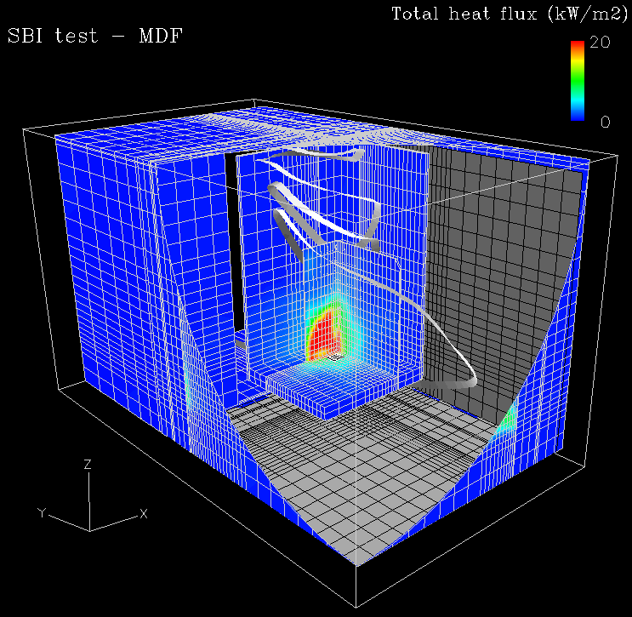
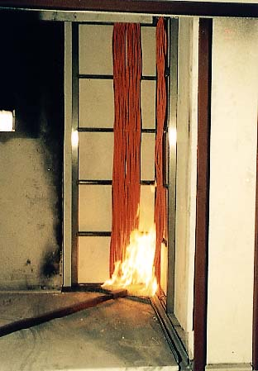
Fires in Buildings

Slide 34
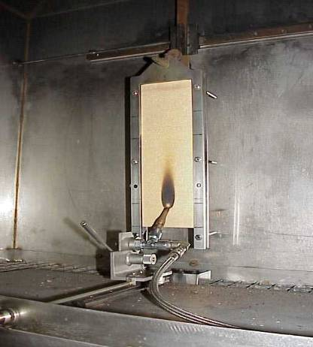
Flame test
  AS 1530.2-1993 :
  Test for flammability of materials
  This test evaluates the ignitability of a product when exposed to a flame.
  The test is relevant for the classes B, C, D, and E

Slide 35
FLAME TEMPERATURE
Fuel | Adiabatic Flame Temperature (K)
 | Oxygen as Oxidizer | Air as Oxidizer
Hydrogen - H₂ | 3079 | 2384
Methane - CH₄ | 3054 | 2227
Propane - C₃H₈ | 3095 | 2268
Octane - C₈H₁₈ | 3108 | 2277
A combustion process without heat loss or gain is adiabatic.
The adiabatic flame temperature of some common fuel gases like hydrogen, methane, propane and octane with oxygen or air as oxidizers is shown in the opposite Table

Slide 36


Hydro Carbons
Structure | Name
1. CH₄ | Methane
2. CH₃ - CH₃ | Ethane
3. CH₂-CH₂-CH₃ | Propane
4. CH₃-CH₂CH₂CH₃ | Butane
5. CH₃-(CH₂)₃-CH₃ | Pentane
6. CH₃-(CH₂)₄-CH₃ | – Hexane
7. CH₃(CH₂)₅CH₃ | – Heptane
8. CH₃ (CH₂)₆ CH₃ | – Octane
One of the important families of organic compounds is the Hydrocarbon family. Hydrocarbons as the name implies, are compounds whose molecules contain only carbon and hydrogen.
Homologous series :
A series of compounds which have a common general formula and in which each member differs from the next member by a constant unit, which is the methylene group
(- CH₂-) is called the homologous series.
Propane
Octane a major constituent of gasoline

Slide 37
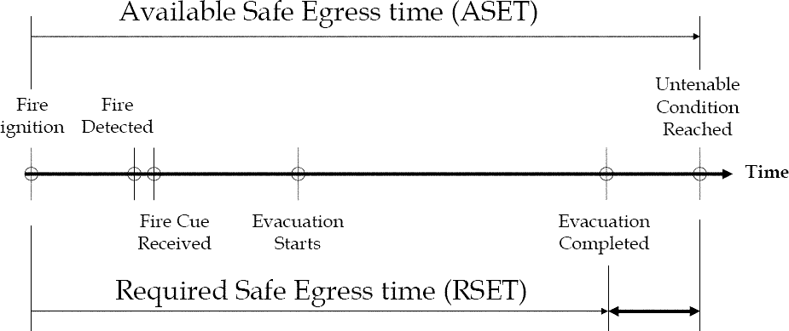
Timeline Approach
Safety
Margin

Slide 38
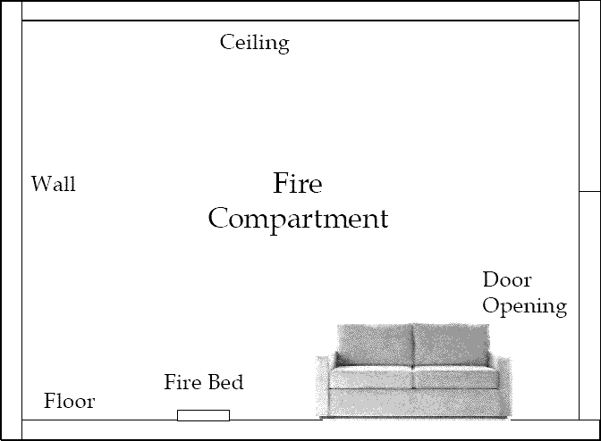
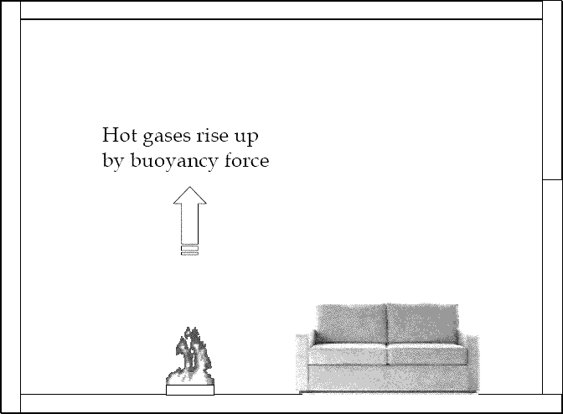
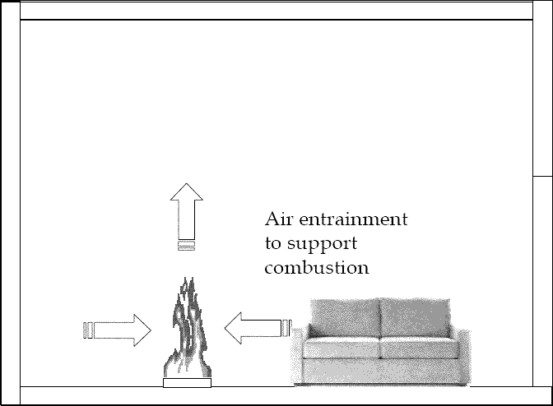
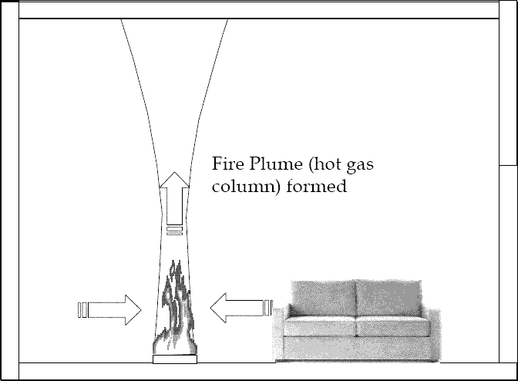

Slide 39
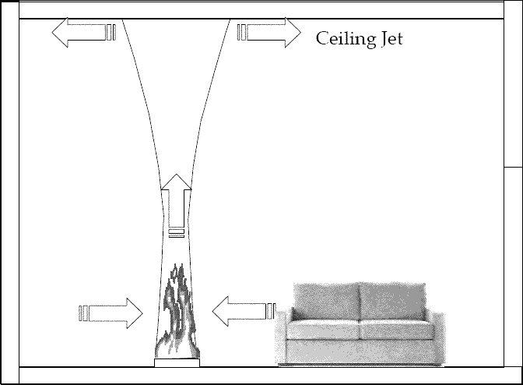
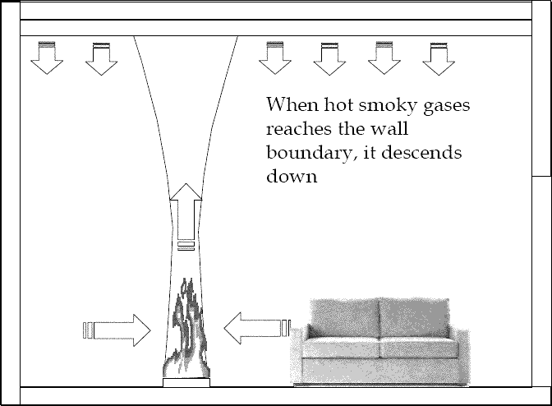
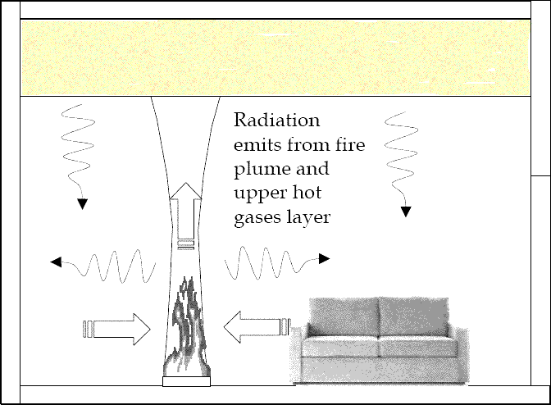
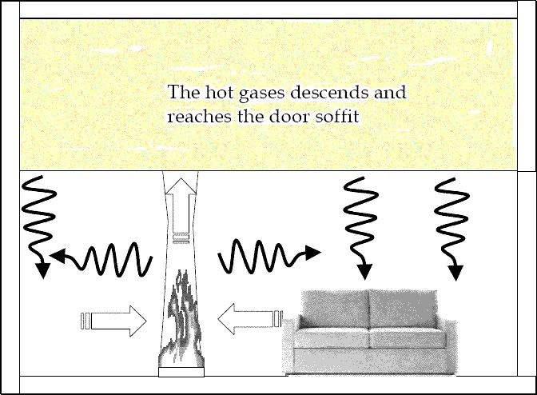

Slide 40
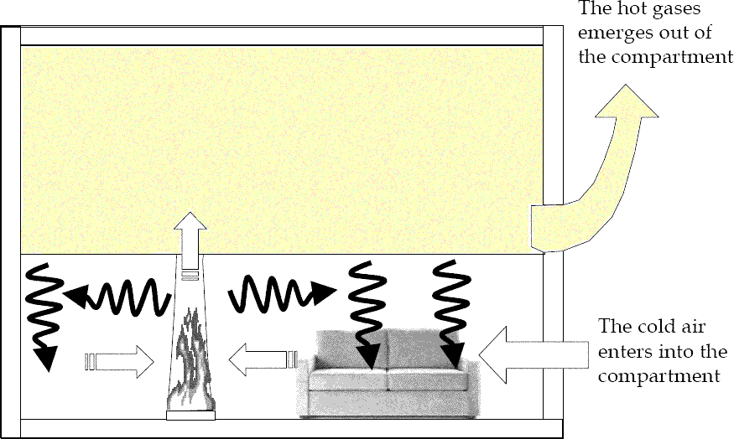
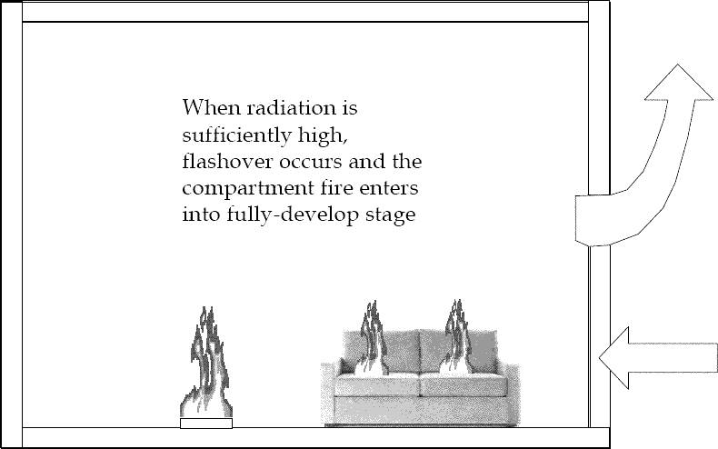
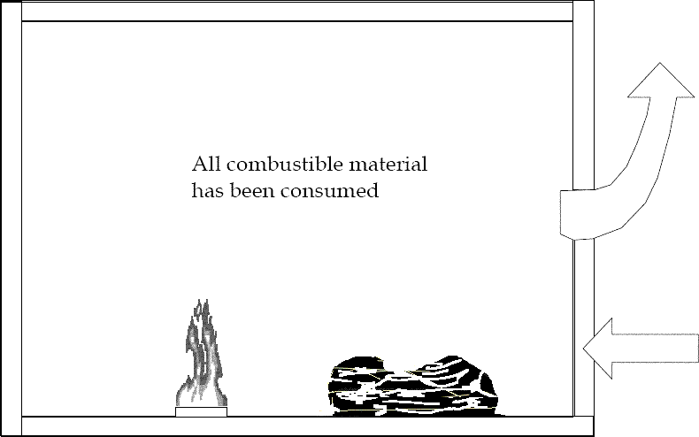
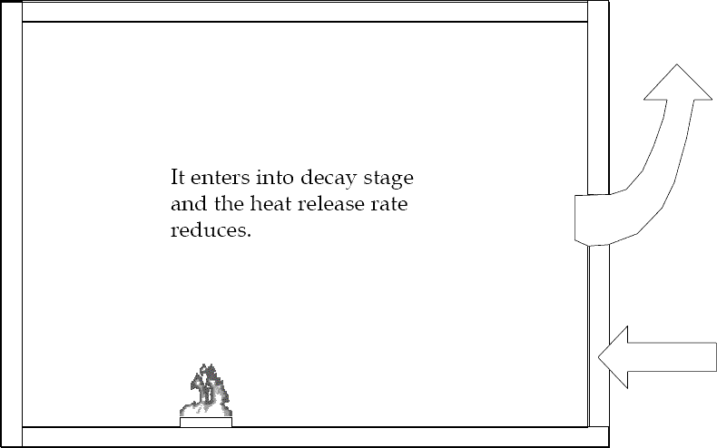

Slide 41
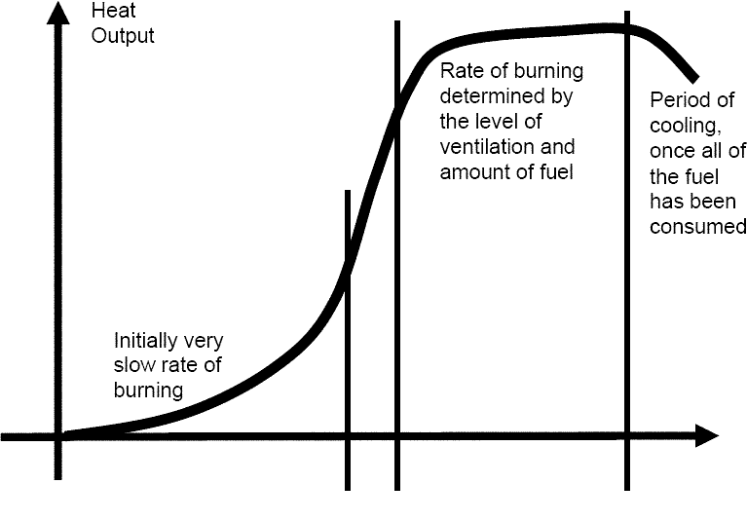
Compartment Fire Development
Stages
• Ignition
• Growth
• Flashover
• Fully-develop
• Decay
Growth
Fully-develop
Ignition
Flashover
Decay

Slide 42
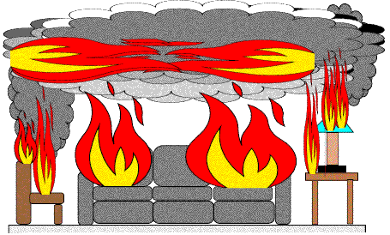
Flashover
• Radiant heat from fire plume and hot gases at upper layer is sufficiently high to ignite any combustible material inside the fire
compartment at simultaneously
• Some Criteria
– Hot gas temperature at 10mm below ceiling soffit reaches 500 ~ 600oC above ambient
– Radiation on floor reaches approx. 20kW/m2

Slide 43
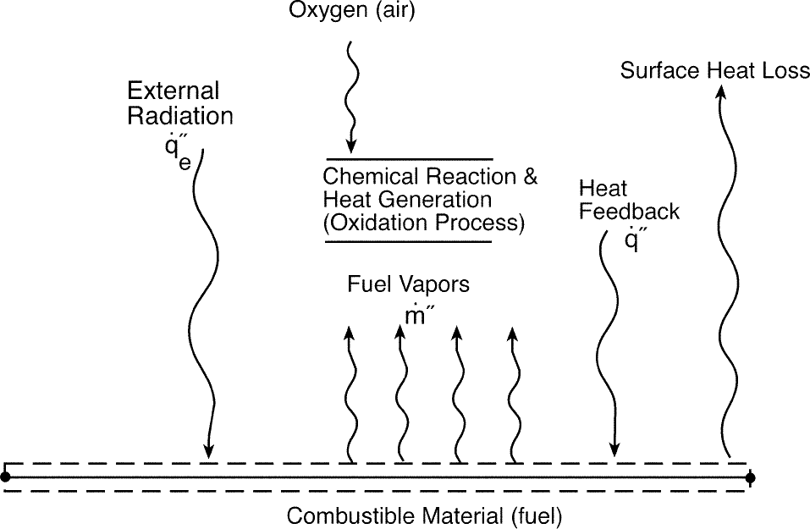
http://www.nrc.gov/reading-rm/doc-collections/nuregs/staff/sr1805/final-report/ch1-2.pdf

Slide 44
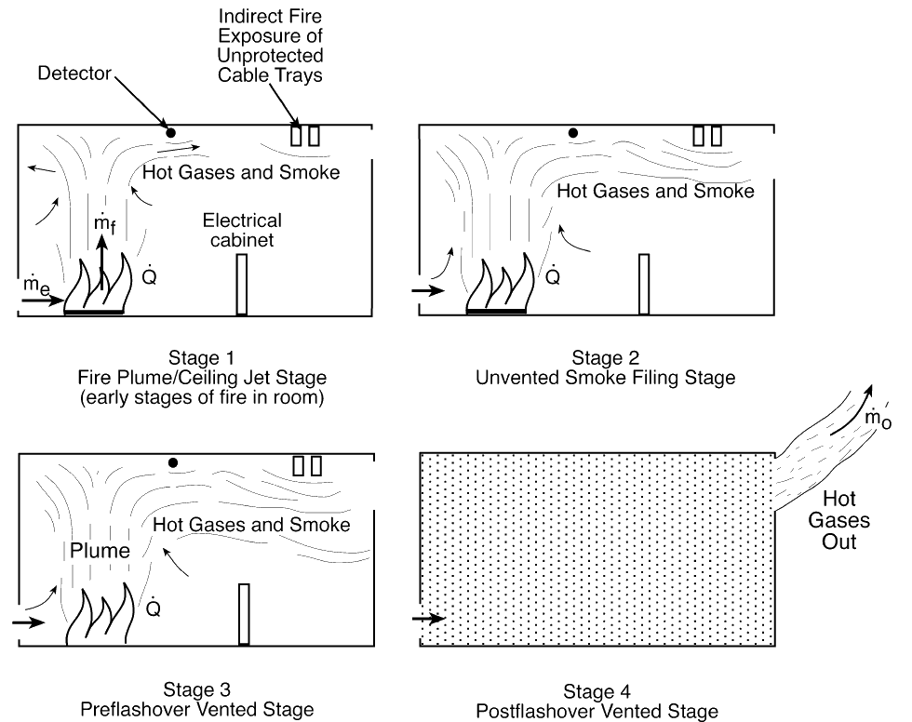
The course of compartment fires, and the conditions that result, depend on the following variables
(among others):
• fire heat release rate (HRR) of the combustible
• enclosure size
• enclosure construction
• enclosure ventilation
Stages of
Compartment
Fire

Slide 45
Compartmentalization
Buildings are designed to prevent fire, heat, and smoke from spreading beyond locations of origination. Building elements such as fire walls, fire dampers, and fire doors, are designed to seal off one location from the next. This system is called compartmentalization.
Compartmentalization increases the safety of evacuating building occupants because smoke and fire are not able to escape into exit passageways.
Containment of fire and smoke reduces property damage and prevents small fires from growing into large fires.
In order for compartmentalization efforts to be effective fire barriers must be maintained.

Slide 46
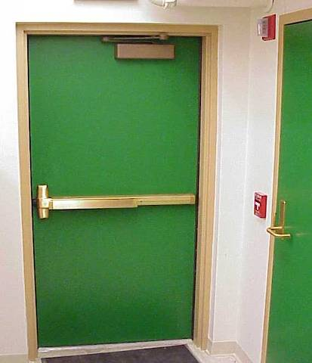
What’s A Fire Door?
Fire doors are designed to withstand fire, heat and smoke for a period of 20-minutes to 3 hours.
Did you know that corridor office doors are fire doors and should have a fire rating?
Corridor laboratory doors should have a 60 minute rating.
Fire Doors are required to:
  Be Self Closing: fire doors should have a door closure that pulls doors completely shut after the door has been opened
  Have Positive latching: a positive latch locks a door in place so can open swing open freely.

Slide 47
4 Reasons Not to Wedge Open Fire Doors
For the safety of your buildings occupants.
  If a fire occurs in a location where the fire door has been wedged, smoke and heat will travel freely into exit corridors hindering or preventing occupant evacuation.
It’s important to:
  Periodically check and inspect buildings for fire access and egress
To reduce or prevent damage to property, research, personal belongings, etc.
  Keeping your door shut will keep out smoke or fire originating in other locations.
To hold open your door you may have an electro-magnetic device installed.
  This device releases a fire door upon activation of the fire alarm allowing it to close and latch.

Slide 48
Maintaining Fire Barriers
Fire doors need occasional maintenance and repairs to function properly and should be periodically checked. To test a fire door:
  Open the door fully and allow it to swing shut.
  The door should close and latch completely by itself. Give the door a push after it closes to ensure that the latch has engaged.
  If the door is not operating properly contact manufacturer for repairs.
Ceiling, Floor, Wall Penetrations
  All areas should be properly sealed to prevent the escape of fire, heat and smoke.
  Common penetrations include holes in walls, around ducts, pipes, etc. These types of penetrations should be sealed with appropriate fire-stopping material.

Slide 49
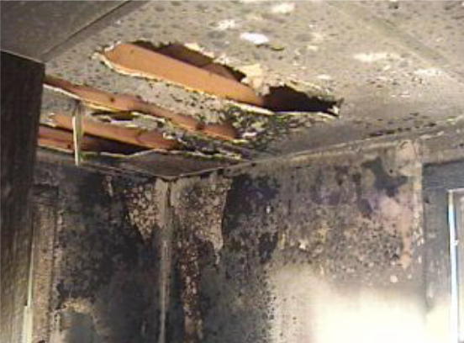
Practice Burn Photographs
What clues might a fire investigator gain from
this photograph?
Photos provided by Brock Brooks & the Havana Fire Department

Slide 50
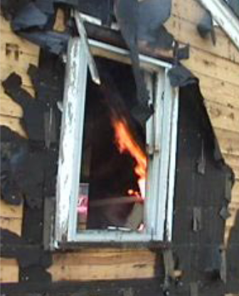
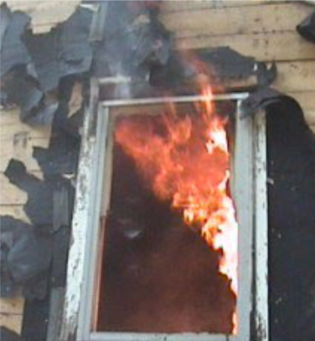
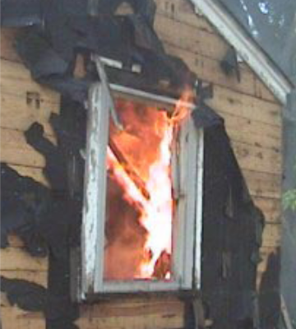
Practice Burn Photographs
Photos provided by Brock Brooks & the Havana Fire Department

Slide 51
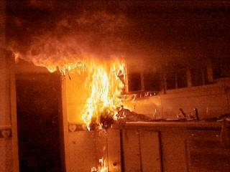
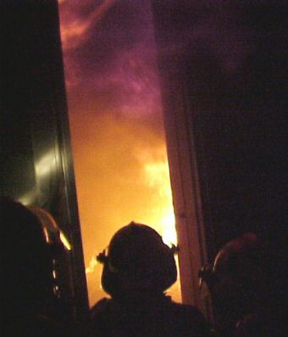
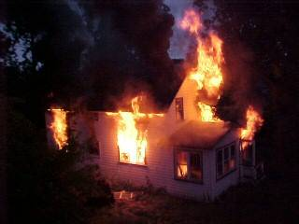
Practice Burn Photographs
A fire started in the kitchen area does not take long before it is a ball of flame reaching quickly to the ceiling.
Fires can easily double in size every 60 seconds, meaning there is little time to extinguish a fire before escape should be your primary goal if trapped.
Fire fighters look on as the fire spreads across a room.
The house is nearly completely consumed.
Source: http://www.ci.east-grand-forks.mn.us/fire/gallery/burn/burn.htm

Slide 52
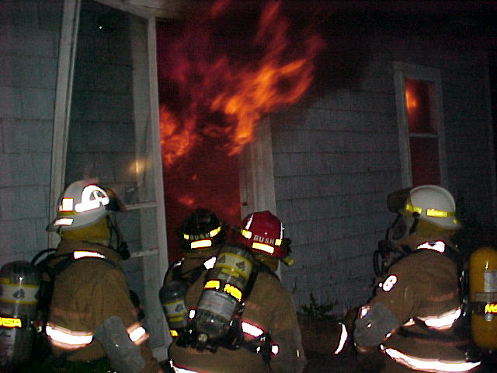

Slide 53
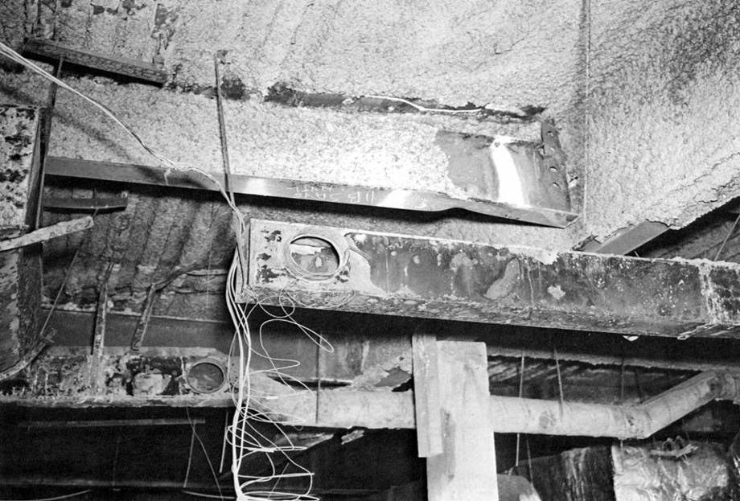

Slide 54
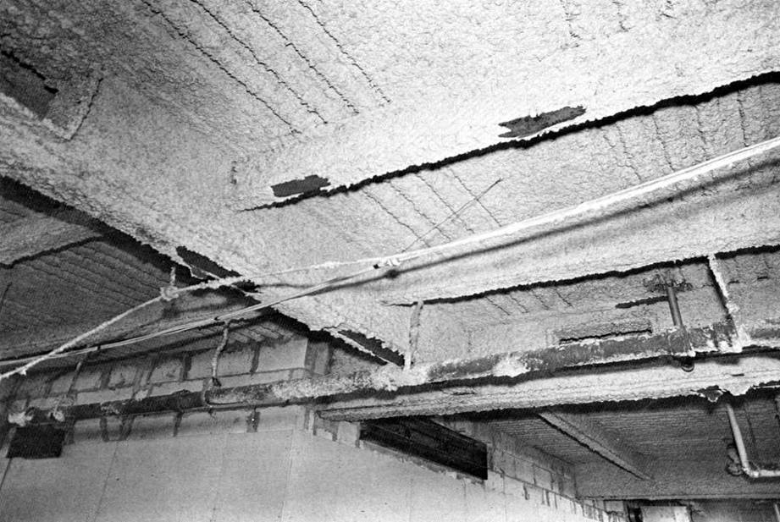

Slide 55
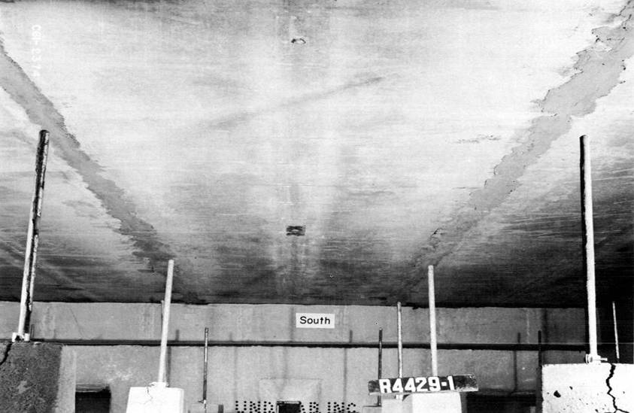

Slide 56
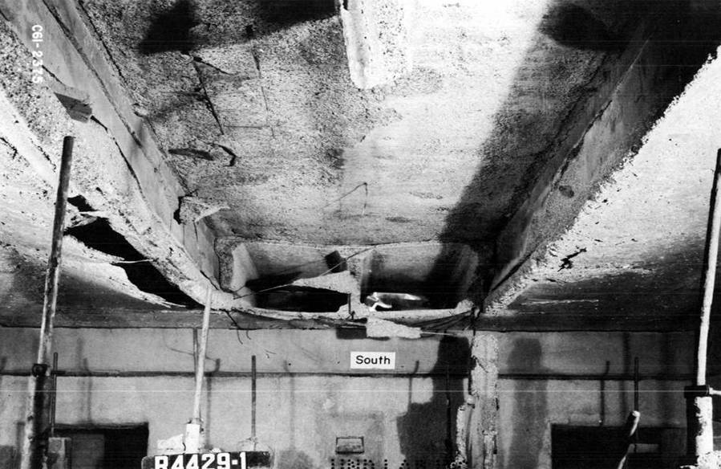
End of Presentation - Thanks for your attention

Slide 57
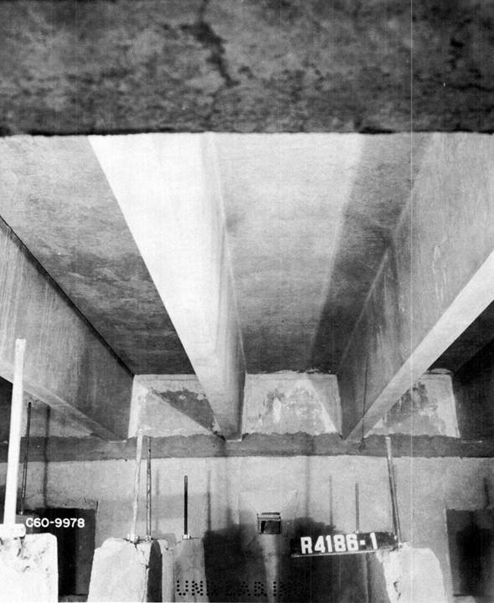

Slide 58
