Slide 1
Fire classes & fire in buildings

Slide 2
Classes of Fire
Not all fires are the same and not all extinguishing agents are compatible with all types of fuel.
Fires are normally classified according to the fuel involved.
Most fire extinguishers will have a pictograph label telling you which fuels the extinguisher is designed to fight. (Band on fire extinguisher)
Notes:
If you use the wrong type of fire extinguisher on the wrong class of fire, you can, in fact, make matters worse (eg water used on a flammable liquid fire is likely to increase the rate of burning dramatically and to disperse the fuel to cover a greater area. It is therefore very important to understand the six different classes of fires.
For example, a simple water extinguisher should have a label indicating that it should only be used on Class A fuels and never on Class B fuels (flammable liquids) and class (E), electrical fires.

Slide 3
Fire Classes in Australia Europe & UK
Class A Ordinary combustible or fibrous material such as wood, paper, fabric, coal, leather, sugar, rubber and some plastics.
Class B Flammable liquids such as petrol, kerosene, alcohol, oil and paint thinners.
Class C Flammable Gasses such as LPG, Butane, Acetylene, Hydrogen, natural gas and methane.
Class D Combustible Metals: potassium, sodium, lithium, aluminium, magnesium and metal swarf. Fires of this class may occur in laboratories or industries that use these materials. Metal swarf fires may occur in machine shops where metal turning or milling is carried out. These fires burn at high temperatures and give off sufficient oxygen to support combustion. They may also react violently with water or other chemicals.
Class E Electrical Hazards. Fires involving live electrical equipment (e.g. computers, switchboards and power tools). As long as it's "plugged in," it would be considered a class (E) fire. If the electricity supply to the equipment is disconnected (plug pulled out), then the fire is not class (E). It takes the class of the fuel that is burning.
Class F Cooking Oil or Fat.

Slide 4

EXTINGUISHER
Understand the combustion process and different fire classes.
Understand fire extinguisher types, operating procedures, capabilities, and limitations.
Understand basic firefighting concepts:
► R.A.C.E.
    ► P.A.S.S.
Rescue Alarm Contain Extinguish
Pull the pin
Aim low at the base of flames
Squeeze the Handle
Sweep side to side
Notes:
BRIEFLY REVIEW OBJECTIVES.

Slide 5
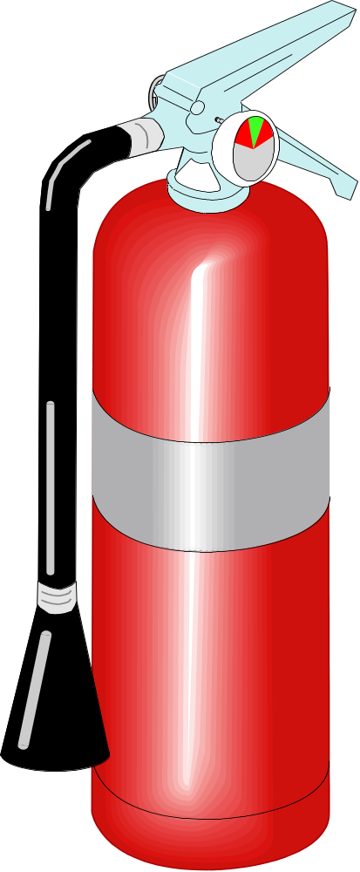
Fire Extinguisher Anatomy
DISCHARGE LEVER
PRESSURE GAUGE
(not found on CO₂
extinguishers)
DISCHARGE LOCKING PIN
AND SEAL
CARRYING
HANDLE
DISCHARGE HOSE
BAND INDICATES TYPE OF FIRE
DISCHARGE NOZZLE
BODY
DISCHARGE ORIFICE
Notes:
POINT OUT DIFFERENT COMPONENTS OF PORTABLE FIRE EXTINGUISHER.
POINT OUT THAT CO₂ EXTINGUISHER IS UNIQUE IN THAT IT DOES NOT HAVE PRESSURE GAUGE.

Slide 6
Australia
Type | Pre-1997 | Current | Class
Water | Solid red |  | A
Foam | Solid blue | Red with a blue band | A | B
Powder | Red with a white band |  | A | B | C | E
Carbon dioxide | Red with a black band |  | A (limited) | B | C | E | F
Vapourising liquid (not halon) | Red with a yellow band |  | A | B | C | E
Halon^{[1]} | Solid yellow | — | A | B |  | E
Wet chemical | Solid oatmeal | Red with an oatmeal band | A |  |  |  | F
Internationally there are several accepted classification methods for hand-held fire extinguishers. Each classification is useful in fighting fires with a particular group of fuel.

Slide 7
Australian Standards for Portable Fire Extinguishers
AS/NZS 1841.1:1997 :
Portable fire extinguishers - General requirements
AS/NZS 1841.2:1997
Portable fire extinguishers - Specific requirements for water type extinguishers
AS/NZS 1841.3:1997
Portable fire extinguishers - Specific requirements for wet-chemical type extinguishers _x000b_
AS/NZS 1841.4:1997
Portable fire extinguishers - Specific requirements for foam type extinguishers
AS/NZS 1841.5:1997
Portable fire extinguishers - Specific requirements for powder type extinguishers
AS/NZS 1841.6:1997
Portable fire extinguishers - Specific requirements for carbon dioxide type extinguishers
AS/NZS 1841.7:1997
Portable fire extinguishers - Specific requirements for vaporizing-liquid type extinguishers

Slide 8
Fire design of building
The two stages to be considered in the fire safety design of buildings in relation to building materials and structures are the
  Initial stage and the
  Fully stage.
In the initial fire, the building contents such as furniture etc, are of major importance both for the initiation of the fire and its development.
Surface linings may also play an important role in the initial fire, especially in escape routes and limitations of their reaction to fire is required in most building codes.
In the fully developed fire, the performance of load bearing and separating structures is important in order to limit the fire to the room or fire compartment of origin. This is called the fire resistance of the building structure.

Slide 9
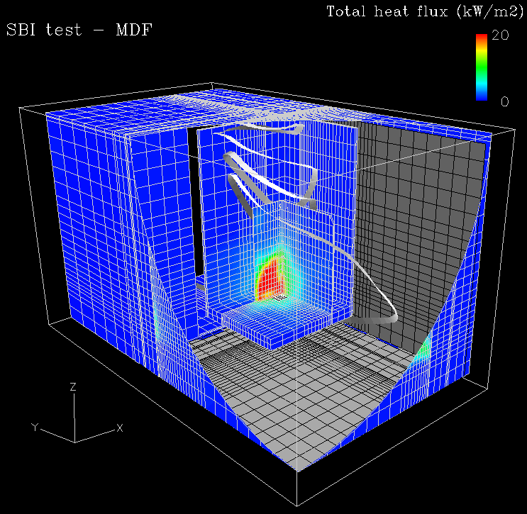
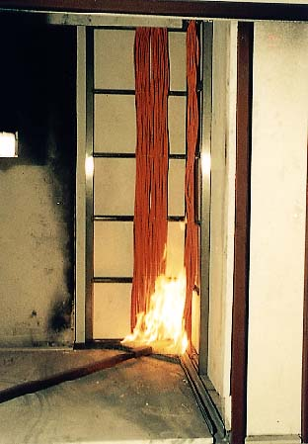
Fires in Buildings

Slide 10
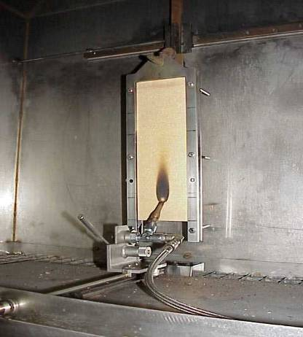
Flame test
  AS 1530.2-1993 :
  Test for flammability of materials
  This test evaluates the ignitability of a product when exposed to a flame.
  The test is relevant for the classes B, C, D, and E

Slide 11
FLAME TEMPERATURE
Fuel | Adiabatic Flame Temperature (K)
 | Oxygen as Oxidizer | Air as Oxidizer
Hydrogen - H₂ | 3079 | 2384
Methane - CH₄ | 3054 | 2227
Propane - C₃H₈ | 3095 | 2268
Octane - C₈H₁₈ | 3108 | 2277
A combustion process without heat loss or gain is adiabatic.
The adiabatic flame temperature of some common fuel gases like hydrogen, methane, propane and octane with oxygen or air as oxidizers is shown in the opposite Table

Slide 12


Hydro Carbons
Structure | Name
1. CH₄ | Methane
2. CH₃ - CH₃ | Ethane
3. CH₂-CH₂-CH₃ | Propane
4. CH₃-CH₂CH₂CH₃ | Butane
5. CH₃-(CH₂)₃-CH₃ | Pentane
6. CH₃-(CH₂)₄-CH₃ | – Hexane
7. CH₃(CH₂)₅CH₃ | – Heptane
8. CH₃ (CH₂)₆ CH₃ | – Octane
One of the important families of organic compounds is the Hydrocarbon family. Hydrocarbons as the name implies, are compounds whose molecules contain only carbon and hydrogen.
Homologous series :
A series of compounds which have a common general formula and in which each member differs from the next member by a constant unit, which is the methylene group
(- CH₂-) is called the homologous series.
Propane
Octane a major constituent of gasoline

Slide 13
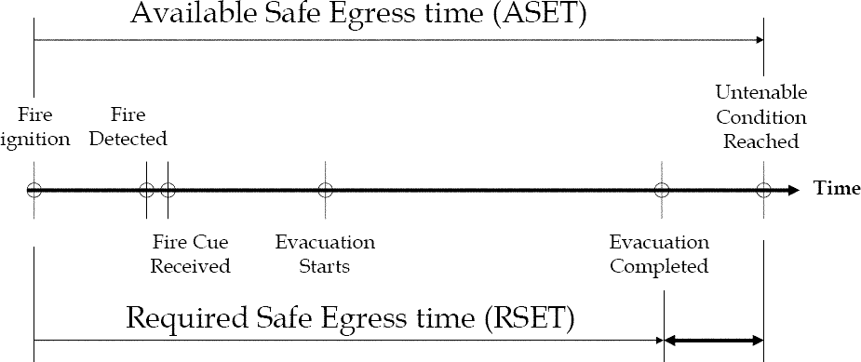
Timeline Approach
Safety
Margin

Slide 14
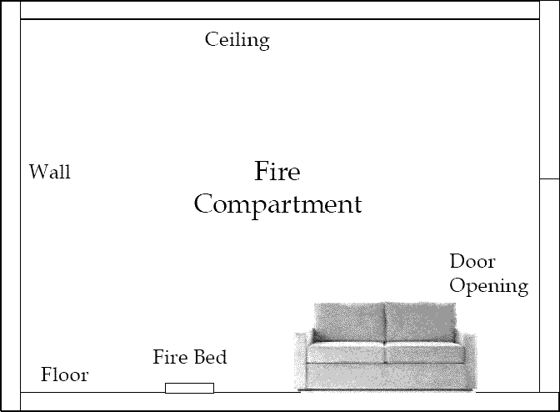
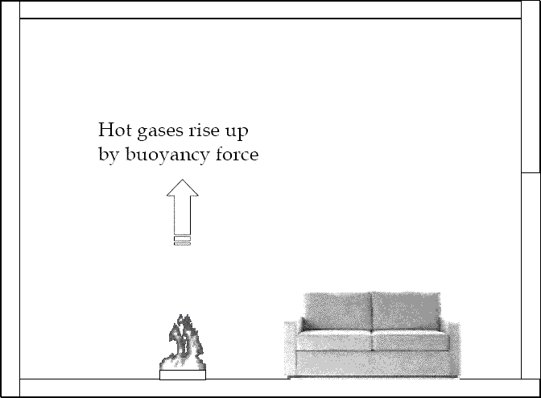
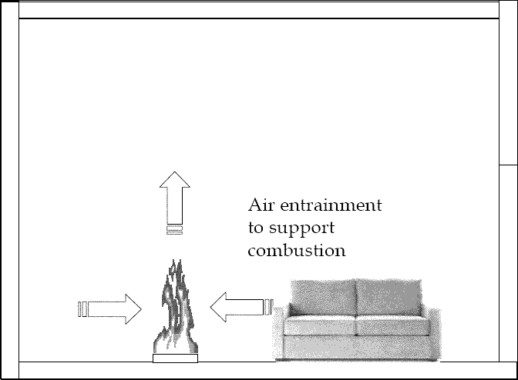
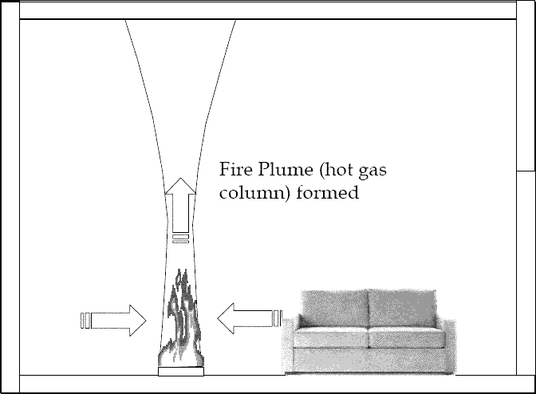

Slide 15
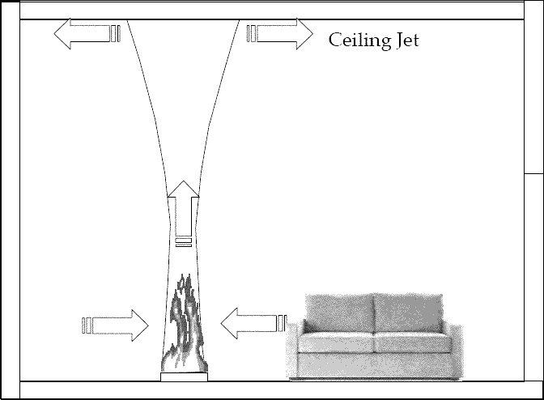
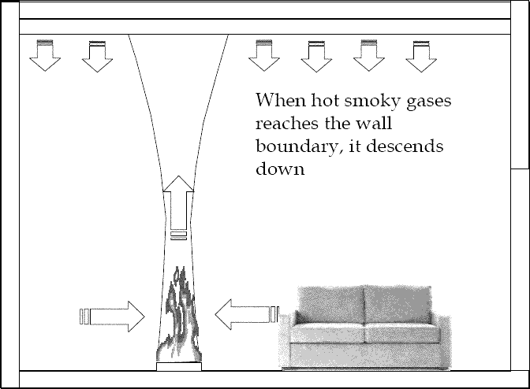
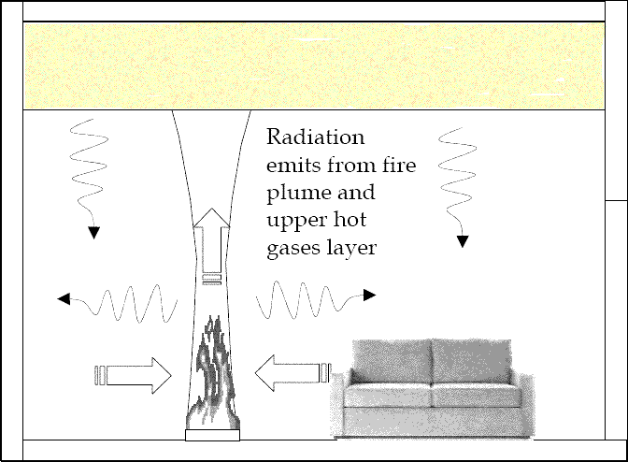
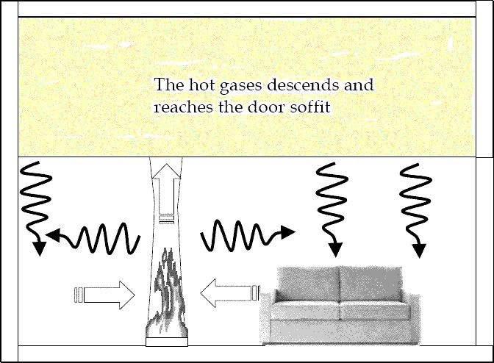

Slide 16
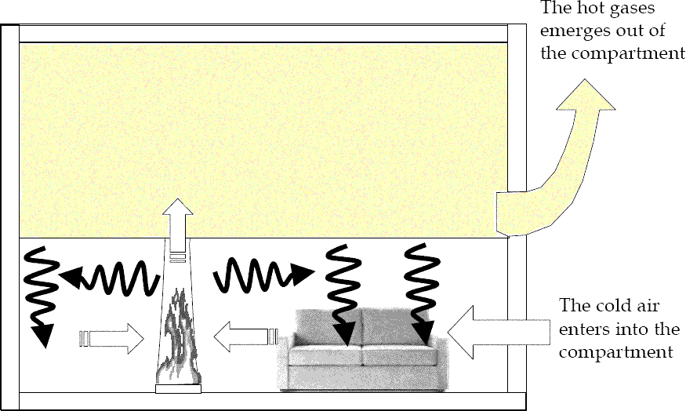
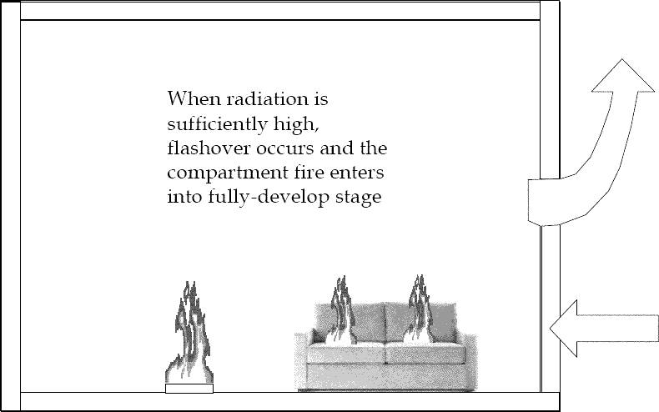
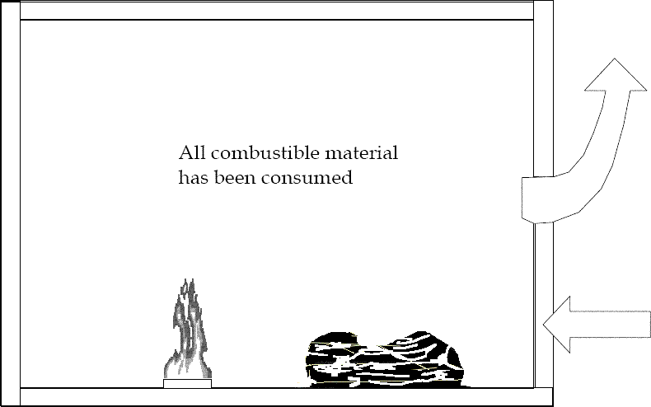
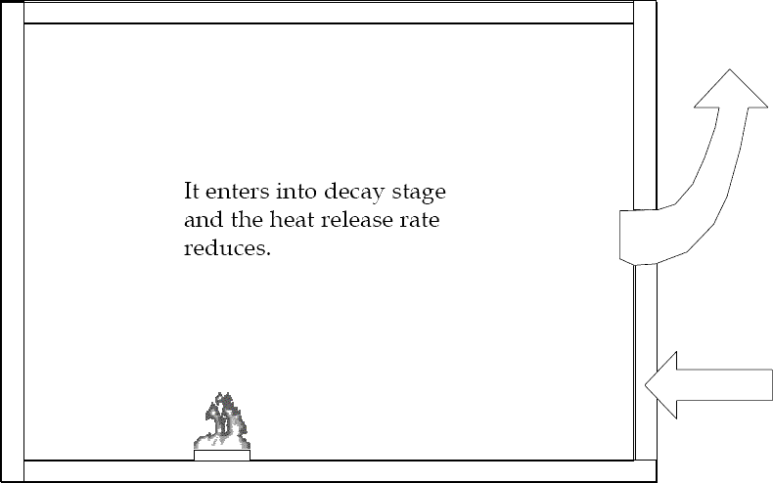

Slide 17
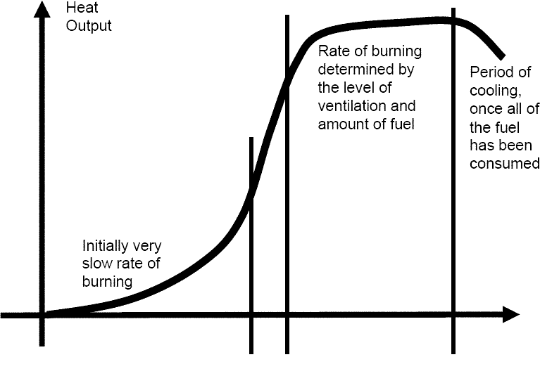
Compartment Fire Development
Stages
• Ignition
• Growth
• Flashover
• Fully-develop
• Decay
Growth
Fully-develop
Ignition
Flashover
Decay

Slide 18
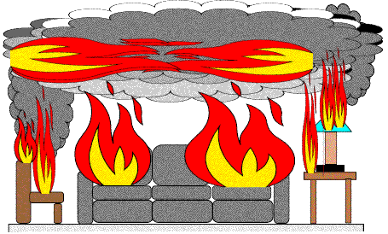
Flashover
• Radiant heat from fire plume and hot gases at upper layer is sufficiently high to ignite any combustible material inside the fire
compartment at simultaneously
• Some Criteria
– Hot gas temperature at 10mm below ceiling soffit reaches 500 ~ 600oC above ambient
– Radiation on floor reaches approx. 20kW/m2

Slide 19
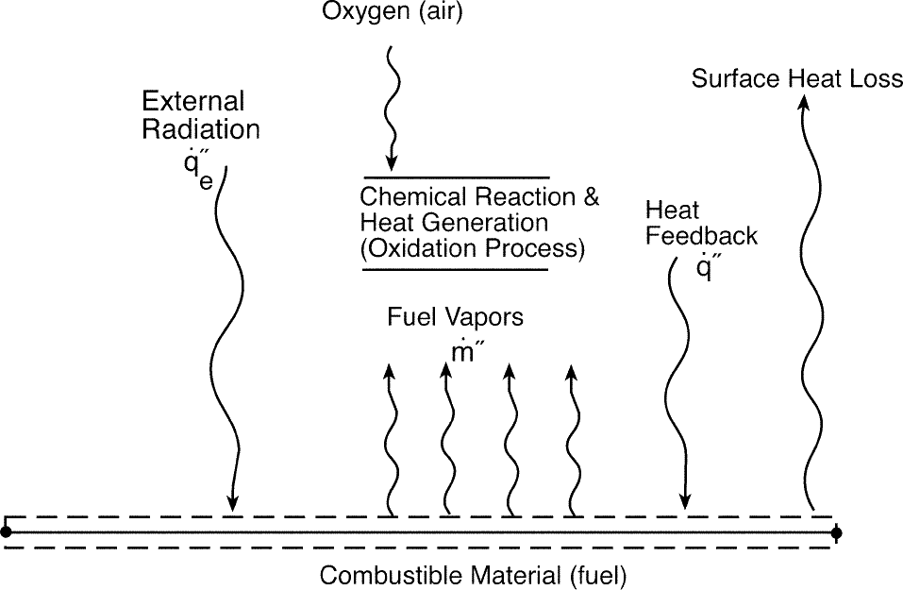
http://www.nrc.gov/reading-rm/doc-collections/nuregs/staff/sr1805/final-report/ch1-2.pdf

Slide 20
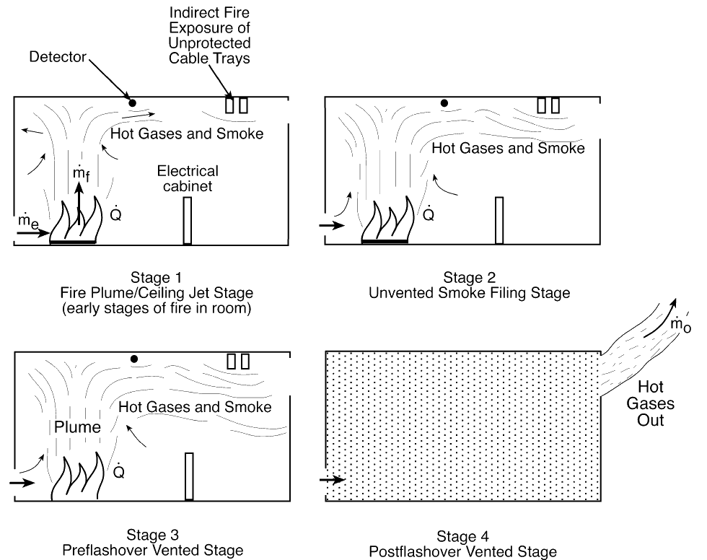
The course of compartment fires, and the conditions that result, depend on the following variables
(among others):
• fire heat release rate (HRR) of the combustible
• enclosure size
• enclosure construction
• enclosure ventilation
Stages of
Compartment
Fire

Slide 21
Compartmentalization
Buildings are designed to prevent fire, heat, and smoke from spreading beyond locations of origination. Building elements such as fire walls, fire dampers, and fire doors, are designed to seal off one location from the next. This system is called compartmentalization.
Compartmentalization increases the safety of evacuating building occupants because smoke and fire are not able to escape into exit passageways.
Containment of fire and smoke reduces property damage and prevents small fires from growing into large fires.
In order for compartmentalization efforts to be effective fire barriers must be maintained.

Slide 22
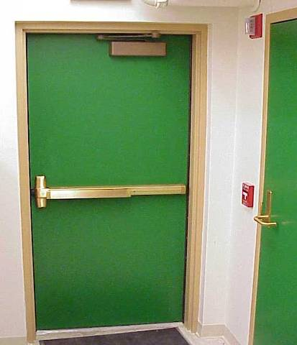
What’s A Fire Door?
Fire doors are designed to withstand fire, heat and smoke for a period of 20-minutes to 3 hours.
Did you know that corridor office doors are fire doors and should have a fire rating?
Corridor laboratory doors should have a 60 minute rating.
Fire Doors are required to:
  Be Self Closing: fire doors should have a door closure that pulls doors completely shut after the door has been opened
  Have Positive latching: a positive latch locks a door in place so can open swing open freely.

Slide 23
4 Reasons Not to Wedge Open Fire Doors
For the safety of your buildings occupants.
  If a fire occurs in a location where the fire door has been wedged, smoke and heat will travel freely into exit corridors hindering or preventing occupant evacuation.
It’s important to:
  Periodically check and inspect buildings for fire access and egress
To reduce or prevent damage to property, research, personal belongings, etc.
  Keeping your door shut will keep out smoke or fire originating in other locations.
To hold open your door you may have an electro-magnetic device installed.
  This device releases a fire door upon activation of the fire alarm allowing it to close and latch.

Slide 24
Maintaining Fire Barriers
Fire doors need occasional maintenance and repairs to function properly and should be periodically checked. To test a fire door:
  Open the door fully and allow it to swing shut.
  The door should close and latch completely by itself. Give the door a push after it closes to ensure that the latch has engaged.
  If the door is not operating properly contact manufacturer for repairs.
Ceiling, Floor, Wall Penetrations
  All areas should be properly sealed to prevent the escape of fire, heat and smoke.
  Common penetrations include holes in walls, around ducts, pipes, etc. These types of penetrations should be sealed with appropriate fire-stopping material.

Slide 25
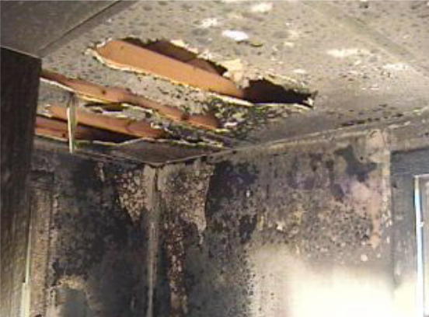
Practice Burn Photographs
What clues might a fire investigator gain from
this photograph?
Photos provided by Brock Brooks & the Havana Fire Department

Slide 26
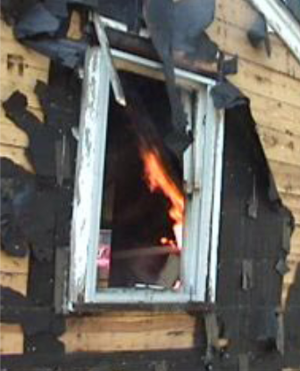
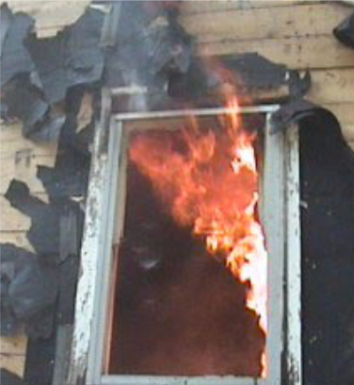
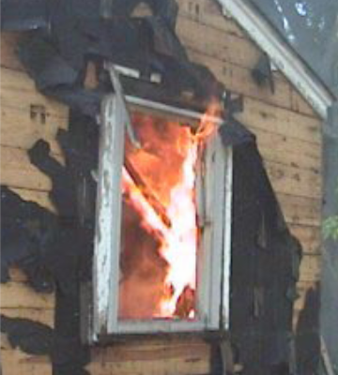
Practice Burn Photographs
Photos provided by Brock Brooks & the Havana Fire Department

Slide 27
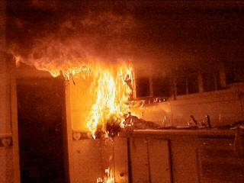
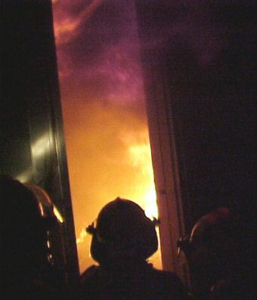
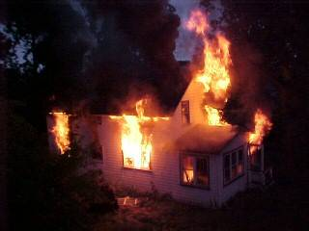
Practice Burn Photographs
A fire started in the kitchen area does not take long before it is a ball of flame reaching quickly to the ceiling.
Fires can easily double in size every 60 seconds, meaning there is little time to extinguish a fire before escape should be your primary goal if trapped.
Fire fighters look on as the fire spreads across a room.
The house is nearly completely consumed.
Source: http://www.ci.east-grand-forks.mn.us/fire/gallery/burn/burn.htm

Slide 28
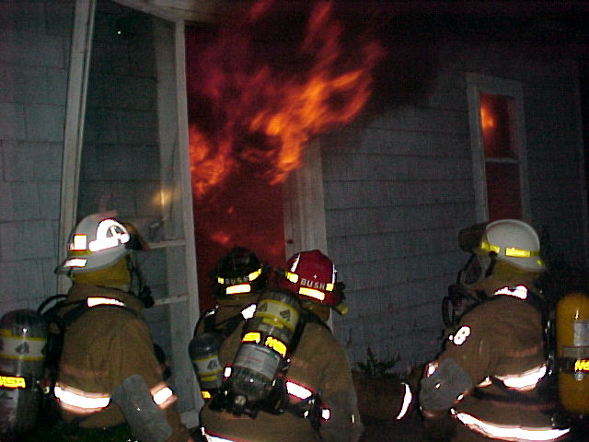

Slide 29
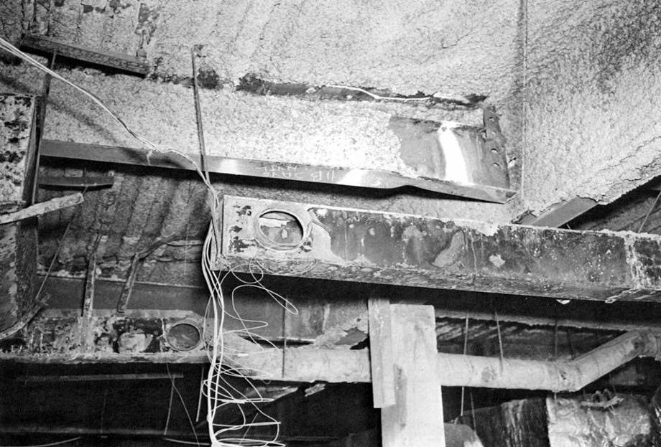

Slide 30
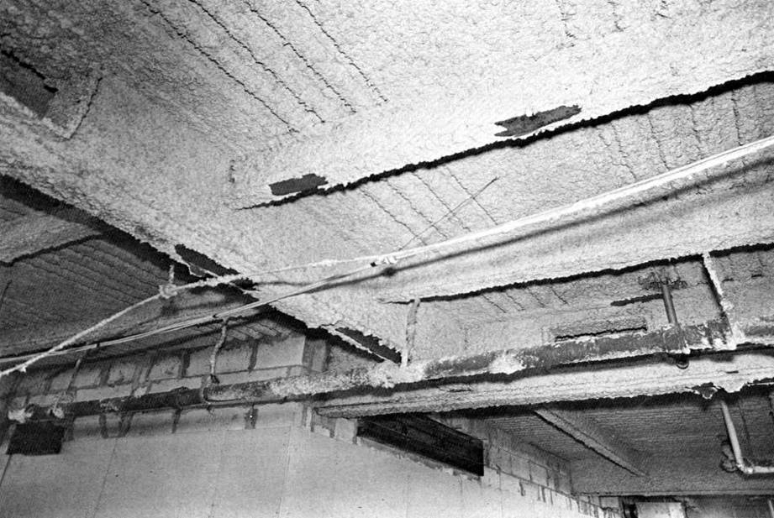

Slide 31
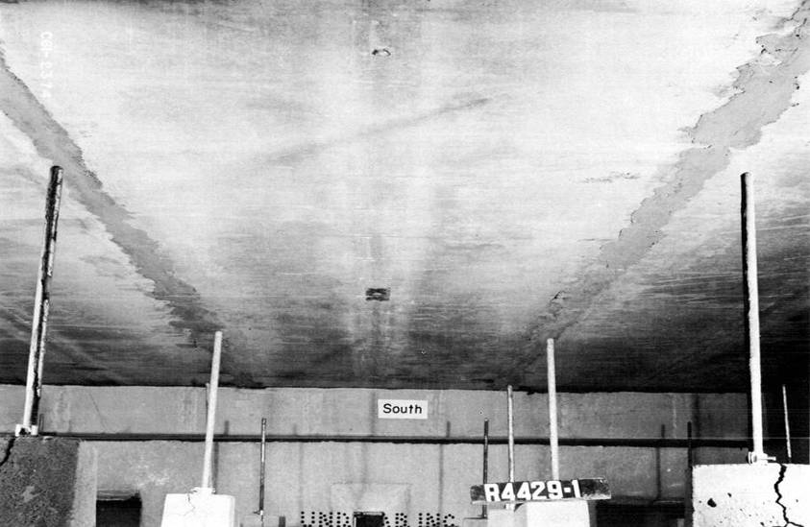

Slide 32
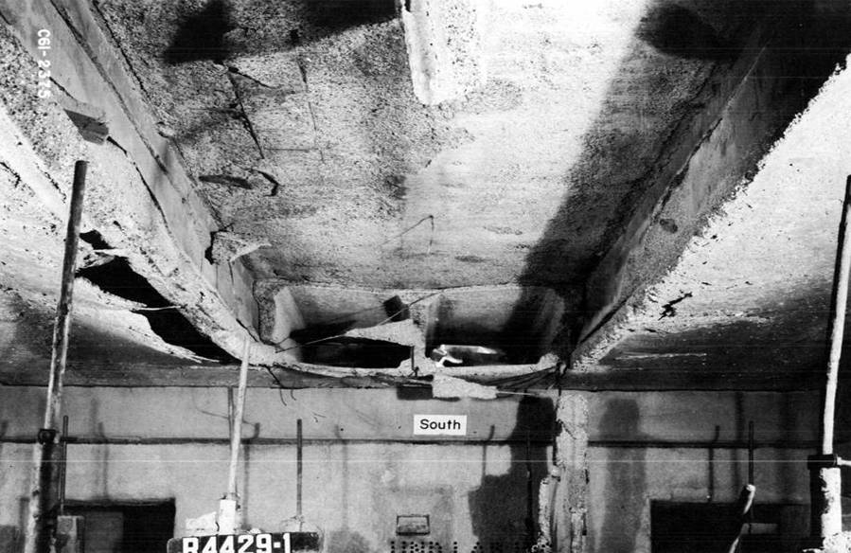
End of Presentation - Thanks for your attention

Slide 33
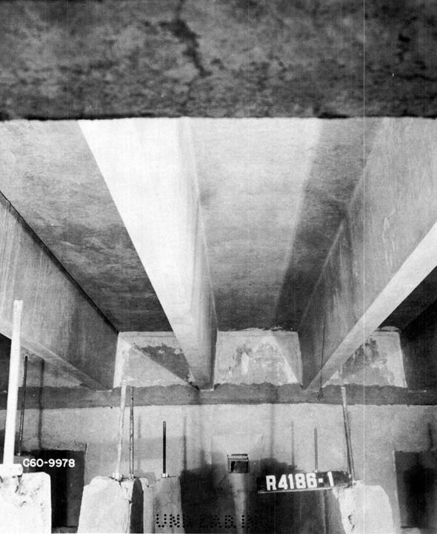

Slide 34
