Slide 1
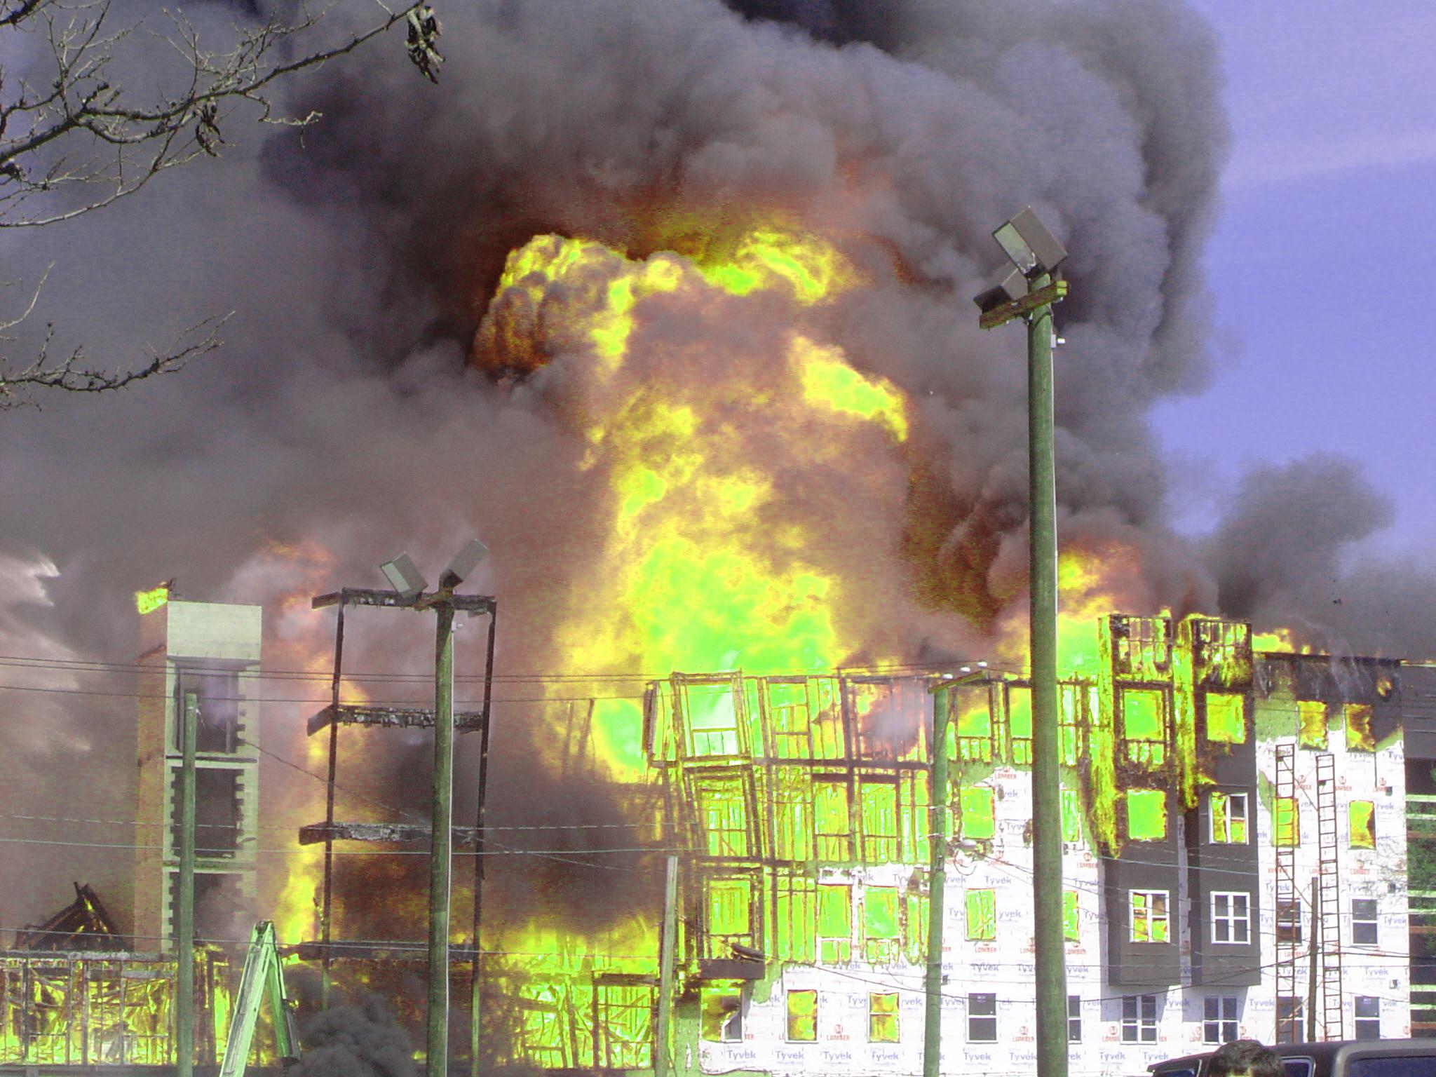


Slide 2
Content of Presentation
Slide 3 Combustion
Slide 4 Fire Triangle
Slide 5 Fire Tetrahedon
Slide 6 Adiabatic flame temperature
Slide 7 The Four Stages of a Fire
Slide 15 Products of Combustion
Slide 16 Principle of Fire Extinction
Slide 18 The Strategy of Preventing a Fire
Slide 19 Causes of Ignition
Slide 20 Flammable and combustible liquids
Slide 21 How do I tell what’s flammable?
Slide 22 Storage Guidlines

Slide 3
What is combustion ?
Combustion is the act or process of burning. For combustion to occur, fuel, oxygen (air), and heat must be present together.
The combustion process is started by heating the fuel above its ignition temperature in the presence of oxygen. Under the influence of heat, the chemical bonds of the fuel are split.
If complete combustion takes place, the elements carbon (C), hydrogen (H) and sulphur (S) react with the oxygen content of the air to form carbon dioxide CO₂, water vapour H₂O and sulphur dioxide SO₂ and, to a lesser degree, sulphur trioxide SO₃.
Back to top

Slide 4
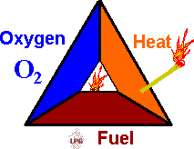
Fire Triangle
Fuel + Oxygen + Heat = Fire
The FIRE TRIANGLE represents the three elements
needed for fire to occur: heat, fuel, and oxygen.
The air we breathe is about 21% oxygen. Fire requires an atmosphere with at least 16% oxygen.
Heat is the energy necessary to increase the temperature of the fuel to a point where sufficient vapors are given off for ignition to occur.
Fuel can be any combustible material in any state of matter - solid, liquid, or gas. Most solids and liquids become a vapor or gas before they will burn.
Back to top

Slide 5
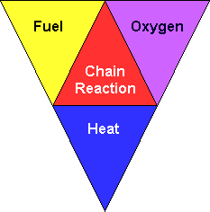
Fire Tetrahedron
1. There must be Fuel to burn.
Any combustible material - solid, liquid or gas. Most solids and liquids must vaporise before they will burn.
2. There must be Air to supply Oxygen.
Sufficient oxygen (at least 16%) must be present in the atmosphere surrounding the fuel for fire to burn. This is usually not a problem since the air we breathe is about 21% oxygen.
3. There must be Heat (ignition temperature) to start and continue the combustion process. Sufficient heat energy must be applied to raise the fuel to it's ignition temperature
However by adding in a fourth element, you have a fire "tetrahedron".
4. CHEMICAL CHAIN REACTION - This reaction can occur when all three of the above elements are present in the proper conditions and proportions. Fire (rapid oxidisation) is the result of this chemical reaction.

Slide 6
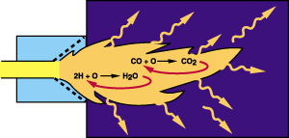
ADIABATIC FLAME TEMPERATURE
Adiabatic is a term used to describe a combustion reaction in which all heat generated is retained in the products of combustion.
Adiabatic flame temperature is the theoretical temperature that would be attained by the products of combustion provided the entire chemical energy of the fuel is transferred to the products of combustion.
This assumes that there is no heat loss to surroundings and no dissociation
Dissociation is a reaction involving the breakdown of chemical compounds. In the case of combustion, these are water vapour and carbon dioxide.
Back to top

Slide 7
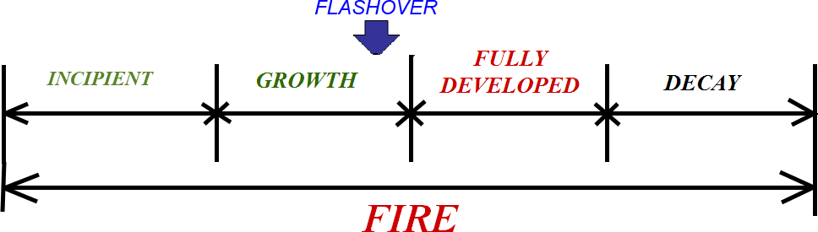
The Four Stages of a Fire
1 INCIPIENT STAGE
2 GROWTH STAGE
3 FULLY DEVELOPED STAGE
4 DECAY STAGE
Back to top

Slide 8
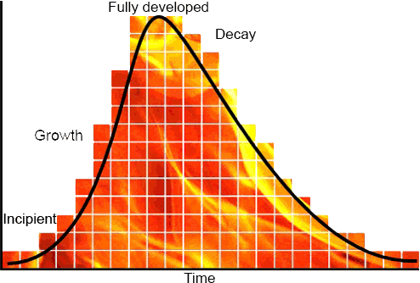
Heat Release Rate (HRR) and Fire Development
Incipient Stage
Going back to the basics of fire behavior, ignition requires heat, fuel, and oxygen. Once combustion begins, development of an incipient fire is largely dependent on the characteristics and configuration of the fuel involved (fuel controlled fire).
Fires barely follow the simple, idealized fire development curve as illustrated in Figure 1.
Peak heat release rate, and duration of burning are dependent on:
the characteristics of the fuel
and
the ventilation profile (available oxygen).
Figure 1

Slide 9
1.) INCIPIENT STAGE
  Earliest of the four phases of a fire.
  Development of a fire is largely dependent on the fuel involved
  Fire can be controlled or extinguished by portable fire extinguishers
  No detectable flame at this stage
  Smoke particles are released into the atmosphere.
  The layer of hot gases becomes more clearly defined and increases in volume
  The fire nears the growth stage.

Slide 10
2.) GROWTH STAGE
Earliest stage of a fire beginning with actual ignition.
  Fire limited to origin of ignition material.
  Flame temperature may be well above 540°C.
  Some heat being generated. Amount of heat will increase with the progress of the fire.
  Sufficient oxygen and fuel are available for fire growth to a point where total involvement is possible.
  Heat carried to uppermost region of confined area.
  Heated gases spread laterally from the top and then down.
  Cooler air forced to lower levels.
  Upper region can exceed 700°C.

Slide 11
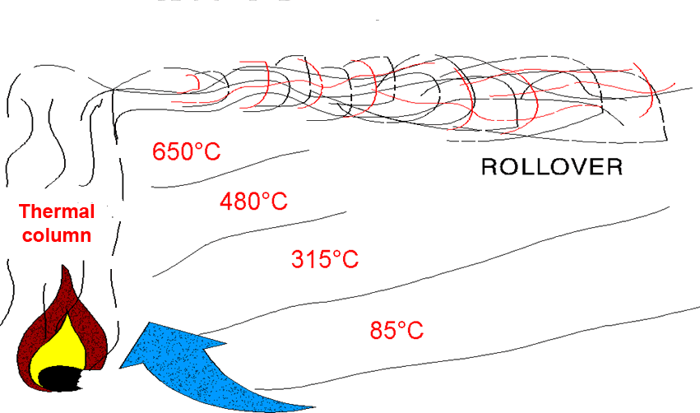
THERMAL BALANCE
Heated gases move to the upper levels of a room. Highest temperatures will be at the ceiling, and lowest temperatures and best visibility will be at ground level.
Sporadic flashes of flame mixed with smoke at the upper ceiling level just before flashover occurs

Slide 12
FLASHOVER
  Simultaneous ignition of all contents of the compartment.
  Normally occurs when the upper gas layer reaches 600°C.
  Flashover can also occur in the space above the fire.
  Can usually be prevented by proper fog application or venting.

Slide 13
3.) FULLY DEVELOPED STAGE
  All combustibles in the space have reached their ignition temperature.
  Burning rate limited by the amount of oxygen available in the air for combustion.
  Unburned fuel in the smoke may burn as it meets fresh air in adjacent compartments.
  Structural damage to exposed steel normally occurs.
  Normally inaccessible by hose teams.
  Best fought using indirect attack.

Slide 14
4.) DECAY STAGE
  Available oxygen is consumed or reduced to a point where there is insufficient oxygen to react with fuel.
  Flame may cease to exist if the area is sufficiently airtight.
  Burning reduced to glowing embers
  If fire continues to smolder, compartment will fill with dense smoke and gases and temperatures could reach well over 1000⁰C.
  Intense heat and high concentration of fire gases could produce suitable conditions for a backdraft explosion.

Slide 15
PRODUCTS OF COMBUSTION
When a material (fuel) burns, it undergoes a chemical change. None of the elements making up the material are destroyed in the process, but all of the matter is transformed into another form or state.
When a fuel burns there are four products of combustion:
Fire gases gaseous part of combustion product(s)
Flame Flame is the visible, luminous body of a burning gas.
Heat Heat is a form of energy that is measured in degrees of temperature to signify its intensity.
Smoke Smoke at most fires consists of a mixture of oxygen, nitrogen, carbon dioxide.
Back to top

Slide 16
Principle of Fire Extinction
The principles of fire extinction consist of the elimination or removal of one or more of the four elements. These principles are:
COOLING
The most commonly used fire fighting medium is water. Water absorbs heat from the fire and cools the fuel to a temperature where it no longer produces flammable vapors.
SMOTHERING
By excluding the oxygen in the surrounding atmosphere, the fire will be extinguished.
Back to top

Slide 17
Principle of Fire Extinction (cont.)
STARVATION
Starvation is achieved by removal of the fuel burning in the fire. Sometimes combustible material can be removed such as by shutting off gas valves or fuel flows.
STOP CHAIN REACTION
Stop or interrupt the chain reaction between the fuel, heat and oxygen the fire will be extinguished.
Specific methods of extinguishing fires often involve a combination of more than one of the four principles

Slide 18
The Strategy of Preventing a Fire
A fire must have three things to ignite and maintain combustion:
  Fuel
  Heat
  Oxygen
The basic strategy of fire prevention is to control or isolate sources of fuel and heat in order to prevent combustion.
If all three are not present in sufficient quantities a fire will not ignite or a fire will not be able to sustain combustion
Back to top

Slide 19
Causes of Ignition
Flammable materials may ignite in many ways, some familiar, some less so.
The most common ignition source is flame.
Hot surfaces can also cause fire
Sparks generate very high temperatures in a very small space, but it is rare that a spark will cause ignition in the absence of other factors.
Back to top

Slide 20
Flammable and combustible liquids
Flammable and combustible liquids are potential fuel sources for fires and are present in almost every workplace.
It is actually the vapor created by flammable and combustible liquids that ignites and burns.
It is important to understand what materials in your work area are flammable and combustible so that you may properly store and isolate them from ignition sources.
Back to top

Slide 21
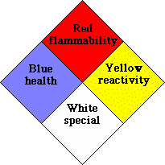
How do I tell what’s flammable?
NFPA classification system
  The NFPA diamond is an easy way to determine the safety risks associated with hazardous materials. To determine a materials flammability refer to the red section of the diamond. A number in this section will indicate the flammability rating of the material.
The following numbering system is used to indicate flammability
      0- will not burn
      1- must be preheated to burn
      2-ignites when moderately heated
      3-ignites at normal temperature
      4-extremely flammable
NFPA Diamond
Back to top

Slide 22
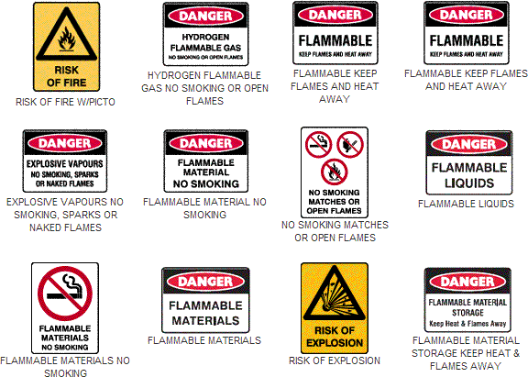
Example of Warning Signs 1

Slide 23
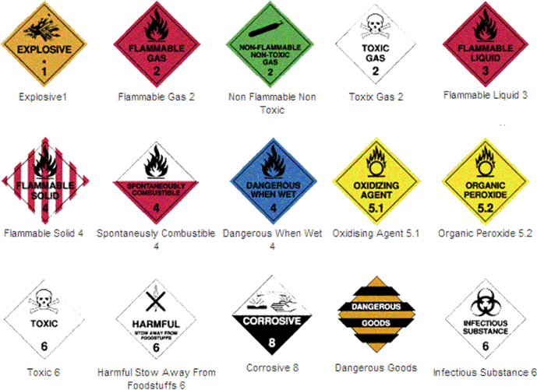
Example of Warning Signs 2

Slide 24
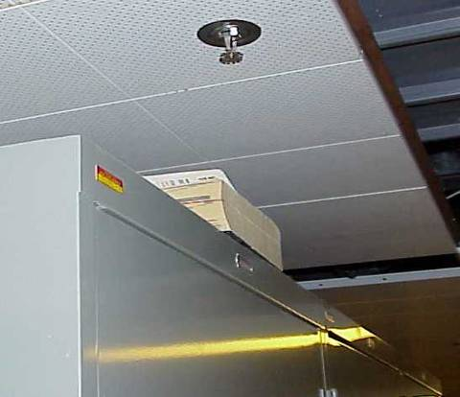
Storage Guidelines
No storage is allowed in corridors and stairwells. A cluttered hallway could slow down emergency evacuation.
Storage must not exceed a plane of 450 mm below sprinkler heads or smoke detectors. Storage that breaks this plane may prevent sprinkler heads from fully covering room during a fire.
NOTICE
Storage guidelines are applicable to all locations within buildings and are not limited to storage rooms. This includes stored materials in offices, labs, etc.
A simulated example of how storage can protrude into 450 mm plane below sprinkler heads.
Back to top

Slide 25
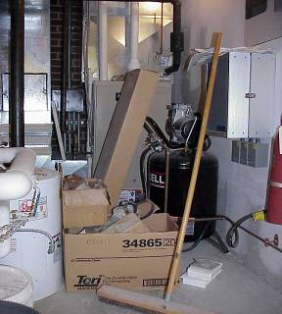
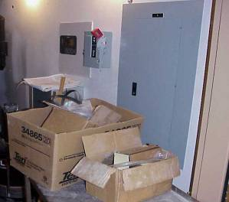
Storage Guidelines
Maintain at least a 1 m clearance from heating surfaces, air ducts, heaters, and lighting fixtures.
Storage of combustible materials in mechanical rooms is prohibited.
All storage must be at least 1 m from electrical panels. In some emergency situations it will be necessary to access these panels quickly.
Improper Mechanical Room Storage
Improper Storage in front of Electrical Panel

