Slide 1

CHAIN SURVEYING
OLDEST METHOD OF SURVEYING
HORIZONTAL MEASUREMENT
PRINCIPLE OF TRIANGULATION
USED FOR MEASURING SMALL AREAS OF LAND WHEN THE LEVEL OF ACCURACY REQUIRED IS NOT HIGH

Slide 2
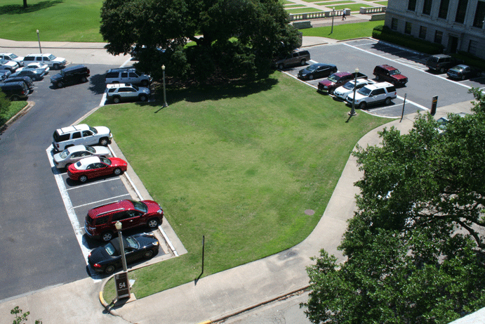
RECONNAISSANCE
WALK OVER SITE
GOOGLE EARTH!

Slide 3
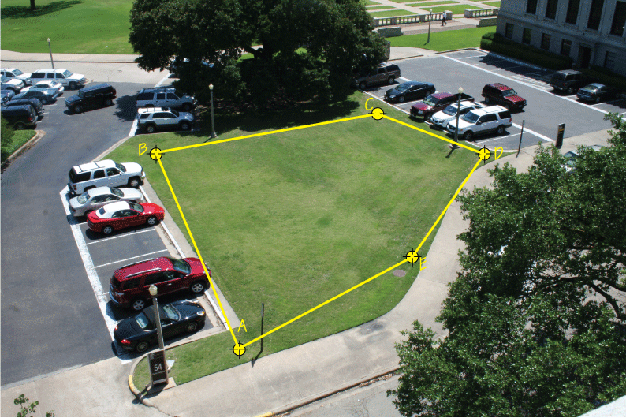
ESTABLISH SURVEY STATIONS
HUBS & TACK
LINE OF SIGHT BETWEEN STATIONS

Slide 4
PRIMARY CONTROL LINES
AB, BC, CD, DE, EF
USED TO GATHER INFORMATION AROUND PERIMETER OF SITE

Slide 5
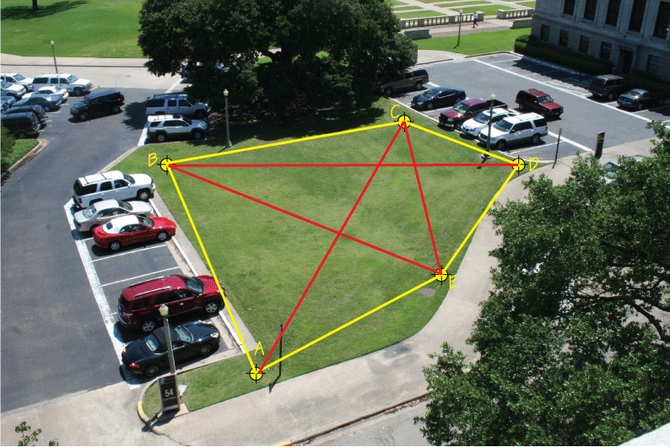
DIAGONAL CHECK LINES
AC, BD, BE, CE
USED TO TRIANGULATE CHAIN LINES
WELL-CONDITIONED TRIANGLES (ROUGHLY EQUILATERAL)

Slide 6
FRAMEWORK OF CHAIN SURVEY
ERRORS HERE ARE COSTLY – CHECK ASAP (AUTOCAD)
DOUBLE CHECK MAIN CHAIN LINES & DIAGONALS

Slide 7
ONCE THE FRAMEWORK OF THE CHAIN SURVEY IS ESTABLISHED THEN MEASUREMENTS CAN BE TAKEN FROM EACH CHAIN LINE & SURVEY STATIONS TO FIND THE LOCATION OF DISTINCT FEATURES SUCH AS PAVEMENT, KERBS, TREES ETC.

Slide 8
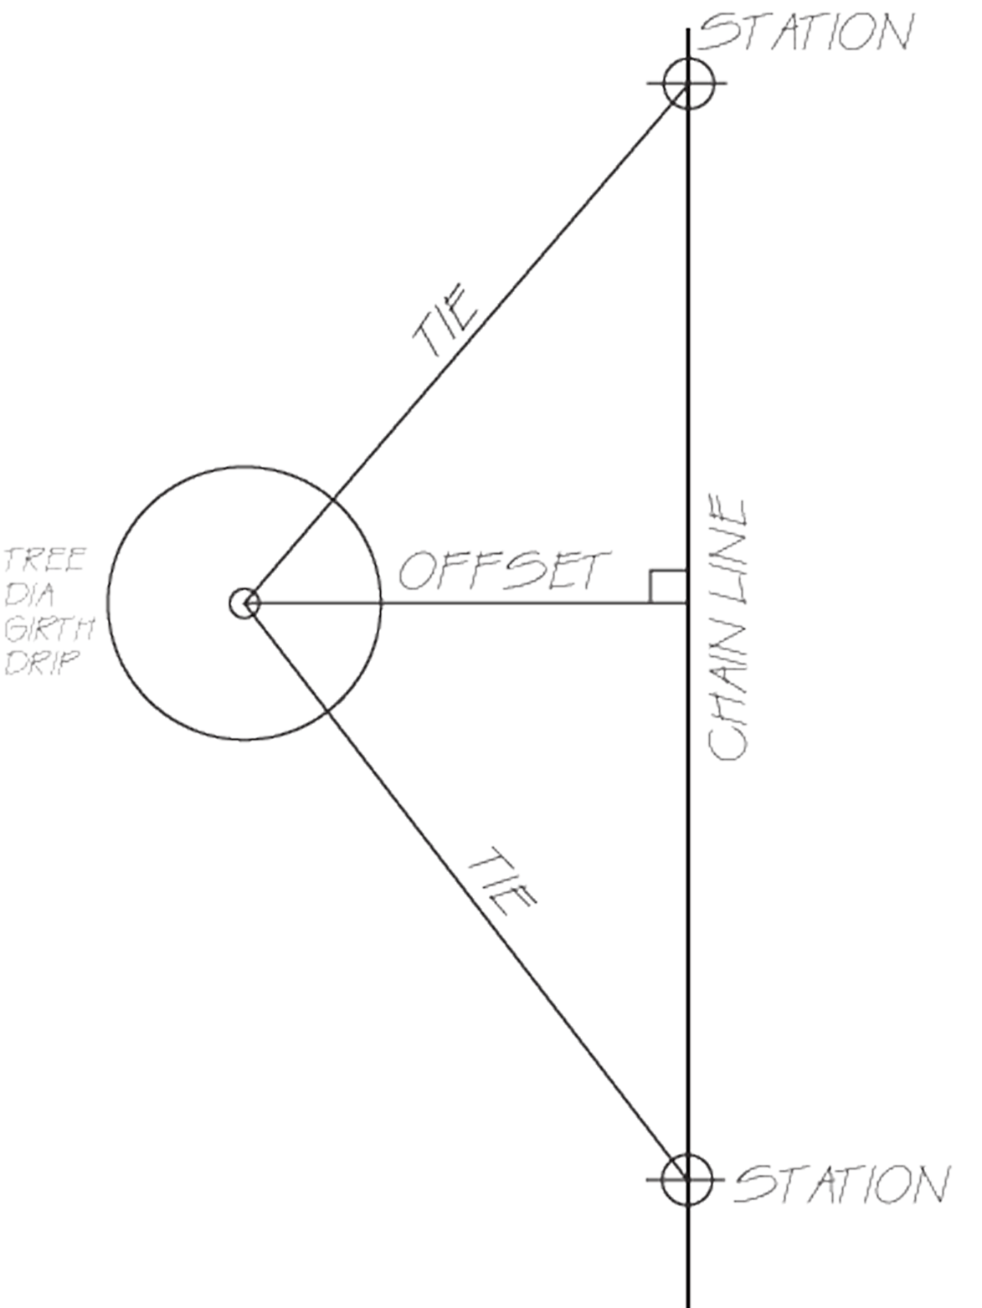
DETAIL IS ADDED TO FRAMEWORK BY TAKING TWO TYPES OF MEASUREMENTS:
1. OFFSETS
2. TIES
OFFSETS ARE MEASURED AT RIGHT ANGLES TO THE CHAIN LINE (SHORTEST DISTANCE BETWEEN POINT BEING MEASURED & CHAIN LINE)
TIES ARE MEASURED FROM A SURVEY STATION OR POINT ON A CHAIN LINE TO LOCATE THE POSITION OF A DISTINCT FEATURE. THEY ARE USUALLY USED IN PAIRS.

Slide 9
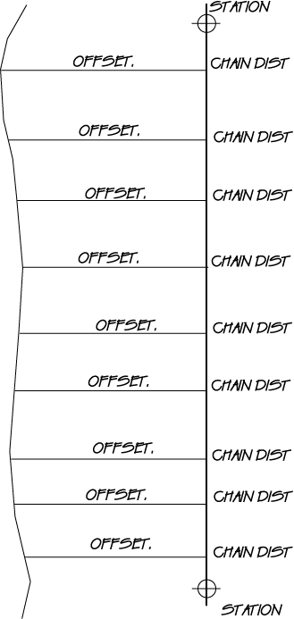
THE OUTLINE OF A PAVEMENT, BOUNDARY, DITCH OR SIMILAR LINEAR FEATURE CAN BE MEASURED BY TAKING A SERIES OF OFFSET MEASUREMENTS ALONG A CHAIN LINE.
TO LOCATE A POINT ON A DISTINCT FEATURE BOTH THE PERPENDICULAR OFFSET & THE DISTANCE ALONG THE CHAIN LINE HAVE TO BE RECORDED
TO MINIMISE MEASUREMENT ERRORS LENGTHS OF OFFSETS SHOULD BE KEPT SHORT

Slide 10
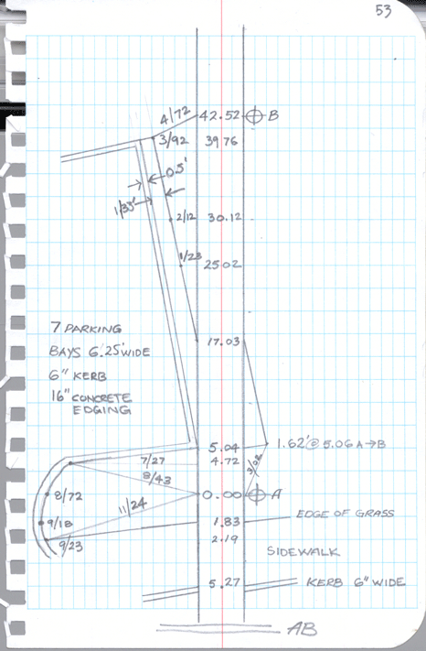
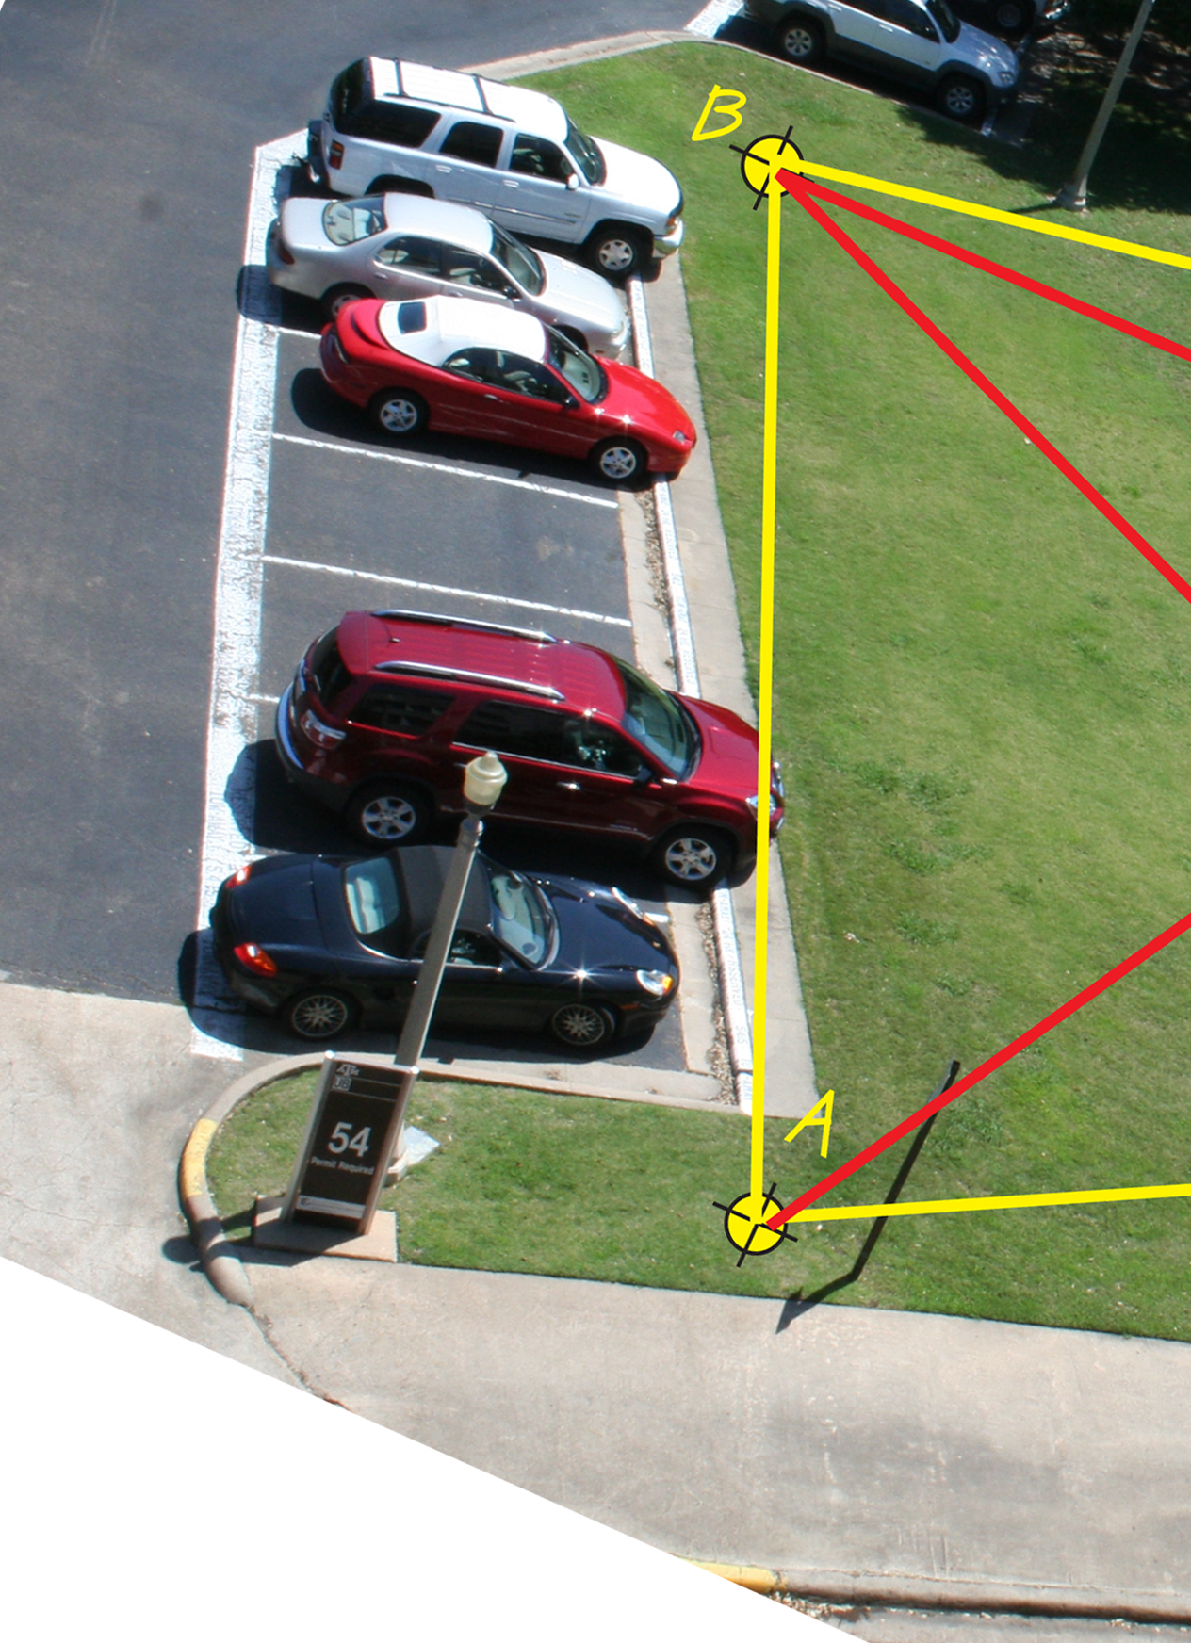

Slide 11
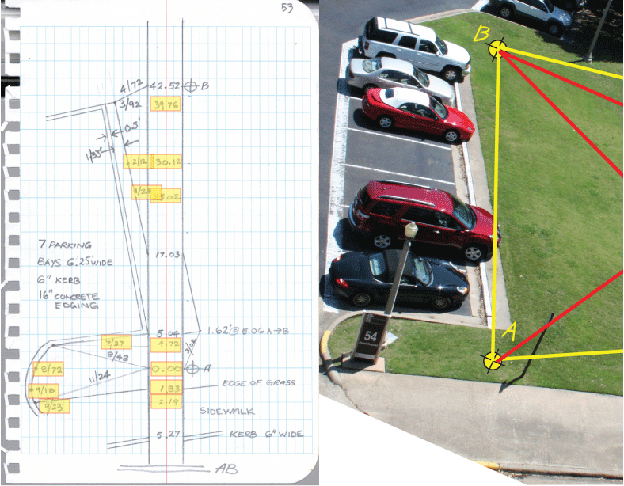

Slide 12
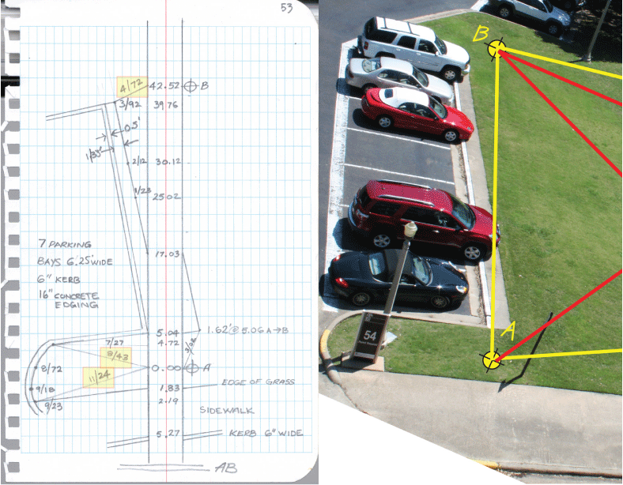

Slide 13
