Slide 1
Chapter 4 Traversing
Definitions
Traverse
Series of straight lines connecting survey stations (begin at known points as baseline)
Traversing:
Determination of horizontal coordinates by measuring horizontal angles & distances
Classification: closed vs. open
Open traverse: does not end at a known point.

Slide 2
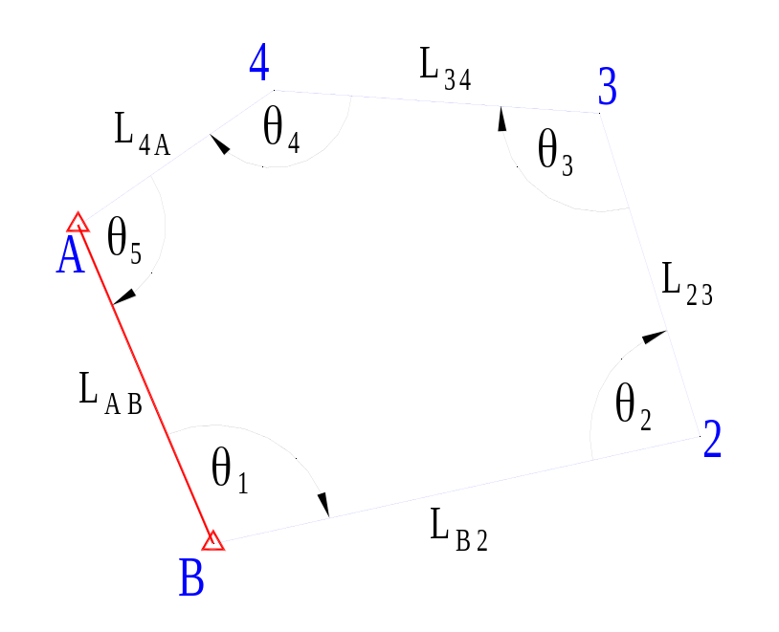
Closed Traverse
Ends at a known point with known direction;
(Polygonally) closed-loop traverse:
  A & B: known points
  (E, N) of 2, 3 & 4 to be found:
    6 unknowns
  Measure L_{B2}, L₂₃, L₃₄, L_{4A}, θ₁₋₅:
    9 observed quantities ;
9 – 6 = 3 redundant measurements
Geometrical Constraints:
Interior angles of polygon:
  Σ = (n – 2)×180°, or
Exterior angles: Σ = (n +2)×180°
Also: closure on E & N
3 constraints total
Fig. 4.1(a) Closed-loop traverse

Slide 3
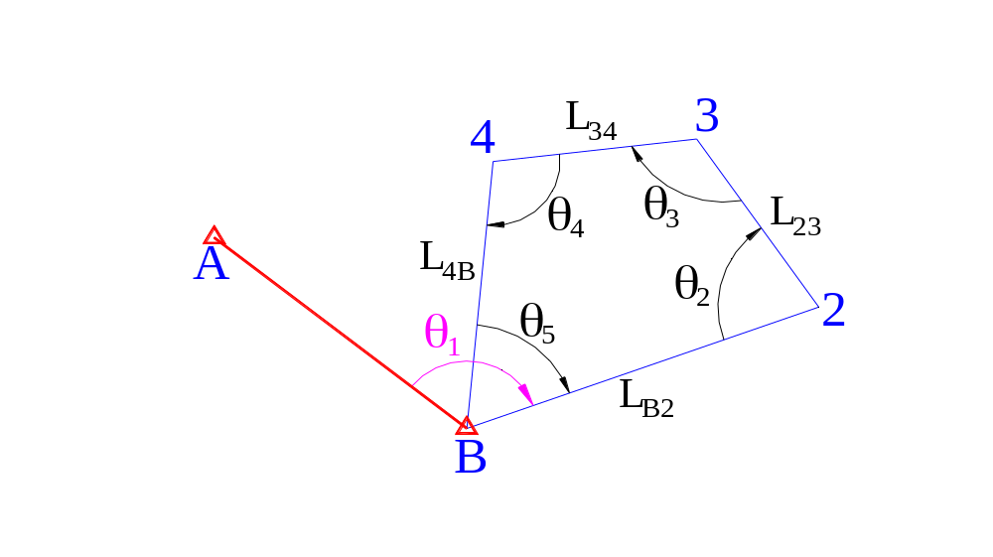
Closed-loop Traverse (2nd type)
Fig. 4.1(b)Closed-loop traverse (2nd)
Known coordinates: A & B;
Bearing of AB known;
Measure: L_{B2}, L₂₃,L₃₄, L_{4B} & θ₁₋₅

Slide 4
Closed-line / “Link” Traverse
A
D
θ₃
θ₅
θ₁
B
θ₂
T2
θ₄
L₁
L₃
C
L₂
L₄
T1
T3
Fig. 4.1(c) Closed-line traverse
Known coordinates: B & C;
Known bearings: AB & CD;
Measure: L₁₋₄ & θ₁₋₅

Slide 5
Open Traverse
A
θ₁
θ₃
B
θ₂
2
θ₄
L₁
L₂
L₃
C
L₄
1
3
Fig. 4.1(d) Open traverse
Known coordinates: B only;
Known bearing: AB only;
Measured: L₁₋₄ & θ₁₋₅
Avoid whenever possible (large errors can go undetected )

Slide 6
Choosing location of traverse stations
Some practical guidelines:
1. Min. no. of stations (each line of sight as long as possible)
2. Ensure: adjacent stations always inter-visible
3. Avoid acute traverse angles
4. Stable & safe ground conditions for instrument
5. Marked with paint or/and nail; to survive subsequent traffic, construction, weather conditions, etc.

Slide 7
Choosing location of traverse stations
6. Include existing stations / reference objects for checking with known values
7. Traverse must not cross itself
8. Network formed by stations (if any): as simple as possible
9. Do the above w/o sacrificing accuracy or
omitting important details

Slide 8
Three-tripod traversing:
Field Procedures
Target removed
from A to D
A
Exchange theodolite and target
w/o disturbing tribrach & tripod
F
C
E
B
D
Fig. 4-2 The three tripod system (plan)

Slide 9
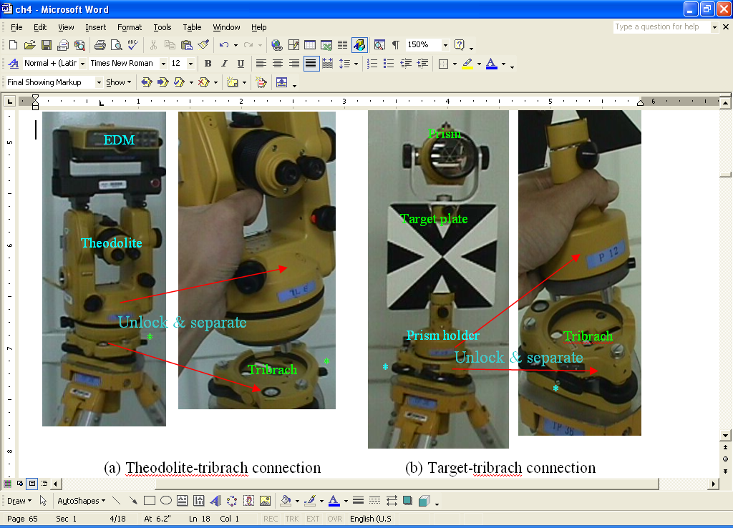
Exchanging theodolite & target

Slide 10
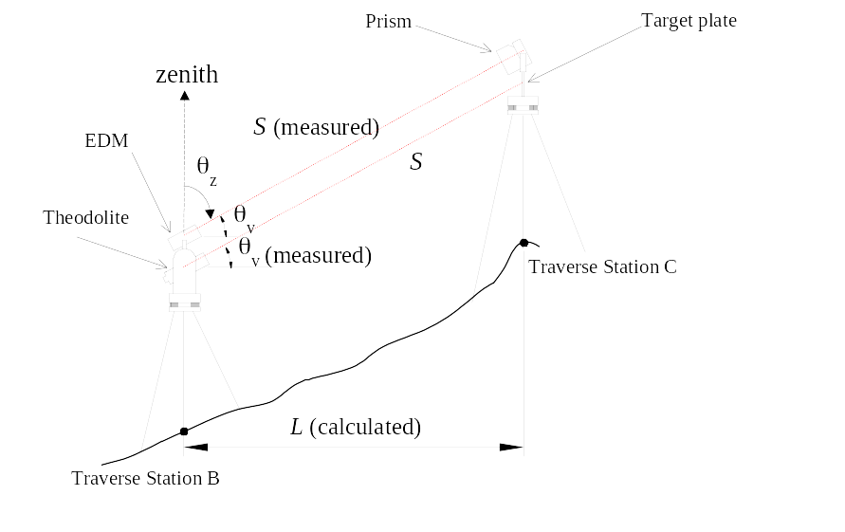
Calculation of Plan Distance
L = S sinθ_{z}

Slide 11
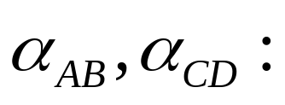
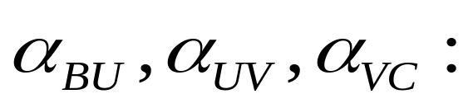
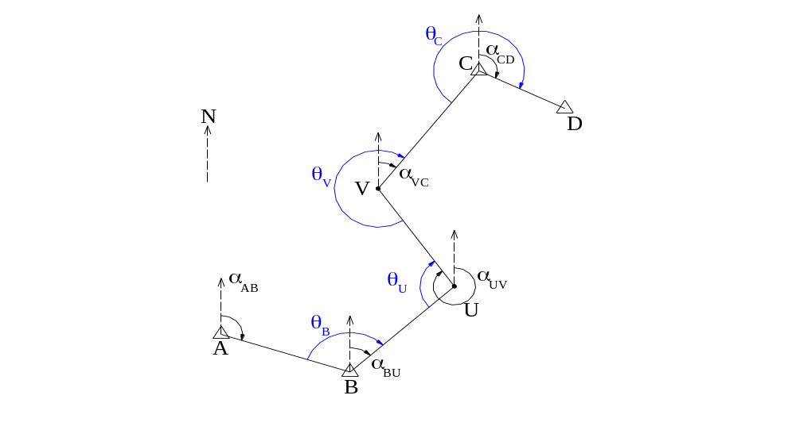
Basic Traverse Computations
calculated by control coordinates;
calculated by observed angles.
Fig. 4.5 Link traverse (A, B, C, D: known stations)

Slide 12
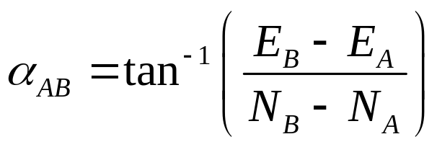
Calculation of known bearing using E,N
On Excel:
=DEGREES(ATAN2(N_{B}-N_{A},E_{B}-E_{A}))
where
DEGREES(...)
    converts angle in radians to decimal degrees
ATAN2(Δx,Δy)
    gives radian angle bet. x-axis & line from origin to (Δx,Δy)
but...
bearings measured from the north (y) rather than x-axis
hence
Let Excel treat our north as its “x”, and our east as its “y”,
Use ATAN2(ΔN,ΔE), not ATAN2(ΔE,ΔN) for bearing of vector AB

Slide 13
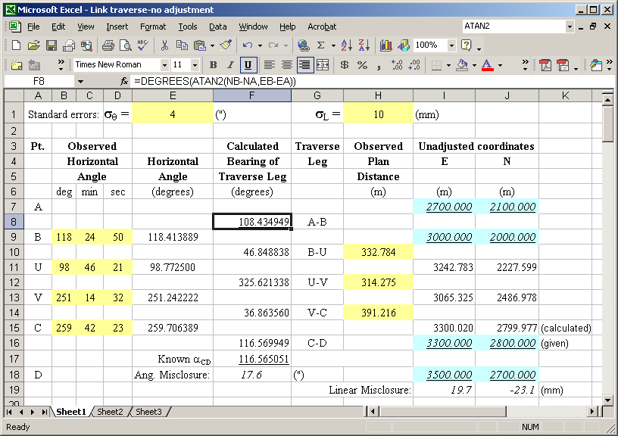
Example Calculation: known bearing

Slide 14
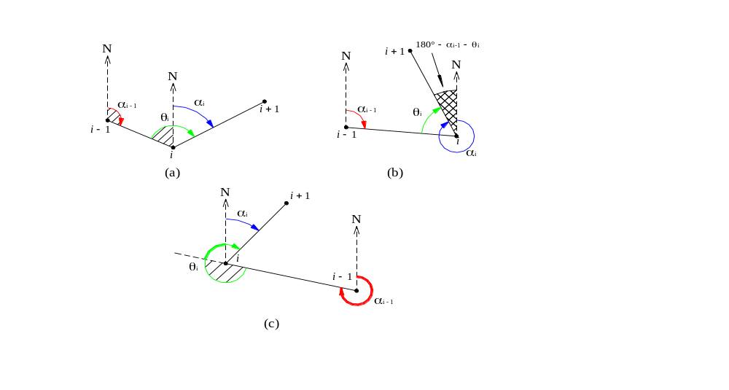
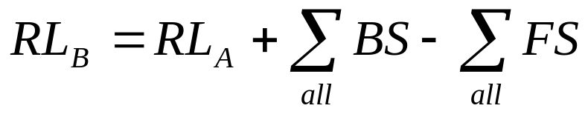
Calculating unknown bearings: 3 possible cases
This angle is
–(α_{i–1} + θ_{i} – 180°), or
Fig. 4-6 Relation between bearing and observed angle

Slide 15
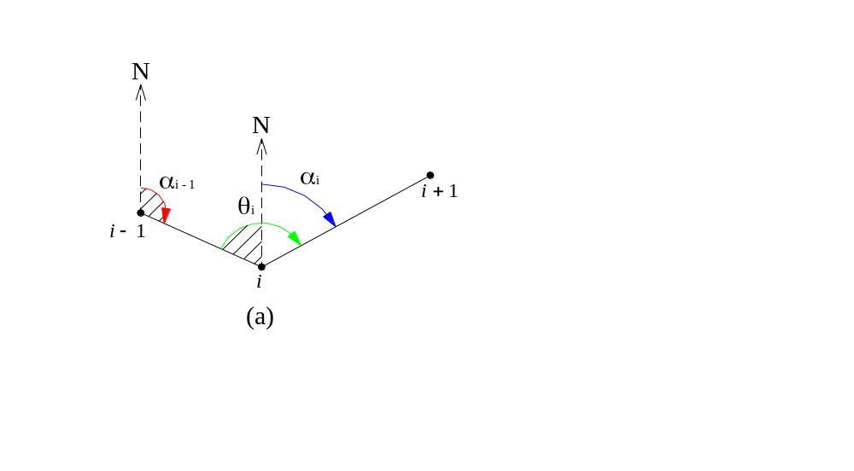
Calculating subsequent bearings
Case (a): α_{i} = α_{i-1}+ θ_{i} – 180º (i = 0, 1, 2, ...)

Slide 16
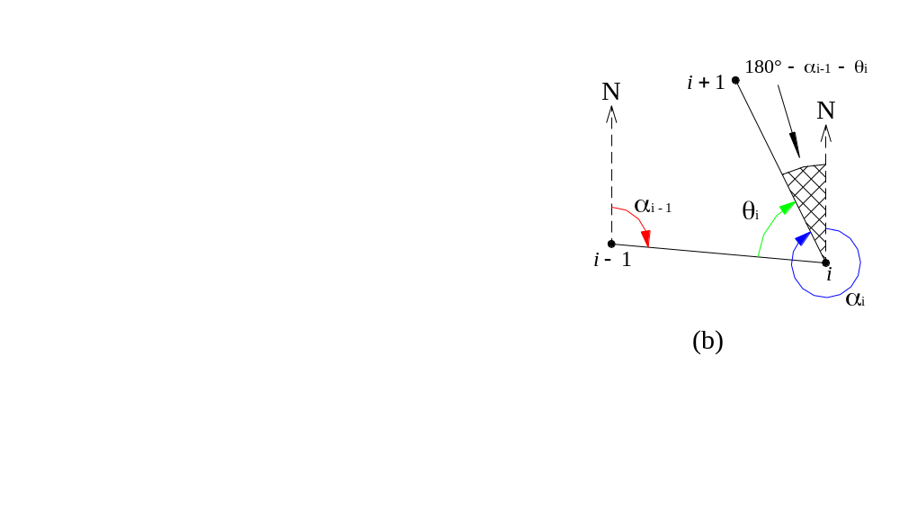
Case (b): when (α_{i-1}+ θ_{i} – 180º) < 0: α_{i} = (α_{i-1} + θ_{i} – 180º) + 360º

Slide 17
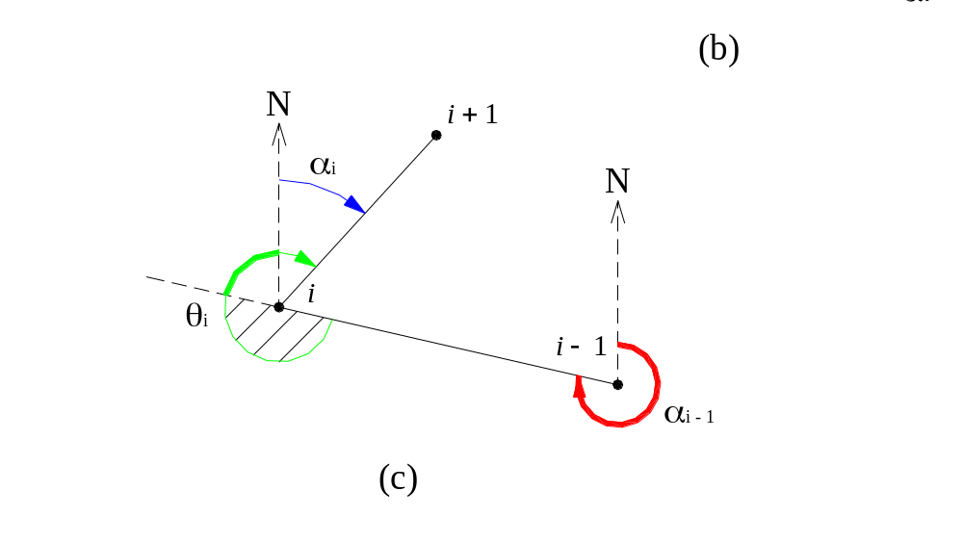
Case (c): when (α_{i-1}+ θ_{I} – 180º) > 360º: α_{i} = (α_{i-1}+ θ_{i} – 180º) – 360º

Slide 18
Calculation of Bearings on Spreadsheet

Slide 19
Excel:
MOD(n,d) = n – d*INT(n/d)
Can treat cases (a),(b),(c) by one succinct formula
In cell F10, enter
=MOD(F8+E9-180,360)
Select F9, F10 together & copy down through F16
Correct value of α_{CD} by given coordinates: entered in F17 using ATAN2

Slide 20
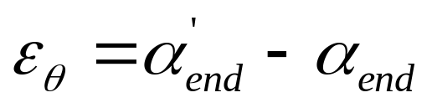

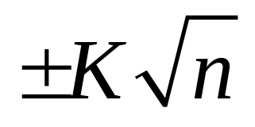
Angular Misclosure of Traverse
where observed bearing of the end traverse line
Accepted maximum angualr misclosure (in sec.):
Adopted values for constant K :
From
K = 2” (precise control work; 1” theodolites)
to
K = 60” (ordinary construction surveys; 20” theodolites)

Slide 21
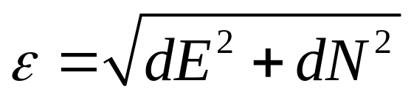
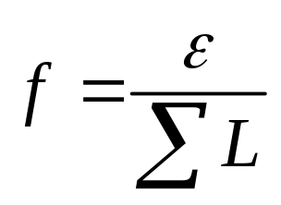




Linear Misclosure of Traverse
dE = error in easting of last station (= observed - known)
dN = error in northing of last station (= observed - known)
Fractional accuracy:
Order | Max ε_{θ} | Max f | Typical survey task
First |  | 1 in 25000 | Control or monitoring surveys
Second |  | 1 in 10000 | Engineering surveys; setting out
Third |  | 1 in 5000
Fourth |  | 1 in 2000 | Surveys over small sites

Slide 22
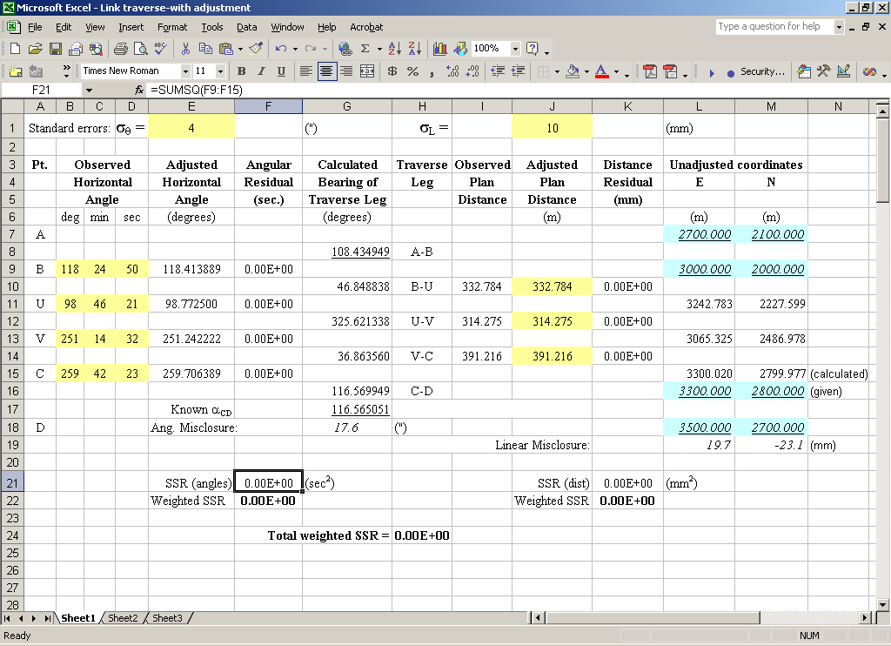
Least Squares Traverse Adjustment
Table 4-3 Formulation of LS problem (before adjustment)

Slide 23
Least Squares Traverse Adjustment (cont’)
Insert a column before column F (calculated bearings)
Turn angles in column E into pure numbers w/o formulas: Copy - Paste Special - Values (done over the same cells)
Cell F9: enter first angular residual (= observed – adjusted angle, in seconds):
  =(B9+C9/60+D9/3600-E9)*3600
Select F8 & F9 together, copy down through row 15;
Insert a column before column I (observed distances) to
store a copy of observed distances
Copy observed angles in column J, and paste values to column I.
Give columns I & J the respective headings
“Observed” & “Adjusted” plan distances
Ensure E, N coordinates computed using adjusted
(column J) not observed (column I) distances.

Slide 24
Least Squares Traverse Adjustment (cont’)
Insert a column before column K (eastings) for storing distance residuals in mm.
Cell K10: first residual (in mm):
  =(I10-J10)*1000
Select K9 (blank) & K10 together, copy formula down to row 14.
Cells F21 & K21: sum of squared residuals for angles / distances by respective formulas
        =SUMSQ(F9:F15)
        =SUMSQ(K10:K14)
  where
  SUMSQ(cells):
    sums up squared values of all the selected cells
    any blank cell treated as 0

Slide 25
Least Squares Traverse Adjustment (cont’)
Multiply the two SSRs to respective weights (inverse variances) based on SDs in E1 & J1
Add the two weighted SSRs (both dimensionless now) for total in H24 (to be minimized).
We will vary the seven variables (four angles; three distances) to minimize cell H24 while ensuring they meet all geometric constraints, i.e. make the misclosures in G18, L19 & M19 vanish.
Select Tools – Solver
Target cell: select H24, and we seek its min.
Changing cells: select the four angles & three distances in columns E and J requiring adjustment.

Slide 26
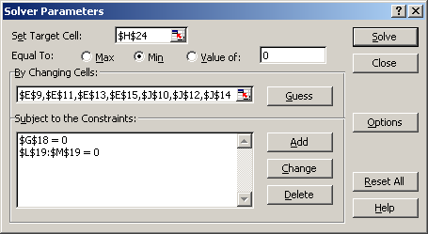
Least Squares Traverse Adjustment (cont’)
Fig. 4-8 Adjusting the link traverse

Slide 27
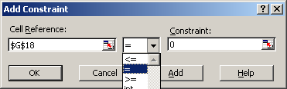
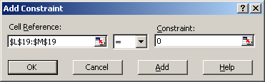
Least Squares Traverse Adjustment (cont’)
Constraints: each of the three misclosure cells must vanish.
Click Add to enter each constraint.
Click OK to return to main solver menu.
Fig. 4-9 Adding constraints

Slide 28
Least Squares Traverse Adjustment (cont’)
Solver Options: use Central Derivatives – OK.
Click Solve to obtain adjusted results.
All misclosures vanish while total SSR increased from 0 to 6.35 (min. possible when satisfying constraints).
See adjustment results in Table 4-4
Note: coordinates: viewed as by-products, not adjustment variables in traverse adjustment.

Slide 29
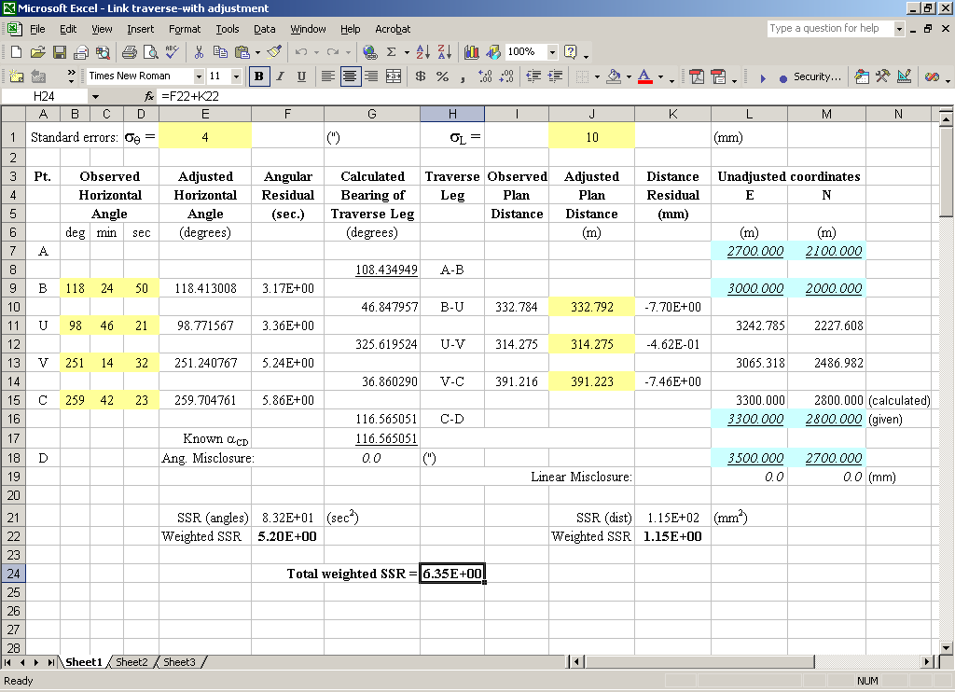
Least Squares Traverse Adjustment (cont’)
Table 4-4 Adjustment results

Slide 30
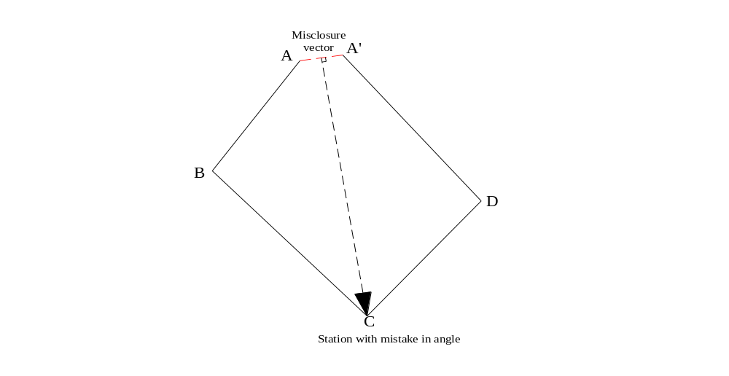
Error Detection Methods
Exceedingly large angular misclosure (e.g. a few degrees): blunder in angle(s)
To determine the responsible station:
Plot misclosure vector AA’ at open end
Draw line perpendicular to AA’ at its midpoint.
This line will point to the station where the (only) erroneous angular observation (C) too place.

Slide 31
(One) blunder in distance measurement: bearing of misclosure vector will indicate direction of the line in error
AutoCAD can help locate such angular/linear mistakes efficiently.

