Slide 1
Apply site survey and set out procedures to building and construction projects
Vertical Distances - Levelling
Measuring the height
Measuring and calculating the height of a point
relative to another point
Level
Spirit level
Water level
Optical level
Notes:
We are used to measuring heights eg your height might be 1.83m or 1.55m
The height of the seat you are sitting on might be 0.45m. Above the floor.
On the other hand the height of the seat for you (4 ROWS BACK) would be 0.45m above your feet but 4*0.45m (1.80m) above my feet.
So it’s important that we start thinking about height relative to some point.
We could talk about each row of you being on a different level.
We could use a spirit level and straight edge to find the different heights or levels.
Ancient civilisations used Water levels.
We could use the ceiling to measure up to and down from to get difference in height or level from the back row to the front row.
That is OUR HORIZONTAL PLANE
Show an OPTICAL LEVEL and TRIPOD

Slide 2
A surveying optical telescope
line of
collimation
diaphragm
focusing screw
eyepiece
Focusing
object lens
focusing lens
object lens
focusing lens
1. Rotate eyepiece to give a sharp,
clear image of the cross hairs
cross hairs
2. Rotate focusing screw to give a
sharp, clear image of the object
being observed.
Typical diaphragms - in different makes of instrument
The aim of focusing is to remove (eliminate) PARALLAX

Slide 3
Pond Bubble
When pond bubble is centred the instrument’s standing axis
is approximately vertical.
The compensators in the instrument take over and adjust
the optical Line of Collimation so that it is horizontal (hopefully)
When the instrument is rotated the compensators ensure that
a horizontal plane of collimation is swept out (hopefully)

Slide 4
Parallax
When focussing any optical instrument it is vitally important
that we eliminate Parallax.
Move the eye up and down (or from left to right) over the
eyepiece of the telescope.
If the cross hairs move relative to the object being observed
then Parallax exists and the focussing is not satisfactory.

Slide 5
Elimination of Parallax
Focus the crosshairs
(using the Eyepiece)
Focus the object
(using the Focussing screw)
Move eye
up and down
over the
eyepiece
Parallax exists and
must be removed by
better focussing
Parallax has
been removed
Therefore focussing
is good
Images appear
to move

Slide 6
Levelling Staff
Levelling
Height of
the Plane of Collimation
(HPC)
S1
S2
Reduced
Level of B
(unknown)
RL A (known)
Measured and Calculated
Level of A
Reduced
Level of A
RL B
A
B
DATUM
HPC = RL A + S1
HPC = RL A + S1
RL B = HPC - S2
DATUM

Slide 7
Datum
Could be our
own Datum
- Assumed Datum
- Arbitrary Datum
RL
- Site Datum
or
A National Datum
- Australian Height Datum
AHD
AHD Australian Height Datum - the datum used for the
determination of elevations in Australia. The determination
used a national network of bench marks and tide gauges,
and set mean sea level as zero elevation.
The Datum that we use is an assumed, arbitrary or site datum
known as Reduced Level, short RL.

Slide 8
Bench Marks (BM)
Reduced Level
Bottom of
Level Staff
BM
Arrow or Crowsfoot
TBM
mark
Section through
wall
Temporary BM

Slide 9
Some Terminology
BS
S1
RL C
RL A
RL B
C
A
B
Level staff on A
Back Sight (BS) reading is first reading

Slide 10
FS
S2
RL C
RL A
RL B
C
A
B
Level staff on A
Back Sight (BS) reading is first reading
Level staff on B
Fore Sight (FS) reading is last reading
Move instrument to new position

Slide 11
S3
BS
RL C
RL A
RL B
C
A
B
CP
Move instrument to new position
Level staff stays on B
The instrument has changed its position about point B
Point B is known as a Change Point
(CP)
2nd instrument position starts with BS to B

Slide 12
FS
S3
S4
BS
RL C
RL A
RL B
C
A
B
and finishes with
FS to C

Slide 13
HPC
HPC
BS
FS
BS
FS
RL C
RL A
RL B
C
A
B
(CP)
RL A is known
HPC =
RL A + BS
RL B =
HPC - FS
Now the RL B is known
So we can repeat the process
HPC =
RL B + BS
RL C =
HPC - FS
Generally : HPC = Known RL + Back Sight
Unknown RL = HPC - Fore Sight

Slide 14
Summary of Levelling Procedure
When the level has been set up we always start with a BS to
a point whose RL is known
- such as an BM or a TBM
The last reading at any instrument position is always a FS
Either the instrument moves or the staff moves -
never move both
We must always finish levelling at a point of known RL value
- such as an BM or a TBM
always close your levelling

Slide 15
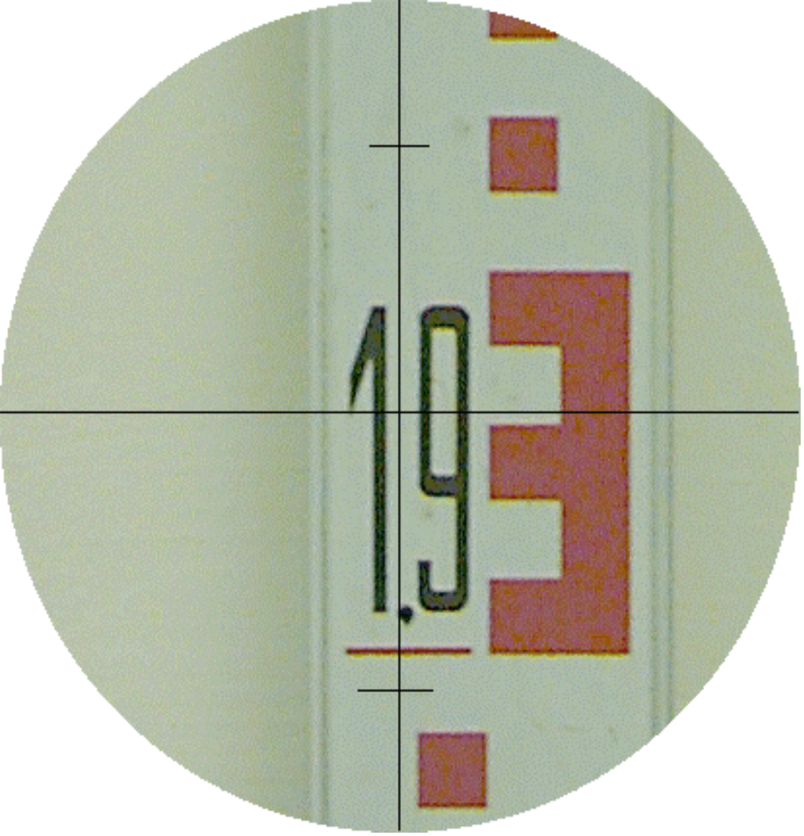
Reading an E-type levelling staff
The value is ?
Read value at
the
horizontal
cross hair
1.932
1.930
1.920
1.910
1.900

Slide 16
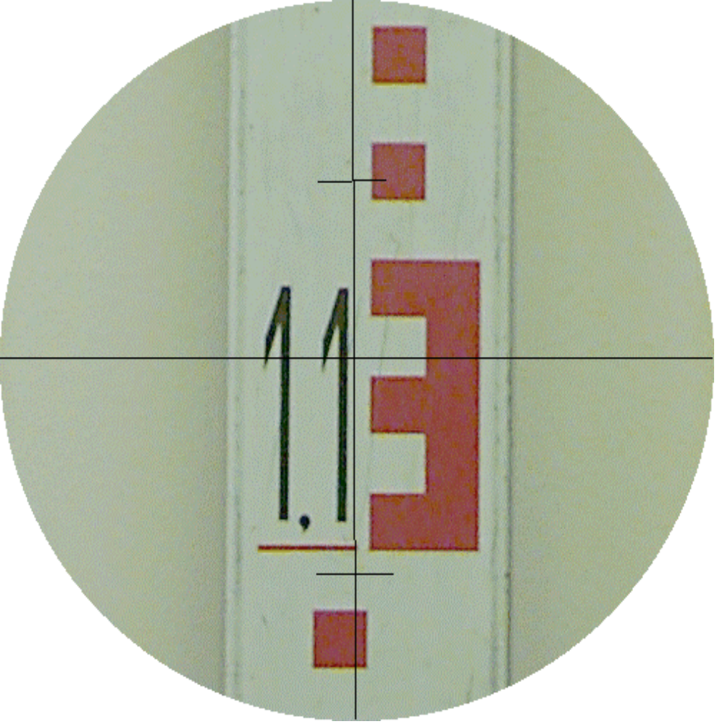
one more reading
The value is ?
1.133
1.130
1.120
1.110
1.100

Slide 17
It is necessary to practice with a real level and staff
Practical session – Will be today inside or outside
depending on weather conditions
Usage of - Level and Tripod
N.B. Please - ALWAYS GET YOURSELF
ORGANISED BEFORE GETTING THE EQUIPMENT
i.e. pencils - notes - field books etc.
Carry out : Setting up an automatic level
Eliminating PARALLAX
Reading level staff
When you finish the levelling exercise you can leave
the gear inside the locker room (access code CZ016)

Slide 18
Levelling
HPC
HPC
BS
FS
BS
FS
RL C
RL A
RL B
C
A
B
(CP)
RL A is known
HPC =
RL A + BS
RL B =
HPC - FS
Now the RL B is known
So we can repeat the process
HPC =
RL B + BS
RL C =
HPC - FS
Generally : HPC = Known RL + Back Sight
Unknown RL = HPC - Fore Sight

Slide 19
Summary of Levelling Procedure
When the level has been set up we always start with a BS
to a point whose RL is known
- such as an OBM or a TBM
The last reading at any instrument position is always a FS
i.e.always end with a FS
Either the instrument moves or the staff moves -
never move both
We must always finish levelling at a point of known RL value
- such as an BM or a TBM
always close your levelling

