Slide 1
Apply site survey and set out procedures to building and construction projects
Vertical Distances - Levelling
Measuring the height
Measuring and calculating the height of a point
relative to another point
Equipment used that can be used:
Level
Spirit level
Water level
Optical level
Notes:
We are used to measuring heights eg your height might be 1.83m or 1.55m
The height of the seat you are sitting on might be 0.45m. Above the floor.
On the other hand the height of the seat for you (4 ROWS BACK) would be 0.45m above your feet but 4*0.45m (1.80m) above my feet.
So it’s important that we start thinking about height relative to some point.
We could talk about each row of you being on a different level.
We could use a spirit level and straight edge to find the different heights or levels.
Ancient civilisations used Water levels.
We could use the ceiling to measure up to and down from to get difference in height or level from the back row to the front row.
That is OUR HORIZONTAL PLANE
Show an OPTICAL LEVEL and TRIPOD

Slide 2
Levelling find the RL at B
Levelling Staff
Height of
the Plane of Collimation
(HPC)
S1
S2
Reduced
Level of B
(unknown)
RL A (known)
Measured and Calculated
Level of A
Reduced
Level of A
RL B
A
B
HPC = RL A + S1
HPC = RL A + S1
RL B = HPC - S2

Slide 3
Levelling & Change Point at B
BS
S1
RL C
RL A
RL B
C
A
B
Level staff on A
Back Sight (BS) reading is first reading

Slide 4
FS
S2
RL C
RL A
RL B
C
A
B
Level staff on A
Back Sight (BS) reading is first reading
Level staff on B
Fore Sight (FS) reading is last reading
Move instrument to new position

Slide 5
S3
BS
RL C
RL A
RL B
C
A
B
CP
Move instrument to new position
Level staff stays on B
The instrument has changed its position about point B
Point B is known as a Change Point
(CP)
2nd instrument position starts with BS to B

Slide 6
FS
S3
S4
BS
RL C
RL A
RL B
C
A
B
and finishes with
FS to C

Slide 7
HPC
HPC
BS
FS
BS
FS
RL C
RL A
RL B
C
A
B
(CP)
RL A is known
HPC =
RL A + BS
RL B =
HPC - FS
Now the RL B is known
So we can repeat the process
HPC =
RL B + BS
RL C =
HPC - FS
Generally : HPC = Known RL + Back Sight
Unknown RL = HPC - Fore Sight

Slide 8
Summary of Levelling Procedure
When the level has been set up we always start with a BS to
a point whose RL is known
- such as an BM or a TBM
The last reading at any instrument position is always a FS
Either the instrument moves or the staff moves -
never move both
We must always finish levelling at a point of known RL value
- such as an BM or a TBM
always close your levelling

Slide 9
Levelling
HPC
HPC
BS
FS
BS
FS
RL C
RL A
RL B
C
A
B
(CP)
RL A is known
HPC =
RL A + BS
RL B =
HPC - FS
Now the RL B is known
So we can repeat the process
HPC =
RL B + BS
RL C =
HPC - FS
Generally : HPC = Known RL + Back Sight
Unknown RL = HPC - Fore Sight

Slide 10
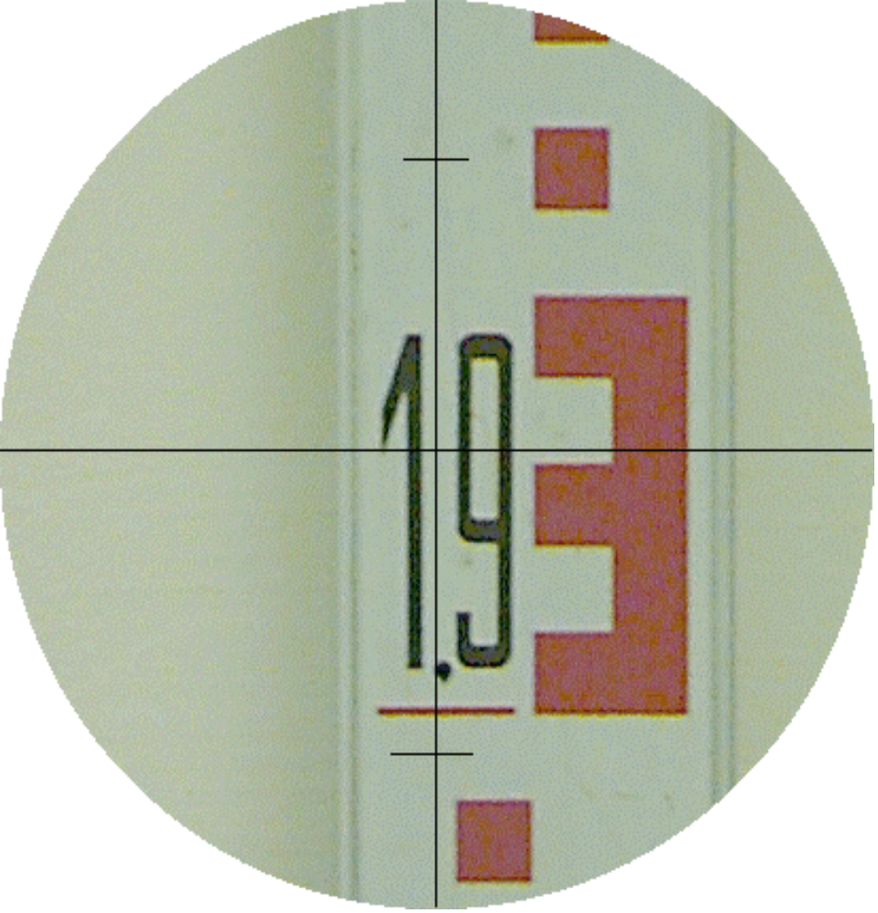
Reading an E-type levelling staff
The value is ?
Read value at
the
horizontal
cross hair
1.932
1.930
1.920
1.910
1.900

Slide 11
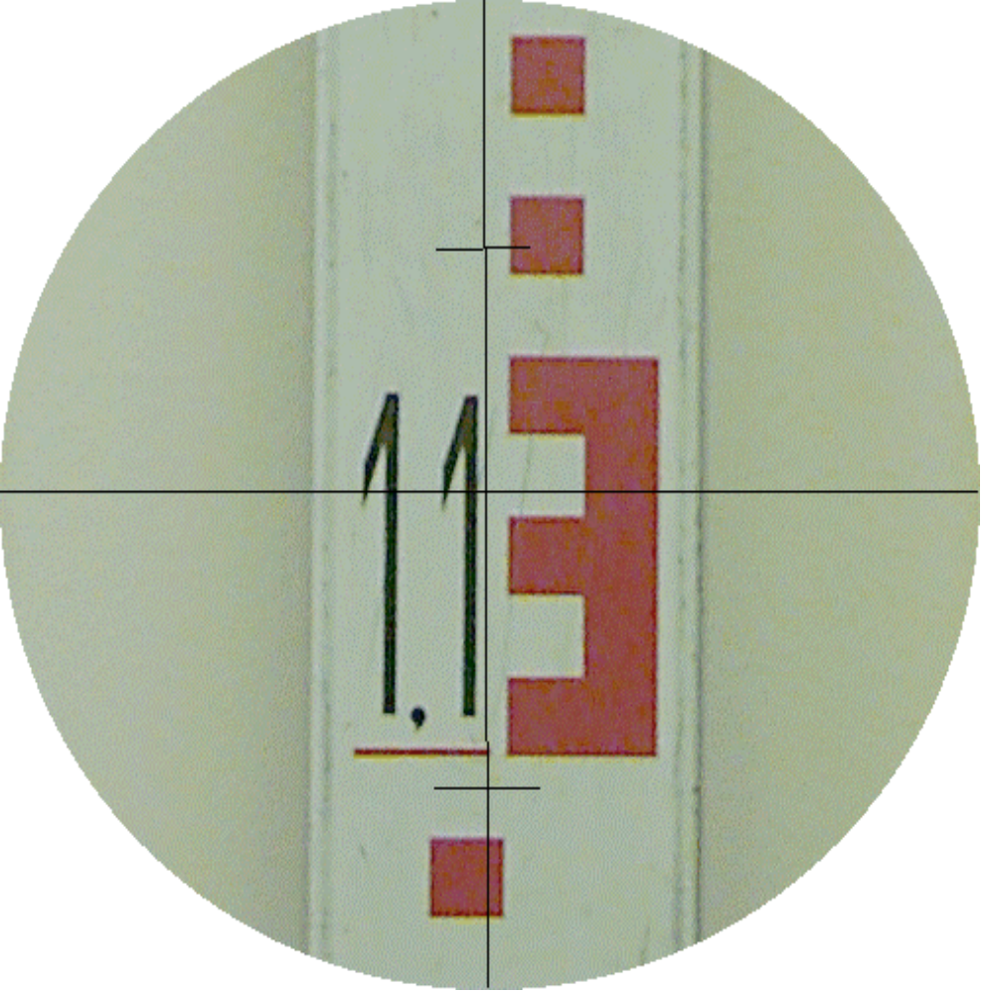
one more reading
The value is ?
1.133
1.130
1.120
1.110
1.100

Slide 12
Summary of Levelling Procedure
When the level has been set up we always start with a BS
to a point whose RL is known
- such as an OBM or a TBM
The last reading at any instrument position is always a FS
i.e.always end with a FS
Either the instrument moves or the staff moves -
never move both
We must always finish levelling at a point of known RL value
- such as an BM or a TBM
always close your level run & check misclosure

