Slide 1
Trigonometry Topics
Pythagoras Theorm
Radian Measure
The Unit Circle
Reference Angles
Trigonometric Functions

Slide 2
When you have a right triangle there are 5 things you can know about it..
the lengths of the sides (A, B, and C)
the measures of the acute angles (a and b)
(The third angle is always 90 degrees)
b
C
A
a
B

Slide 3
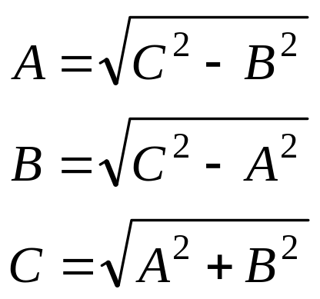
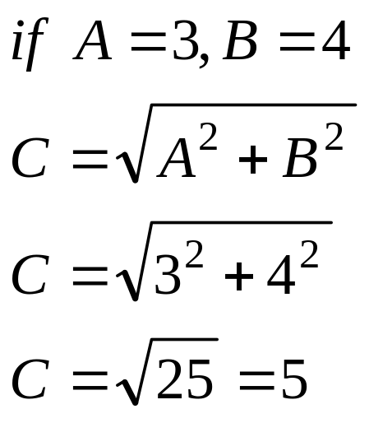
If you know two of the sides, you can use the Pythagorean theorem to find the other side
b
C
A = 3
a
B = 4

Slide 4
And if you know either angle, a or b, you can subtract it from 90 to get the other one: a + b = 90
This works because there are 180º in a triangle and we are already using up 90º
For example:
if a = 30º
b = 90º – 30º
b = 60º
b
C
A
a
B

Slide 5
But what if you want to know the angles?
Well, here is the central insight of trigonometry:
If you multiply all the sides of a right triangle by the same number (k), you get a triangle that is a different size, but which has the same angles:
k(C)
b
C
b
A
k(A)
a
a
B
k(B)

Slide 6
How does that help us?
Take a triangle where angle b is 60º and angle a is 30º
If side B is 1unit long, then side C must be 2 units long, so that we know that for a triangle of this shape the ratio of side B to C is 1:2
There are ratios for every
shape of triangle!
C = 2
60 º
A = 1
30º
B

Slide 7
Radian Measure
To talk about trigonometric functions, it is helpful to move to a different system of angle measure, called radian measure.
A radian is the measure of a central angle whose intercepted arc is equal in length to the radius of the circle.

Slide 8
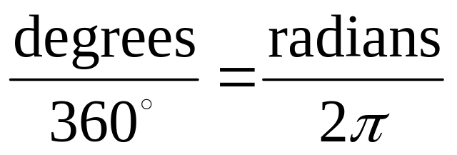
Radian Measure
There are 2π radians in a full rotation -- once around the circle
There are 360° in a full rotation
To convert from degrees to radians or radians to degrees, use the proportion
Back to contents page

Slide 9
The Unit Circle
Imagine a circle on the coordinate plane, with its center at the origin, and a radius of 1.
Choose a point on the circle somewhere in quadrant I.

Slide 10
The Unit Circle
Connect the origin to the point, and from that point drop a perpendicular to the x-axis.
This creates a right triangle with hypotenuse of 1.

Slide 11
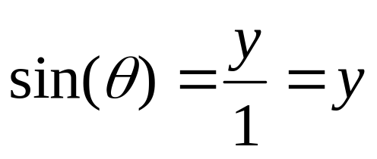
The Unit Circle
θ is the angle of rotation
The length of its legs are the x- and y-coordinates of the chosen point.
Applying the definitions of the trigonometric ratios to this triangle gives
1
y
x

Slide 12
The Unit Circle
The coordinates of the chosen point are the cosine and sine of the angle θ.
  This provides a way to define functions sin(θ) and cos(θ) for all real numbers θ.
  The other trigonometric functions can be defined from these.

Slide 13
Around the Circle
As that point moves around the unit circle into quadrants II, III, and IV, the new definitions of the trigonometric functions still hold.
II
x-/y+
I
x+/y-
III
x-/y-
IV
x+/y-
Back to slide 11

Slide 14
Reference Angles
The angles whose terminal sides fall in quadrants II, III, and IV will have values of sine, cosine and other trig functions which are identical (except for sign) to the values of angles in quadrant I.
The acute angle which produces the same values is called the reference angle.

Slide 15
Reference Angles
The reference angle is the angle between the terminal side and the nearest arm of the x-axis.
The reference angle is the angle, with vertex at the origin, in the right triangle created by dropping a perpendicular from the point on the unit circle to the x-axis.

Slide 16
Quadrant II
Original angle
In quadrant II,
  ►sin(θ) is positive
  ►cos(θ) is negative
  ►tan(θ) is negative
Reference angle
Back to slide 8

Slide 17
Quadrant III
Original angle
In quadrant III,
  ►sin(θ) is negative
  ►cos(θ) is negative
  ►tan(θ) is positive
Reference angle

Slide 18
Quadrant IV
Reference angle
In quadrant IV,
  ►sin(θ) is negative
  ►cos(θ) is positive
  ►tan(θ) is negative
Original angle
Back to contents page

Slide 19
Trigonometric Functions!
There are three sets of ratios for any triangle
They are mysteriously named:
sin…short for sine
cos…short for cosine
tan…short or tangent
and the ratios are already calculated, you just need to use them

Slide 20
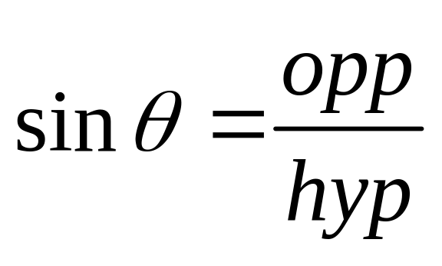
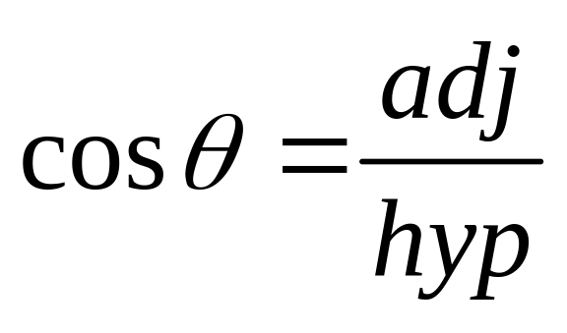
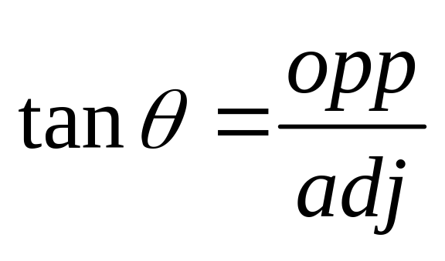
So what are the formulas?
Tan is Opposite over Adjacent
Sin is Opposite over Hypotenuse
Cos is Adjacent over Hypotenuse
SOH
CAH
TOA

Slide 21
Some terminology:
Before we can use the ratios we need to get a few terms straight
The hypotenuse (hyp) is the longest side of the triangle – it never changes
The opposite (opp) is the side directly across from the angle you are considering
The adjacent (adj) is the side right beside the angle you are considering

Slide 22
A picture always helps…
looking at the triangle in terms of angle b
A is the adjacent (near the angle)
b
C
A
B is the opposite (across from the angle)
B
Longest
b
Near
C is the hypotenuse
hyp
adj
opp
Across

Slide 23
But if we switch angles…
looking at the triangle in terms of angle a
A is the opposite (across from the angle)
C
A
a
B is the adjacent (near the angle)
B
Longest
C is the hypotenuse
hyp
Across
opp
a
Back to contents page
adj
Near

