Slide 1
Setting-out of buildings and land survey for construction industry
Setting-out of a building – marking of a building position, size and shape in terrain.
Setting-out plan – plan where a projected building is drawn and numeric values of setting-out elements are written.
1

Slide 2
Land survey for setting-out:
creation of a setting-out net (measurement, calculation and marking of survey stations which can be used for setting-out)
setting-out of the spatial position of a building = setting-out of the building main position line (= frontage), setting-out of the axis or the main points of a linear structure (road, railway, watercourse)
detailed setting-out = setting-out of a building size and shape.

Slide 3
Setting-out nets:
planimetric networks – an aligning base, a traverse or an orthogonal setting-out net. The net is usually connected to points of S-JTSK (the coordinate system of Křovák’s projection).
altimetric networks – either independent of the planimetric network or the points of the planimetric network are used.

Slide 4
Setting-out accuracy is given and it is judged according to the standards:
ČSN 73 0420 – 1: Accuracy of setting out of constructions. Fundamental requirements.
ČSN 73 0420 – 2: Accuracy of setting out of constructions. Setting out deviations.

Slide 5
Setting-out of a position
1. Setting-out of an angle
2. Setting-out of a point position
3. Setting-out of a straight line
4. Setting-out of a circular arc

Slide 6
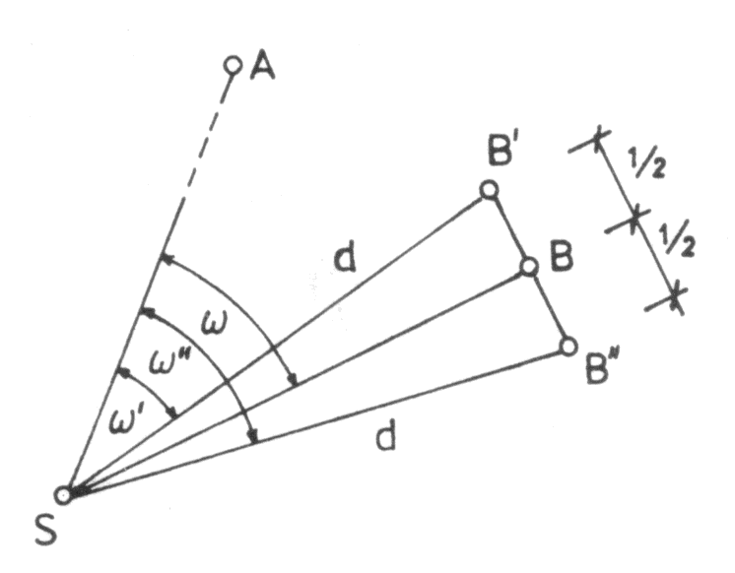
1. Setting-out of an angle
1. 1 Setting-out of a general angle
- by means of a theodolite or a total station
task: horizontal angle ω should be set out at the survey station S from point A

Slide 7
Procedure
centering and levelling of the instrument at the survey station S
pointing at A in the face left position of the telescope and horizontal circle reading
adding the angle ω to this reading and „setting“ calculated value by means of the alidade turning
marking of point B´ in this direction in required distance d (if high accuracy is not necessary → result)
if high accuracy is demanded, setting-out of the angle ω has to be repeated in the face right position of the telescope and point B´´ is marked. In the middle of points B´and B´´ → B (result).

Slide 8
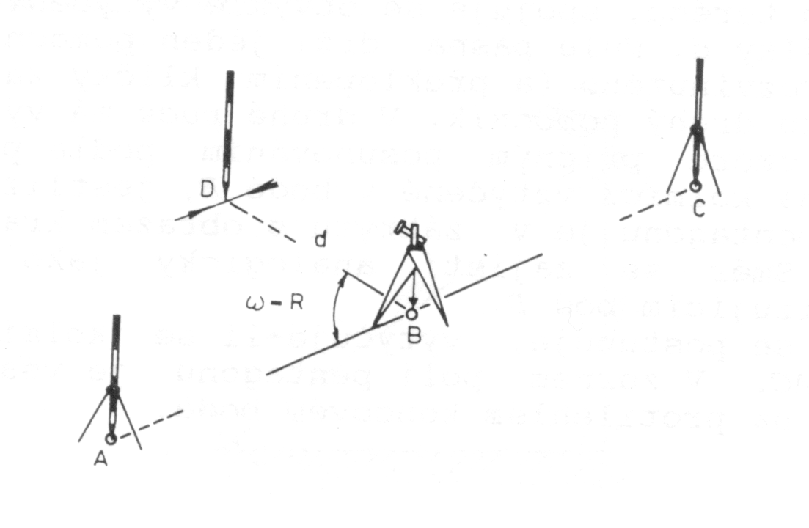
1.2 Setting-out of the right angle
by means of a theodolite
by means of a pentagonal double prism (if high accuracy is not demanded)

Slide 9
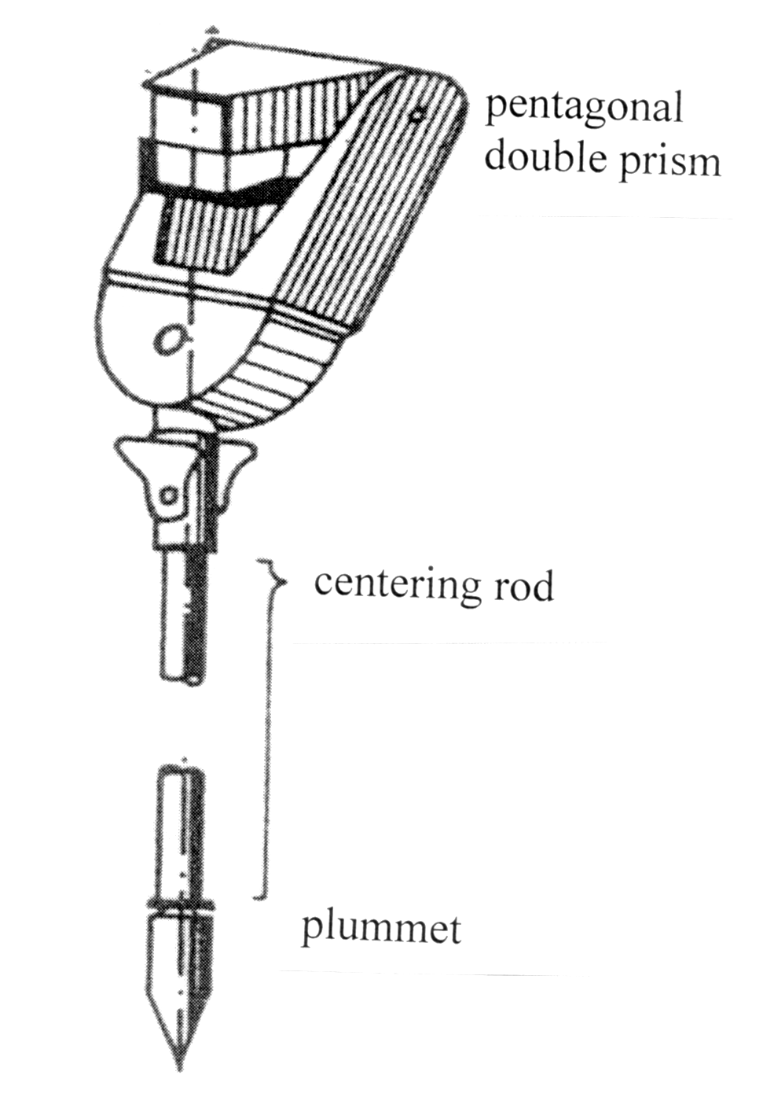
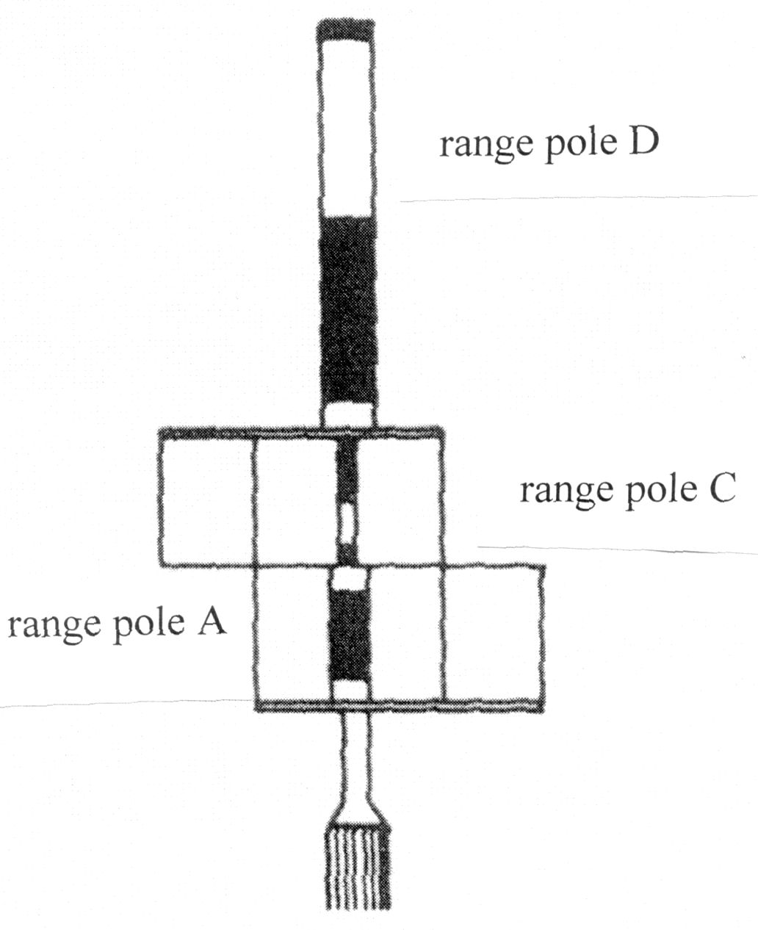

Slide 10
images of the range poles at points A and C have to create one vertical line in the field of view of the pentagonal prism → then the prism is above point B
the range pole at point D (it is observed by eye closely above or under the prism) has to be in the same vertical line
angular accuracy of the setting-out is 0,04 gon, therefore the prism is used for the maximum distance 40 m

Slide 11
2. Setting-out of a point position
  2.1 setting-out from rectangular coordinates,
  2.2 setting-out from polar coordinates,
  2.3 setting-out of a point by forward intersection,
2.4 setting-out of a point as the intersection of two straight lines.

Slide 12
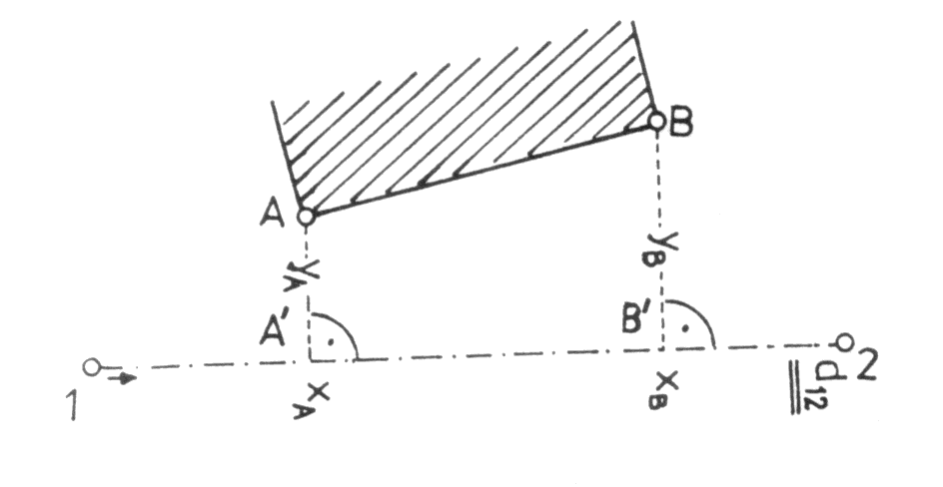
2.1 Setting-out from rectangular coordinates
Task: setting-out of the building main position line defined by points A and B. Rectangular coordinates x_{A}, x_{B}, y_{A}, y_{B} in reference to a part of setting-out network given by points 1 and 2 are known.

Slide 13
The foot of a perpendicular A´ is set out by means of a theodolite at point 1. Point A´ is in the distance x_{A} from point 1. This distance is called stationing and it is measured by a tape. The right angle is set out by a theodolite at point A´ and distance y_{A} (called offset) is measured by a tape. The same procedure is used for setting-out of point B.
If high accuracy is not demanded, points A and B can be set out by means of a pentagonal double prism and a tape.

Slide 14
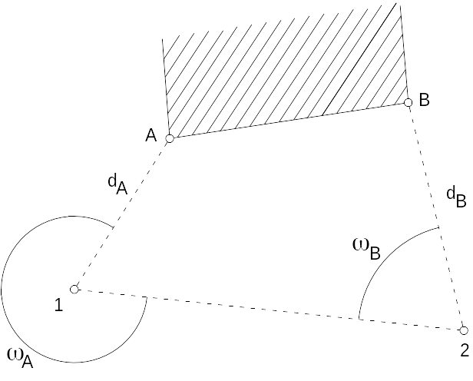
2.2 Setting-out from polar coordinates

Slide 15
setting-out elements = the horizontal angles ω_{A}, ω_{B} and the horizontal distances d_{A}, d_{B}
the procedure of horizontal angles setting-out is described in 1.1 (setting-out of a general angle)
this is the most frequent method of setting-out of a point position especially if a total station is available

Slide 16
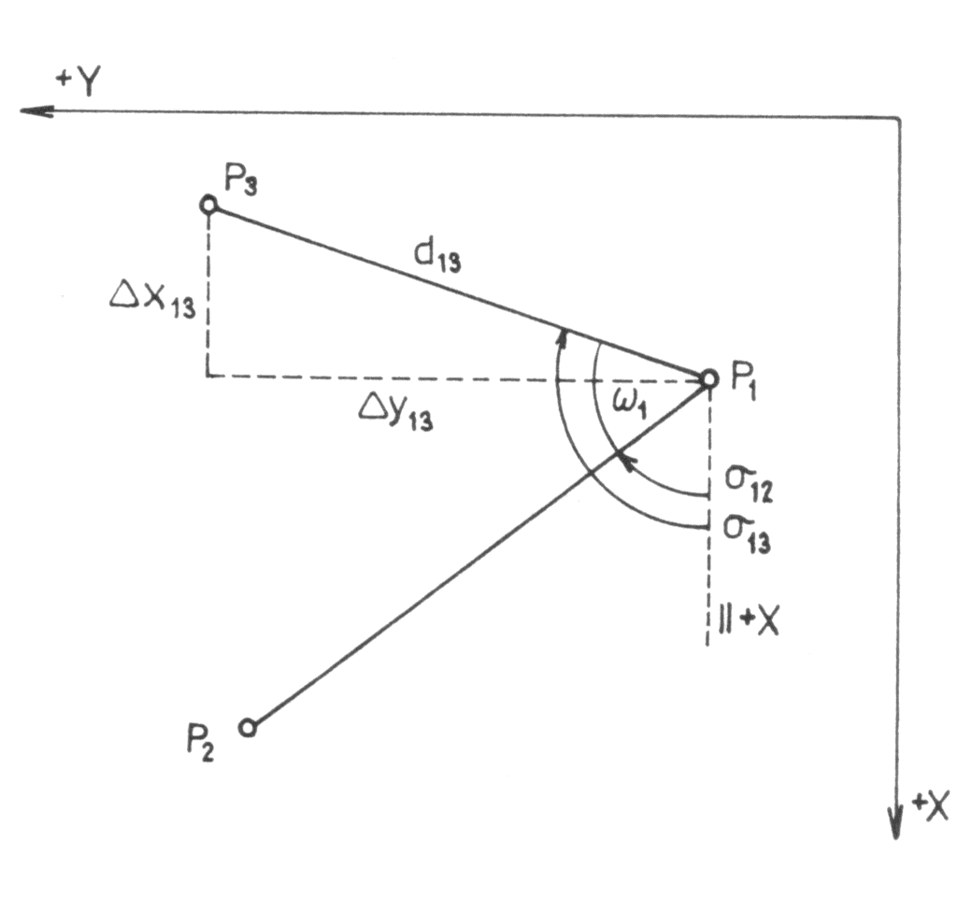
Calculation of polar setting-out elements using coordinates
Given: rectangular coordinates of points P₁, P₂ and P₃:
P₁ – survey station,
P₂ – orientation point,
P₃ – point which is set out.
Calculate:
horizontal distance d₁₃,
horizontal angle ω₁

Slide 17
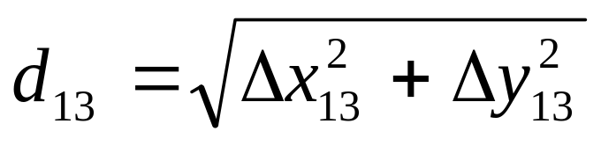
First of all the bearings σ₁₂ and σ₁₃ are calculated using coordinates of the points P₁, P₂ and P₃ (see lecture 2).
The the horizontal angle ω₁:
ω₁ = σ₁₃ – σ₁₂ .
The horizontal distance d₁₃:

Slide 18
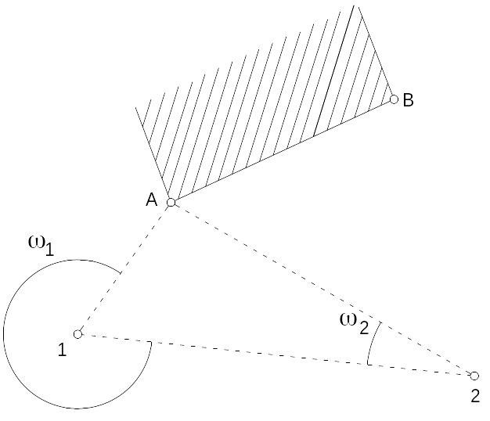
2.3 Setting-out of a point by forward intersection
Setting-out elements = the horizontal angles ω₁ and ω₂.
Two theodolites placed at the survey stations 1 and 2 are used for setting-out.

Slide 19
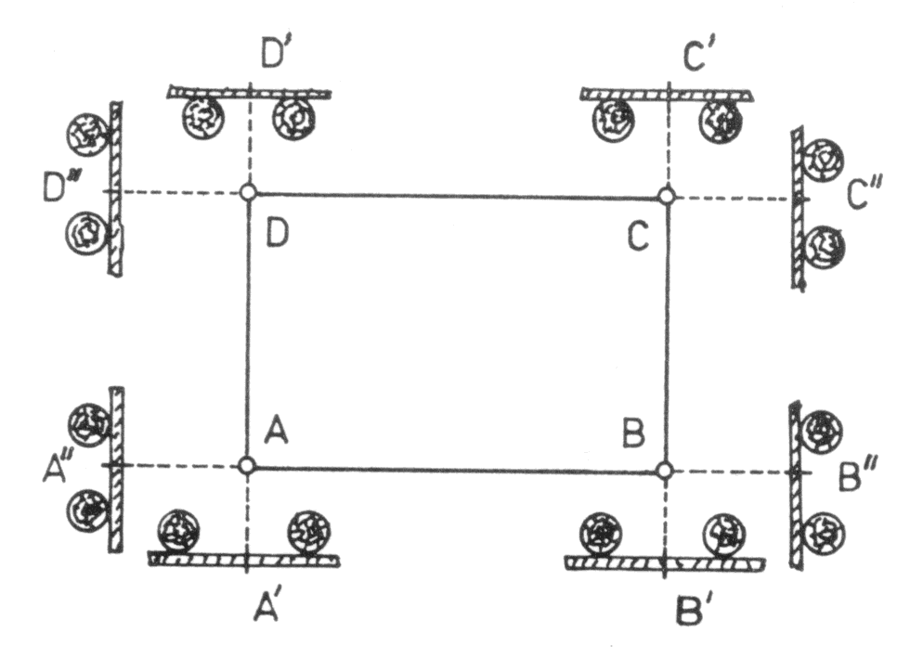
2.4 Setting-out of a point as the intersection of two straight lines
A set-out point is the intersection of two lines of sight which connect permanent marked points.

Slide 20
points A, B, C, D are set out by one of the previously mentioned methods
so-called berms (boards nailed up to stakes) are established so that they cannot be demaged by building operations
a wire is stretched across points AB, AD etc. and points A´, A´´ etc. are marked by notches at berms
when earthwork is realized, points A, B, C, D can be set out anytime quickly in the intersections of particular straight lines

Slide 21
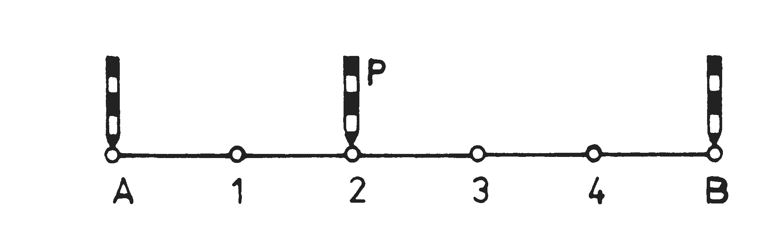
3. Setting-out of a straight line
3.1 Setting-out of intermediate points if the end points A and B are accessible and mutually visible.

Slide 22
high accuracy is required → intermediate points are set out by a theodolite placed at one of the end points
high accuracy is not necessary → the end points are marked by range poles and the observer stands to extended straight line (several metres behind the range pole at A). Then the observer places a lineman (helper) with a range pole to the alignment of points A and B.

Slide 23
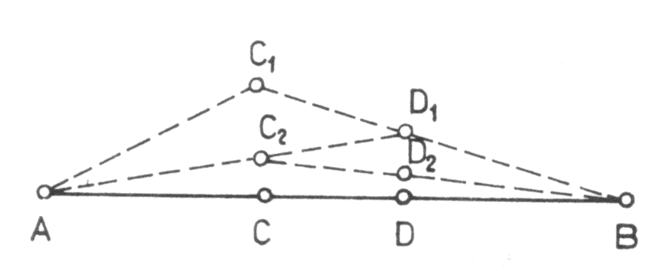
3.2 Setting-out of intermediate points if the end points A and B are inaccessible and if they are not mutually visible

Slide 24
Point C₁ is chosen approximately in the straight line AB and it is marked by a range pole. Points A and B have to be visible from the point C₁. A lineman with a range pole is placed by sight to the straight line C₁ B and point D₁ is marked. Then the range pole from the point C₁ is placed by sight to the straight line D₁ A and point C₂ is marked. Then a range pole is placed by sight to the straight line C₂ B and point D₂ is marked. This procedure is repeated till the points C a D lie in the straight line AB.

Slide 25
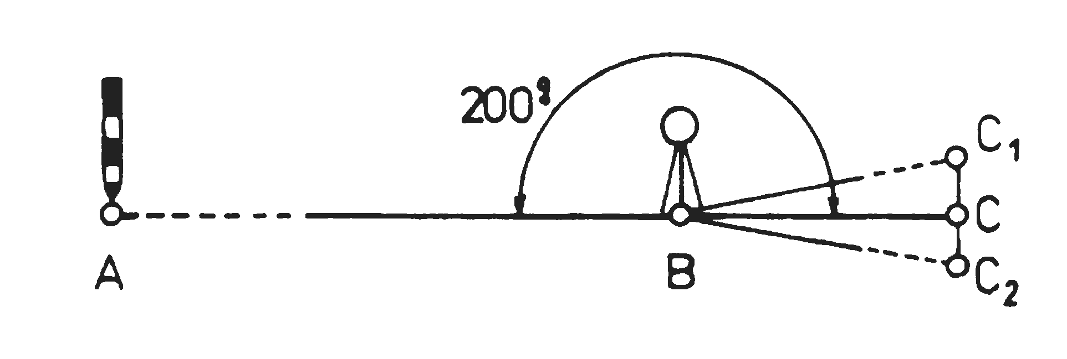
3.3 Extension of a straight line
by turning of the telescope of the theodolite around the horizontal axis (horizontal rough clamp is tightened)
by setting-out of the straight angle

