Slide 1
Start to Timeline 12 March (Jessica)
(9 March) Arrange Meeting
12 March First Client Meeting
Functional requirements: (Page 5)
--- After Meeting
Technical Stack
Created a quick prototype, implemented some basic functions like …
Haven't integrated with API
16 March Email clarification of Visibility
Timeline 26 March- 23 April (Shang)
26 March Second Client Meeting
Show, Functional requirements: (Page 12)
(UniMelb teaching break and unintended breaks)
Timeline 23 Apr -14 May(xf)
23 April Third Client Meeting
24 April First online demo
29 April Feedback from Email
Timeline 14-28 May and lessons learned(Chang)
14 May Fourth C.M.
28 May Final C.M.
Show templates function and go through all function.

Slide 2

Software project
COMP90082_2020_SM1
Eportfolio System
Xuefeng Chen, Yiyang Xu, Shang Gao, Chang Liu, Chuanxi Fu

Slide 3
Project scope
Project Aim and Purpose
Our team is aimed at building a web-based e-portfolio system which could provide users the ability to create their own e-portfolio on the website.
Key Stakeholders
Client: Marion Zalk
Supervisor: Austen William Mcclernon
Team members: Xuefeng Chen, Yiyang Xu, Shang Gao, Chang Liu, Chuanxi Fu
Inclusions & Deliverables
A web-based e-portfolio system
An instruction video and manual
Exclusions
Maintenance and web server
Notes:
As per the requirement of the client Marion Zalk. Our team is aimed at building a web-based e-portfolio system which could provide users the ability to create their own e-portfolio on the website.
In this system, the key elements includes:
Web server provides standard http service.
Backend server for storage and data manipulation.
React-based web pages provides user interface to add/edit the component of their portfolio. Components are classified into different modules and each module provide different editing functions.
Version control and automated deployment measure based on Git and Github operation.
Proper security measure and visit point for any Internet users.

Slide 4
Timeline
Functional website
Final Product
Initialization
28 May
26 March
14 May
12 March
23 April
One-page website
with limited function
A working website System

Slide 5
Stage 1: 12 Mar to 26 Mar
Initialization
28 May
26 March
14 May
11 March
23 April

Slide 6
Tools that we used for our project
 | Tools
Backend | Java, Spring boot
 | MySQL
Frontend | React, JavaScript, Html, CSS
 | Material UI
Editor for modules | UI only, by Material-UI
General | Git
 | NginX
Management Tools | Slack, Trello, Google docs

Slide 7
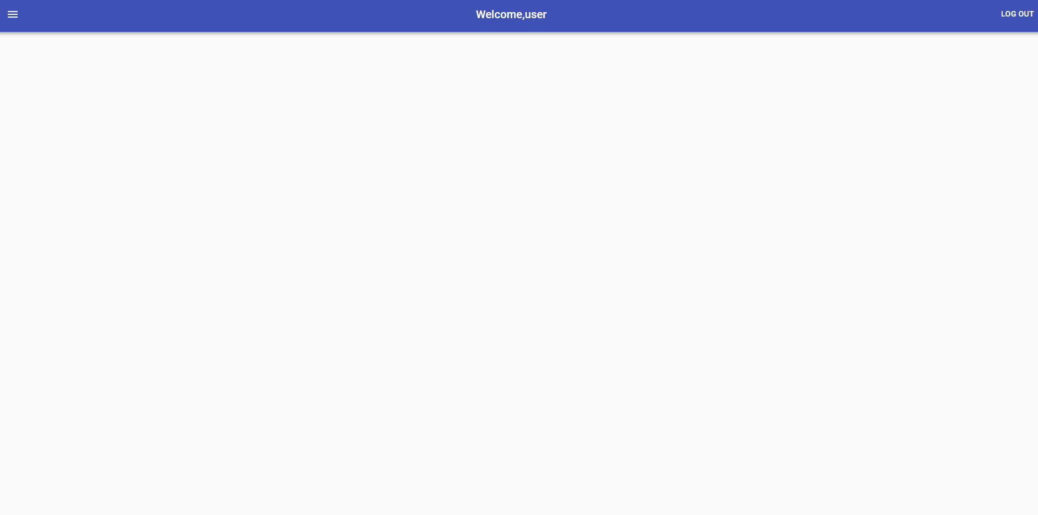

Slide 8
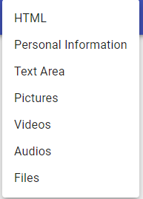
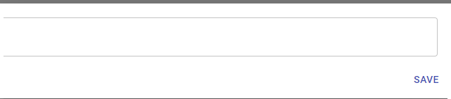

Slide 9
Stage 2: 26 Mar to 23 Apr
One-page website with limited function
28 May
26 March
14 May
11 March
23 April
Notes:
3.11 First Client meeting Client explained her expectation of the product.
Created a quick prototype, implemented some basic functions like ...
3.26 Second Client meeting draggable, reorder, background customization,
achieved all requirement
4.23 3rd Client meeting
5.14
(May also include email communications)

Slide 10
Client requirement and our solution
26 Mar to 23 Apr
Requirement | Solution
Reorder | Dragging
Visibility control | “Share” by token

Slide 11
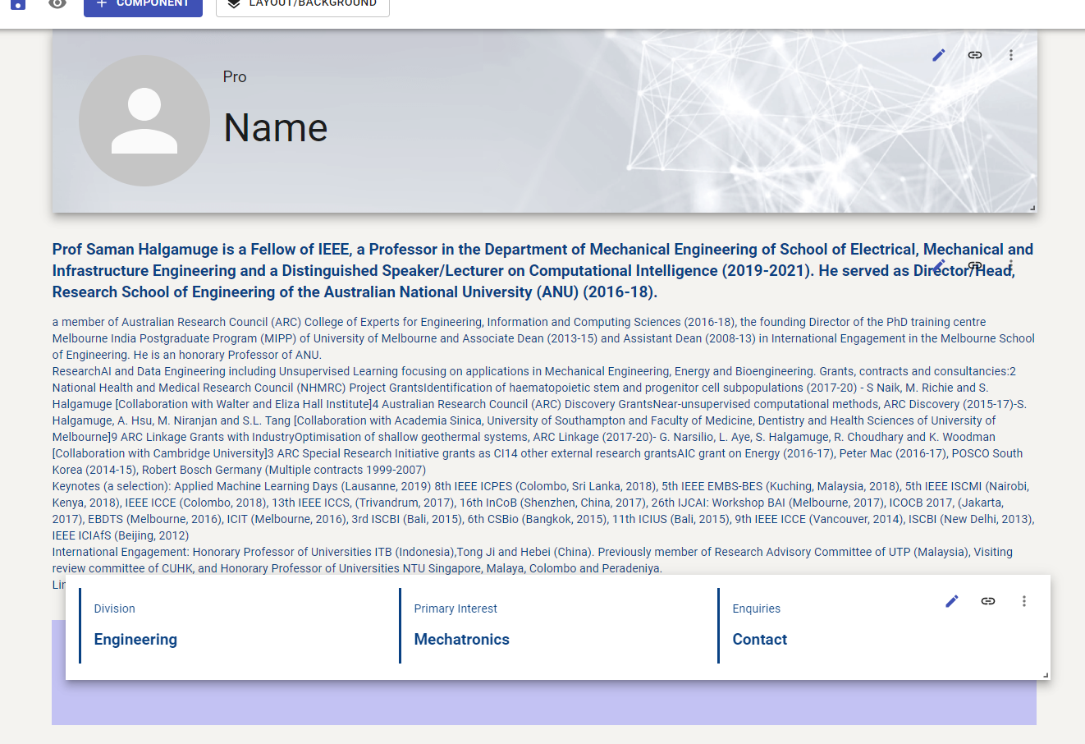
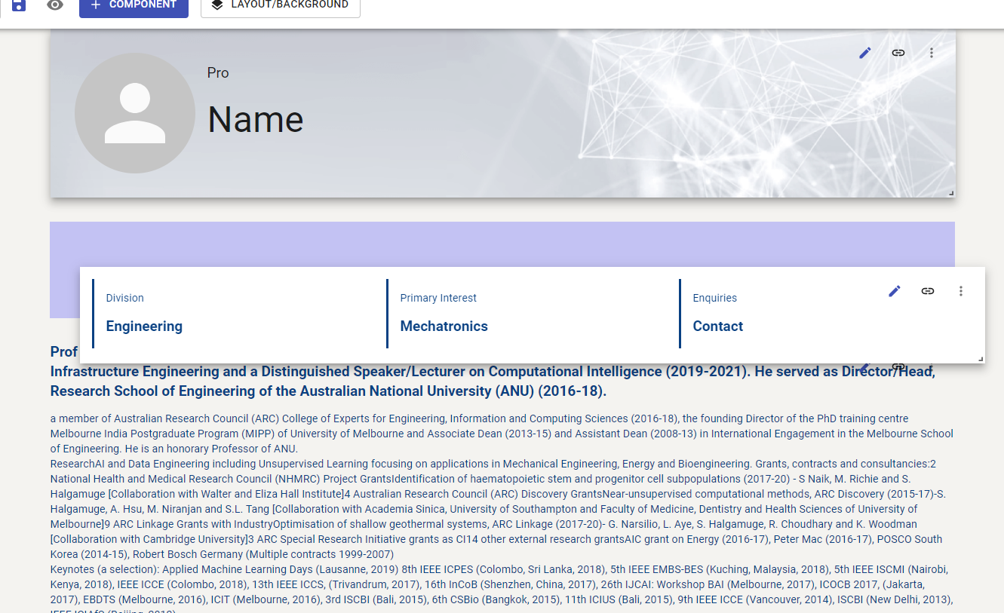
Drag to reorder

Slide 12

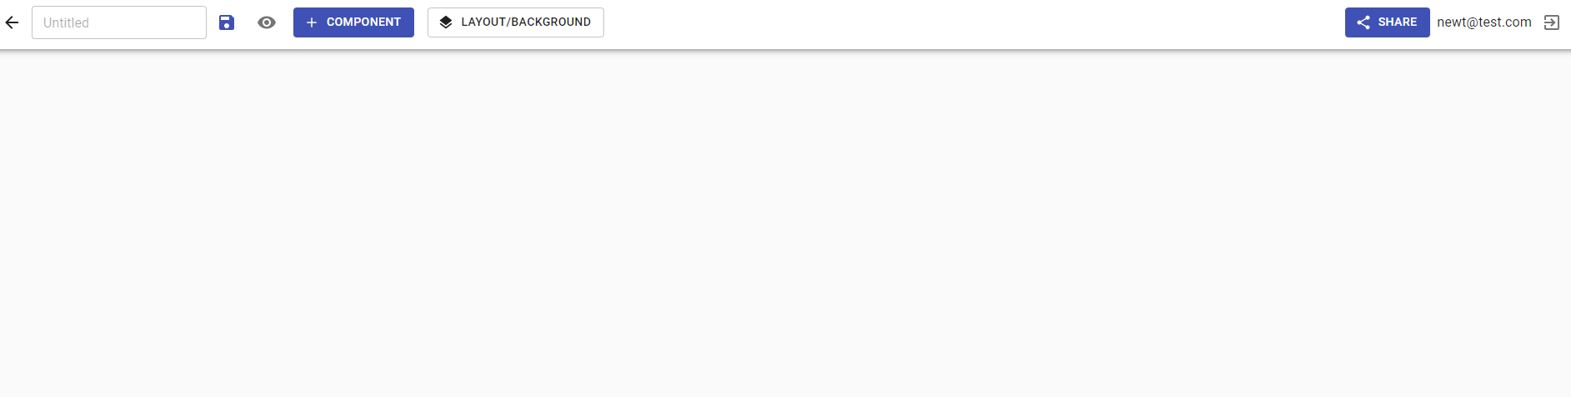
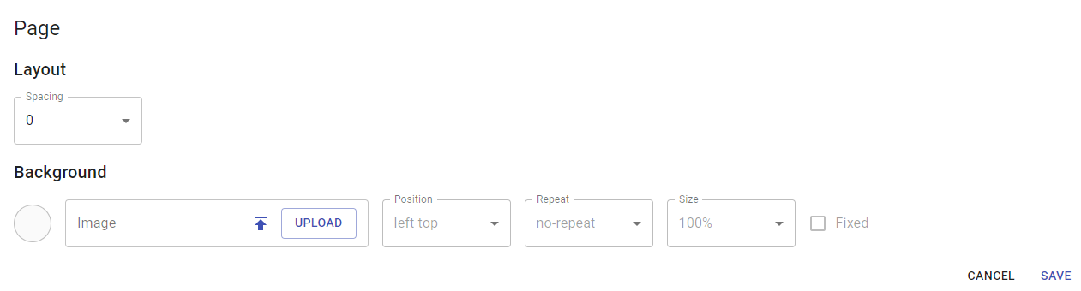
Multiple layer website

Slide 13
Non-functional improvement
Goal | Solution
Easy-accessibility and Security measure | Independent domain & Cloudflare
 | OpenSSL and reverse proxy

Slide 14
Stage 3: 23 Apr to 14 May
Functional website
28 May
26 March
14 May
11 March
23 April
Notes:
When it comes to stage 3, we are at a point that we already has a raw product which statifies the basic requirement and near 70% of the user stories we listed are completed now.

Slide 15
Client requirement and our solution
23 Apr to 14 May
Requirement | Solution
Copy a component | Add a copy button on every component and copy html code.
Module consistency | Reuse layout control module
 | Material UI for each module
Notes:
Thus, after we display the product to our client Marion on 23 th April. She was happy about what we already have, and the only new requirement from her is that as a registered user, I should be able to copy an existing components. After discussion, we started to develop this feature.

Slide 16
Update after team meeting 23 Apr to 14 May
Goal | Solution
Automated testing | Github Action
 | Selenium, spring boot unit test
Auto-deployment | Github Action
Notes:
In addition, as the backend part is already finished and we found our deployment after each update annoying. We started to establish a auto-deployment mechanism. Actually, we initially used github webhook. We run a node server which listens to pushes from github and then run the scripts to update the code and restart our frontend and backend. However, we find this way uses too many resource of our server and always fail. After research, we adopt gtihub action to do the auto deploy job. Also, together with that, we found automated testing is also easy to implement by using github actions. We write several unit test and used selenium to record some basic test cases . When the github branch which is live on server, merged a new pull request, and also when we push to the server, github action wil start a virtual mechine, install all dependency images we need, and do the compile and testing work. if the new version passed all the tests, the new version will be pushed to our server and start working. Otherwise, this will fail.

Slide 17
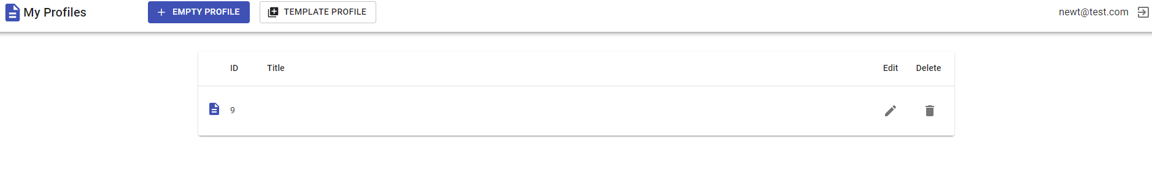
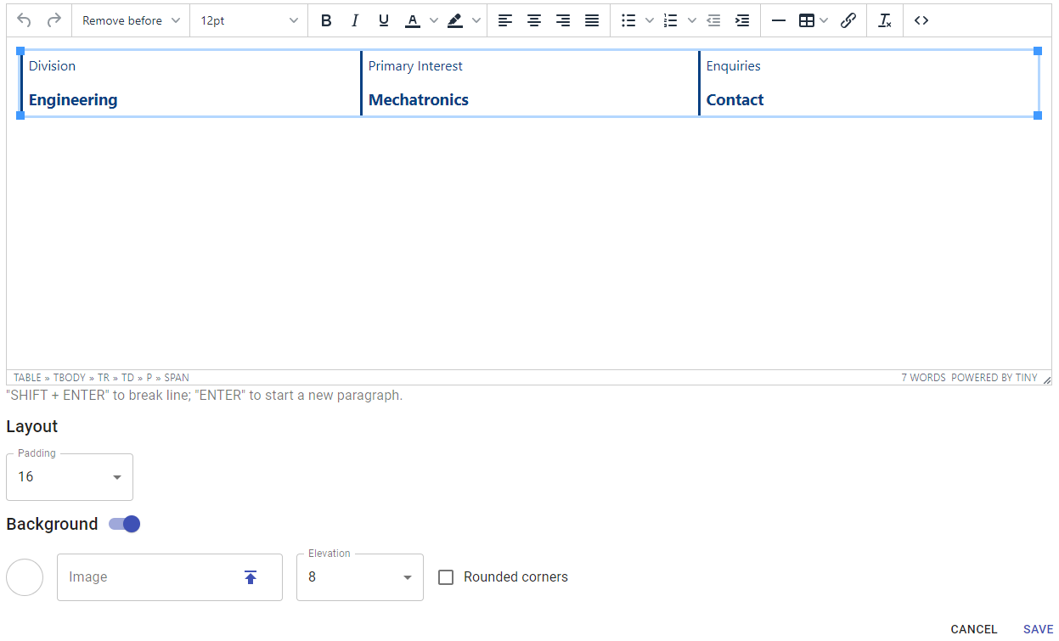
UI improvement and module editor consistency

Slide 18
Final Stage: 14 May to 28 May
Working website System
Requirement:
🔘 Create from template
Final Product
Outcome：
☑️ Create from template
Solution:
local JSON
load from file <> load from remote
26 March
14 May
11 March
23 April
28 May
Notes:
3.11 First Client meeting Client explained her expectation of the product.
Created a quick prototype, implemented some basic functions like ...
3.26 Second Client meeting draggable, reorder, background customization,
achieved all requirement
4.23 3rd Client meeting
5.14
(May also include email communications)

Slide 19
Final Client Meeting 28 May
Client Feedback:
Good flexibility
Easy to use
All function requests have been accomplished
Good job!

Slide 20
What was delivered
A web based E-portfolio management system (https://eport.dev/)
A video shows how to use the E-portfolio management system (https://youtu.be/9RMWfehPQaU)
An instruction manual
Notes:
After development, the system is well-established to provide users a friendly tool for portfolio management.
It has been delivered to user:
1. A running server combined front-end and back-end service with industry standard configuration based on Nginx, MySQL, openSSL, and Selenium.
2. Module-based web system with Text, Picture, Video, File, Raw HTML, Personal Information, Social Network, Background modules. Each module is established for user to add/edit content and layout of specific component of the portfolio. Additionally, template module and sharing module are established as supporting modules to help user quickly establish and sharing their own portfolios. User are suggested to create their own work from templates but they can also create from zero by adding any modules to the white page.
3. A well-designed backend to support all the functions provided in the front-end web system.
4. Automated deployment and independent domain for maintenance and easy-access.

Slide 21
Lessons learned
Communication
Agenda and takeaways (Decisions)
Describe accurately
Get prepared
Ask the right question
Techniques
website development:
frontend and backend
Automated testing
Automated deployment
Self-learning and problem solving：
Tutorials, Documents, other online resources
Teammates is great teacher
Management
Github workflow (branch management, peer reviews)
Project management （Trello）
Notes:
Communication
fully prepared before meetings: prepare showcase, questions to ask
during the meeting: describe accurately, make sure delivered the right info
notify client the time and location each time before a meeting
learning to solve problem independently, asking for help from teammates when in strong needs
Teamwork
effectIve communication ：eg 1，2 ，3
improve technical skills：eg 1 continuous integration 2.continuous delivery
Github workflow (branches, peer reviews and pull request)

Slide 22
Demo
https://eport.dev/

Slide 23
Identifier first line
Second line

Slide 24
· A personal website to show resume and portfolio, personal show case website.
· The user can log in this website to change sessions and information in each session
· The user can upload whatever types of documents they want to add (such as pictures, articles, audios and videos)
· The user can select the visibility of each session or what they want to show on this page
· The user can choose visibility, just like google doc, the website can only access by the person have the link
· The user can choose the layout and UI of the website like background colors (photos)
· The target user is university students, however, may extend to employees as well
· One-page website for view only, other users cannot comment on it.
l Reorder function: drag and drop for reorder
l *Embedded information: Click element for more information (One page so detailed information by clicking)
*Background customization
l Personalization UI, basically font,color,etc. (e.g. Shadows mentioned by Yiyang)
Notes:
3.11 First Client meeting Client explained her expectation of the product.
Created a quick prototype, implemented some basic functions like ...
3.26 Second Client meeting draggable, reorder, background customization,
achieved all requirement
4.23 3rd Client meeting
5.14
(May also include email communications)

Slide 25
(New) Functional Requirement
Non-Functional Requirement
Quality
Security
...

