Slide 1
Delta Study booth tracker
Agnes Annilo
Karl Erik Mander
Ziya Mammadov
Tofig Bakhshiyev

Slide 2
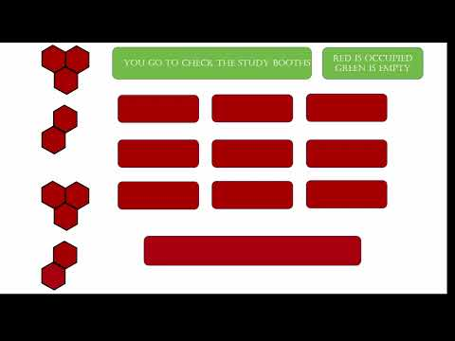

Slide 3
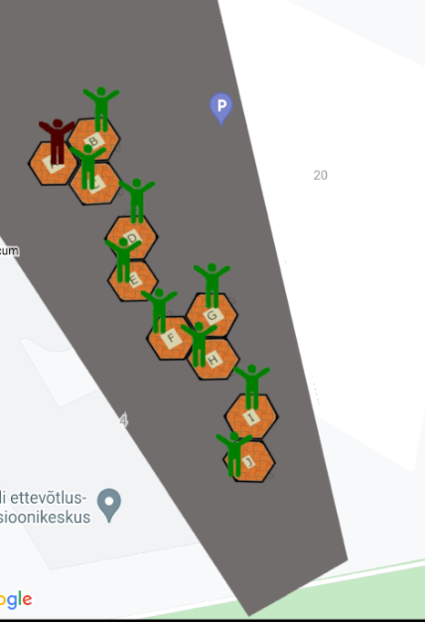
Delta Box App
The target of our project is to provide easiness for students so that they can easily check study boxes whether they are unoccupied.

Slide 4
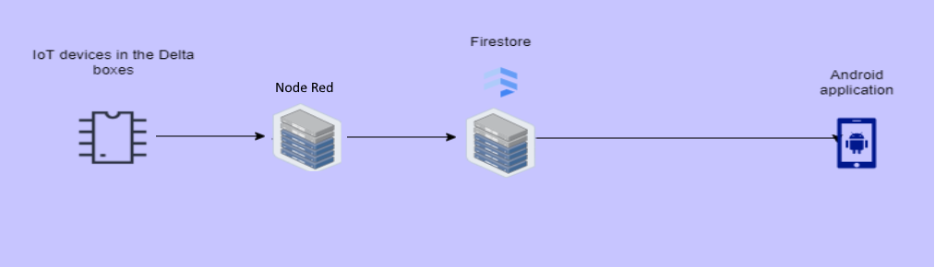
Project consists into two parts
(Mobile and IoT)
Our small microservice architecture

Slide 5
Teamwork
Karl Erik was responsible for developing Android App and getting data from Firestore
Agnes’ work was creating the custom map of second floor of Delta, adding boxes to the map and pitch video
Ziya’s task was to implement IoT device to Delta room and configuration of IoT device, also sending data to Firestore
Tofig was creating rabbitMQ, Node js server on the cloud (Heroku).
Everyone participated in the creating app presentation and writing essay for project.

Slide 6
What went well on the project and what did not
Demo app
What went well
Weekly meetup with teammates
Creating custom map
Sending data to Firebase
Creating simple Node Js server
What did not
Firebase libraries are not reliable for Arduino IDE
Node Red modules crashed
Instability in App
Cloud firestore and Real time database

Slide 7
What we would add if we had more time
Better Firestore authentication
More sensors
Statistics about room usage
Dashboard at the entrance of study box area
Reservation of the study boxes beforehand through the mobile application

Slide 8
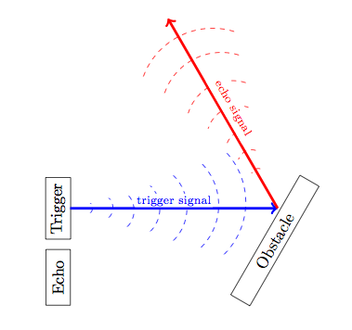
Challenging problem
Every part of the project was challenging but the most challenging problems in our project is that detecting person in the study room because the signals of ultrasonic sensor bounces on the wall if wall is not straight, therefore, ultrasonic sensor is losing echo signal like in the picture.

Slide 9
References
[1] - https://github.com/KarlErikMander/2021-MCIoT-Delta-Study-Booths-Tracker
[2] - https://nodered.org

