Slide 1
OwnPass
Kevin, Cédric and Marc

Slide 2

Goals
Password Manager
  Save passwords in the Cloud...
Eventually open source
Use well known/tested cryptography
Web, Android, iOs, …
Distribute passwords to all system one owns
No NSA PLZ!!!

Slide 3
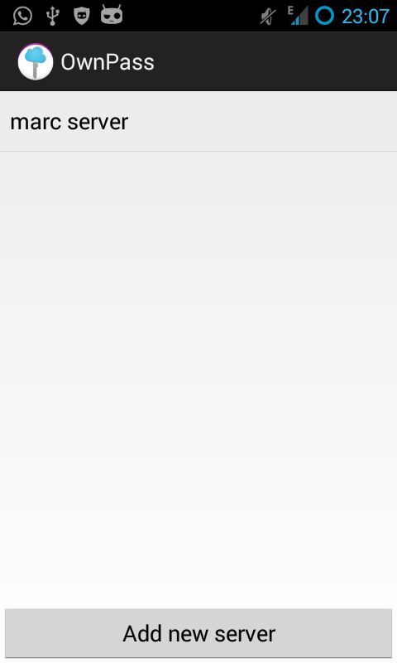
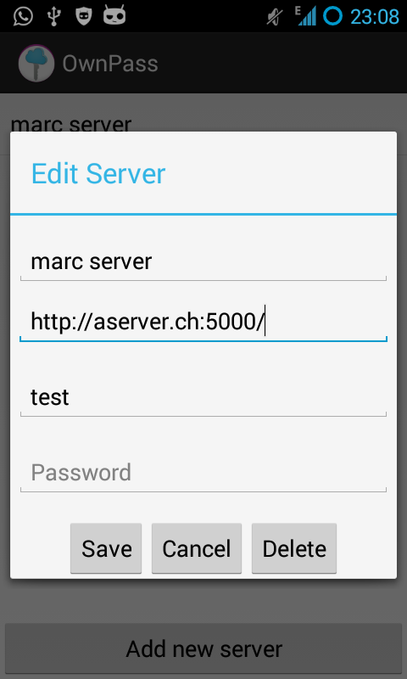
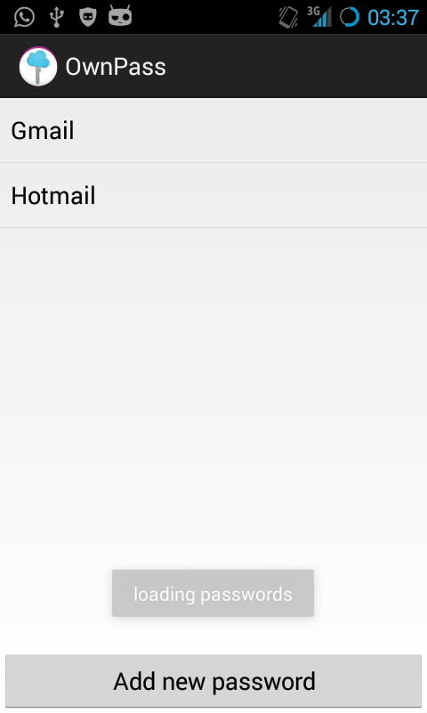
Today
Basic server and android app

