Slide 1
Java-mysql database system for hemophilia of north Carolina
By: Karl Schultz
Regis University Capstone Presentation

Slide 2
Why was this project chosen?
Opportunity to positively impact a local small Non-Profit Organization that has been very helpful to my family
A need for a better data storage/search system was recognized by HNC staff. This need is currently being served by a MS Excel spreadsheet.
Initial design concepts were estimated to be deliverable within the 8 week deadline period.
This project would offer some challenges and learning opportunities that would build upon my current knowledge base and skills.

Slide 3
What was wrong with the current system?
The current system is composed of an Excel spreadsheet that is accessed and updated by three HNC staff members via a privately shared Google Drive folder.
The spreadsheet contained some columns that were unrecognizable, extraneous and unused.
Data entry was all “freehand”, very few established rules lead to data incongruity. Some rows were saved as families others as personal member entries.

Slide 4
What was wrong with the current system?
The Region data was also incongruent due to lack of data entry rules. Some rows were tagged by geographical regions, others by near-by cities. This made searches nearly worthless.
Inability to perform meaningful searches.
Possible multiple version concurrency issues with multiple users editing the record at the same time.

Slide 5
The plan:
Due to the mixed landscape of HNC staff computers (Mac and PC), the project would have to be coded in a platform independent language.
The project would have a Graphical User Interface (GUI) that would connect to a local database management system (DBMS).
Make the GUI easy to use. Allow Save, Delete, Edit, Search methods for both Members and Families.

Slide 6
The plan:
Save individual member data objects and use them to create family objects to be saved on a second table.
Find a DBMS that can be run on PC and Mac, is low cost ($), and is compatible with the chosen programing language.
Institute data input guidelines to make data more useful.

Slide 7
Research results:
Java was found to be one of the best multiplatform coding languages and supports Object Oriented programing.
Java programs are saved as ByteCode that is compiled as it is needed by the Java Virtual Machine (JVM). The JVM then links and translates the code into low level code the host computer can use.
The JVM comes in many versions that are hardware specific, so that the translation can be tailored to the individual machine type. This allows the source code to remain the same. “Code once, run anywhere.”
Java has two wide spectrum adapters that allow it to interface with many of the most popular DBMS.

Slide 8
Research results:
Model View Controller (MVC) model was found to be the best practice architecture for business type applications
MVC allows for separation of responsibilities between three tiers of the application. This promotes abstraction and modularity.
The View is the “front-end” of the application. This is represented by the GUI. It handles the interactions from the user, and displays results back to the user.

Slide 9
Research results:
The Controller is the “middle-man”. This part listens to the View for events, decides what to do about the notification, then tells the Model WHAT to do (but not HOW to do it). Also handles responses back from Model to update View.
The Model is the “back-end” of the application. This is where the data is stored, represented, and modifications happen. The business logic is handled here. Implementations of requests from Controller reside here.

Slide 10
Research results:
MySQL was found to be a very reliable and popular DBMS.
Supports both Mac and PC.
Supports relational databases.
Communicates well with Java via the Connector/J driver and JDBC interface library.
It is open-source so it can be used for free.
MySQL Workbench application allows easy import/export methods for local tables.

Slide 11
Research results:
Data entry rules:
NCDOT region map was found to be a good solution to break up our membership regions.
Changes “freehand entries” into numerical entries 1-14 via a drop down combo-box.
Bleeding disorder entry has also been reduced to a drop down combo-box entry method to avoid typos.

Slide 12
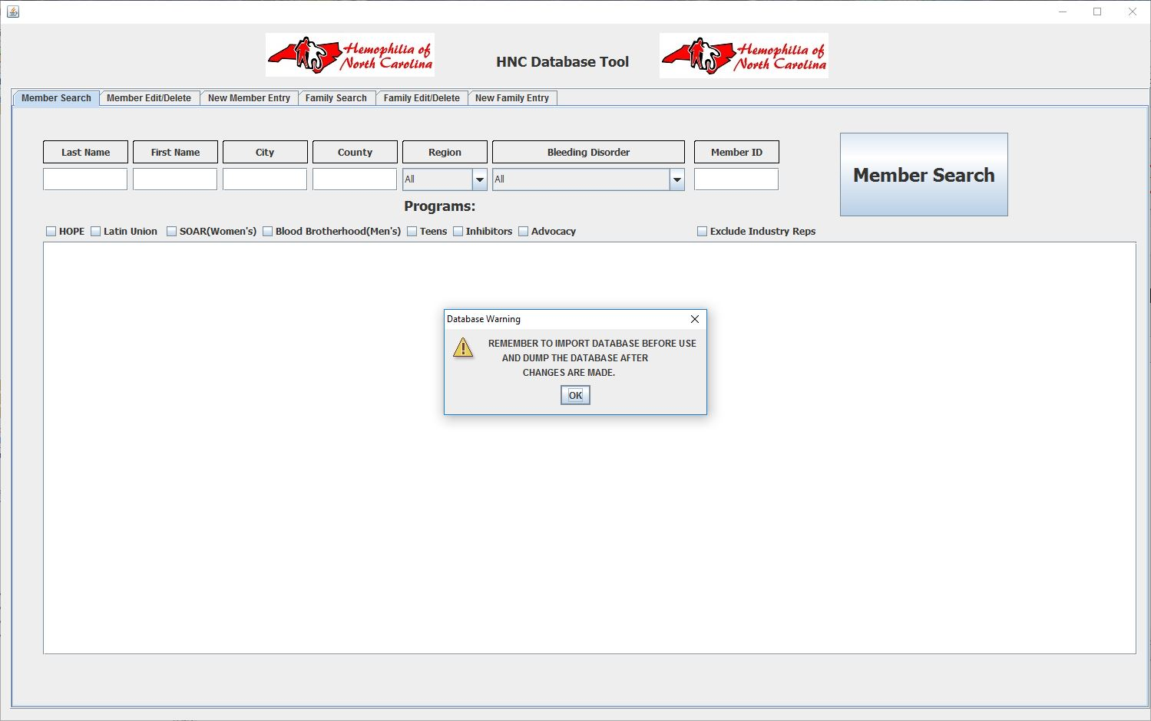
Demo

Slide 13
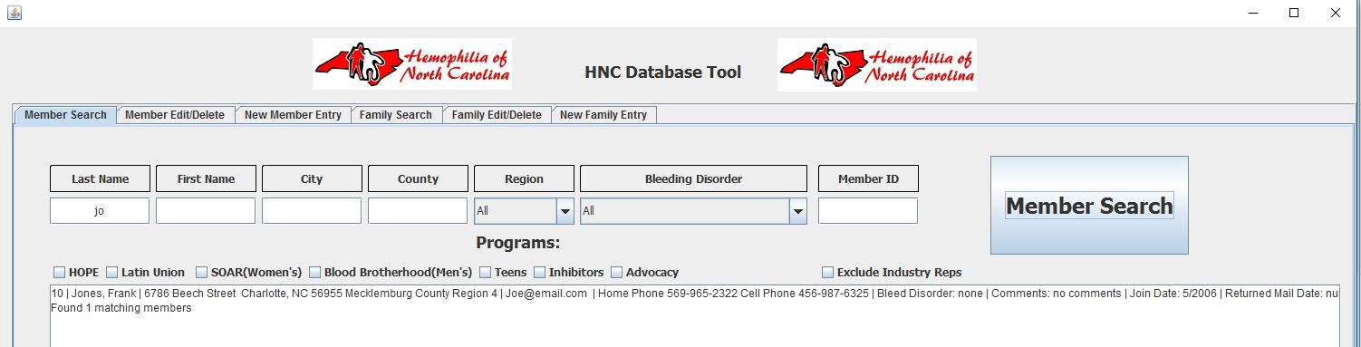
Member Search function
System allows partial parameter searches.

Slide 14
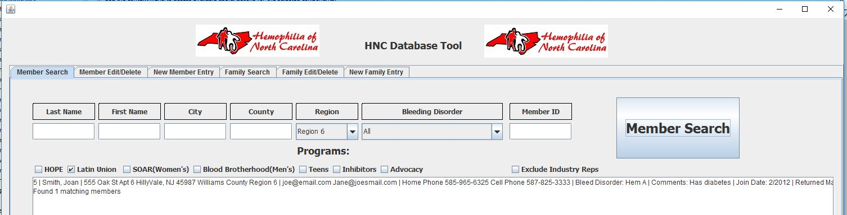
Member Search function
System allows multiple parameter searches, and industry representative exclusion option.

Slide 15
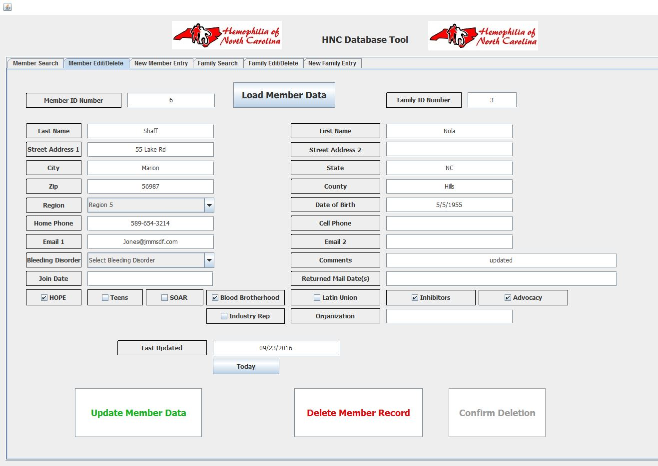
Member edit/delete function

Slide 16
Member edit/delete function
Allows the user to load a Member via the Member ID #.
Changes can be freely made to the Member’s data and then the database can be updated with a button click.
If deletion is requested the safeguard Delete Member Record button must be pushed first, then confirmed by the newly activated Confirm Delete button.

Slide 17
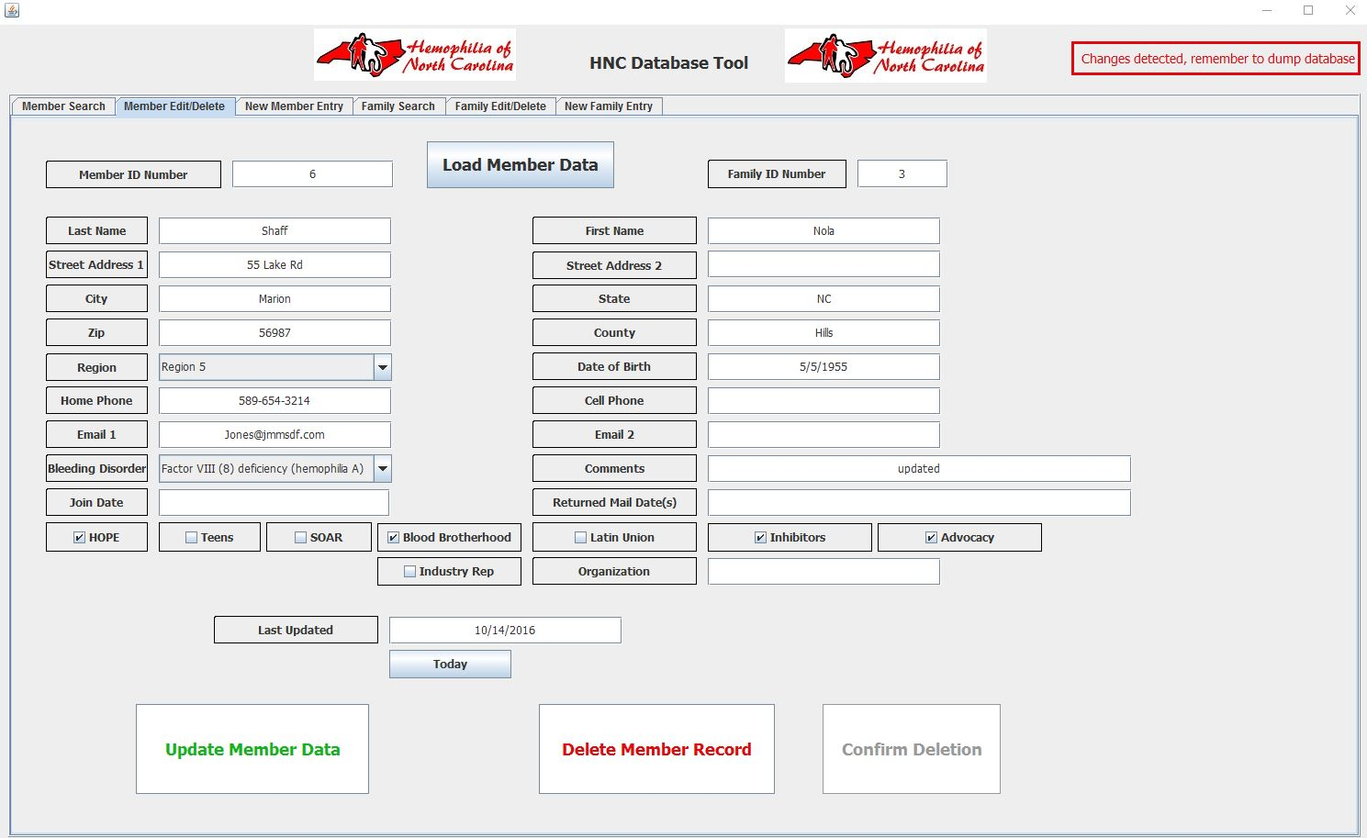
Member edit/delete function
When update or deletion is made, warning message box appears at the top right corner.

Slide 18
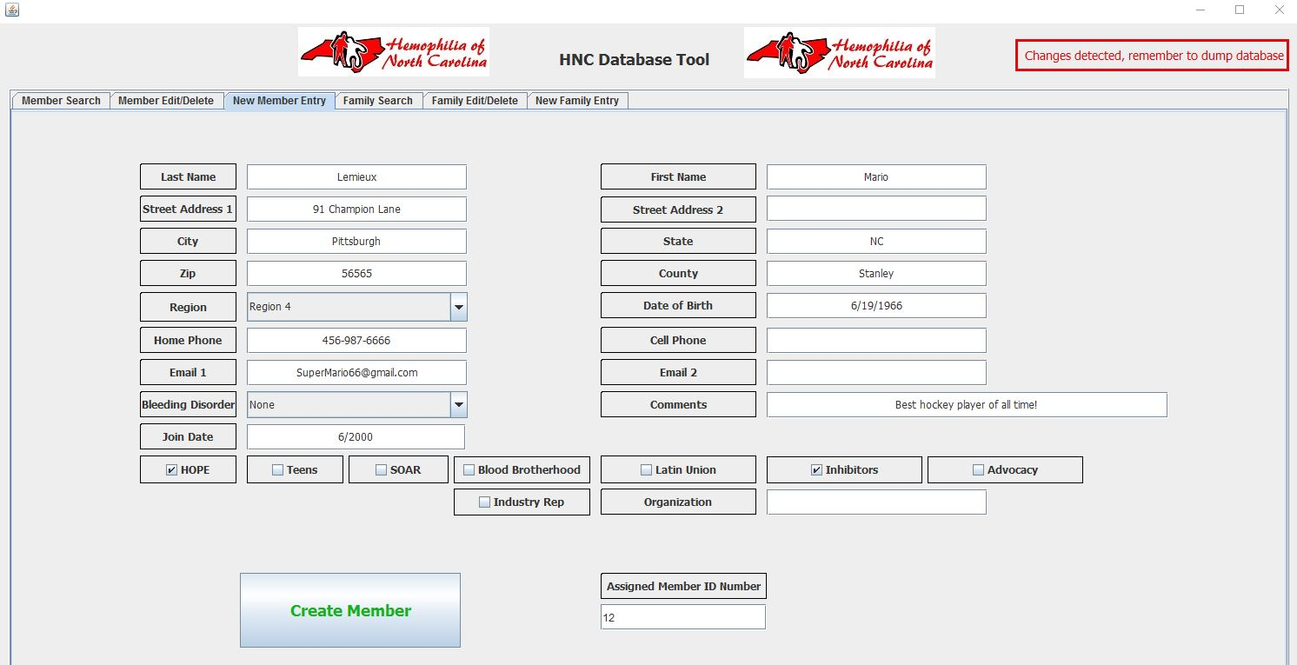
Member creation function
Generates unique Member ID when created.

Slide 19
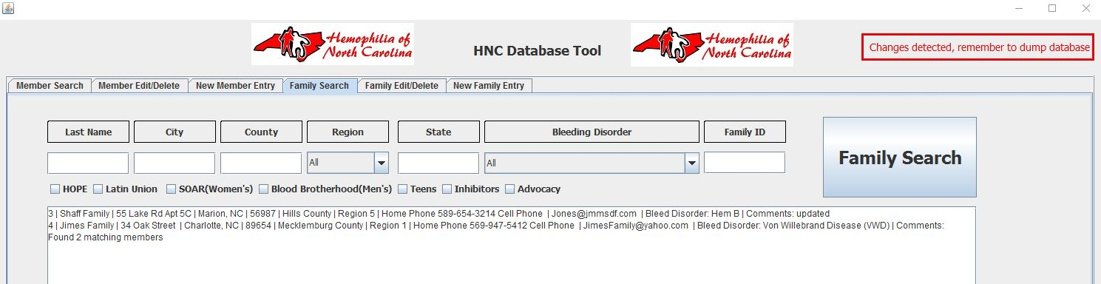
Family search function
Provides same multi-parameter search functionality as Member Search but on Family Data Table.
Displays output in a format that is able to be translated to a label printing program.

Slide 20
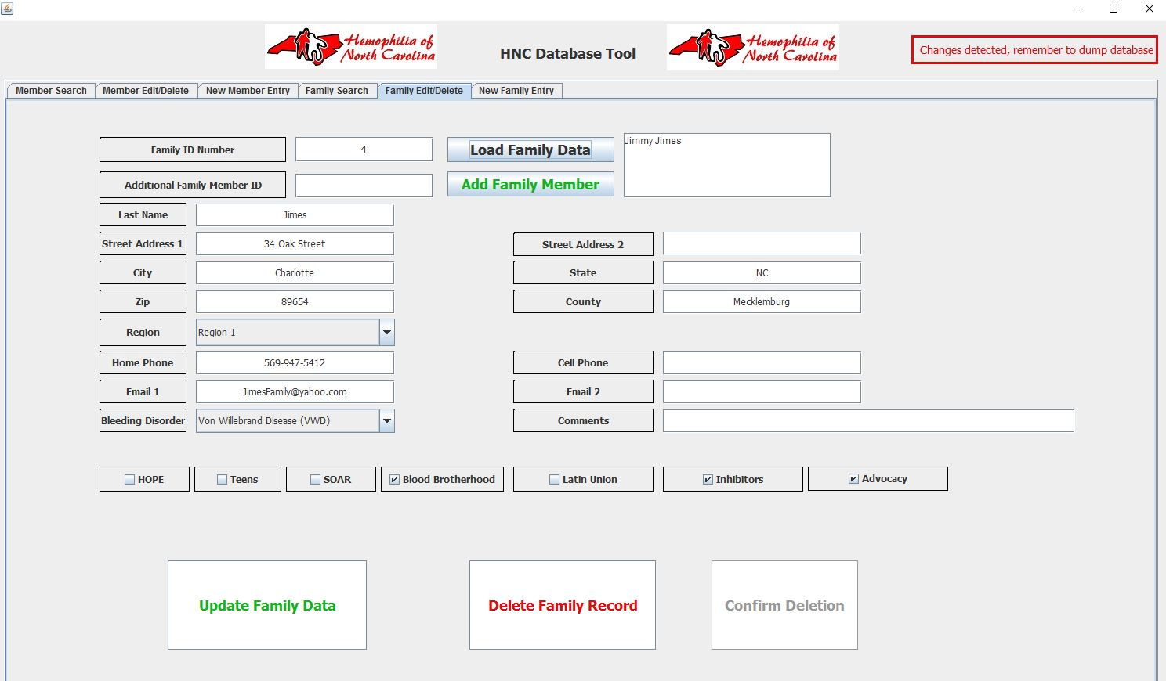
Family edit/delete function
Load family by Family ID #

Slide 21
Family edit/delete function
Edit family data freely, and update to database.
Delete family in same manner as Member deletion with the two-step safety button combination.

Slide 22
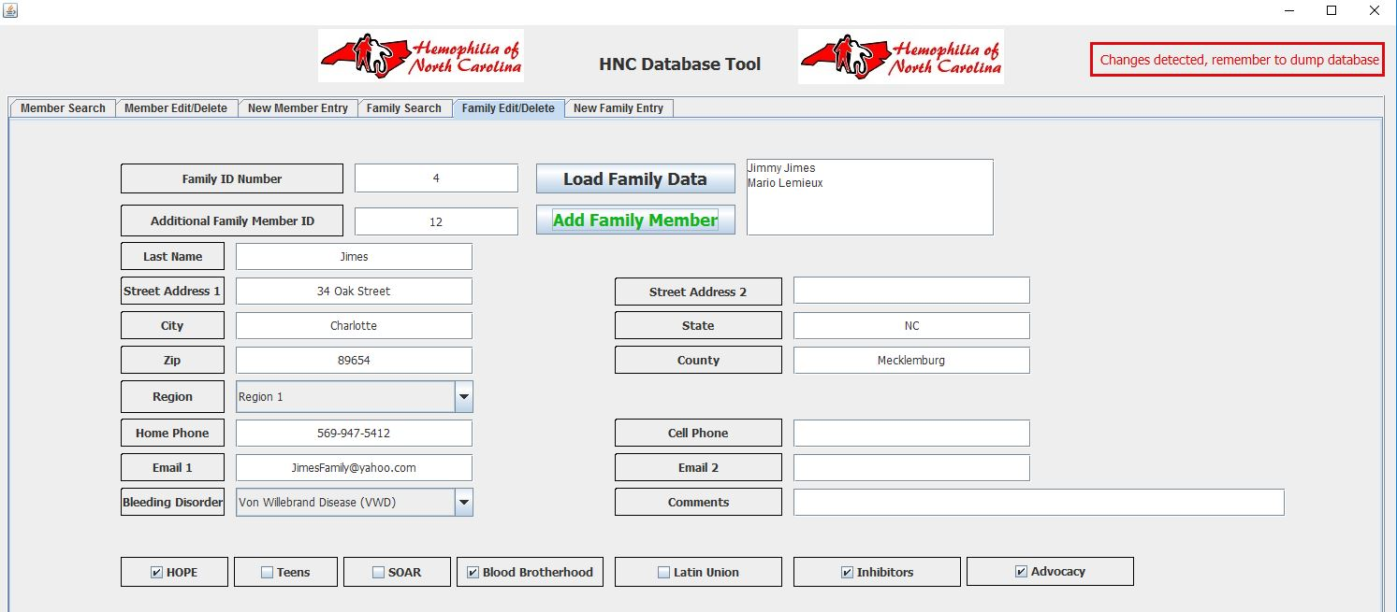
Family edit/delete function
Able to add Members to the Family by entering their Member ID in the Additional Family Member ID field then pressing Add Family Member.
Family bleeding disorder and interest groups are updated with new member additions.

Slide 23
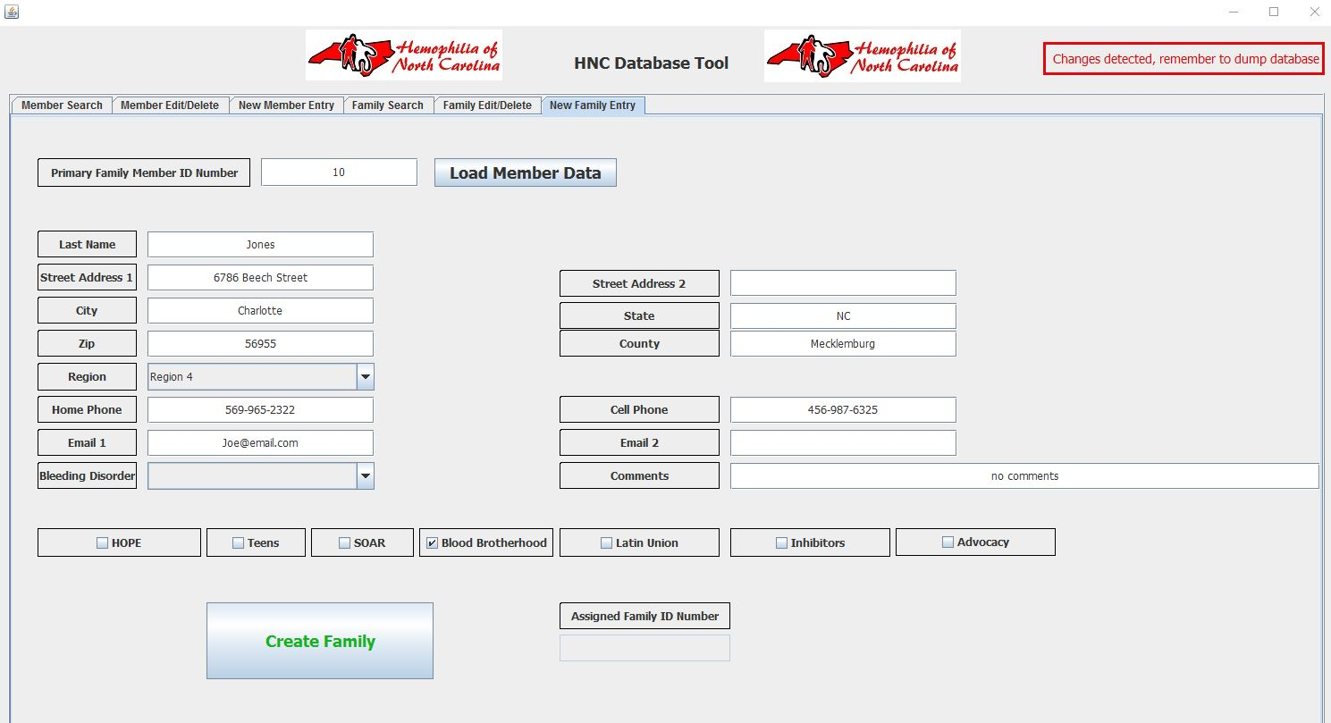
Family creation function
Load data of primary family member, edit as needed then create family. Unique Family ID assigned.

Slide 24
Data concurrency
Ideal situation would be to have the database hosted remotely, but this can be expensive.
Work-around is to have user import database from shared cloud storage before use, and export database to the cloud after changes are made.
System still at risk of concurrent user database edit errors until a lock-out system is implemented (although unlikely with only 3 staff members).

Slide 25
Future considerations
Remote hosting of database, turning program into an access client.
In lieu of remote hosting, a lock-out system involving a .txt file in cloud storage.
Module additions for event RSVP/attendance.
Option to directly output family searches into file format that can be even easier to create mailing address labels from.

Slide 26
Thank you

