Slide 1
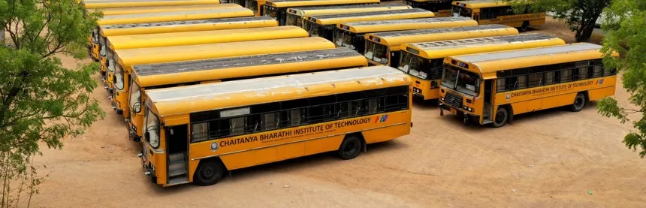
Bus Mitra
Live bus tracking for the CBIT campus fleet. Live map, per-stop ETAs, arrival alerts.
Department of Information Technology, Chaitanya Bharathi Institute of Technology
Notes:
25 buses, 5,000 students, and no way to know where any of them are. No way to know where any of them are right now.

Slide 2
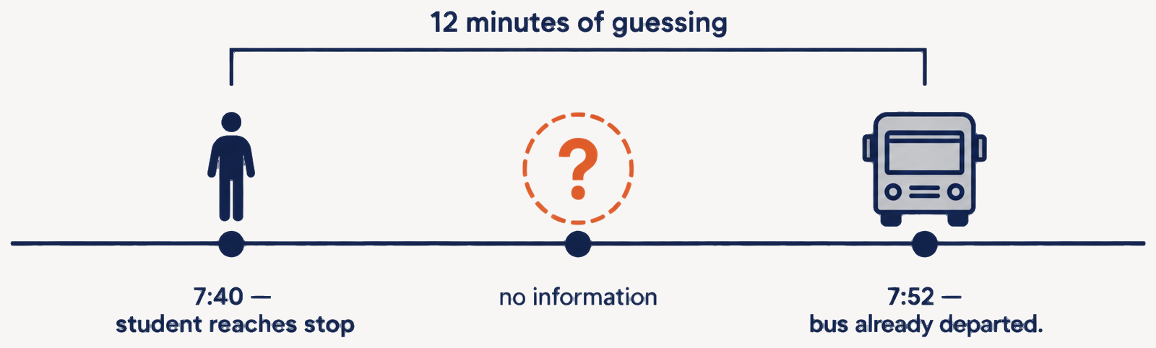
Problem
Students have no way to know where a bus is, or whether it is running at all.
No live position
No per-stop ETA
No data trail
Nobody outside the driver knows where a bus is right now.
Printed timetables don't survive traffic, breakdowns or route changes.
Coordination runs on WhatsApp and phone calls. Nothing is recorded.
Bus Mitra
2
Notes:
A student reaching the stop at 7:40 has no way to tell whether the bus left at 7:38 or is still ten minutes out. Twelve minutes of pure guessing, every single morning.

Slide 3
Alternatives
Bus tracking is solved for regulators and for city transit. Not for a single campus.
Approach | Example | Real-time granularity | Gap for a college campus
Govt. AIS-140 VLTD + state ITS backend | State RTC / school-transport tracking mandates | Vehicle-level, feeds government servers | Built for regulatory compliance, not student-facing search, favourites or alerts. ₹4,000–25,000 per device.
Commercial fleet-tracking SaaS | LocoNav, TrackoBit, Sahaj GPS | Fleet-manager dashboard | No student app and no per-stop ETA. ₹500–900 per vehicle per month, recurring.
City transit apps | Chalo, state RTC apps | Very good UX, the closest parallel | Built on city-wide public ridership economics, which don't exist for a private single-campus fleet.
Status quo at most colleges | WhatsApp groups, phone calls, printed timetables | None | Zero live data, zero accountability, and it breaks completely on holidays and route changes.
Bus Mitra
3
Notes:
We're not claiming nobody has solved bus tracking. We're claiming the economics of every existing solution assume either a regulator or a city-sized ridership. A 25-bus campus fleet is neither.

Slide 4
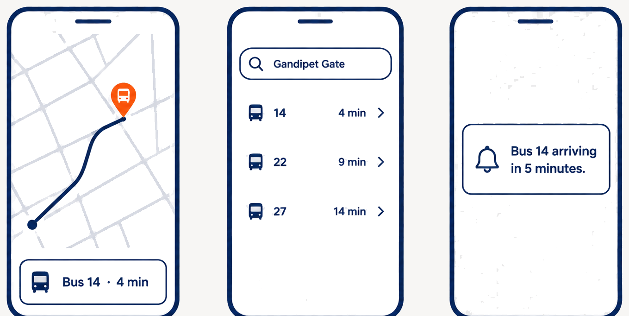
App
Four interactions cover almost everything a student needs.
Live map
Every running bus on the route, updating continuously.
Search a stop
ADMIN CONSOLE
Type a stop, see every bus serving it with an ETA.
Fleet status, which buses are active today, and holiday or route overrides that the student app picks up immediately.
Arrival alert
A push notification a set number of minutes out.
Favourites
Pin the bus you take daily and skip the search.
Bus Mitra
4
Notes:
The admin console is what makes the holiday problem solvable. Transport staff mark which buses are running, and every student sees it within seconds. Note the pilot ships as a web app; the mobile build lands in phase 2.

Slide 5
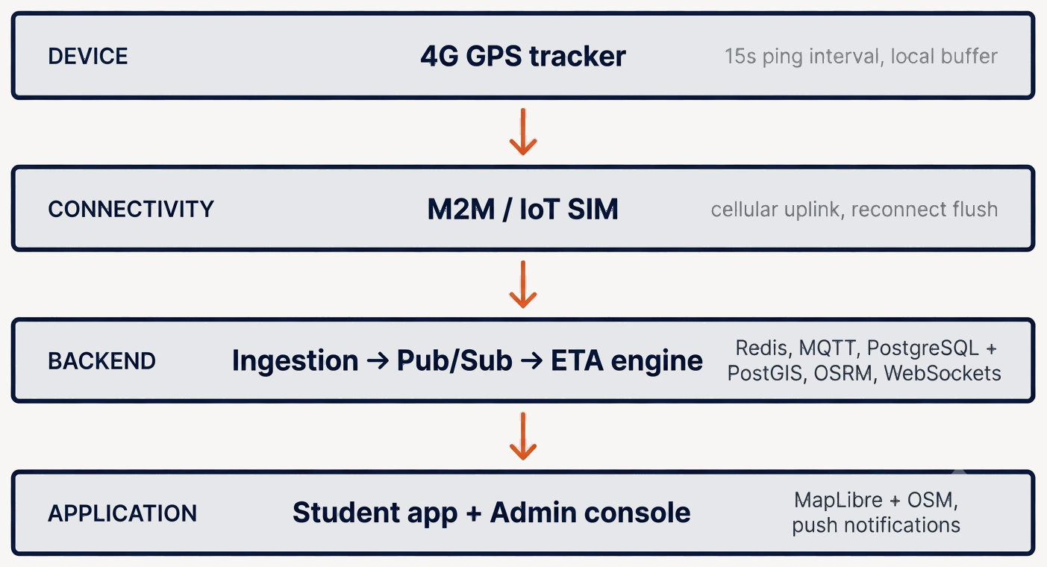
Architecture
Four layers, each independently replaceable.
Decoupling ingestion from delivery: GPS collection keeps running at full rate even when every student opens the app at 4 p.m.
Bus Mitra
5
Notes:
Each layer can be swapped without touching the others: a different tracker vendor, a different SIM provider, a different map renderer. Nothing in the stack locks us in.

Slide 6
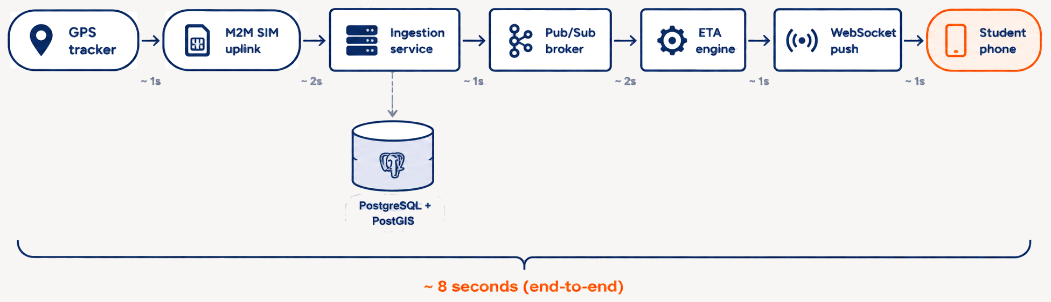
Latency
Target budget for a GPS ping to reach the student's screen.
15 s Ping interval
~8 s Pipeline latency
~23 s Worst-case staleness
How often the tracker reports a new position.
Uplink, ingestion, ETA recompute and push.
Ping interval plus pipeline.
Bus Mitra
6
Notes:
These are design targets, not measured figures. The 3-bus pilot exists to replace them with real numbers. The one that matters is the 23-second upper bound: that is how stale the dot on the map can be, worst case, and it is the number we hold ourselves to.

Slide 7
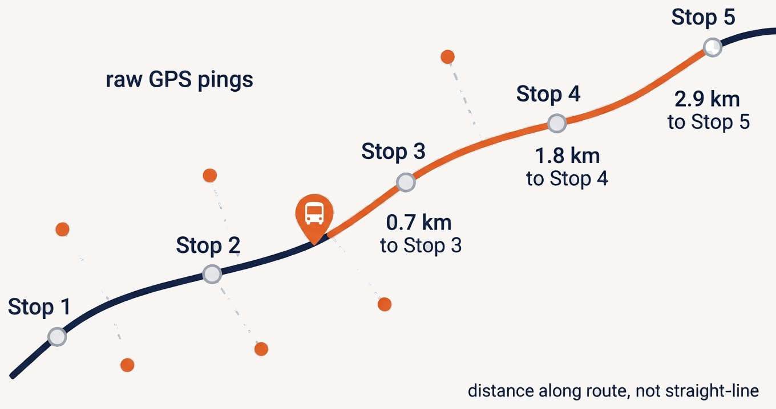
ETA
Raw GPS is noisy. Distance to the next stop is measured along the route, never straight-line.
1
Snap
Each ping is matched to the nearest point on the known route, not trusted as-is.
2
Measure
Remaining distance is computed along the route geometry via OSRM.
3
Estimate
Distance plus recent average speed for that segment gives the per-stop ETA.
Bus Mitra
7
Notes:
Straight-line distance would tell a student the bus is 300 metres away when it still has a kilometre of one-way road to cover. Snapping to the route is what makes the ETA trustworthy.

Slide 8
Failures
Every failure mode has a defined behaviour. The app never fabricates a live position.
Failure mode | System response | What the student sees
Bus passes through a tunnel or cellular dead zone | Tracker buffers pings locally and flushes the backlog on reconnect | "Last seen 2 min ago", an honest stale marker, not a frozen live dot
Tracker loses power or drops off the network | M2M SIM monitoring surfaces the device centrally for transport staff | The bus leaves the live map rather than sitting at a stale position
Traffic spike when every student opens the app at once | Pub/Sub decouples ingestion from delivery; stateless API scales out | Map keeps updating at normal rate; GPS collection is unaffected
Backend node or database failure | Monitoring plus daily backups; stateless services restart clean | Brief reconnect, then live again, with no loss of historical route data
Showing a stale timestamp instead of a confident wrong position is a product decision.
Bus Mitra
8
Notes:
The third column is the point of this slide. A tracking app that lies about where the bus is does more damage than no app at all. A student who trusts a frozen dot misses the bus and stops using the product.

Slide 9
Cost
25-bus fleet. Commodity hardware, India-hosted infrastructure, open-source mapping.
Item | Unit cost | Qty | Year 1 total
GPS + GSM 4G tracker (bulk, non-AIS-140) | ₹1,800 | 25 | ₹45,000
Installation & wiring harness | ₹250 | 25 | ₹6,250
M2M / IoT SIM, bulk enterprise plan | ₹75 / month | 25 SIMs × 12 mo | ₹22,500
Cloud VPS (2 vCPU / 4 GB, India-hosted) | ₹1,200 / month | 12 mo | ₹14,400
Domain name | ₹800 / year | 1 | ₹800
Google Play developer account (one-time) | ₹2,100 | 1 | ₹2,100
Map tiles, push notifications, SSL (OSM, Firebase free tier, Let's Encrypt) | ₹0 | n/a | ₹0
Total (Year 1, 25 buses) |  |  | ≈ ₹91,050
Recurring from Year 2 |  |  | ≈ ₹37,700/yr
₹3,640
per bus, per year
₹18
per student, per year
Bus Mitra
9
Notes:
Year 1 is ₹91,050: hardware plus a year of running costs. From year 2 only the SIMs, the VPS and the domain recur, which is ₹37,700. Per student that is about eighteen rupees a year.

Slide 10
Rollout
Each phase has to prove something before the next one is funded.
01
02
03
PILOT
FLEET
CAMPUS-WIDE
3 buses, web app
25 buses, mobile app
All routes
Ping reliability on live routes
Dead-zone buffering through underpasses
ETA accuracy against actual arrival
Mobile app release to students
Load testing at peak usage
Admin workflows and holiday scheduling
Every bus in the fleet on the map
Open to the full student body
Handover to campus IT
No fleet-wide spend until the pilot proves ETA accuracy on real routes.
Bus Mitra
10
Notes:
Phase 1 is the only thing we are asking to fund now. Three trackers and a web app answer the three questions that decide whether this works at all, before any mobile build or fleet-wide spend.

