Slide 1
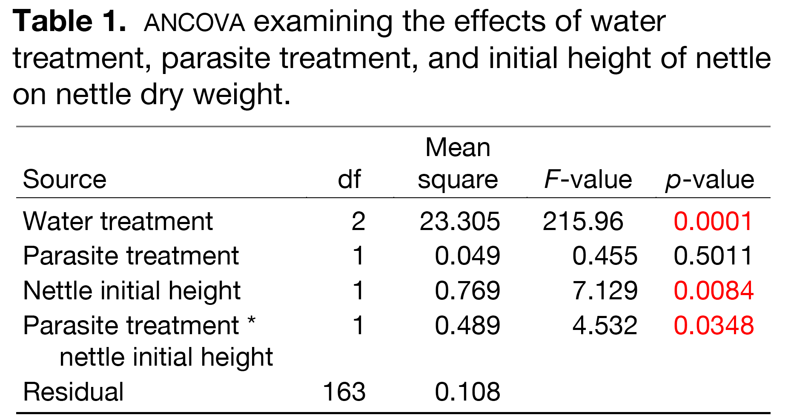
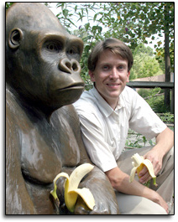
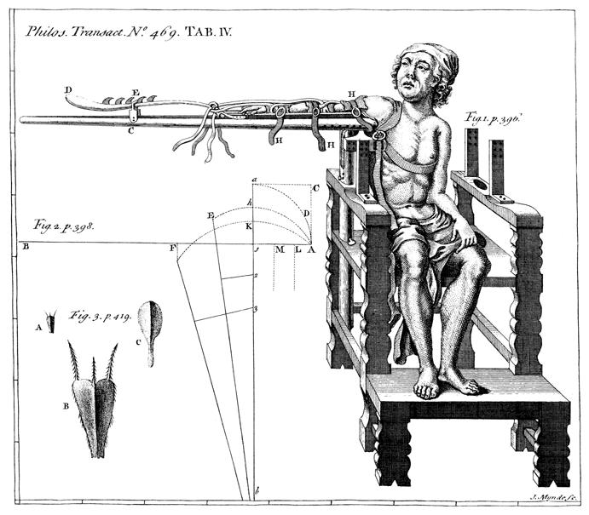
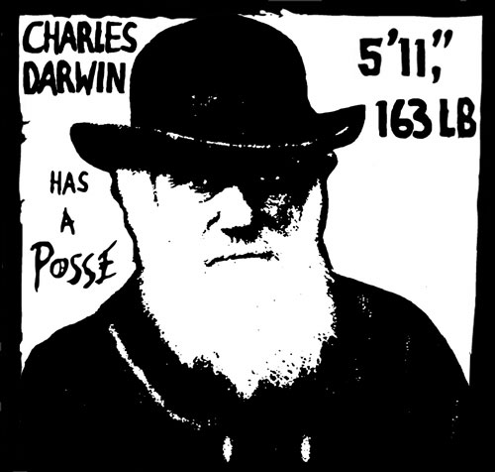
Title that hints at the underlying issue or question
Maintain a good amount of space between your columns. Although you could squeeze them right up against each other, the poster’s aesthetics would suffer. So when your mentor says to do it, just nod your head as if you’re listening, but roll your eyes as soon as she’s not looking.
Format in “sentence case.” This means only the “t” in “title” gets capitalized.
Students name
Entertainment Technology, NYCCT, Brooklyn New York 11201
This is a header. If you make the font size large, and then add bolding…there is no need to also apply underlining or italicization. Adding multiple kinds of styles, needlessly, just marks you as a poster novice.
Make sure the edges of your columns are aligned with adjacent columns. Don’t trust your eyes: select the columns, then “Align” with the proper tool
Introduction
This is a Microsoft Powerpoint template that has column widths and font sizes optimized for printing a 36 x 56” poster—just replace the “tips” and “blah, blah, blah” repeat motifs with actual content, if you have it. Try to keep your total word count under 500 (yea, this suggestion applies to everyone, even you). More tips (18 pages!) can be found at “Advice on designing scientific posters” at my web site (www.swarthmore.edu/natsci/cpurrin1). To see examples of how others have abused this template to fit their presentation needs, perform a Google search for “powerpoint template for scientific posters.”
This paragraph has “justified” margins, but be aware that simple left-justification (other paragraphs) is infinitely better if your font doesn’t “space” nicely when fully justified. Sometimes spacing difficulties can be fixed by manually inserting hyphens into longer words. Powerpoint doesn’t automatically hyphenate, by the way.
Your main text is easier to read if you use a “serif” font such as Palatino or Times (i.e., people have done experiments and found this to be the case). Use a non-serif font for your title and section headings.
Results
The overall layout for this section should be modified from this template to best show off your graphs and other result-related illustrations. You might want a single, large column to accommodate a big map, or perhaps you could arrange 6 figures in a circle in the center of the poster: do whatever it takes to make your results graphically clear. And, for the love of God (or whoever), make your graphs big enough to read from 6’ away.
Paragraph format is fine, but sometimes a simple list of “bullet” points can communicate results more effectively:
  data were so non-normal, they were bizarre
  9 out of 12 brainectomized rats survived
  1 brainectomized rat escaped, killing 12 undergraduates
  Control rats completed maze faster, on average, than rats without brains (Fig. 3b) (t = 9.84, df = 21, p = 0.032)
If you can orient your label horizontally, do it – viewers with fused neck musculature are more likely to read it.
Conclusions
You can, of course, start your conclusions in column #3 if your results section is “data light.”
Conclusions should not be mere reminders of your results. Instead, you want to guide the reader through what you have concluded from the results. What is the broader significance? Would anyone be mildly surprised? Why should anyone care? This section should refer back, explicitly, to the “burning issue” mentioned in the introduction. If you didn’t mention a burning issue in the introduction, go back and fix that -- your poster should have made a good case for why this experiment was worthwhile. A good conclusion will always refer to the literature on the topic -- how does your research add to what is already published on the topic?
Blah, blah, blah. Blah, blah, blah. Blah, blah, blah. Blah, blah, blah. Blah, blah, blah. Blah, blah, blah. Blah, blah, blah. Blah, blah, blah. Blah, blah, blah. Blah, blah, blah. Blah, blah, blah. Blah, blah, blah. Blah, blah, blah. Blah, blah, blah. Blah, blah, blah. Blah, blah, blah. Blah, blah, blah. Blah, blah, blah. Blah, blah, blah. Blah, blah, blah.
Blah, blah, blah. Blah, blah, blah. Blah, blah, blah. Blah, blah, blah. Blah, blah, blah. Blah, blah, blah. Blah, blah, blah. Blah, blah, blah.
Rats with brains navigated mazes faster
Time (s)
Brainectomized
The first sentence of the first paragraph does not need to be indented.
Control (brain intact)
Maze difficulty index
Figure 4. Avoid keys that force readers to labor through complicated graphs: just label all the lines (as above) and then delete the silly key provided by your charting software altogether. The above figure would also be greatly improved if I had the ability to draw mini rats with and without brains. I would then put these really cute little illustrations next to the lines they represent.
(a)
(b)
(c)
Be sure to separate figures from other figures by generous use of white space. When figures are too cramped, viewers get confused about which figures to read first and which legend goes with which figure.
Figures are preferred but tables are sometimes unavoidable. A table looks best when it is first composed within Microsoft Word, then “Inserted” as an “Object.” If you can add small drawings or icons to your tables, do so!
Figure 1. Photograph or drawing of organism, chemical structure, or whatever. Don’t use graphics from the web (they usually look terrible when printed).
Remember: no period after journal name. Ever (unless you use abbreviation).
Literature cited
Bender, D.J., E.M Bayne, and R.M. Brigham. 1996. Lunar condition influences coyote (Canis latrans) howling. American Midland Naturalist 136:413-417.
Brooks, L.D. 1988. The evolution of recombination rates. Pages 87-105 in The Evolution of Sex, edited by R.E. Michod and B.R. Levin. Sinauer, Sunderland, MA.
Scott, E.C. 2005. Evolution vs. Creationism: an Introduction. University of California Press, Berkeley.
Society for the Study of Evolution. 2005. Statement on teaching evolution. < http://www.evolutionsociety.org/statements.html >. Accessed 2005 Aug 9.
Materials and methods
Be brief, and opt for photographs or drawings whenever possible to illustrate organism, protocol, or experimental design. Viewers don’t actually want to read about the gruesome details, however fascinating you might find them.
Blah, blah, blah. Blah, blah, blah. Blah, blah, blah. Blah, blah, blah. Blah, blah, blah. Blah, blah, blah. Blah, blah, blah. Blah, blah, blah. Blah, blah, blah. Blah, blah, blah.
Blah, blah, blah. Blah, blah, blah. Blah, blah, blah. Blah, blah, blah. Blah, blah, blah. Blah, blah, blah.
Figure 3. Make sure legends have enough detail to explain to the viewer what the results are, but don’t go on and on. Note that for posters it is good to put some “Materials and methods” information within the figure legends or onto the figures themselves—it allows the M&m section to be shorter, and gives viewer a sense of the experiment(s) even if they have skipped directly to figures. Don’t be tempted to reduce font size in figure legends, axes labels, etc.—your viewers are probably most interested in reading your figures and legends!
Hi. If you’ve found this poster helpful, please consider sending me a postcard from wherever you are presenting your poster. It makes me feel like a have friends. Colin Purrington, Dept of Biology, Swarthmore College, Swarthmore, PA 19081, USA.
Often you will have some more text-based results between your figures. This text should explicitly guide the reader through the figures.
Blah, blah, blah (Figs. 3a,b). Blah, blah, blah. Blah, blah, blah. Blah, blah, blah. Blah, blah, blah. Blah, blah, blah. Blah, blah, blah. Blah, blah, blah.
Blah, blah, blah. Blah, blah, blah. Blah, blah, blah. Blah, blah, blah. Blah, blah, blah. Blah, blah, blah. Blah, blah, blah. Blah, blah, blah (Fig. 3c). Blah, blah, blah. Blah, blah, blah. Blah, blah, blah. Blah, blah, blah. Blah, blah, blah. Blah, blah, blah (data not shown).
Blah, blah, blah. Blah, blah, blah. Blah, blah, blah. Blah, blah, blah. Blah, blah, blah. Blah, blah, blah. Blah, blah, blah. Blah, blah, blah. Blah, blah, blah. Blah, blah, blah (God, personal communication).
Acknowledgments
We thank I. Güor for laboratory assistance, Mary Juana for seeds, Herb Isside for greenhouse care, and M.I. Menter for questionable statistical advice. Funding for this project was provided by the Swarthmore College Department of Biology, a Merck summer stipend, and my mom. [Note that people’s titles are omitted.]
Abutting these last sections can save you a little space, and subtly indicates to viewers that the contents are not as important to read.
I sure wish I’d presented my theory with a poster before I wrote my book.
Put a figure here that explores a statistical result
This is the gene of interest!
Figure 5. You can use connector lines and arrows to visually guide viewers through your results. Adding emphasis this way is much, much better than making the point with words in the text section. These lines can help viewers read your poster even when you’re not present.
For further information
Please contact email@blahcollege.edu. More information on this and related projects can be obtained at www.swarthmore… (give the URL for general laboratory web site). A link to an online, PDF-version of the poster is nice, too.
If you just must include a pretentious logo,
hide it down here rather than up near where it
would compete with your title.
Figure 2. Illustration of important piece of equipment, or perhaps a flow chart summarizing experimental design. Scanned, hand-drawn illustrations are usually preferable to computer-generated ones. Just bribe (cookies, whatever) an artist to help you out.
Blah, blah, blah. Blah, blah, blah. However, blah, blah, blah.

