Slide 1
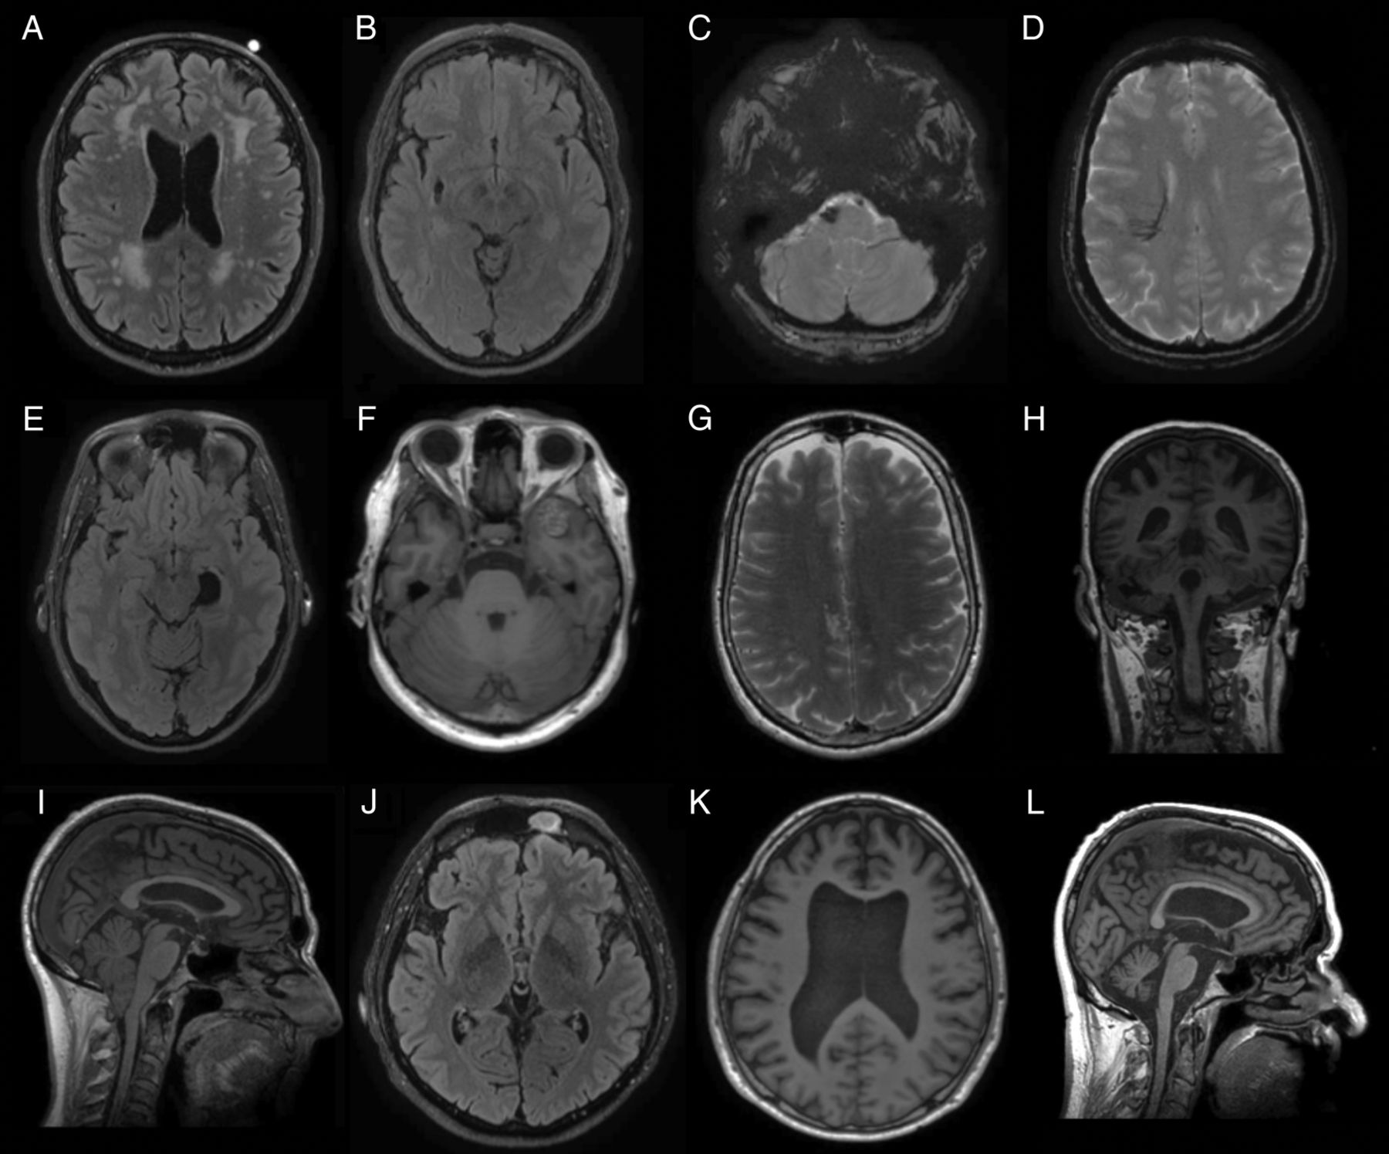
BrainScanML : Stratified Brain MRI Tumour Classification with Ensembles & Calibration
By Karlo Nahro
19003070
This Photo by Unknown Author is licensed under CC BY-NC

Slide 2
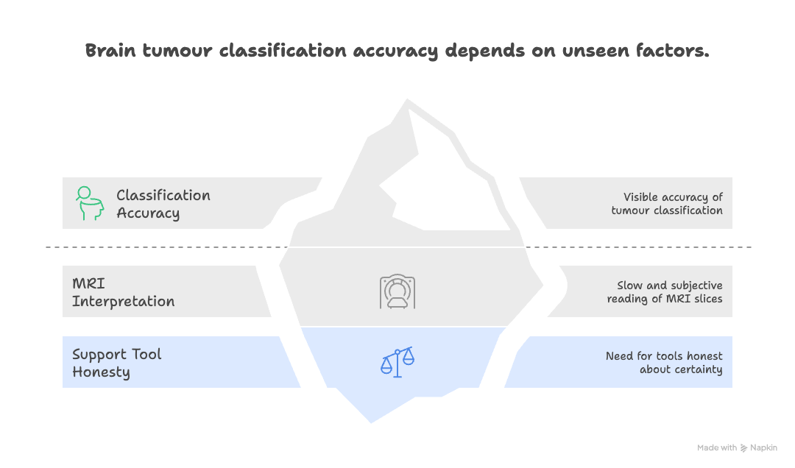
Why it matters ?
Accurate brain tumour classification guides surgery, radiotherapy, the lot. MRI is excellent ,but reading thousands of slices is slow and subjective. We need support tools that are not just accurate, but honest about their certainty

Slide 3
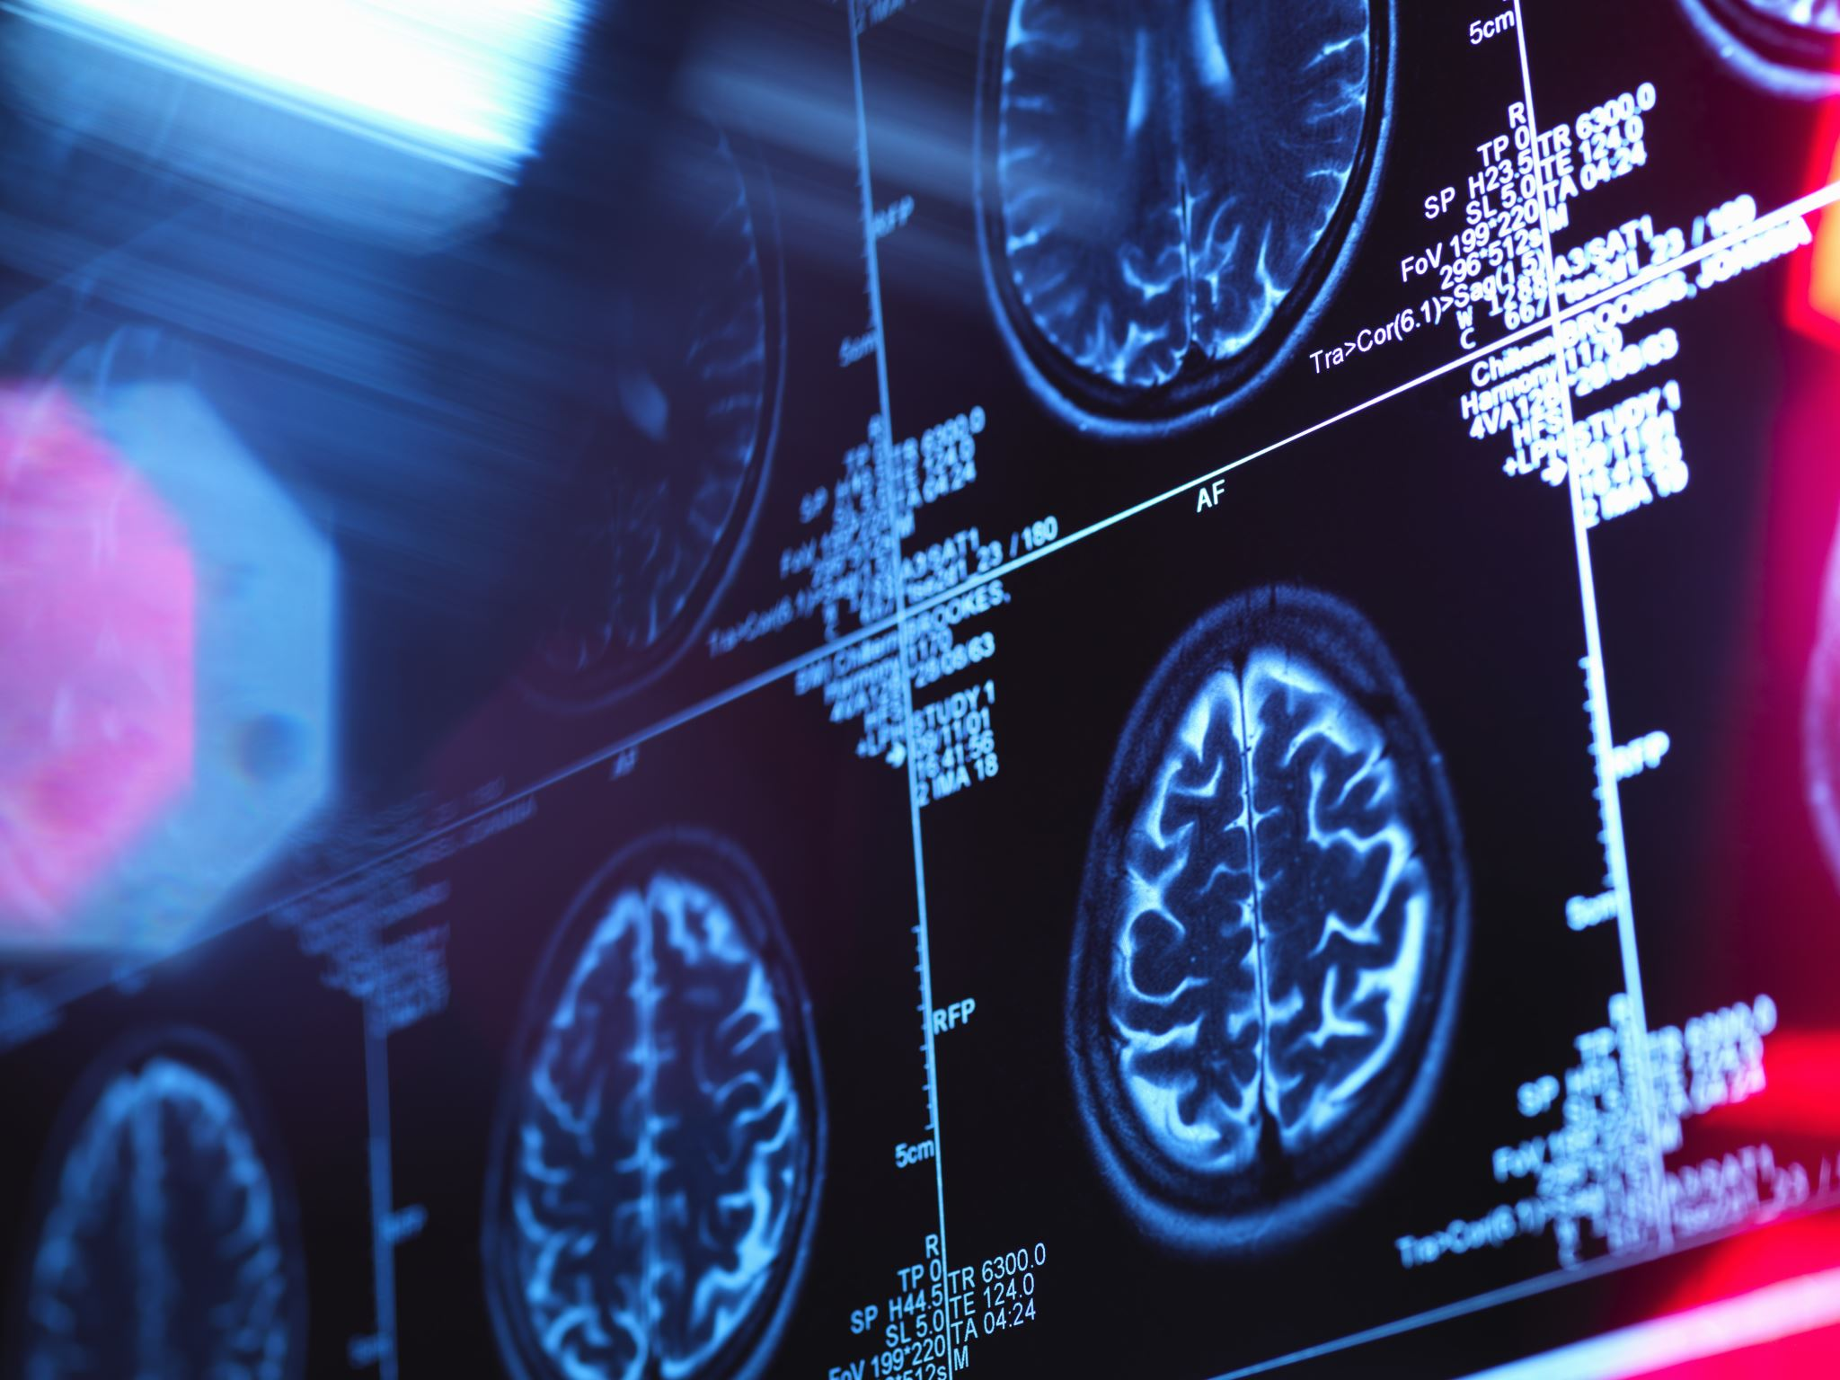
My project challenge: Develop a robust, well-calibrated deep-learning ensemble to classify axial brain MRI slices into four categories glioma, meningioma, pituitary, and no tumour , using stratified splits and transparent evaluation

Slide 4
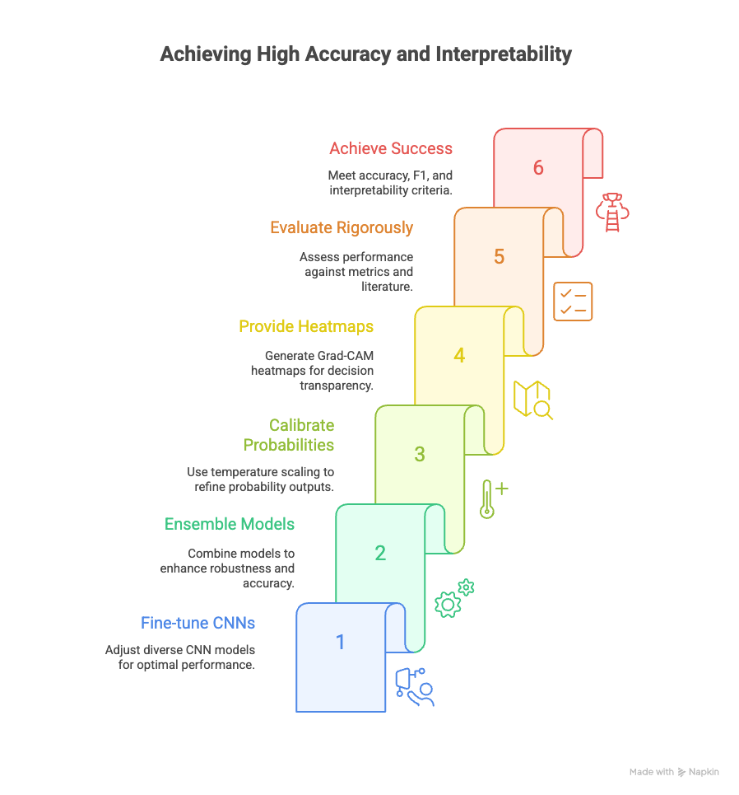
Aims: high accuracy, calibrated confidence, explainable decisions
Fine-tune diverse CNNs (VGG16, Xception, EfficientNet-B0).
2. Ensemble them to improve robustness.
3. Calibrate probabilities with temperature scaling.
4. Provide Grad-CAM heatmaps for transparency.
5. Evaluate rigorously—metrics, calibration, literature comparison, limitations.
Success criteria:
≥95% accuracy, Macro-F1 >0.95, ECE <0.03, plus clear interpretability.”

