Slide 1

Exploratory Data Analysis
<AndreiKartavik_G2M_CaseStudy>
<15.09.2022>

Slide 2
Agenda
Problem Statement
Approach
EDA
EDA Summary
Recommendations

Slide 3
Problem Statement
Problem: XYZ is a private firm in US. Due to remarkable growth in the Cab Industry in last few years and multiple key players in the market, it is planning for an investment in Cab industry and as per their Go-to-Market(G2M) strategy they want to understand the market before taking final decision.
Objective: Provide actionable insights to help XYZ firm in identifying the right company for making
investment.

Slide 4
Approach
Understand the given data
Identify relationships
Create visualization for discovered relationships
Give propositions

Slide 5
Data Exploration
Given data includes:
15 unique features
Timeframe of the data: 2016-01-31 to 2018-12-31
Total data points :355,032
Assumptions:
Outliers are present and they were handled
Revenue was calculated as “Price Charged” – “Cost of Trip”, by not taking into account other factors

Slide 6
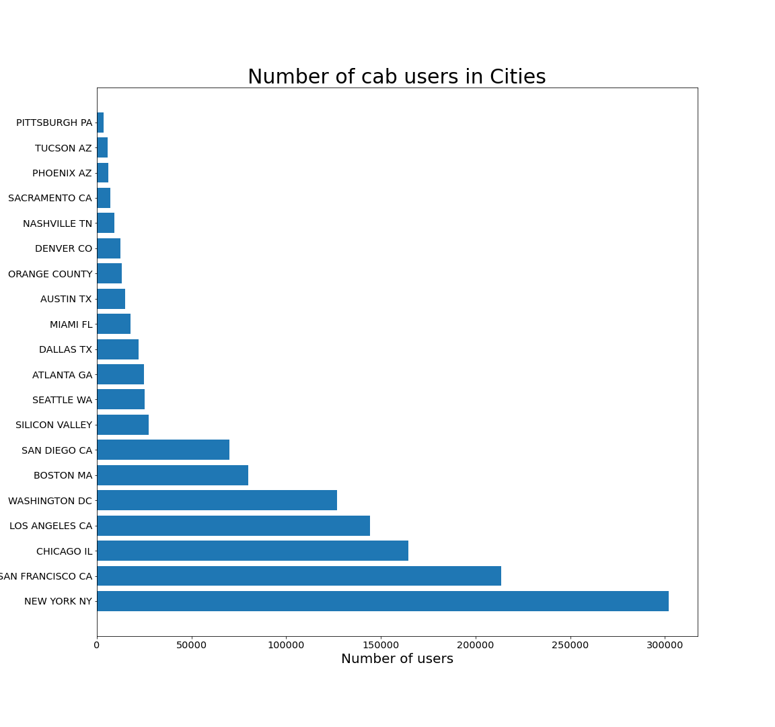
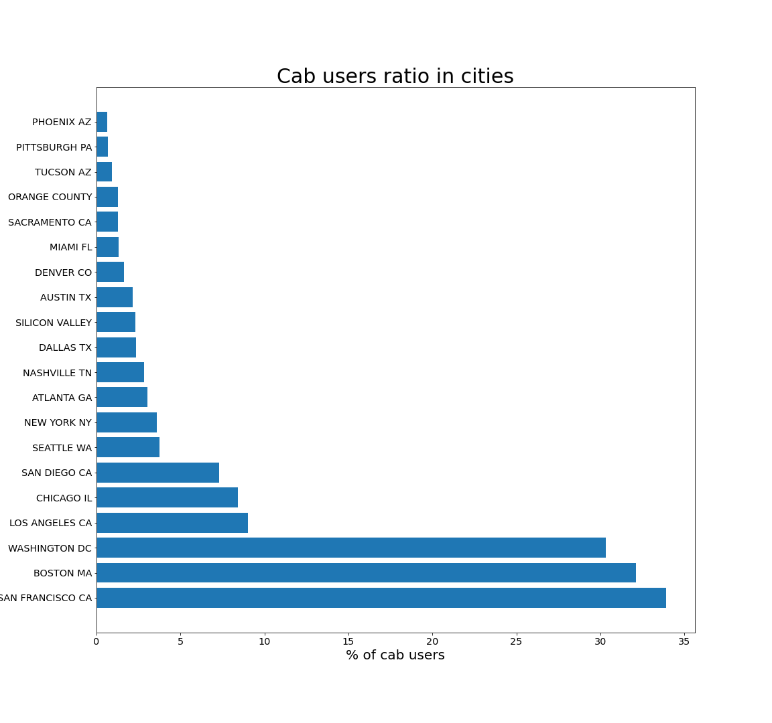
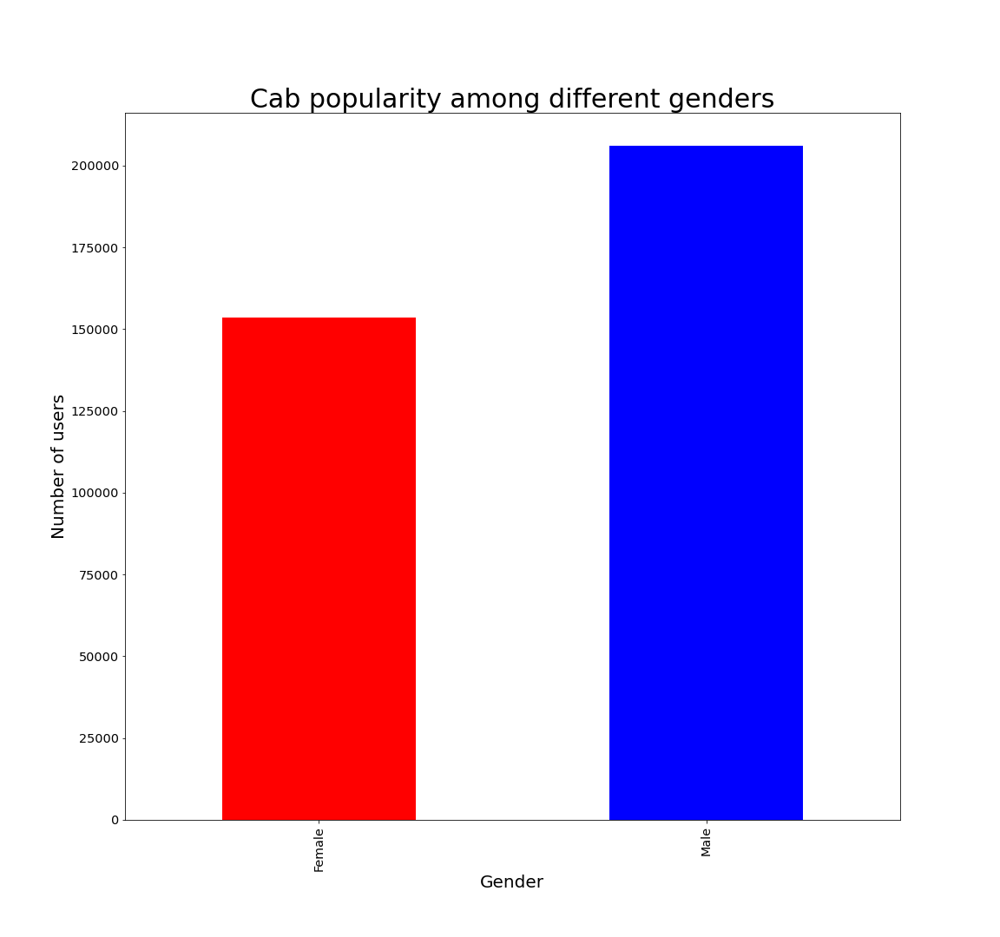
Popularity analysis
The bigger is the city, the more cab users it has. But the best users ratio appears in the cities, without the biggest population. Also, there are more Male cab users than Female.

Slide 7
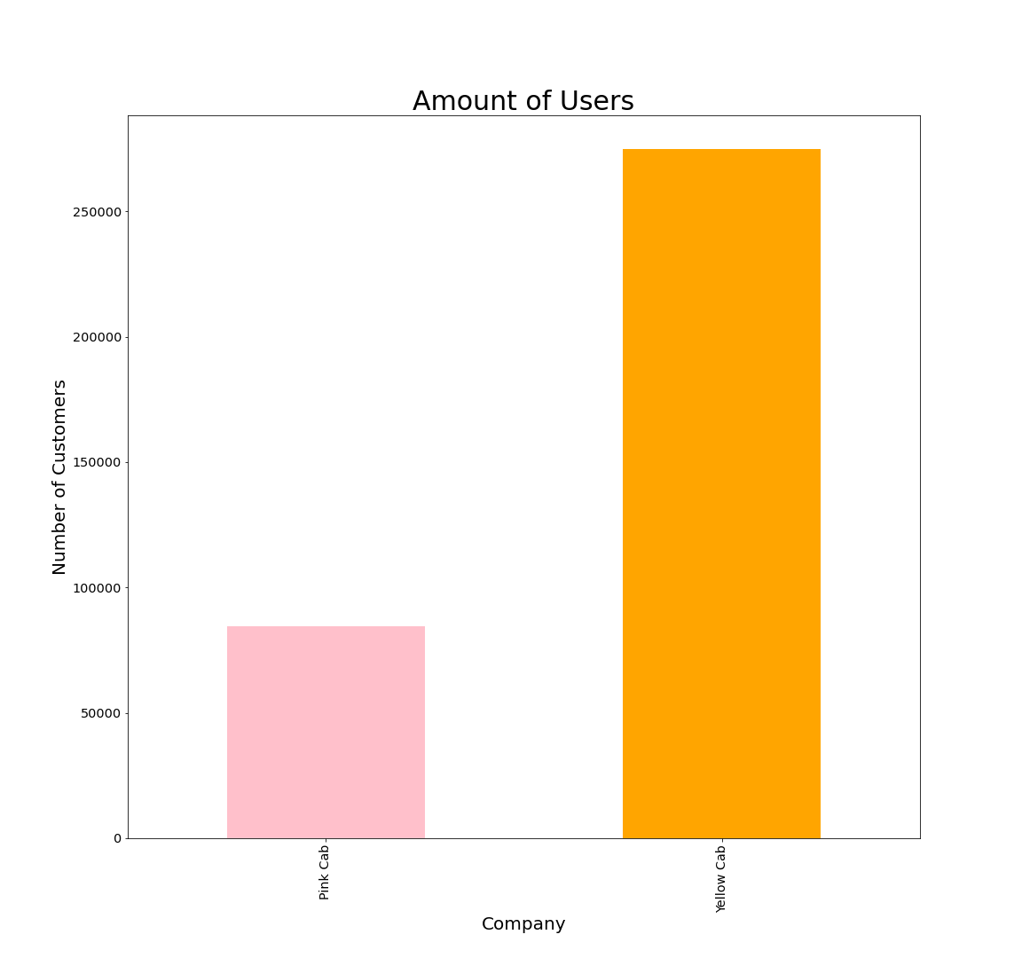
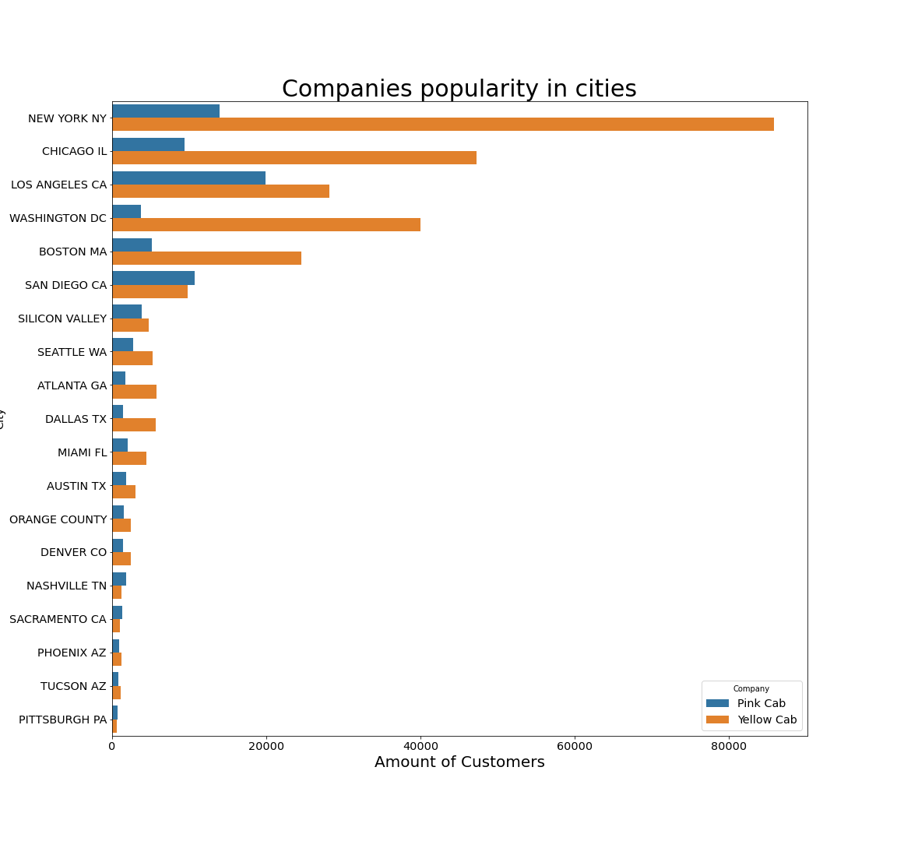
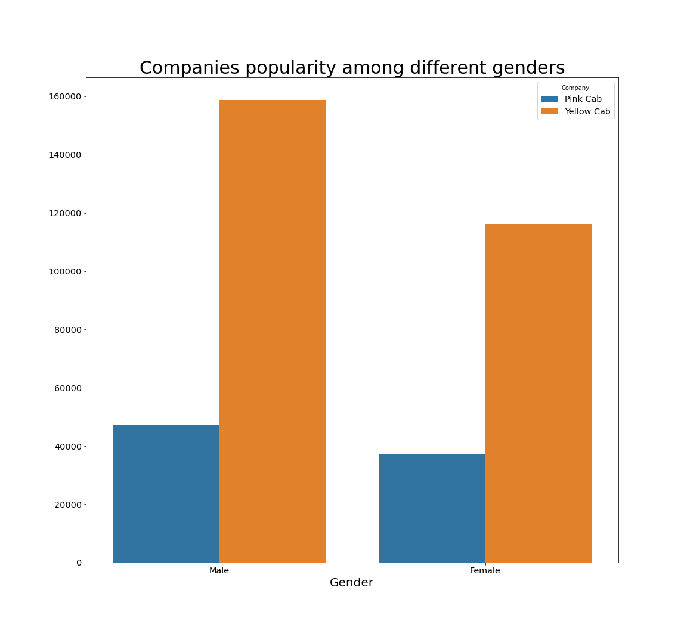
Companies popularity
The Yellow Cab is more popular than Pink Cab. It has more customers than Pink Cab in almost all the big cities and cities with big users ratio. Furthermore, companies have more Male customers than Female

Slide 8
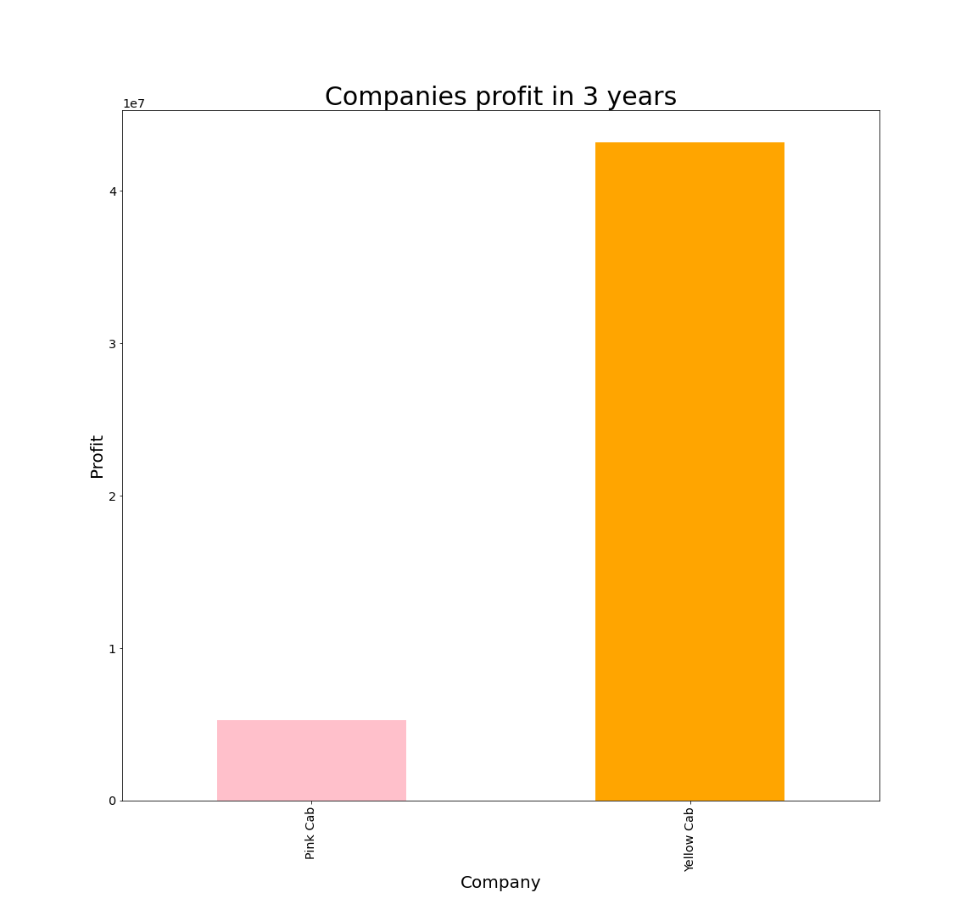
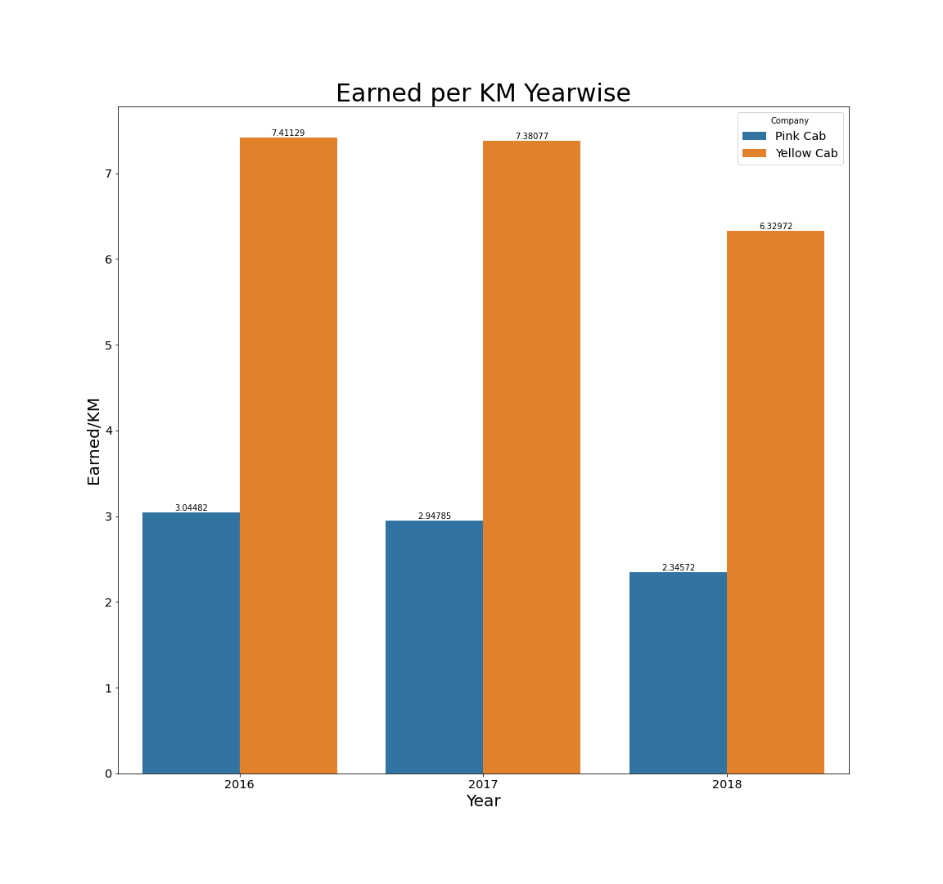
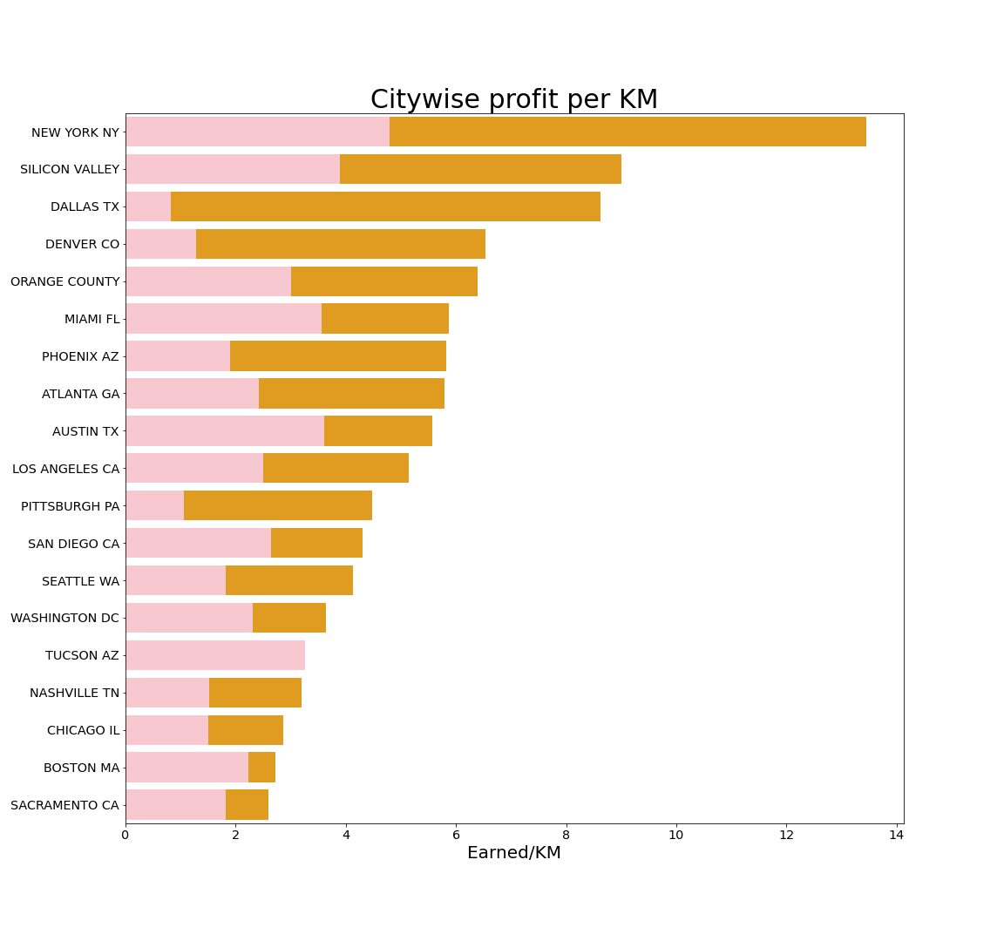
Profit analysis
Yellow Cab makes more money per km for 3 years, it has bigger profit almost in all the cities and it’s overall profit is higher than Pink Cab profit

Slide 9
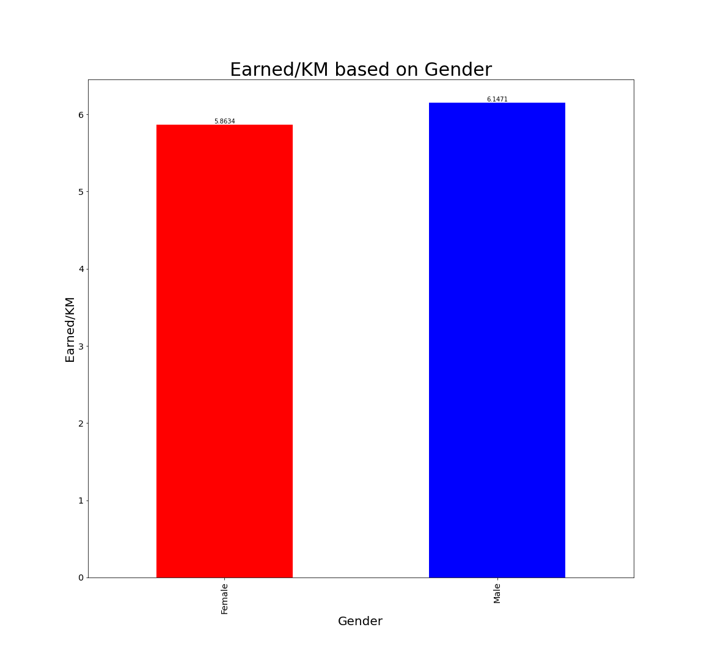
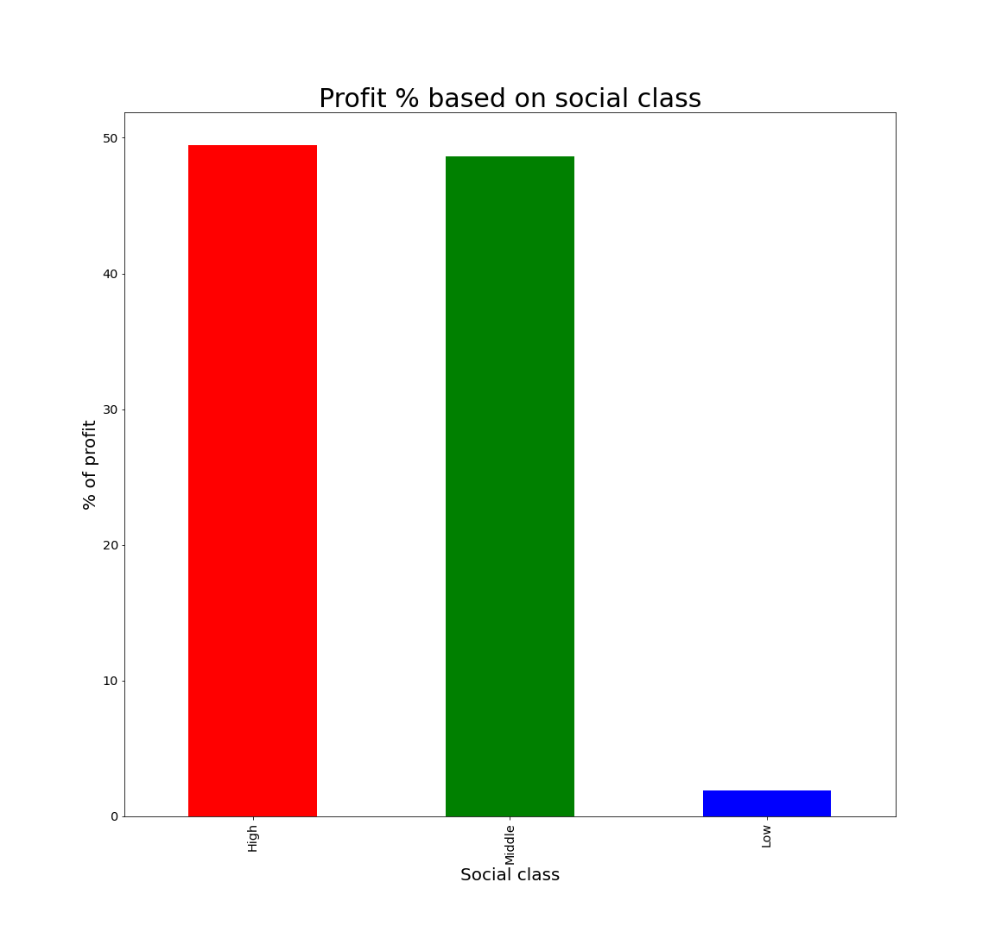
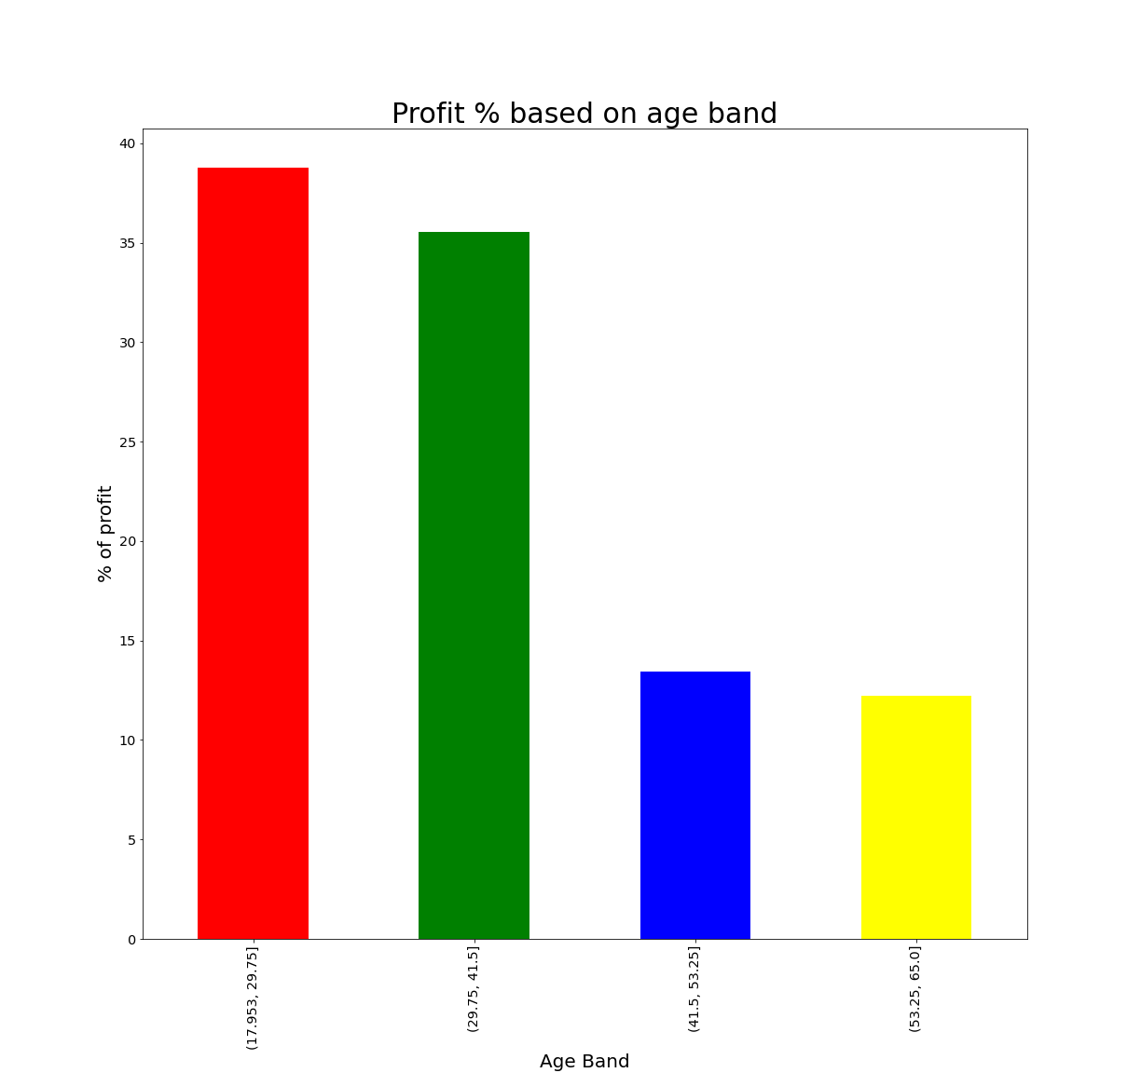
Customer-base revenue analysis
We can see that Profit per KM doesn’t depend on the Gender. Also, high and middle classes are equally important for companies profit and low class has very little contribution to companies profit. Moreover, older groups of people contribute less to overall profit

Slide 10
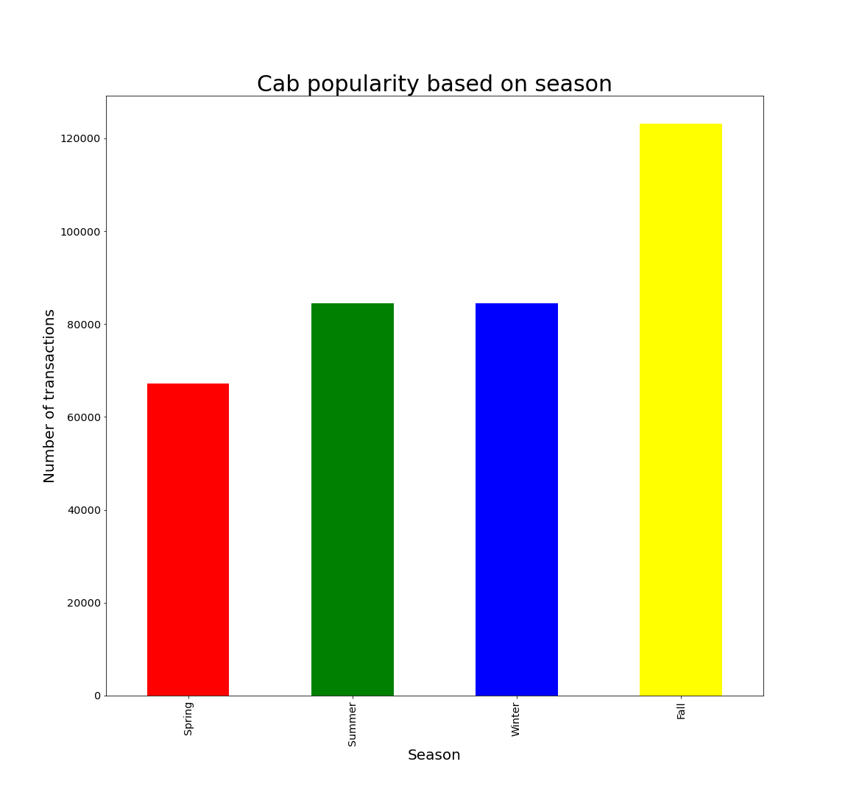
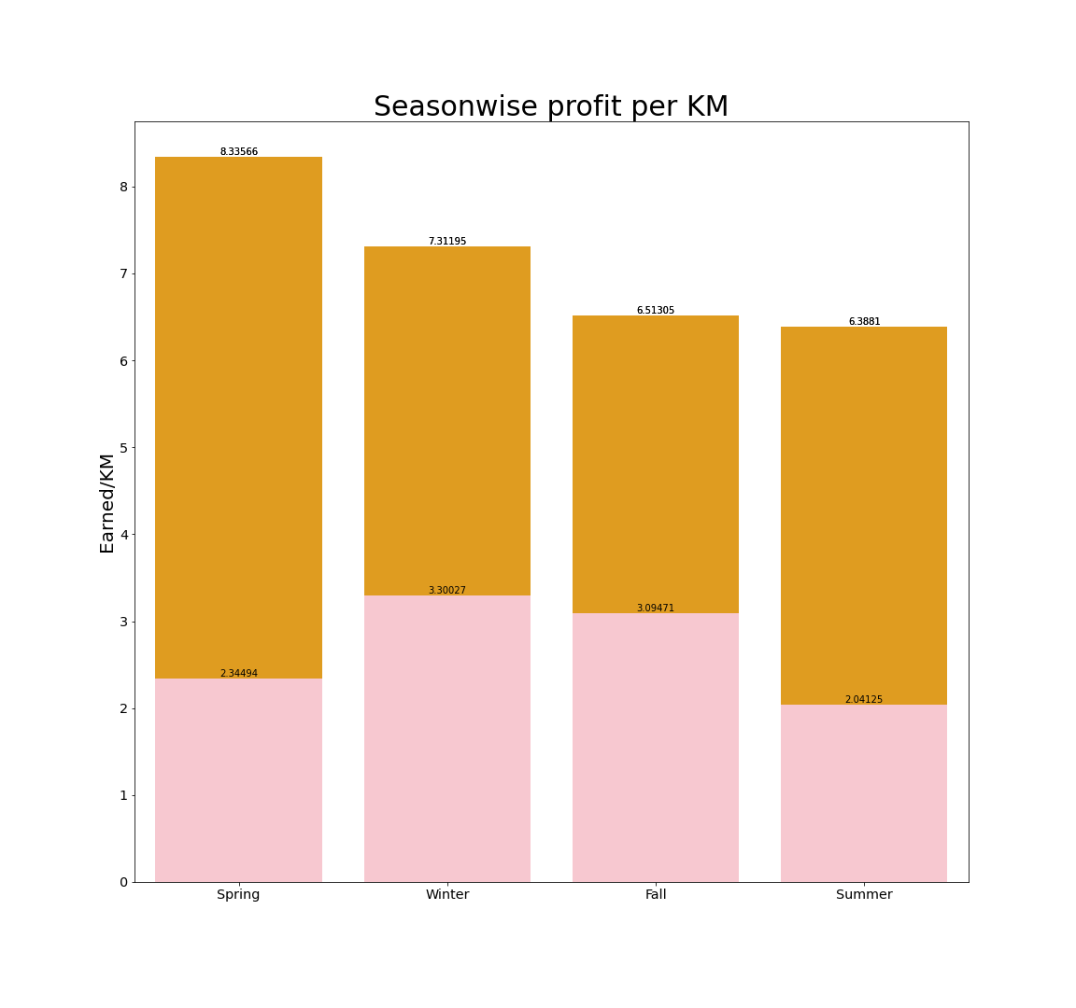
Seasonality analysis
On these graphs we can see, that cab popularity depends on the season. During Spring and Summer the cab popularity is the lowest, probably because when the weather is good people tend to walk or use bikes. And the cab is more popular during Winter and Fall, probably because of the bad weather. Moreover, we can see, that profit per KM also depends on the season: For Yellow Cab company the most profitable season is Spring and the least profitable is Summer, for Pink Cab company the most profitable is Winter and the least is Summer

Slide 11
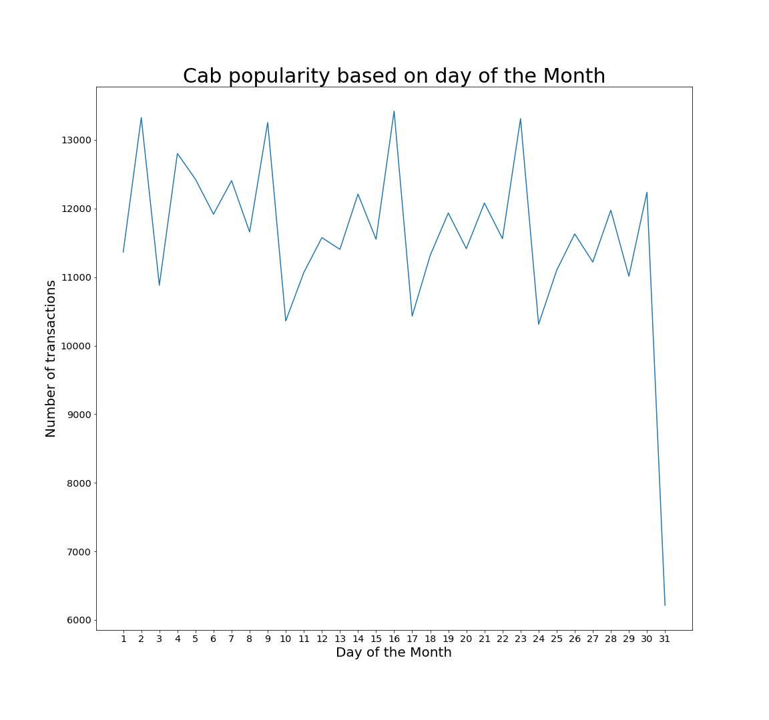
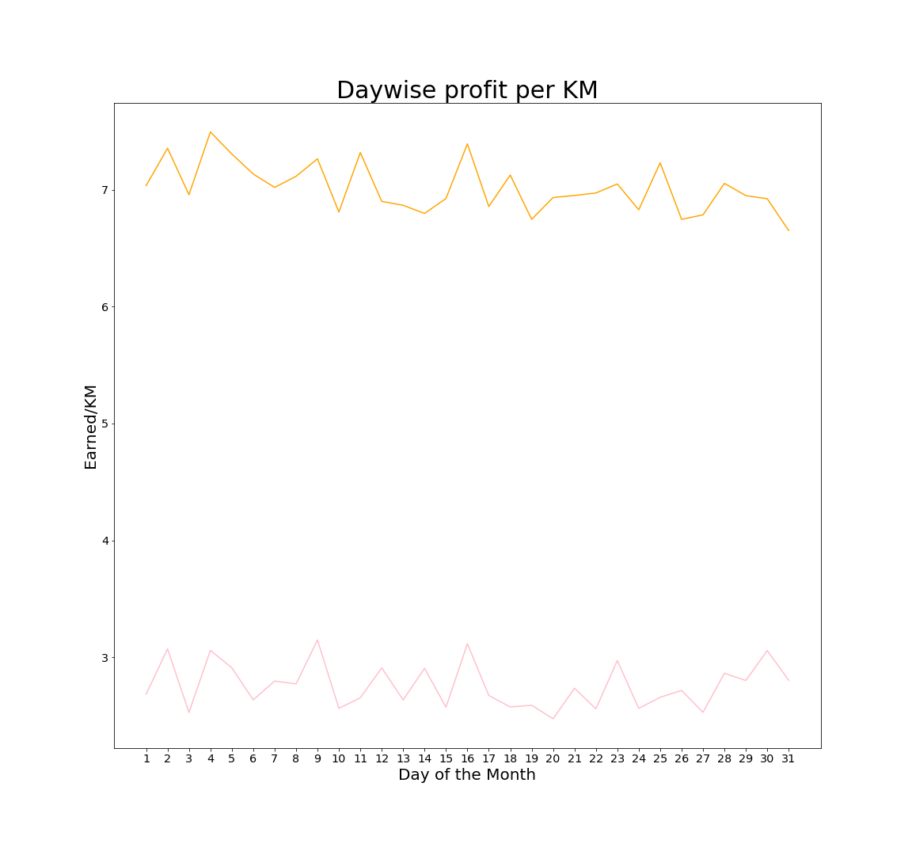
Daywise analysis
Here we can see, that the Cab popularity as well as the profit per KM depend on the day of the month.

Slide 12
Data Analysis results and propositions
Insights:
1) The bigger the city, the more Cab users it has
2) Cities with the biggest users’ ratio are not the biggest ones
3) There are more Male cab users, than Female
4) High and middle social classes are 98 % of cab companies profit
5) Older groups of people contribute less to companies profit
6) There is seasonality in the cab industry, which influences popularity and profit of the cab companies
Propositions:
After comparation of two companies: Yellow Cab and Pink Cab, we can conclude that it’s better to invest in Yellow Cab company… It’s more popular than Pink Cab almost in all big cities, more popular between Male and Female and it just has more users. Moreover, Yellow Cab has higher overall profit during the 2016-2018 years, bigger profit per KM in almost all the cities during every season of the year. But the final decision is up to XYZ company.

Slide 13
Thank You

