Slide 1
Build Your Own Chatbot
Arun Gupta, @arungupta
Amazon Web Services

Slide 2
Docker Captain
Java Champion
JavaOne Rock Star (4 years)
NetBeans Dream Team
Silicon Valley JUG Leader
Author
Runner
Lifelong learner

Slide 3
Star Wars Chatbot

Slide 4
Tell me a Yoda quote

Slide 5
Developer Challenges
Automated
Speech Recognition
Testing
Availability
Mobile
Natural
Language Understanding
Business Logic
Scalability
Disparate Systems
Authentication

Slide 6
Chatbot Components
User Interface
Voice SMS
Chat
Web
Email
ASR/NLU
API.ai
Wit.ai
Watson
Lex/Polly
Rekognition
Alexa Skills Kit Deep Learning
Fulfillment
Node.js
AngularJS
Flask
Java
Grails Serverless
Database
MongoDB
MySQL
MariaDB
RDS
DynamoDB
Logging (ELK, EFK, CloudWatch)
Monitoring (Newrelic, Datadog, X-Ray)
CI/CD (Jenkins, CircleCI, CodePipeline)
Notes:
ASR = (speech -> text) Attempts to determine what exactly was said, map audio speech data to textual sentences or key phrases
NLP = (text -> meaning) Determines the intent of what was said, post-ASR step. (Human originated)
NLU = subset of the wider NLP (unstructured inputs governed by poorly defined and flexible rules that humans can handle), (machine originated)
NLP is AFTER ASR, but helps improve speech recognition and makes it better. Almost like a feedback loop.

Slide 8





Tell
me
a
Get a quote
Yoda
quote
Yoda
“Tell me a
Yoda quote”
Automatic Speech Recognition
Natural Language Understanding
Intent /
Slot
Utterances
Quote
Character | Yoda
Movie | IV
All required slots have values?
“Do. Or do not. There is no try”
Quote: “Here is a quote from Yoda
from Star Wars IV
“Do. Or do Not. There is no try.”

Slide 9




Chatbot Architecture
User Interface
PreProcess
ASR/NLU
Fulfillment
Database
Voice
SMS
Chat
Web
AngularJS
Logging
Monitoring
CI/CD

Slide 10
BYOC: Build Your Own Chatbot
Prepare database
Add documents to DynamoDB, setup indexes
Build a Lex bot
Define utterances, slots, slot-types, prompts, intent
Write Lambda function for business logic (intent -> database)
Integrate with Twilio, Slack, Facebook, Web, mobile
Build an Alexa skill (optional)
Export Lex bot configuration for Alexa Skills Kit
Write Lambda function for business logic (intent -> database)

Slide 11
BYOC #1: Prepare database
{
"dead": true,
"force-sensitive": true,
"forceside": "light",
"id": 1,
"lightsaber": "green",
"planet": "Dagobah",
"quotes": [
"When nine hundred years old you reach, look as good you will not.",
"Truly wonderful, the mind of a child is",
"A Jedi uses the Force for knowledge and defense, never for attack",
"That is why you fail.",
"Adventure. Excitement. A Jedi craves not these things.",
"Judge me by my size, do you?",
"Fear is the path to the dark side",
"Wars not make one great",
"Do, or do not. There is no try",
"Size matters not",
"The dark side clouds everything",
"Impossible to see the future is",
"Clear your mind must be",
"Much to learn you still have ... my old padawan"
],
"weapon": "lightsaber",
"whoami": "Yoda"
}

Slide 12
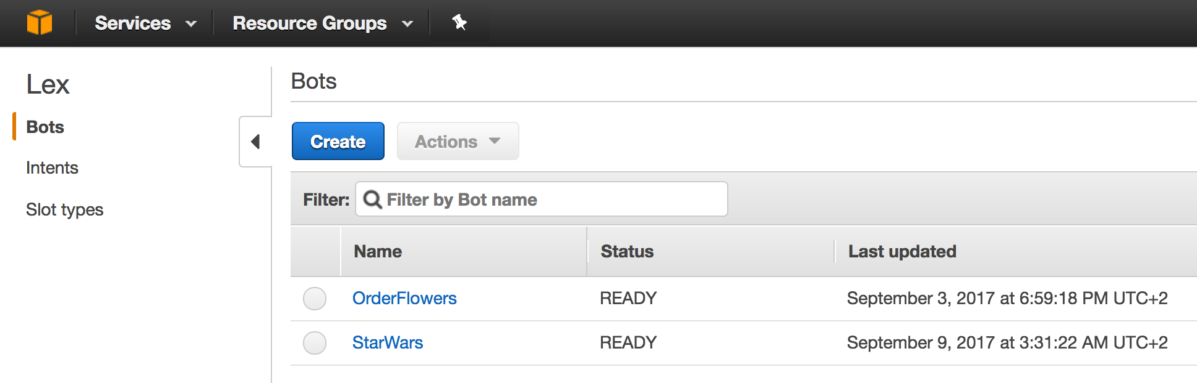
BYOC #2: Build a Lex bot

Slide 13
Amazon Lex
Service for building conversational interfaces using voice and text
Provides
Automatic Speech Recognition (ASR): speech -> text
Natural Language Understanding (NLU): text -> intent
Powered by the same deep learning technologies as Alexa
http://aws.amazon.com/lex
Notes:
Speech recognition and natural language understanding are some of the most challenging problems to solve in computer science, requiring sophisticated deep learning algorithms to be trained on massive amounts of data and infrastructure. Amazon Lex democratizes these deep learning technologies by putting the power of Amazon Alexa within reach of all developers. As a fully managed service, Amazon Lex scales automatically, so you don’t need to worry about managing infrastructure. With Amazon Lex, you pay only for what you use.

Slide 14
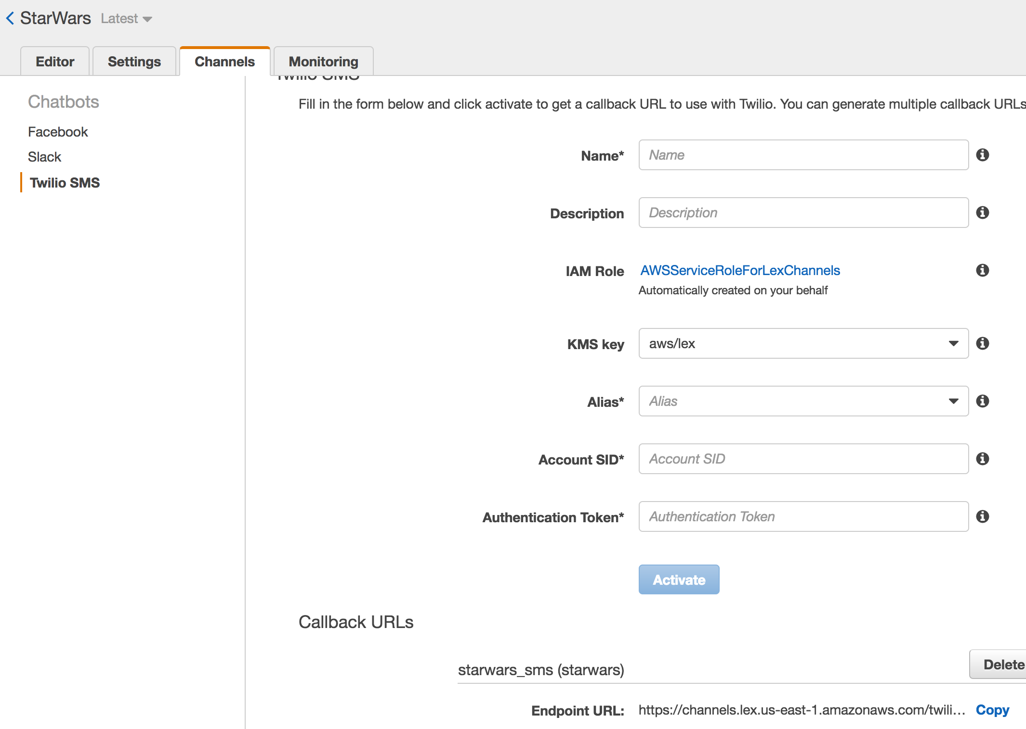
BYOC #2: Twilio

Slide 15
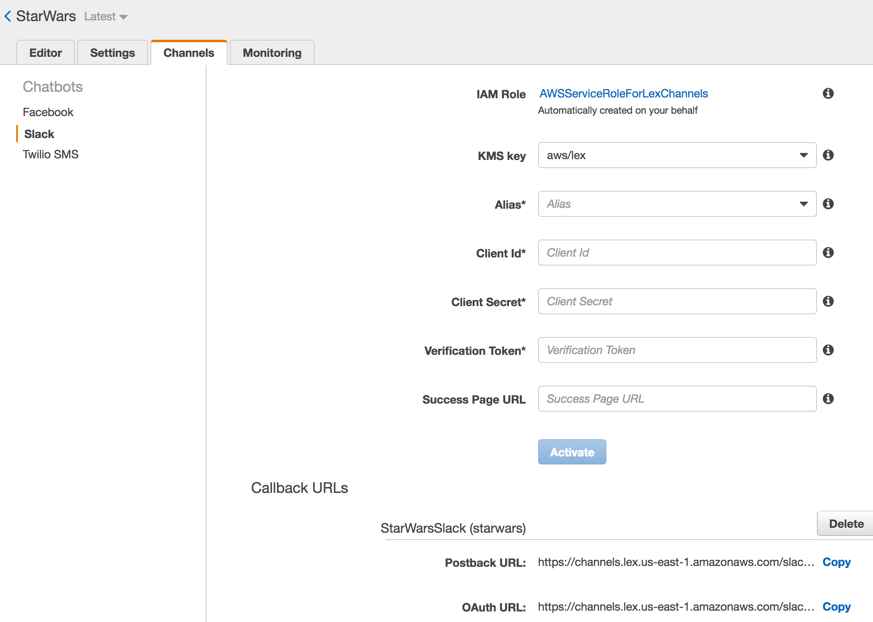
BYOC #2: Slack

Slide 16
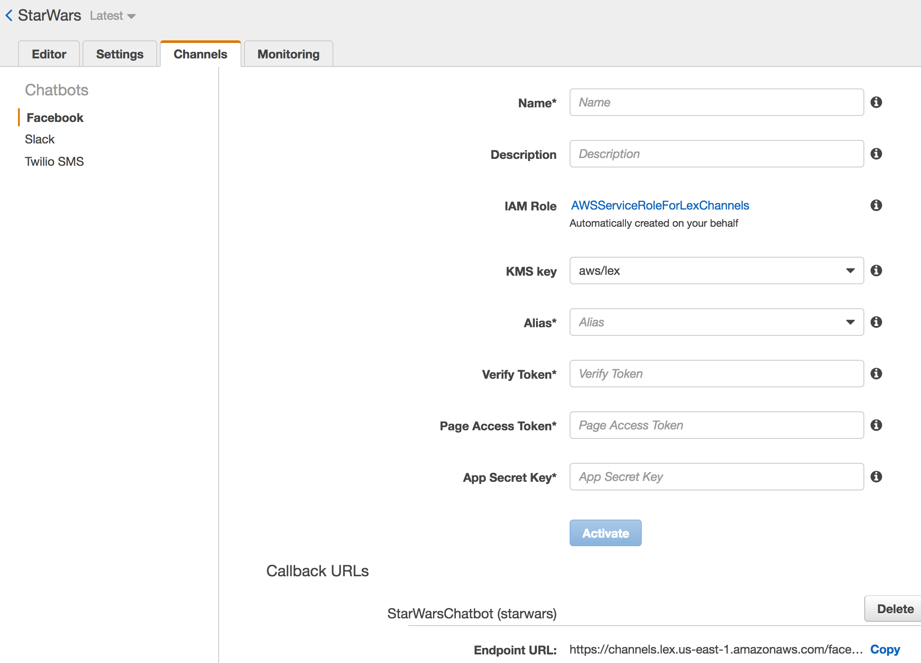
BYOC #2: Facebook Messenger

Slide 17
BYOC #2: AngularJS

Slide 18
BYOC #2: Mobile

Slide 19
Spontaniety
Multiple prompts for a slot type

Slide 20
Build First Alexa Skill using Java
Using Alexa Skills Kit
Custom skill
Smart Home Skill API
Entertainment Device Control
Video Skill API
Flash Briefing Skill API

Slide 22

Steps to Build a Skill
Define utterances
Define Intent Schema
Map utterances to Intent
Handle Intent in Speechlet
Deploy Lambda
Setup skill in Developer Portal

Slide 23
BYOC #3: Build an Alexa Skill
Front end
Voice User Interface (VUI)
Intent, slot, slot-types, utterances, resources
Export Lex bot configuration
Can also be created from scratch (if starting here)
developer.amazon.com
Back end
Lambda function with Alexa Skill Kit (ASK) trigger
aws.amazon.com
Skill certification

Slide 24
Alexa, ask Star Wars tell me a Yoda quote
Wake word
Starting phrase
Skill invocation name
Utterance

Slide 25
Security
AmazonServiceRoleForLexBots
IAM permissions??

Slide 26
Logging
CloudWatch

Slide 27
Monitoring
CloudTrail
X-Ray

Slide 28
CI/CD Pipeline
CodePipeline

Slide 29
References
Amazon Lex: aws.amazon.com/lex
Developer Portal: developer.amazon.com
Slides & code: github.com/arun-gupta/chatbot

