Slide 1
A2
ns-3 Setup &
3GPP XR Pose Traffic Model
A deterministic uplink baseline based on 3GPP TR 26.926 §5.9.2
[Your Name] · [Student ID]
Week 7 · 10-minute presentation
ns-3.44 | Ubuntu 22.04.5 LTS | x86-64

Slide 2
ENVIRONMENT
Setup and reproducibility
ns-3.44
Ubuntu 22.04.5
60 s
Simulator version
Linux platform · x86-64
Traffic duration · 6,000 packets
Build and run
What broke?
$ ./ns3 build xr-pose-uplink
$ ./ns3 run xr-pose-uplink
$ python3 scratch/plot-xr-pose-results.py --prefix xr-pose-uplink
Restricted ccache directory
→ built with CCACHE_DISABLE=1
Matplotlib GUI warnings
→ switched plotting backend to Agg
A2 · ns-3 Setup & Traffic Model
02

Slide 3
TRAFFIC MODEL
3GPP Pose uplink model
Specified by §5.9.2
Experimental choices
Pose is available to the application every 1 ms (1 kHz).
UDP/IPv4 over a point-to-point baseline link.
Each IP packet is 100 bytes: 60-byte payload + 40-byte headers.
One XR device and one application server.
The latest pose is reported every 10 ms (100 Hz).
Fixed pose: position (1,1,1.2), quaternion (0,0,0,1).
Target uplink latency is no greater than 10 ms.
The timestamp changes every sample; motion is not required.
Source: 3GPP TR 26.926 V18.2.0, §5.9.2 — Pose Uplink Model
A2 · ns-3 Setup & Traffic Model
03

Slide 4
IMPLEMENTATION
Topology and 100-byte packet format
XR DEVICE
10.1.1.1
UDP/IPv4 →
10 Mbps · 1 ms one-way
SERVER
10.1.1.2
100-byte IPv4 packet
IPv4 header
20 B
UDP
8 B
Report header
12 B
Pose payload
60 B
Pose payload: position 12 B · quaternion 16 B · sample time 8 B · device ID 4 B · reserved 20 B
Sequence 4 B + send time 8 B
Network delay = receive time − send time
Pose age = receive time − sample time
PCAP adds a 2-byte PPP header: captured frame = 102 B
A2 · ns-3 Setup & Traffic Model
04

Slide 5
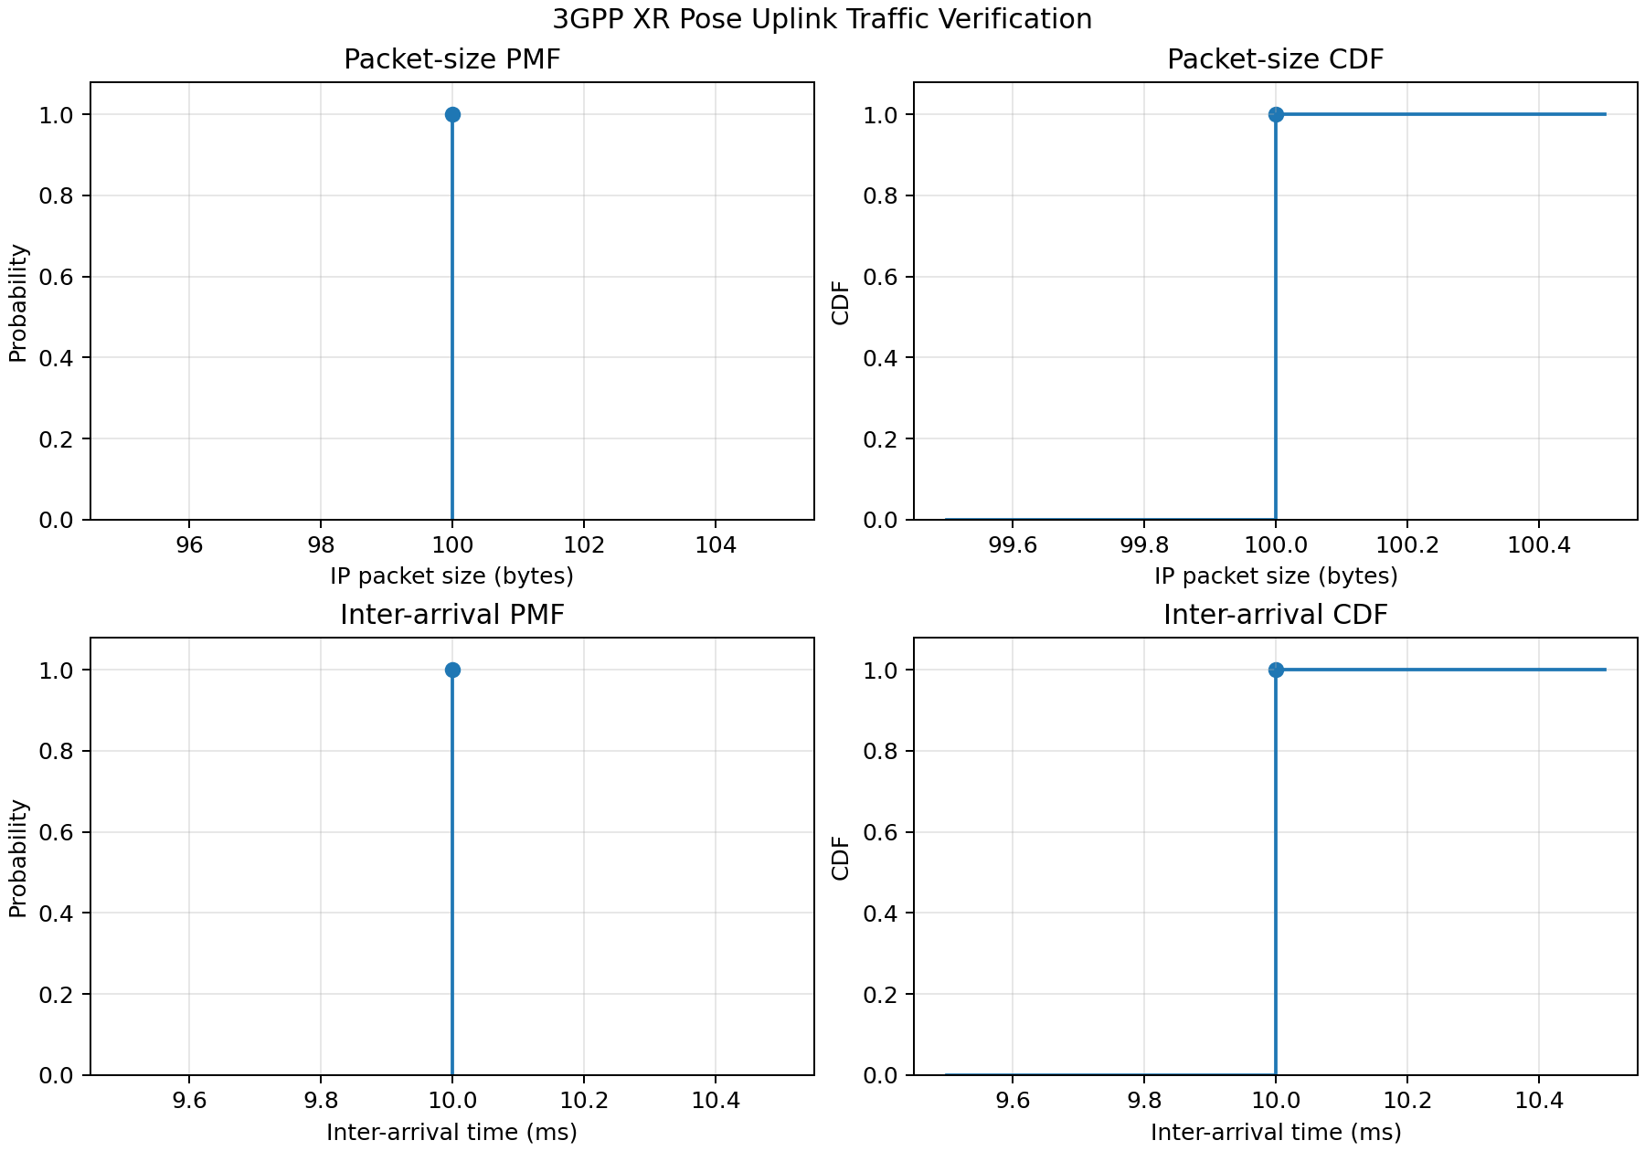
RESULTS
Traffic-model verification: PMF and CDF
P(size = 100 B) = 1
P(inter-arrival = 10 ms) = 1
A2 · ns-3 Setup & Traffic Model
05

Slide 6
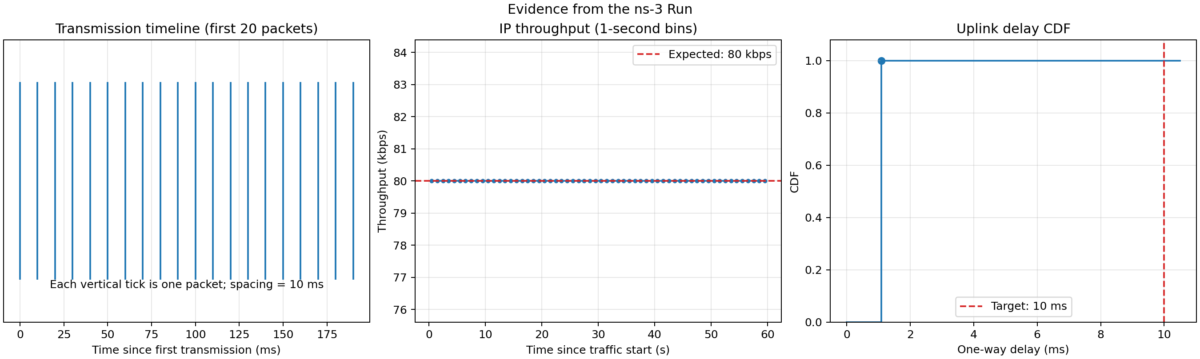
RESULTS
Evidence from my ns-3 run
80 kbps
1.0816 ms
100%
Measured IP offered rate
Mean and maximum delay
Packets meeting ≤10 ms
A2 · ns-3 Setup & Traffic Model
06

Slide 7
WIRESHARK
PCAP proof and packet accounting
1.000000 IP (0x0021), length 102: 10.1.1.1 → 10.1.1.2 UDP, length 72
1.010000 IP (0x0021), length 102: 10.1.1.1 → 10.1.1.2 UDP, length 72
1.020000 IP (0x0021), length 102: 10.1.1.1 → 10.1.1.2 UDP, length 72
What to verify in Wireshark
Why does PCAP show 102 B?
Filter: udp.port == 5000
2 B
100 B
+
Time delta between packets: 0.010 s
PPP header
IPv4 packet
IPv4 total length: 100 bytes
UDP length: 80 bytes; UDP payload: 72 bytes
= 102-byte captured frame
A2 · ns-3 Setup & Traffic Model
07

Slide 8
TAKEAWAYS
Conclusion
The implemented traffic model matches the configured 3GPP baseline.
6,000 / 6,000
100 B · 10 ms
1.0816 ms
Packets sent / received · 0% loss
Deterministic size and reporting period
Well below the 10 ms latency target
Why UDP?
Next step
Pose updates become stale quickly. UDP avoids retransmission, acknowledgements, and head-of-line blocking; the next fresh pose is more useful than a delayed old pose.
Add movement, wireless loss, jitter, or congestion only after the baseline traffic model is verified.
Questions?
A2 · ns-3 Setup & Traffic Model
08

