Slide 1
IML PROJECT LAPTOP PRICE PREDICTION
PRESENTED BY: HRITIK KUMAR
ROLL NO: IIT2021014

Slide 2
Table of Contents
Describing Problem Statement
Literature Review
Proposed Methodology
Analysis of Proposed Model Performance
Overview about dataset
Data Cleaning
Exploratory Data Analysis
Feature Engineering
Machine learning Modeling
Comparison of Performance with Another Model
ML web app development
Conclusion and Future Work

Slide 3

Problem Statement for Laptop Price Prediction
We will make a project for Laptop price prediction. The
problem statement is that if any user wants to buy a laptop
then our application should be compatible to provide a tentative
price of laptop according to the user configurations. Although it looks
like a simple project or just developing a model, the dataset we have
is noisy and needs lots of feature engineering, and preprocessing that
will drive your interest in developing this project.

Slide 4
Literature Review
[1]. Sorower MS, published the paper (A literature survey on algorithms for multi-label learning). Various studies have extensively researched predicting
the lifetime of laptops. In her Master's thesis, Listian found that using a regression model built with Decision Tree and Random Forest Regressor provided
more precise predictions for the price of a leased laptop compared to using multivariate regression or simple multiple regression. This is because the
Decision Tree Algorithm is more efficient in handling datasets with higher dimensions and is less susceptible to overfitting and underfitting. However,

Slide 5
the weakness of this research lies in the lack of comparison between the basic indicators such as mean, variance, or standard deviation of simple regression
and the more advanced Decision Tree Algorithm regression. Additionally, the research focused solely on supervised learning algorithms, limiting the
scope of predictions.
[2].Pandey M, Sharma VK, published the paper (A decision tree algorithm pertaining to the student performance analysis and prediction. To fully utilize a predictive analytics solution and make informed decisions based on data, it is important for a company to identify the most suitable predictive modeling techniques. Predictive analytics tools employ a variety of models and algorithms that can be applied across a wide range of use cases. Machine Learning
is an AI application that utilizes algorithms to process or assist with statistical data processing. Although it incorporates automation concepts, it still necessitates human guidance

Slide 6
Proposed Methodology
The Random Forest algorithm is used in building a model to predict the price of the laptop. "Random Forest is a classifier that contains a number of decision trees on various subsets of the given dataset and takes the average to improve the predictive accuracy of that dataset." Instead of relying on one decision tree, the random forest takes the prediction from each tree and based on the majority votes of predictions, and it predicts the final output. The greater number of trees in the forest leads to higher accuracy and prevents the problem of overfitting

Slide 7
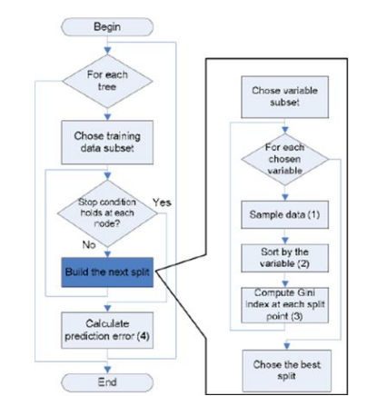
Analysis of Proposed Model Performance
The Working process can be explained in the below
steps
Step-1: Select random K data points from the training
set.
Step-2: Build the decision trees associated with the
selected data points (Subsets).
Step-3: Choose the number N for decision trees that
you want to build.
Step-4: Repeat Step 1 & 2.
Step-5: For new data points, find the predictions of
each decision tree, and assign the new data points to
the category that wins the majority votes.

Slide 8
Dataset for Laptop Price Prediction
For dataset I m going to use csv file from Kaggle. To access the dataset click
https://www.kaggle.com/datasets/nehalgund/laptop-price-prediction-dataset?select=laptop.csv
Most of the columns in a dataset are noisy and contain lots of information. But with feature engineering we’ll do, we will get more good results. The only problem is we are having less data but we will obtain a good accuracy over it. The only good thing is it is better to have a large data. we will develop a website that could predict a tentative price of a laptop based on user configuration.

Slide 9
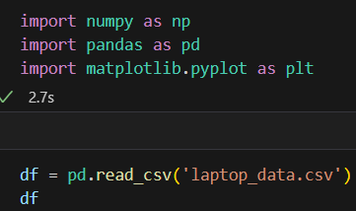
Basic Understanding of Laptop Price Prediction Data
The first step is to import the libraries and load data. After that we will take a basic understanding of data like its shape, sample, is there are any NULL values present in the dataset.
And we need little changes in weight and Ram column to convert them to numeric by removing the unit written after value. So we will perform data cleaning here to get the correct types of columns.

Slide 10
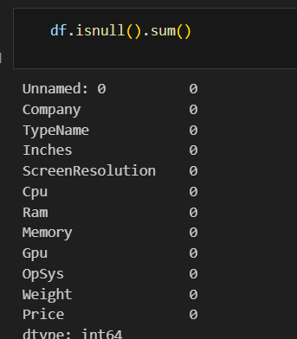
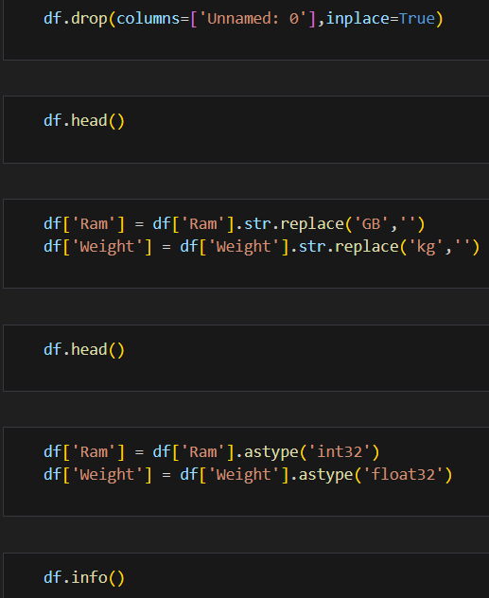
Here we check for NULL values
It is good that there are no NULL values.
And we need little changes in weight and Ram column to
convert them to numeric by removing the unit written after
value. So we will perform data cleaning here to get the correct
types of columns.

Slide 11
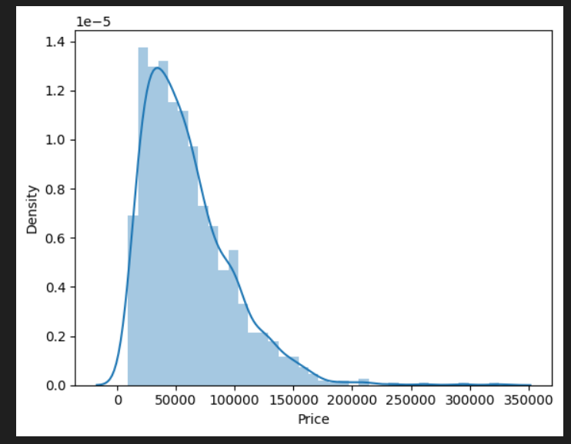

EDA of Laptop Price Prediction Dataset
At the required step, we will a perform preprocessing and feature engineering tasks. our aim in performing in-depth EDA is to prepare and clean data for better machine learning modeling to achieve high performance and generalized models. so let’s get started with analyzing and preparing the dataset for prediction.
1) Distribution of target column
The distribution of the target variable is skewed and it is obvious that
commodities with low prices are sold and purchased more than the
branded ones.

Slide 12
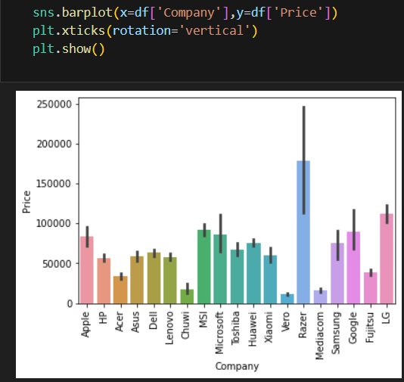
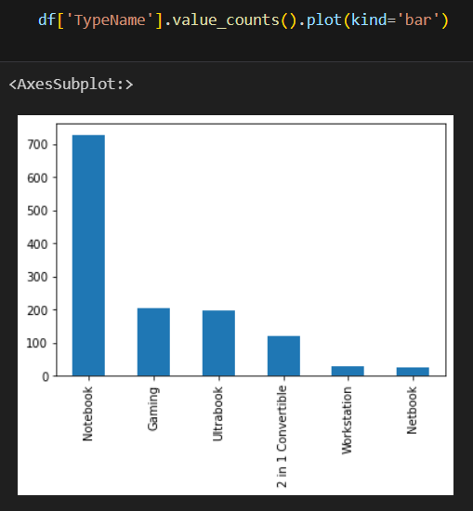
2) Company column
we want to understand how does brand name impacts the laptop price or what is the average price of each laptop brand?
Now if we plot the company relationship with price then you can observe that how price varies with different brands.
Razer, Apple, LG, Microsoft, Google, MSI laptops are expensive,
and others are in the budget range.
3) Type of laptop
Which type of laptop you are
for like a gaming laptop,
workstation, or notebook.
As major people prefer notebook
because it is under budget range
and the same can be concluded
from our data.

Slide 13
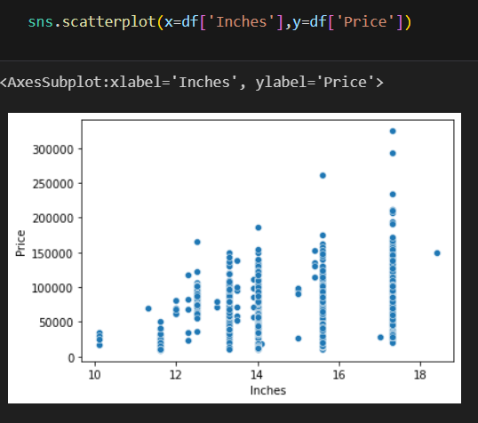
4) Does the price vary with laptop size in inches?
A Scatter plot is used when both the columns are numerical and it answers our question in a better way.
From the plot we can conclude that there is a relationship b but not a strong relationship between the price and size column.

Slide 14
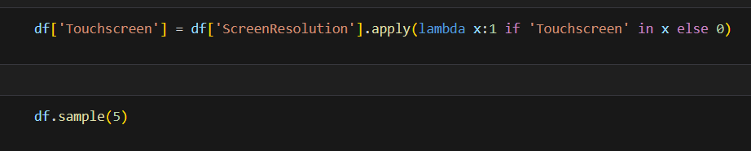
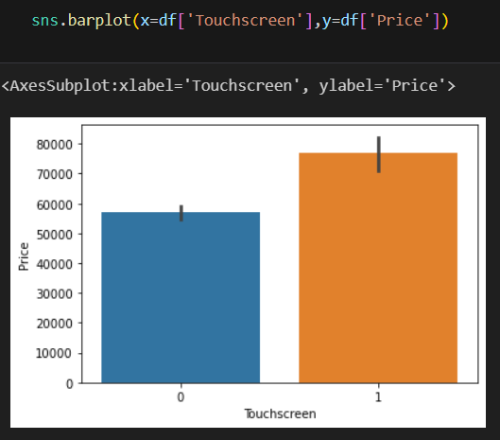
Feature Engineering and Preprocessing of Laptop Price Prediction Model
Feature engineering is a process to convert raw data to meaningful information. there are many methods that come under feature engineering like transformation, categorical encoding, etc. Now the columns we have are noisy so we need to perform some feature engineering steps.
5) Screen Resolution
Extract Touch screen information
It is a binary variable so we can encode it as 0 and 1. one means the laptop is a touch screen and zero indicates not a touch screen
If we plot the touch screen column against price then laptops with
touch screens are expensive which is true in real life.

Slide 15
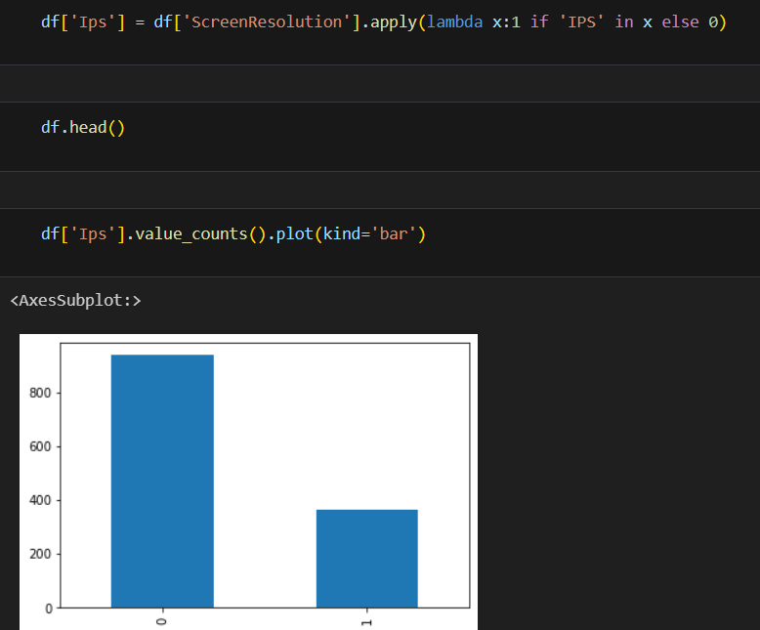
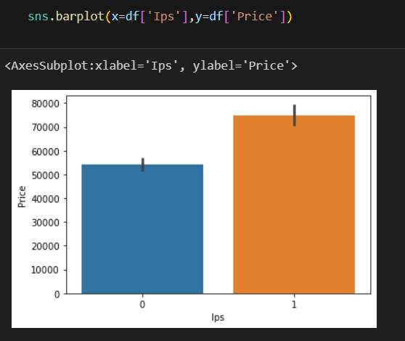
Extract IPS Channel presence information
It is a binary variable and the code is the same we used above. The laptops with IPS channel are present less in our data but by observing relationship against the price of IPS channel laptops are high.

Slide 16
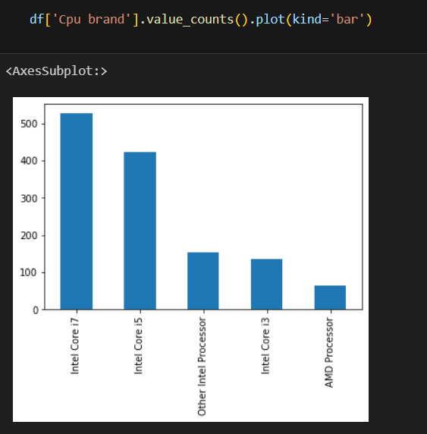
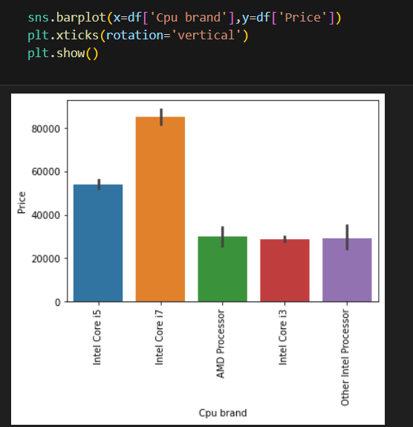
6) CPU column
If you observe the CPU column then it also contains lots of information. If you again use a unique function or value counts function on the CPU column then we have 118 different categories. The information it gives is about preprocessors in laptops and speed.
The following shows the counts of different processors and according
to it Intel i7 has maximum number of counts.
How does the price vary with processors?
The following graph gives us the
Trend of price of different
Processors.

Slide 17
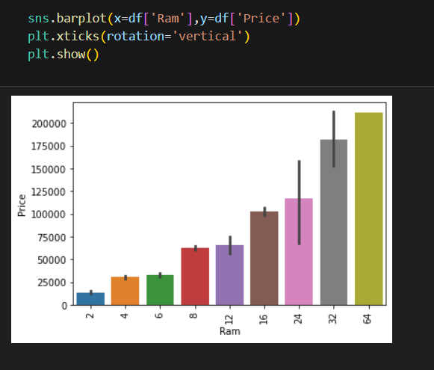
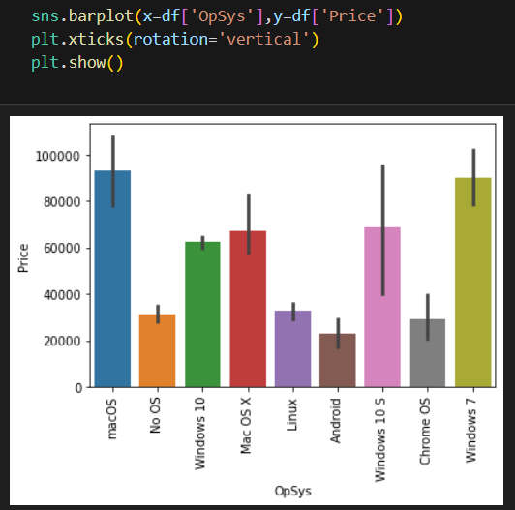
7) Price with Ram
If we observe the plot then Price is having a very strong
positive correlation with Ram or you can say a
linear relationship.
8) Operating System Column
Following plot shows the correlation of
Operating system with Price.
When you plot price against operating
system then as usual Mac is most expensive

Slide 18
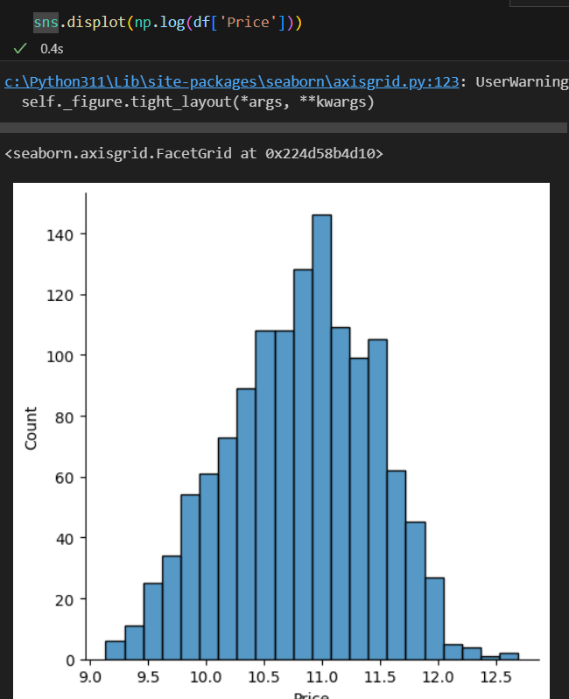
Log-Normal Transformation
we saw the distribution of the target variable above which was right-skewed. By transforming it to normal distribution performance of the algorithm will increase. we take the log of values that transform to the normal distribution which you can observe below. So while separating dependent and independent variables we will take a log of price, and in displaying the result perform exponent of it.

Slide 19
Machine Learning Modeling for Laptop Price Prediction
Now we have prepared our data and hold a better understanding of the dataset. so let’s get started with Machine learning modeling with the best hyperparameters to achieve maximum accuracy.
As proposed methodology we are going to use Random Forest algorithm to train our model.
We will compare our model with other Models:

Slide 20
Linear Regression
Ridge Regression
Lasso Regression
KNN
Decision Tree
SVM
AdaBoost
XG Boost
Voting Classifier

Slide 21
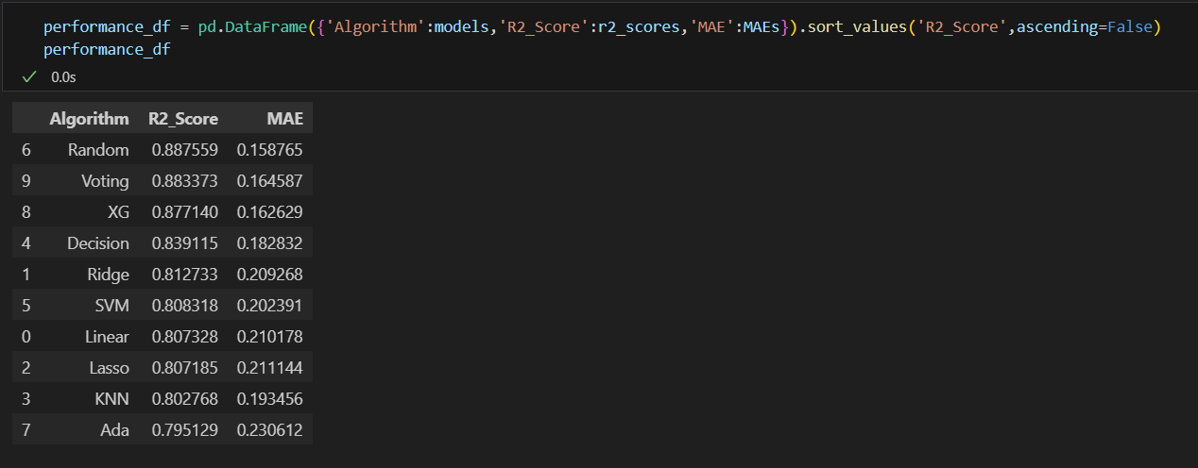
Comparison of Performance with other Models
Comparison is done on the basis of R2_score and MAE
Lets know it is:
R2_Score:The R2 score is a value between 0 and 1. A score of 1 indicates that the regression model perfectly predicts the dependent variable, while a score of 0 indicates that the model does not explain any of the variability in the dependent variable.

Slide 22

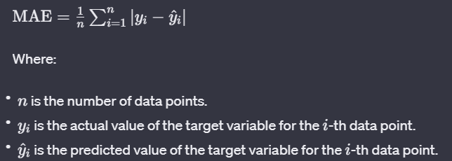
In other words, R2 measures the proportion of the response variable's variance that is captured by the model. It is calculated using the formula:
​
MAE: MAE stands for Mean Absolute Error. It is a metric used to evaluate the performance of a regression model. The Mean Absolute Error measures the average absolute difference between the actual and predicted values. The formula for calculating MAE is as follows:

Slide 23
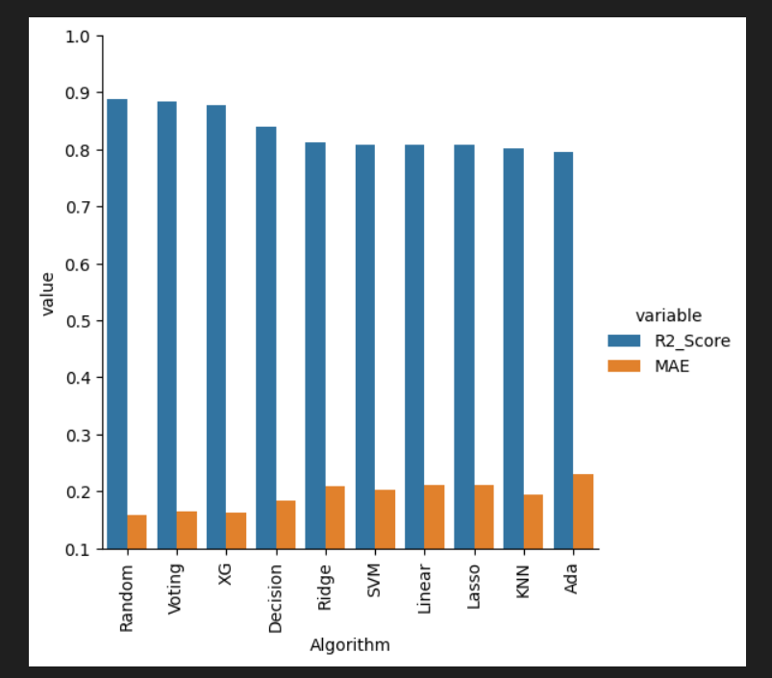
Graphical representation of comparison

Slide 24
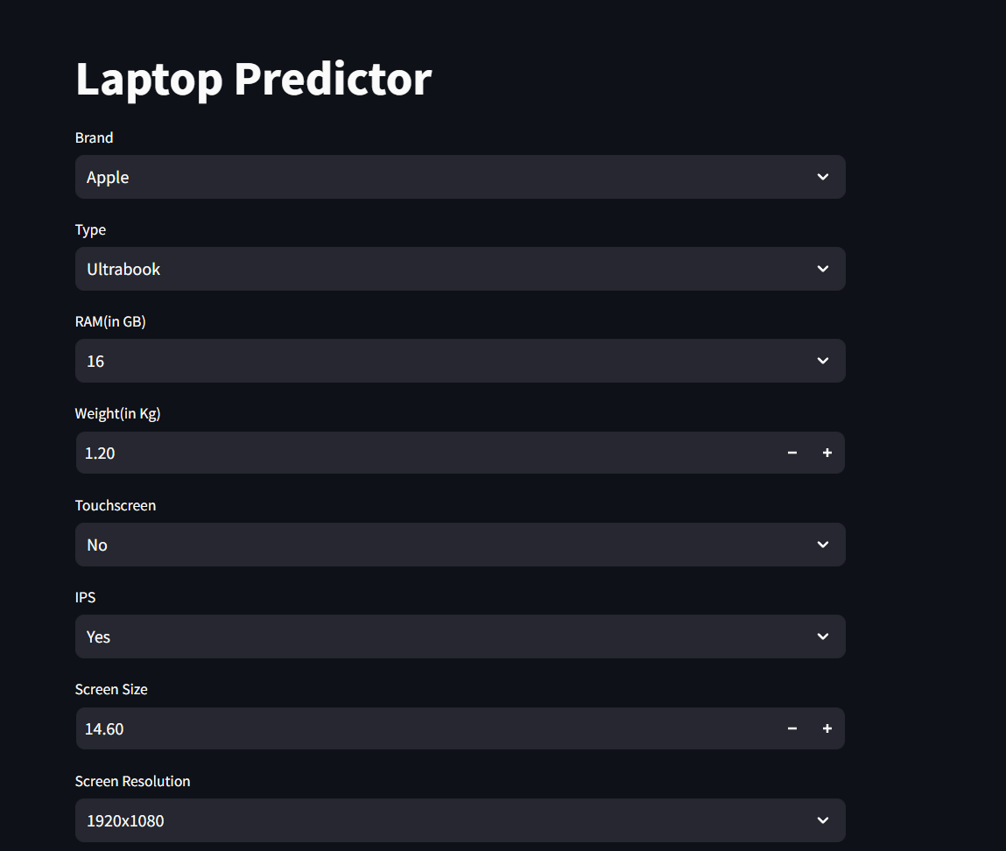
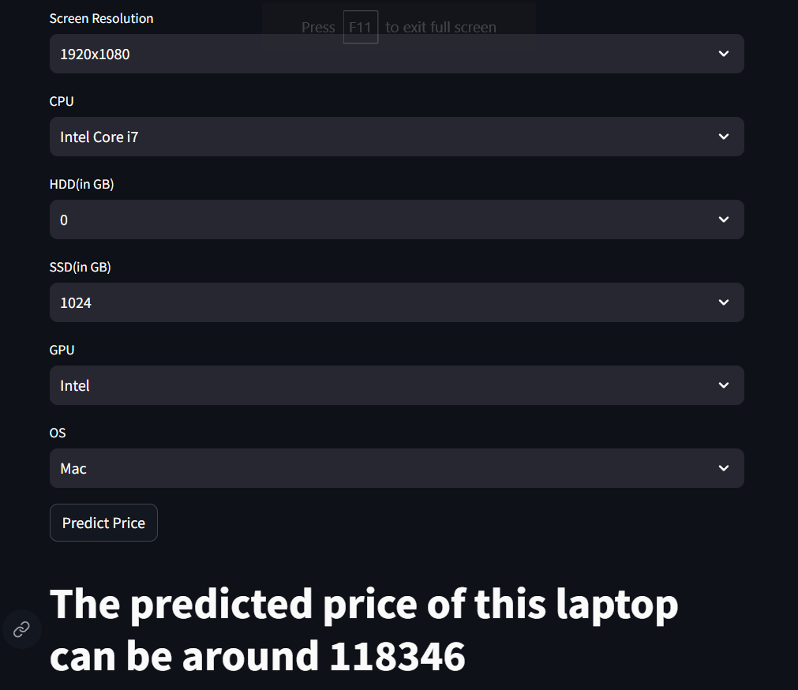
ML web app development

Slide 25
Conclusion and Future Work
Conclusion:
In conclusion, our laptop price prediction model has demonstrated promising performance in estimating laptop prices based on various features. The model, primarily built on linear regression and enhanced by incorporating categorical features through one-hot encoding, has shown good accuracy in capturing the relationships between input features and laptop prices.
Key Findings and Achievements:
The model achieved a high R2_score, indicating a strong correlation between the predicted and actual laptop prices.
The inclusion of categorical features through one-hot encoding enhanced the model's ability to handle non-numeric data.
Our model provides a valuable tool for both consumers and retailers in estimating laptop prices based on specific configurations and features.

