Slide 1

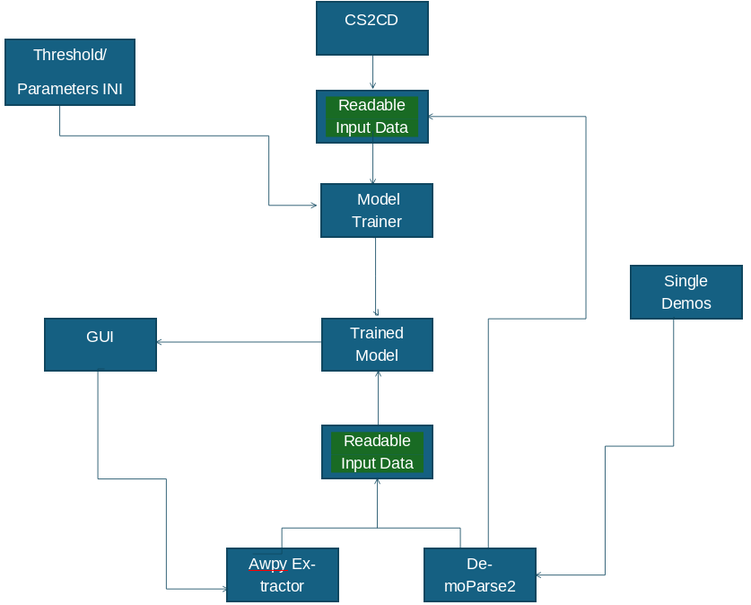
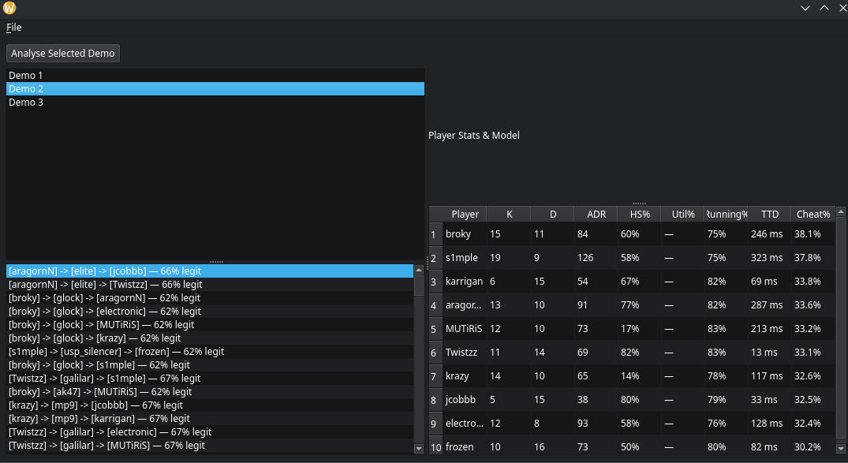
Cheat Detection in Competitive Games Through Machine Learning Analysis of Player Input Vectors.
Joseph Troughton
BSc (Hons) Computer Science Cyber Security
Problem & Motivation
Problem
Cheating remains a major challenge in online competitive games & tournaments
Modern Aim assist tool can operate externally to the computer meaning no cheat exists on the computer this severely hinders conventional anti-cheats methods
Competitive tournaments require reliable wide suite of tools to handle flagging and review of games; both during and after.
Project Goal
Develop a machine learning system capable of analysing input vectors extracted from gameplay data to analyses suspicious behaviour primary in aim
System Diagram
Feature Extraction
Gameplay demos provide tick-based player state data, including view angles, position and gameplay events.
Demo files are parsed using AWPy and DemoParse2, producing structured datasets describing player behaviour.
From this data several behavioral metrics are extracted:
• Reaction time to enemy appearance • Crosshair alignment with targets • View-angle change rate (aim acceleration) • Snap detection in aiming behaviour • Movement synchronisation (counter-strafing)
These metrics form input vectors used by the machine learning model to identify suspicious behaviour.
Machine Learning Model
The Counter-Strike 2 Cheat Detection Dataset (CS2CD)was used as a base for training this data, as it has ~1000 Demos that have been converted using Demo Parser 2 into readable files allow for quick deployment and adjustment.
This was used in conjunction with the AI classifier XGBoost which is what used to create the models it was chosen because:
Effective for structured datasets
Efficient training and inference
Provides interpretable feature importance
Supports a wide range of systems and is very lightweight
Evaluation
The system is evaluated using multiple gameplay datasets with both legitimate and cheating players.
Evaluation focuses on:
classification accuracy
false positive rate
performance across different player skill levels
Target performance:
Minimum of 80%
Manual review of flagged gameplay events is used to validate model predictions.
Interface
Ethics / Risks
Incorrect detection may result in false accusations against legitimate players, particularly if models are poorly configured or trained on biased data.
Key risks include:
• False positives leading to unfair suspicion of legitimate players • Dataset bias if training data does not represent different skill levels • Data poisoning, where malicious training data could reduce detection accuracy • Reverse use, where cheat developers analyse the system to avoid detection
For these reasons, the system is designed as a decision-support tool to assist human reviewers and enable flagging rather than an automated banning system.

