Slide 1
Medical Information System
Centralized Cloud Migration
Centro Médico del Bajío — IT Project Management Unit II
José Manuel Ortiz Medrano (UP230598) · José Luis Sánchez Vázquez (UP230269) · Carlos Arturo Orozco Huitron (UP230562) · Marco Polo Muñoz Nájera (UP230328)
June 1 – July 31, 2026 | $147,900 MXN

Slide 2
Project Overview
▸ 3 hospital branches: Aguascalientes, León, Morelia
▸ 53,208 duplicated clinical records → target 0% redundancy
▸ Decentralized local servers → centralized cloud platform
▸ 4 VMs, 32 GB RAM, sub-2-second query response
▸ 8-week timeline (Jun 1 – Jul 31, 2026), 40 business days
▸ Budget: $147,900 MXN | Sponsor: Dr. Alejandro Vance de la Vega

Slide 3
Project Charter — Key Elements
Objective
Centralize medical data on cloud, eliminate 53K duplicates, sub-2s queries, by Jul 31 within $147,900 MXN.
Scope
Cloud DB (4 VMs), deduplication scripts, full migration of annual records, equipment across 3 branches.
Risks
Data loss, vendor delays, user resistance, connectivity failure, cybersecurity incident.
Major Milestones
▸ M1 — Cloud requirements defined (Jun 3)
▸ M2 — Architecture designed & provider selected (Jun 22)
▸ M3 — Equipment installed in 3 branches (Jun 25)
▸ M4 — Digitization completed (Jul 9)
▸ M5 — Migration & deduplication done (Jul 18)
▸ M6 — System validated & Go-Live (Jul 31)

Slide 4
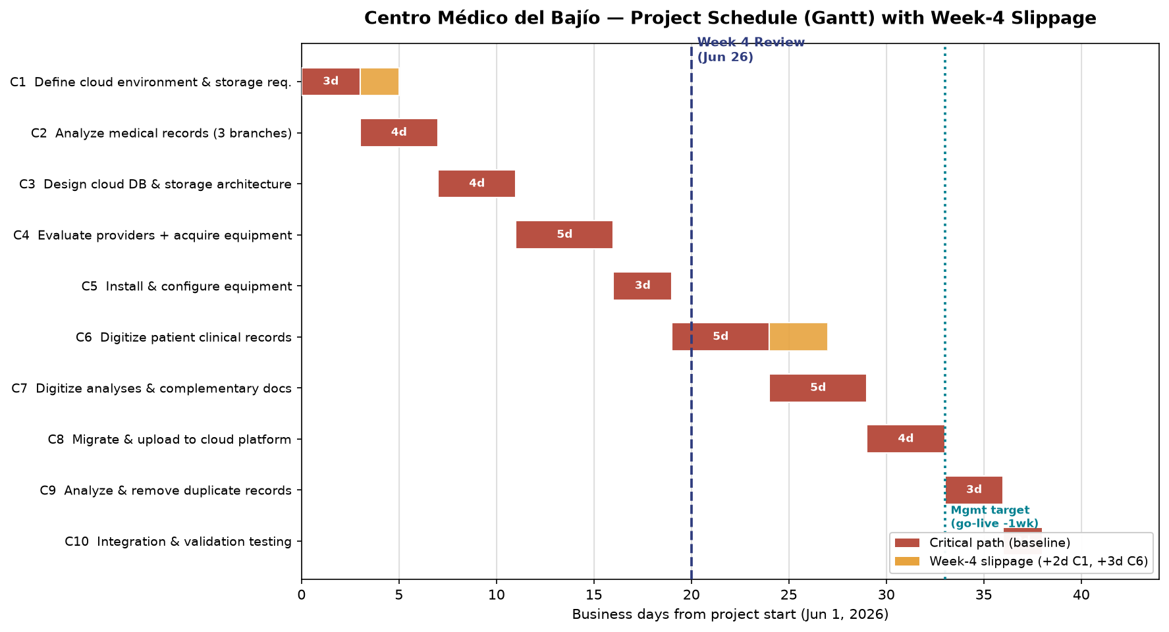
Project Schedule — Gantt Chart

Slide 5
Week-4 Review — Events & Change Requests
5 Reported Events
▸ 1. Staff sick leave → C1 +2 days delay
▸ 2. 3 deliverables pending at review
▸ 3. Mgmt request: go-live 1 week earlier
▸ 4. C6 (longest activity) needs +3 days
▸ 5. Equipment costs +4% (inflation)
CR | Description | Type | Impact
CR-01 | Extend C6: 5→8 days | Schedule | +3 days
CR-02 | Go-live 1 week earlier | Scope | −5 days target
CR-03 | +4% equipment inflation | Cost | +$2,680
CR-04 | 2nd digitization crew (crash C6/C7) | Resource | Recover delay

Slide 6
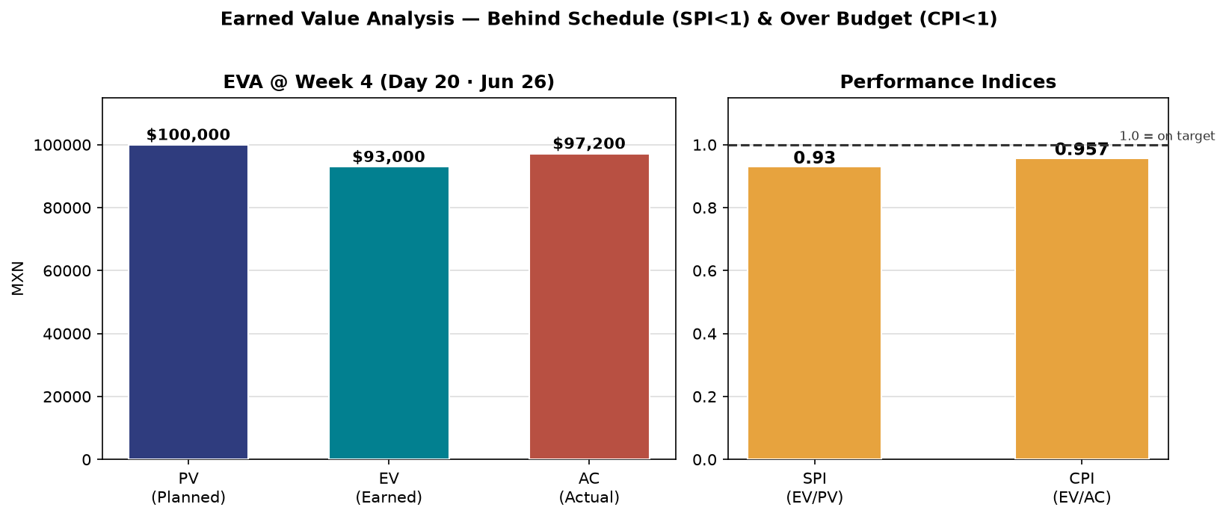
Earned Value Analysis — Week 4 (Jun 26)
▸ PV (Planned): $100,000 | EV (Earned): $93,000 | AC (Actual): $97,200
▸ SV = −$7,000 (behind schedule) | CV = −$4,200 (over budget)
▸ SPI = 0.93 (< 1 → behind) | CPI = 0.957 (< 1 → over budget)
▸ EAC = BAC / CPI = $154,545 (forecast at completion)

Slide 7
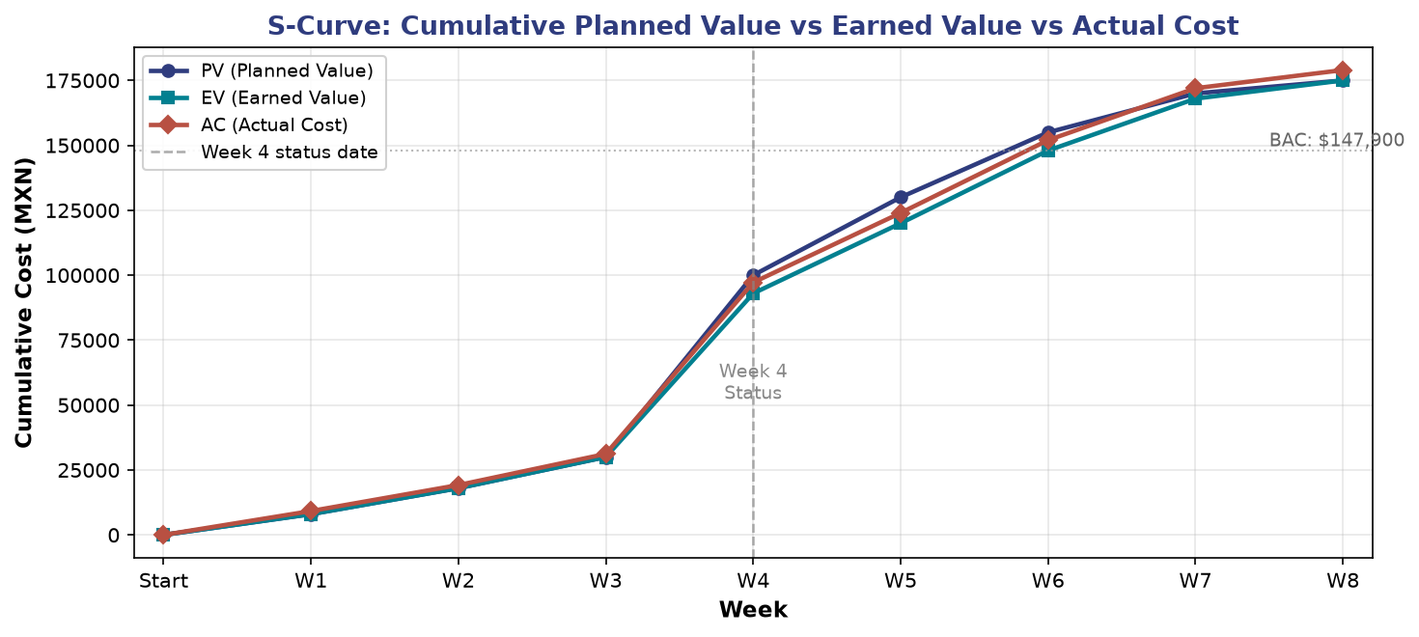
EVM — S-Curve: Cumulative Cost Performance
PV vs EV vs AC over the 8-week project timeline

Slide 8
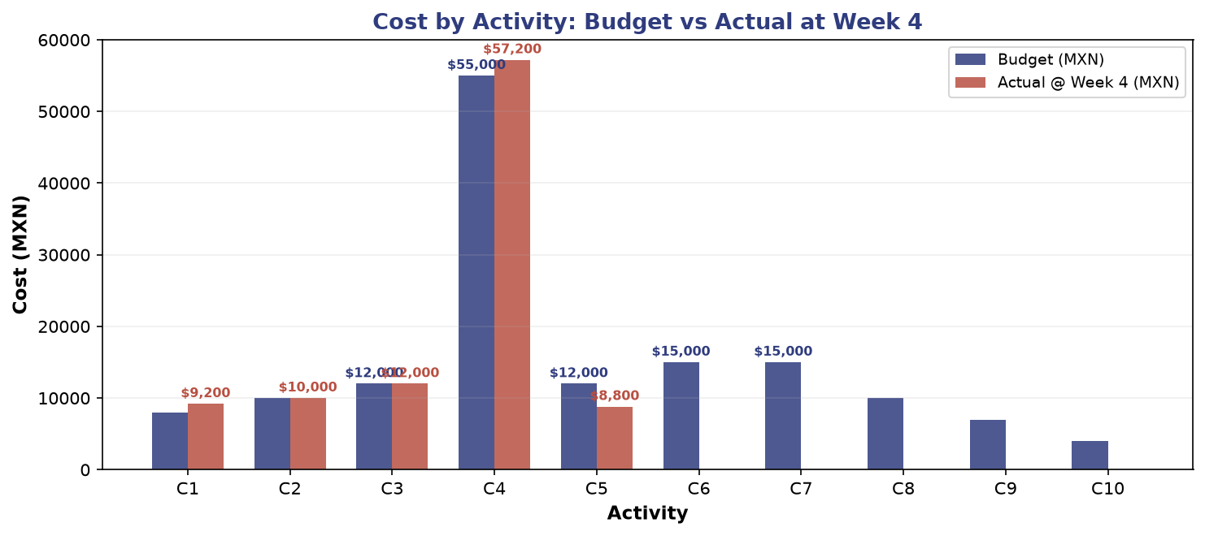
Cost by Activity: Budget vs Actual at Week 4
C4 dominates the budget (55K) — equipment + cloud provider

Slide 9
Cloud Provider Selection — Weighted Criteria (Activity C4)
Criterion | Weight | Provider 1 | Provider 2 | Provider 3
Cost | 40% | 10 | 5 | 7
Delivery Time | 30% | 5 | 10 | 5
Quality | 20% | 8 | 7 | 10
Post-Service | 10% | 7 | 5 | 0
Weighted Total | 100% | 7.8 ★ | 6.9 | 6.3
✓ Provider 1 selected — highest score (7.8/10): best cost and post-service support

Slide 10
Project Closure — Results & Lessons Learned
✓ Hits (What Went Right)
▸ Centralized cloud infrastructure deployed (4 VMs, 32 GB RAM)
▸ 100% elimination of 53,208 duplicate records
▸ Sub-2-second query response across all branches
▸ Objective provider selection via weighted criteria (7.8/10)
▸ Change control kept July 31 go-live on track
✗ Failures (What Went Wrong)
▸ C1 delayed 2 days — no backup owner assigned
▸ 3 procurement deliverables pending at Week 4
▸ C6 underestimated: record volume needed +3 days
▸ EVA formulas initially swapped (SV/CV corrected)
→ Improvements for Future Projects
▸ Assign backup owners for every critical-path activity
▸ Use per-record parametric estimation instead of flat durations for digitization
▸ Pre-qualify vendors and lock SLAs during Week 1
▸ Standardize EVA templates to prevent formula confusion
▸ Keep daily stand-up alignment meetings (introduced during rework)

Slide 11
Conclusion
The project achieved its strategic objective: 3 branches consolidated on a single cloud platform
53,208 duplicate records eliminated → 0% redundancy
EVA at Week 4: SPI 0.93, CPI 0.957 — corrective action via crashing + contingency reserve
Delivered on time (July 31, 2026) and within adjusted budget
Structured change control absorbed 5 disruption events without derailing the critical path
Thank you — Questions?

